Slide 1
1950s: Peace, Prosperity, & PRogress
Unit 9: The Cold War #4

Slide 2
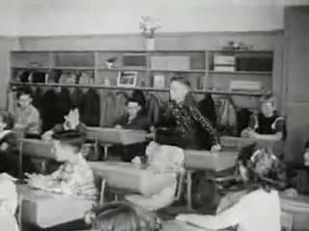

Slide 3
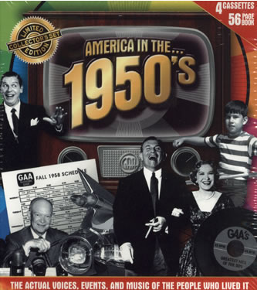
Prosperity in the 1950’s
Reasons for prosperity:
Increased consumer spending/consumption
WWII industry (new jobs)
G.I. Bill

Slide 4
The G.I. Bill
Passed in 1944
Helped veterans by giving them:
Money for education grants
Low cost loans for housing, businesses, and farms
Guaranteed a year’s worth of unemployment benefits while job hunting
Used by millions
Prevented them from flooding the job market

Slide 5
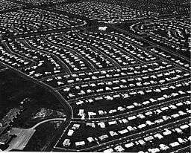
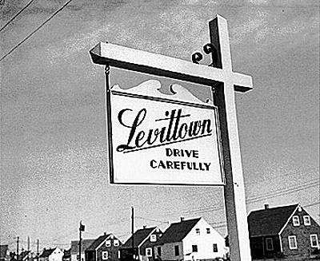
Living in the Suburbs
Housing shortage for returning vets
G.I. Bill helped families purchase homes
Baby Boom encouraged house building & buying
Interstate highways made commuting easier

Slide 6
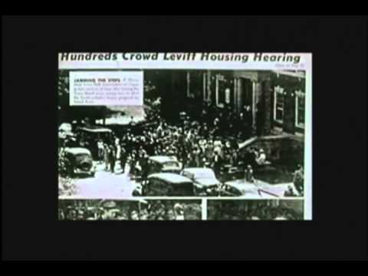

Slide 7
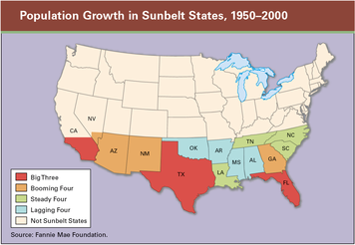
Population Shifts
Not only did people move from the city to country
The Sunbelt: Southern half of the country
This “belt” of warm weather states stretched across the southern 1/3 of the U.S. from Florida to California
Massive water projects and development of air conditioners made this population shift possible

Slide 8
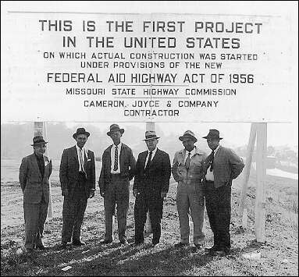
Interstate Highway Act (1956)
Authorized the building of a nationwide highway network (41,000 miles of new roadways)
High speed, long haul trucking made possible, decline of railroads
More access to cars
Better roads
More Americans traveled

Slide 9
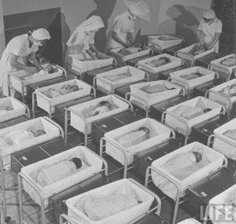
Baby BOOM!
Large increase in birth rates from the late 1940s to early 1960s
Largest generation in nation’s history
1957: An infant born every 7 seconds (4,308,000 that year)

Slide 10
Women’s Changing Roles
Women did not want to give up the independence they had gained while working during the war
Rising divorce rate because of clash of changing men’s & women’s roles
In 1950, 1 million+ war marriages had ended in divorce
The ideal modern woman married, cooked and cared for her family, and kept herself busy by joining the local PTA and leading a troop of Campfire Girls. She entertained guests in her family’s suburban house and worked out on the trampoline to keep her size 12 figure.
-- Life magazine, 1956

Slide 11
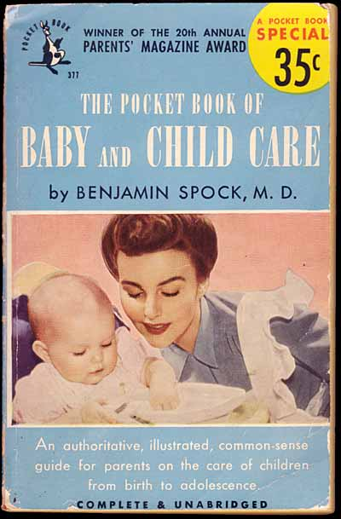
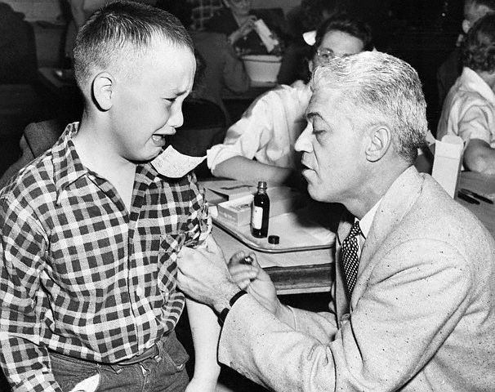
Medical Advances
Polio: crippling disease that affected over half a million worldwide every year
Dr. Jonas Salk - developed vaccine for polio (tested it on his family first)
Measles vaccine
1st heart transplant
The discovery of streptomycin (antibiotic to treat tuberculosis)
Dr. Benjamin Spock published national best selling book on child care

Slide 12
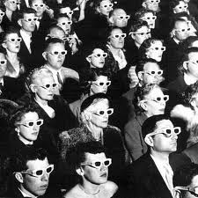
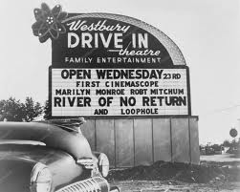
Movies
Drive-in movies
3D movies made possible by special glasses (became popular)
Widescreen (CinemaScope) and stereosound

Slide 13
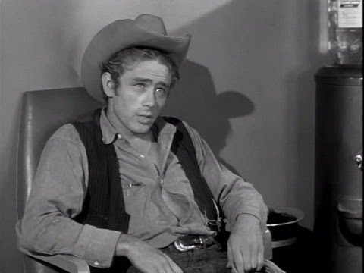

Slide 14
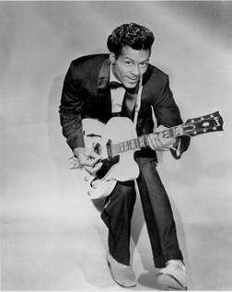
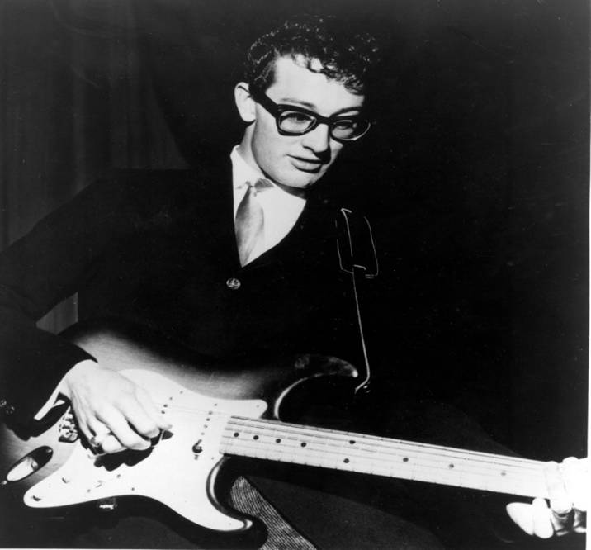
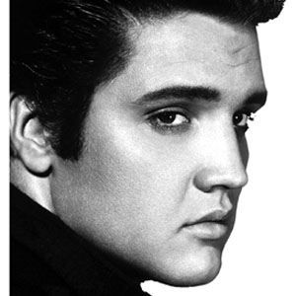
Rock-N-Roll
Music captivated teens across the country
Roots in jazz, rhythm and blues, country, & folk music
Reflected a desire to break from the traditional norms
Broke down barriers between whites & blacks
Adults condemned rock music - believed music would contribute to teenage delinquency & immorality
Some cities banned rock (called it “race” music)
Radio & TV exposure helped rock gain acceptance

Slide 17
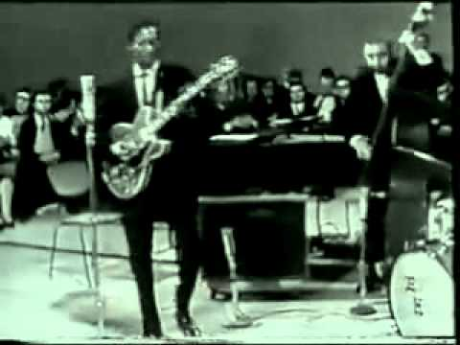

Slide 18
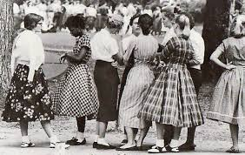
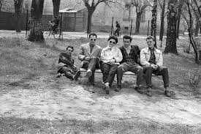
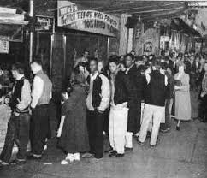

Slide 19
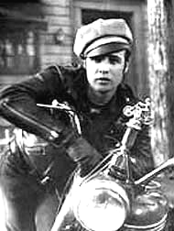
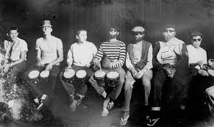
Subculture: The Beat Generation
Expressed social and literary movement of artists, poets, & writers that broke from conventional society & expressed nonconformity
Followers were called “Beatniks” & lived non-conformist lives
People will begin questioning “conforming”

Slide 21
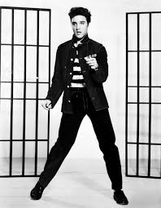
Non-Conformist in the 1950s

Slide 22
