Slide 2
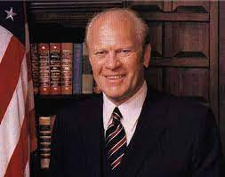
38th President Gerald Ford (1974-1977)
Ford was considered to be a really nice guy…Perfect President to follow Nixon’s paranoid, corrupt administration!!!
His famous quote "To Leave the Country Better Than I Found It." was the way he led the United States.

Slide 3
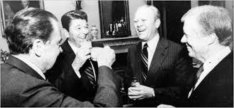
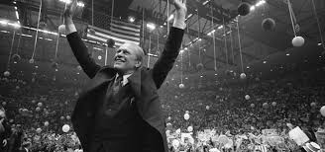
He supported:
Women's Rights- advocating an Equal Rights Amendment to the Constitution
Identifying (after his presidency) as pro-choice.
He continued:
The policy of détente, visiting China and working with the Soviets to form what is today called Human Rights Watch .

Slide 4
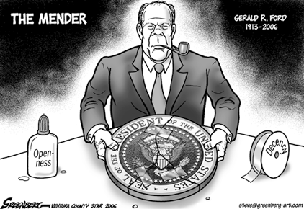
Wanted to repair trust

Slide 5
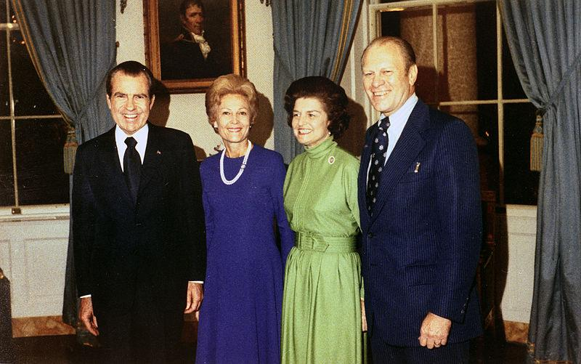
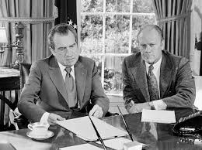
The Fateful Pardon
Ford went down in history as an unpopular president due to his pardoning of Richard Nixon.
He claimed to have done it in order to close the matter… and to move on
also out of a Christian sense of mercy
compassion for the Nixon family.
He will run for President and not win!

