Slide 1
1970s

Slide 2
Warm Up
The most current Gallup poll shows that only about 18% of Americans trust the government to almost always do the right thing. Why do you think Americans have such little trust in their government? How about you? Do you trust the government? Why or why not?

Slide 3
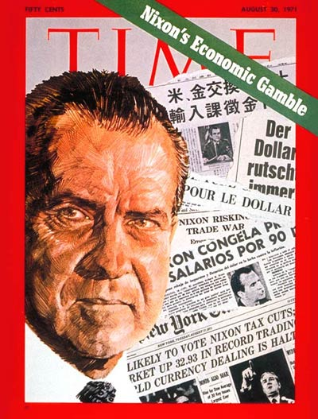
Nixon’s Domestic Policy
Nixon's Domestic Policy - the New Federalism - was based on saving taxpayer money by cutting funding for Great Society programs(Medicare and Job Corps)

Slide 4
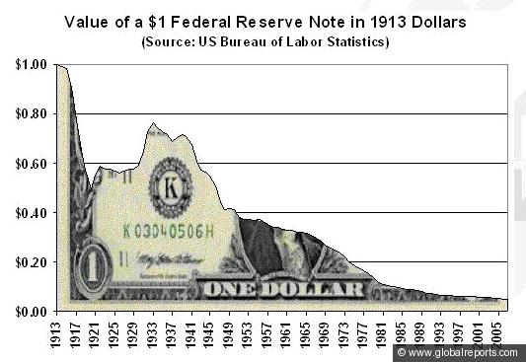
Leaving the Gold Standard
One of Nixon's most infamous moves was taking the U.S. off of the gold standard.
He also enacted price freezes that were incredibly unpopular and resulted in farmers destroying product rather than sell it at a loss.
Nixon said the dollar would retain its value. It's now worth only 19 cents in 1971 dollars.

Slide 5
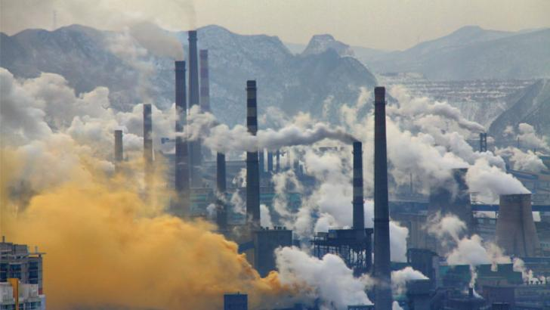
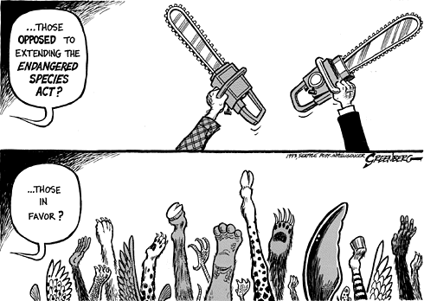
Nixon and the Environment
The Environmental Protection Agency (EPA) Was created in 1970 by the Nixon Agency due to an increased national concern for the environment. Set standards to reduce pollution.
The Clean Air Act of 1972 Established emission standards for factories and cars and restricted dumping pollutants into rivers and lakes
Endangered Species Act of 1973 Created plans to save threatened animal and plant species.

Slide 6
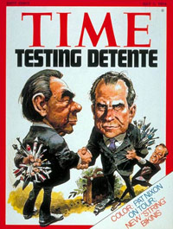
Nixon’s Foreign Policy
Nixon's policy of dealing with the Cold War is called "détente." French for "relaxation"
Détente refers to an easing of tensions between the United States and the Soviet Union.

Slide 7
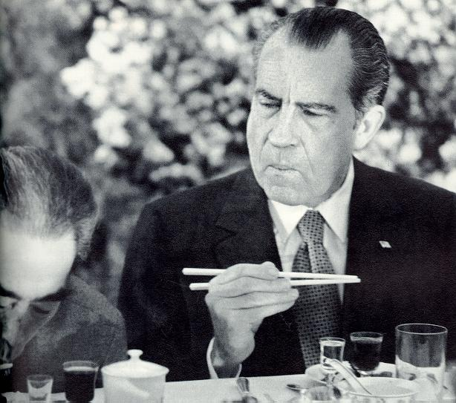
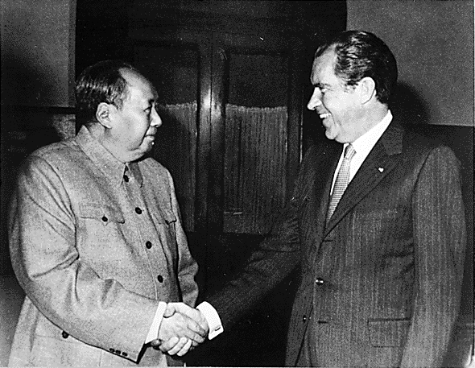
How to Détente
Even though they were both Communists, China and the Soviet Union were big rivals and each feared the other.
Nixon played on this by improving relations between the U.S. and China. In 1972, he became the first U.S. President to visit China.
His main goal was to make the Soviet Union jealous and get them to open negotiations with us.

Slide 8
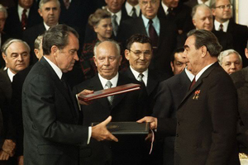
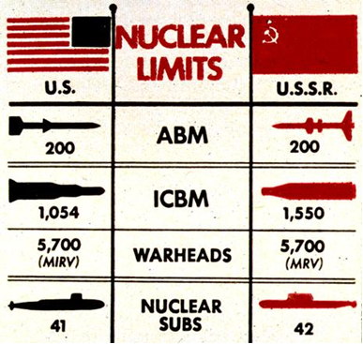
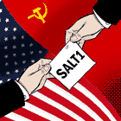
Did it Work?
SALT I - The same year Nixon Visited China (1972), He was invited to meet with the Soviet Union
When there, he and the Soviet leaders signed the first Strategic Arms Limitation Treaty (S.A.L.T.), which limited production of nuclear weapons in the U.S. and Soviet Union
This was a MAJOR step in the direction of Detente

Slide 9
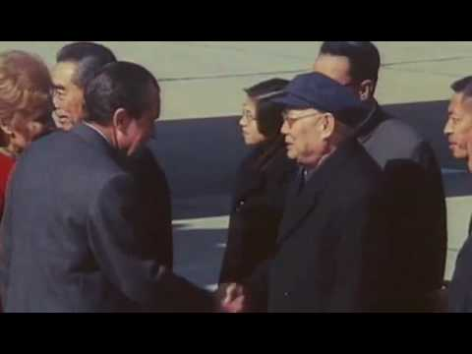

Slide 10
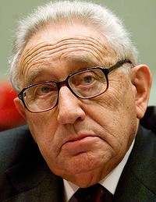
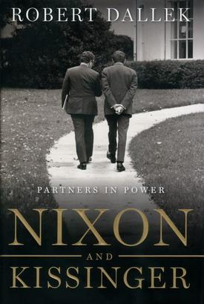
Henry Kissinger
Henry Kissinger was Nixon's National Security Adviser and eventually Secretary of State but he is best known as Nixon's partner in the presidency. Nixon and Kissinger took over almost the entirety of U.S. foreign policy (and more) during Nixon's time as President. Kissinger had his hands in almost every event of Nixon's presidency.

Slide 11
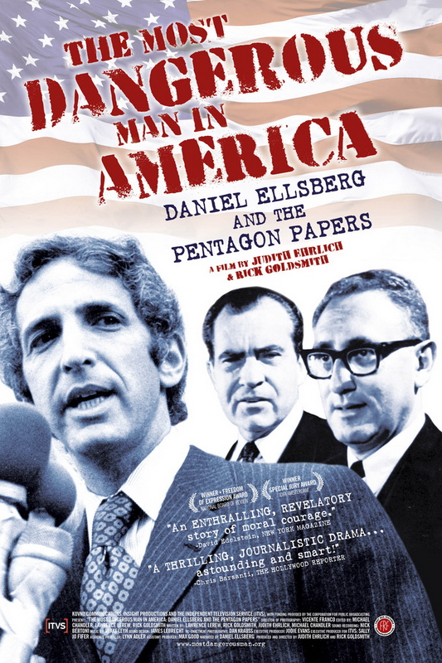
The Pentagon Papers and the Plumbers
Pentagon Papers - A top secret document showing U.S. involvement in Vietnam before the war began
Effect: This made Nixon paranoid of info leaks
Nixon formed the "White House Plumbers," a secret investigation group to prevent any other information leaks
Nixon also ordered a recording system to be installed in the White House to record all conversations in certain places

Slide 12
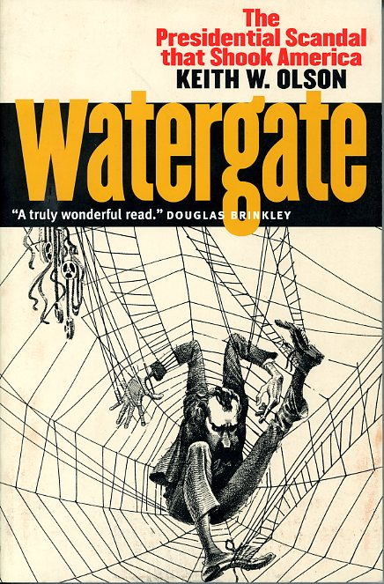
Watergate
Some of the Plumbers were part of Nixon's re-election committee.
In the summer of 1972, Watergate-Nixon's re-election committee (CREEP) was caught breaking into the headquarters and wiretapping the phones of Nixon's opponent in the election
But the Question remained, was Nixon involved?

Slide 13
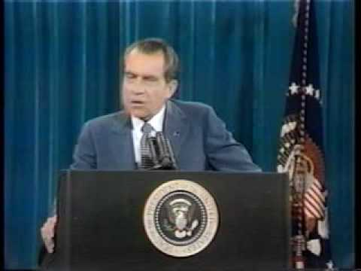

Slide 14
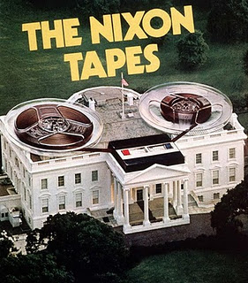
The Watergate Tapes
Nixon previously had a recording system installed in the White House that automatically recorded any audio in several locations, including the Oval Office and Nixon's private office.
The Justice Department ordered Nixon to hand over the tapes, but Nixon refused to turn them over, then tried to fire the investigators and others.
Finally Nixon had to give them the tapes and some of them revealed that Nixon had given his approval to a plan to cover up the Watergate break-ins.
This is OBSTRUCTION OF JUSTICE!!! Nixon was almost guaranteed to be impeached

Slide 15
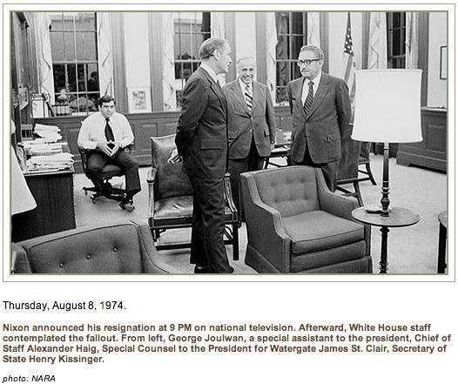
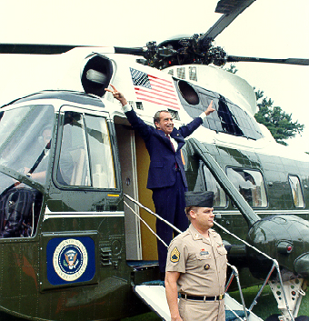
Nixon Resigns
Nixon decided to resign before he could be impeached
This made him the only president in U.S. history to ever resign the presidency
He could still face criminal charges as a civilian, though

Slide 16
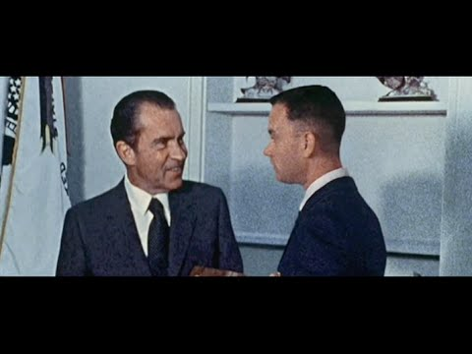

Slide 17
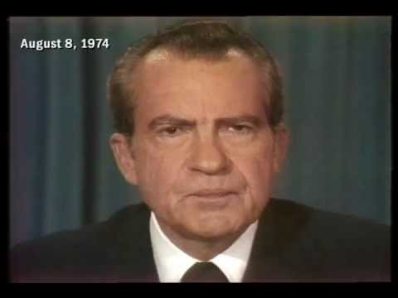

Slide 18
Nixon
What was foreign policy to relax tension in the Cold War called?
Who was his running partner?
What did create to limit nuclear weapons?
What document leak (involving Vietnam) caused Nixon to become paranoid?
What scandal was Nixon caught trying to cover up?
How did Nixon's presidency end?

Slide 20
Think/Pair/Share
"My fellow Americans, our long national nightmare is over. Our Constitution works; our great Republic is a government of laws and not of men. Here, the people rule."
-- President Gerald Ford (speech upon taking office)
Think about this quote. What do you think Ford meant? Now talk to a partner about it. Be prepared to share your opinions with the class.

Slide 21
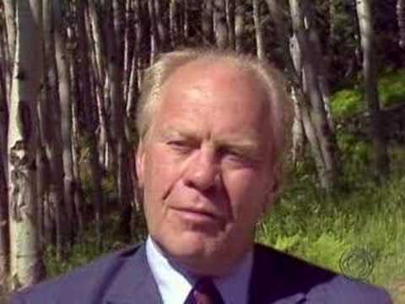

Slide 22
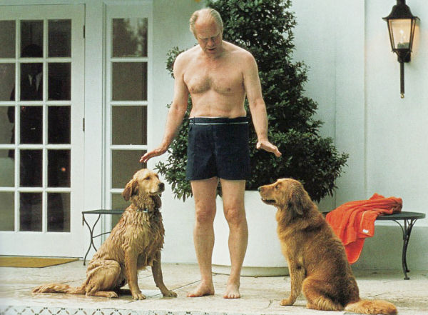
"To Leave the Country Better Than I Found It."
Ford was considered to be a really nice guy without a corrupt bone in his body. He was the perfect President to follow Nixon's paranoid, corrupt administration.
He supported women's rights, advocating an Equal Rights Amendment to the Constitution and identifying (after his presidency) as pro-choice.
He also continued the policy of détente, visiting China and working with the Soviets to form what is today called Human Rights Watch .

Slide 23
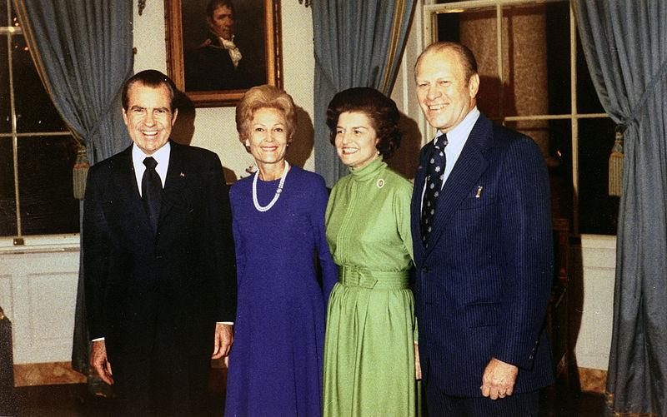
The Fateful Pardon
Unfortunately, Ford went down in history as an unpopular president due to his pardoning of Richard Nixon.
He claimed to have done it in order to close the matter, move on and out of a Christian sense of mercy and compassion for the Nixon family.

Slide 24
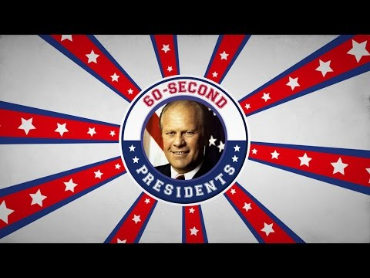

Slide 25
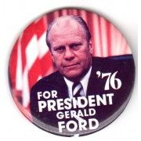
What do you think?
Many historians believe that pardoning Nixon is the main reason Ford lost the election in 1976.
Why do you think pardoning Nixon cost Ford the next election?

Slide 27
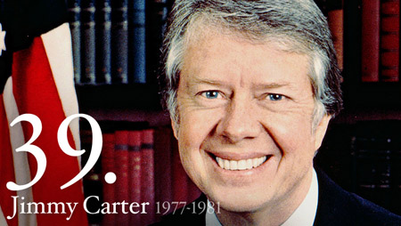
President Nice Guy
Jimmy Carter was a Baptist Sunday School teacher and was the first extremely devout Christian President in many years. Before becoming President, Jimmy Carter was the governor of Georgia. There, he had gone against tradition by being a strong supporter of African-American Civil Rights. This commitment to equality among the races continued into his presidency. He also supported gay rights. Due to his religious beliefs, Carter did not believe in abortion; however, he felt it was his duty as President to uphold Roe v. Wade. Instead, he attempted to make abortion less necessary by making it easier to adopt and by improving conditions for mothers through programs like WIC. Also due to his religious beliefs, he spoke against the death penalty and tried to abolish it as governor. He even gave a full amnesty to all Vietnam draft-dodgers.

Slide 28
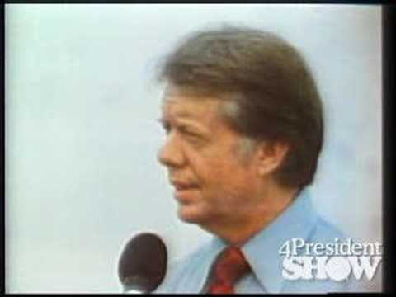

Slide 29
Economic Problems of the 70s
Stagflation is high unemployment and inflation or money loses its value
Stagnant Economy: high unemployment
Inflation:money loses its value and prices go up

Slide 30
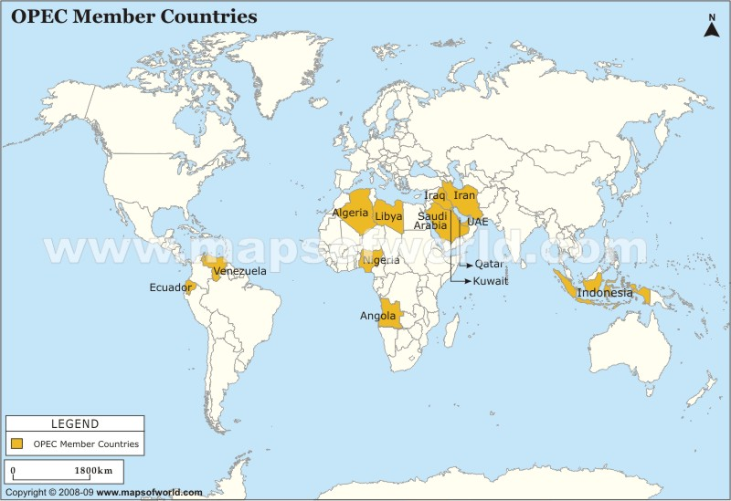
OPEC and the Oil Crises
The Organization of Petroleum Exporting Countries (OPEC) was formed in 1960 in order for oil producing countries to maintain control over their resources and control oil prices.
In 1973, the Yom Kippur War broke out between Israel and several Arab nations, including members of OPEC.
The United States helped keep the Israeli military supplied. In response, OPEC initiated an oil embargo.
This embargo caused the price of oil to go way up. In response, President Nixon set a price freeze on gasoline, causing shortages.
To avoid another energy crisis, in 1977, Jimmy Carter had Congress create the Department of Energy. He also urged Americans to conserve energy and installed solar water heaters in the White House, among other things.

Slide 31
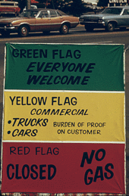
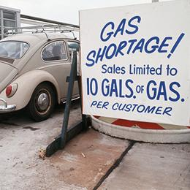
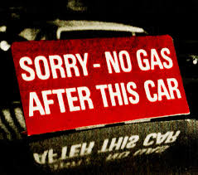
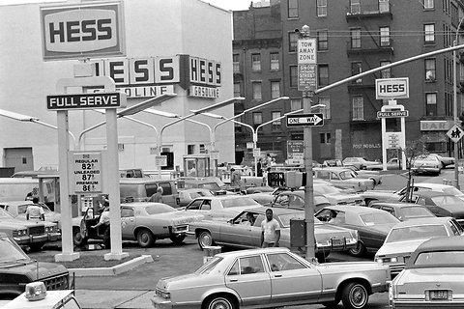
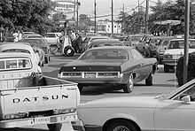
Economic Problems of the 70s
Energy Crises of 73 & 79
The Oil Embargo of 73 and issues with Iran in 79 caused extreme gas shortages

Slide 32
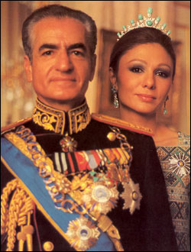
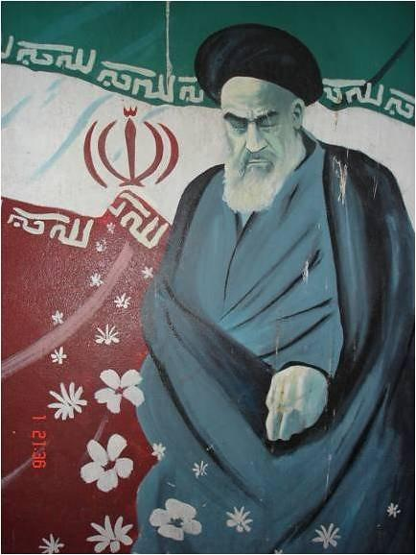
The Iranian Revolution
Prior to 1953, Iran had been ruled by a constitutional monarchy. That year, the United States and Great Britain orchestrated a coup that overthrew the democracy and helped the Shah (king) go from being a figurehead to a dictator. In 1979, this came back to bite the U.S., when a popular revolution overthrew the American-friendly Shah in favor of the anti-American Ayatollah Khomeini.
Shah Mohammad Reza
Ayatollah Khomeini

Slide 33
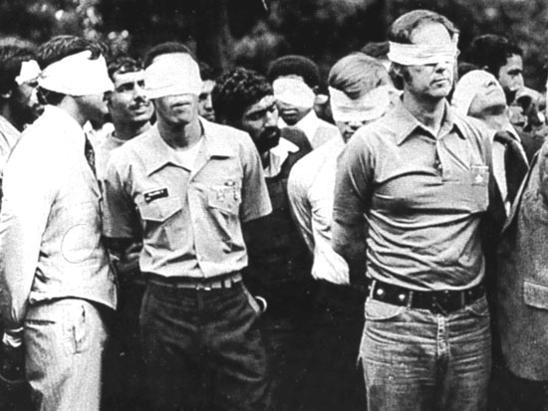
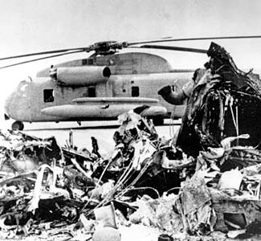
The Hostage Crisis
After the Shah had been kicked out of Iran, he was diagnosed with terminal cancer. The U.S. allowed him to enter the country for treatment in 1979, enraging Iranians. On November 4th, 1979, Iranian students took over the U.S. embassy in Tehran, taking the American diplomats there hostage.
In April 1980, Carter authorized a rescue mission, Operation Eagle Claw. Extremely over-complicated, the operation was an embarrassing failure in which 8 U.S. servicemen died and two aircraft crashed. Carter still tried to get the Iranians to release the hostages, eventually agreeing to unfreeze several billion dollars of Iranian money sitting in American banks. The hostages were released the moment Reagan finished his inauguration speech - 444 days after they were captured.

Slide 34
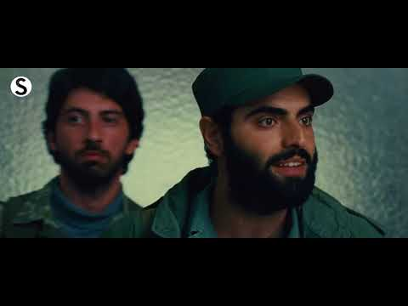

Slide 35
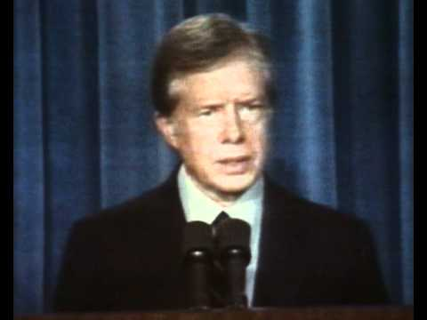

Slide 36
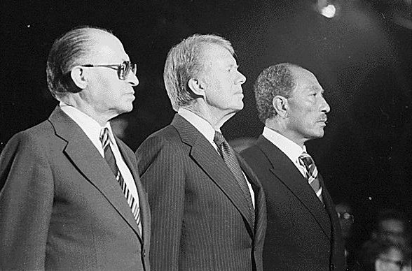
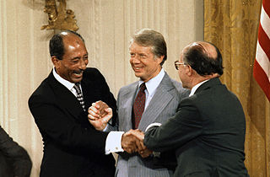
The Camp David Accords
Jimmy Carter's greatest accomplishment were undoubtedly the Camp David Accords.
The result of thirteen days of secret talks between Israeli Prime Minister Menachem Begin, and Egyptian President Anwar El Sadat, the Camp David Accords created peaceful relations between Israel and Egypt.
At the time, Egypt was considered to be the most powerful military in the Arab world and very influential in the region.

Slide 37
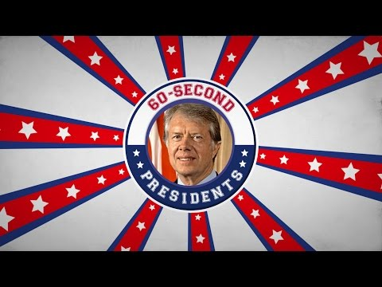

Slide 38
Ford and Carter
Why was Ford believed to have not been re-elected?
What crisis happened in American in 73 and 79 under Carter?
What crisis happened abroad under Carter?
What was Carter's greatest accomplishment? Who did it create peace among?

Slide 39
The 1980s

Slide 41
Warm-up
What role do you think religion should play in government? Would you be more or less likely to vote for someone if he/she was a certain religion? Why/why not?

Slide 42
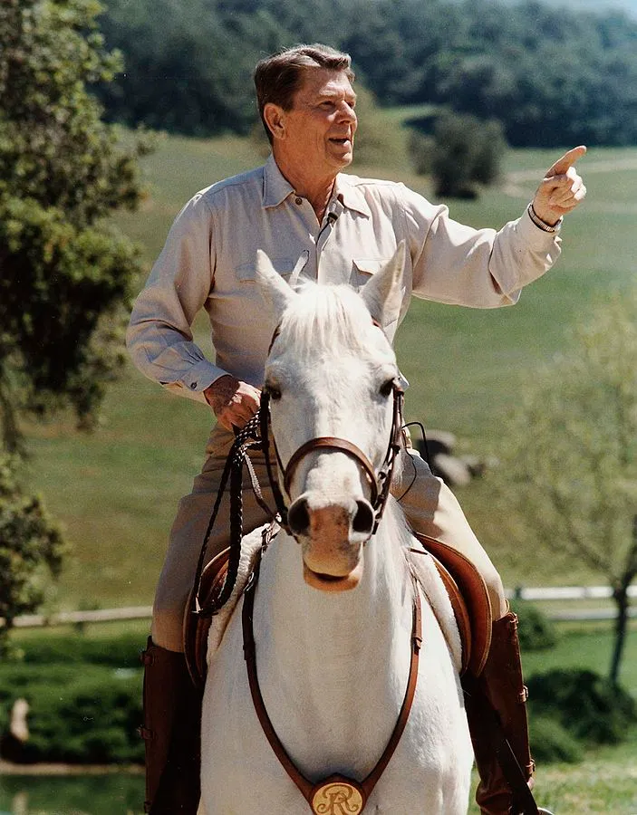
Ronald Reagan
The Great Communicator

Slide 43
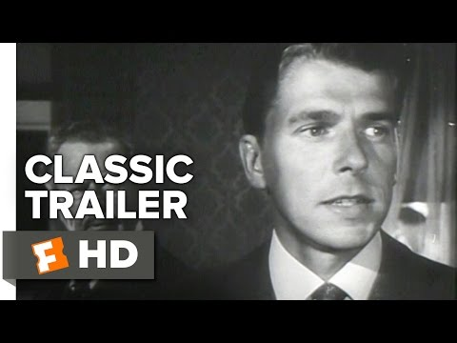

Slide 44
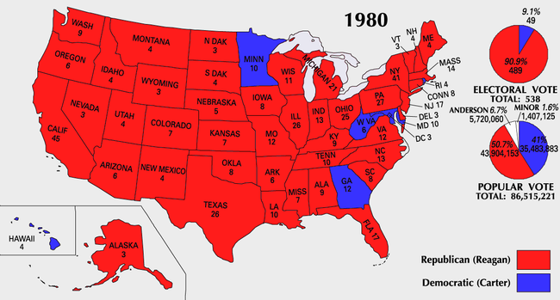

Slide 45
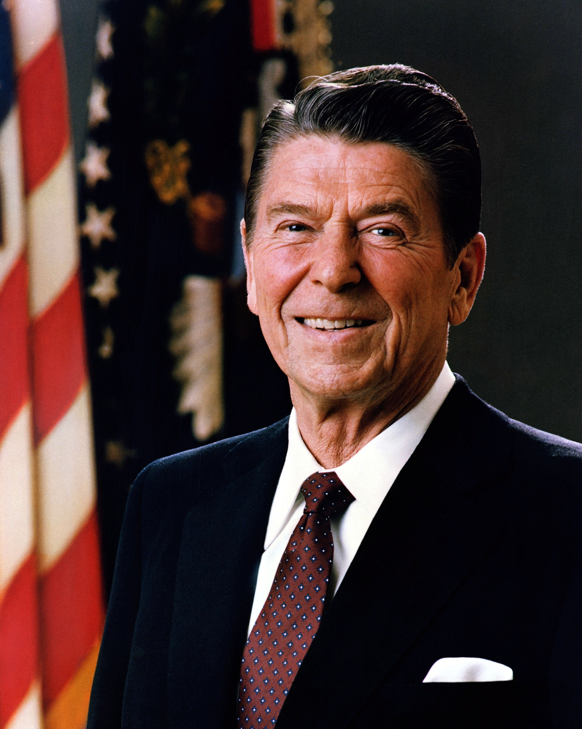
Ronald Reagan and the New Conservatives
A social backlash against the hippies of the 60s and 70s as well as dissatisfaction with the economic policies of Jimmy Carter led to a Conservative resurgence in the 1980s
Ronald Reagan quickly became the leader of this new movement
A Conservative think-tank (an organization that conducts research and advocates certain positions on issues) called the Heritage Foundation was formed in 1973
They became one of the leading forces in the new Conservative movement and helped push for Reagan’s election
Among other things, they advocated drastically reducing the role of government in America
The Reagan administration eventually enacted over 60% of their proposals.

Slide 46
Reaganomics
Reagan’s economic policies were sometimes called “Reaganomics” or, more technically, “Supply Side Economics.” Critics called them “Trickle Down Economics” or “Voodoo Economics.” This is how they worked:
Reduce taxes for everyone, but especially for the wealthy and for businesses.
Reduce government spending (not on the military though) in order to make up for the lack of tax revenue.
Reduce regulation of businesses.
Intended Results:
The wealthy use the money they saved on taxes to invest in the economy.
Businesses use the money they saved to hire more workers and pay them better wages.

Slide 47
Did Reaganomics Work?
Some Say Yes
GDP increased at a rate of 4.1% in 1988 as opposed to -0.3% in 1980.
Inflation fell to 4.1% in 1988 from 13.5% in 1980.
Unemployment decreased to 5.4% in 1988, from 7% in 1980 (and over 10% in 1982, before Reaganomics had taken full effect).
Median family income increased by about $4000, adjusted for inflation.
The Federal Deficit fell from 6% in 1983 to 3% in 1988 (it still went up in actual dollars though).
Some Say No
National debt increased from 26.1% GDP in 1980 to 41.0% GDP by 1988 (that’s $712 billion in 1980 to over $2 TRILLION in 1988).
The gap between rich and poor increased (upper 5% ended up with about 3% more of the money, bottom 5% with about 0.5% less).
Though the rate itself went down, average unemployment was the highest since the Great Depression.
Reagan was the only president since FDR to not raise the minimum wage.

Slide 48
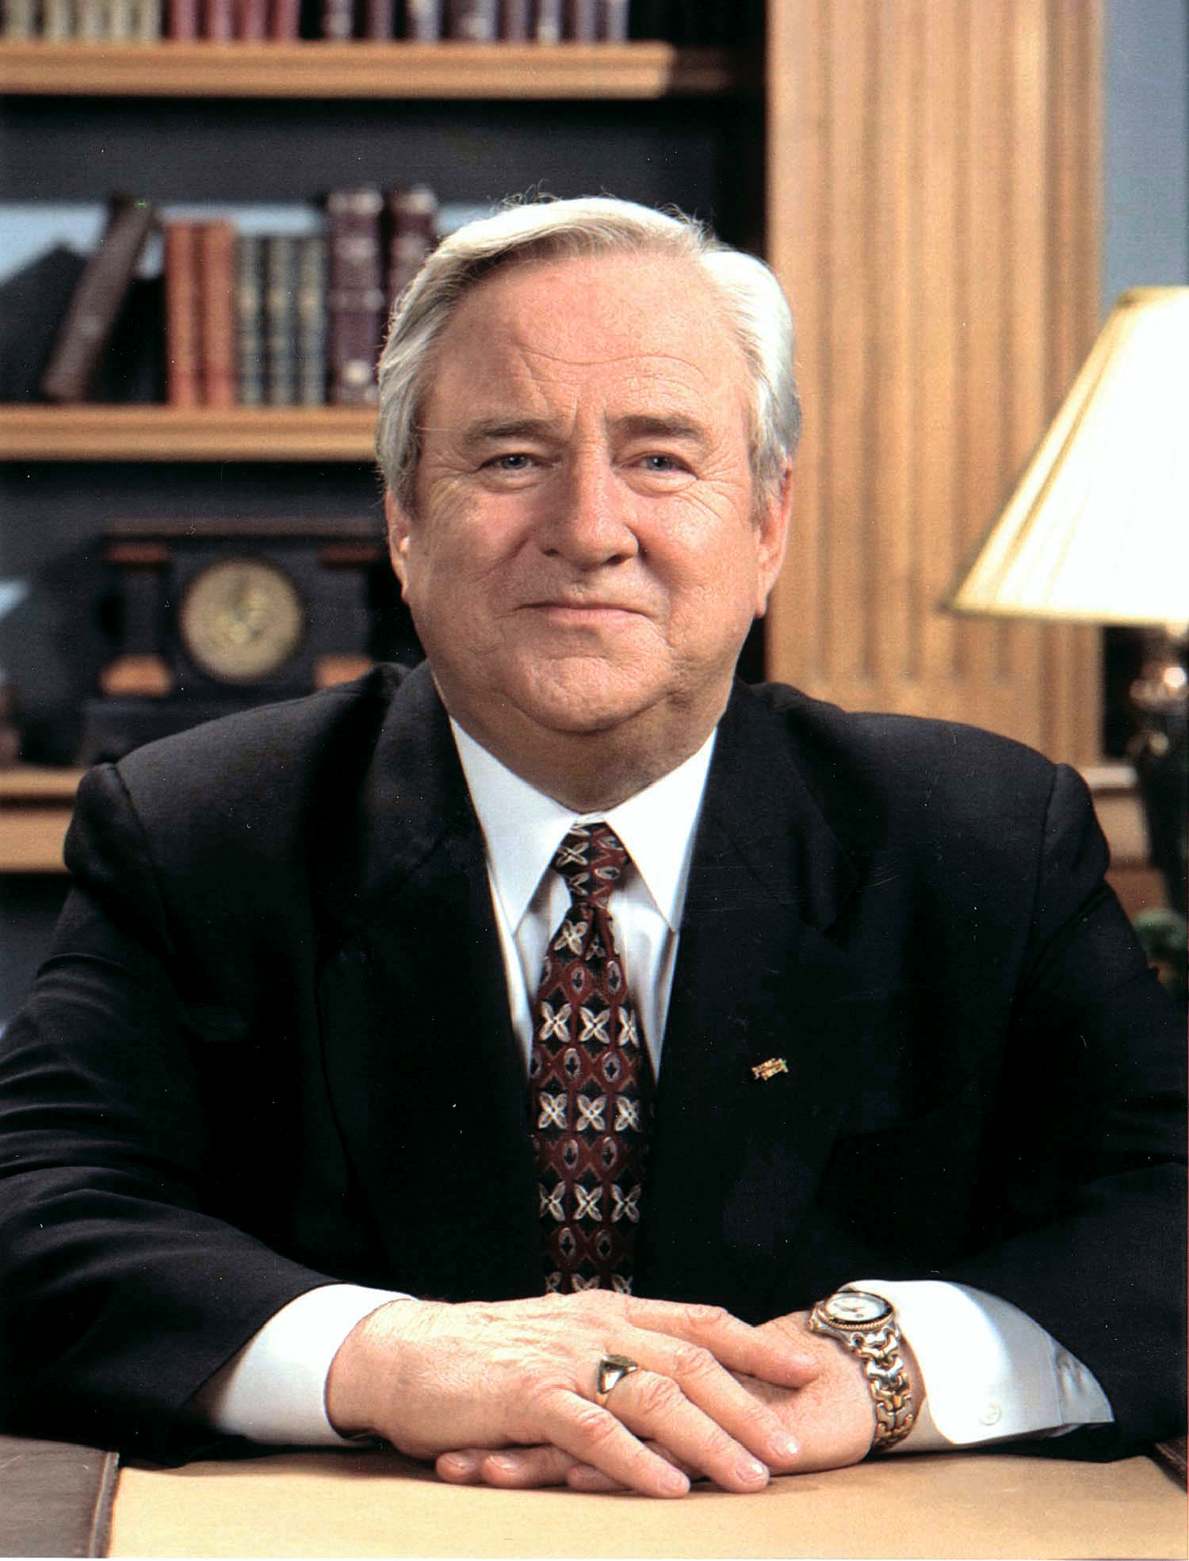
The Moral Majority
The Moral Majority was a conservative political organization founded in the 1970s & operated throughout the 1980s
Led by Southern Baptist minister Jerry Falwell, the Moral Majority’s agenda was based on a very Conservative, Fundamentalist interpretation of Christianity
Among other things, they worked to get media removed that went against their values, opposed the Equal Rights Amendment, fought to totally outlaw abortion, fought to outlaw gay marriage, and to vote liberals out of office at all levels of government

Slide 49
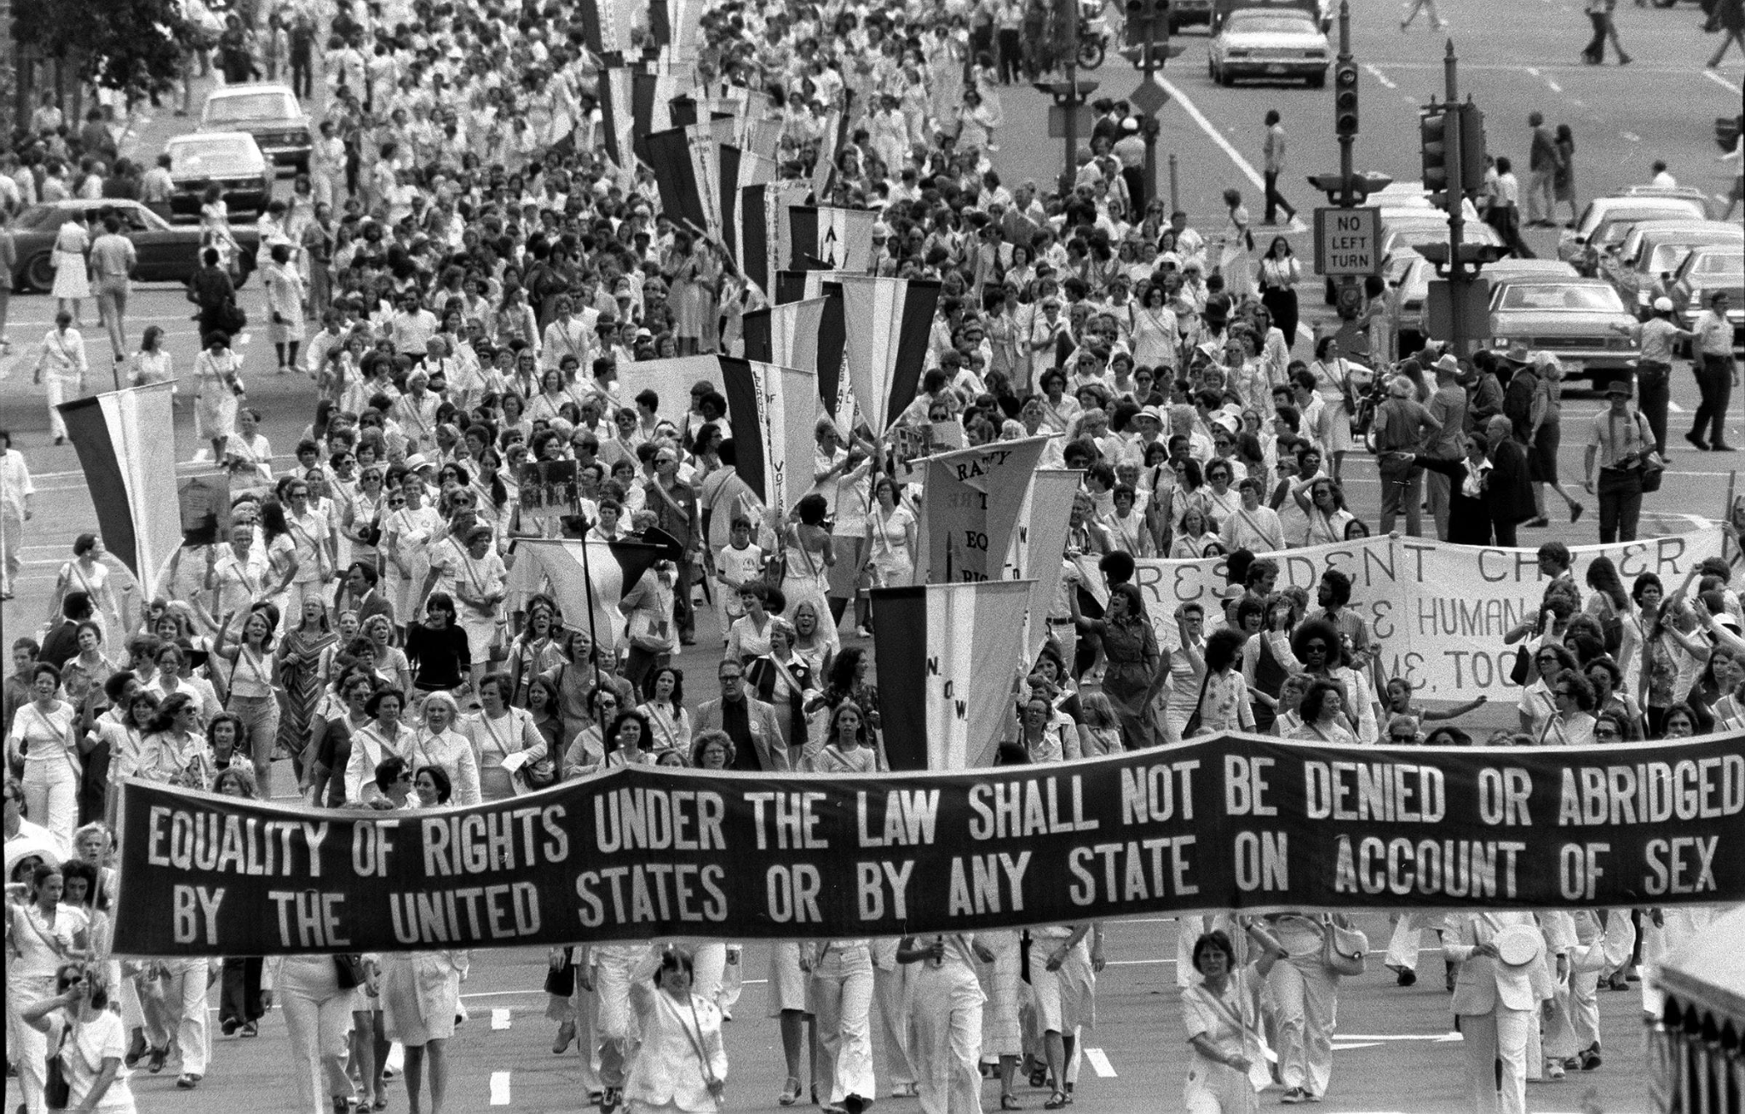
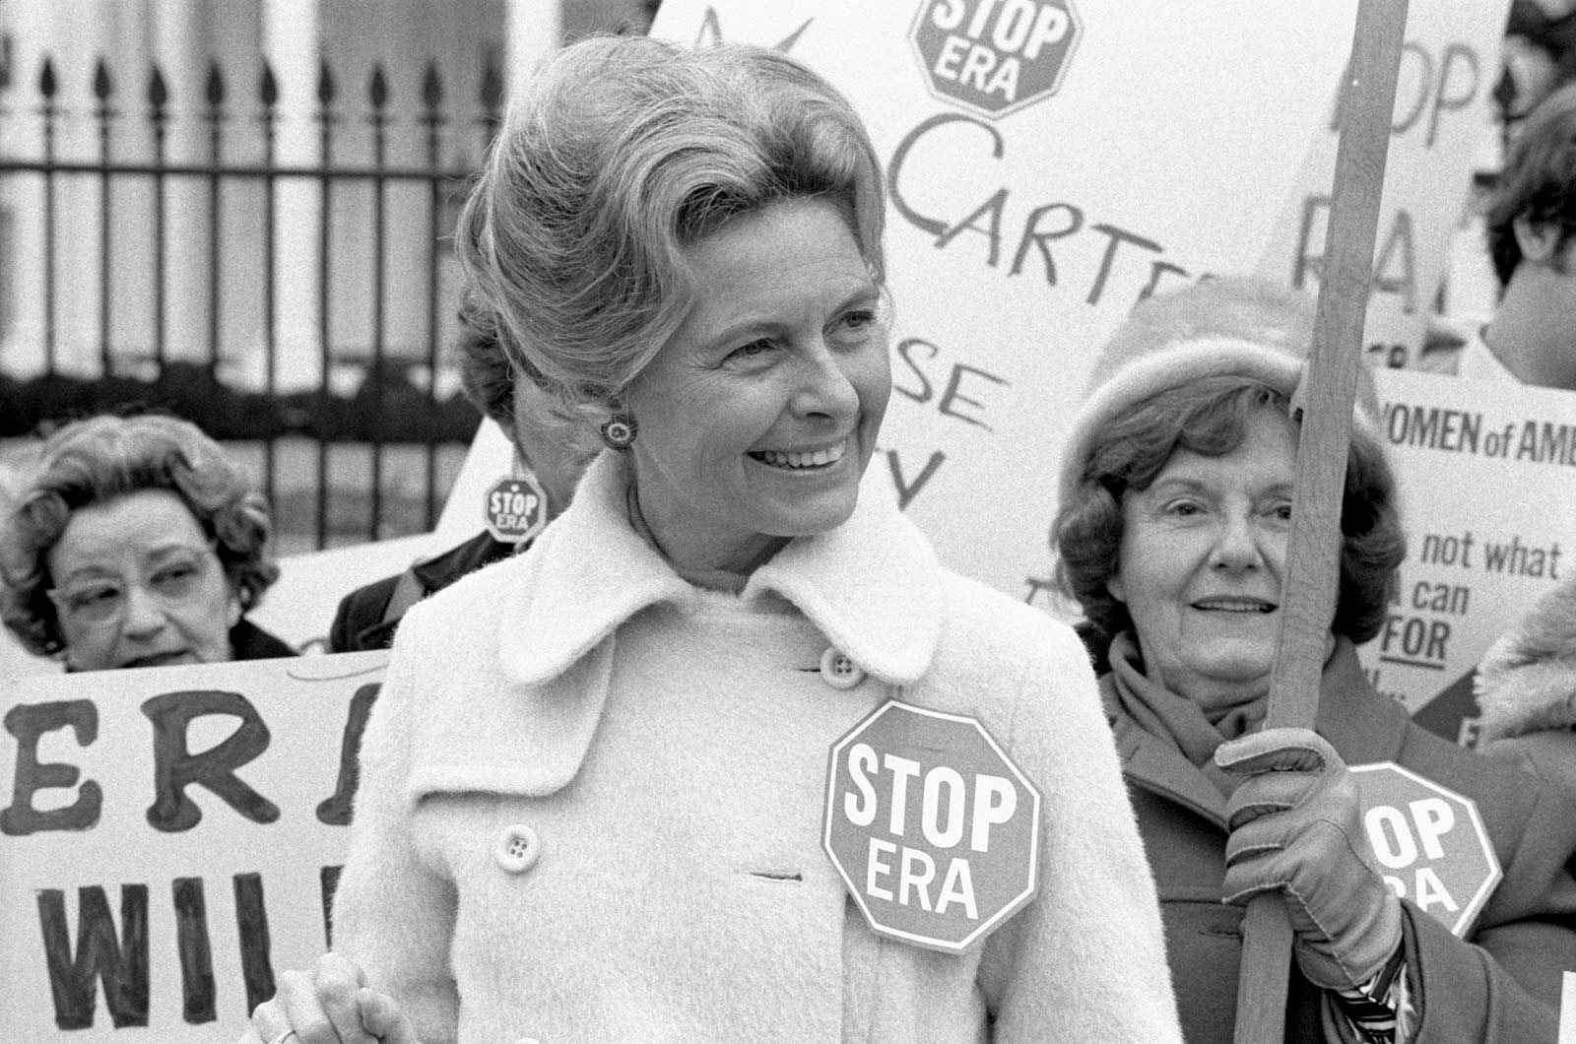
Opposition to the ERA
Equal rights Amendment- Proposed change to the constitution that would end all gender discrimination under the law.
Opposition:
Phyllis Schlafly led opposition to the ERA, and many began to fear that it would have very negative outcomes

Slide 51
Fears of the Equal Rights Amendment
Make it more difficult for women to get a divorce
End Single-Gender colleges
End Women’s exemption from the draft
Take away laws that give women special protection in the workforce
Force non-gender bathrooms

Slide 52
ERA is rejected
To ratify an amendment, it has to be passed by congress & be passed by a popular vote in ¾ of the states (they would need 38 states to ratify)
By 1979 35 states had passed, but then opposition grew, and 5 states voted to take away their support of amendment.
Finally in 1982 the deadline to pass the amendment failed.
Initially passed by congress in 1973 and went to a vote by states

Slide 53
The NRA
The National Rifle Association- Extremely powerful conservative political organization dedicated to protecting the right to own guns (2nd amendment).
-Against laws that make it more difficult to buy guns
-Because of its large membership, it has a big influence in elections.

Slide 54
Quick Check
What three groups promoted conservative ideals in politics during the 1980s?

Slide 55
HIV/AIDS
HIV/AIDS: Acquired Immune Deficiency Syndrome:
First AIDS cases were reported in the U.S. in June 1981, the number of cases and deaths among persons with AIDS increased rapidly during the 1980s followed by substantial declines in new cases and deaths in the late 1990s.
Many died but there have been vast improvements in medical care today.

Slide 60
You need a writing utensil and a highlighter

Slide 61
The War on Drugs
In Reagan’s second term, the big social issue was his War on Drugs
Reagan stepped up drug enforcement to a level never previously seen, allocating over $1.7 BILLION per year to drug enforcement.
The first lady, Nancy Reagan, made the War on Drugs her special mission
She started the “Just Say No” campaign, advocating for kids to avoid peer pressure and to say no to drugs

Slide 62
Nancy Reagan
“Now you can see why drug abuse concerns every one of us-all the American family. Drugs steal away so much. They take and take, until finally every time a drug goes into a child, something else is forced out - like love and hope and trust and confidence. Drugs take away the dream from every child's heart and replace it with a nightmare, and it's time we in America stand up and replace those dreams.”
- First Lady Nancy Reagan

Slide 63
Results of the War on Drugs
The US will see a significant increase in the number of inmates convicted of drug offenses
Drugs were still widely available, prison populations swelled, and states spent themselves into debt dealing with the overflowing prisons
On the other hand, teen drug use dropped dramatically
The US will have fewer resources to build and fund social programs and public education

Slide 69
Reagan Wins the Cold War

Slide 71
Destroying the Evil Empire
During his first several years as President, Reagan’s policy on the Cold War was the exact opposite of detente. Instead of calming things down, Reagan purposefully escalated the Cold War in the following ways:
He greatly increased military spending and the size of the military, including our number of nuclear missiles. “Peace through strength”
He called the Soviet Union the “Evil Empire”
Under the “Reagan Doctrine,” the U.S. gave aid to anti-Communist resistance movements around the world (a continuation of the Truman Doctrine)
Introduced the Strategic Defense Initiative (SDI)

Slide 72
Star Wars
Strategic Defense Initiative (SDI) was a proposed program of ground and space-based detectors, missiles, lasers, and other devices that would create a virtual “missile shield,” protecting the U.S. from Soviet nuclear missiles
The media made fun of SDI, calling it Star Wars, implying that it was all science fiction
Whether or not it was realistic (it mostly wasn’t), the Soviets believed in it and feared it
This fear of SDI caused the Soviets to continue spending vast amounts of money on arms even as their economy was collapsing

Slide 74
Gorbachev, Glasnost, and Perestroika
In the late 1980s, the Soviet Union came under the control of Mikhail Gorbachev (head of the communist party 1985-1988, President 1988-1991).
Initially, he and Reagan were antagonistic toward each other; however, as the Soviet economy began to fail, Gorbachev started working with Reagan to reduce nuclear weapons and other military spending.
The U.S. had won the Cold War.
Symbols of the Cold War now collapsed:
Collapse of the Soviet Union economy
Fall of the Berlin Wall
Dissolution of the Soviet Union

Slide 77
End of the Cold War
Which location on the map was the site of the symbolic fall of the U.S.S.R. and the end of the Cold War?

Slide 78
Sandra Day O’Connor
When he ran for President in 1980, Reagan promised that he would appoint a woman to the Supreme Court.
True to his word, in 1981, he appointed Sandra Day O’Connor to become the very first woman on the Supreme Court.
He got a lot of criticism for his choice from other conservatives, who feared that O’Connor would not be willing to vote with Conservatives against abortion rights.
In his diary, Reagan wrote: “Called judge O’Connor and told her she was my nominee for Supreme Court. Already the flak is starting and from my own supporters. Right to life people say she is pro abortion. She says abortion is personally repugnant to her. I think she’ll make a good justice.”
She ended up voting to restrict abortion but not to outlaw it.

Slide 79
Grenada, the Isle of Spice
In 1979, a Communist revolution occurred in the Caribbean island nation of Grenada.
Over the course of the next four years, there were several acts of violence, culminating in a military takeover in 1983.
A group of Caribbean nations asked the United States to intervene. Also, there were U.S. citizens attending medical school there.
In October 1983, Reagan ordered a military invasion of Grenada.

Slide 80
Grenada Liberated...that’s good, right?
By December, the U.S. invasion of grenada was successful.
Afterward, the Grenadians held elections and formed a free, democratic government.
Today, they celebrate the day of the invasion as “Thanksgiving Day.”
Many criticized the invasion, however.
The United Nations, Canada, and the U.K. said that the U.S. had violated international law.
Many in the U.S. were angry that 19 Americans were killed (116 wounded) in a secret invasion of a country that didn’t threaten America in any way.
And the Reagan administration got into heated arguments with the media over their right to report on secret operations. Also, many people couldn’t help but notice that the invasion came two days after terrorists blew up a marine base in Lebanon, on the other side of the world, suggesting that the invasion had been nothing but a “show of force.”

Slide 82
Lebanon
American and French service members of the Multinational Force in Lebanon (MNF), a military peacekeeping operation during the Lebanese Civil War were stationed in Beirut, Lebanon
Reagan sent U.S. Marines to Beirut to help establish peace during the Lebanese Civil War
Early on a Sunday morning, October 23, 1983, two Iranian truck bombs struck buildings where American Marines and other service members were housed
The attack killed 307 people: 241 U.S. and 58 French military personnel, six civilians, and two attackers
Reagan withdrew forces from Lebanon due to lack of diplomatic progress.

Slide 83
The Iran-Contra Affair
Iran
In 1986, terrorists with ties to Iran had taken 7 American citizens hostage. At this time, Iran was fighting a very costly war with Iraq and running low on weapons due to an international weapons embargo placed on them earlier in the decade.
Contra
Nicaragua was a Communist country, controlled by a group called the Sandanistas. The Contras were anti-communist rebels trying to take over the country. The Contras weren’t great though. They had committed terrible acts such as kidnapping and killing healthcare workers, raping and murdering women, torturing and executing children, etc. So Congress passed an act saying the U.S. couldn’t support them in any way.
The Affair
The Reagan administration sold weapons to Iran through Israel, bypassing the embargo. The Iranians promised to do all that they could to get the terrorists to release the hostages. Some of the money from these weapons sales then went to help the Contras in Nicaragua, in violation of a U.S. law that specifically made it illegal to fund them. To get around this, the money was funneled through private groups in other countries. When this became public, Reagan admitted to authorizing the arms sales to Iran, but said he didn’t know about the funding of the Contras. Retired Admiral John Poindexter and Lieutenant Colonel Oliver North were both convicted of various crimes, though both were later cleared in appeals due to violations of their 5th Amendment rights. North later claimed Reagan definitely knew about almost everything.

Slide 84
Iran Contra in Summary:
Reagan administration sold weapons to Iran to get American hostages released
Reagan administration used the money from that to get weapons to the Contras
They denied that Reagan knew about it
Ultimate issue: breaking an international agreement by selling weapons to Iran and using the profit to aid anti-communist rebels in Nicaragua

Slide 87
Other events of the 1980s

