Slide 1
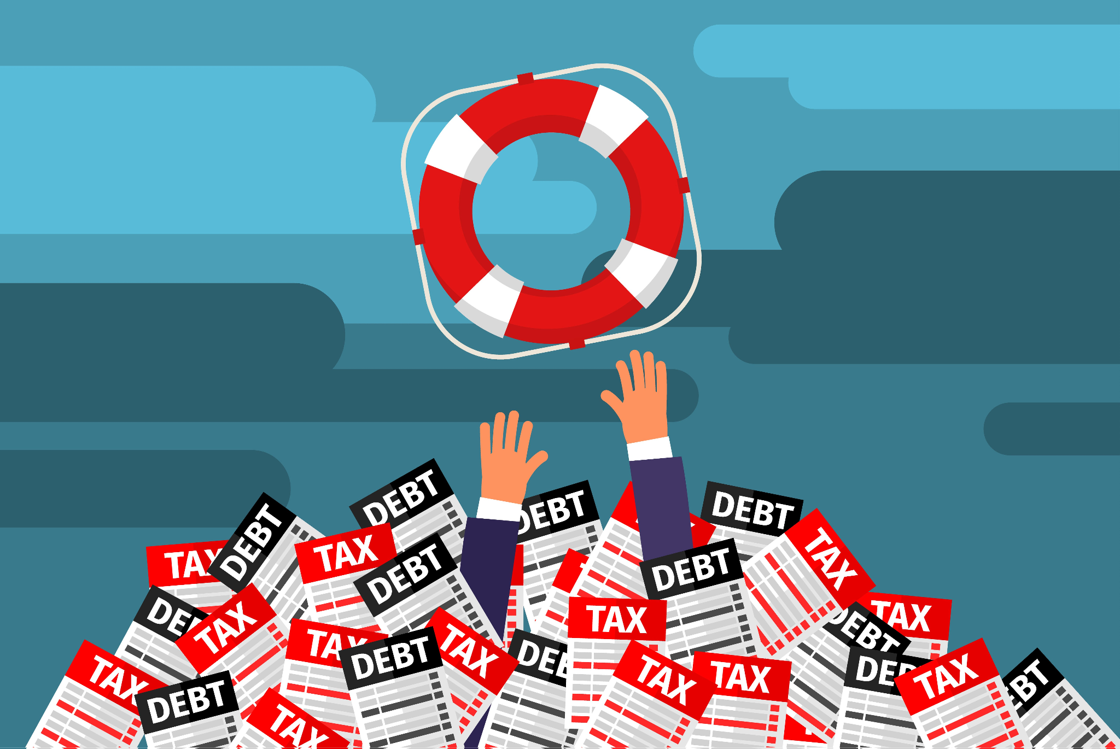
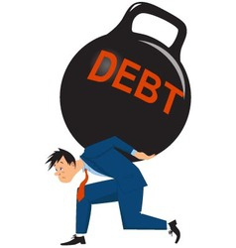
Bankruptcy
a legal proceeding initiated when a person or business is unable to repay outstanding debts

Slide 2
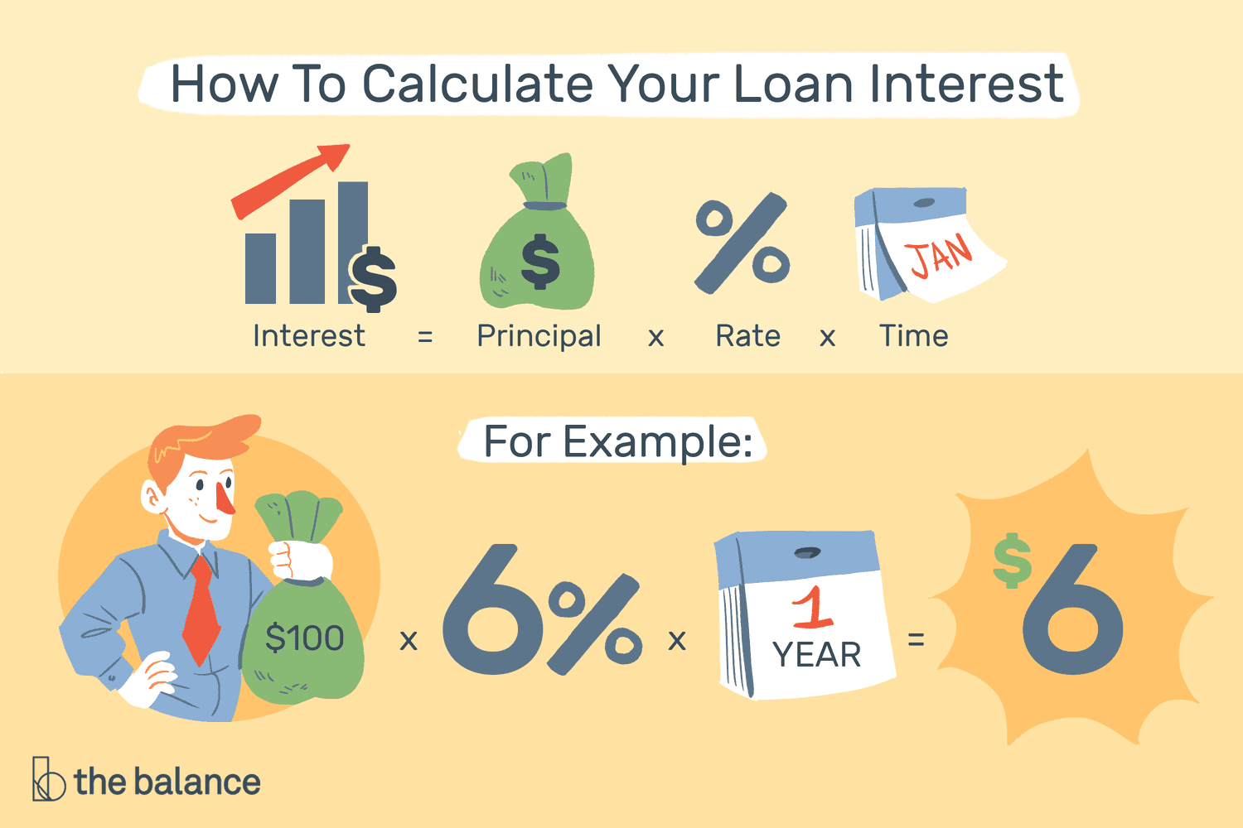
Interest
the cost of borrowing the principal

Slide 3
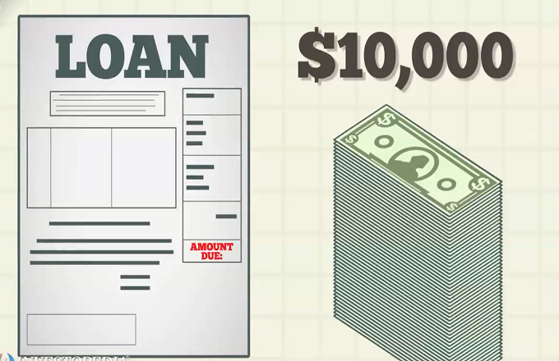
Principal
the original sum of money borrowed in a loan

Slide 4
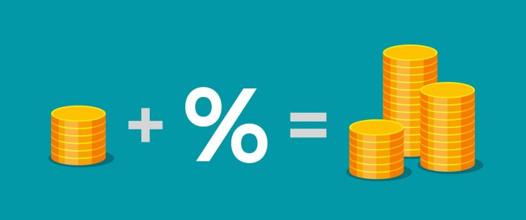
Savings Accounts
an interest earning deposit held at a bank or credit union

Slide 5
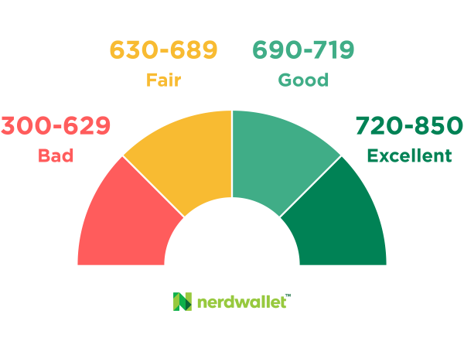
Credit Score
a prediction of your credit behavior, such as how likely you are to pay a loan back on time

Slide 6
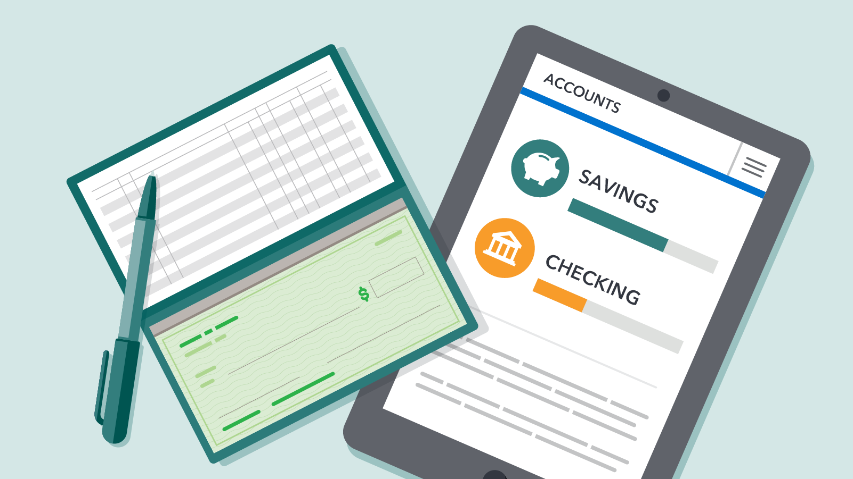
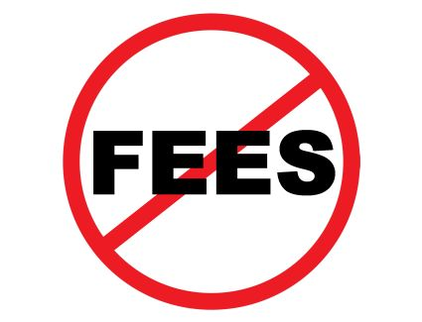
Checking Accounts
a bank or credit union account where you can make deposits and withdrawals quickly

Slide 7
Mutual Funds
an investment vehicle consisting of a portfolio of stocks, bonds, and other securities, overseen by a professional money manager

Slide 8
Credit Fraud / Identity Theft
someone physically steals your credit/debit card or virtually hacks your account to make purchases or remove funds

Slide 9
FAFSA
Free Application for Federal Student Aid, a form completed to determine aid financial qualifications

Slide 10
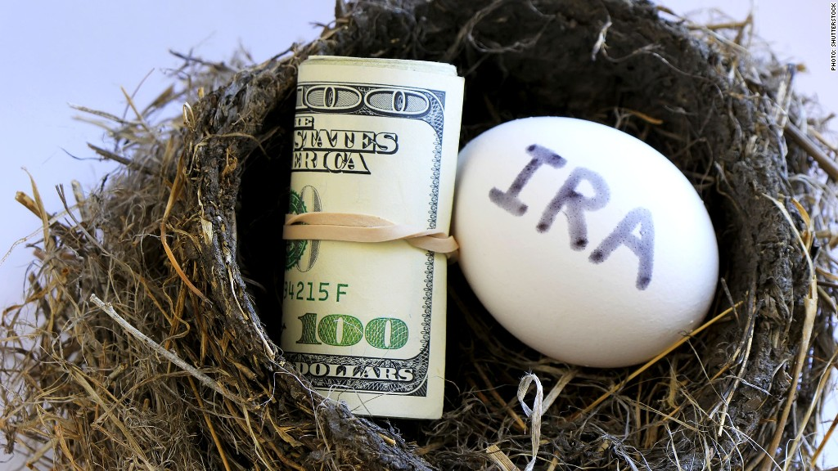
IRA / 401k
Tax-deferred retirement savings accounts

Slide 11
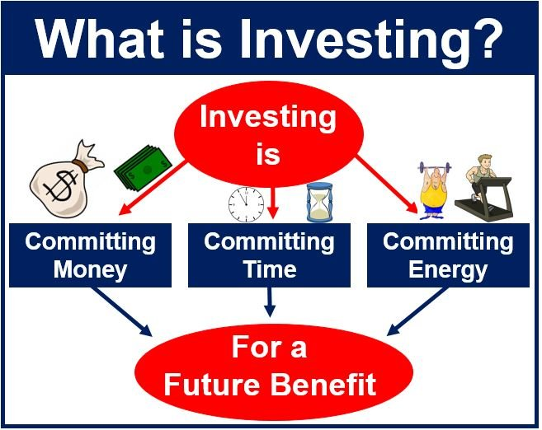
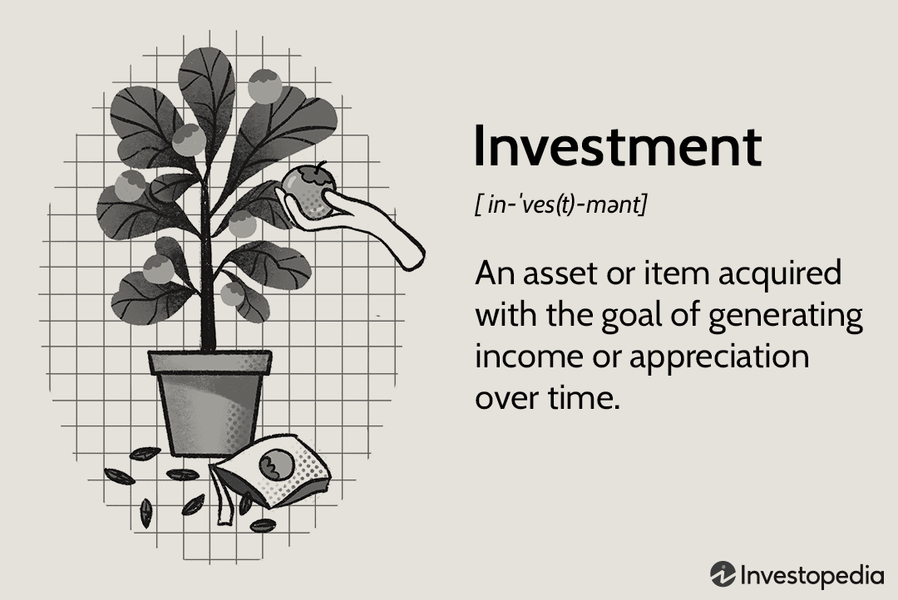
Insurance
to grow ones money over time

Slide 12
stock market
several exchanges in which shares of publicly held companies are bought and sold

