Slide 1
World War II: America at War, The War In the Pacific Theater, & The Aftermath of the War
Unit 8: World War II #4

Slide 2
The Battling Sides
The Allied Powers
Winston Churchill → Great Britain
Charles de Gaulle —> France
Joseph Stalin → USSR (Russia/Soviet Union)
Chiang Kai-Shek → China
Franklin Roosevelt → United States
The Axis Powers
Adolf Hitler → Germany
Benito Mussolini —> Italy
Emperor Hirohito & Military General Tojo → Japan

Slide 3
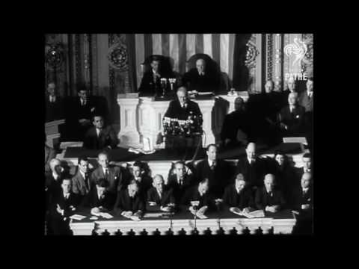
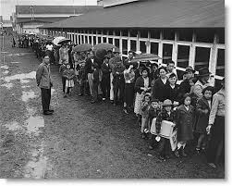
Attack at Pearl Harbor & Japanese Internment
December 7, 1941 → a day that will forever live in infamy
Japan, led by Hideki Tojo, attacked the U.S. at Pearl Harbor, Hawaii
U.S. trade embargos had caused shortages of oil & gas (angry)
The U.S. enters World War II:
Leads to war in the Pacific
Japanese internment camps in the U.S.
Fears that Japanese Americans might spy or sabotage for the enemy led to FDR signing Executive Order 9066
Forced 110,000 Japanese Americans (most American citizens) to be relocated to concentration camps
The dropping of the atomic bombs

Slide 4
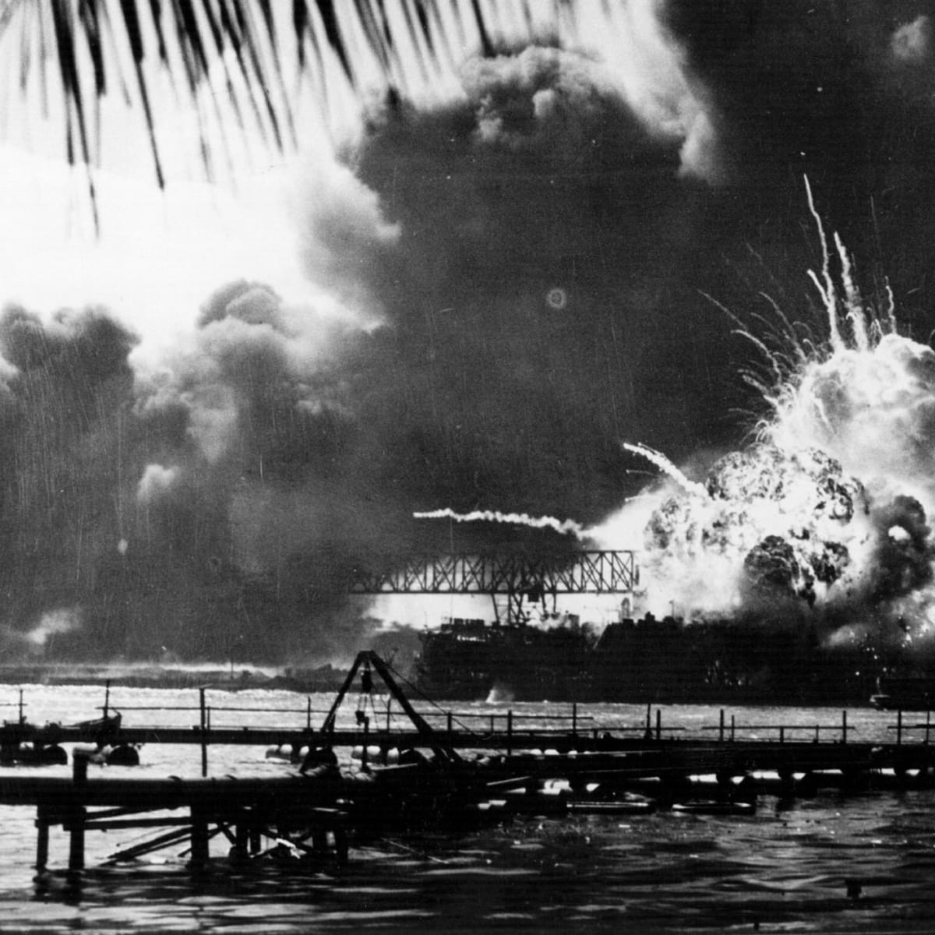
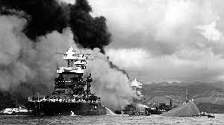
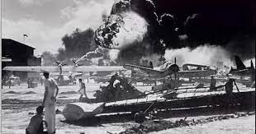
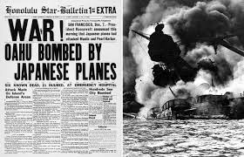
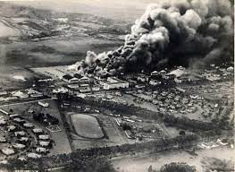
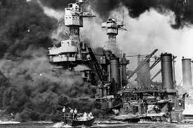
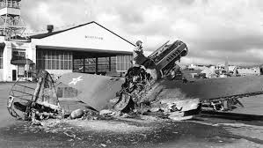
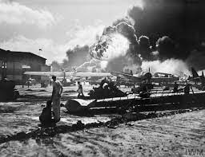

Slide 5
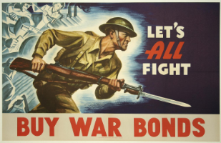
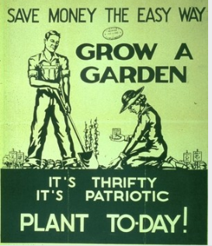
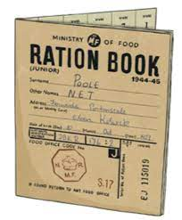
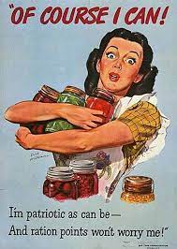
The War in America
At home, Americans were mostly very united behind the war effort
People bought war bonds, which kept inflation down and helped pay for the war
Victory gardens: allowed people to grow their own food to save supplies for the military and our allies
Mandatory rationing of supplies meant that people could only buy certain amounts of certain necessary goods → CONSERVE

Slide 6
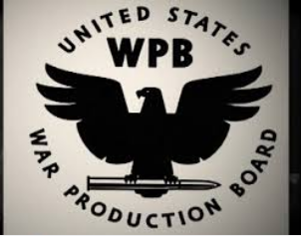
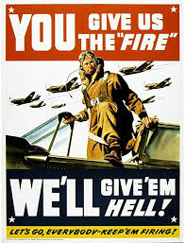
Propaganda
In 1942, FDR created the Office of War Information focused on war propaganda
Propaganda: official communications meant to influence opinions (posters, movies, and newsreels)

Slide 7
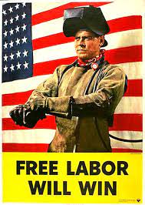
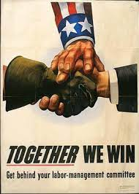
War Efforts in America
Many products were needed for success during WWII
National War Labor Board: converted factories into wartime industries
Conversions:
Lipstick case → ammunition cartridges
Baby carriages → hospital carts
Vacuum cleaners → gas mask parts
Beer cans → grenades
Cars → airplanes

Slide 8
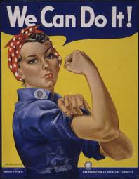
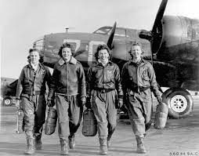
Women & Minorities
Roughly 16.6 million Americans served in WWII (more than 12% of the population)
Women and minorities played an important role at home: women worked traditional male jobs
Filled jobs that were left behind by soldiers going overseas
The war will give women and minorities opportunities
Women served in the Women’s Army Corps (WACs)
They served non-combat roles but held full military rank
General MacArthur said that they were his “best soldiers”
Women also served in the Navy and civilian WASPS (Women’s Air Service Pilots - they ferried military aircraft between bases)

Slide 9
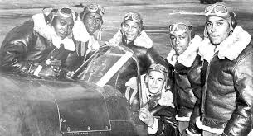
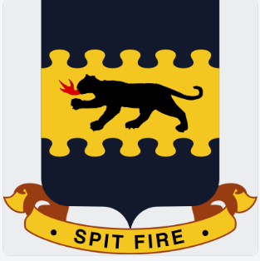
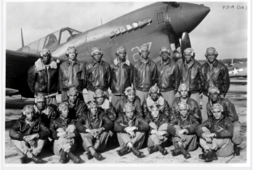
African-Americans & WWII
Many African-Americans had served in the military off-and-on since the Civil War (segregated units)
Tuskegee Airmen - an all-black fighter pilot group escorted American bombers
Bomber groups began requesting them by name
Broke down stereotypes and inspired military changes
The military will actually be the first to desegregate

Slide 10
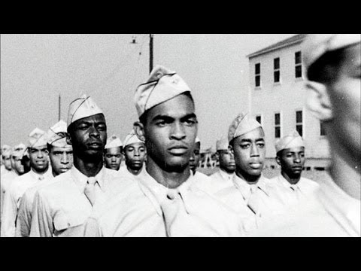

Slide 11
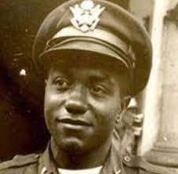
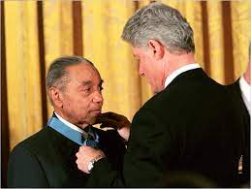
Vernon Baker
African-American Army Lt.
Received a Medal of Honor for wiping out German machine-gun nest
Baker managed to crawl and use grenades to destroy two German machine gun nests clearing the way for his remaining men to reach the safety of the nearest forward aid station
The attacks had lasted 12 hours and 19 of Baker’s men lost their lives
He was a paratrooper in the Korean War

Slide 12
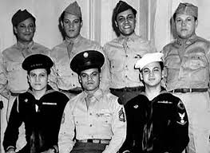
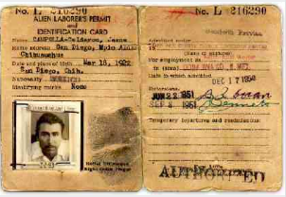
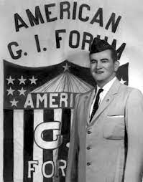
Mexican-Americans & WWII
Roughly 500,000 Latino soldiers served during WWII
The majority of those identified as Mexican-Americans
Latinos would earn 12 Medals of Honor during WWII
General MacArthur would also champion some of them in Arizona’s 158 Infantry Regiment as “the greatest fighting combat team ever deployed for battle”
Hector Perez Garcia
Mexican-American combat surgeon
Civil rights activist
Founded American G.I. Forum
The American G.I. Forum is a congressionally chartered Hispanic veterans and civil rights organization founded in 1948
Motto: “Education is Our Freedom and Freedom should be Everybody’s Business”
Operates chapters throughout the U.S., with a focus on veterans’ issues, education, and civil rights

Slide 13
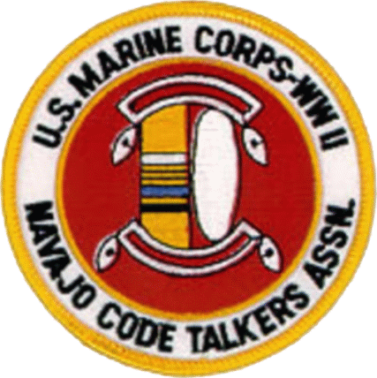
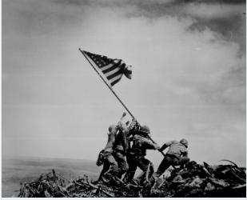
Native Americans & WWII
Volunteered for the military at a higher percentage than any other minority group
Navajo Code Talkers:
Used the Navajo language to encode military communications for secure (secret) transmission
Sent messages in their native language
The Japanese could never decipher (instrumental for success in the Pacific)
Native American Marine Corporal Ira Hayes (far left) was one of the men in the famous “Raising the Flag on Iwo Jima” photograph

Slide 14
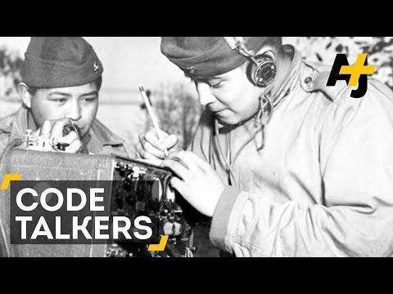

Slide 15
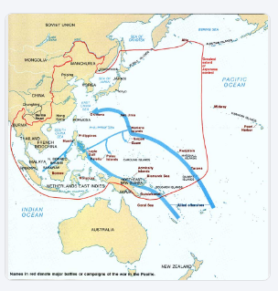
Island Hopping
The U.S. strategy of taking over islands one-by-one on the way to Japan
Avoided the well defended islands
U.S. cut off the Japanese supplies to the islands (successful strategy)

Slide 16
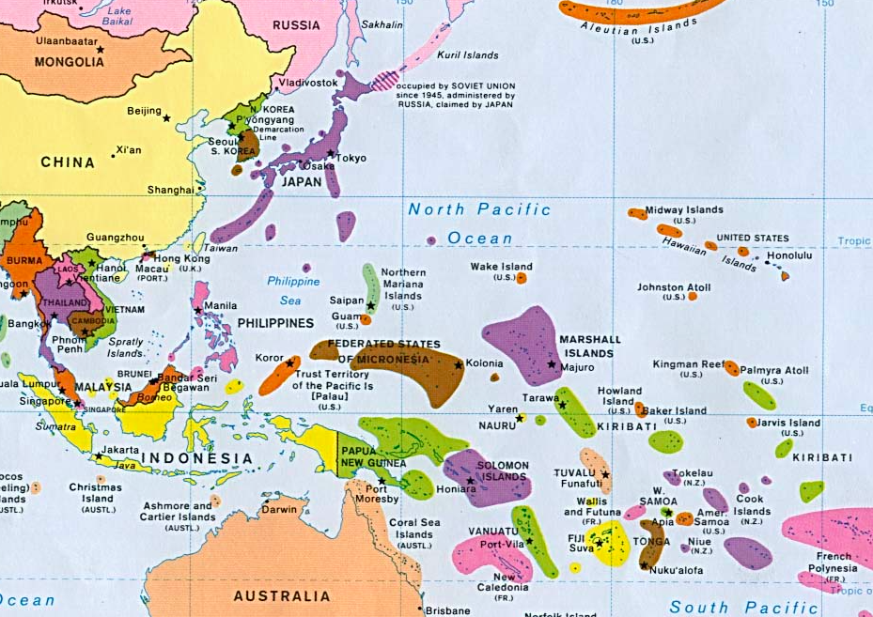
Taking the War to Japan

Slide 17
Island Hopping

Slide 18
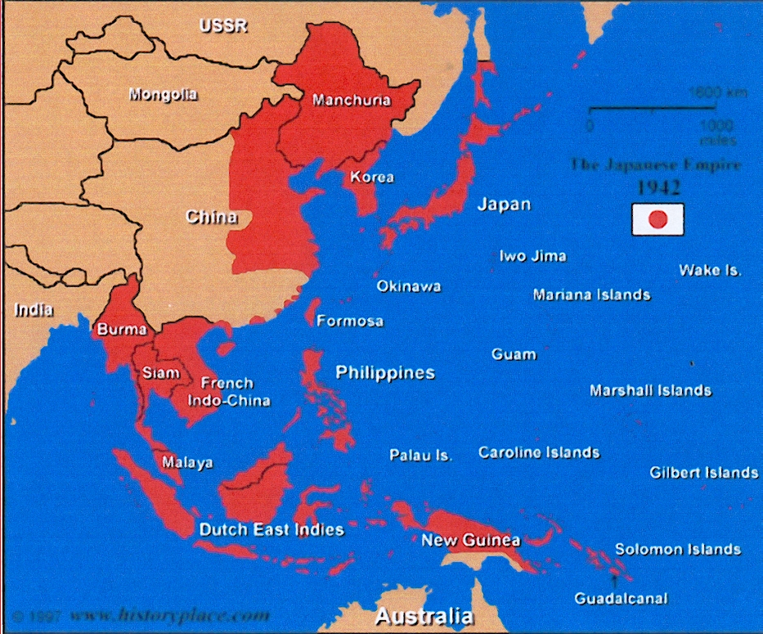
Most islands controlled by Japan - you don’t want to have to fight on them all

Slide 19
Island Hopping
The Philippines is less than 1,500 miles from Iwo Jima

Slide 20
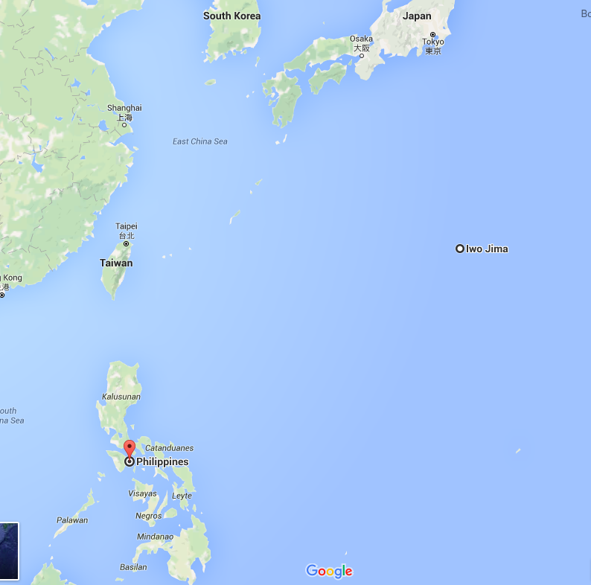
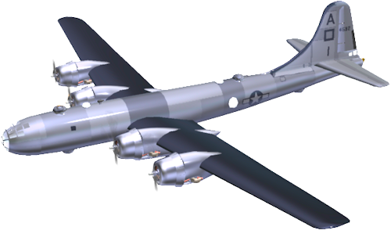
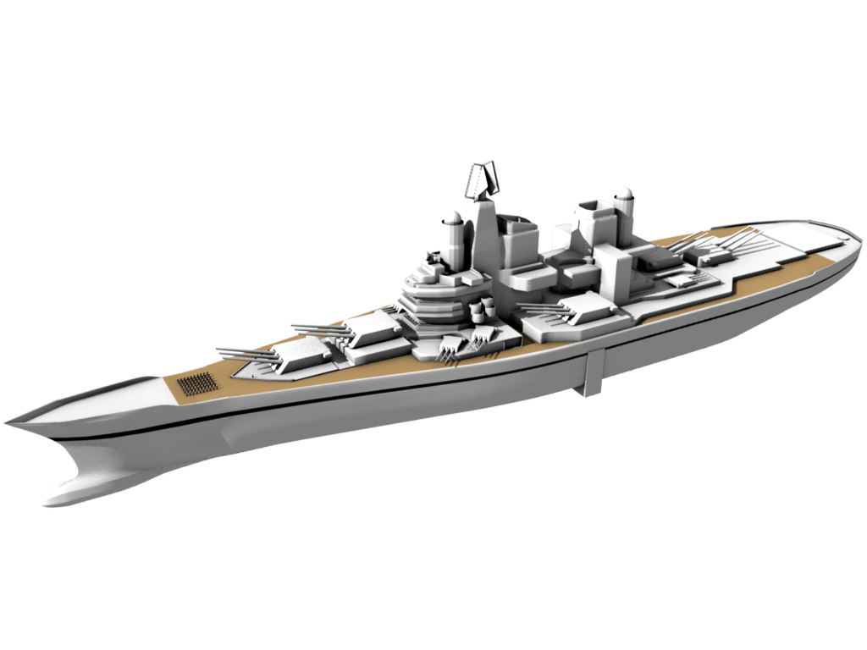
The Philippines is 1,300 miles away from Iwo Jima
Iwo Jima is 1,000 miles from Japan

Slide 21
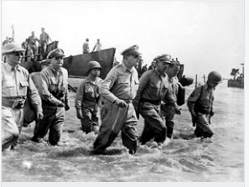
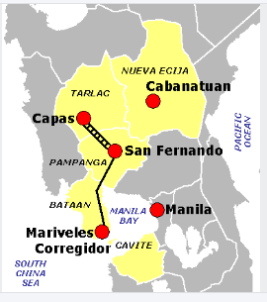
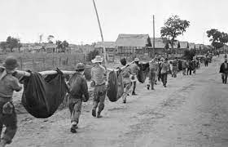
The Philippines
On the same day Japan attacked Pearl Harbor, they also attacked the Philippines
This was a U.S. territory since 1898
General Douglas MacArthur (commander of the Army) in the Pacific, had been forced to retreat from the Philippines in 1942
He came back again to take the islands in 1945
The Bataan Death March:
Americans and Filipinos captured by the Japanese were forced on a single, 60-mile march
As many as 5,000 Americans and possibly 10,000 Filipinos died

Slide 22
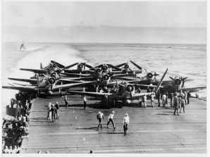
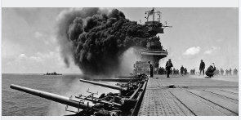
The Battle of Midway
The Japanese planned a surprise attack at Midway Island
The U.S. cracked the Japanese secret codes and know about the attack ahead of time
Under the command of Admiral Chester Nimitz (the Commander-in-Chief of the U.S. Pacific Fleet)
The U.S. destroyed 4 of Japan’s aircraft carriers
The Battle of Midway is considered the turning point of the Pacific War because it crippled the Japanese Navy

Slide 23
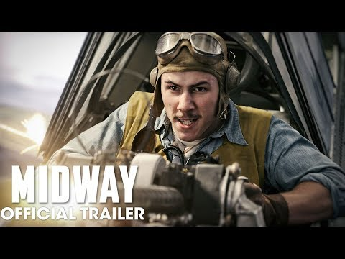

Slide 24
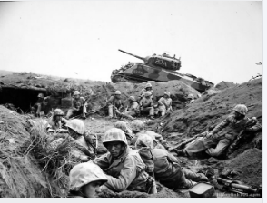
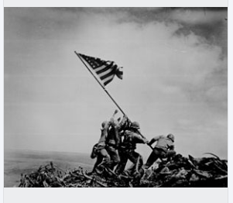
The Battle of Iwo Jima
Iwo Jima was the only battle by the U.S. Marine Corps in which the overall American casualties (killed and wounded) exceeded (more) than those of the Japanese
Of the 70,000 Americans that attacked, nearly 7,000 died and 19,000 wounded; while 18,000 of the 22,000 Japanese were killed
“Victory was never in doubt… its cost was, “ 3rd Marine Division leader Graves B. Erskine later said of Iwo Jima. “What was in doubt, in all our minds, was whether there would be any of us left to dedicate our cemetery at the end or whether the last Marine would die knocking out the last Japanese gun and gunner.”

Slide 25
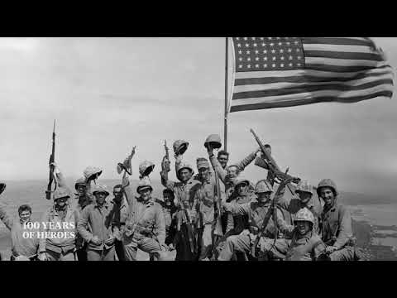

Slide 26
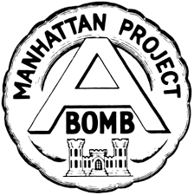
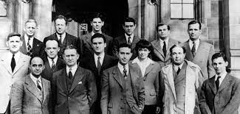
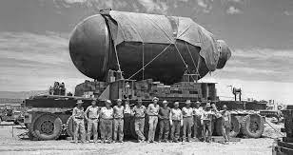
The Manhattan Project
In 1942, the U.S. Army Corps of Engineers began a top-secret project code-named The Manhattan Project
The goal of this project was to create an atomic bomb (a weapon that gets its power from a reaction involving the nucleus of an atom)
The idea for this project came from a letter sent to President FDR in 1939:
The letter, called the Einstein-Szilard letter, told FDR that other countries, such as Germany and Italy, were close to developing an atomic bomb and that the U.S. should get to it first

Slide 29
The End of the War!!

Slide 30
Allies Win
On September 2, 1945, WWII ended when U.S. General Douglas MacArthur accepted Japan’s formal surrender aboard the U.S. Battleship Missouri
At the signing of the agreement that brought an end to 2,194 days of global war, MacArthur told the world in a radio broadcast:
“Today the guns are silent. A great tragedy has ended. A great victory has been won.”

Slide 31
The Paris Peace Treaties
The Paris Peace Treaties were signed on February 10, 1947 following the end of WWII in 1945
The Paris Peace Conference lasted from July 29 - October 15, 1945

Slide 32
The Aftermath of WWII

Slide 33
Dividing Up Germany
Germany is going to be divided into four zones to be temporarily governed by the Allies (Soviet Union, Great Britain, France, and U.S.)
The capital, Berlin, will also be divided into 4 zones, even though it lay far within the Soviet zone (this will have impact on the future)

Slide 34
Death Toll & The Nuremberg Trials
Most common estimate of the Holocaust death toll: 6 million Jews
This is a VERY conservative, but widely accepted estimate
Other studies have concluded that as many as 21 million were killed and possibly 27 million Soviet civilians
Nuremberg Trials:
The Holocaust began in Nuremberg, so it was perhaps poetic justice that the Nuremberg Trials (war-crimes trials for Nazi leaders) (Nov. 20, 1945 - Oct. 1, 1946)
These trials were very important because they set the principle that individuals are responsible for their actions, even if they were just “following orders”
The most important defendant was Hermann Goring (Hitler’s highest officer)
He was found guilty and sentenced to hanging
A Nazi sympathizer in the U.S. Army snuck a cyanide pill into his cell so that he could commit suicide on his own terms

