Slide 1
Unit 7
Personal Financial Literacy

Slide 2
Unit 7
** Vocabulary
5% Occupation Research
5% Goals
30% Checkbook (Big)
5% Pre-Project budget
10% Average Budget
-Credit
-Buying vs Renting
10% Transportation Pros/Cons
5% Furnishings*
30% Budget (Big)

Slide 3
Do not fall behind
www.glscott.org
-Economics
-Unit 7
Penalty for late work !

Slide 5
End of the Beginning
Next ---- Checkbook

Slide 7
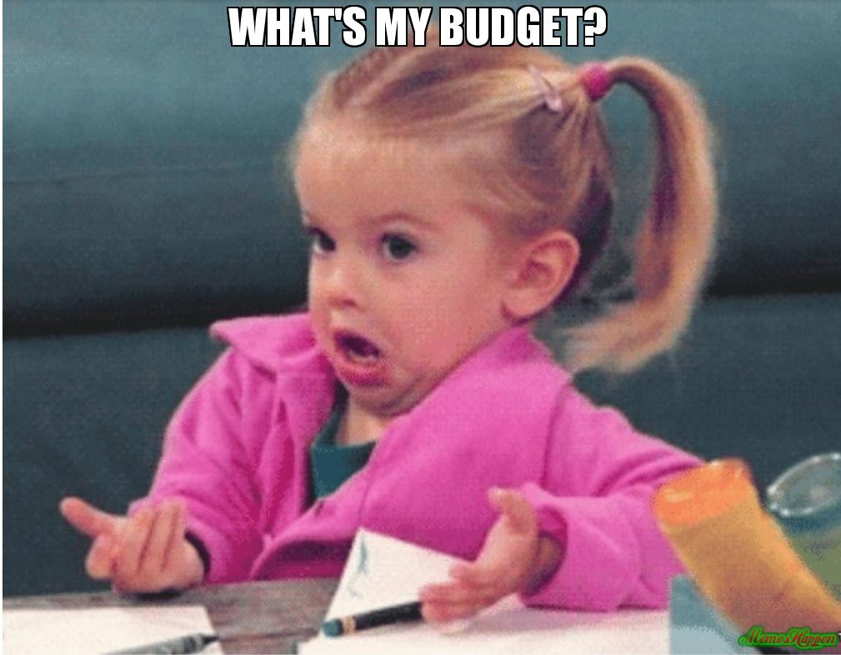
Understanding How to Balance A Budget

Slide 8
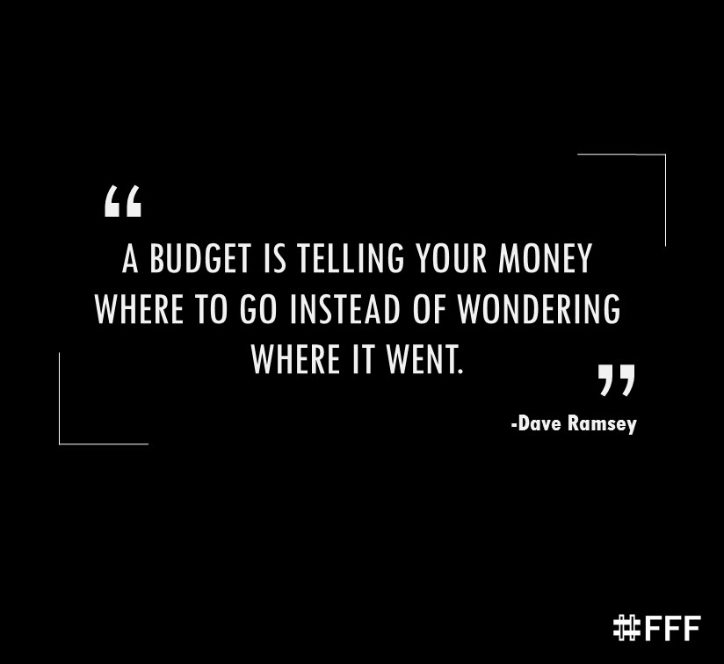
What Exactly Is A “Budget?”
A budget is what you use to decide what you are going to spend your money on, and how much of your money you are going to spend.

Slide 9
What’s the Difference Between a Monthly Income and a Monthly Available Income?
A Monthly Income is the amount of money you make before taxes, savings, and retirement are taken out.
A Monthly Available Income (MAI) is the amount of money you actually get to spend after taxes, savings, and retirement are taken out.

Slide 10
How About Surplus and Shortage?
A surplus of money is a good thing… it means you have money left over after all of your expenses.
A shortage means you are spending more than you can afford and don’t have enough money.
A good rule to live by…
if you can’t afford it…
you can’t afford it.

Slide 11
Fun Fact #1
The average household in the USA has almost $7,000 of credit card debt due to spending more than they can afford each month.

Slide 12
Fun Fact #2
Americans, on average, pay about $550/month
in car payments.
That’s $6,600 a year just to drive!

Slide 13
Fun Fact #3
The average person in the USA works until age 62.
If you put $300/month into a retirement account that earned 8% interest from age 22 to 42, you would have just over $1,000,000 saved for retirement!
Use this investment calculator with a caring adult to help you understand how much you would need to save for retirement to live comfortably

Slide 14
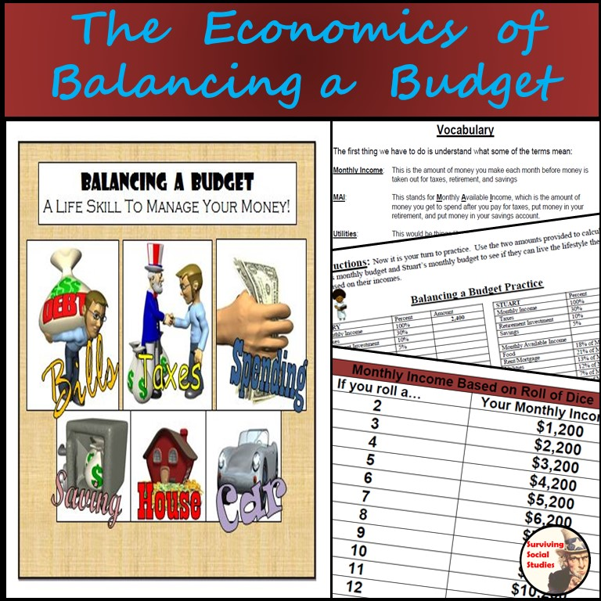
Types of Budgets!
50/30/20 Budget
Zero-Based Budget
Envelope Budget

Slide 15
Types of Budgets!
50/30/20 Budget
Set aside 50% of income for essentials: Rent, Food
30% allotted for things you want
Remaining 20% for paying down debt or savings
Notes:
Not very restrictive
Adjustable

Slide 16
Types of Budgets!
Zero-Based Budget
Draw up in advance each month to break even
This budget accounts for each dollar

Slide 17
Types of Budgets!
Envelope Budget
Envelope system of paying bills
Takes discipline!

Slide 18
It is Now Time to Practice Balancing A Budget!

