Slide 1
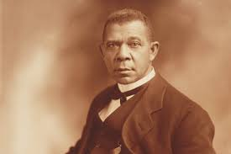
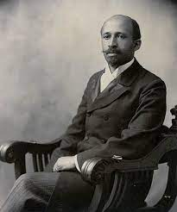
Booker T. Washington
W.E.B DuBois

Slide 2
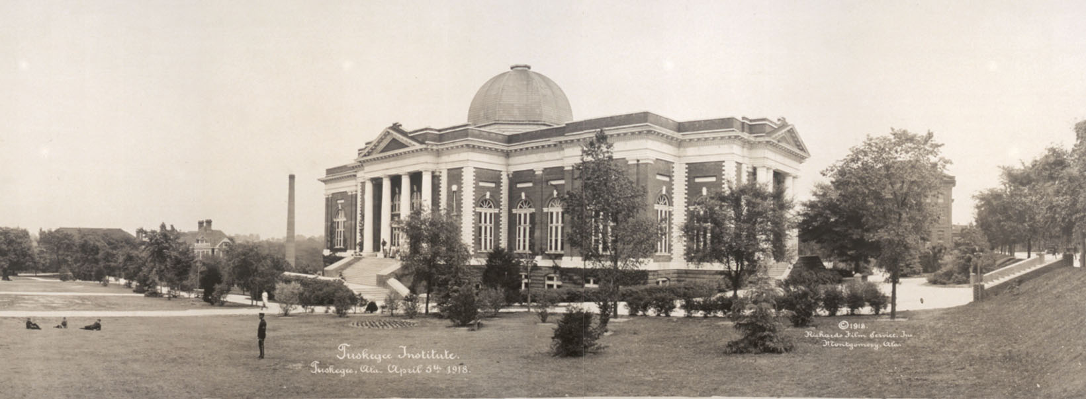
Two Perspectives on African American Education
Notes:
Private university in Tuskegee, Alabama, U.S. Booker T. Washington founded the school in 1881 as a teachers' college for blacks, and it still has a predominantly African American student body. George Washington Carver conducted most of his research (1896 – 1943) at Tuskegee, and Frederick D. Patterson, founder of the United Negro College Fund (1944), served as the school's president (1935 – 53). The infamous Tuskegee syphilis study, a U.S. Public Health Service project examining the course of untreated syphilis in black men, was based there from the 1930s. Today the university comprises schools of arts and sciences, agriculture, business, education, engineering and architecture, nursing, and veterinary medicine.

Slide 3
Booker T. Washington
Founded Tuskegee Institute (school to learn trades or jobs)
Did not openly challenge segregation
Born into slavery
Accepted compromise
Not focused on formal education
Focused on training for trade jobs & the economy

Slide 4
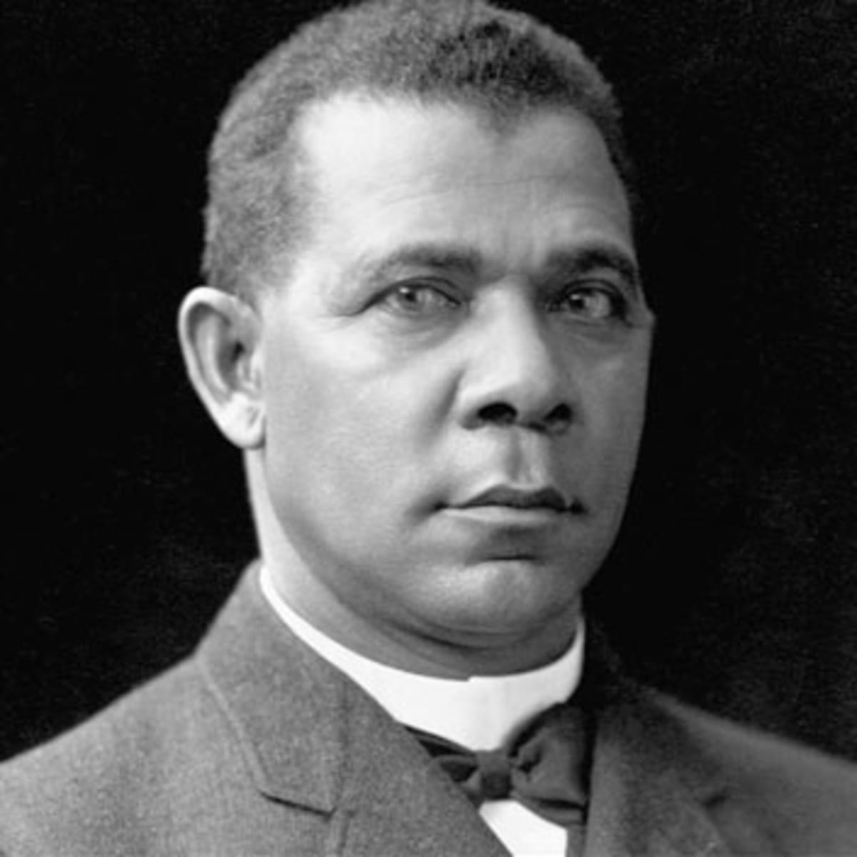
“You can't hold a man down without staying down with him.”
~ Booker T. Washington
In your own words Explain what the Speaker is Saying.

Slide 5
W.E.B. DuBois
Founded NAACP
Wanted to end segregation
Encouraged African Americans to get an education
Went to Harvard and valued education
Born after slavery, middle class
Encouraged African Americans to reject segregation
Wanted big changes, end segregation
Valued education
Wanted to create the Talented Tenth (top 10% performing African Americans) as a model

Slide 6
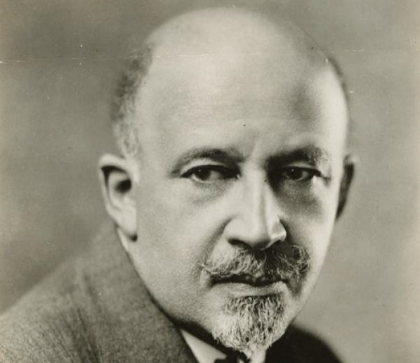
“I believe in pride of race and lineage and self; in pride of self so deep as to scorn injustice to other selves.”~ W.E.B DuBois
In your own words Explain what the Speaker is Saying.
Notes:
🍐 This is a Pear Deck Text Slide
🍐 To edit the type of question, go back to the "Ask Students a Question" in the Pear Deck sidebar.

Slide 7
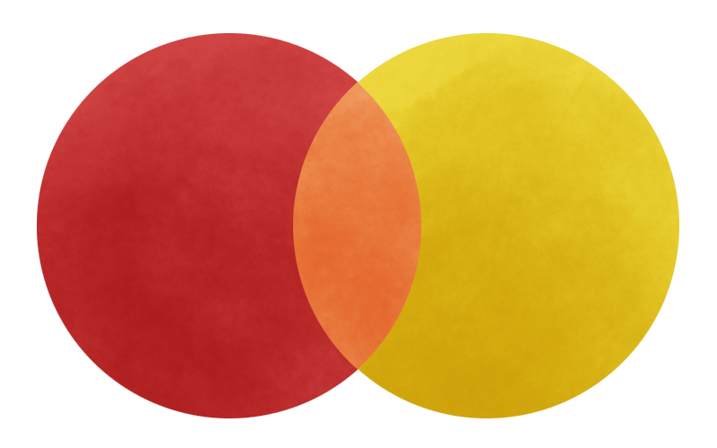
Compare: Booker T. Washington and W.E.B DuBois
Similarities
Booker T. Washington
W.E.B. DuBois
Notes:
🍐 This is a Pear Deck Drawing Slide
🍐 To edit the type of question, go back to the "Ask Students a Question" in the Pear Deck sidebar.
Compare and Contrast
This template can be used for any kind of comparing and contrasting. Students can type or draw their ideas in the appropriate area of the Venn diagram.

Slide 8
Progressive Era Open Note Quiz on Canvas

