Slide 1
QUESTION OF THE DAY
Budgeting
Q:
What percent of 18-29 year olds are currently living with their parents?
View blog post
ngpf.org 7/21/22

Slide 2
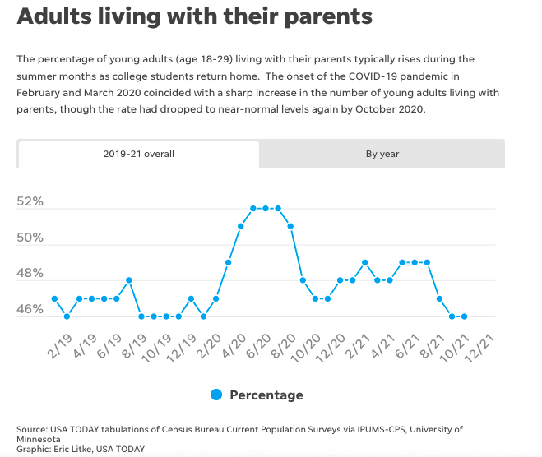
QUESTION OF THE DAY
Budgeting
A:
47%
Click here for more info on this topic

Slide 3
FOLLOW-UP QUESTIONS
Do you know anyone in the 18-29 year age range who lives with their parents? Who? Why do they live with their parents?
Why do you think that certain states have higher percentages of 18-29 year olds living at home with their parents?
At what age do you envision yourself living on your own? What is your plan to develop financial independence?
How will this number change as the world continues to respond to COVID-19?

