Slide 1
The Business Cycle
Economic Health

Slide 2
Essential Question
What is the business cycle and what does it tell us about the health of our economy?

Slide 3
Warm Up Activity: Spending Money!
Assume you are an employee at a factory. You make $100 per week. Your living expenses cost about $70 per week. Therefore you have $30 left per week to spend, save or invest. For each scenario, keep track of how you would use that $30 in the table on your student notes. You may divide up your spending rather than spending it all in one place.
 | Scenario 1 | Scenario 2 | Scenario 3
How you will spend your money
Notes:
Teacher Note:

Slide 4
Warm Up Activity: Spending Money!
Scenario #1: The economy seems to be doing well. You feel somewhat optimistic about the stock market performance. You’re a bit unsure of how the market works. You also really want to buy your partner some flowers for $10. Record your spending or saving in the table.
 | Scenario 1 | Scenario 2 | Scenario 3
How you will spend your money
Notes:
Teacher Note:

Slide 5
Warm Up Activity: Spending Money!
Scenario #2: You hear on the news that a leading economist predicts an unprecedented boom in the economy. People have jobs, are getting raises, and there’s plenty of growth in the stock market. Record your spending or saving in the table.
 | Scenario 1 | Scenario 2 | Scenario 3
How you will spend your money
Notes:
Teacher Note:

Slide 6
Warm Up Activity: Spending Money!
Scenario #3: Disaster! The economy is in recession, you’ve lost your job, and the stock market has crashed. Any money you invested there is lost ☹ Record your spending or saving in the table.
 | Scenario 1 | Scenario 2 | Scenario 3
How you will spend your money
Notes:
Teacher Note:

Slide 7
Warm Up
Use the space in your notes to respond to the prompts below. Please write in complete sentences.
Based on prior knowledge and the warm up activity, how do people tend to spend their money when the economy is doing well?
What do people tend to do with their money when the economy is in a recession? How would this behavior affect the economy?
Why do you think the economy tends to perform well and then go into a recession?

Slide 8
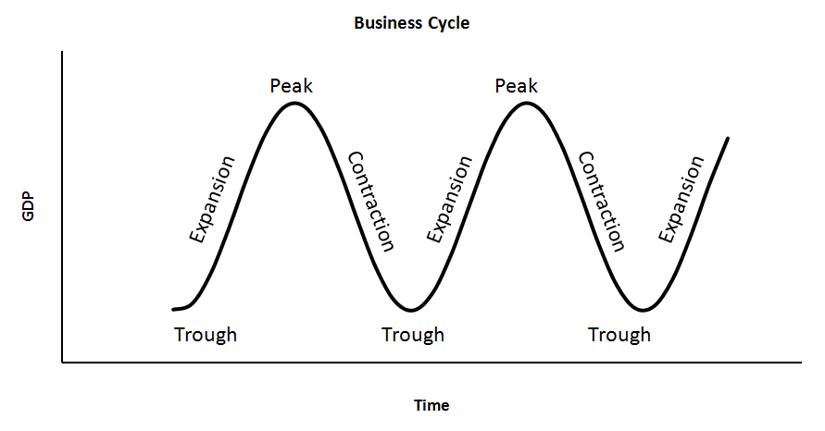
The Business Cycle
What is the business cycle?
The growth and decline of an economy as economic activity increases and decreases periodically
All market and mixed economies experience the business cycle; it is an inevitable pattern

Slide 9
Phases of the Business Cycle
What are the four phases of the business cycle?
Expansion: during this period, there is growing, consistent economic activity
Usually lasts 3-5 years
Peak: this is the highest point of economic expansion before the economy enters into a period of decline
Economists look back at the data later and designate one month as the “peak”

Slide 10
Phases of the Business Cycle
What are the four phases of the business cycle?
Contraction: during this period, economic activity is in decline
Measured by decreasing real GDP and increasing unemployment
Usually lasts 10-12 months
Trough: this is the lowest point of economic contraction before the economy enters into a period of growth
Economists look back at the data later and designate one month as the “trough”

Slide 11
The Business Cycle

Slide 12
Think-Pair-Share
Why does consumer confidence matter for the economy?
When was the last time the US experienced a period of contraction? Do you remember anything about this period of time?
Notes:
Confidence affects consumer spending, which would increase during expansions and decline during contractions
Answers will vary based on date PPT is used; 2009 recession might be mentioned, 2020 COVID contraction might be mentioned

Slide 13
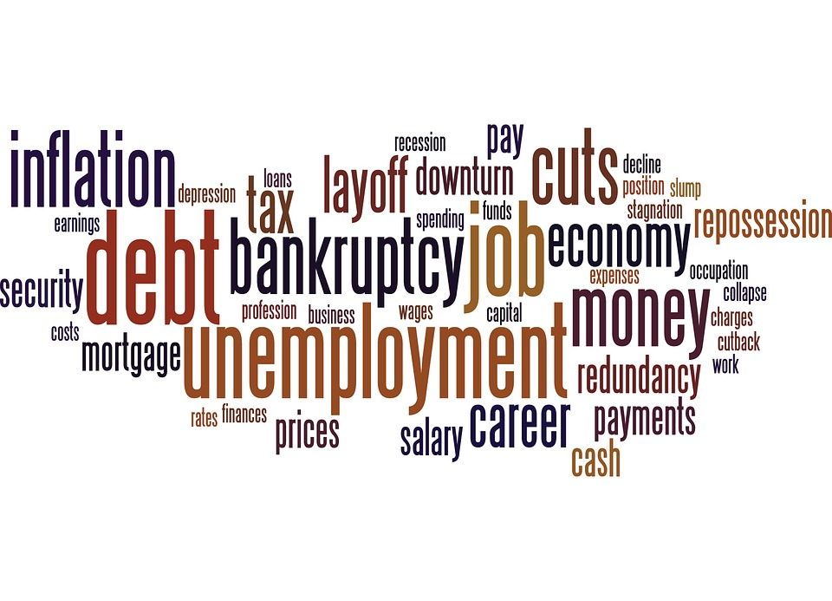
Recession
What’s the difference between a recession and an economic depression?
Recession: economic decline usually lasting at least 6 months
Example: Great Recession of 2008-2009
Depression: a severe recession usually lasting at least 2 years
Example: Great Depression of the 1930s

Slide 14
Think About It
Why do you think recessions occur?

Slide 15
Recessions
What helps create a recession?
Negative Economic Shock: stock market crash, wars or international events, restrictions of major commodities (like oil)
Land (raw material) shortages: due to the law of supply, this would raise prices
High Interest Rates: make it harder for people to get loans for businesses, houses, etc.
How does consumer behavior affect recessions?
Saving: when consumers see economic decline, they start saving money which decreases economic activity

Slide 16
Economic Indicators
How do economists figure out which phase of the business cycle we’re in?
Economists look at the following indicators:
Indicator | Rising | Falling
Real GDP | Expansion | Contraction
Unemployment Rate | Contraction | Expansion
Disposable Income | Expansion | Contraction
Interest Rates | Expansion | Contraction

Slide 17
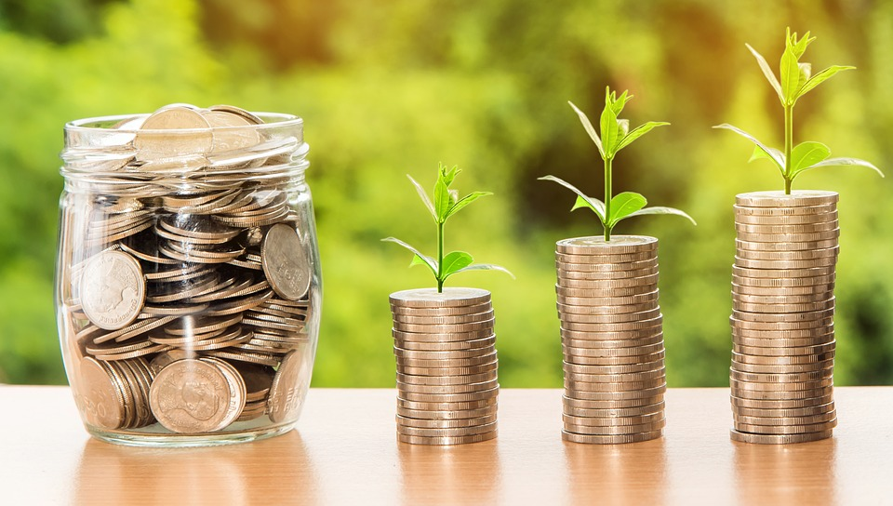
Economic Indicators
How do economists figure out which phase of the business cycle we’re in?
Economists also want to see a healthy, steady inflation rate of about 2%

