Slide 1
Ways of the World: A Brief Global History First Edition
Robert W. Strayer
CHAPTER XIX-XX
IMPERIALISM
1800–1914

Slide 2
The External Challenge: European Industry and Empire
The nineteenth century was Europe’s greatest age
of global expansion.
1. Became the center of the world economy
2. Millions of Europeans moved to regions beyond
Europe
3. Explorers and missionaries reached nearly
everywhere
4. Much of the world became part of European
colonies
Notes:
1. the controversy reflects Japan’s surprising rise to world importance, which started in the mid-nineteenth century
2. both Japan and China had to face the threat of European dominance
B. Most peoples of Asia, Middle East, Africa, and Latin America had to deal in some way with European imperialism as well as with internal challenges.
C. This chapter focuses on societies that faced internal crises while maintaining formal independence.
D. Four main dimensions of European imperialism confronted these societies:
1. military might and political ambitions of rival European states
2. involvement in a new world economy that radiated from Europe
3. influence of aspects of traditional European culture (e.g., language, religion, literature)
4. engagement with the culture of modernity

Slide 3
The External Challenge: European Industry and Empire
Four main dimensions of European imperialism
confronted these societies:
1. Military might and political ambitions of rival
European states
2. Involvement in a new world economy that
radiated from Europe
3. Influence of aspects of traditional European
culture (e.g., language, religion, literature)
4. Engagement with the culture of modernity
Notes:
Modernity-a modern way of thinking, working, etc.; contemporariness

Slide 4
In comparison to the early modern era, expansion by industrialized nineteenth-century Europe
Change
Was no longer driven by the needs of trade because Europe produced all the manufactured goods that it required.
b. Did not bring cultural change because Europeans considered their culture of modernity beyond the capacity of non-Europeans to understand.
c. Never led to large-scale migration of Europeans.
d. Was backed by far more powerful militaries.

Slide 5
New Motives, New Means
1. The Industrial Revolution fueled much of Europe’s
expansion
a. Demand for raw materials and agricultural
products
b. Need for markets to sell European products
c. European capitalists often invested money
abroad
d. Foreign markets kept workers within Europe
employed
Notes:
New Motives, New Means
1. the Industrial Revolution fueled much of Europe’s expansion
a. demand for raw materials and agricultural products
b. need for markets to sell European products
c. European capitalists often invested money abroad
d. foreign markets kept workers within Europe employed

Slide 6
New Motives, New Means
2. Growth of mass nationalism in Europe made
imperialism broadly popular
a. Italy and Germany unified by 1871
b. Colonies were a status symbol
Notes:
New Motives, New Means
2. growth of mass nationalism in Europe made imperialism broadly popular
a. Italy and Germany unified by 1871
b. colonies were a status symbol

Slide 7
New Motives, New Means
3. Industrial-age developments made overseas
expansion possible
a. Steamships
b. Underwater telegraph
c. Quinine
d. Breech-loading rifles and machine guns
Notes:
New Motives, New Means
3. industrial-age developments made overseas expansion possible
a. steamships
b. underwater telegraph
c. quinine (Malaria)
d. breech-loading rifles and machine guns

Slide 8
New Perceptions of the “Other”
1. In the past, Europeans had largely defined
others in religious terms
a. But had also adopted many foreign
ideas and techniques
b. Mingled more freely with Asian and
African elites
c. Had even seen technologically simple
peoples at times as “noble savages”
Notes:
Heathen
1. in the past, Europeans had largely defined others in religious terms
a. but had also adopted many foreign ideas and techniques
b. mingled more freely with Asian and African elites
c. had even seen technologically simple peoples at times as “noble savages”

Slide 9
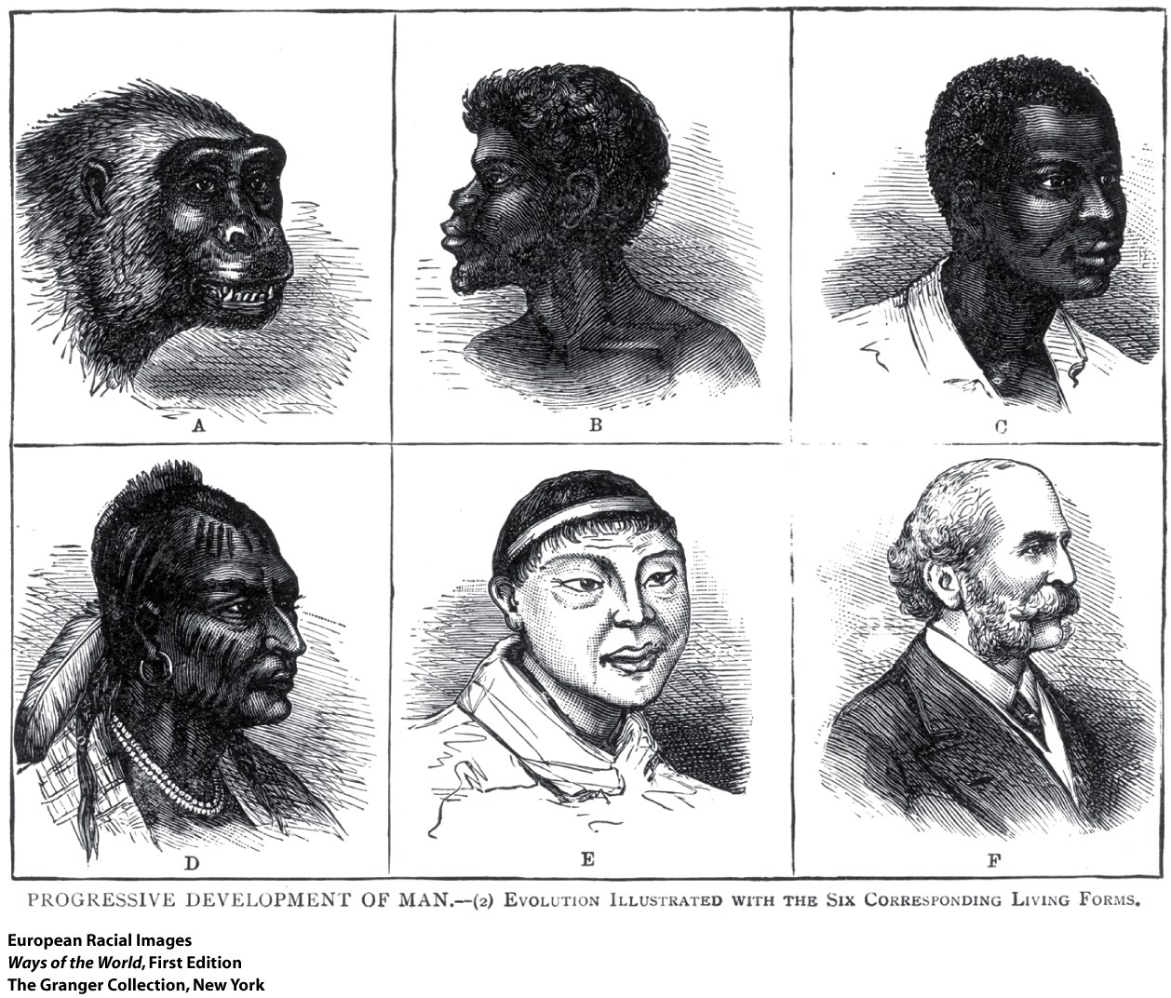
New Perceptions of the “Other”
2. The industrial age promoted a secular arrogance
among Europeans
a. Was sometimes combined with a sense of religious
superiority
b. Europeans increasingly despised other cultures
c. African societies lost status
d. New kind of racism, expressed in terms of
modern science
Notes:
2. the industrial age promoted a secular arrogance among Europeans
a. was sometimes combined with a sense of religious superiority
b. Europeans increasingly despised other cultures
c. African societies lost status
d. new kind of racism, expressed in terms of modern science

Slide 10
New Perceptions of the “Other”
3. Sense of responsibility to the “weaker races”
a. Duty to civilize them
b. Bringing them education, health care, Christianity,
good government, etc., was regarded as “progress”
and “civilization”
4. Social Darwinism: an effort to apply Darwin’s
evolutionary theory to human history

Slide 11
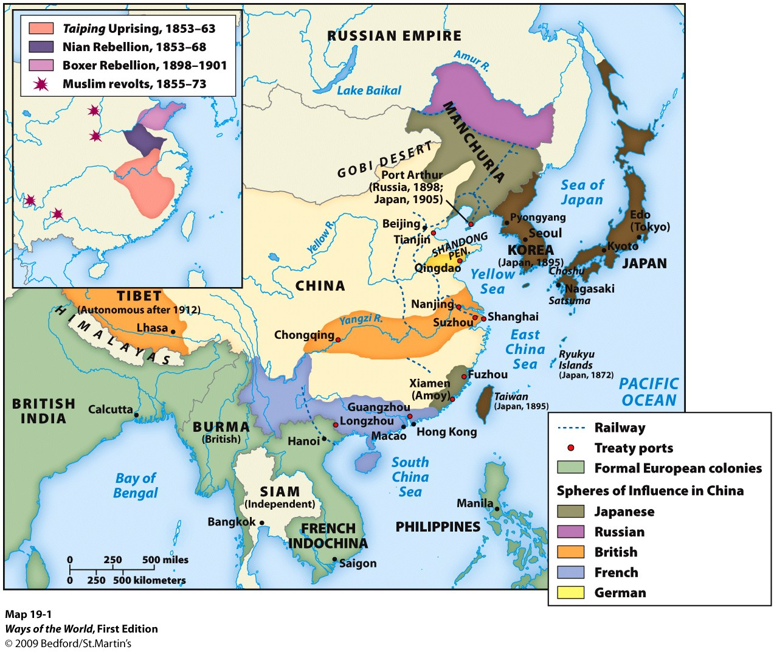
The Crisis Within

Slide 12
The Crisis Within
1. China was, to a large degree, the victim of its own
success
2. Chinese bureaucracy did not keep pace with growing
population
3. Bandit gangs and peasant rebellions became common
4. Culmination of China’s internal crisis: the Taiping
Uprising
5. Resolution of the Taiping rebellion consolidated the
power of the provincial gentry landowners even more
Notes:
1. China was, to a large degree, the victim of its own success
a. population had grown from about 100 million in 1685 to some 430 million in 1853
b. but China didn’t have an accompanying Industrial Revolution
c. growing pressure on the land, impoverishment, starvation
2. Chinese bureaucracy did not keep pace with growing population
a. by 1800, county magistrates had to deal with four times as many people as in 1400
b. central state gradually lost control of provincial officials and gentry
3. bandit gangs and peasant rebellions became common
4. culmination of China’s internal crisis: the Taiping Uprising
a. affected much of China 1850–1864
b. leader Hong Xiuquan (1814–1864) proclaimed himself the younger brother of Jesus, sent to establish a “heavenly kingdom of great peace”
c. called for radical equality
d. even planned to industrialize China
e. Taiping forces established their capital at Nanjing (1853)
f. armies mobilized by provincial gentry crushed the rebellion by 1864
5. resolution of the Taiping rebellion consolidated the power of the provincial gentry landowners even more
a. intense conservatism, so China’s problems weren’t resolved
b. the massive civil war had seriously weakened the Chinese economy
c. 20 million–30 million people died in the rebellion

Slide 13
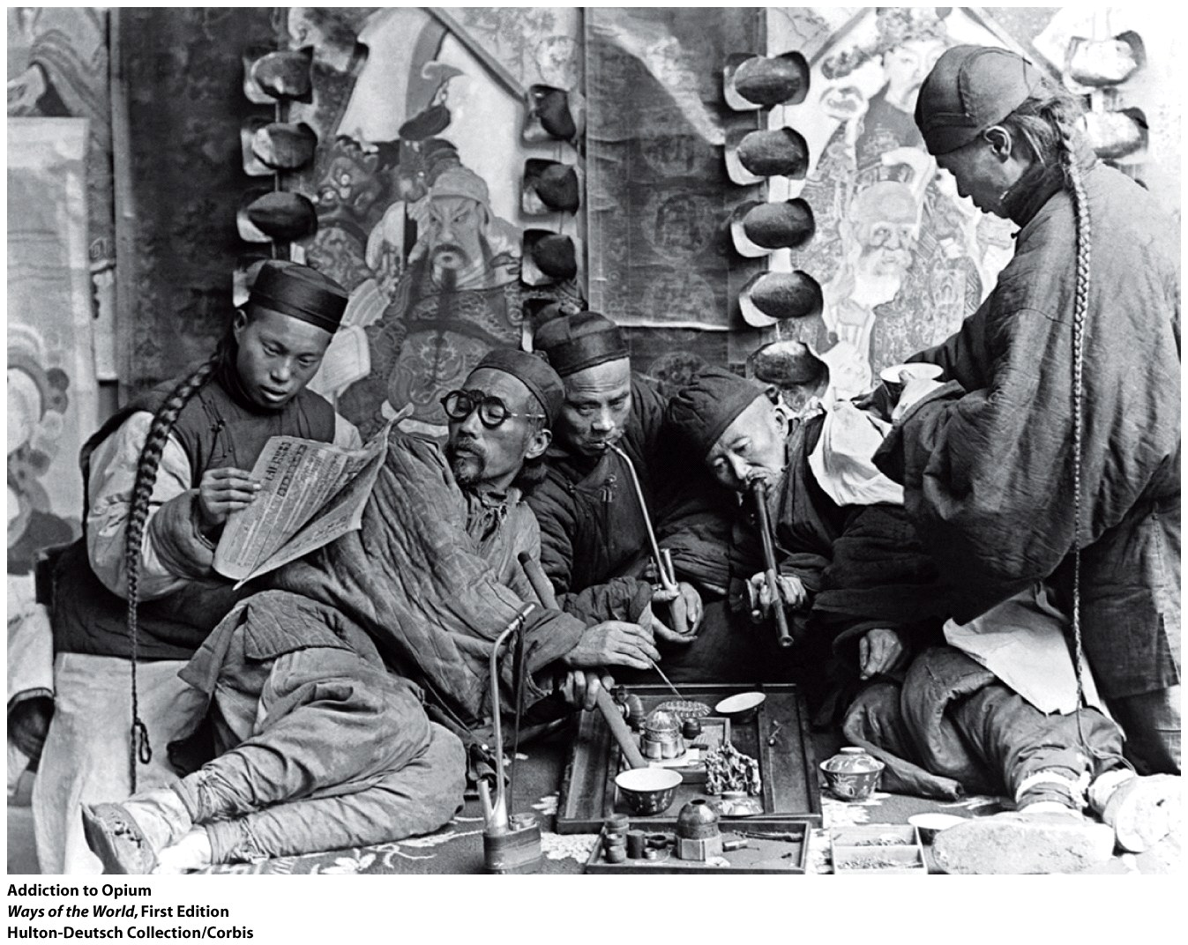
Western Pressures
1. The Opium Wars show the transformation of China’s
relationship with Europe
2. The British responded with the first Opium War (1839–
1842), which they won decisively
Notes:
1. the Opium Wars show the transformation of China’s relationship with Europe
a. opium had been used on a small scale in China for centuries
b. British began to sell large quantities of Indian opium in China
c. Chinese authorities recognized the dangers of opium addiction, tried to stop the trade
d. European merchants bribed officials to smuggle opium in
e. China suffered a specie drain from large quantities of silver spent on opium
f. 1836: the emperor decided to suppress the trade
2. the British responded with the first Opium War (1839–1842), which they won decisively
a. war was ended by Treaty of Nanjing (1842), which imposed restrictions on Chinese sovereignty and opened five ports to European traders
b. forced Chinese to accept free trade and “proper” relations among countries

Slide 14
Western Pressures
3. Second Opium War (1856–1858)
4. China was also defeated by the French (1885)
and the Japanese (1895) and lost control of
Vietnam, Korea, and Taiwan
5. Qing dynasty was deeply weakened at a time
when China needed a strong government to deal
with modernization
6. “Unequal treaties” inhibited China’s
industrialization
Notes:
3. second Opium War (1856–1858)
a. Europeans vandalized the imperial Summer Palace
b. more treaty ports were opened to foreigners
c. China was opened to foreign missionaries
d. Western powers were given the right to patrol some of China’s interior waterways
e. Chinese were forbidden to use the character for “barbarians” to refer to the British in official documents
4. China was also defeated by the French (1885) and the Japanese (1895) and lost control of Vietnam, Korea, and Taiwan
5. Qing dynasty was deeply weakened at a time when China needed a strong government to deal with modernization
6. “unequal treaties” inhibited China’s industrialization

Slide 15
The Failure of Conservative Modernization
1. The Chinese government tried to act against problems
2. Conservative leaders feared that development would
harm the landlord class
3. Boxer uprising (1900): militia organizations killed many
Europeans and Chinese Christians, besieged foreign
embassies in Beijing
4. Growing number of educated Chinese became disillusioned with
the Qing dynasty
5. The government agreed to some reforms in the early twentieth century, but
not enough—the imperial order collapsed in 1911
Notes:
1. the Chinese government tried to act against problems
a. policy of “self-strengthening” in 1860s and 1870s
b. application of traditional Confucian principles, along with very limited borrowing from the West
c. efforts to improve examination system
d. restoration of rural social and economic order
e. establishment of some modern arsenals and shipyards, some study of other languages and sciences
f. foundation of a few industrial factories
2. conservative leaders feared that development would harm the landlord class
3. Boxer uprising (1900): militia organizations killed many Europeans and Chinese Christians, besieged foreign embassies in Beijing
a. Western powers and Japan occupied Beijing to crush the revolt
b. imposed massive reparation payments on China
4. growing number of educated Chinese became disillusioned with the Qing dynasty
a. organizations to examine the situation and propose reforms
b. growing drive for a truly unified nation in which more people took part in public life
c. Chinese nationalism was against both foreign imperialists and the foreign Qing dynasty
5. the government agreed to some reforms in the early twentieth century, but not enough—the imperial order collapsed in 1911

Slide 16
The Ottoman Empire and the West in the Nineteenth Century
1. Had felt that they did not need to learn from the West
2. Avoided direct colonial rule, but were diminished
3. Attempted “defensive modernization”
4. Suffered a split in society between modernists and
those holding traditional values
Notes:
The Ottoman Empire and the West in the Nineteenth Century
1. had felt that they did not need to learn from the West
2. avoided direct colonial rule, but were diminished
3. attempted “defensive modernization”
4. suffered a split in society between modernists and those holding traditional values

Slide 17
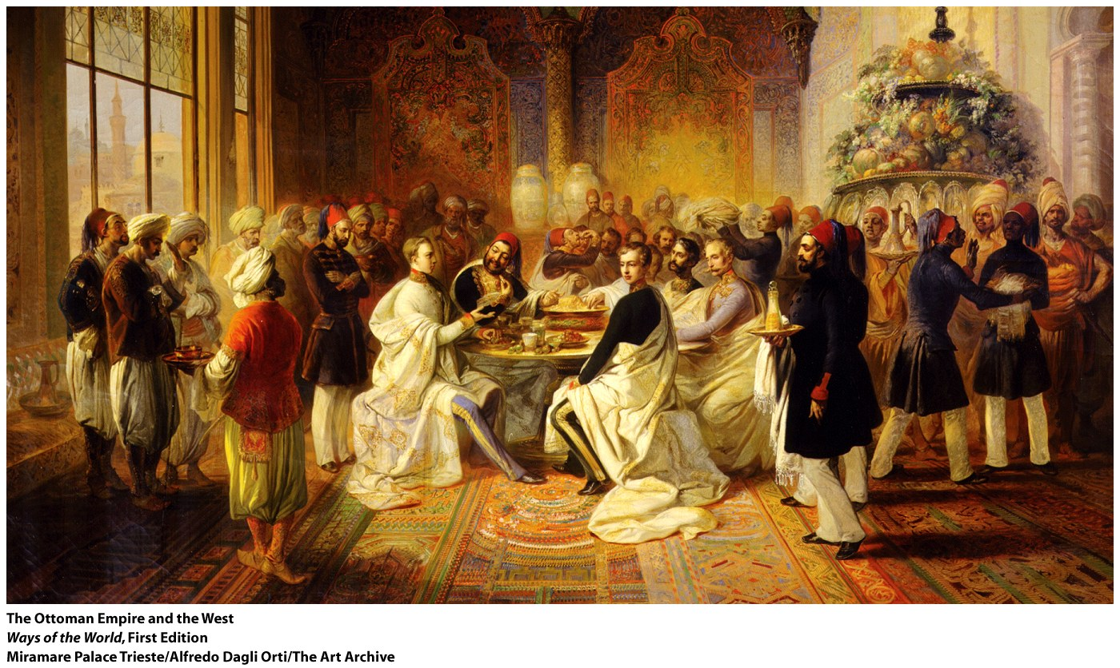
“The Sick Man of Europe”
1. 1750: the Ottoman Empire was still strong, at center of
the Islamic world; by 1900, was known as “the sick
man of Europe”
2. Region by region, Islamic world fell under Christian
rule, and the Ottomans couldn’t prevent it
3. Central Ottoman state had weakened
Notes:
“The Sick Man of Europe” 1750: the Ottoman Empire was still strong, at center of the Islamic world; by 1900, was known as “the sick man of Europe”
2. region by region, Islamic world fell under Christian rule, and the Ottomans couldn’t prevent it
a. Ottomans lost territory to Russia, Britain, Austria, and France
b. Napoleon’s 1798 invasion of Egypt was especially devastating
c. Greece, Serbia, Bulgaria, and Rumania attained independence
3. central Ottoman state had weakened
a. provincial authorities and local warlords gained more power, limited the government’s ability to raise money
b. the Janissaries had become militarily ineffective

Slide 18
“The Sick Man of Europe”
4. The economy was hit hard by Western
developments
5. Had reached a state of dependency on Europe
Notes:
4. the economy was hit hard by Western developments
a. Europeans achieved direct access to Asia
b. cheap European manufactured goods harmed Ottoman artisans
c. foreign merchants won immunity from Ottoman laws and taxes
d. government came to rely on foreign loans to finance economic development efforts
5. had reached a state of dependency on Europe

Slide 19
Reform
1. Ottomans attempted ambitious reforms, going
considerably further than the Chinese
Late eighteenth century: Selim III tried to establish new military and administrative structures
3. Selim III’s modest reforms stirred up so much hostility
among the ulama and the Janissaries that he was
deposed in 1807
4. After 1839: more far-reaching reformist measures
(Tanzimat, or “reorganization”) emerged
Notes:
1. Ottomans attempted ambitious reforms, going considerably further than the Chinese
a. didn’t have an internal crisis on the scale of China
b. did not have to deal with explosive population growth
c. rulers were Turkic and Muslim, not like foreign Qing
2. late eighteenth century: Selim III tried to establish new military and administrative structures
a. sent ambassadors to study European methods
b. imported European advisers
c. established technical schools
3. Selim III’s modest reforms stirred up so much hostility among the ulama and the Janissaries that he was deposed in 1807
4. after 1839: more far-reaching reformist measures (Tanzimat, or “reorganization”) emerged
a. beginning of an extensive process of industrialization and modernization
b. acceptance of the principle that all citizens are equal before the law
c. tide of secular legislation and secular schools

Slide 20
Reform
5. Supporters of reform saw the Ottoman Empire as
a secular state
6. Sultan Abd al-Hamid (r. 1876–1909) accepted a new
constitution in 1876 that limited the sultan’s authority
7. Opposition coalesced around the “Young Turks”
(military and civilian elites)
8. After 1900, growing efforts to define a Turkish
national character
9. Military coup (1908) gave the Young Turks real
power
Notes:
5. supporters of reform saw the Ottoman Empire as a secular state
a. reform created a new class of writers, etc.—the “Young Ottomans”
b. urged creation of a constitutional regime
c. Islamic modernism: accepted Western technology and science but not its materialism
6. Sultan Abd al-Hamid (r. 1876–1909) accepted a new constitution in 1876 that limited the sultan’s authority
a. almost immediately suspended it
b. turned to decisive autocracy in the face of a Russian invasion
7. opposition coalesced around the “Young Turks” (military and civilian elites)
a. advocated a militantly secular public life
b. shift to thinking in terms of a Turkish national state
8. after 1900, growing efforts to define a Turkish national character
9. military coup (1908) gave the Young Turks real power
a. antagonized non-Turkic peoples in the Ottoman Empire
b. stimulated Arab and other nationalisms
c. the Ottoman Empire completely disintegrated after World War I

Slide 21
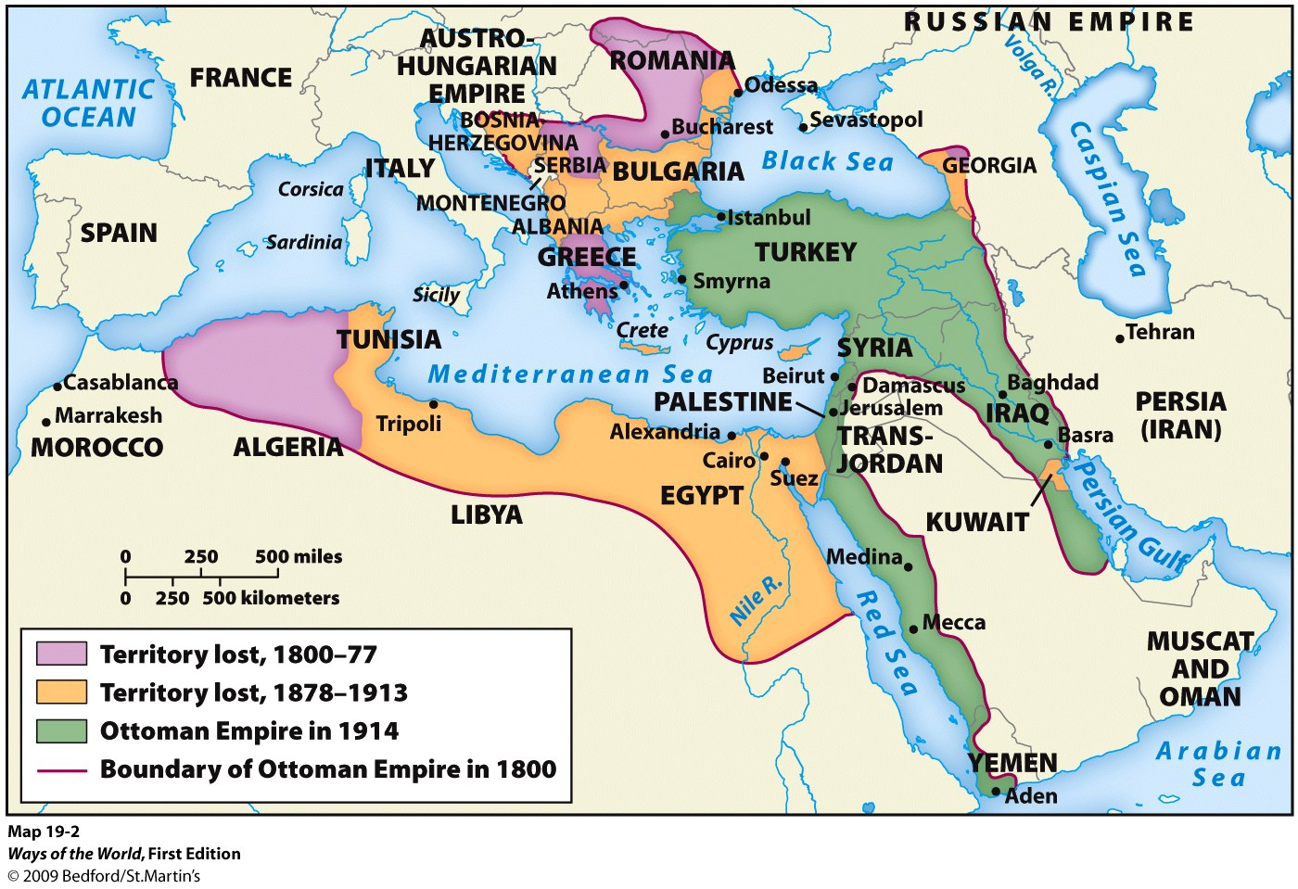
Outcomes: Comparing China and the Ottoman Empire
1. By 1900, both China and the
Ottoman Empire were “semicolonies”
2. Both gave rise to a new
nationalist conception of
society
3. China: the imperial system
collapsed in 1911
4. Ottoman Empire: the empire
collapsed following World War I
5. Chinese revolutionaries rejected
Confucian culture much more than
Turkish leaders rejected Islam
Notes:
1. by 1900, both China and the Ottoman Empire were “semicolonies”
2. both gave rise to a new nationalist conception of society
3. China: the imperial system collapsed in 1911
a. followed by a vast revolution
b. creation of a communist regime by 1949, within the same territory
4. Ottoman Empire: the empire collapsed following World War I
5. Chinese revolutionaries rejected Confucian culture much more than Turkish leaders rejected Islam

Slide 22
Compare the outcomes of China and the Ottoman Empire by the twentieth century
China | Similarities | Ottoman Empire
Notes:
Handout

Slide 23
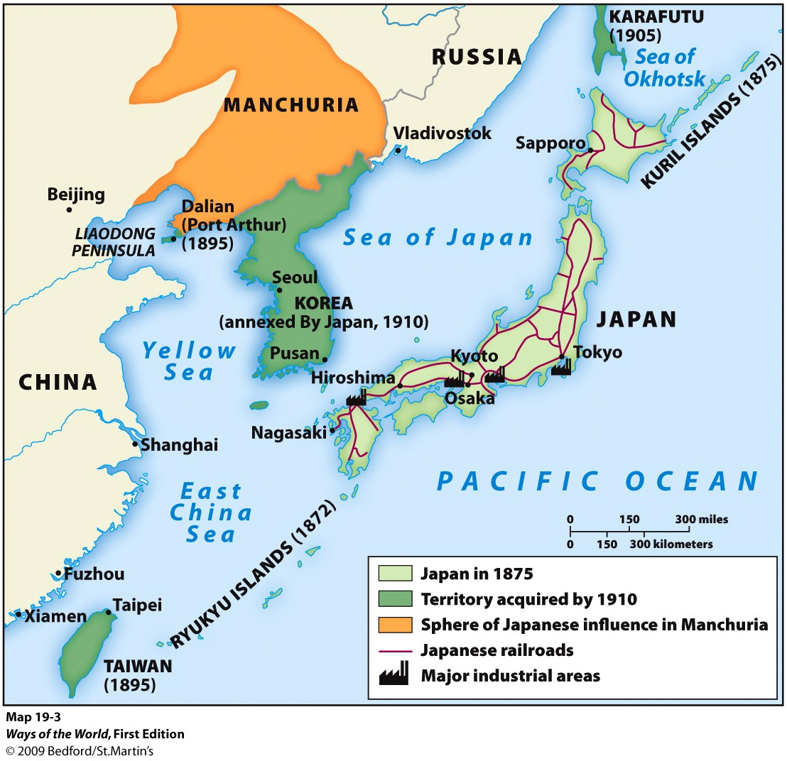
The Japanese Difference: The Rise of a New East Asian Power
A. Japan was forced to open up to more “normal” relations with the world by U.S. commodore Matthew Perry in 1853.
1. 1853–1900: radical transformation of Japanese society
2. Japan became powerful, modern, united, industrialized
3. Japan created its own East Asian empire
Notes:
A. Japan was forced to open up to more “normal” relations with the world by U.S. commodore Matthew Perry in 1853.
1. 1853–1900: radical transformation of Japanese society
2. Japan became powerful, modern, united, industrialized
3. Japan created its own East Asian empire

Slide 24
The Tokugawa Background
B. The Tokugawa Background
1. Tokugawa shoguns had ruled since about 1600
2. Considerable change in Japan in the Tokugawa
period
3. Corruption was widespread
Notes:
B. The Tokugawa Background
1. Tokugawa shoguns had ruled since about 1600
a. main task was preventing civil war among rival feudal lords (the daimyo)
b. Japan enjoyed internal peace from 1600 to 1850
c. daimyo were strictly regulated but retained considerable autonomy
d. Japan wasn’t unified by a single law, currency, or central authority that reached to the local level
e. hierarchical society: samurai at the top, then peasants, artisans, and merchants at the bottom
2. considerable change in Japan in the Tokugawa period
a. samurai evolved into a bureaucratic/administrative class
b. great economic growth, commercialization, and urban development
c. by 1750, Japan was perhaps the world’s most urbanized country
d. high literacy rates (40 percent of males, 15 percent of females)
e. change made it impossible for the shogunate to freeze society
3. corruption was widespread

Slide 25
American Intrusion and the Meiji Restoration
1. U.S. sent Commodore Perry in 1853 to demand better treatment for castaways, right to refuel and buy provisions, and the opening of trade ports
2. The shogunate gave into Perry’s demands, triggering a civil war
3. In 1868, a group of young samurai from the south took over
4. The West wasn’t as interested in Japan as it was in China
Notes:
U.S. sent Commodore Perry in 1853 to demand better treatment for castaways, right to refuel and buy provisions, and the opening of trade ports
2. the shogunate gave into Perry’s demands, triggering a civil war
3. in 1868, a group of young samurai from the south took over
a. they claimed to be restoring the 15-year-old emperor Meiji to power
b. aimed to save Japan from foreigners by transformation of Japanese society rather than by resistance
4. the West wasn’t as interested in Japan as it was in China

Slide 26
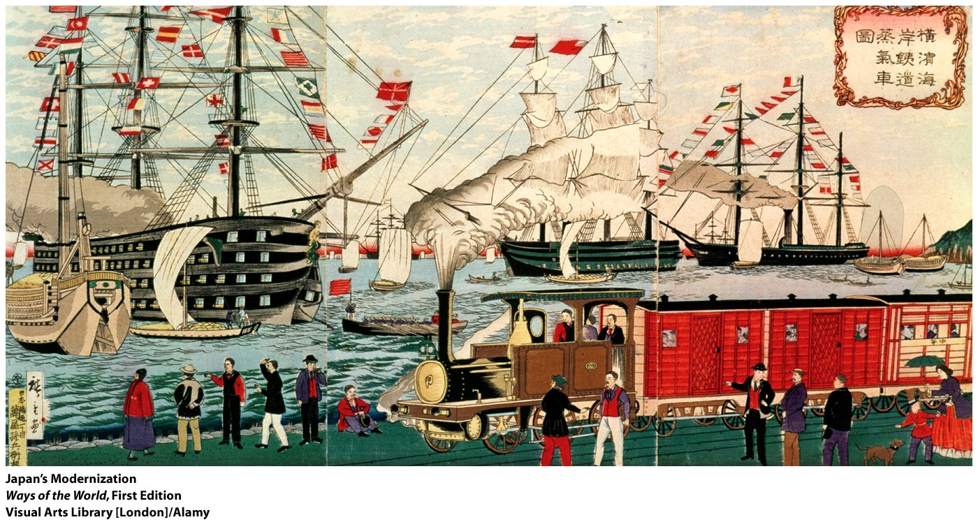
Modernization Japanese Style
1. First task was creating national unity
2. Widespread interest in many aspects of the West, from science to hairstyles
3. Eventually settled down to more selective borrowing from the West
4. Feminism and Christianity made little progress
5. Shinto was raised to the level of a state cult
Notes:
1. first task was creating national unity
a. attacked power and privileges of the daimyo and the samurai
b. dismantled the Confucian-based social order
c. almost all Japanese became legally equal
2. widespread interest in many aspects of the West, from science to hairstyles
a. official missions were sent to the West
b. hundreds of students studied abroad
c. translation of Western books into Japanese
3. eventually settled down to more selective borrowing from the West
4. feminism and Christianity made little progress
5. Shinto was raised to the level of a state cult

Slide 27
Modernization Japanese Style
6. State-guided industrialization program
7. Society paid a heavy price
Notes:
6. state-guided industrialization program
a. established model factories, opened mines, built railroads, created postal, telegraph, and banking systems
b. many state enterprises were then sold to private investors
c. accomplished modernization without acquiring foreign debt
d. by the early twentieth century, Japan’s industrialization was organized around large firms called zaibatsu
7. society paid a heavy price
a. many peasant families were impoverished
b. countryside suffered infanticide, sale of daughters, and famine
c. early urban workers received harsh treatment
d. efforts to organize unions were repressed

Slide 28
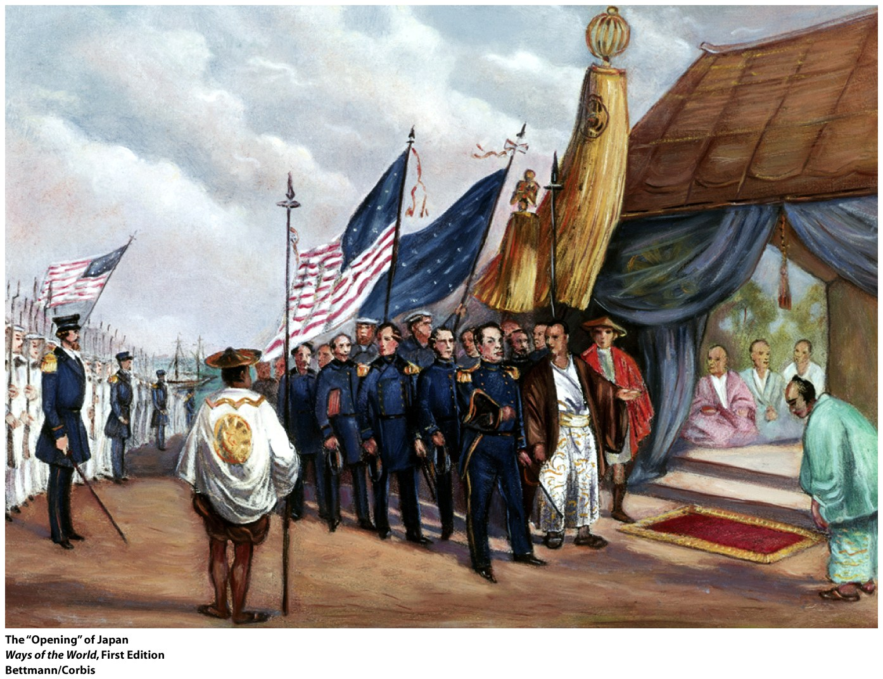
Japan and the World
1. By the early twentieth century, Western powers readjusted treaties in Japan’s favor
2. Japanese empire building
3. Japan’s rise was widely admired
4. Japan’s colonial policies were at least as brutal as European ones
Notes:
1. by the early twentieth century, Western powers readjusted treaties in Japan’s favor
2. Japanese empire building
a. wars against China (1894–1895) and Russia (1904–1905)
b. gained colonial control of Taiwan and Korea, won a foothold in Manchuria
3. Japan’s rise was widely admired
4. Japan’s colonial policies were at least as brutal as European ones

Slide 29
The encounter between Japan and the increasingly aggressive Western powers in the nineteenth century resulted in all EXCEPT which of the following outcomes?
Connection
a. Japan’s industrialization
b. Japan’s rejection of external expansion and its defense of other regional states threatened by Western powers
c. Major reforms in the Japanese government
d. The selective borrowing in Japan of western ideas

Slide 30
Which of the following was NOT a factor that distinguished how Japan experienced Western imperialism as compared to the Ottoman Empire and China?
Comparison
a. Japan was less reliant on Western finance than either the Ottoman Empire or China.
b. Only Japan saw parts of its territory physically occupied by Western troops.
c. Japan chose not to renegotiate its “capitulation” treaties with Western powers while both the Ottoman Empire and China did.
d. Western powers considered Japan of far greater strategic and economic importance leading to more active Western intervention in Japan than either the Ottoman Empire or China.

Slide 31
Compare the outcomes of China and the Ottoman Empire by the twentieth century
China | Similarities | Ottoman Empire
The collapse of the imperial system was followed by a vast revolutionary upheaval that by 1949 led to a Communist regime within the territorial space of the old empire. China’s 20th C. revolutionaries rejected traditional Confucian culture far more thoroughly than the secularizing leaders of modern Turkey rejected Islam. China had a more elitist and secular outlook of Confucianism. | Both had experienced the consequences of a rapidly shifting balance of global power. As “semi-colonies,” neither was able to create industrial economies or strong states. Both gave rise to new nationalist conceptions of society. Both empires had collapsed. | The collapse of the Ottoman Empire after WWI led to a creation of a new but smaller nation-state in the Turkish heartland of the old empire, having lost its vast Arab and European provinces. Almost everywhere in the Islamic world, traditional religion retained its hold on the private loyalties of most people and later in the 20th C. became a basis for social renewal in many places. It had many independent centers and was never closely associated with a single state. It was embedded in a deeply religious tradition.
Notes:
Handout KEY

