Slide 1
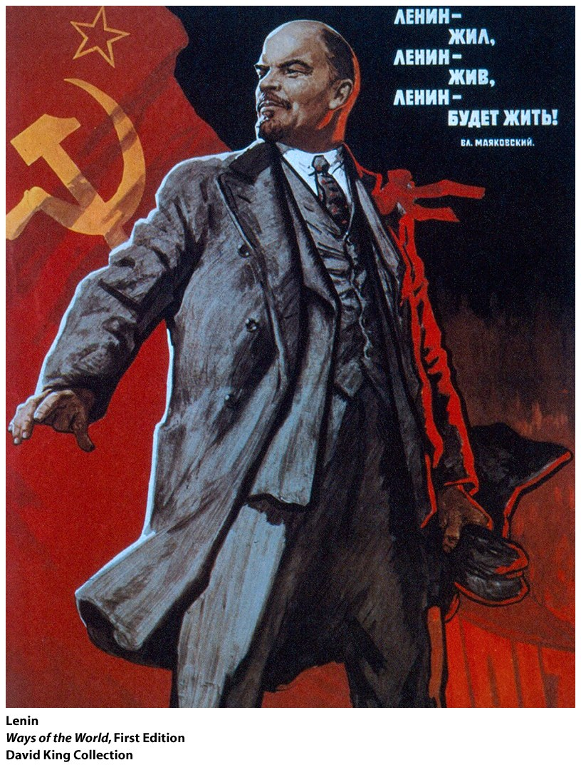
Russia: Revolution in a Single Year

Slide 2
Ways of the World: A Brief Global History First Edition
Robert W. Strayer
CHAPTER 22
The Rise and Fall of World Communism
1917–Present

Slide 4
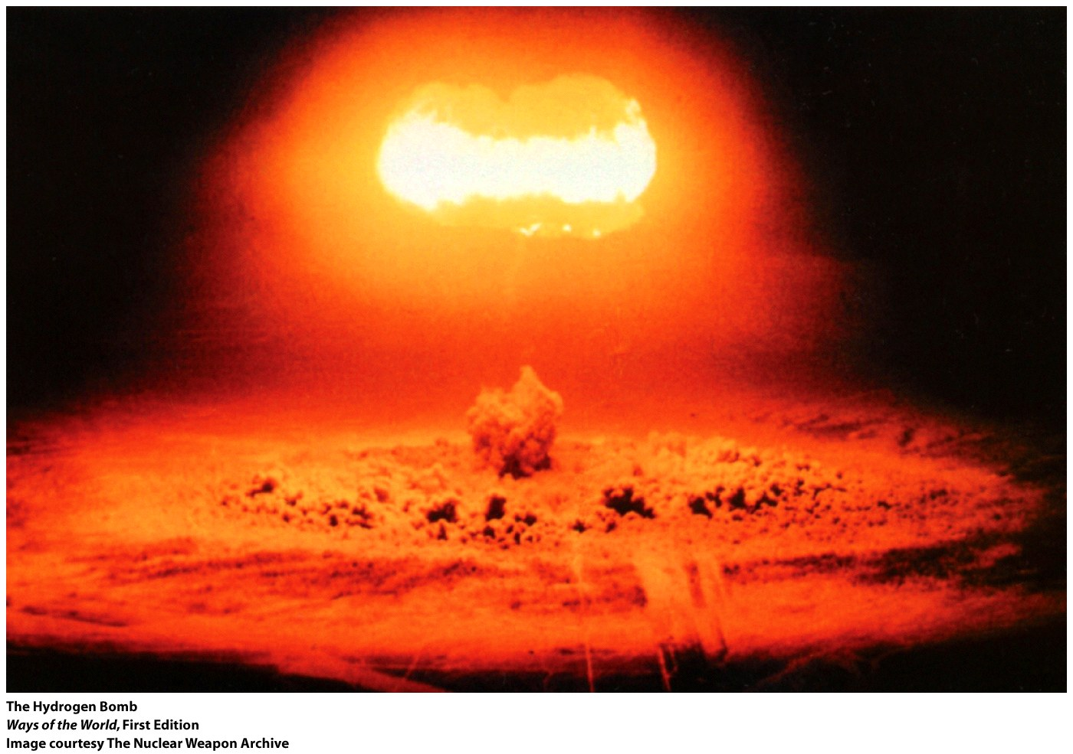
East versus West:
A Global Divide and a Cold War

Slide 6
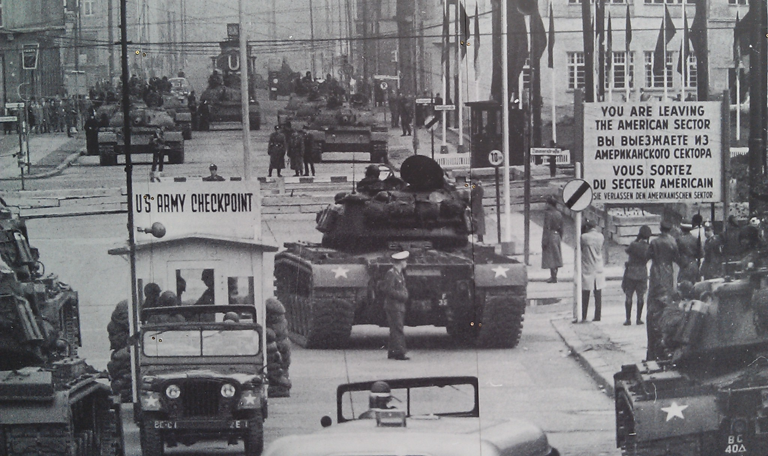

Slide 7
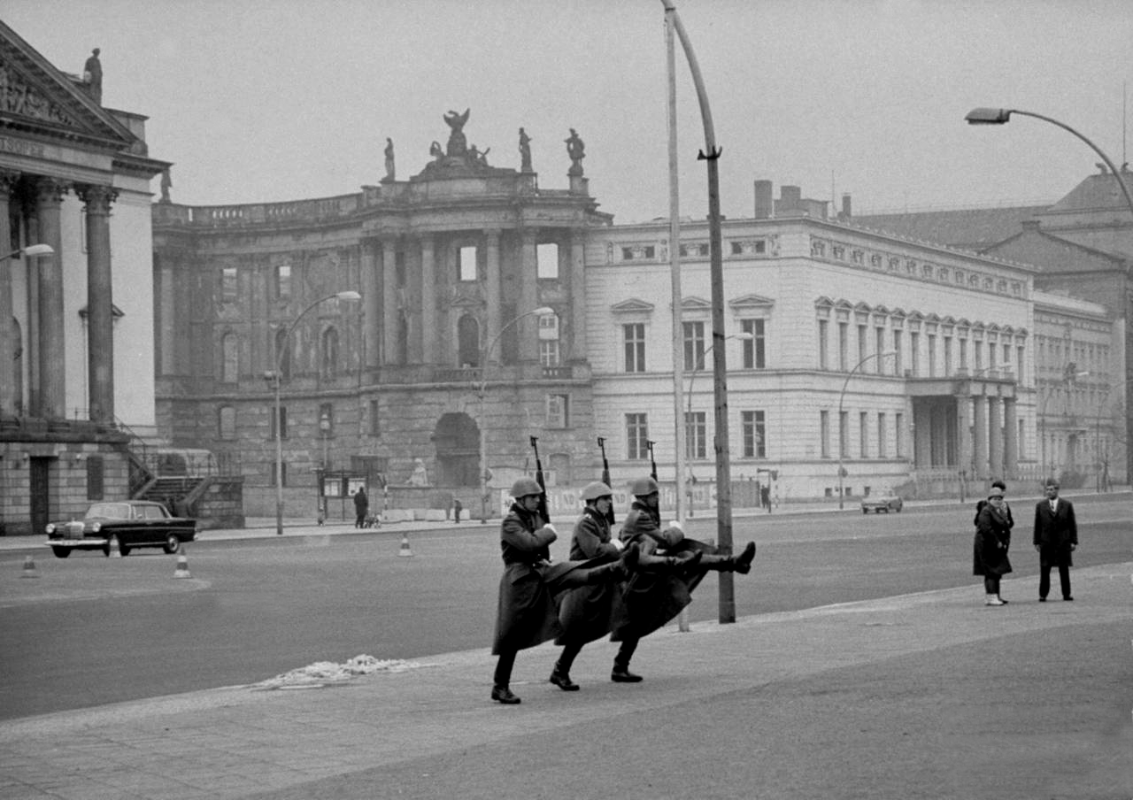

Slide 8
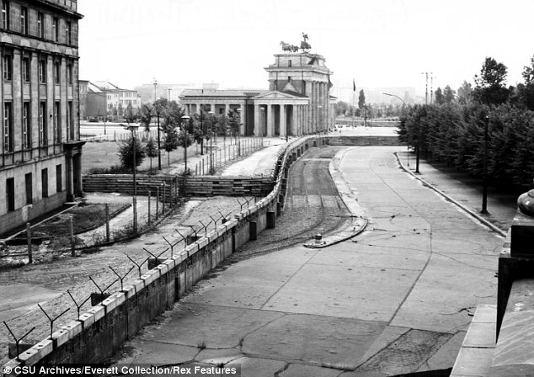

Slide 9
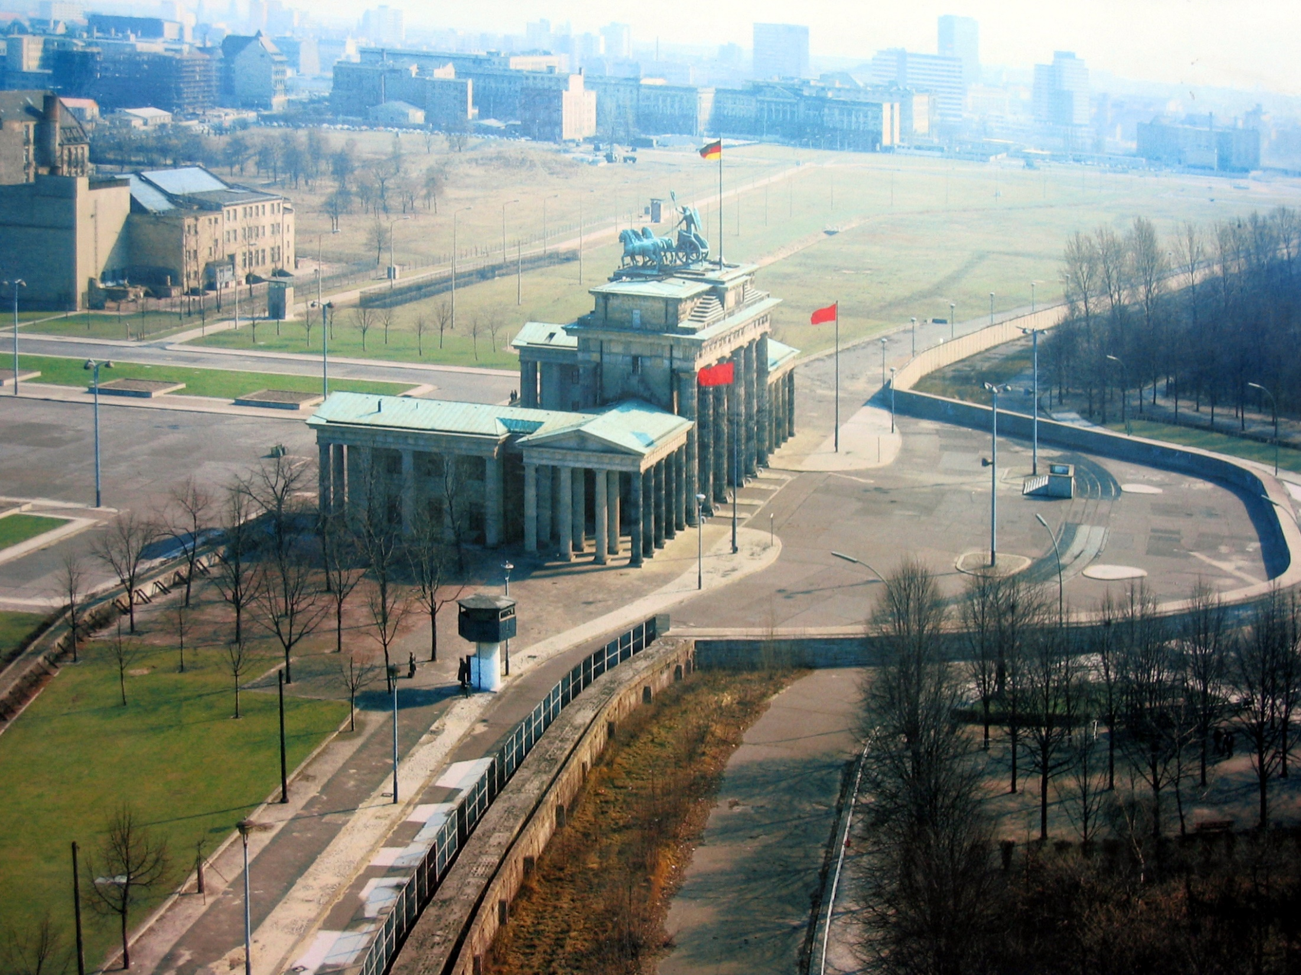

Slide 10
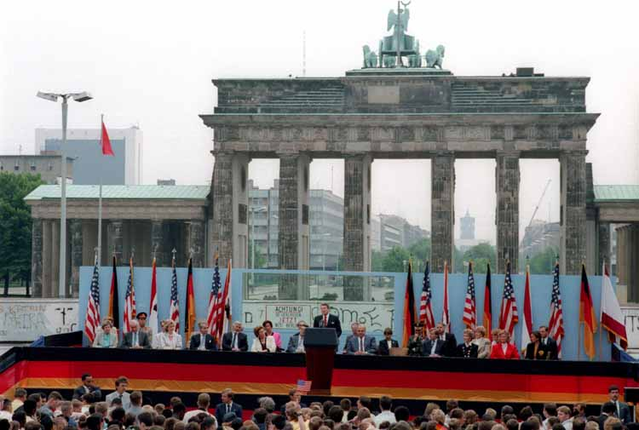

Slide 11
Union of the Soviet Socialist Republic
The recurring problems that the USSR faced in Eastern Europe in the 1950s stemmed from citizen revolts that showed the presence of disdain for Stalin’s take on communism.
East Germany 1953
Czechoslovakia 1953
Hungary 1956
Czechoslovakia 1968
Threatened invasion of Poland 1980’s
Notes:
The recurring problems that the USSR faced in Eastern Europe in the 1950s stemmed from citizen revolts that showed the presence of disdain for Stalin’s take on communism.
The East German uprising of June 17, 1953 was a significant event in compromising Soviet control over the eastern bloc both because it was the first violent outbreak within the bloc, and because it showed the absence of conformity to Soviet-style communism in East Germany.
The Czechoslovakian uprising of 1953, centred mainly in the city of Plzen, had similar cause and course to the aforementioned East German uprising of the same year.
Stalin’s death in March of 1953 set off a wave of consequences both inside and outside of the Soviet Union.
Following the same post-Stalin loosening of Soviet restrictions on the eastern bloc that was present in the East Germany uprising, the 1956 Hungarian revolt started as protests in support of the previously mentioned Polish movement towards independence, but quickly evolved into large-scale rioting.
It is likely that the Soviets chose to deal with the revolts of the 1950s in such a swift and brutal manner due to the fear that, in the absence of Soviet authority, the eastern bloc would be tempted by Western capitalism and its aid schemes, such as the Marshall Plan, thus causing the sought-after communist buffer zone to backfire.

Slide 12
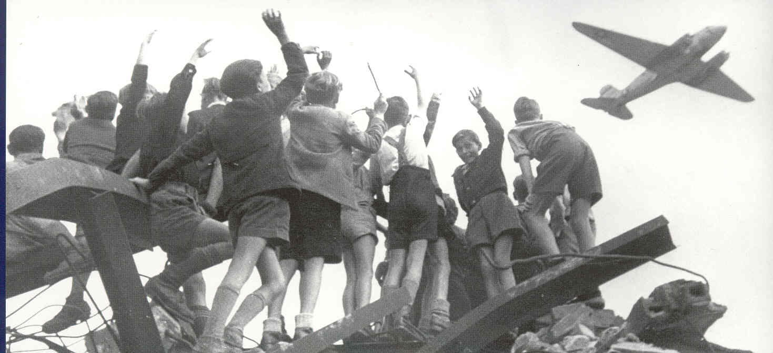

Slide 13
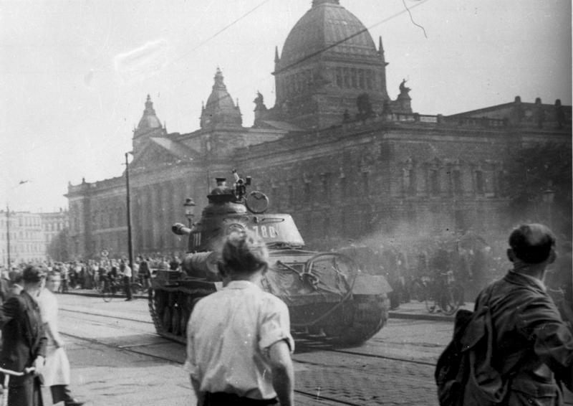

Slide 14
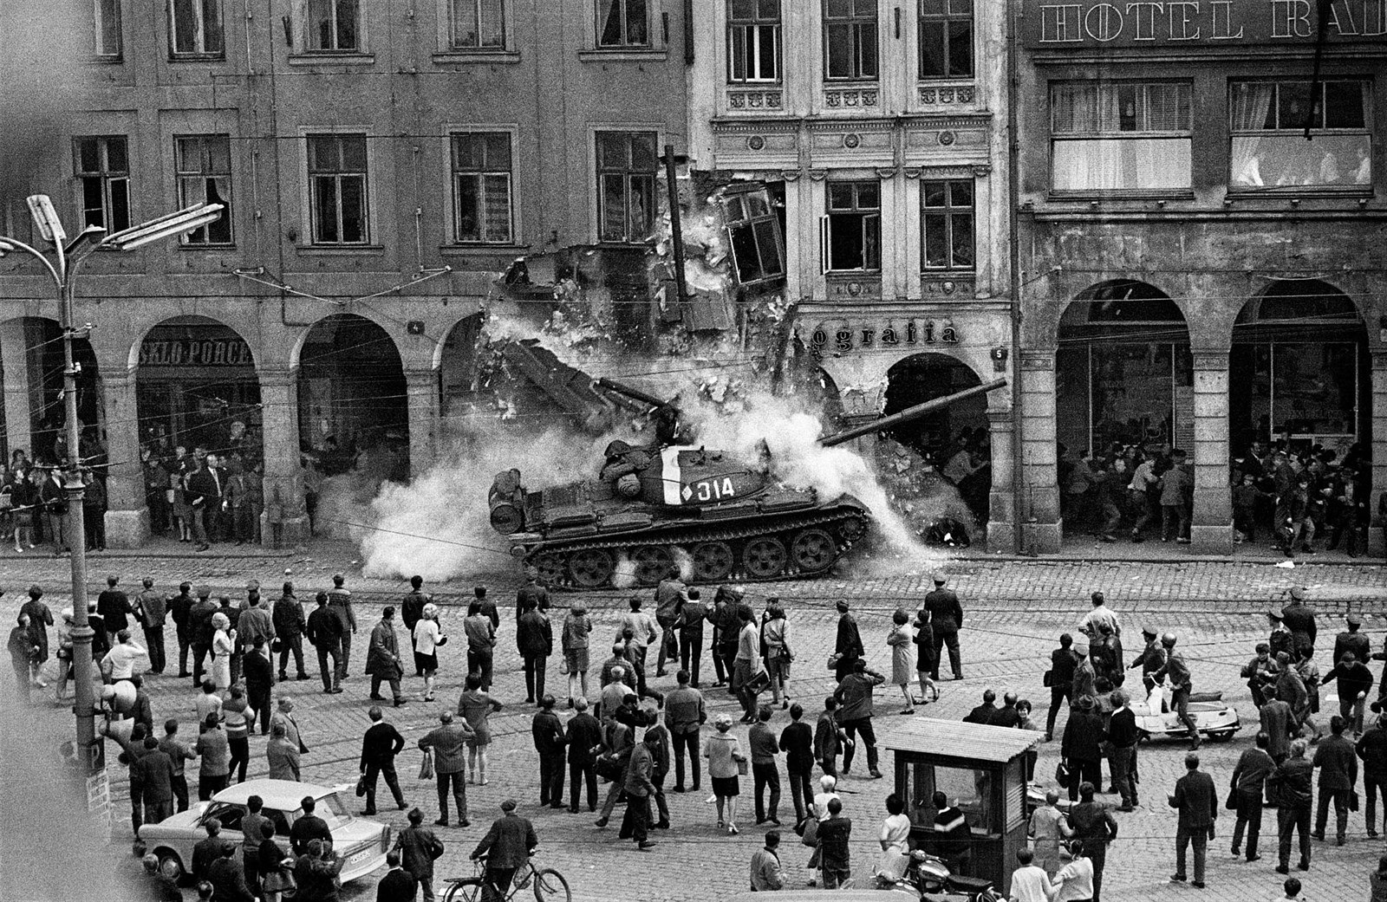

Slide 16
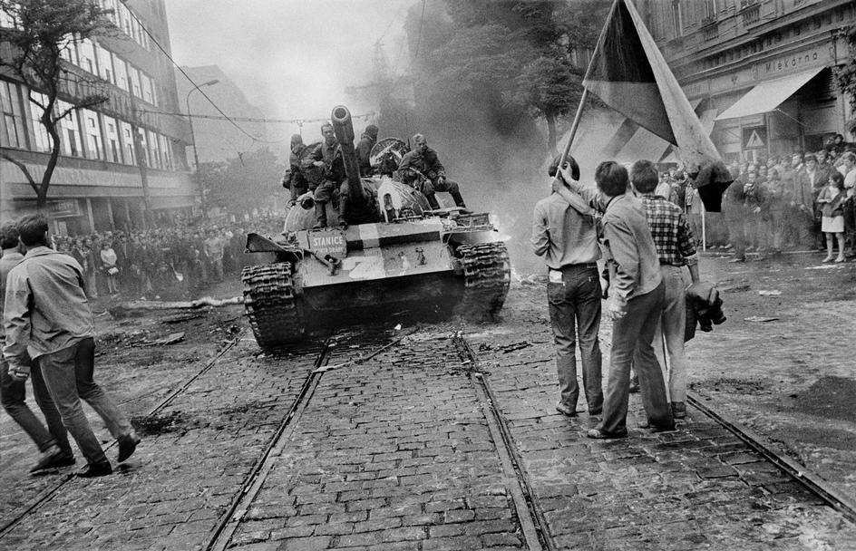

Slide 19
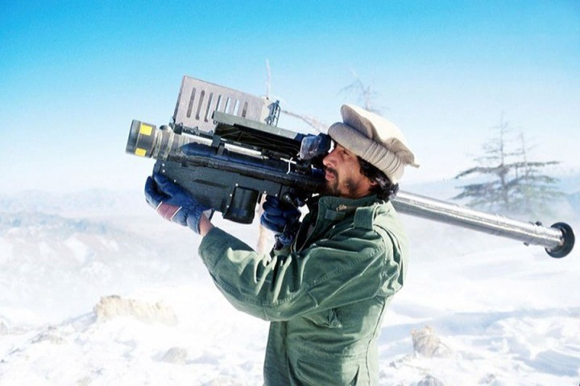

Slide 20
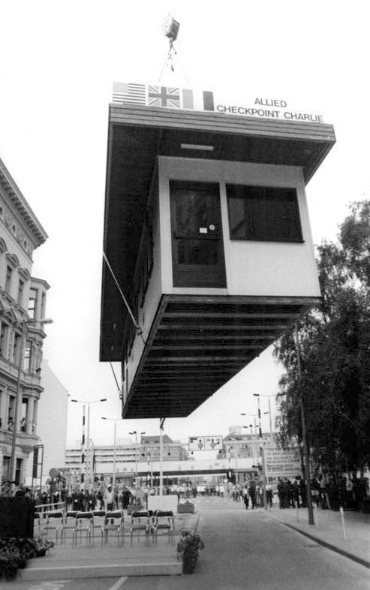
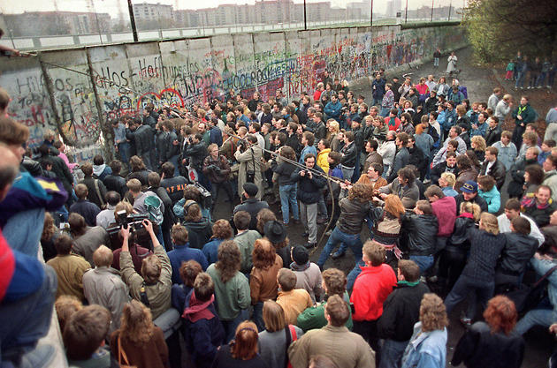

Slide 21
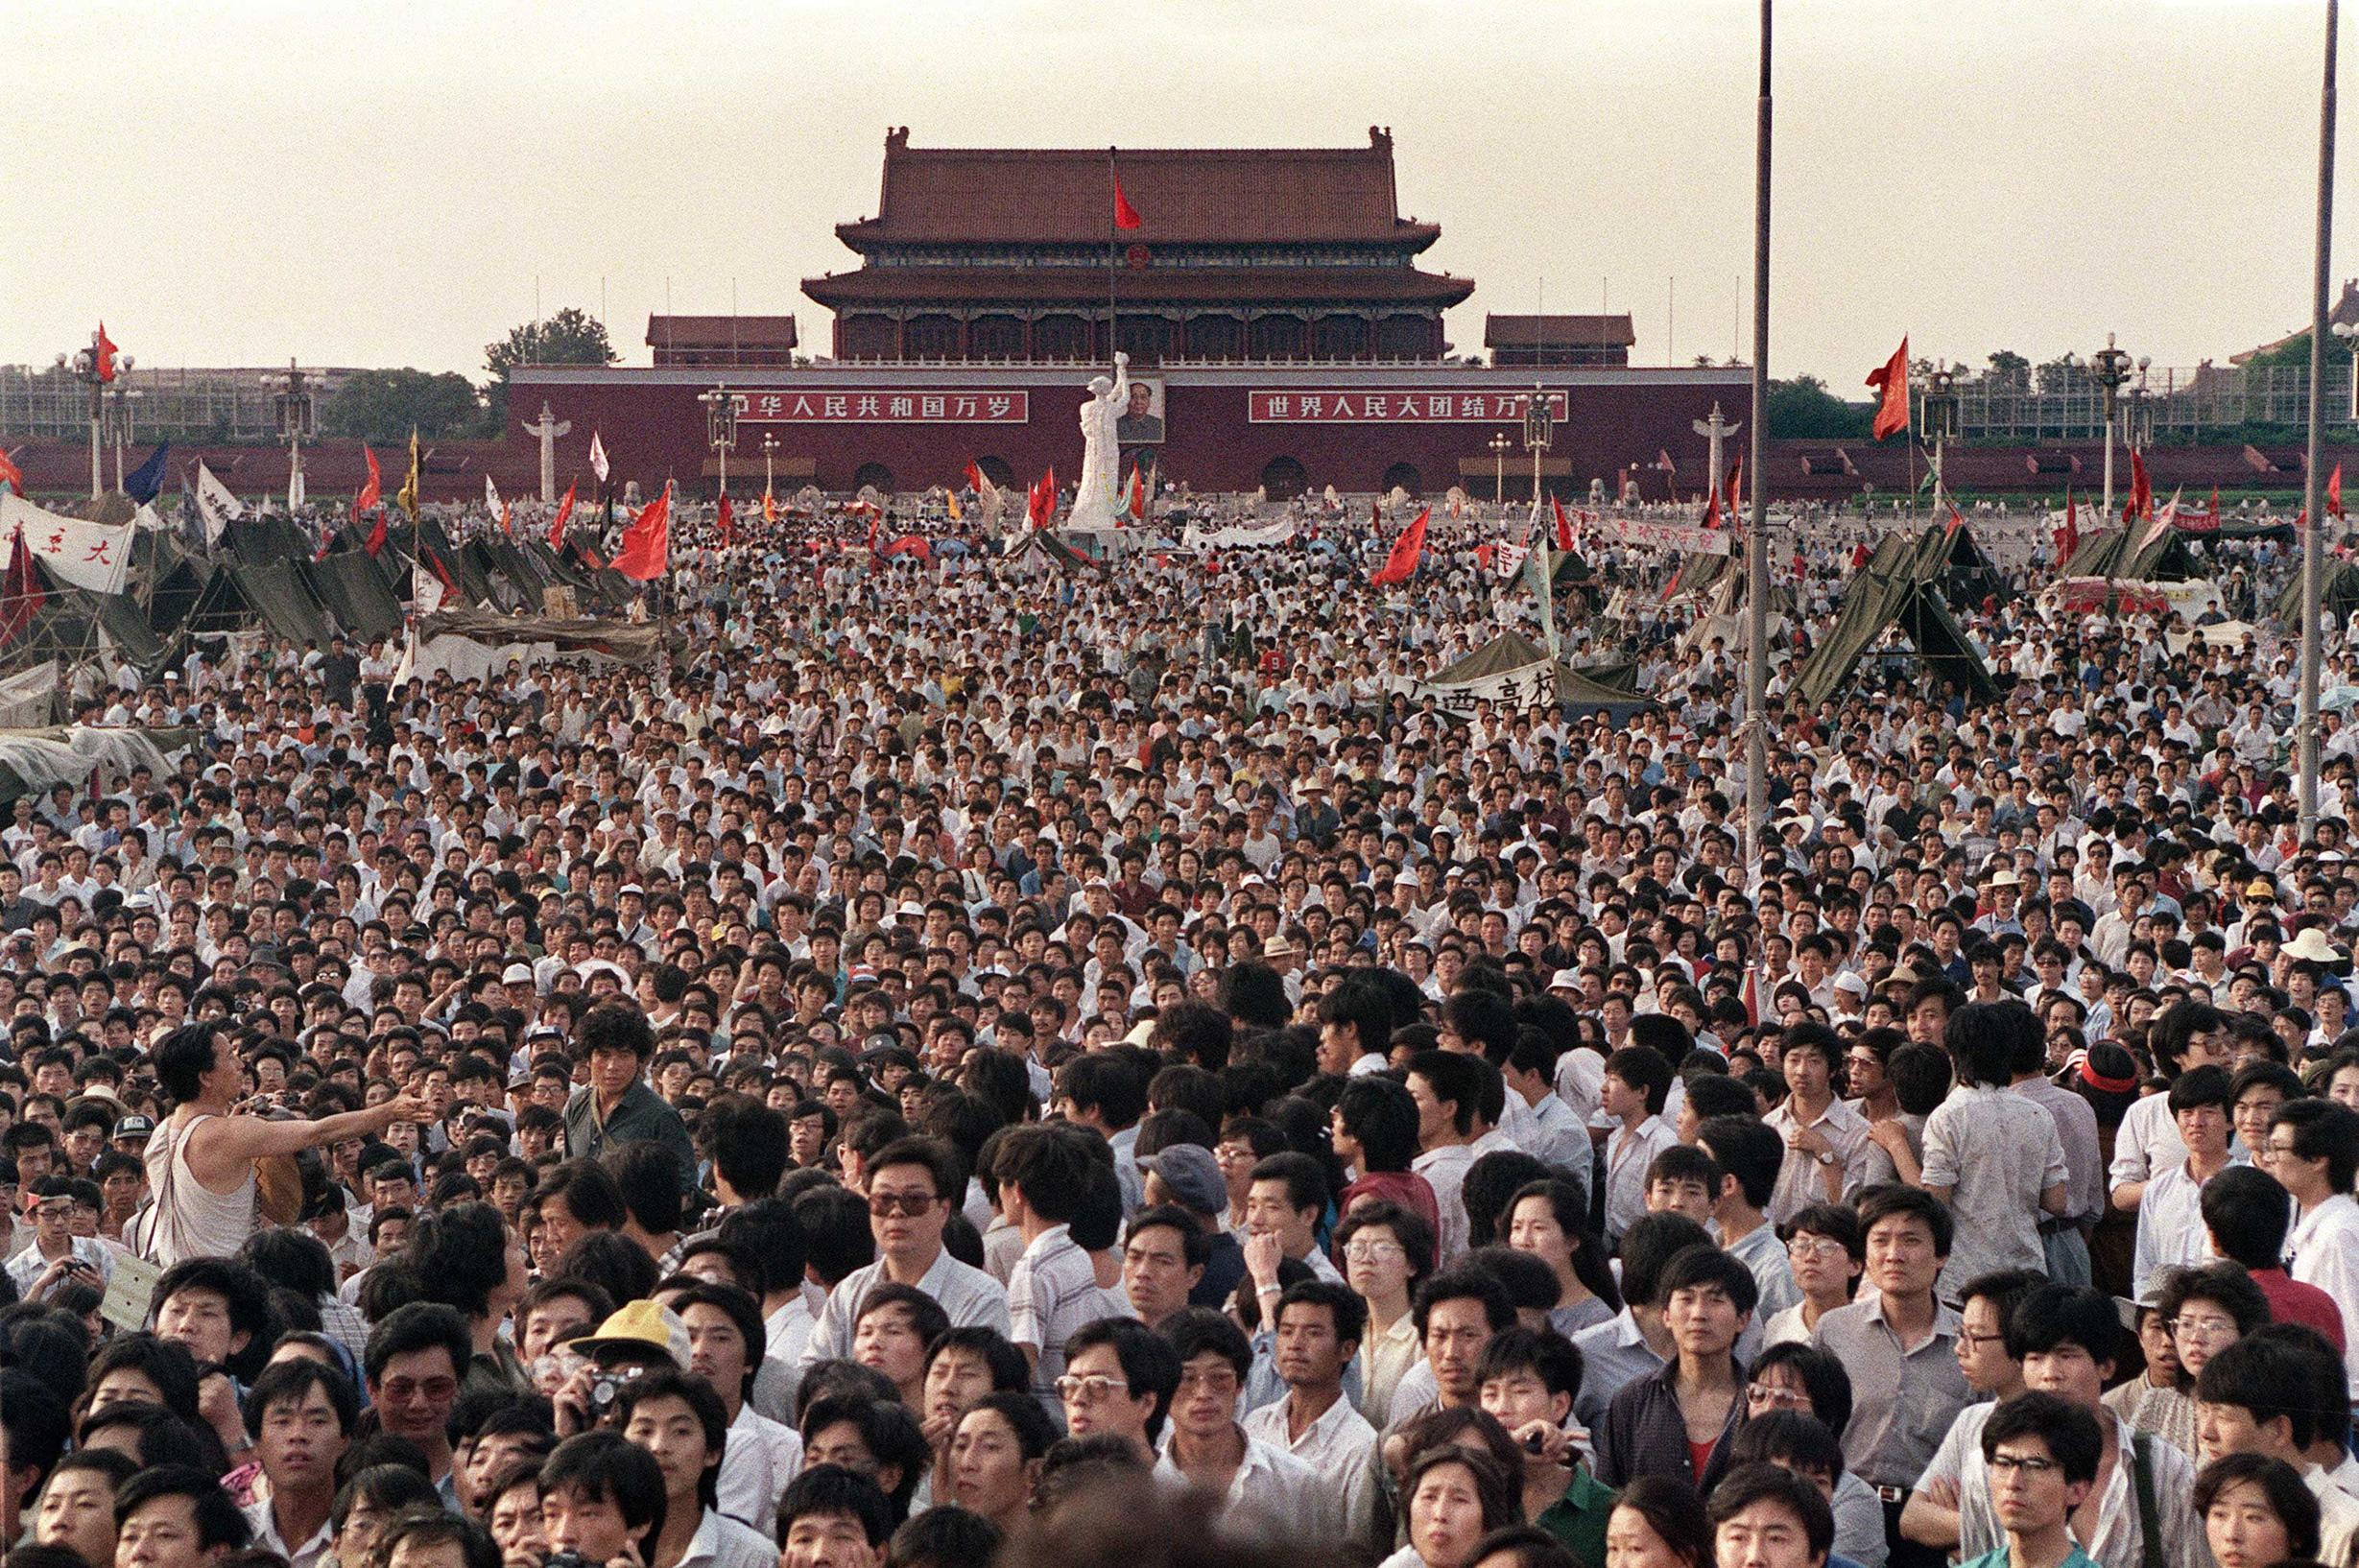

Slide 22
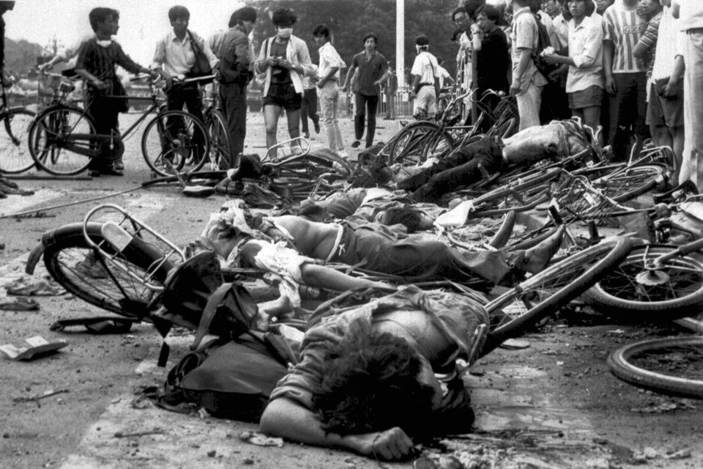

Slide 23
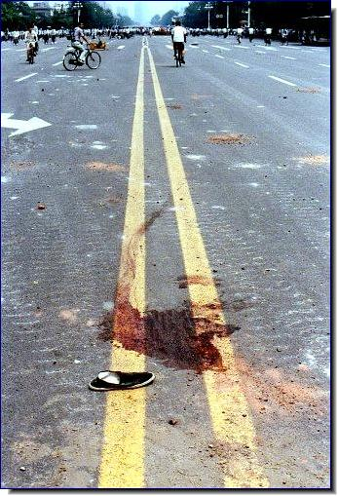

Slide 24
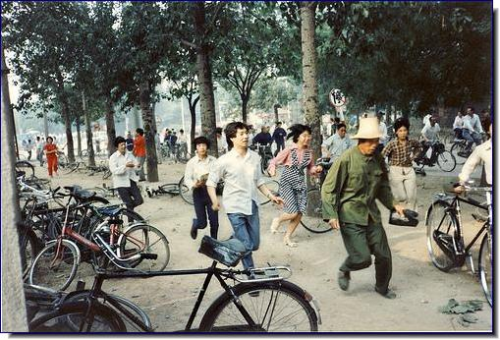

Slide 25
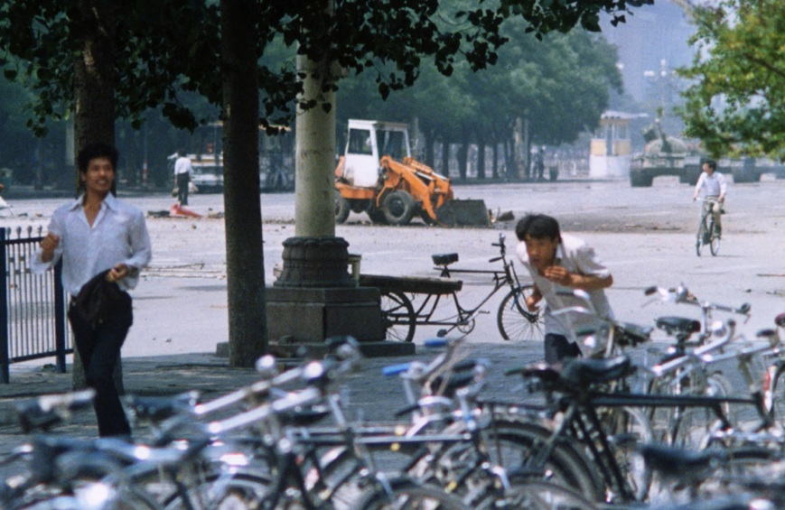

Slide 26
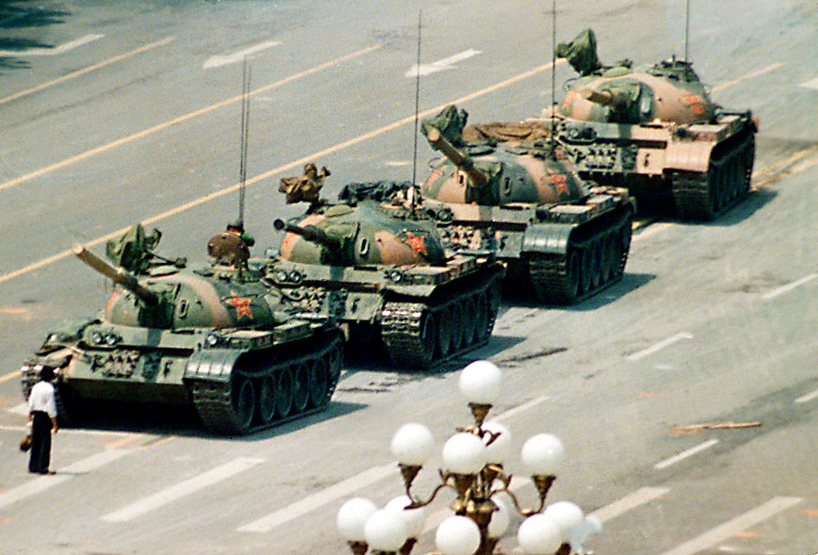
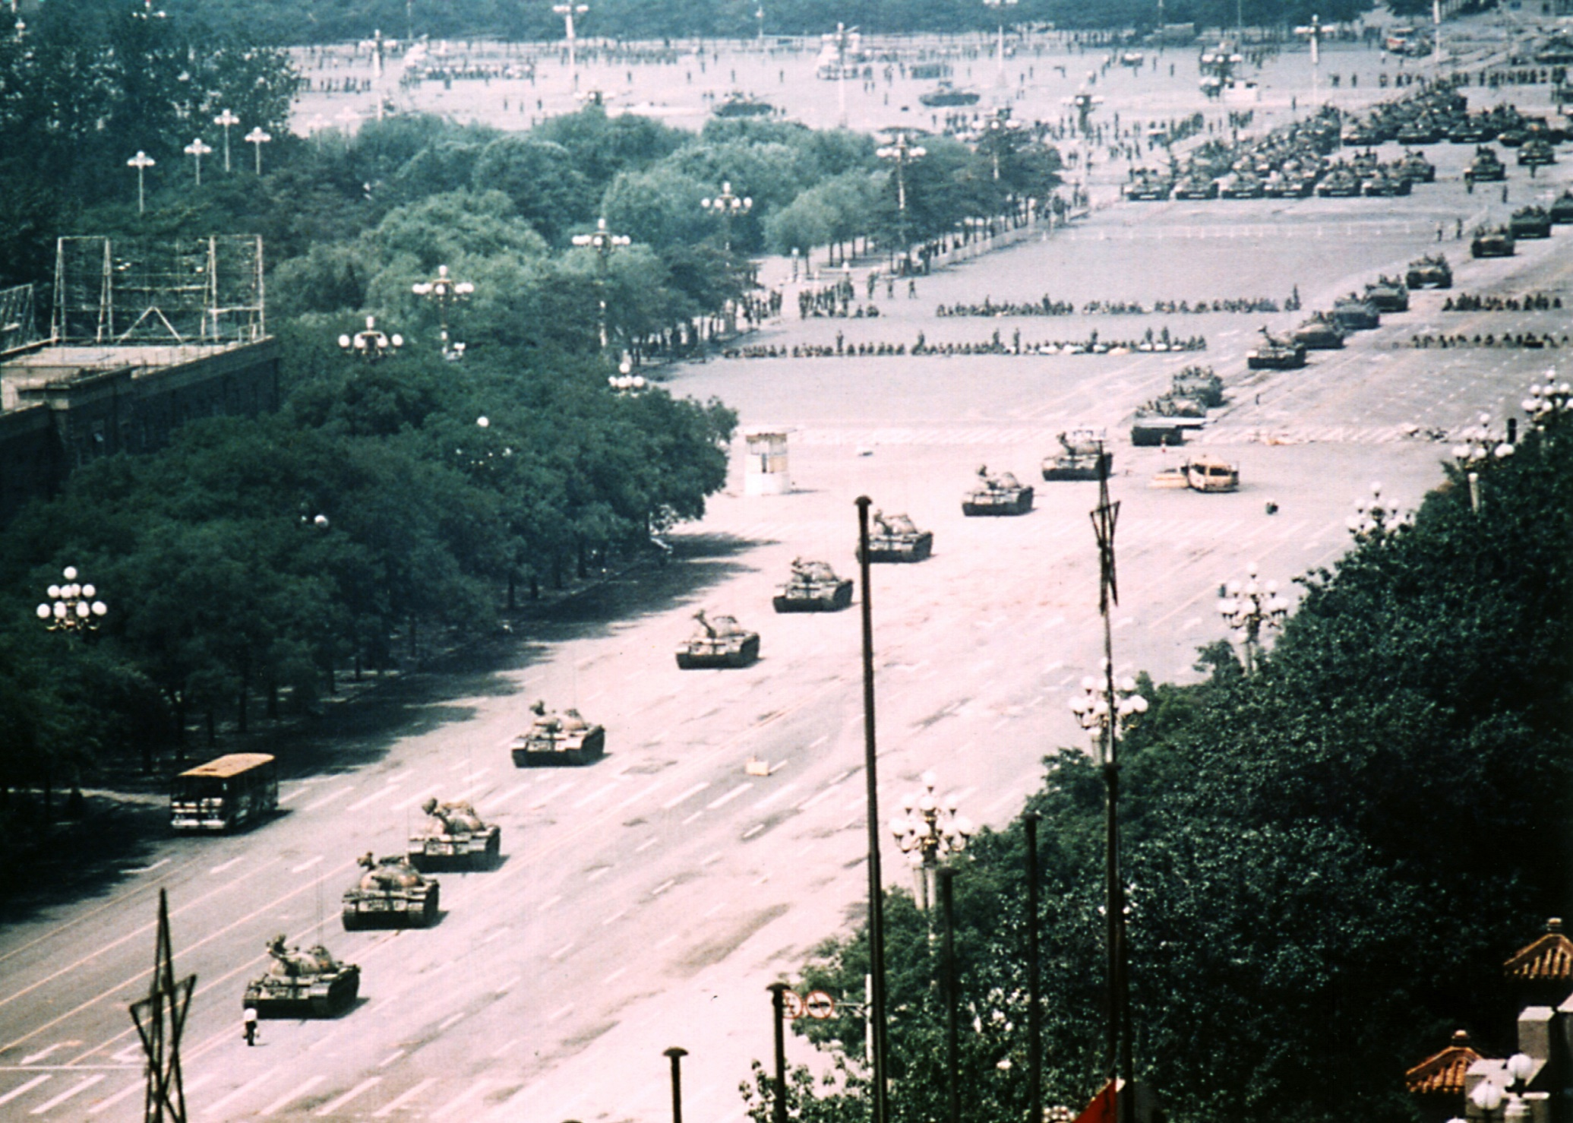

Slide 27
