Slide 1
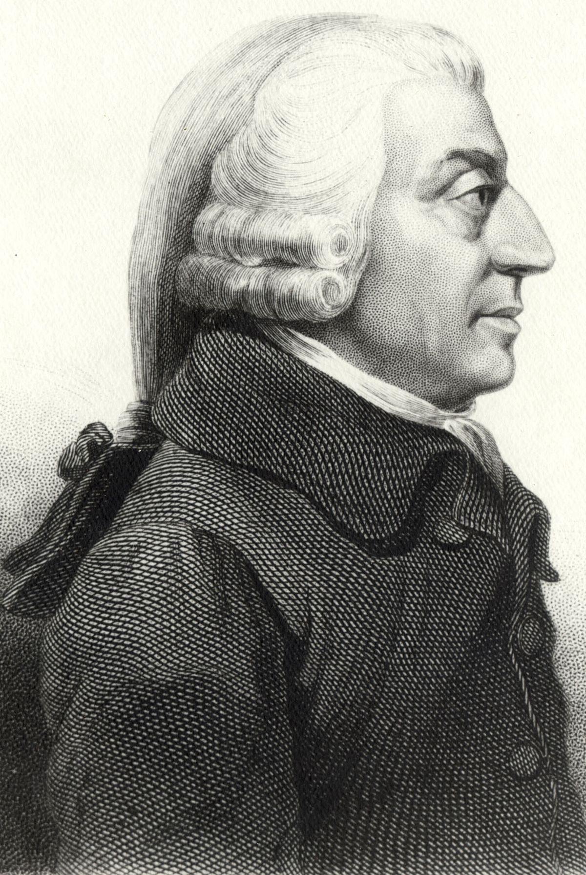
Characteristics of Capitalism

Slide 2
Review: What are the three basic economic questions?
What good or service is to be made or produced?
How a good or service is to be made or produced?
How much of the good or service will be made or produced?

Slide 3
Characteristics of Capitalism
1) Economic Freedom
2) Private Property
3) Economic incentives
4) Competition
5) Price System
6) Limited Government role (Laissez-faire)

Slide 4
1) Economic Freedom
Two Aspects to economic freedom:
1) Freedom of economic choice – A
person has the freedom to make their own economic decisions.
2) Freedom of enterprise – freedom to own and operate a business.

Slide 5
2) Private Property
Goods, services and factors of production are privately held by individuals.
As owners of the productive resources, they are free to utilize or dispose of the property as they see fit.
This includes the right to the reward or suffer the consequences of their economic decision-making.
As owners of the FOP the reward would be rent for use of their land, wages for their use of labor or interest as a return for lending them capital (money).

Slide 6
3) Economic incentives
Decisions are directly influenced by self-interest.
1. Self-interest is pursued by responding to economic incentives.
2. Positive incentives encourage economic decision makers and negative incentives discourage economic decision makers.
3. Adam Smith – Father of capitalism,
If everyone pursues his own economic self-interest, everyone will benefit
Notes:
These economic incentives guide resource allocation
-towards what society wants and away from what is not desired
Business owner pursuing self-interest would benefit society as a whole
-their desire for profit would direct him to put his productive resources into the
production of goods and services commanding a high demand
in the marketplace.
-their desire to avoid losses would discourage him from putting productive resources
into the production of goods and services that people do not want.
Consumers seek low prices and avoid high prices
Labor seeks high wages and avoid low wages

Slide 7
4) Competition
1. Economic rivalry in the marketplace is the means by which the excesses of individual self-interest are controlled.
2. There must be enough buyers and sellers that a single buyer or seller can control the demand or supply, and ultimately the price.
3. Freedom of entry or exit from the market.
Notes:
If a business exists and commands a high price for a product it sells other producers
must be able to move into the market and compete.
There should be no artificial barriers to entry or exit from the market.

Slide 8
5) Price System
How the desires of buyers and sellers are communicated
1. Interactions of buyers and sellers results in a market price.
2. Adam Smith believed the marketplace acted as “invisible hand” operating to balance the desires of both buyers and sellers and establish a price both could agree on.
3. Prices help answer the “what, how and for whom” question

Slide 9
6) Limited role of Government (Laissez-faire)
1. Government is to make and enforce laws and settle disputes that arise between economic players.
2. Its role is to establish a legal framework for the economic system to operate in rather than to play a role in making economic decisions. (Picking winners and losers)
3. Adam Smith believed government intervention in the marketplace would interfere with the invisible hand and prevent the system from operating efficiently.

