Slide 1
QUESTION OF THE DAY
Checking
Q:
What is the average fee when you overdraw your checking account using your debit card?
View blog post
ngpf.org 3/22/23

Slide 2
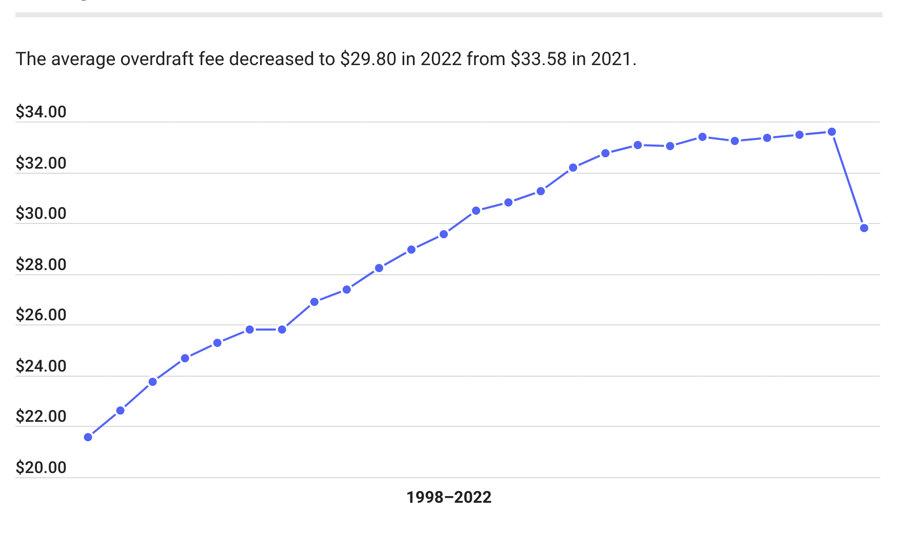
QUESTION OF THE DAY
Checking
A:
$29.80
Source: BankRate

Slide 3
FOLLOW-UP QUESTIONS
What do you think are the reasons that people spend more money than what they have in their checking accounts?
What has been the recent trend with the average amount of overdraft fees? Why do you think some banks have started removing overdraft fees?
What are the ways that you can prevent your account from being overdrawn (spending more than you have in your account)?

