Slide 1
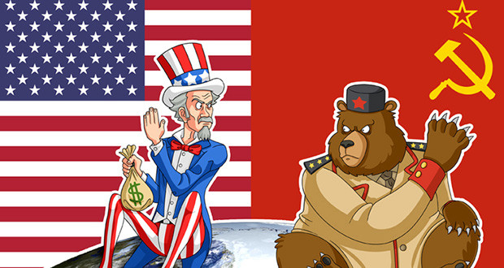
Cold War 1950’s Vocabulary

Slide 2
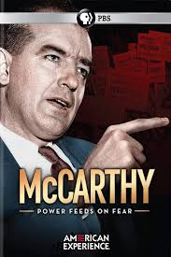
McCarthyism
The attacks, often unsubstantiated,by Senator Joseph McCarthy and others on people suspected of being Communists in the early 1950's.

Slide 3
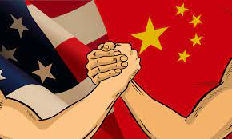
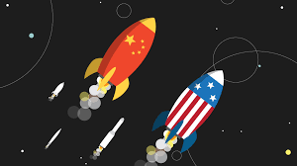
Arms Race
Competition between US and Russia to have the best armed forces

Slide 4
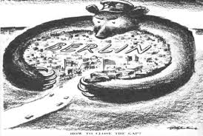
Blockade
Soviets attempt to cut off supplies to West Berlin for almost a year (327 days)

Slide 5
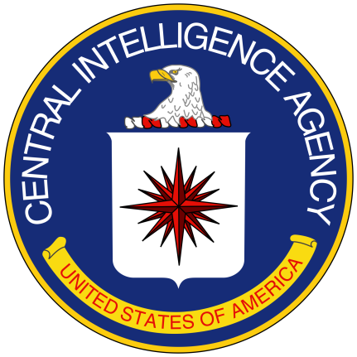
CIA (Central Intelligence Agency)
US agency created to gather secret information about foreign governments

Slide 6
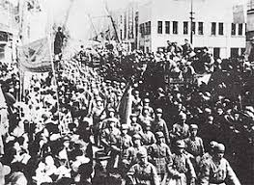
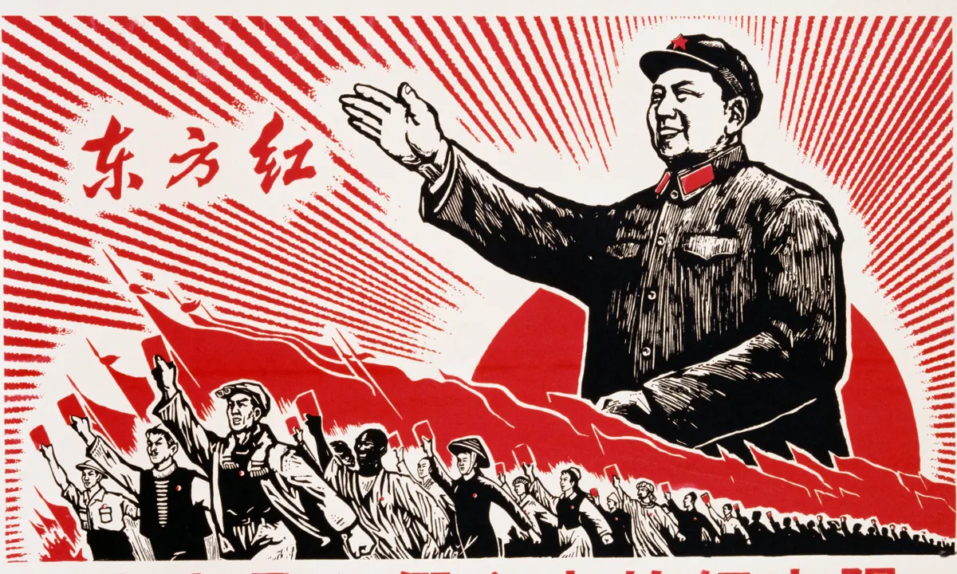
Chinese Revolution
Chinese led by Mao Zedong (Communist) won against nationalist government under Chiang Kai-Shek, Nationalist fled to Taiwan

Slide 7
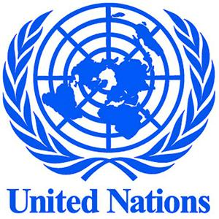
United Nations
An international peacekeeping organization to which most nations in the world belong; in promotes peace, security, and economic development.

Slide 8
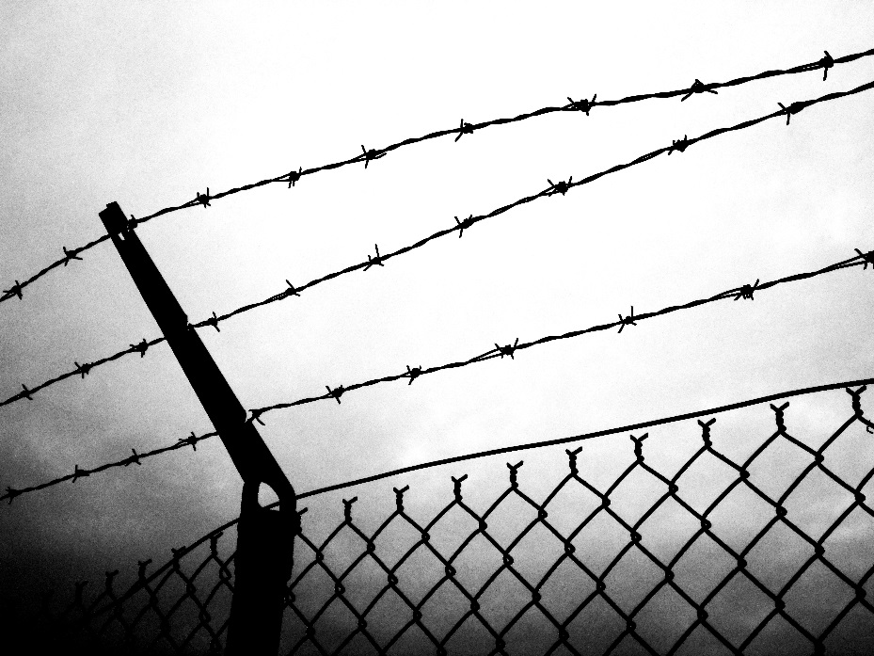
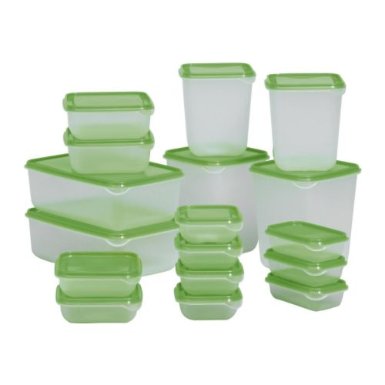
Containment
The efforts of the United States to block the Soviet Union’s spread of influence in the 1940’s and 1950’s

Slide 9
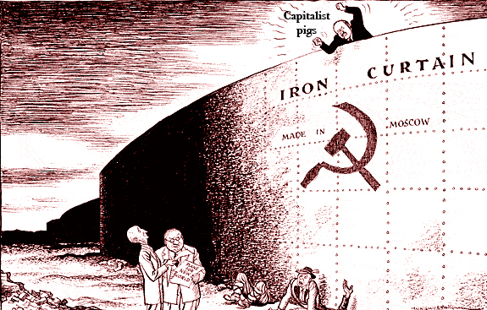
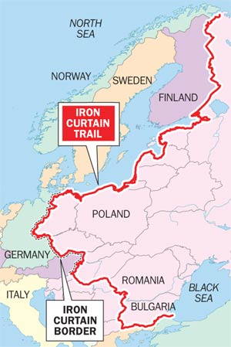
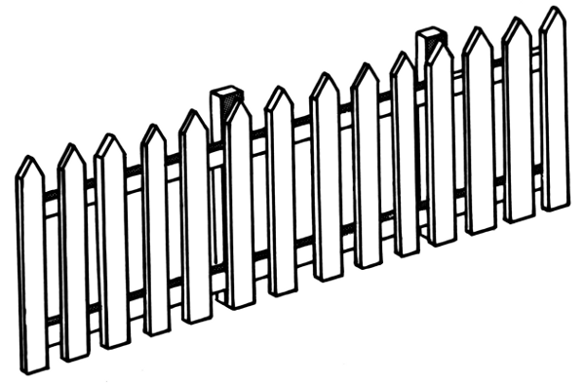
Iron Curtain
Describes the imaginary line that separated Communist countries in Eastern Europe from non-Communist countries in Western Europe

Slide 10
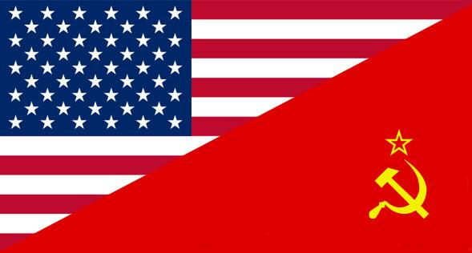
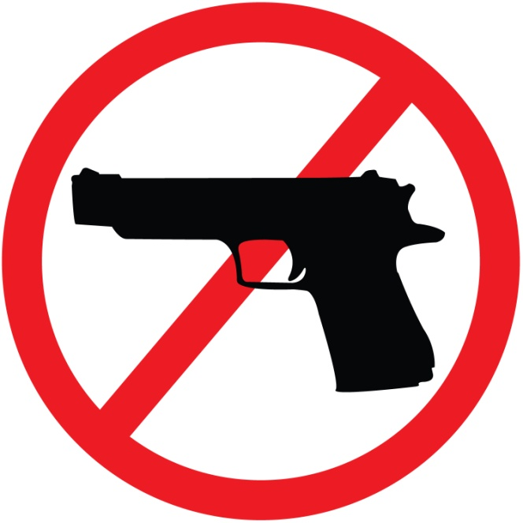
Cold War
State of hostility, without direct military contact, that developed between the US and Soviet Union after WWII.

Slide 11
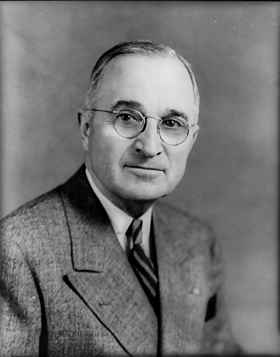
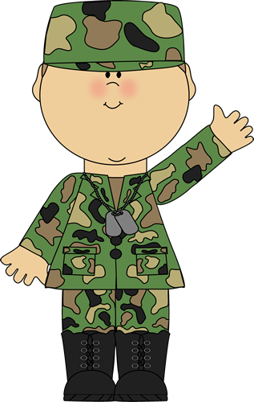
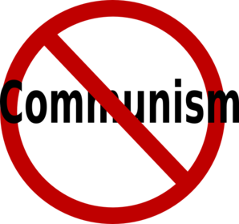
Truman Doctrine
A US policy of providing economic and military aid to free nations threatened by internal or external opponents.

Slide 12
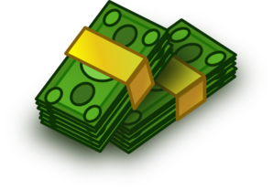
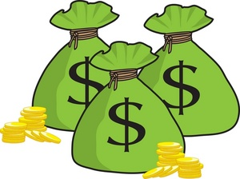
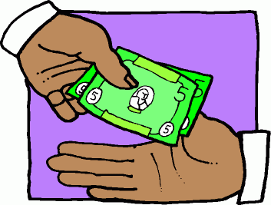
Marshall Plan
The program under which America supplied economic aid to European nations to help them rebuild after WWII.

Slide 13
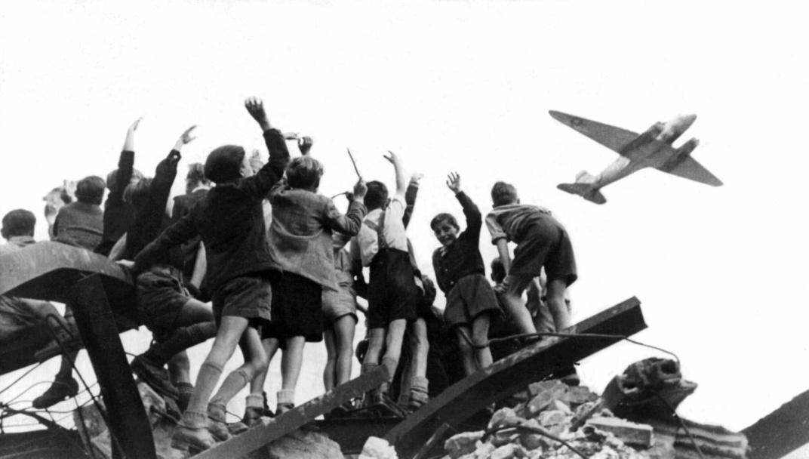
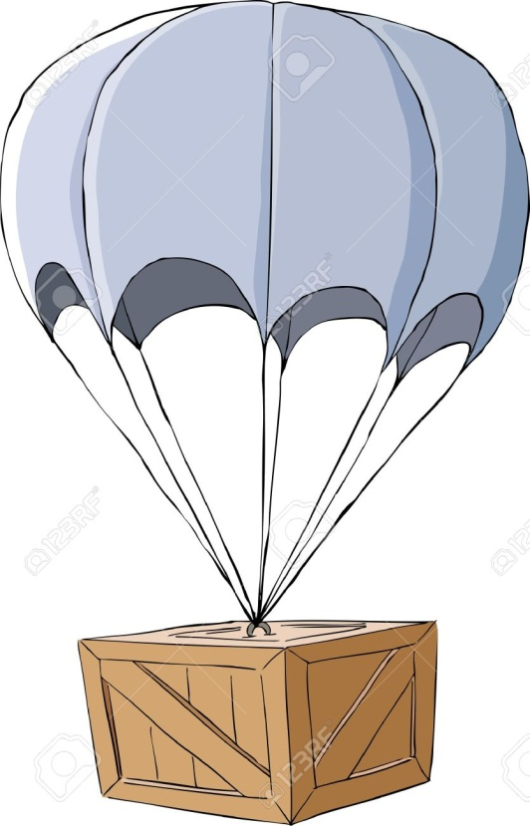
Berlin Airlift
A 327-day operation in which US and British planes flew supplies into West Berlin after the Soviets blockaded the city.

Slide 14
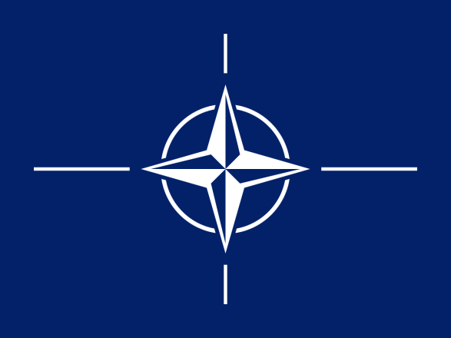
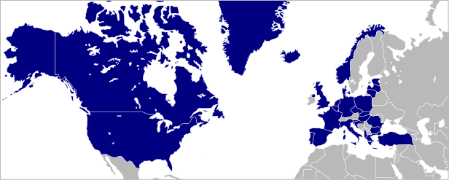
NATO (North Atlantic Treaty Organization)
A defensive alliance formed during the Cold War by the US, Canada, and ten Western European nations.

Slide 15
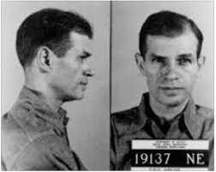
Alger Hiss
Accused/convicted spy for Soviet Union

Slide 16
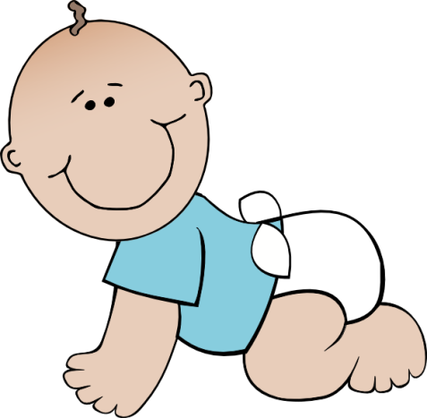
Baby Boom
The sharp increase in the US birthrate following WWII

Slide 17
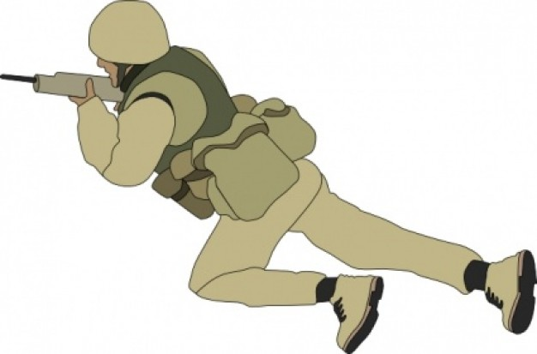
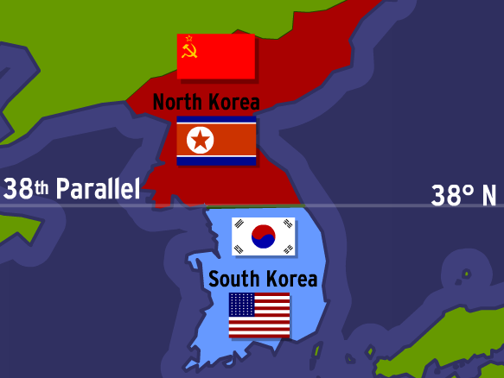
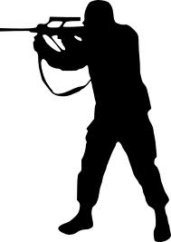
Korean War
A conflict between North and South Korea in which the United States and United Nations fought on the side of South Korea and China fought on the side of North Korea.

Slide 18
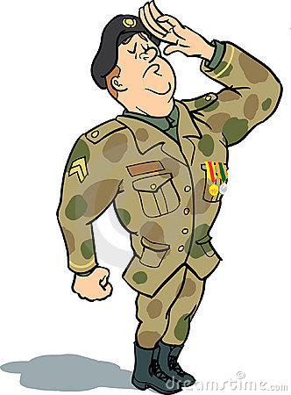
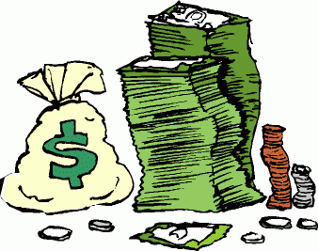
GI Bill
A name given to the Servicemen's Readjustment Act, a 1944 law that provided financial and educational benefits for veterans of WWII.

Slide 19
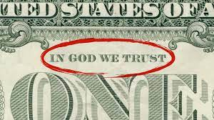
“In God We Trust”
1956 US official motto (Eisenhower creation)
US does not restrict religious freedoms

Slide 20
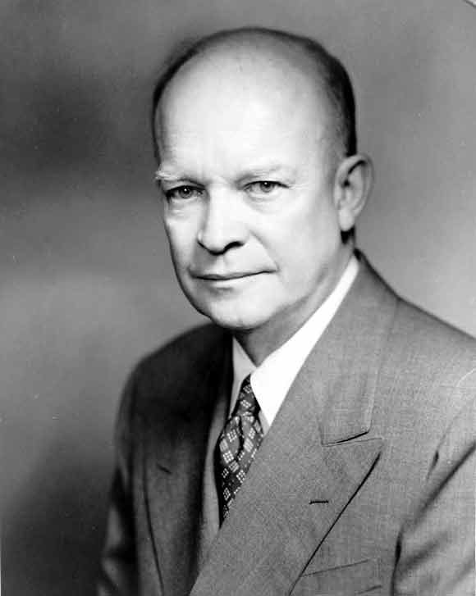
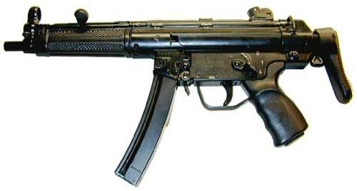
Eisenhower Doctrine
A US commitment to defend the Middle East against attack by any communist country.

Slide 21
Suburb
A neighborhood outside a city to which mostly middle class people began moving in the 1950's

Slide 22
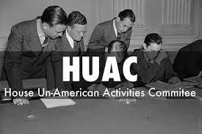
House Un-American Activities Committee
(HUAC) investigation into Hollywood actors, directors, producers of being communist

Slide 23
Satellite Nations
Nations during the cold war that were aligned with the Soviet Union. They were Poland, Czechoslovakia, Hungary, Romania, Bulgaria, and East Germany.

Slide 24
Jonas Salk
The Scientist that invented the Polio Vaccine.

Slide 25
Beatnik
A young person in the 1950s and early 1960s belonging to a subculture associated with the beat generation.

Slide 26
38th Parallel
This is the dividing line between Communist North Korea and Democratic South Korea

Slide 27
Domino Theory
Theory that a political event in one country will cause similar events in neighboring countries.

Slide 28
Warsaw Pact
The defensive military alliance between the Soviet Union and its satellite nations

Slide 29
Interstate Highway System
Plan by Dwight Eisenhower to connect the US with roads.

Slide 30
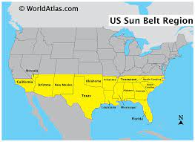
Rust Belt to Sun Belt
Northern manufacturers began relocating to warmer climate and lower tax rate states in the southern region of the US

Slide 31
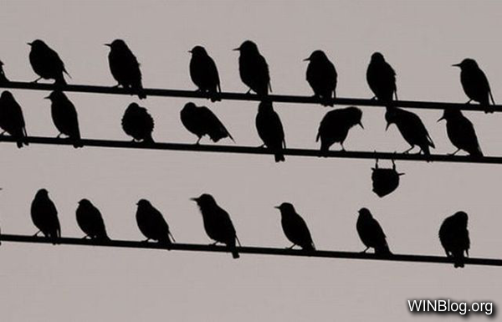
Conformity
Doing what society expects you to do.

Slide 32
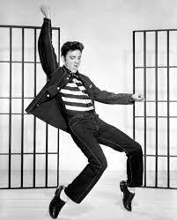
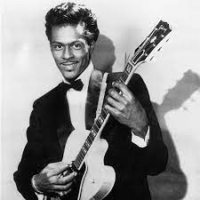
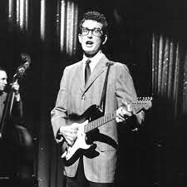
Rock and Roll
Music with roots in Jazz, Blues, and Country; broke traditional norms and helped break barriers between whites and blacks as well as generations. Ex: Elvis Presley, Chuck Berry, & Buddy Holly.

Slide 33
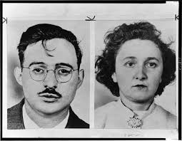
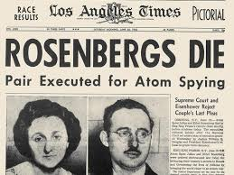
Julius and Ethel Rosenberg
Americans convicted of giving the Soviets information about the atomic bomb

Slide 34
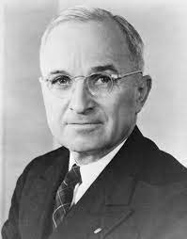
Harry Truman
US President at the end of WWII and when the Cold War began; ordered atomic bomb dropped

Slide 35
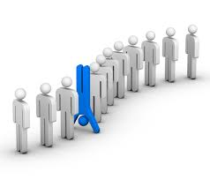
Non-Conformity
Not doing what society expects you to do

Slide 36
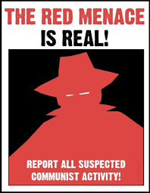
Red Scare
Fear of communism in the US.

