Slide 1
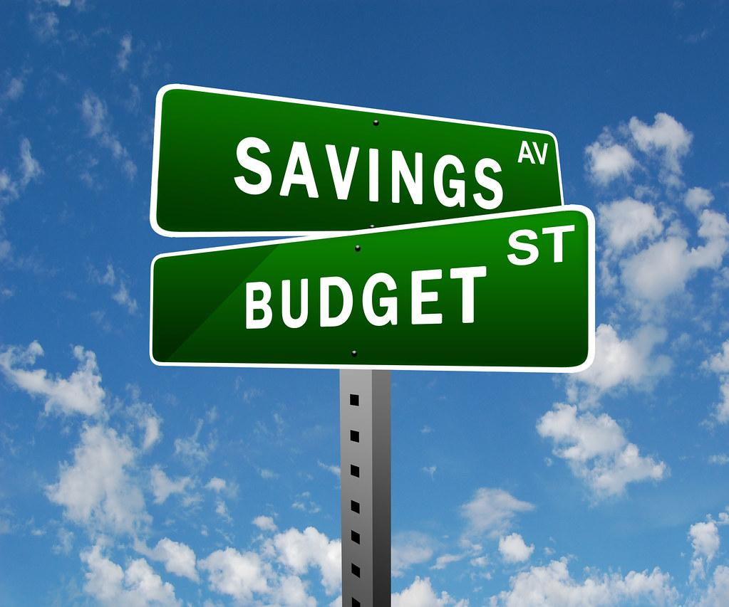
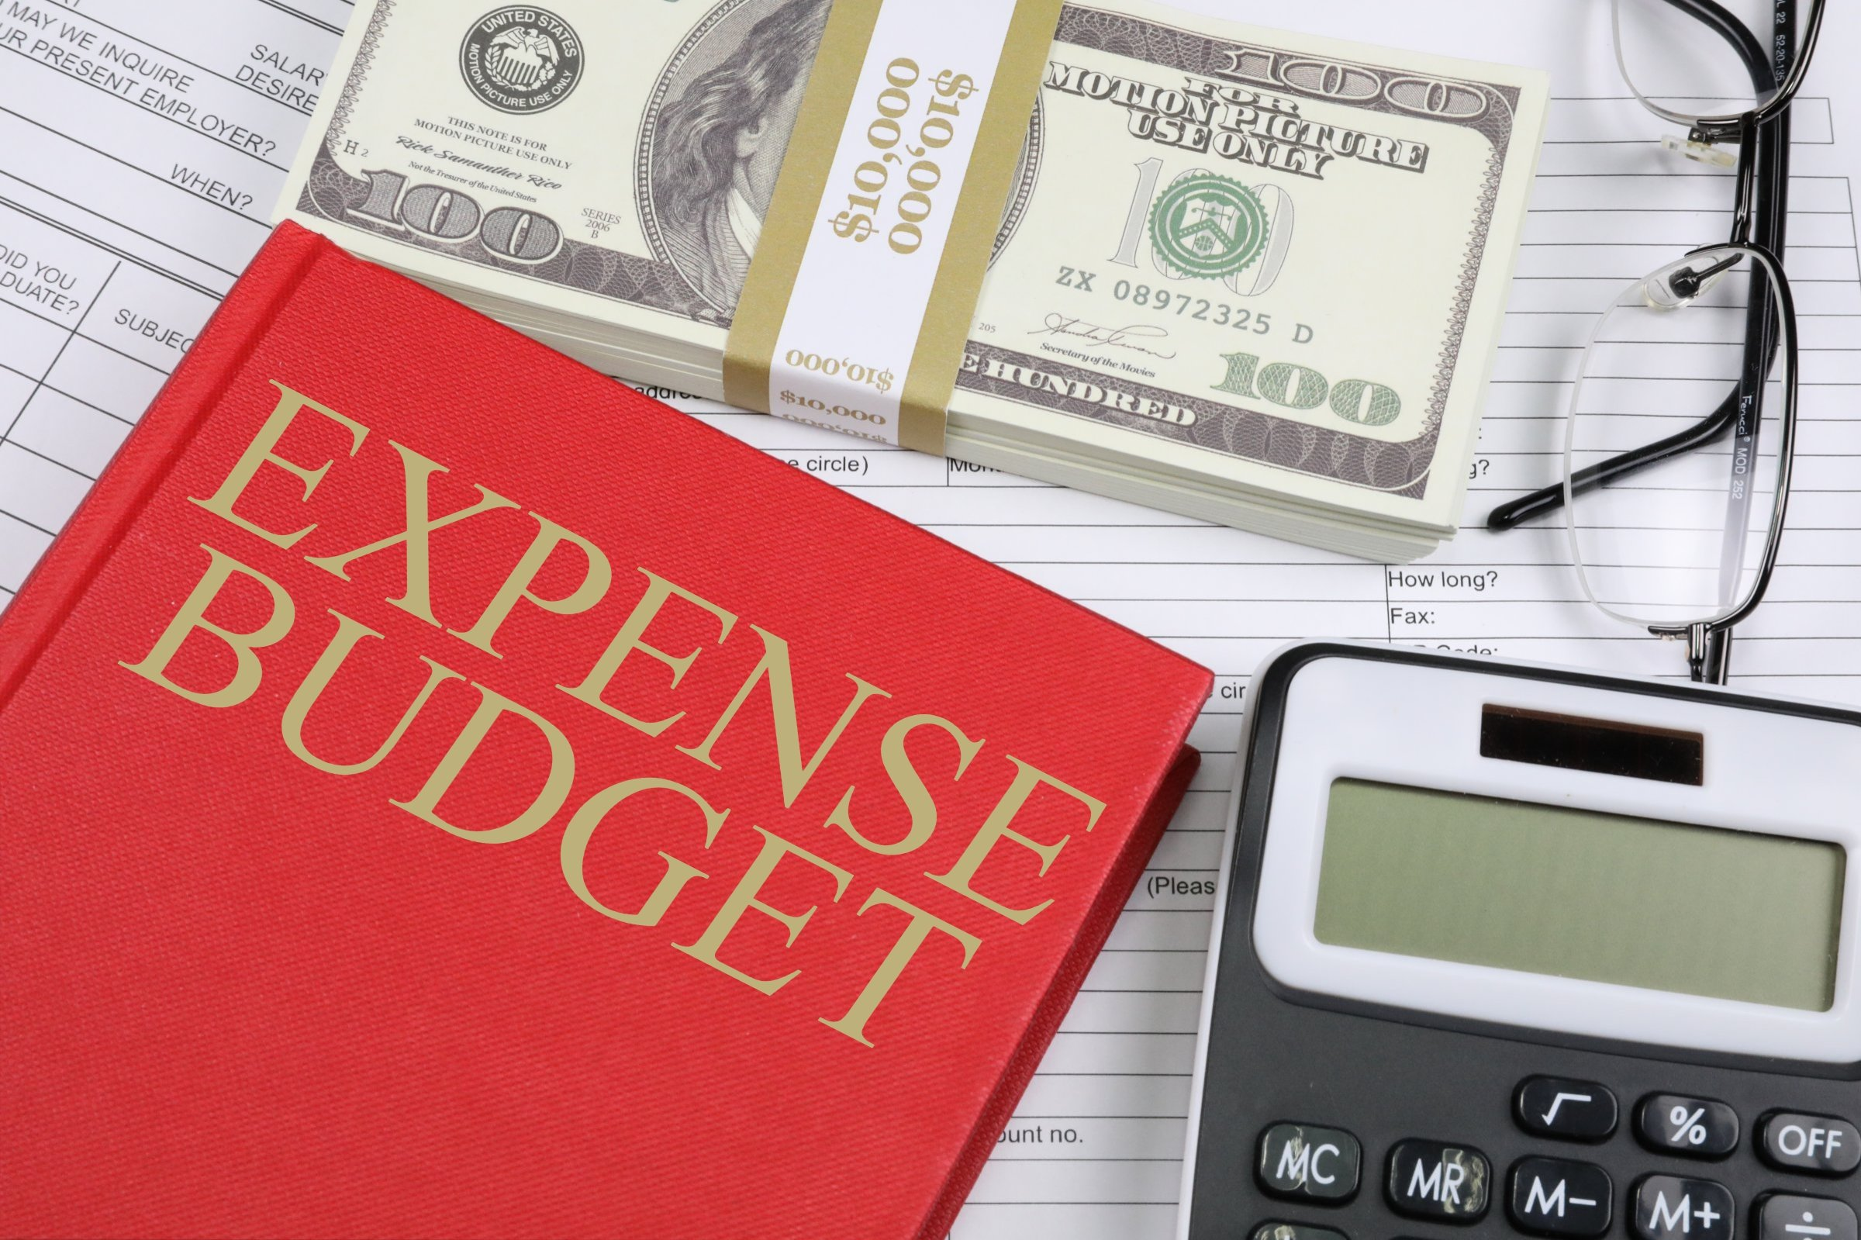
What you need to know: Credit Score Good Debt vs Bad Debt

Slide 2
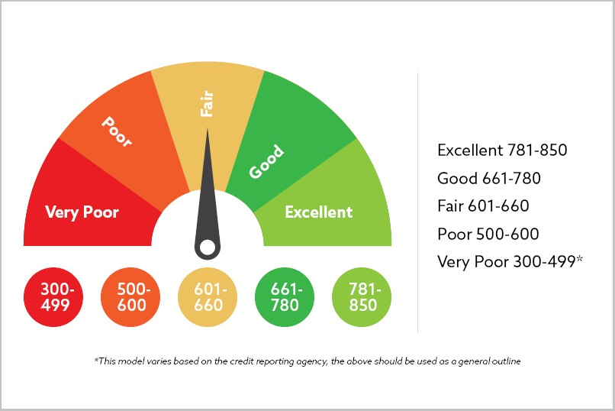
Credit Score
Tells lenders about your creditworthiness (how likely you are to pay back a loan based on your credit history)

Slide 3
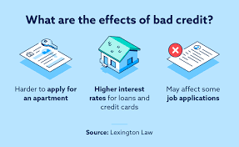
Credit Score
1) Important – will follow you the rest of your
life. Protect it!
2) This will affect how much you pay for items
such as a House, Car or any other item you
finance.
a) The higher the Credit Score the lower the
interest rate you will receive.
b) If its to low nobody will take a chance on you
and give you the loan/financing or credit card. If you do get the loan or Credit Card, it will be at a much higher rate because you will be deemed a higher risk for default.

Slide 4
QUESTION OF THE DAY
Managing Credit
Q:
Which credit score band has the highest percentage of people: 300-599, 600-699, 700-749, 750-799, 800-850?
View blog post
ngpf.org 10/22/20

Slide 5
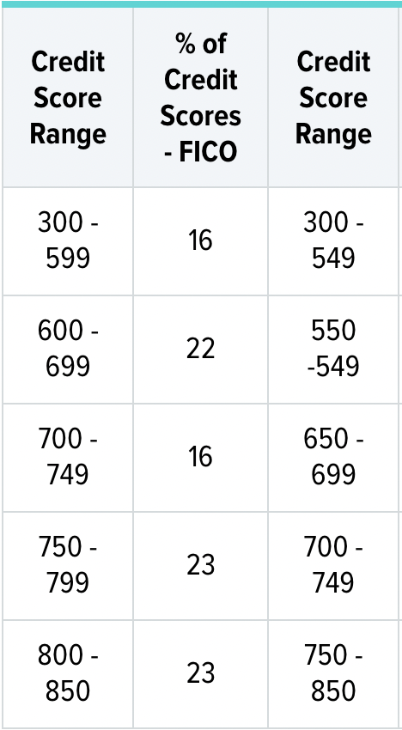
QUESTION OF THE DAY
Managing Credit
A:
23.3% at 800-850
Source: WalletHub

Slide 6
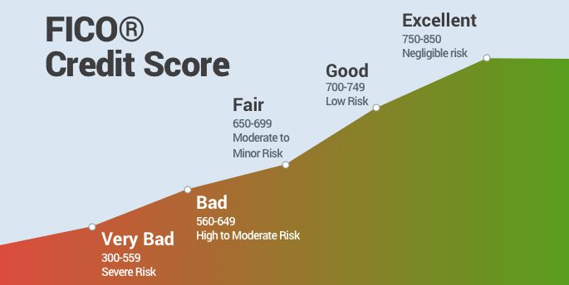
Credit Score
3) This could also affect your ability to get a
job or rent/lease an apartment.

Slide 7
QUESTION OF THE DAY
Managing Credit
Q:
What's the average credit score needed to rent an apartment?
View blog post
ngpf.org 5/11/22

Slide 8
QUESTION OF THE DAY
Managing Credit
A:
The average credit score of renters in the U.S. was 638 in 2020.
Click here for more info on this topic
ngpf.org

Slide 9
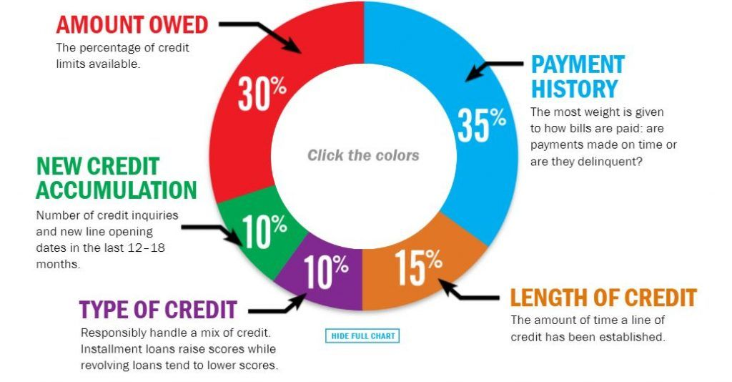
What Effects Your Credit Score

Slide 10
What Effects Your Credit Score
1) On-time payments is the largest portion of
your credit score. This is reported
monthly!
EX. IIIIIIIIIXIIIIIII
IIIIIIIIIIIIIIIXI

Slide 11
QUESTION OF THE DAY
Types of Credit
Q:
What is #1 reason that people give for paying their credit card bill late?
View blog post
ngpf.org 10/19/20

Slide 12
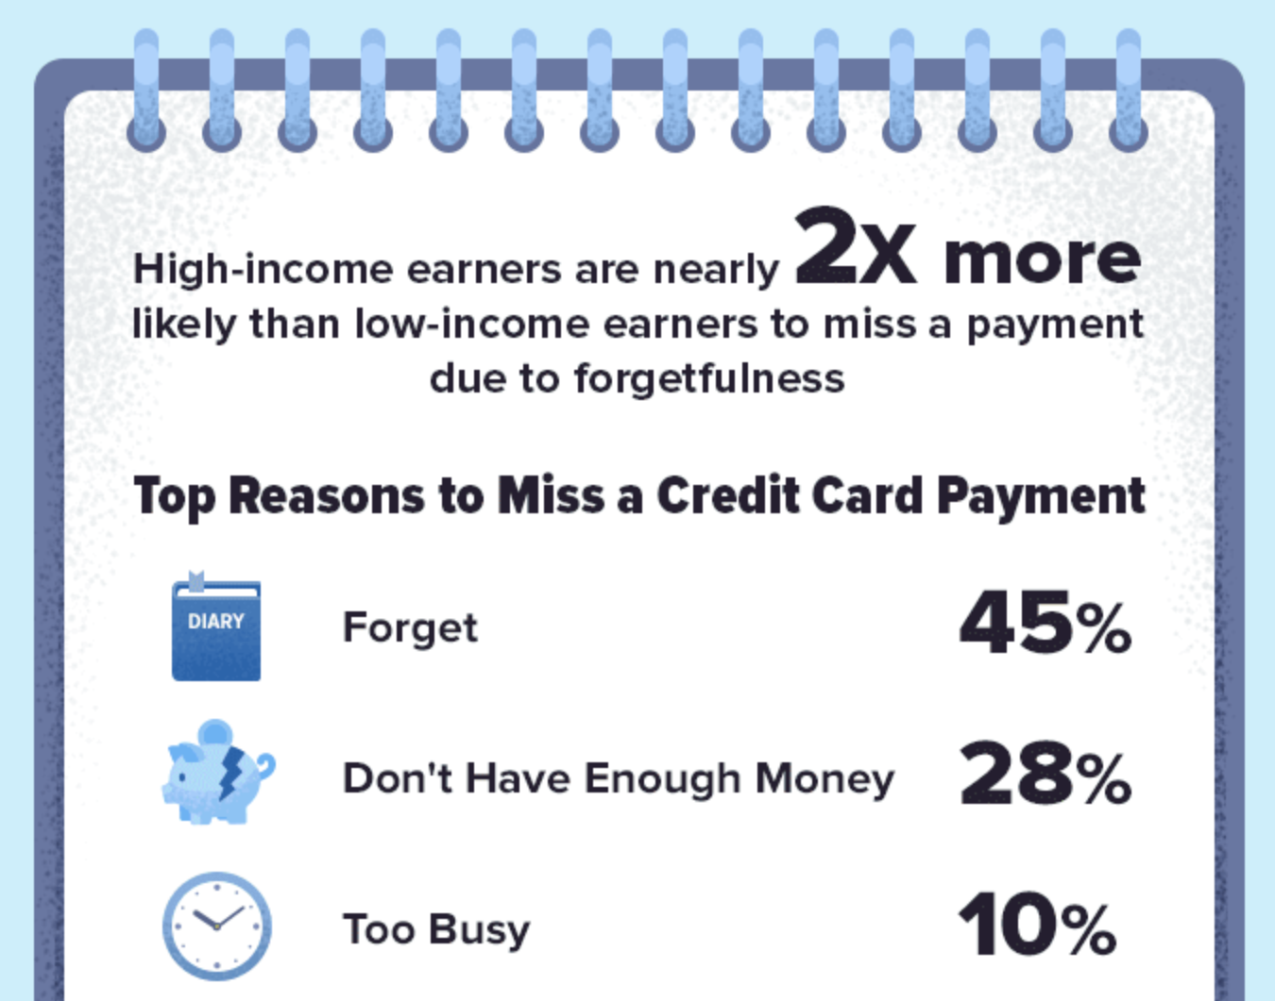
QUESTION OF THE DAY
Types of Credit
A:
45%
Forgot to make the payment
Click here for more info on this topic

Slide 13
QUESTION OF THE DAY
Managing Credit
Q:
How much more in interest does a consumer with a low credit score pay when it comes to a home loan (mortgage)?
View blog post
ngpf.org 3/6/22

Slide 14
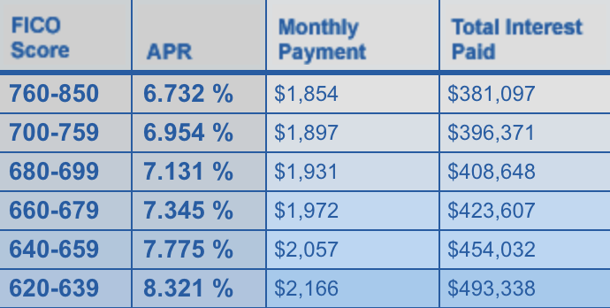
QUESTION OF THE DAY
Managing Credit
$312 per month OR $112,241 over a 30 year period
A:
Click here for more info on this topic

Slide 15
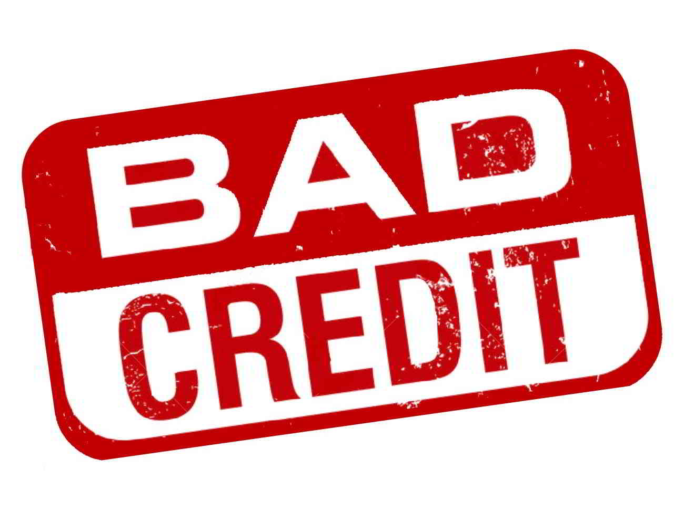
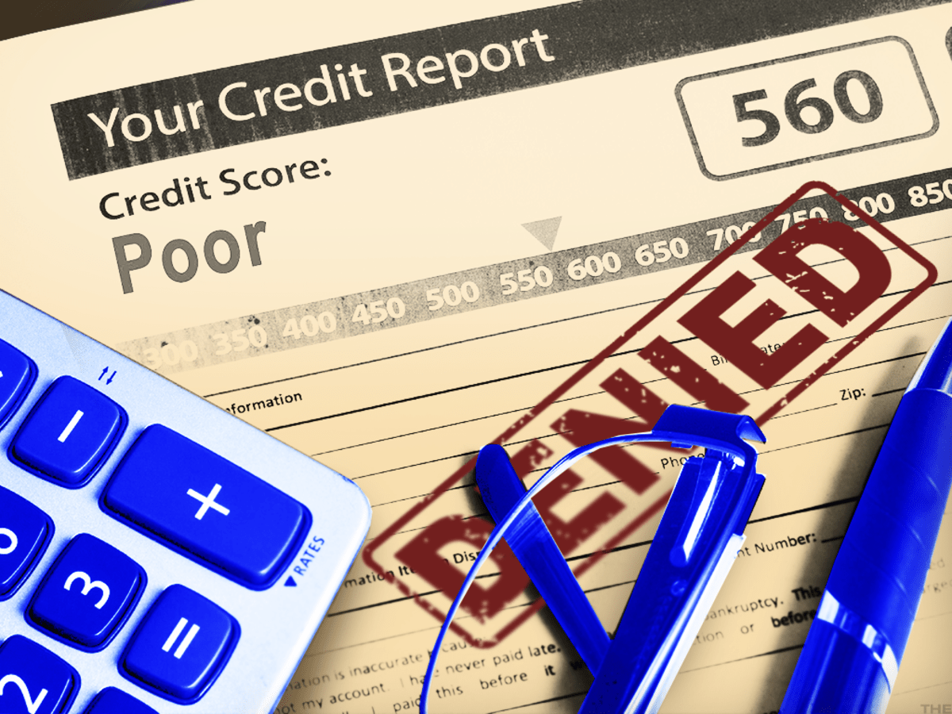
Credit Score
2) Bad Credit report or ding
will follow you for 7 years
3) A bankruptcy will follow
you for 10 years

Slide 16
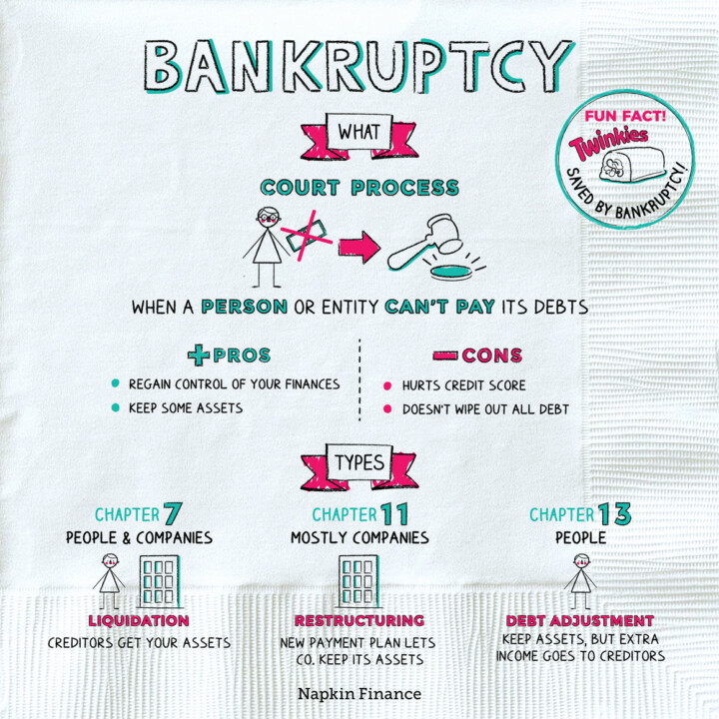
Bankruptcy
a. Court Process: No guarantee
a Bankruptcy will be allowed.
b. Not all debt is wiped out

Slide 17
QUESTION OF THE DAY
Types of Credit
Q:
What is the recommended age to get a credit card?
View blog post
ngpf.org 5/30/22

Slide 18
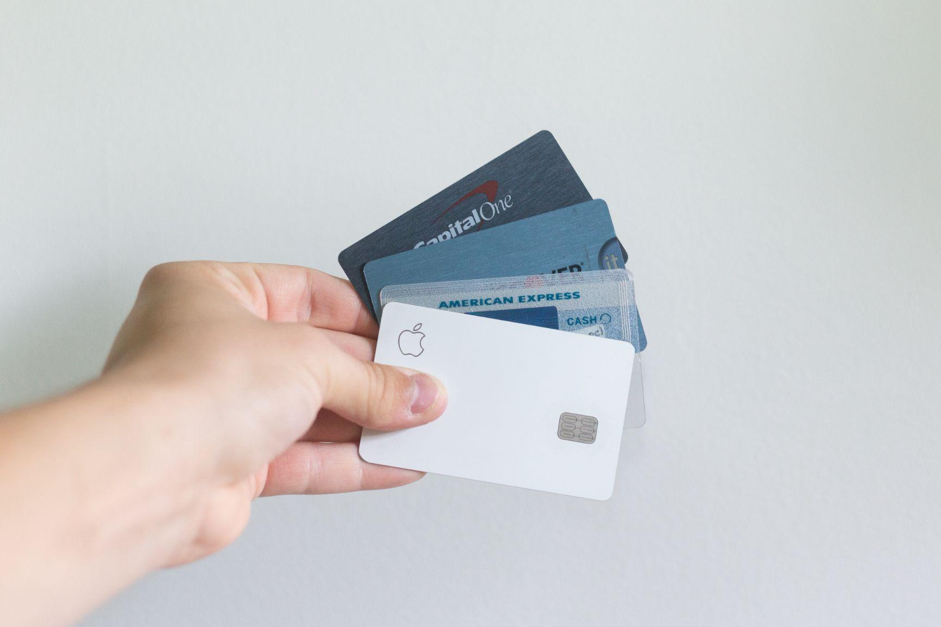
QUESTION OF THE DAY
Types of Credit
A:
Some experts recommend getting a credit card when you turn 18 to start responsibly building credit
Source: CNBC

Slide 19
QUESTION OF THE DAY
Types of Credit
Q:
Can you name ONE of the ways that consumers, under age 25, establish credit?
View blog post
Ngpf.org 1/27/23

Slide 20
QUESTION OF THE DAY
Types of Credit
A:
1. Get a secured card
2. Get a credit-builder product or a secured loan
3. Use a co-signer
4. Become an authorized user
5. Get credit for the bills you pay
6. Practice good credit habits
Source: NerdWallet

Slide 21
Good Debt vs. Bad Debt
Is there such a thing as “good debt” and “bad debt?”
It depends. While borrowing allows you to get something more quickly, you now owe someone money and most likely had to pay interest on top of the purchase price.
Source How to Get Out of Debt - YNAB Guides - You Need A Budget

Slide 22
Does the value increase or decrease?
When trying to decide if a debt is more helpful than harmful, consider the following rule of thumb: will your purchase typically increase or decrease in value?
Your house = increase in value
Borrowing for higher education or Trade School = (lead to higher income) likely to increase in value.
That bag of Doritos = Not so much
This is why a mortgage debt is sometimes positioned as “good debt.” Virtually no one has that kind of money up front, and houses tend to increase in value.
You could say borrowing money to pay for groceries is bad debt since grocery items are essentially disposable and decrease in value.
However, imagine a desperate situation where a family has suffered job loss, and incurring debt offers the only way to eat.
Currently, U.S. Household Debt Is at an All-Time High!

Slide 23
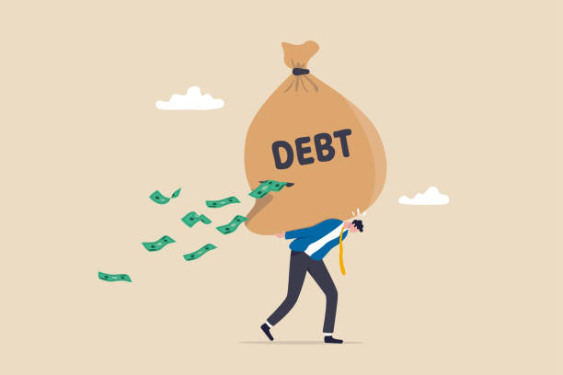
Does the value increase or decrease?
What about your car? While a car depreciates the second you drive it off the lot, making it to work is important, so a reliable car has significant value.
Consider these guiding questions as you weigh borrowing money.
Source: How to Get Out of Debt - YNAB Guides - You Need A Budget

Slide 24
5 Guiding Questions
Is the Purchase Absolutely Necessary? If it’s not a necessary expense, it’s better to save for it rather than borrow, reduce cash flow, and incur interest.
How Will This Impact My Monthly Cash Flow? If the loan payment will affect you for years and impede your ability to pay for monthly and non-monthly expenses, then borrowing isn’t a good idea.
Will You Own the Item for a Long Time? If the loan payment will last longer than the item, borrowing does not offer a strong option.
Will the Item Increase in Value? Avoid borrowing money to pay for something that decreases in value. In this case, you lose money beyond the interest rate.
What Is the Amount Being Borrowed? “Good debt” like mortgage debt or student loans often reach so high that borrowing becomes financially risky and therefore “bad debt.” Even if you want to buy a house, that doesn’t mean you should borrow the absolute maximum amount allowed. You have to weigh this debt against all your other financial responsibilities.
Source: How to Get Out of Debt - YNAB Guides - You Need A Budget

Slide 25
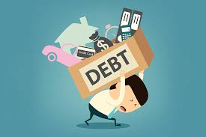
Another Way to Look at Debt
While a Mortgage or business is set up to create wealth over time other debt such as credit card debt or a car note can keep you in debt for decades.
An economist will look at debt for items that do not increase in value as trading your future happiness for instant gratification.

Slide 26
What you need to know: Creating a Budget

Slide 27
What is the difference between gross income and net income?

Slide 28
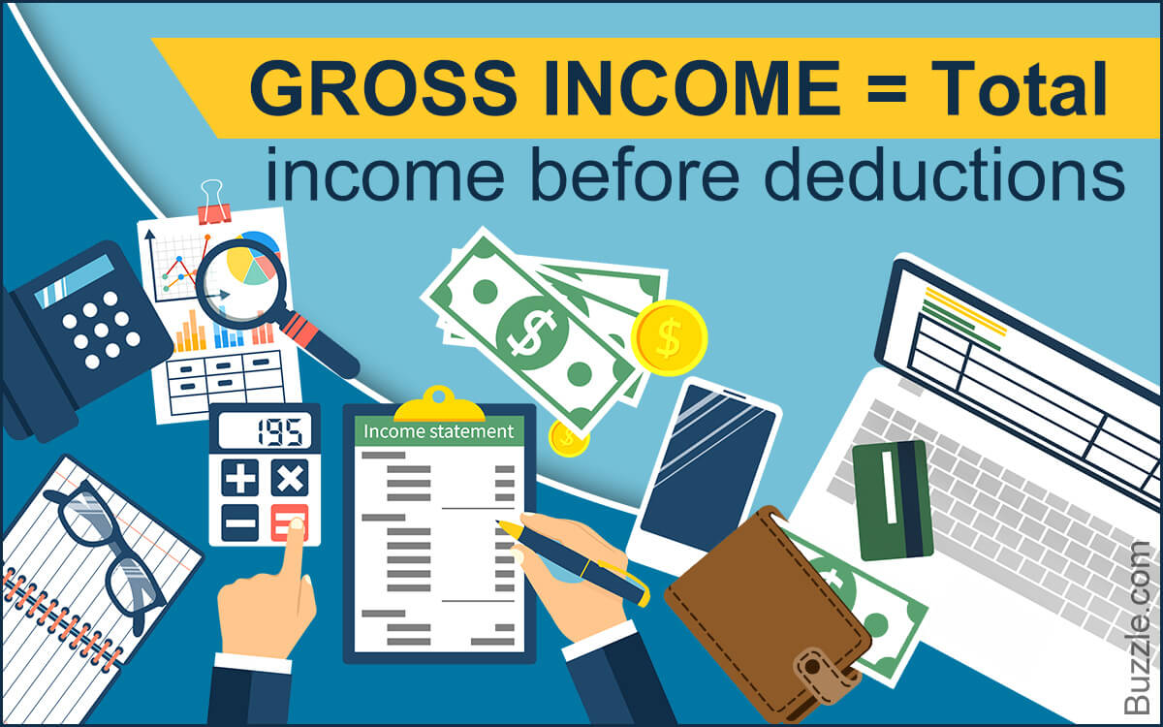
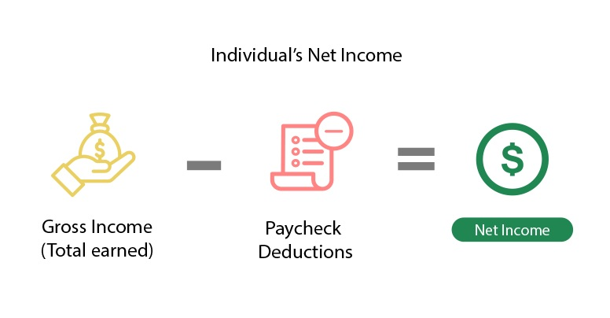

Slide 29
1. Which two things does a budget compare?
Savings and interest
Income and expenses
Income and investments
Expenses and expenditures

Slide 30
2. Which of the following is a true statement ?
They encourage people to spend as much money as possible
Setting up a budget will allow you to earn more money
The idea behind keeping a budget is to spend exactly as much as you earn
They allow people to track how and where their money is spent

Slide 32
What’s your monthly income?
-Add up your paychecks
-Add to this any additional income
*Use NET income, not GROSS income*

Slide 33
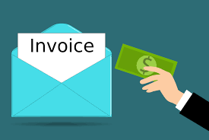
Fixed, Variable, or Periodic?
-Fixed - contractual payments such as rent, car
payments, phone service
-Variable - food, gasoline, entertainment, electricity
-Periodic - insurance, tuition, property taxes, license plate renewals

Slide 34
Create a plan and track spending
-WRITE IT DOWN
-Monthly income
-Monthly expenses (fixed, variable, & periodic)
-Track spending to compare what you’ve budgeted to your actual spending.
Know where your money is going!

Slide 35
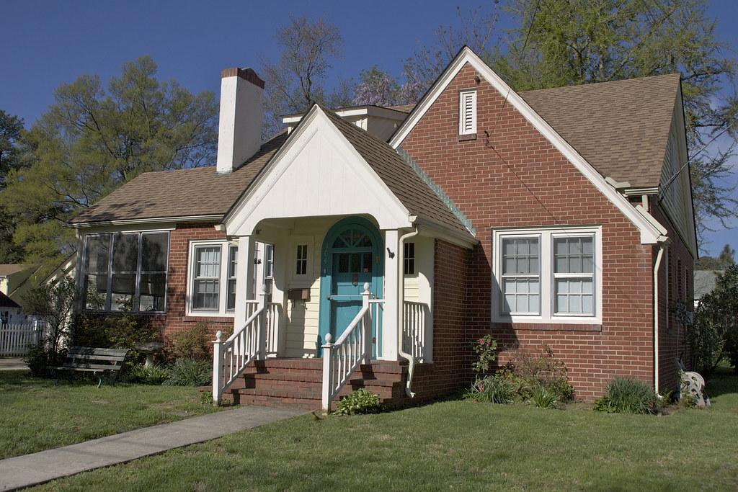
Set $ Goals
-Create measurable goals (budget for them)
-Why?-Saving for something specific makes the act more rewarding
Emergency fund – 3 to 6 months salary
Down payment on house/car
Vacation
Education
Retirement

Slide 36
How can you make ends meet?
-Decrease spending
Determine “wants” vs. “needs”
-Increase income
2nd job or look for a better paying job
*STICK TO YOUR PLAN*

Slide 37
Additional Budget information
1) Buying a house will create wealth
- a typical down payment is 20%.
$200,000 house will require $40,000

Slide 38
Additional Budget information
Begin establishing your credit. Get a credit card or something similar.
a) Guard your credit, your score will determine how much you will pay.
b) Don’t trade future earnings for something you won’t be using in the future.
c) Use a debit card to guard against debt.

Slide 39
Additional Budget information
3) Retirement – Start early $50 a month at a moderate 5%
compounded annually.
Total invested after 50 years = $30,000
Total earned after 50 years = $128,985

