Slide 1
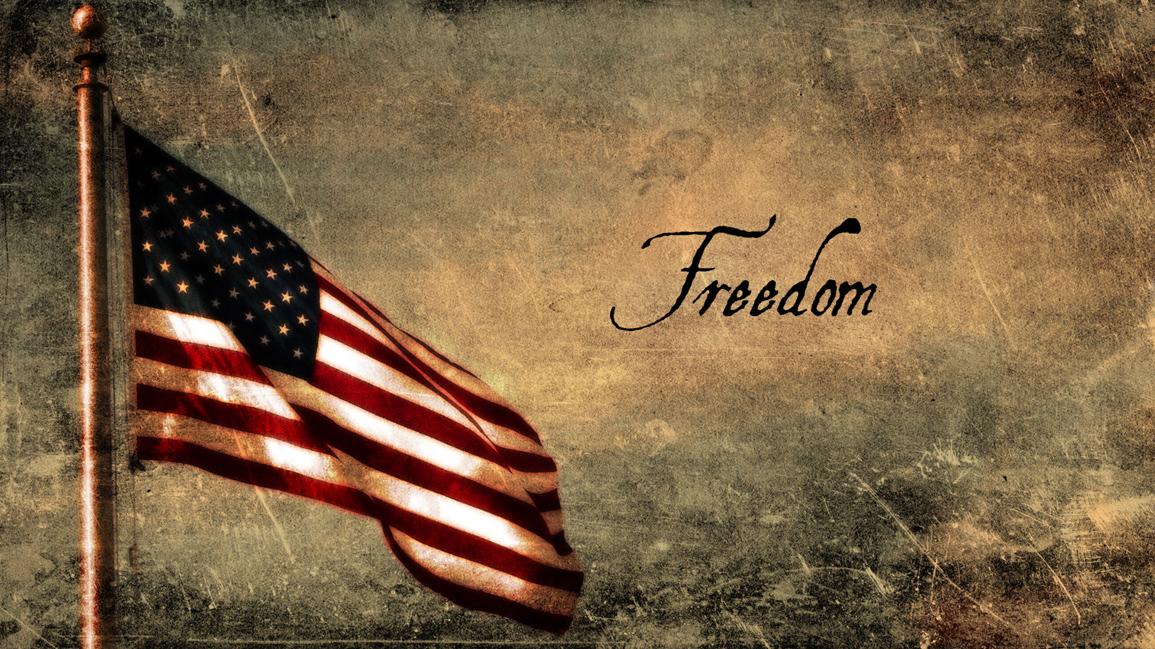
FREEDOM WEEK

Slide 2
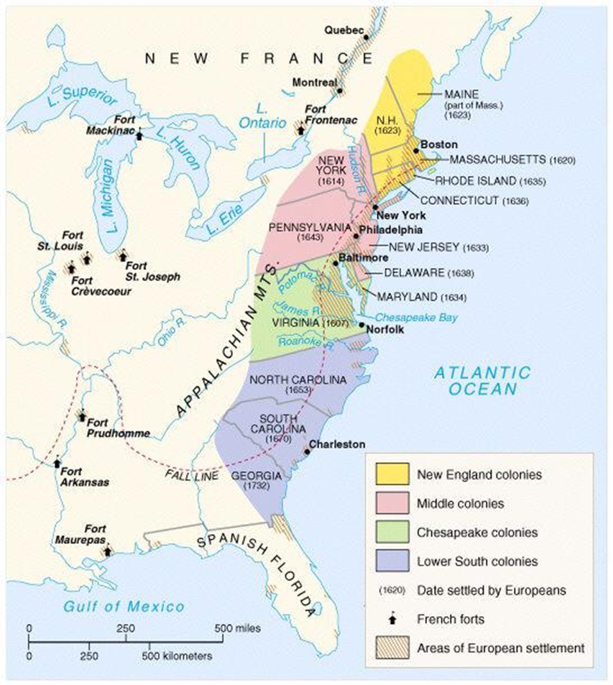
THE BEGINNING
Started as a British colony
Grew to 13 colonies over a short span of time
As British colonies, we were under control of British government (King George III & parliament)
The colonies believed:
They were misrepresented (no reps in parliament) and because of that…
Government did not meet their needs of the colonies
Taxed unfairly

Slide 3
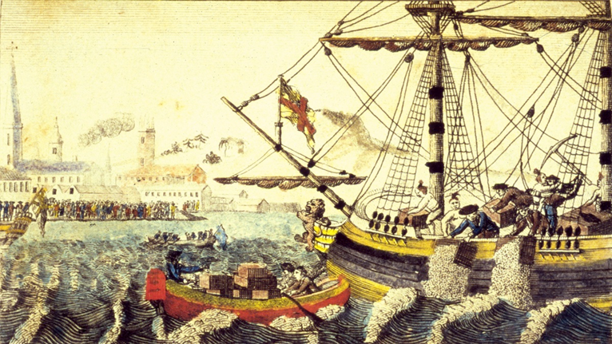
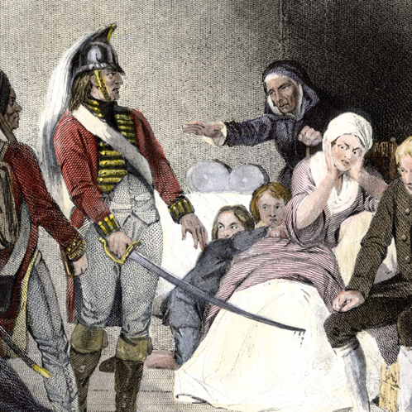
THE BUILD UP TO A BREAK UP
Acts that allowed Britain to collect taxes:
Tea Act (1773): required colonists to only buy tea from the British India Tea Company
Stamp Act (1765): required colonists to use special stamped paper that was produced in London for legal documents, magazines, newspapers, playing cards, and required the special paper to be purchased with British currency, not colonial currency
Quartering Act (1765 & 1774): required colonists to pay for housing and provisions of British troops; also allowed British royal officers to house troops in unused houses, barns, inns, etc. Later, troops were housed in private homes

Slide 4
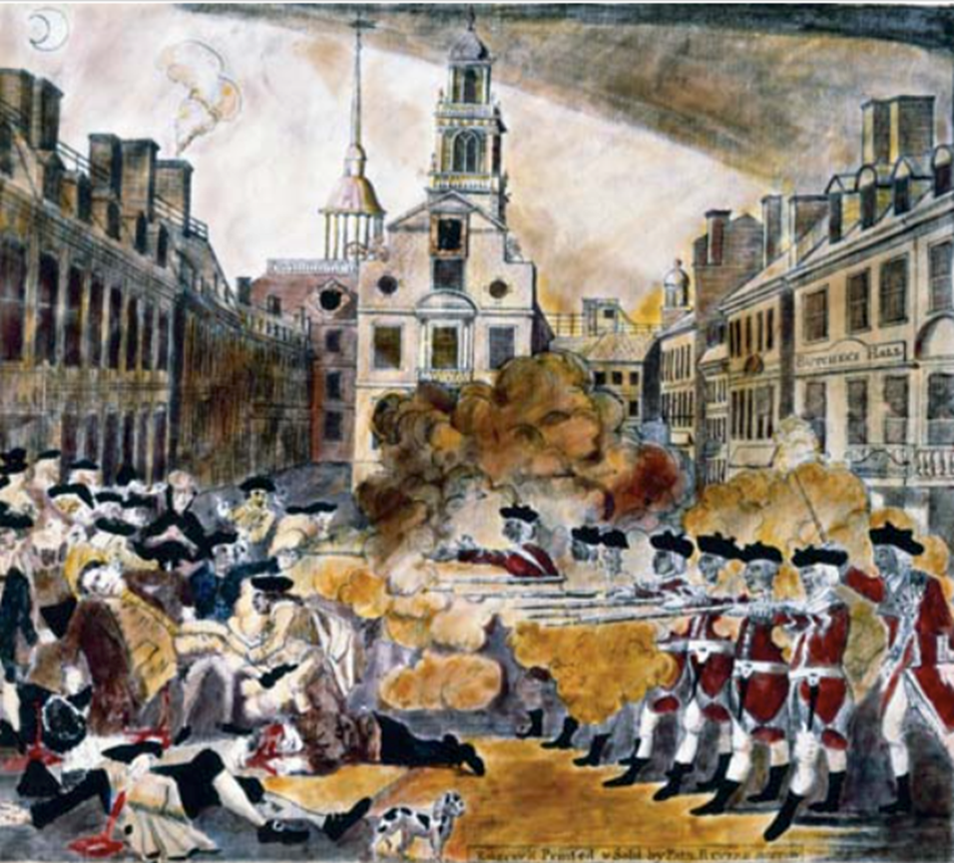
DECIDING TO BREAK UP… BYE, BYE, BYE
Imposed taxes by the British government was unfair
No voice for colonies in Parliament (“NO TAXATION WITHOUT REPRESENTATION”)
Disrespectful to their personal liberties (freedoms guaranteed by the U.S. Constitution)
Appealed concerns to King George, but felt he was just imposing requirements
Ultimately, colonists felt the best thing to do was separate from Great Britain.

Slide 5
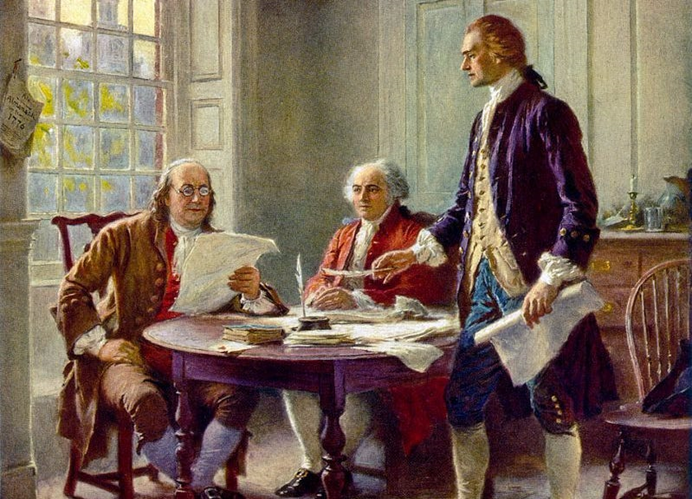
THE BREAK UP LETTER
Representatives from the colonies gathered together to create a letter to King George
Addressed their grievances (official complaints)
5 men responsible to draft letter:
Thomas Jefferson (primary writer)
John Adams, Benjamin Franklin, Roger Sherman, & Robert Livingston
The letter, the Declaration of Independence (official separation), was set in 3 parts:
Preamble: explains that people have a right to separate from a government they feel is unjust. Based on the theory of Thomas Hobbs, who developed the idea of a social contract (the idea that people should follow the laws of government so long as the laws are fair)
Grievances: 27 complaints against the British that caused the colonies to leave
Official Separation: redefined our relationship with Great Britain and stated that we would be forming our own independent country

Slide 6
DECLARATION OF INDEPENDENCE - THE PREAMBLE
The unanimous Declaration of the thirteen United States of America, When in the Course of human events, it becomes necessary for one people to dissolve the political bands which have connected them with another, and to assume among the powers of the earth, the separate and equal station to which the Laws of Nature and of Nature's God entitle them, a decent respect to the opinions of mankind requires that they should declare the causes which impel them to the separation.
We hold these truths to be self-evident, that all men are created equal, that they are endowed by their Creator with certain unalienable Rights, that among these are Life, Liberty and the pursuit of Happiness.--That to secure these rights, Governments are instituted among Men, deriving their just powers from the consent of the governed, --That whenever any Form of Government becomes destructive of these ends, it is the Right of the People to alter or to abolish it, and to institute new Government, laying its foundation on such principles and organizing its powers in such form, as to them shall seem most likely to effect their Safety and Happiness. Prudence, indeed, will dictate that Governments long established should not be changed for light and transient causes; and accordingly all experience hath shewn, that mankind are more disposed to suffer, while evils are sufferable, than to right themselves by abolishing the forms to which they are accustomed. But when a long train of abuses and usurpations, pursuing invariably the same Object evinces a design to reduce them under absolute Despotism, it is their right, it is their duty, to throw off such Government, and to provide new Guards for their future security.--Such has been the patient sufferance of these Colonies; and such is now the necessity which constrains them to alter their former Systems of Government. The history of the present King of Great Britain is a history of repeated injuries and usurpations, all having in direct object the establishment of an absolute Tyranny over these States. To prove this, let Facts be submitted to a candid world.
-He has refused his Assent to Laws, the most wholesome and necessary for the public good.

Slide 7
WHAT DO YOU THINK?
Our letter to Great Britain was written because we felt our personal liberties were being violated. The Declaration of Independence was created partially to establish these liberties. Do you think/feel that we still have these personal liberties today? Why or why not?

Slide 8
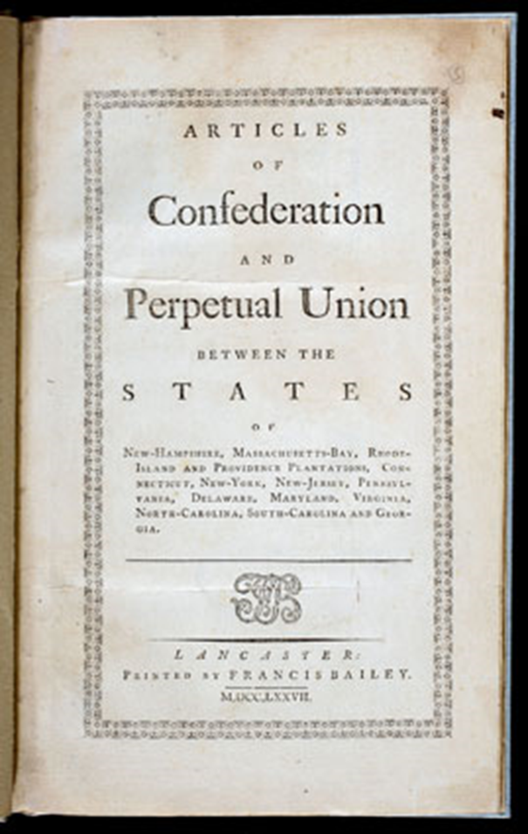
NOW… HOW TO RULE?
13 independent colonies will become states after Declaration.
Each state had its own idea of how to govern
Representatives of each state met together to create a federation (organizing independent states into a central control)
They called these rules the Articles of Confederation
First document to outline a central government
Problem: created a central government that was too weak to address the needs of all states
It did not work in the way it was intended and allowed each state too much independent power and did not protect states
France had interest in the new world as well

Slide 9
THE CONSTITUTION
Our Constitution created a balanced and limited government. It was written based on 7 major principles
Individual rights: personal liberties and rights guaranteed to all U.S. citizens by the Bill of Rights; government cannot take these away (investment)
Republicanism: rule by the people through elected officials (republicans)
Popular sovereignty: the people rule; the power of government comes from the people; people control their government through voting (popular)
Federalism: power is divided between a central government and individual states (10th Amendment; Fedex)
Checks & Balances: the ability of each branch of government to exercise controls over the other two branches (checks)
Limited Government: government is not all powerful; citizens including government officials must obey the law (limiting)
Separation of Powers: division of basic government roles into branches, with no one branch having all of the power (separate)

Slide 10
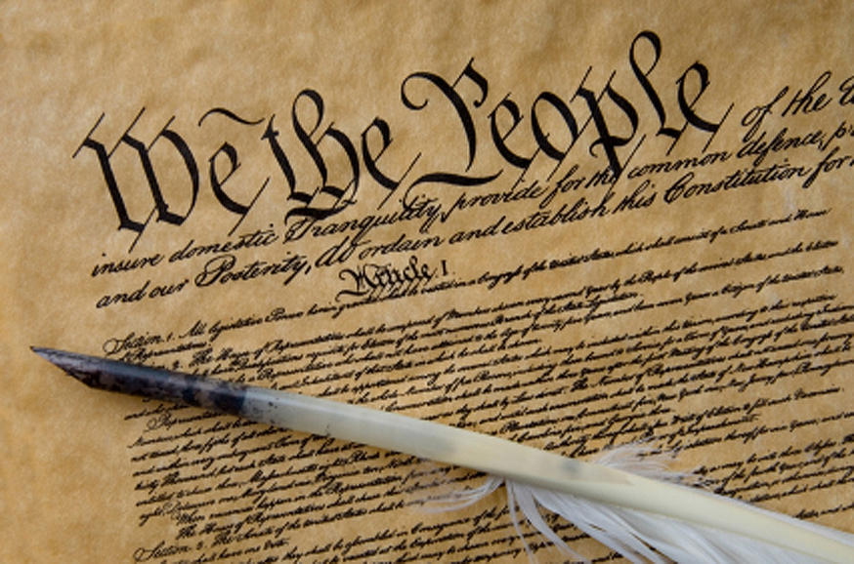
THE CONSTITUTION
Constitution = supreme law of the land
Addressed concerns of states and structured government
Not everyone at the Constitutional Convention was happy with the way the document was written
1791: Bill of Rights added to Constitution
Guaranteed individual rights and freedoms
Constitution has 3 sections:
Preamble: establishes the purpose of document
Articles: defines branches and roles of the government
Amendments: changes made to the document as needed to preserve the union

Slide 11
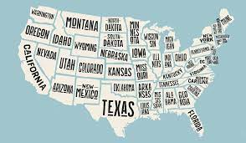
THE PREAMBLE (PURPOSE)
“We the People of the United States, in Order to form a more perfect Union, establish Justice, insure domestic Tranquility, provide for the common defense, promote the general Welfare, and secure the Blessings of Liberty to ourselves, and our Prosperity, do ordain and establish this Constitution for the United States of America.”

Slide 12
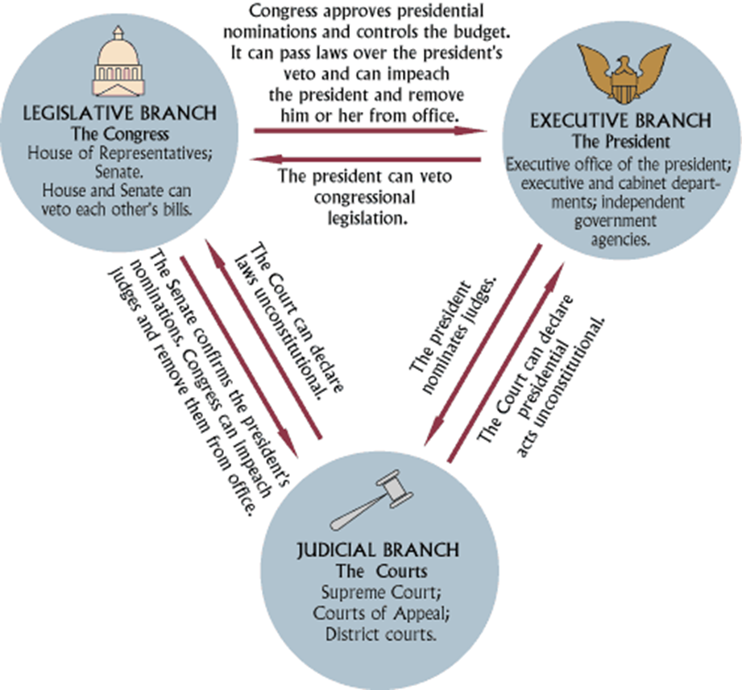
THE ARTICLES
Define the responsibilities and structure of our government by establishing a central government with 3 branches each with their own power:
Legislative: a bicameral (2 houses) Congress who makes the laws
Executive: President who enforces the laws
Judicial: Led by a Supreme Court who interpret the laws
Each of these branches has checks (controls) over the other branches so that no one branch can become too powerful

Slide 13
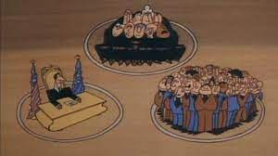
SCHOOLHOUSE ROCK - THREE RING GOVERNMENT

Slide 14
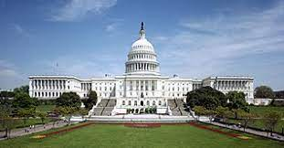
LEGISLATIVE BRANCH
Congress:
Bicameral - two houses
Senate: 2 reps per state
House of Reps: number based on population of each state
Powers:
Makes laws
Can declare war
Sets budget and controls spending
Sets taxes

Slide 15
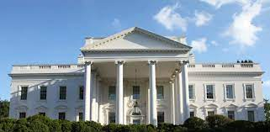
EXECUTIVE BRANCH
Made up of:
President & Vice President
Cabinet: group of advisors
Powers:
Enforces the law
Commander in Chief of Armed Forces
Appoints Federal positions
Can declare war for 90 days only

Slide 16
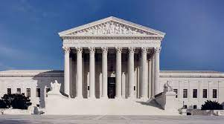
JUDICIAL BRANCH
Made up of:
Supreme Court: 9 Justices (appointed for life)
Federal courts
Powers:
Interprets the law
Judge whether or not a law has been broken
Make sure laws and actions do not violate (go against) the Constitution

Slide 17
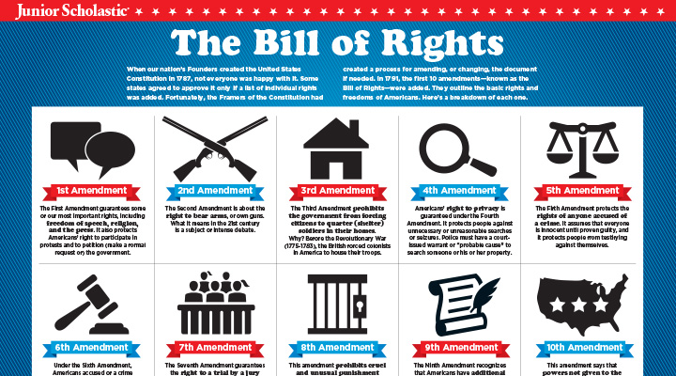
AMENDMENTS
As issues arise within the United States, the government may make changes to the Constitution to address those issues
Amendments are changes to our Constitution
The first ten amendments are called the Bill of Rights and lay the foundation for our unalienable rights (individual rights) - rights that are given by God and cannot be taken away

Slide 18
1ST AMENDMENT
Freedom of:
Religion
Speech
Press
Peaceful assemble
Freedom to address grievances against the government

Slide 19
2ND AMENDMENT
Freedom to bear arms (own and carry weapons)

Slide 20
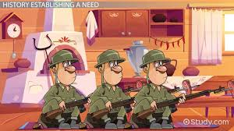
3RD AMENDMENT
No quartering (do not have to house or feed troops)

Slide 21
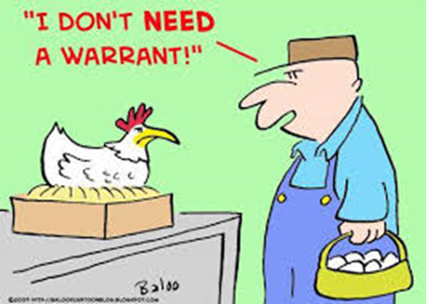
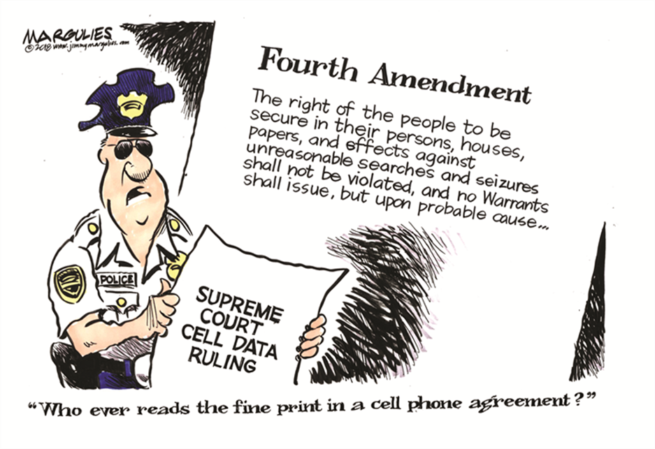
4TH AMENDMENT
No illegal searches & must have a warrant (or probable cause) to search

Slide 22
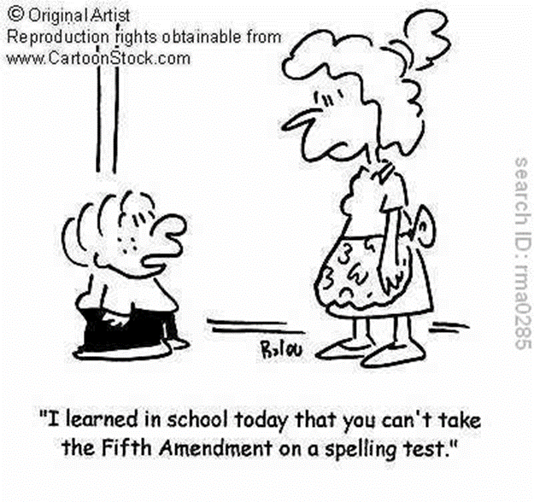
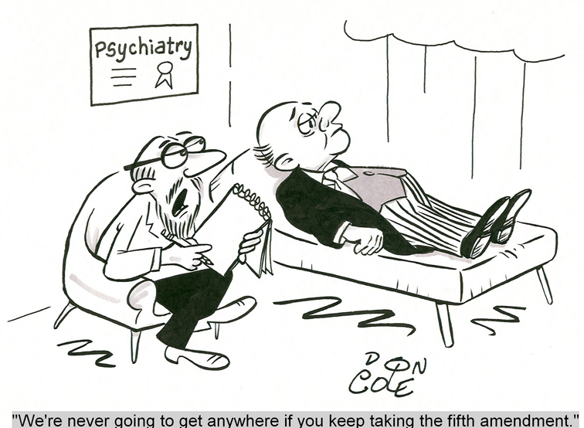
5TH AMENDMENT
“I plead the 5th!”
Miranda Rights
Right to remain silent
Do not have to testify against yourself
Double Jeopardy (OJ Simpson; movie with J.Lo)

Slide 23
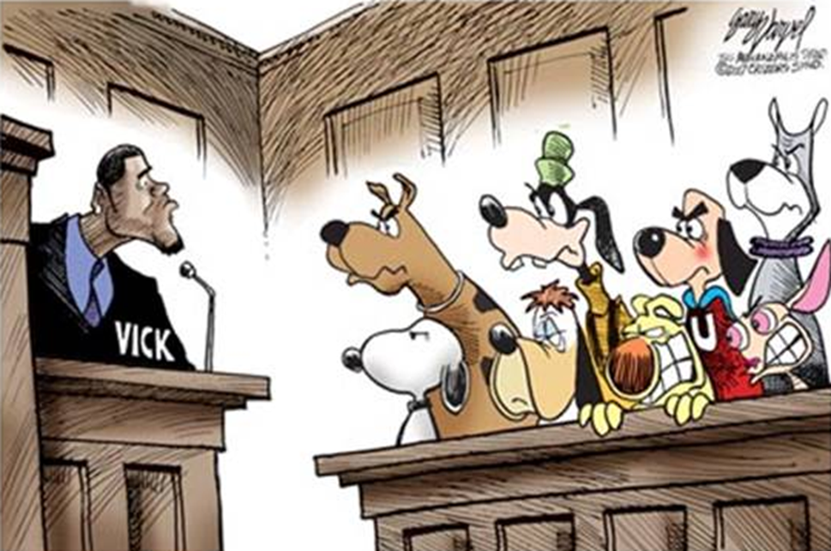
6TH AMENDMENT
Right to a quick, public trial by jury
Right to an attorney
Right to know what you are being accused of

Slide 24
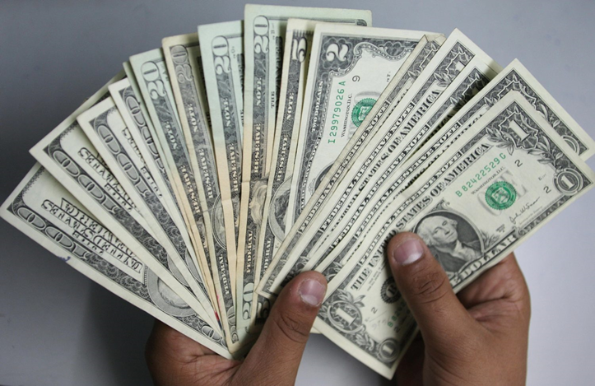
7TH AMENDMENT
Right to a jury in civil lawsuits (jury of peers)
Civil lawsuits usually involve money

Slide 25
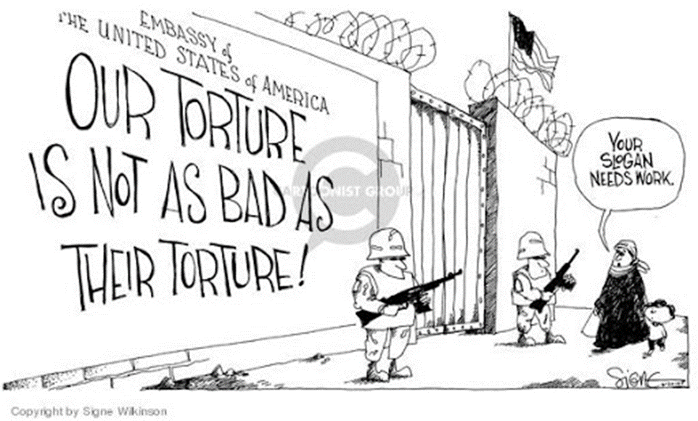
8TH AMENDMENT
No cruel and unusual punishments inflicted

Slide 26
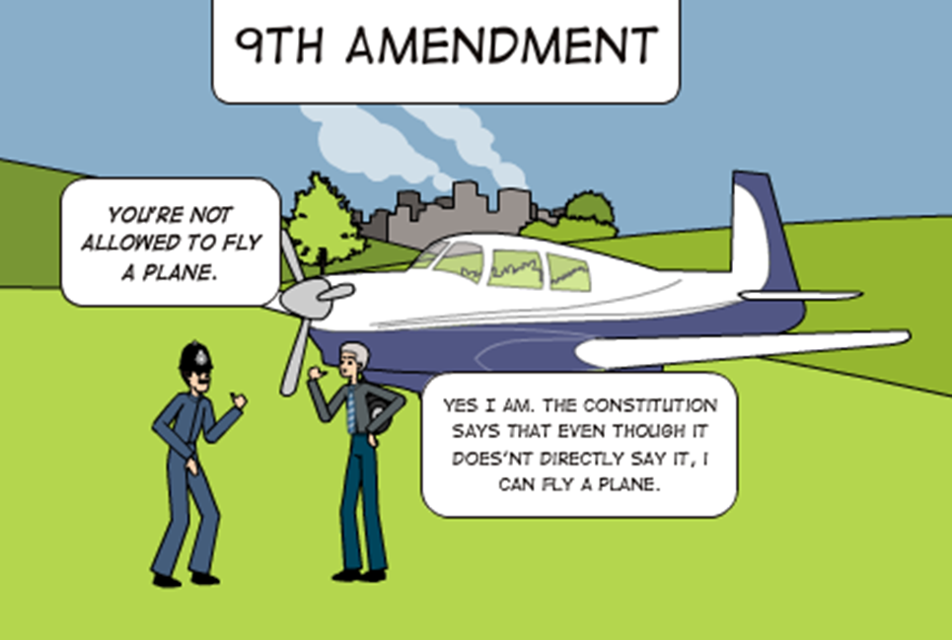
9TH AMENDMENT
Rights in the Constitution cannot be used to take away other rights

Slide 27
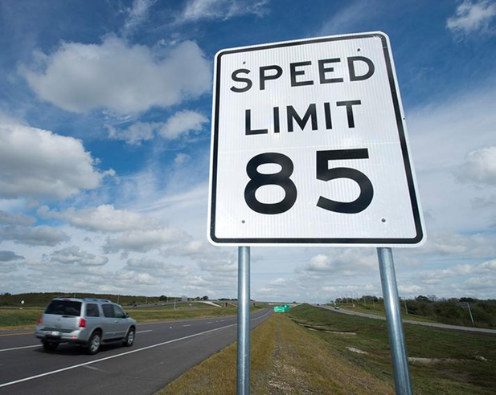
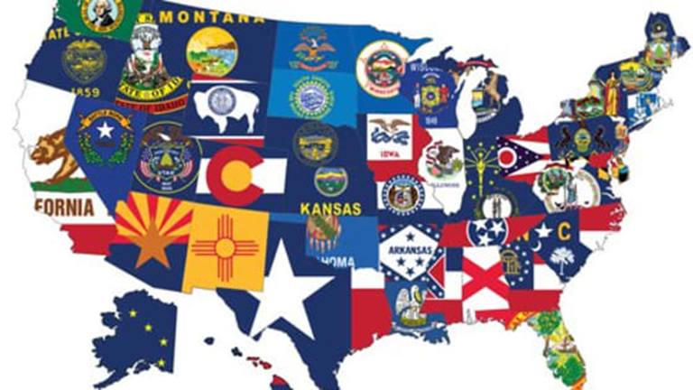
10TH AMENDMENT
Powers not given to the national government in the Constitution belong to the states

Slide 28
WHAT DO YOU THINK?
Which one of the Bill of Rights Amendments do you think is the most important? Why?

Slide 29
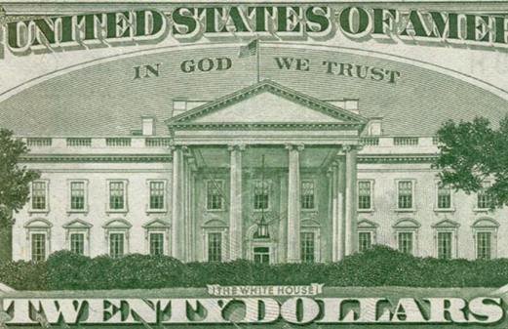
MOTTOS OF THE U.S.
Our country has two mottos:
E Pluribus Unum: means “out of many, one” represents the 13 colonies coming together under one government.
It is used on the Great Seal of the United States, our money, and other seals
It is not our official motto, but is generally accepted as one of the U.S. mottos
In God We Trust:
Became our official motto in 1956, but can be found on money as early as the 1860’s. It is still on our money today.

Slide 30
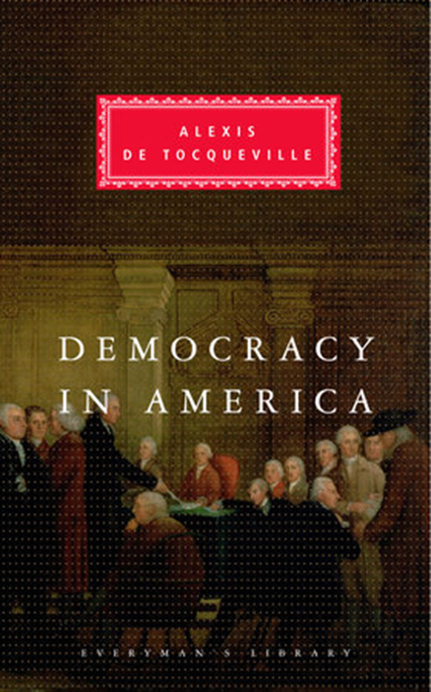
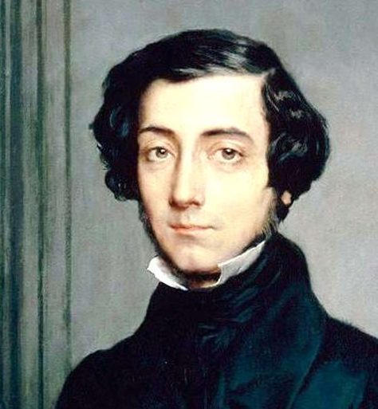
ALEXIS DE TOCQUEVILLE
Part of a team sent to America from France in the 1800’s to study our prison system
Upon his return and after completion of his report to the French government, he wrote a book of his own titled, “Democracy in America,” in 1835
In this book, he describes 5 values he encountered traveling throughout America that he felt were crucial to America’s success as a constitutional republic

Slide 31
5 VALUES OF A CONSTITUTIONAL REPUBLIC
Liberty: freedom from control, interference, obligation, restrictions or hampering conditions
Egalitarianism: society is made up of equals under the law; no social classes with one better than another
Individualism: the ability to be mobile in society; to succeed or fail where hard work and labor are considered the key to becoming successful
Populism: participation by the common; each individual is allowed an opinion and can voice it
Laissez-Faire: theory that government should not interfere with economic issues

Slide 32
YOUR THOUGHTS?
Do you see these values in America today? If so, how do you see them demonstrated? If not, why do you think these values would have diminished?
Explain in 5 complete sentences on your paper.

Slide 33
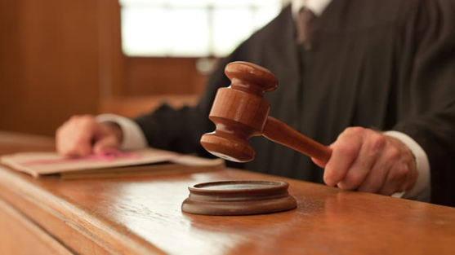
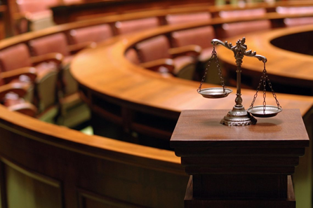
WAYS TO PARTICIPATE IN DEMOCRATIC PROCESS
Lobbying: the act of persuading legislators (lawmakers) to vote for legislation that favors a certain position
Non-Violent Protest: protesting without the use of violence (MLK Jr.’s March to Montgomery, AL)
Court Decisions: courts can declare laws discriminatory or constitutional to promote equal participation (Brown v. Board of Education)
Litigation: laws are a legal method to change discriminatory practices but must be enforced (Voting Rights Act of 1965)
Litigation: process of taking legal action
Amendments: a change to the Constitution to change the opportunities for participation in government (15th & 19th Amendments)

Slide 34
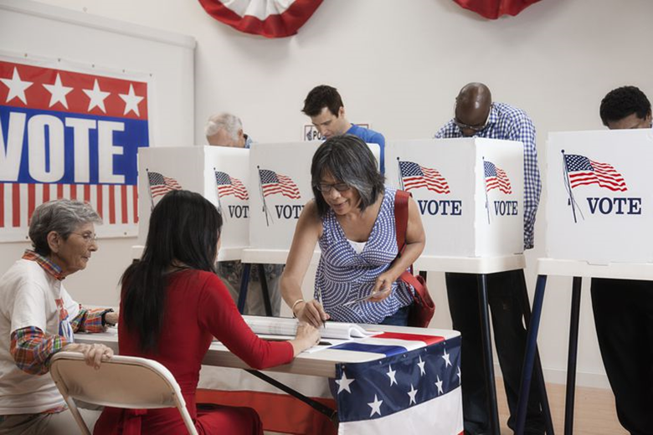
HOW DO CITIZENS PARTICIPATE IN THE GOVERNMENT?
Right to vote
Right to assemble
Can participate in various levels of government
Recall, referendum, and initiative
Write to representatives

Slide 35
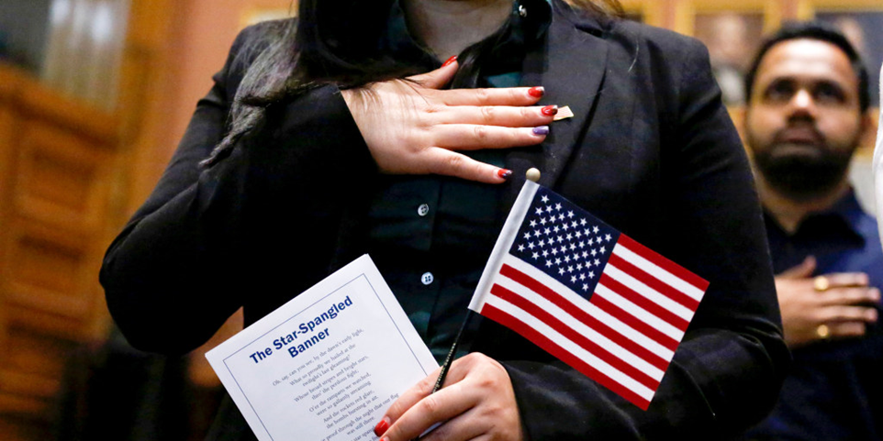
U.S. CITIZENSHIP
There are two ways to be a U.S. citizen:
Be born in the U.S. (or have American parents deployed overseas)
Became a naturalized citizen: someone who is of foreign birth but granted full citizenship through the naturalization process

Slide 36
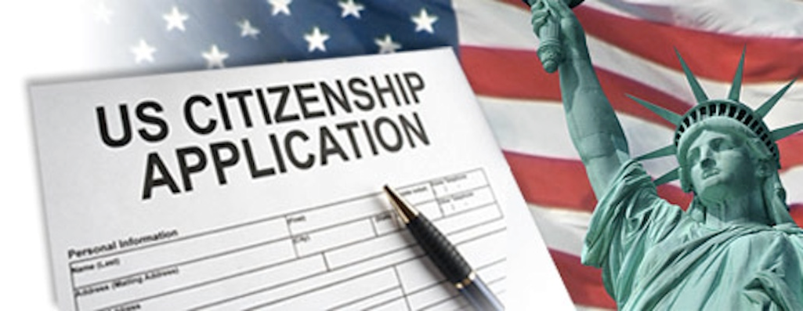
ELIGIBILITY
To be eligible:
At least 18 years old
Permanent residence for at least 5 years
Be able to read, write, and speak basic English
Have a basic understanding of U.S. history and government
Be of good moral character
Demonstrate an attachment to the United States

Slide 37
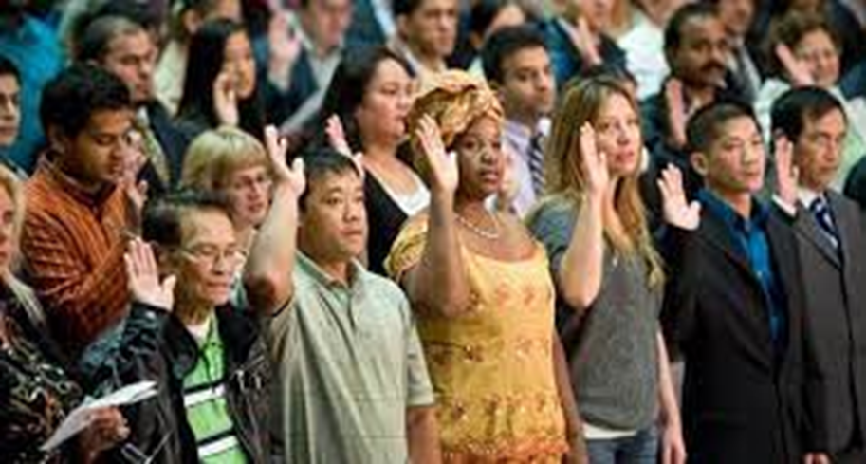
STEPS IN THE NATURALIZATION PROCESS
Apply for naturalization and pay the fee
Complete the fingerprinting
Complete interview at which civic questions will be asked
Receive decision from the U.S. Citizenship and Immigration Services (USCIS)
Take an Oath of Allegiance to the U.S.
Understand the rights and responsibilities of being a citizen

Slide 38
IN CONCLUSION…
Do you think that America still stands for its founding principles today? Why or why not?
Should America be selective as to who it allows to become a citizen? Why or why not?
Explain both your answers in 8 complete sentences.

