Slide 1
Friday, August 25th
AGENDA
Retest/Reteach
Notes over Industrialization
Work on Gilded Age vocabulary if time permits
HEADS UP
**Make ups for test and test corrections need to be completed on Monday, Tuesday or Wednesday!!

Slide 2
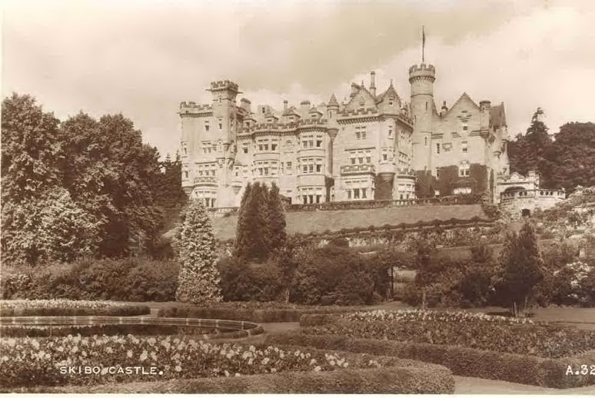
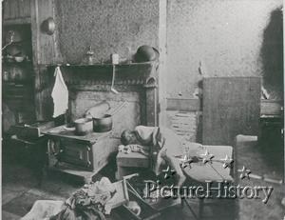
Gilded Age 1865-1901
INDUSTRIALIZATION
Notes:
End of the Civil War 1865 to 1900. Overlaps Reconstruction & West units.
2

Slide 3
Write what is highlighted
Highlight what is highlighted

Slide 4
U.S. INDUSTRIALIZATION
1860 U.S. is a second rate industrial power
1890 U.S. has become a world production power
So, what changed in 30 years?
Manifest Destiny?

Slide 5
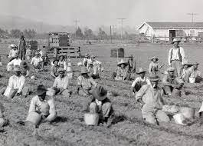
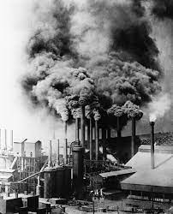
What is Industrialization?
Industrialization - a time period when a country transforms primarily from an agricultural society to manufacturing of goods and services
Using machines and new technology to do jobs previously done by people
New technologies made production:
much faster
and cheaper

Slide 6
Population Growth
U.S. 1800 5.3 Million
Population in 1900 76 Million
Today 350 million
U.S. population was becoming more urban(city), due to Industrialization and Immigration.
People were taking jobs in factories in the cities
Less manpower needed on farms.

Slide 7
Inventions and Technology
Technology had the greatest impact on growth in the Gilded Age (late 1800’s)
Steam and electricity replaced human and animal strength
Iron replaced wood; steel replaced iron
Areas of greatest need:
Transportation
Communication

Slide 8
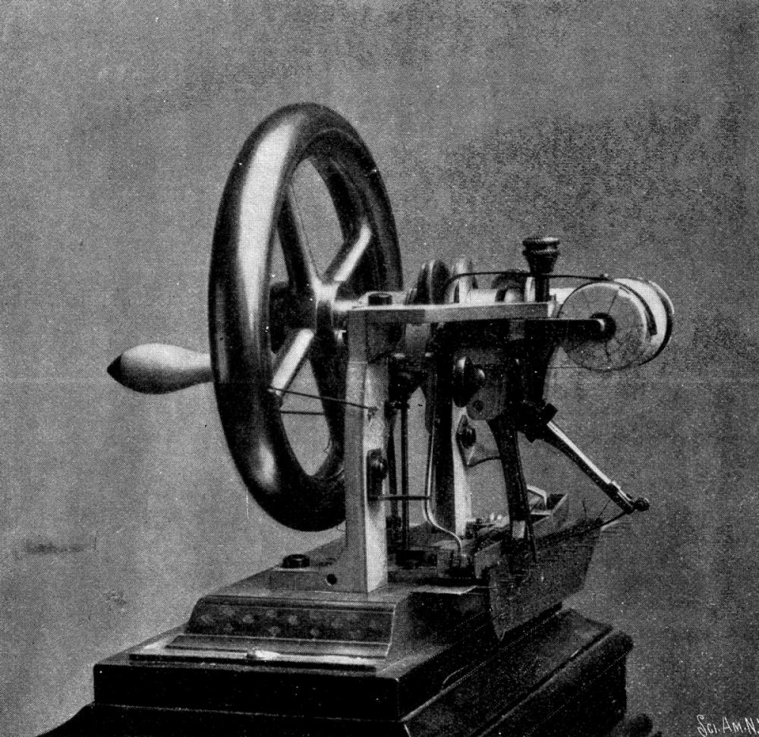
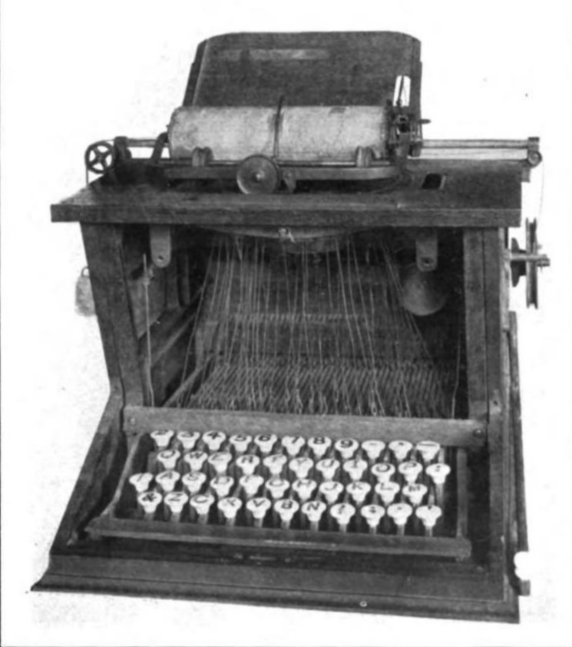
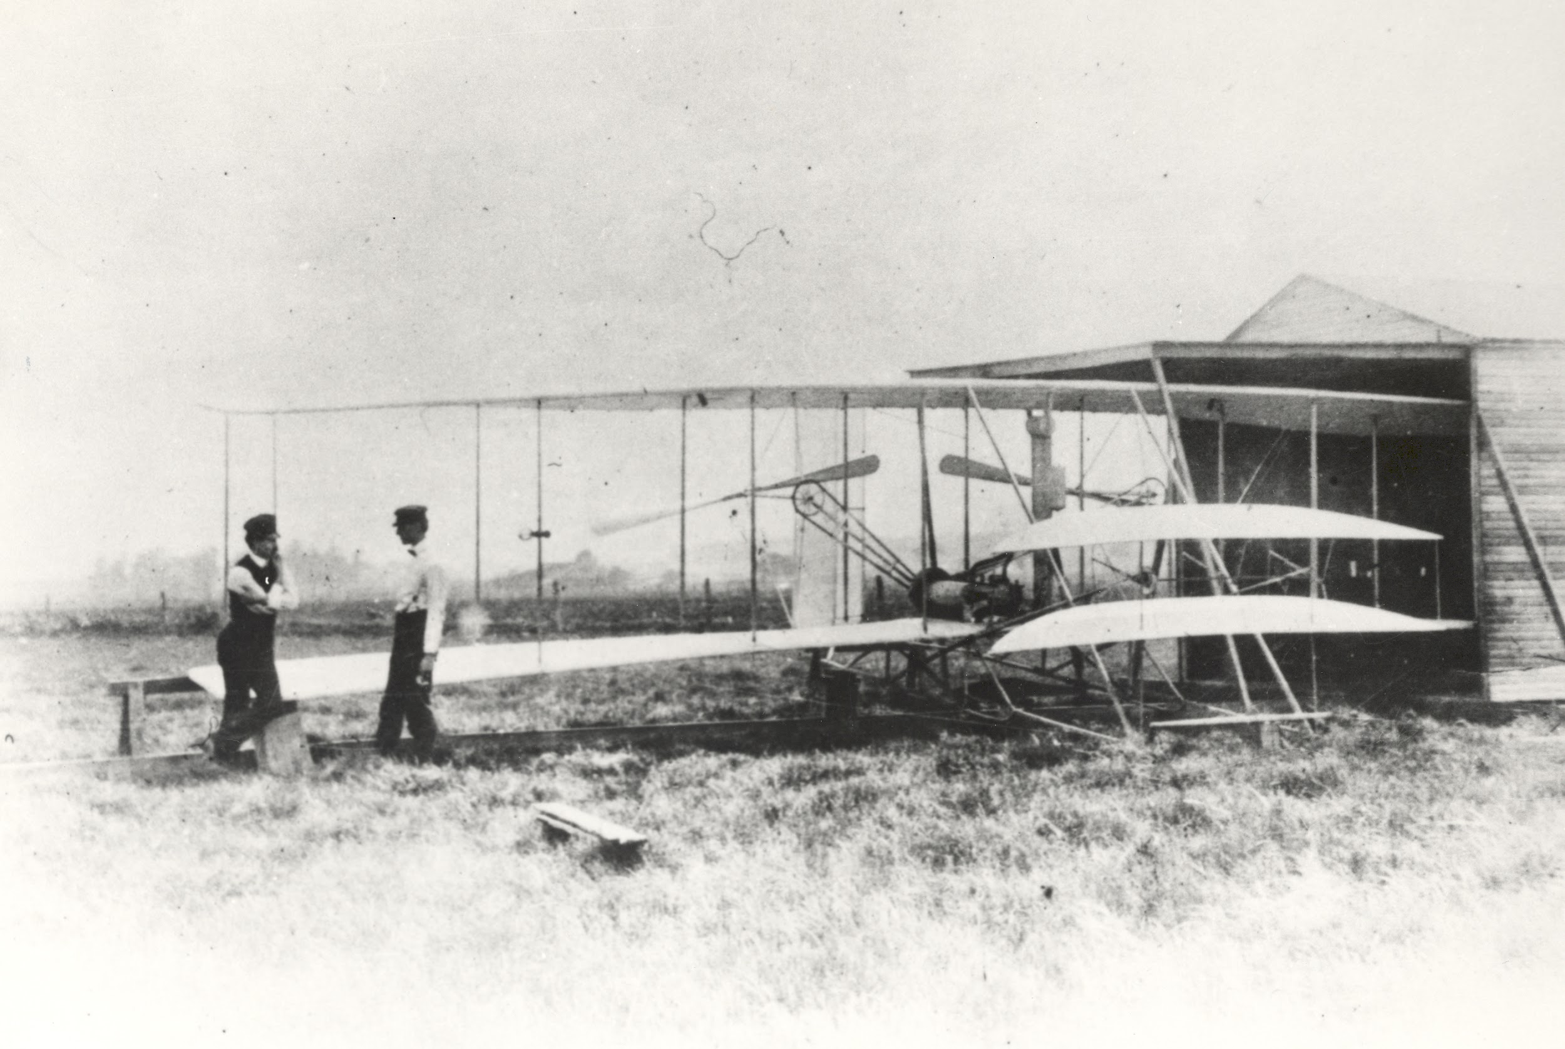
Technological Innovations
Technological innovations will inspire economic growth

Slide 9
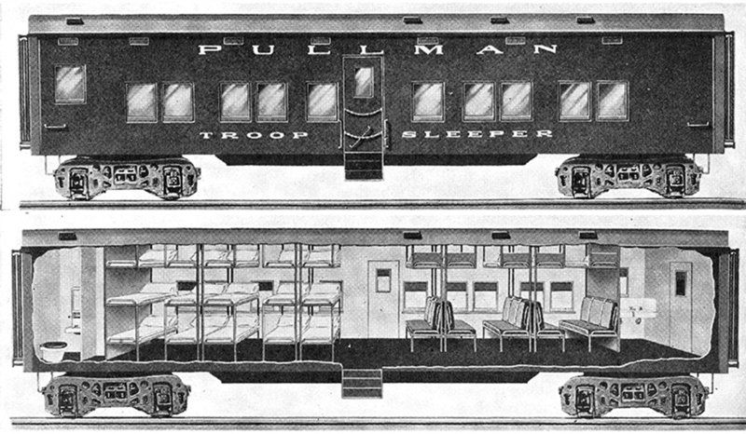
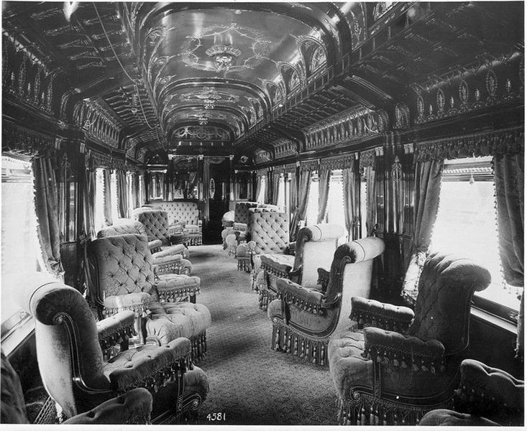
RAILROADS
Convenience:
Pullman car - 1st class sleeping and eating car
Most luxurious and fastest way to get across country

Slide 10
Notes:
Pullman car- 1st class sleeping and eating car. Most luxurious and fastest way to cross the country

Slide 11
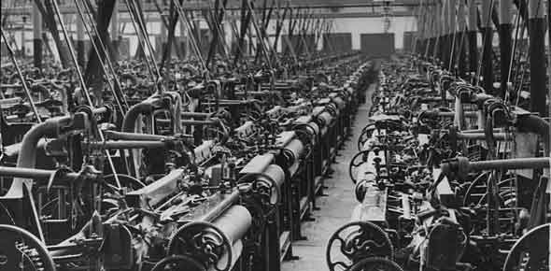
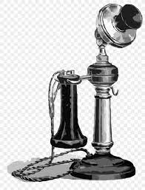
*Electricity
Transformed cities and factories with lighting.
With electricity factories could extend(increase) work hours and the number of shifts-Overnight if needed.
Began to be used for telephones and telegraphs
This allowed people to communicate over great distances

Slide 12
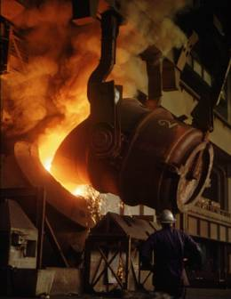
*Bessemer Process
Henry Bessemer
*cheap and efficient process for making steel *1856*
Benefit or Use
Steel is lighter, harder and more durable than iron.

Slide 14
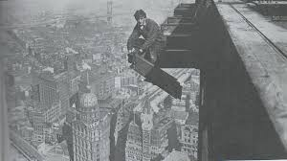
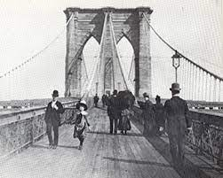
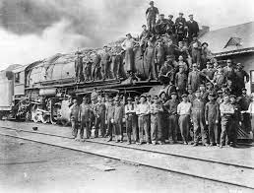
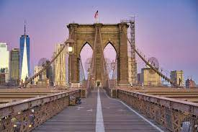
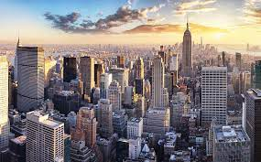
*Improved…
*Skyscrapers (built much taller)
*Suspension Bridges (Brooklyn Bridge )
Stronger engines for trains
Rails improved
Farm equipment

Slide 15
Mastery Check
What effect did the Bessemer process have on the growth of cities?
It end the political corruption in cities by destroying the political machine.
It developed a system to fairly distribute electricity throughout the city.
It forced cities to expand to large areas due to a lack of space.
It allowed cities to build skyscrapers and span bodies of water with suspension bridges

Slide 16
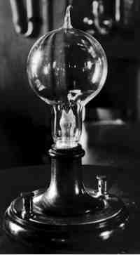
*Light bulb
1879-Thomas Edison-invented light bulb
(tried 9,000 times!!!!)
*Benefit or Use
Use in:
factories
homes,
cheap to make.
Notes:
Though Thomas Edison is credited as the man who invented the lightbulb, this revolutionary technology was in fact developed by several inventors.

Slide 17
Answer the following..
Factory Shifts Prior to Electricity | Factory Hours After Electricity
7 am - 7 pm 7:30 am - 7:30 pm 8 am - 8 pm | 4am - 6pm 6pm - 2am 8am - 11 pm
What is the effect of electrical lights on factories, according to the chart above?
The effect of electric lights on factories is...

Slide 18
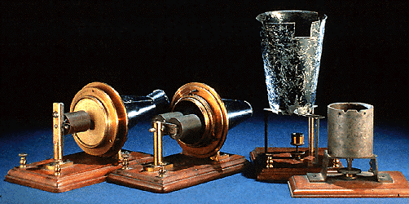
*Telephone
Invented in 1876 by Alexander Graham Bell
By 1900, 1.5 million telephones in use
*Benefit or Use: Increased speed and efficiency of communication

Slide 19
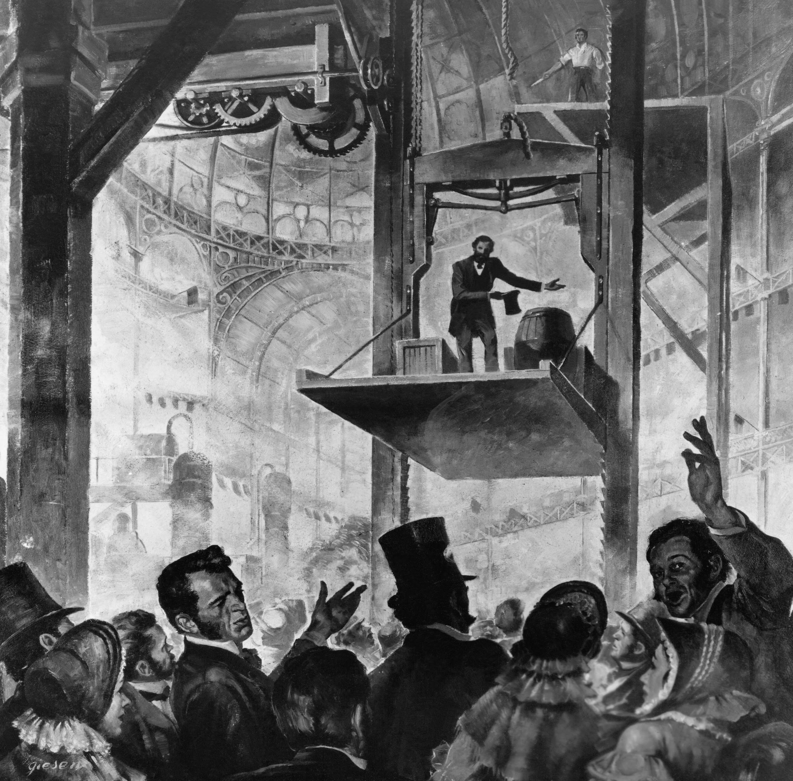
*Other new technologies
Christopher Sholes: Typewriter
Elisha Otis: Elevator
Elias Howe: Sewing Machine

Slide 20
Corporation
During industrialization a new type of business emerged
CORPORATION: sells shares (or stocks) to investors
This makes each investor a shareholder, or partial owner, in the company

Slide 21
Shareholders: get a portion of the profits that the company earns

Slide 22
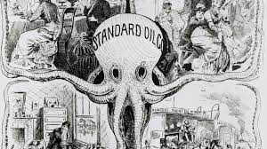
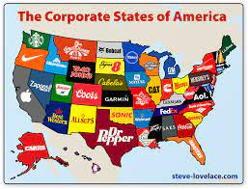
Corporations made it possible for people to raise large amounts of money to form businesses
Led to the creation of large numbers of industrial companies resulting in the American Industrial Revolution.

Slide 23
Entrepreneur
Entrepreneur: a person or group who starts their own business
During the Industrial Revolution, entrepreneurs used industrial power to lower the price of goods and improve their quality to make huge profits

Slide 24
The industrial revolution and the lavish lifestyles will usher the United States into the Gilded Age

Slide 25
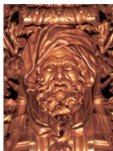
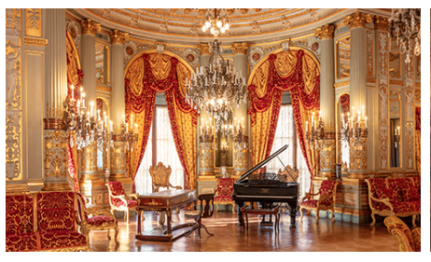
Gilded Age
Gilded = to cover with a thin thin layer of gold.
Covered in gold, but not solid gold.
Things seemed good, but weren’t always. (fake)

Slide 26
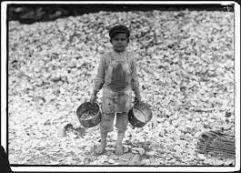
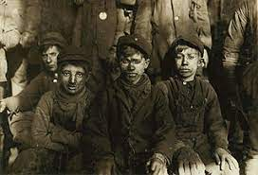
Characteristics:
Extreme differences between upper & lower class
Industrial progress – Booming Economy
Political Corruption
Child Labor

