Slide 1
Dr. Seuss’s Butter Battle Book vs. The Cold War
Unit 9: The Cold War

Slide 2
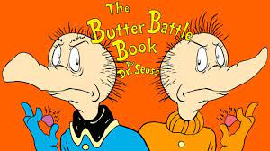

Slide 3
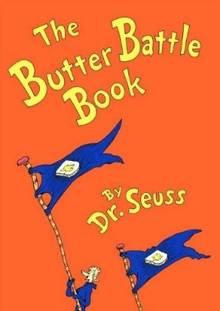
Dr. Seuss wrote the Butter Battle Book in 1984 about the Cold War, specifically about mutually assured destruction and the nuclear arms race
The story tells of two separate groups of people, the Yooks and the Zooks and their disagreement over which side of the bread should be buttered
The conflict between the two leads to an escalating weapons race where each culture tries to outdo the other

Slide 4
Instructions:
Watch the cartoon short
*Be prepared to answer the following questions
How does The Butter Battle Book parallel with the Cold War?
What do the characters and objects in the story symbolize?

Slide 5
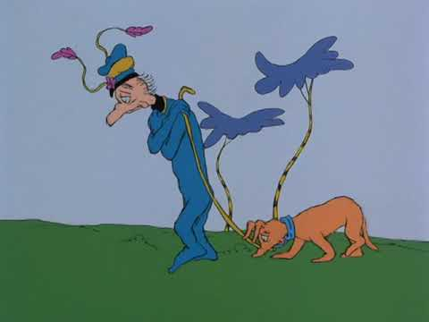

Slide 6
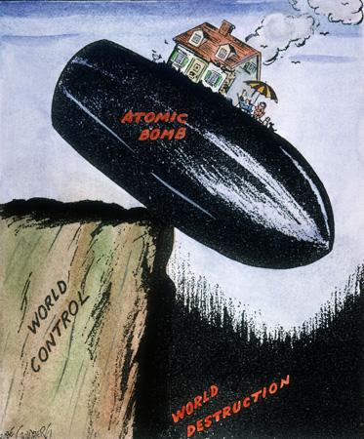
Write the words that stand out to you on your paper.

Slide 7
The Cold War was “cold” primarily because of the threat of nuclear weapons
The Soviet Union launched its first nuclear weapon in 1949, an event that started an “arms race” between the United States and the Soviet Union
At the height of the Cold War, the combined weapons of both countries were enough to destroy the world six times over
The two “superpowers” used their weapons as a deterrent (discourage) against nuclear war

Slide 8
Now you are going to answer the question from the Instructions slide
How does The Butter Battle Book parallel with the Cold War?

Slide 9
Agree or Disagree
The story shows that each believe that the other should surrender, but would not allow themselves to give in.
Stand if you agree with this statement
Or
Raise your hand if you disagree with this statement

Slide 10
Exit Ticket
You will see that there are additional questions on your paper.
Answer those questions to complete the assignment for today.
Lastly, your exit ticket (also on your paper) is this: How does this cartoon compare to the ideas of Dr. Seuss in the Butter Battle Book?
Complete the activity for today and turn in before you leave class.

