Slide 1
Early Civil Rights
Unit 10: Civil Rights #1

Slide 2
The Reconstruction Amendments (After the Civil War)
13th Amendment:
Abolished slavery = FREE
14th Amendment:
African Americans are now citizens of the U.S. = CITIZENS
15th Amendment:
No person can, regardless of color, race, & ethnicity can be denied the right to = VOTE

Slide 3
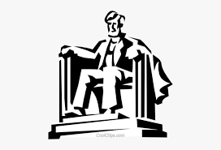
When people are oppressed, they will demand change

Slide 4
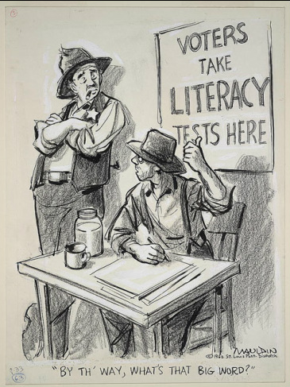
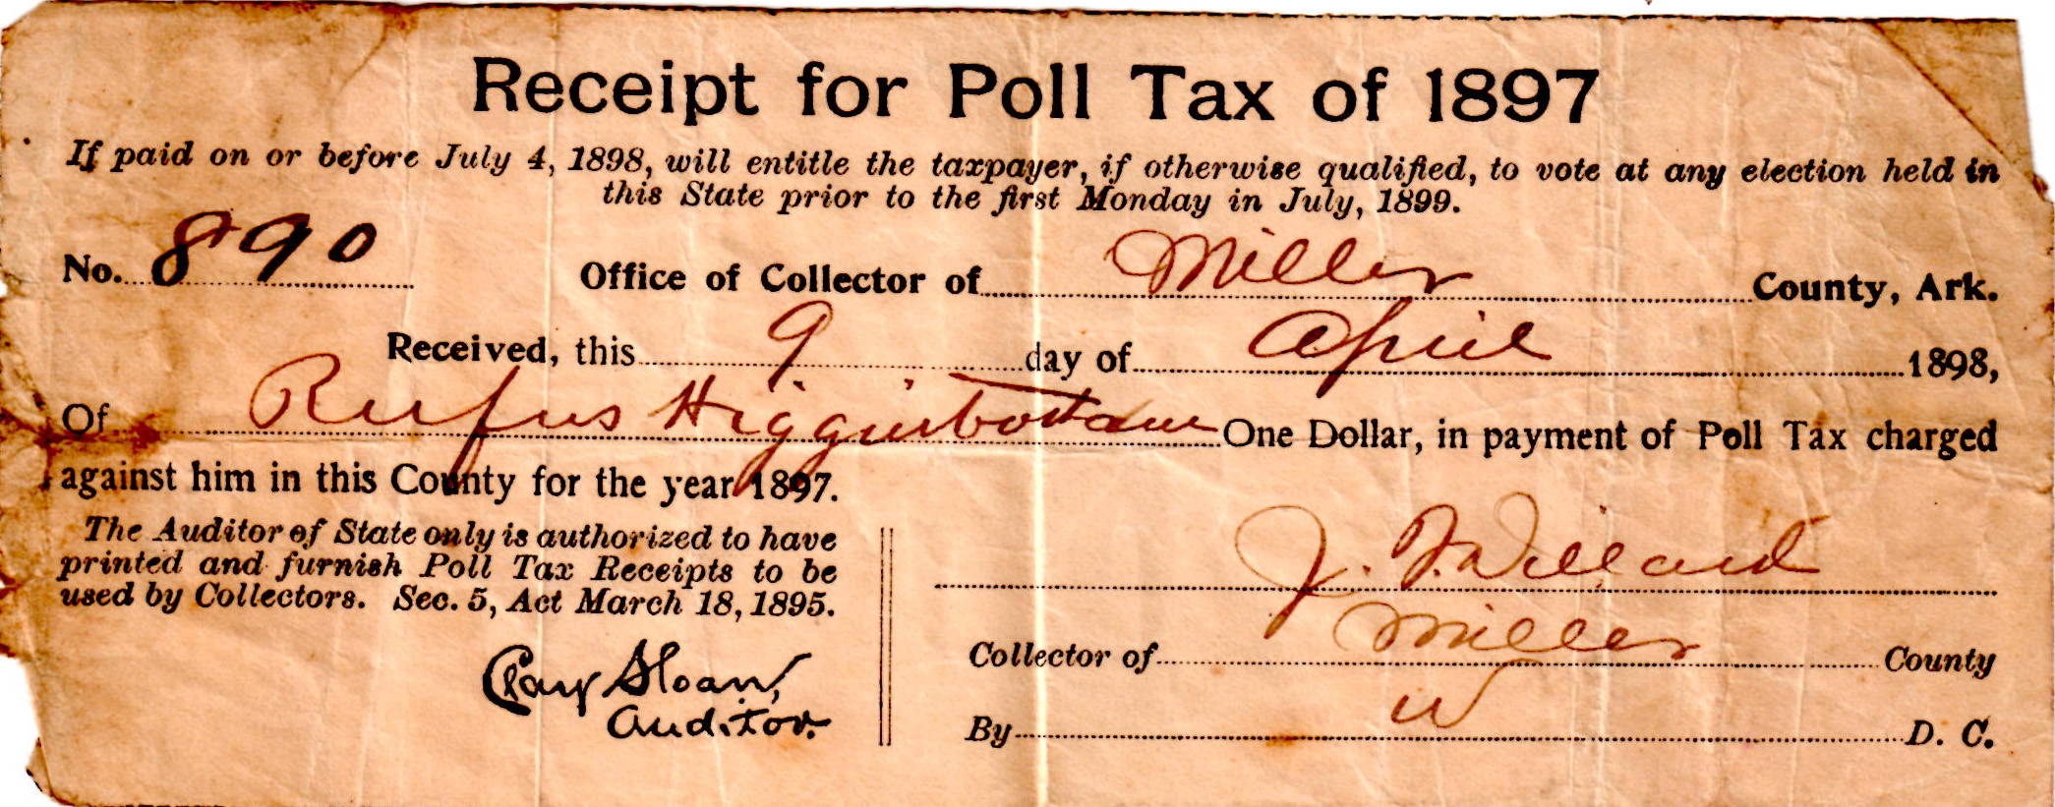
Preventing African Americans from Voting
Poll Taxes
Required to pay in order to vote
Literacy Tests
Have to be able to read to vote

Slide 5
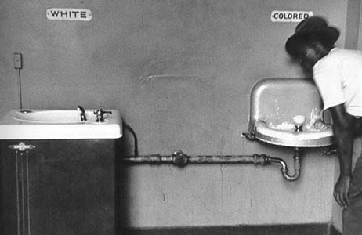
Plessy V. Ferguson (1896)
The Supreme Court case of Plessy v. Ferguson was instrumental in supporting discrimination in the South
The case established the rule of “Separate but Equal”
Meant that it was OK to separate the races as long as they both had equal facilities (never actually equal)

Slide 6
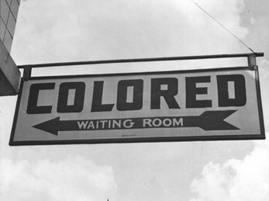
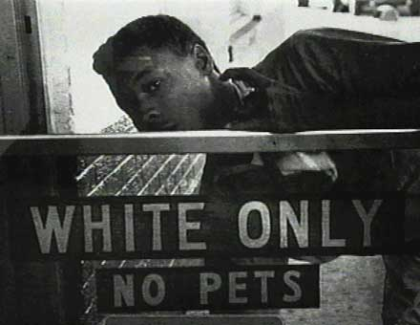
Jim Crow Laws
The segregation laws in the South came to be called “Jim Crow” Laws
These laws separated public places in the South into “white” and “colored”

Slide 8
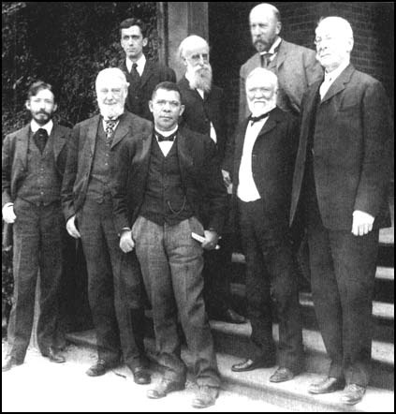
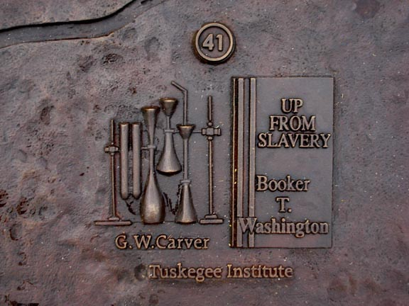
Booker T. Washington
Booker T. Washington was an early African-American civil rights leader
In 1882, he became the first president of the Tuskegee Institute (an all-black vocational college)
Washington believed that African Americans should focus on getting an “industrial” education that would help them to get good jobs and that THEN they could work for civil rights

Slide 9
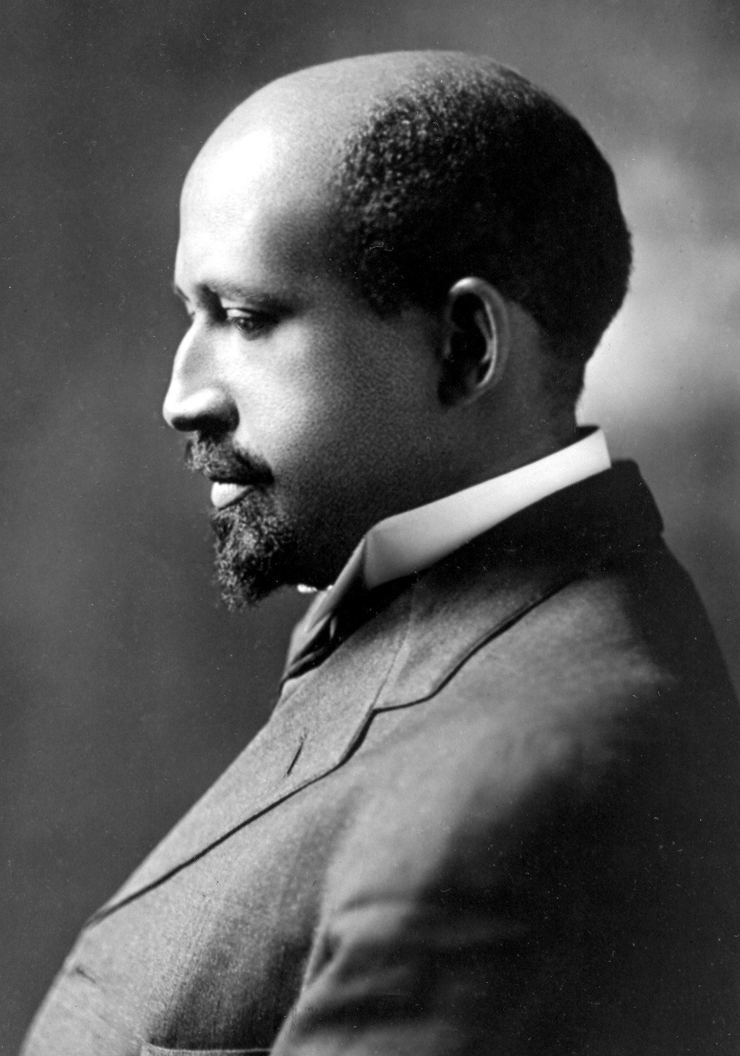
W.E.B. Du Bois
W.E.B. Du Bois was an African-American civil rights leader at the same time as Booker T. Washington
He was the first African-American to graduate from Harvard Law School and help start the NAACP
Du Bois famously and publicly disagreed with Washington
Said that African-Americans should get an academic education and immediately insist on full civil rights and political freedoms

Slide 10
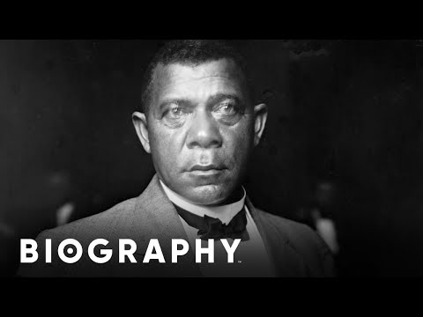

Slide 11
Setting the Stage
In WWII, African-Americans played an important part in the war effort, both by serving in the military and by working in industry
When the war was over, many African-Americans were no longer content with the status-quo of racism in America

Slide 12
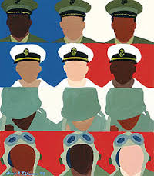
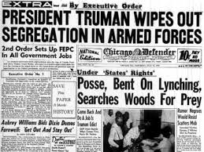
Executive Order 9981:
Ends discrimination in the armed forces, eventually ended segregation in the services

Slide 13
Civil Rights in the 1950s & 1960s

Slide 14
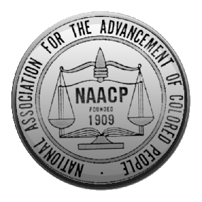
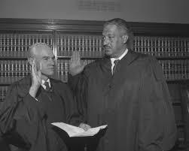
The Legal Strategy of the NAACP
The National Association for the Advancement of Colored People (NAACP) was a civil rights organization started by W.E.B. Du Bois and others in 1909
In the 1950s & 1960s, they focused on winning court cases
One of their main lawyers for this strategy was Thurgood Marshall
He later became the first black Supreme Court Justice

Slide 15
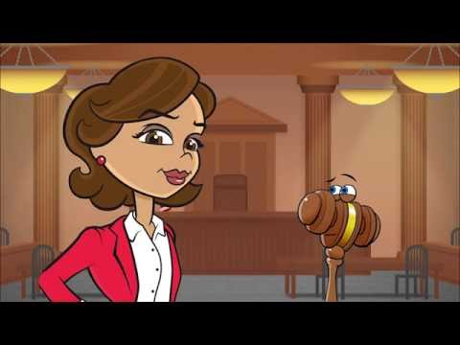

Slide 16
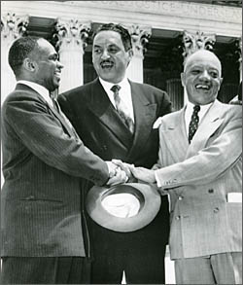
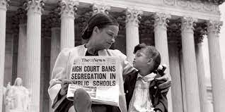
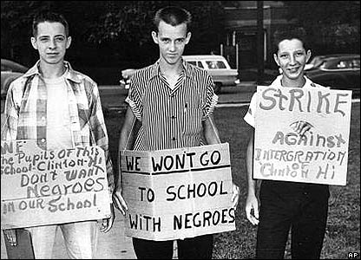
Brown v. Board of Education
In Brown v. Board of Education of Topeka, Kansas, the U.S. Supreme Court ruled that segregation in schools was illegal
Thurgood Marshall successfully argued that separate but equal was actually NOT equal

Slide 17
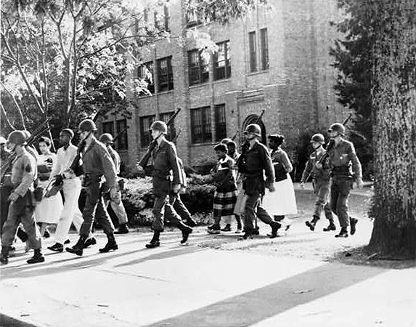
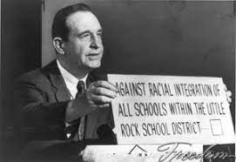
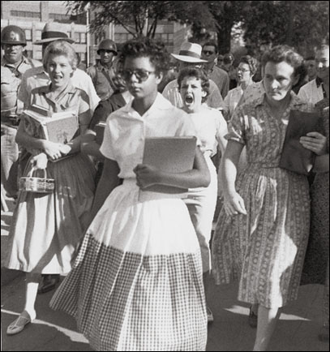
The Little Rock Nine
In 1957, the governor of Arkansas, Orville Faubus, refused to honor the Brown v. Board of Education decision
He used the Arkansas National Guard to stop 9 black high school students from attending an all-white school
President Eisenhower then sent the national guard to take them out of the governor’s control
He also sent in the 101st Airborne, the “Band of Brothers,” to protect the students and forcibly integrate the school

Slide 18
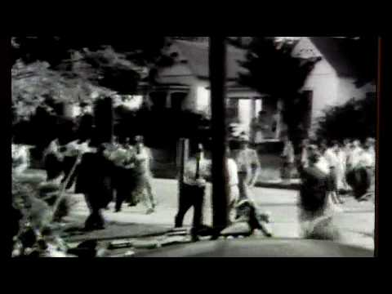

Slide 19
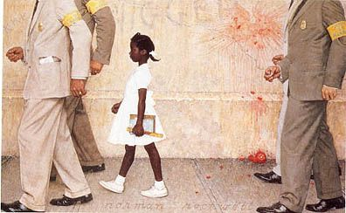
Ruby Bridges
In 1960, at the age of 6, Ruby Bridges became the first black elementary school child to attend a white school
Due to white opposition of integration, Ruby needed to be escorted to school by federal marshals
After Ruby entered the school, many of the teachers refused to teach and many of the white students went home
Ruby went to school everyday
The Problem We All Live With, by Norman Rockwell

Slide 20
