Slide 1
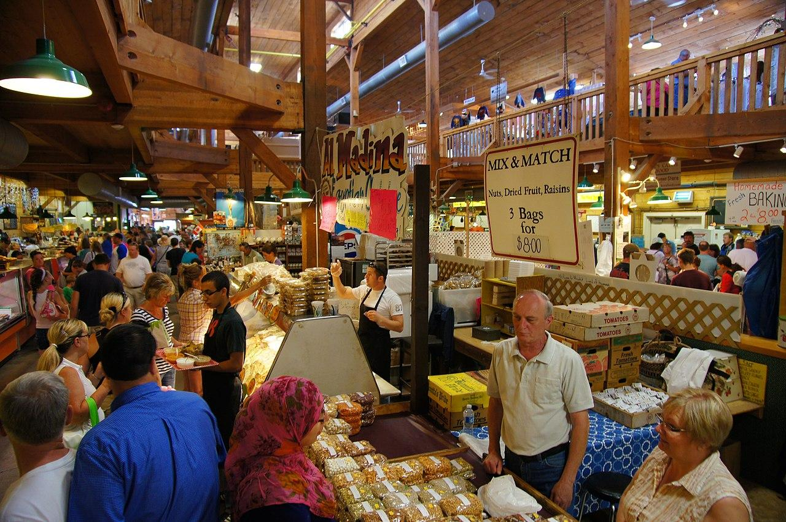
We have four Market Structures. What do you think we mean by Market Structure?
Market Structures

Slide 2
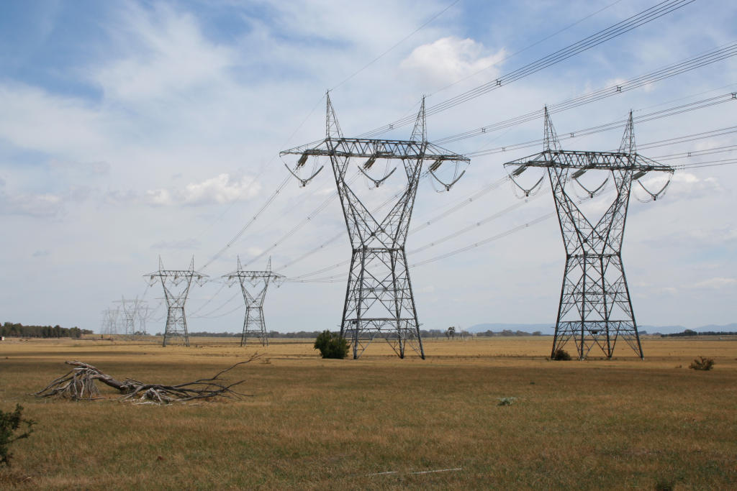
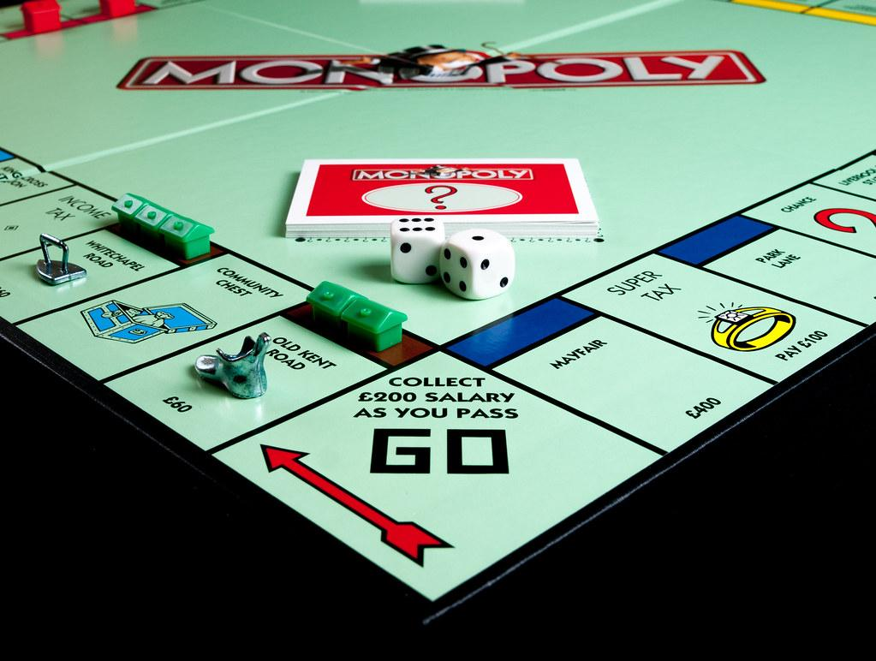
A Monopoly is a type of business. If mono = single and poly = seller, what can you conclude about this type of firm?
A Monopoly is _____________________________________.
What is a Monopoly?

Slide 3
Why could Oligopolies be dangerous for consumers?
Oligopoly

Slide 4
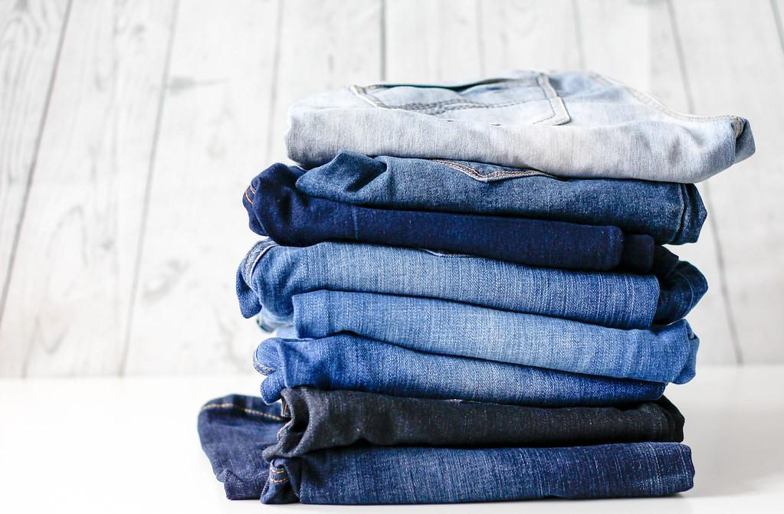
How is Monopolistic Competition different from Pure Competition?
Monopolistic Competition

Slide 5
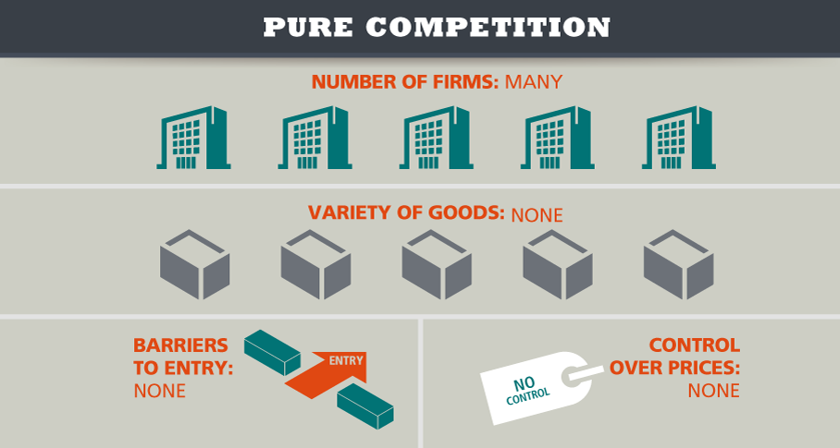
Give an example of Pure (Perfect) Competition and explain why it’s considered pure competition.
Perfect Competition

Slide 6
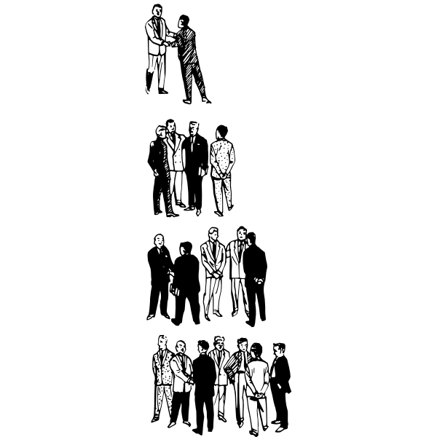
When starting a business, you must first choose a business structure. What do you think this means?
Business Organizations 1
Business Organizations 2

Slide 7
Why do you think there so many Sole Proprietorships?
What Is A Sole Proprietorship?

Slide 8
When might you want to enter into a Partnership?
What Is A Partnership?

Slide 9
What are some advantages or disadvantages of making your business a Corporation?
Corporation Part 1
Corporation Part 2

Slide 10
How could selling Stocks improve your ability to start your own business?
What are Stocks?

Slide 11
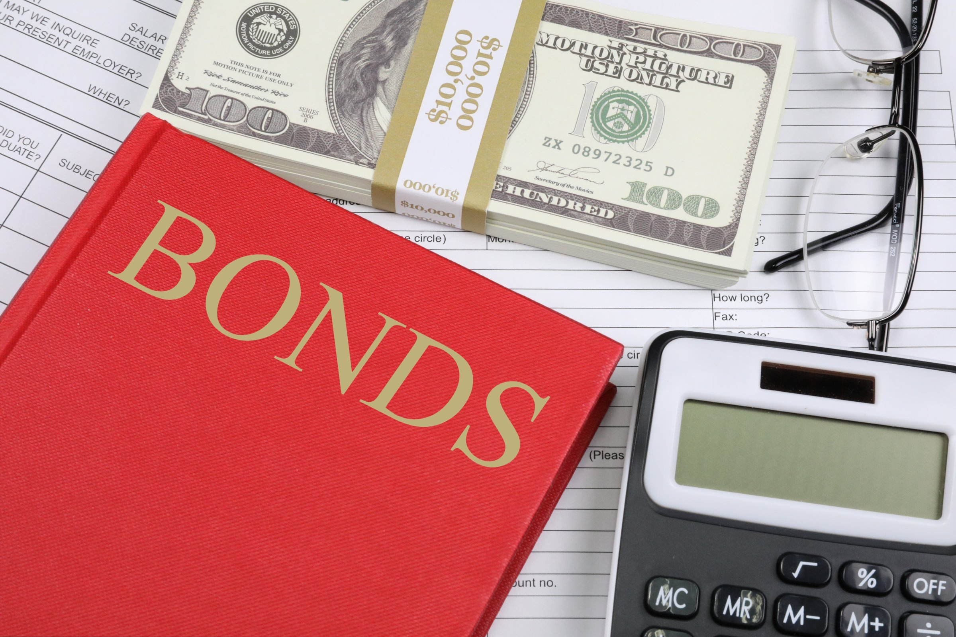
What is one way Bonds are similar to stocks? How are they different?
What is a Bond?

