Slide 1
What are the four Factors of Production
Warm-up 1/10

Slide 2
1. Warm-up 2. Notes FOP 3. Notes – PPC 4. PPC Practice 5. Friday assignments
Agenda
Notes – You may use on tests and /or Quizzes

Slide 3
Factors of Production
Foundations of Economics

Slide 4
Essential Question
What are the factors of production and how do they help us satisfy our wants?

Slide 5
Warm Up Activity
Assume you are a businessperson who makes and sells pencils.
You need to calculate how much it costs you to make one pencil (cost of input/production).
Make a list of every single material or resource you would need to make ONE pencil.

Slide 6
Warm Up Activity
Now, share your list with a neighbor. Did you get all of the same resources?
Did your list include:
Raw materials (like wood, brass, and graphite)
Labor (factory workers, lumberjack)
Factory equipment
Warehouse
Shipping & Transportation
Marketing Team
Bookkeeper (makes sure you’re on track with finances)

Slide 7
Warm Up
Use the space in your notes to respond to the prompts below. Please write in complete sentences.
What is a good? What is a service?
What types of materials or resources go into making a good or service?
How do goods and services affect our economy?

Slide 8
Goods & Services
What are goods and services?
Goods: physical items created for selling
Example: shampoo, conditioner
Services: actions or activities done for buyers
Example: nursing, teaching

Slide 9
Think About It
What goods and services do you (or your parents/guardians) currently pay for?
Why are you willing to exchange your money for these goods and services?

Slide 10
Factors of Production
What’s the difference between outputs and inputs?
Inputs: scarce resources that go into making a product
Outputs: the goods or services that are created using inputs
What are the factors of production?
Inputs used in making a product
The main categories are: land, labor, and capital
Land + Labor + Capital = Goods & Services

Slide 11
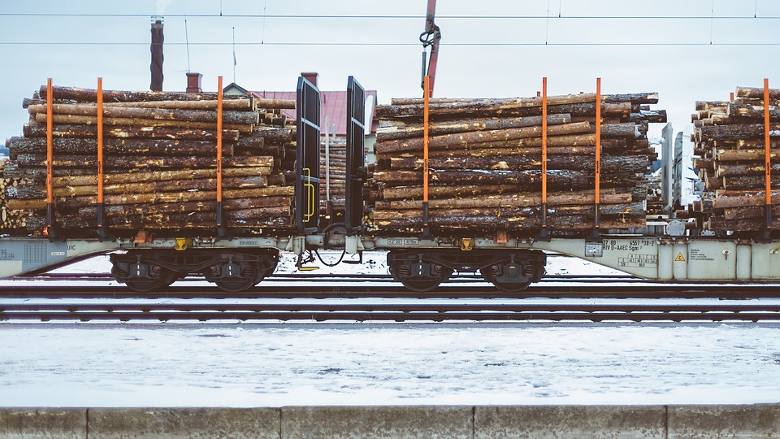
Land
What is land?
Land: ALL natural resources
Examples: soil, air, wood, animals, plants
What are the types of natural resources?
Perpetual resources: resources we’re unlikely to use up like sunlight
Renewable resources: resources that, as they are used, can also be replaced like forests and fish
Nonrenewable resources: resources that are used and then gone completely like oil and coal

Slide 12
Think Pair Share
List 5 new examples of land.
Why is land important to the production of goods and services?

Slide 13
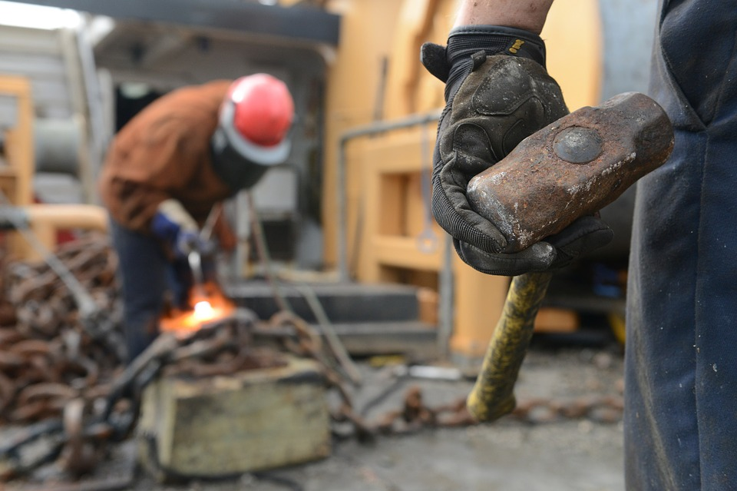
Labor
What is labor?
Labor: the effort and time put into production for which someone is paid
Examples: teaching you this lesson, a plumber paid for plumbing, lawyers paid for preparing legal documents

Slide 14
Think About It
What labor do you plan to be paid for in your first career?

Slide 15
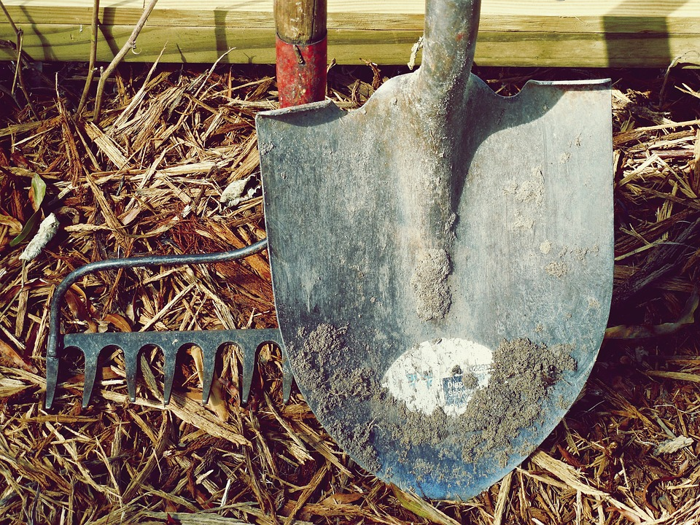
Capital
What are the two types of capital in economics?
Human capital: the expertise, experience, skill, education, and knowledge of laborers
Usually, the higher the level of human capital, the more a laborer is paid
Example: The training and education a teacher needs to teach students
Physical capital (or capital goods): physical, man-made tools, machines, and resources involved in the production process
Example: An assembly line and a factory would both be physical capital

Slide 16
Think Pair Share
What’s the difference between labor and human capital?
What kind of human capital do you currently have or plan to have when you enter your first career?

Slide 17
Entrepreneur
What is an entrepreneur?
Entrepreneur: the risk taker who combines the factors of production to create goods and services
They are the backbone of the economy

Slide 18
Think About It
Name a few famous entrepreneurs. What goods or services did they create?

Slide 19
Productivity
How do economists measure productivity?
Productivity =
Output
Input

