Slide 1
FDR: Alphabet Agencies & Court Packing
Unit 7: #3

Slide 2
VOCAB REVIEW: Can you match the term with the definition?
Radio speeches about current issues and proposed New Deal policies
Programs to help the poor
FDR’s plan to fix the Great Depression
Fixing the economy with programs to help business recover
Financial fixes to help with the lack of banking rules.
Word Bank
Relief
Recovery
Fireside Chats
New Deal
Reform
Notes:
Formative Assessment - Fill in the Blank
Students will be able to write in the blank spaces to fill in the correct term. You can edit the word bank and sentences to fit your lesson.
🍐 This is a Pear Deck Drawing Slide
🍐 To edit the type of question, go back to the "Ask Students a Question" in the Pear Deck sidebar.

Slide 3
The Second Hundred Days

Slide 4
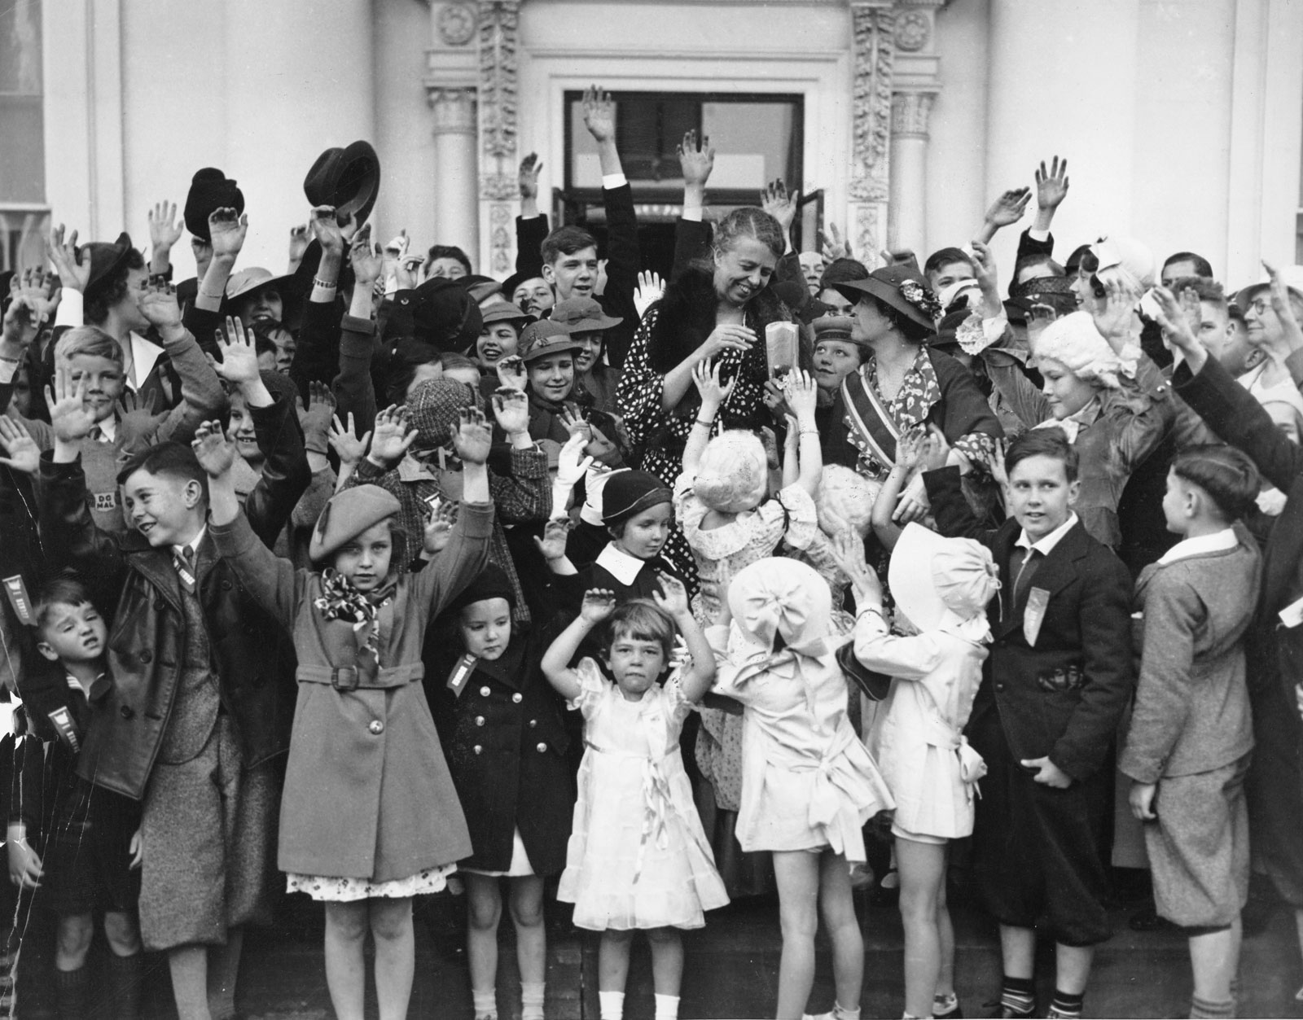
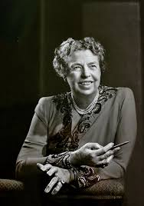
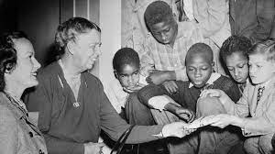
Eleanor Roosevelt: FDR’s wife
Considered by most historians to be the most-loved first lady in presidential history.
She had a deep concern for the poor.
Was outspoken in her support for African- Americans
(promoted freedom and equality).
In 1934, she convinced FDR to get Congress to provide more extensive relief for farmers and workers.
Notes:
**Always STAAR tested**

Slide 5
FDR & Minorities

Slide 6
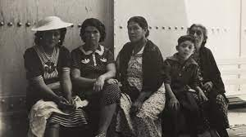
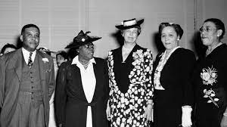
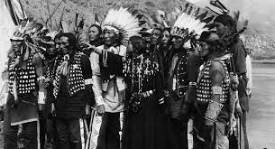
Women: Appointed women to government positions More options in the workplace | Mexican Americans: Large numbers deported to free up jobs for Americans
African Americans: Played key roles in government FDR did not support Civil Rights | Native Americans: Citizenship Return of some Native American lands

Slide 7
Alphabet Agencies

Slide 8
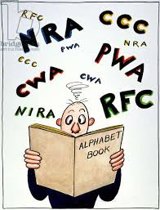
Over the course of the New Deal and the Second New Deal, FDR initiated many programs with acronyms.
These have come to be commonly called Alphabet Agencies.
Relief organizations

Slide 9
Agricultural Adjustment Administration: AAA
Protected farmers from price drops by providing crop subsidies to reduce production.
Farmers paid to not grow too much food.
Help keep prices for crops stable

Slide 10
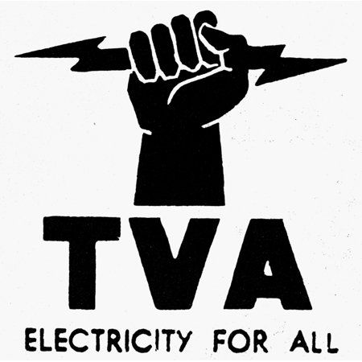
Tennessee Valley Authority:TVA:1933 - present
Provided jobs
to build dams for flood control
Brought electricity to rural areas of Tennessee.
Notes:
The Tennessee Valley Authority (TVA) – created jobs and brought hydroelectric power to the rural Tennessee River Valley area, most of which had never had electricity before.

Slide 11
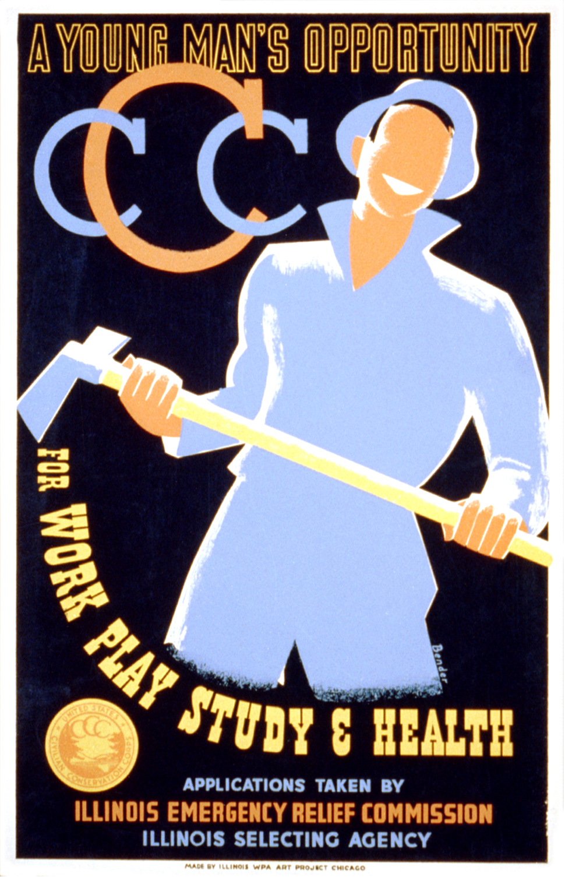
Civilian Conservation Corps:(CCC):1933 - 1942
Provided jobs to young men
250 thousand attended camps to perform reforestation & conservation
Repaired roads & parks
unemployment
Notes:
The Civilian Conservation Corps (CCC) – provided jobs to the young men building roads, parks, rest areas, etc. The young men lived in camps similar to the military, with most of their money being sent home to their families.

Slide 12
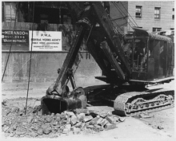
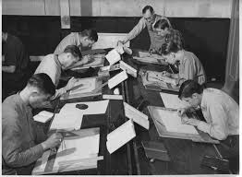
✰ The Public Works Administration (PWA) – 1933-1939
the government provided jobs to adult men to build schools bridges, libraries, courthouses, etc.
✰ The National Youth Administration (NYA) –1935-1945
originally part of the WPA, the NYA paid high school students a small monthly wage to do various part time work that included job training.

Slide 13
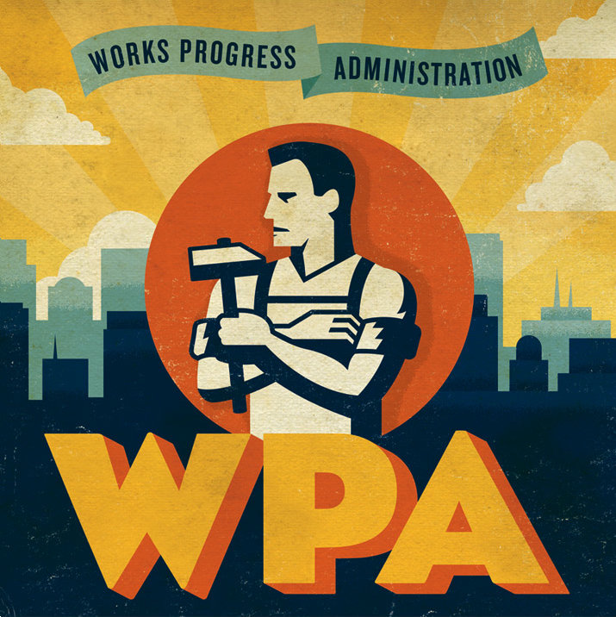
Works Progress Administration:(WPA):1935 - 1943
Employed 8.5 million workers
Projects in art, theater, culture, etc.
Notes:
✰ The Works Progress Administration (WPA) – similar to the PWA, but also employed artists, musicians, writers, actors, etc. to do various cultural projects (painting murals, writing plays, doing historical research, etc.)

Slide 14
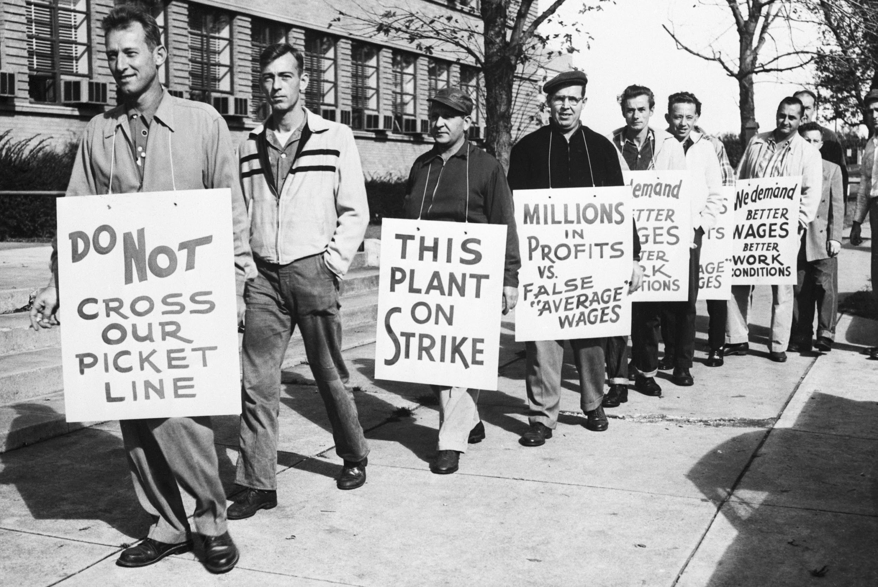
Most of the programs for the New Deal expired after the Great Depression.
Two important New Deal programs, however, still exist and affect Americans today.
The Wagner Act: (National Labor Relations Act) – protects the rights of the workers to join unions and to collectively bargain (negotiate) with their employers. It also created the National Labor Relations Board to oversee all of this.

Slide 15
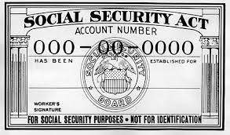
The Social Security Act:(SSA)– created many different programs.
Main Program: provides retirement money (benefits)to the elderly and the permanently disabled.
It was created by the Labor Secretary Francis Perkins
The first woman named to a presidential cabinet in U.S. history.

Slide 16
Home Owners Loan Corporation:(HOLC)
Loaned money at a low interest rate to homeowners who could not make their mortgage payments.

Slide 17
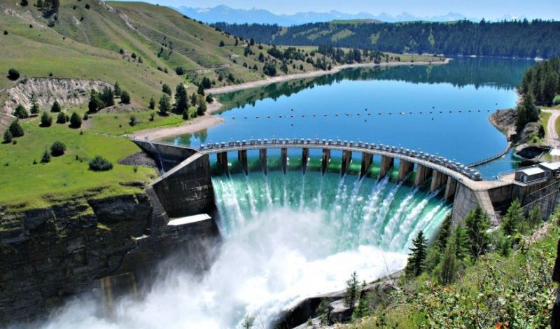
Relief Recovery Reform
 | FDIC: 1933 - Present Federal Deposit Insurance Corporation; Protects citizens from potential bank failures; Ensures savings
 | TVA: 1933 - Present Tennessee Valley Authority; Provided jobs to build dams for flood control and electricity
 | The Social Security Act created many different programs, but main programs provides retirement money (benefits)to the elderly and the permanently disabled
 | SEC: 1934 - Present Securities Exchange Commission; Regulates the stock market; The “stock cops”
 | CCC: 1933 - 1942 Civilian Conservation Corps; Provided jobs for young men; Reforestation, conservation
Notes:
FDIC: Reform
TVA: Recovery
SSA: Reform
SEC: Reform
CCC:Relief

Slide 18
Quick Check
The New Deal ended the Great Depression
True or False
How many terms do you think FDR served???
Notes:
False
4

Slide 19
Court Packing

Slide 20
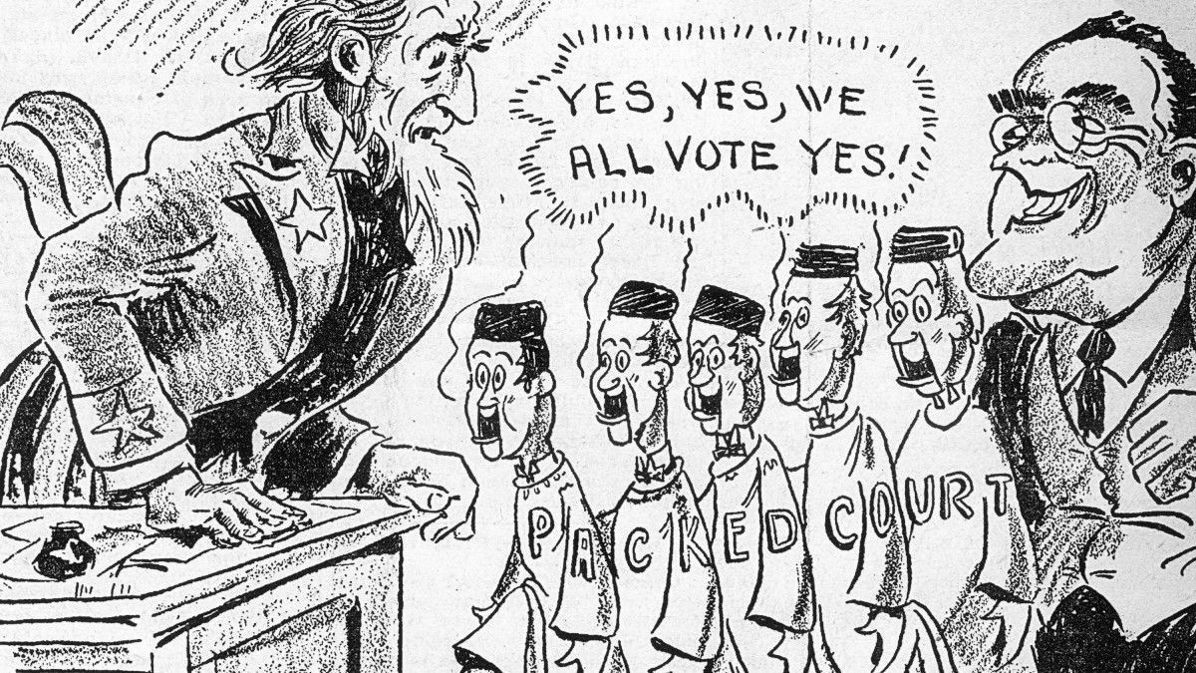
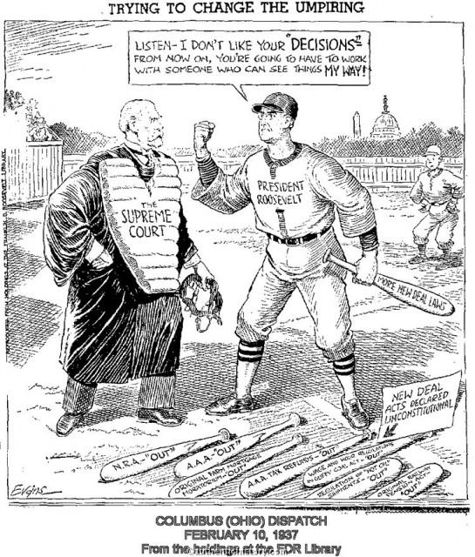
FDR Court-packing:
Powerful Democrat president; House and the Senate Democrat controlled as well.
This meant Congress would approve of his programs and would make them laws.
3 Supreme Court Justices said some of the laws gave FDR too much power (unconstitutional)
**Remember there are 3 branches of government**
Notes:
The fairly conservative court had a reputation for interpreting the Constitution very strictly and thus knocked down several New Deal programs such as the Agricultural Adjustment Act as unconstitutional.

Slide 21
FDR Court-packing:
There was just one thing holding back FDR’s New Deal – the Supreme Court.
The Plan: FDR would appoint six new Supreme Court Justices who would not overturn his laws and programs. *very sneaky**
Notes:
The fairly conservative court had a reputation for interpreting the Constitution very strictly and thus knocked down several New Deal programs such as the Agricultural Adjustment Act as unconstitutional.

Slide 22
FDR Court-packing:
Americans worried, especially Congress, who worried that it would violate the principle of Separation of Powers. (abusing power)
Congress rejects his appointment because it would give FDR give the president too much power.
In the end, Roosevelt didn’t get his way and his reputation was hurt, but the more conservative judges retired and were replaced with judges more friendly to the New Deal anyway.
Notes:
The fairly conservative court had a reputation for interpreting the Constitution very strictly and thus knocked down several New Deal programs such as the Agricultural Adjustment Act as unconstitutional.

Slide 23
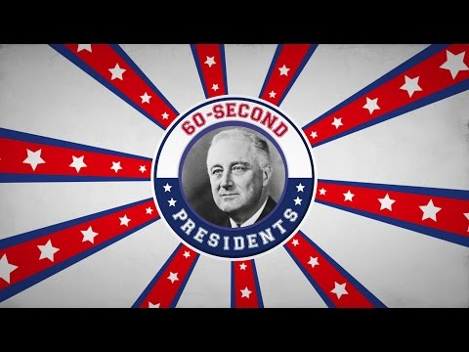

Slide 24
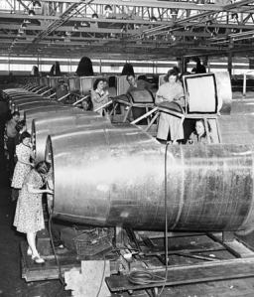
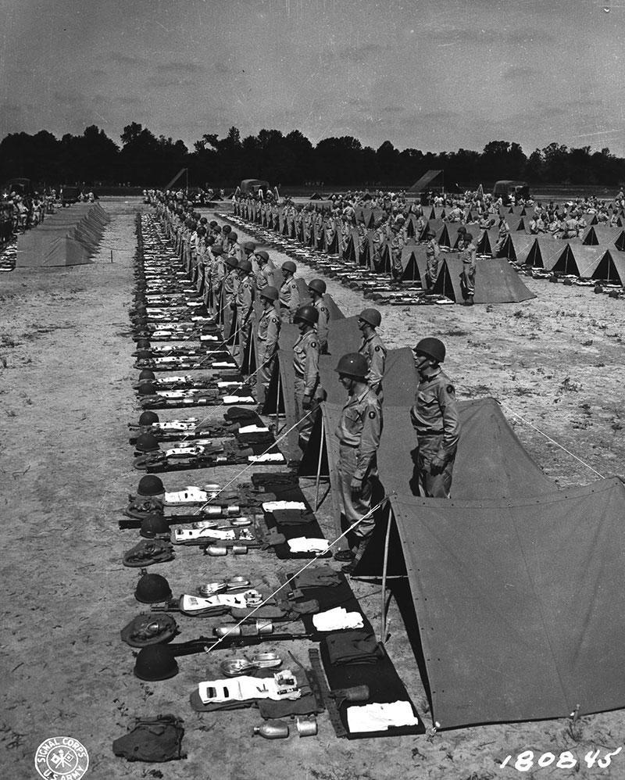
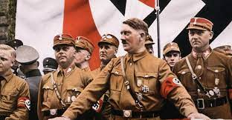
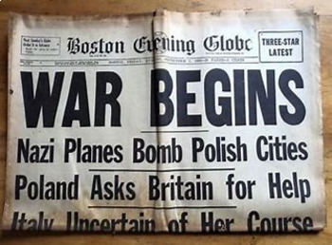
What DID end the Great Depression?
Historians agree that while the New Deal helped a lot with the Great Depression, it didn’t do enough to actually end it. So, how did the Great Depression end?
It was a massive military spending in preparation for and during World War II that actually helped pull the American economy out of the Great Depression.

