Slide 1
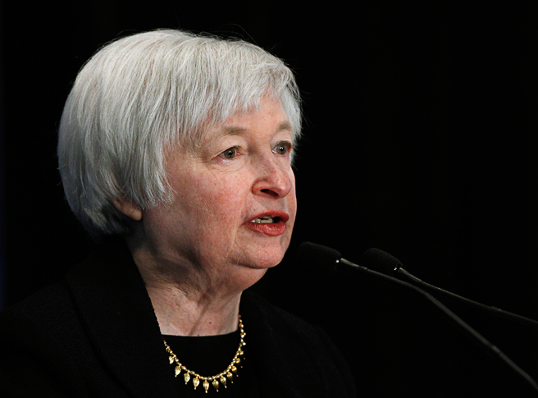
The Federal Reserve System

Slide 2
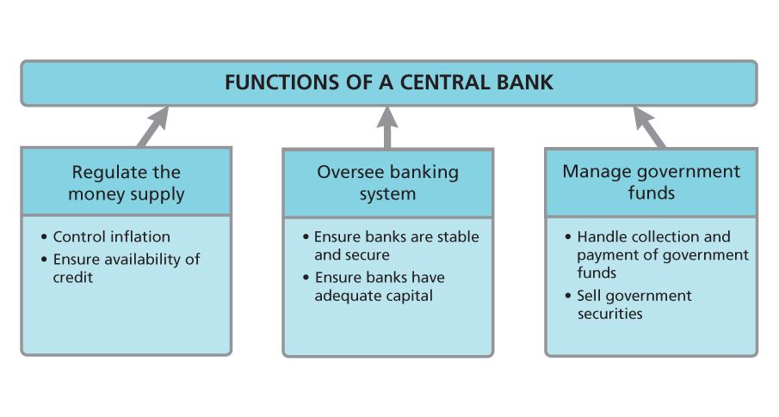
A Review of U.S. Banking History
Central banks have three core functions, which include overseeing aspects of the whole economy and serving as the government’s banker. Analyze Information What is the overall purpose behind the first two functions?

Slide 3
A Review of U.S. Banking History
One reason why the United States established a central banking system was to avoid financial speculation and panics. Analyze Information How can a central bank help achieve that goal?

Slide 4
The History of the Federal Reserve System
Attempting to prevent problems such as the Panic of 1907, Congress passed the Federal Reserve Act in 1913.
The resulting Federal Reserve System, now often referred to simply as “the Fed,” consisted of a group of 12 independent regional banks. These banks could lend to other banks in times of need.

Slide 5
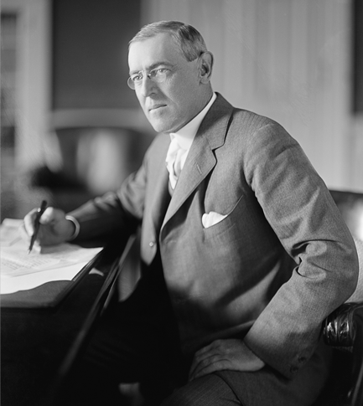
The History of the Federal Reserve System
After almost a year of debate, Congress passed the Federal Reserve Act in December 1913, and President Woodrow Wilson signed it into law.

Slide 6
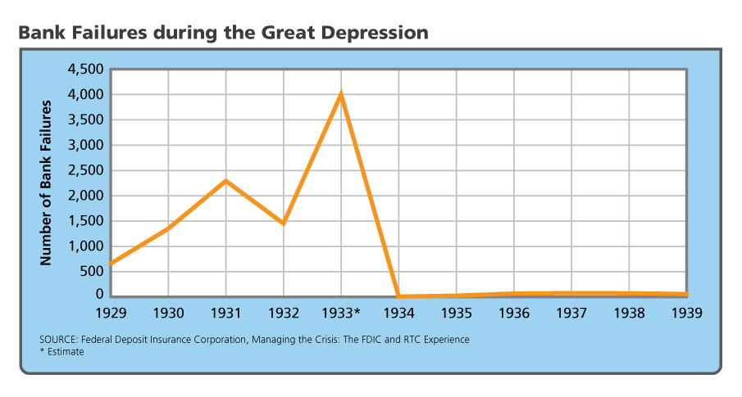
The History of the Federal Reserve System
Analyze Graphs What year did bank failures reach their peak, and what was that peak?

Slide 7
The Structure of the Federal Reserve System
The Federal Reserve System is privately owned by the member banks themselves, but it is publicly controlled by the federal government.
Like so many American institutions, the structure of the Federal Reserve System represents compromises between centralized power and regional powers. Figure 6.2 illustrates that structure.

Slide 8
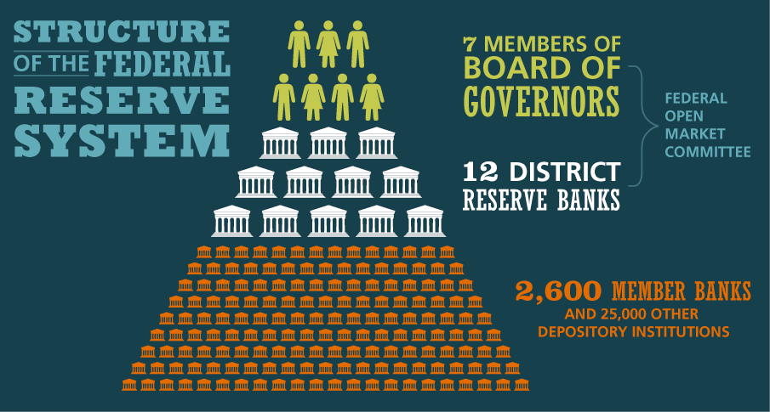
The Structure of the Federal Reserve System
The Federal Reserve System is made up of three levels. Analyze Charts At which level would a nationally chartered bank in your community fit?

Slide 9
The Structure of the Federal Reserve System
Janet Yellen succeeded Ben Bernanke as Chairman of the Fed in 2014. Currently, appointed by President Biden as Secretary of the Treasury

Slide 10
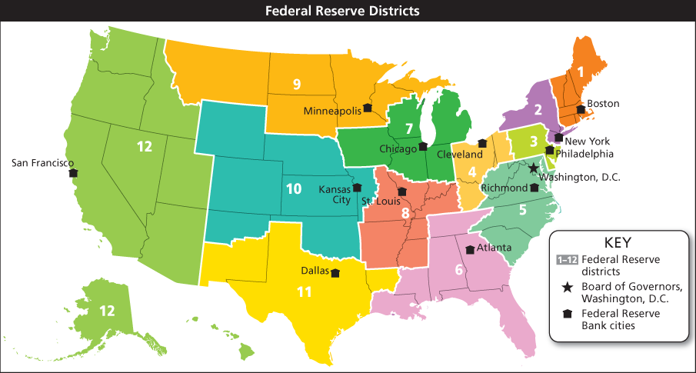
The Structure of the Federal Reserve System
The 12 District Banks are different sizes as measured by their assets. The New York Reserve Bank has a small geographic area but the largest number of assets.

Slide 11
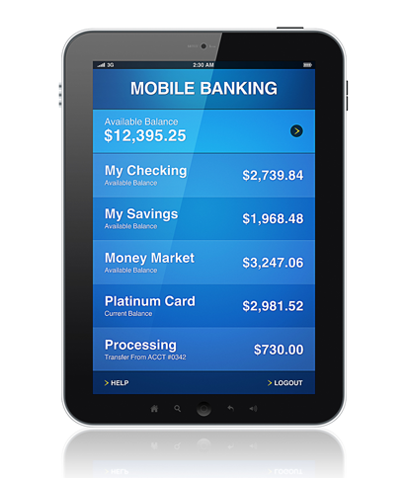
The Fed’s Roles: Serving the Government
Mobile banking has become increasingly popular in recent years. One of the Fed role’s is to process electronic transactions.

Slide 12
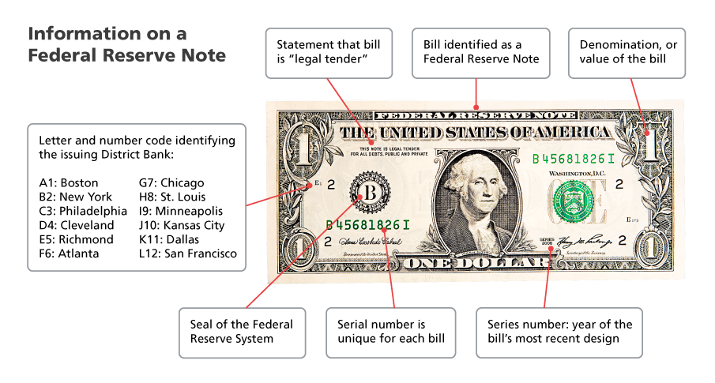
The Fed’s Roles: Serving the Government
Federal Reserve Notes have various codes and markings that help identify the bill and the issuing bank.

Slide 13
The Fed’s Roles: Serving and Regulating Banks
The Federal Reserve also provides services to banks throughout the nation. It clears checks, safeguards bank resources, and lends funds to help banks that need to borrow in order to maintain their legally required reserves.
It also coordinates the activities of a number of state and federal regulatory authorities.

Slide 14
The Fed’s Roles: Serving and Regulating Banks
Clearing Checks
Supervising Banking Practices
Acting as Lender of Last Resort
The Fed’s Expanded Role
Monitoring Reserves
Conducting Bank Examinations

Slide 15
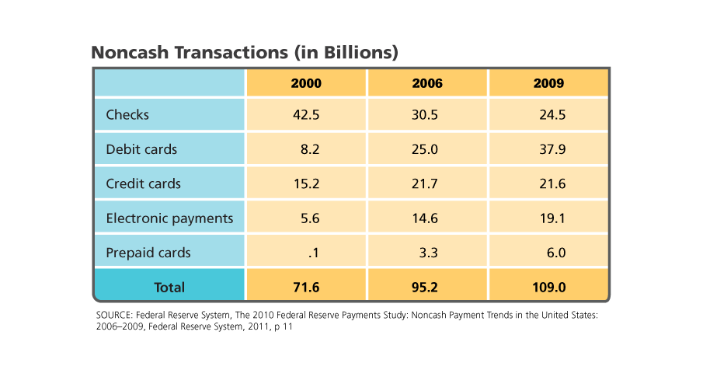
The Fed’s Roles: Serving and Regulating Banks
Between 2000 and 2009, consumers’ use of checks decreased while most other types of noncash transactions increased. Analyze Charts What technological developments occurred during these years that made the changes in non-cash transactions possible?

Slide 16
The Fed’s Roles: Regulating the Money Supply
The Federal Reserve is best known for its role in regulating the nation’s money supply. To do so, it uses several tools: setting the discount rate, setting reserve requirements, setting the federal funds rate target, and using open market operations to meet that target.
Economists and the Fed watch several indicators of the money supply.
M1 is a measure of the funds that are easily accessible or in circulation.
M2 includes the funds counted in M1 as well as money market accounts and savings instruments.

Slide 17
The Fed’s Roles: Regulating the Money Supply
When interest rates are low, credit is easier, and people are more willing to buy luxury goods.

Slide 18
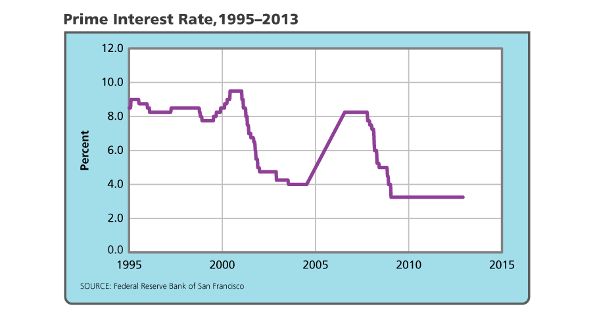
The Fed’s Roles: Regulating the Money Supply
The prime interest rate is not set by the Fed but by banks: it is the rate charged by the top 25 commercial banks. Analyze Charts When was it cheaper to borrow money, in 2000 or 2010? Why?

Slide 19
Quiz: A Review of U.S. Banking History
Why did Congress decide to act to create a central bank in the early twentieth century?
A. alarm over a financial panic
B. desire to legislate reserve requirements
C. electoral victory of the Federalist party
D. lack of business expansion

Slide 20
Quiz: The History of the Federal Reserve System
2) In which financial crisis did the Fed respond
most aggressively?
A. the Panic of 1907
B. the Great Depression
C. the early 1950s
D. 2008

Slide 21
Quiz: The Structure of the Federal Reserve System
3) How does the president of the Federal Reserve Bank
of New York differ from the other Federal Reserve Bank presidents?
A. serves for life
B. has permanent seat on FOMC
C. serves as chair of the Fed
D. serves on the Board of Governors

Slide 22
Quiz: The Fed’s Roles: Serving the Government
4) What body issues paper money in the United States?
A. Federal Reserve Banks
B. the Federal Open Market Committee
C. the United States Mint
D. the United States Treasury

Slide 23
Quiz: The Fed’s Roles: Serving and Regulating Banks
5) What might cause Federal Reserve examiners to take
action against a bank?
A. following truth-in-lending rules
B. issuing risky loans
C. making loans
D. reporting reserves

Slide 24
Quiz: The Fed’s Roles: Regulating the Money Supply
6) How does the Fed try to control inflation?
A. controlling prices
B. clearing checks
C. regulating banks
D. regulating the money supply

