Slide 1
Foundations of the U.S.

Slide 2
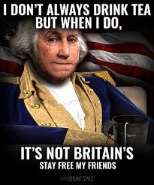
AGENDA: Tuesday & Wednesday

Slide 3
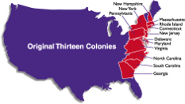
Why we broke up with Great Britain
Colonists’ liberties were not being respected in their relationship with England…​
​
The United States of America was created because of personal liberty (unalienable rights.)​

Slide 4
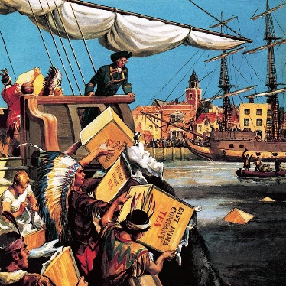
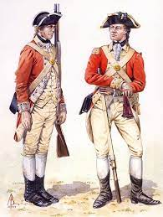
Remember these????
Tea Act (1773) required Americans to only buy tea from the British East India Company.
Stamp Act (1765) Required Americans to use special, stamped paper produced in London for legal documents, magazines, newspapers, and playing cards and required the paper be bought with British currency instead of colonial currency.
Quartering Acts (1765 & 1774) Required colonists to pay for housing/provisions of British troops AND allowed royal officials to house

Slide 5
The Declaration of Independence-Our break up with Great Britain
The Declaration of Independence was written in 1776
In reaction to colonial experiences under British rule
It explained WHY (grievance-complaints) colonists sought independence from England
Notes:
Tea Act (1773) required Americans to only buy tea from the British East India Company.
Stamp Act (1765) Required Americans to use special, stamped paper produced in London for legal documents, magazines, newspapers, and playing cards and required the paper be bought with British currency instead of colonial currency.
Quartering Acts (1765 & 1774) Required colonists to pay for housing/provisions of British troops AND allowed royal officials to house troops in unused housing, barns, inns, etc. Later, they were housed in private homes
Events like the Boston Massacre were one of the armed conflicts between British troops and the colonists over the taxation.

Slide 6
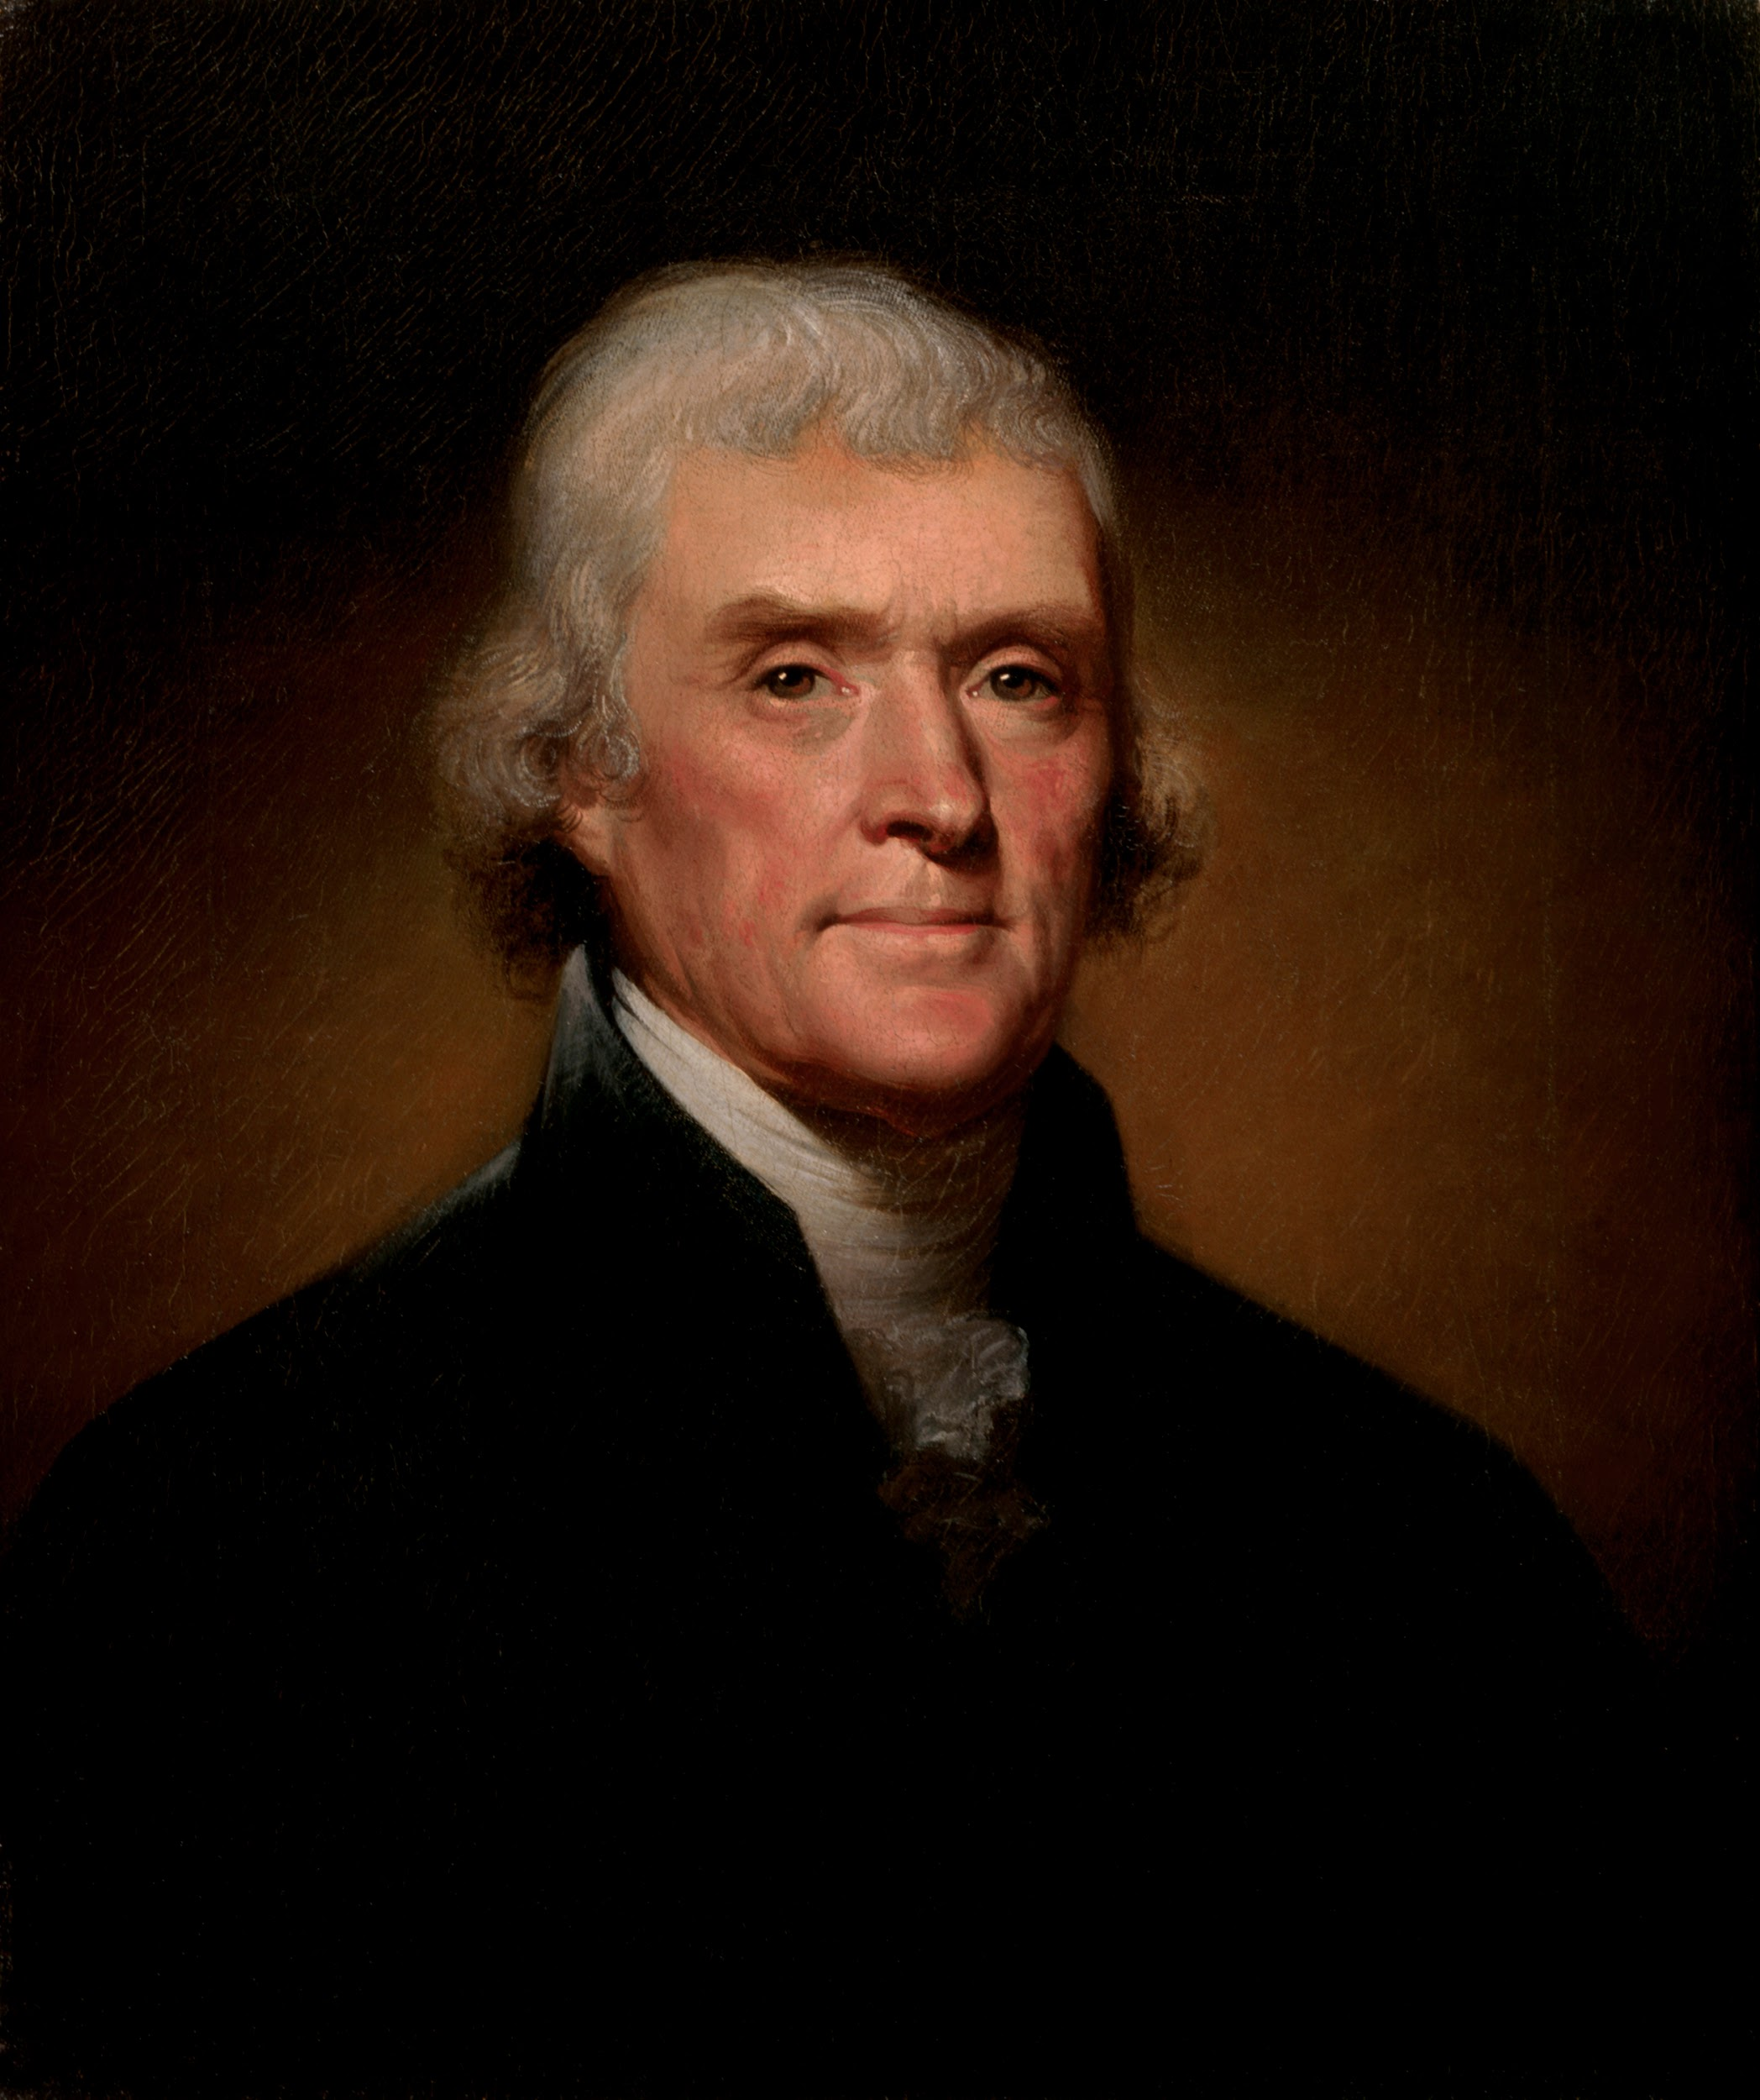
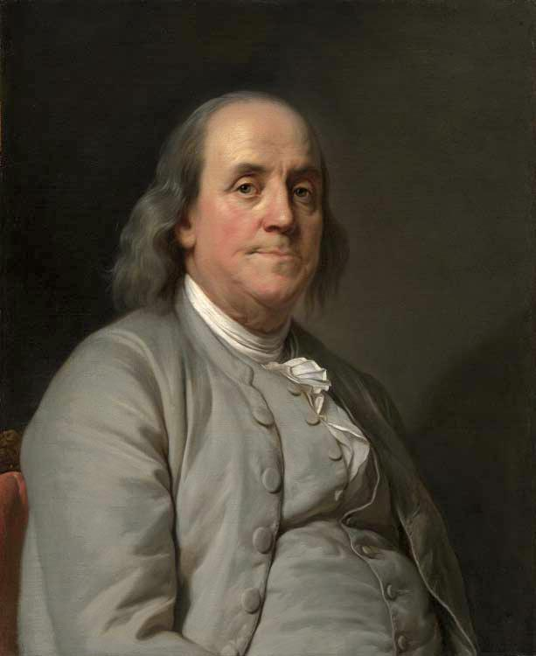
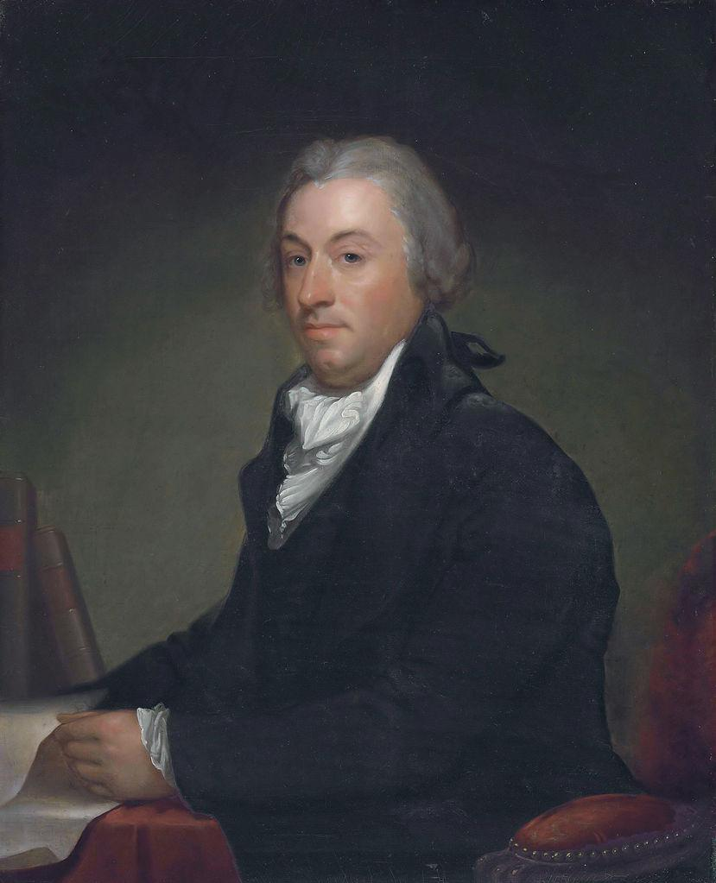
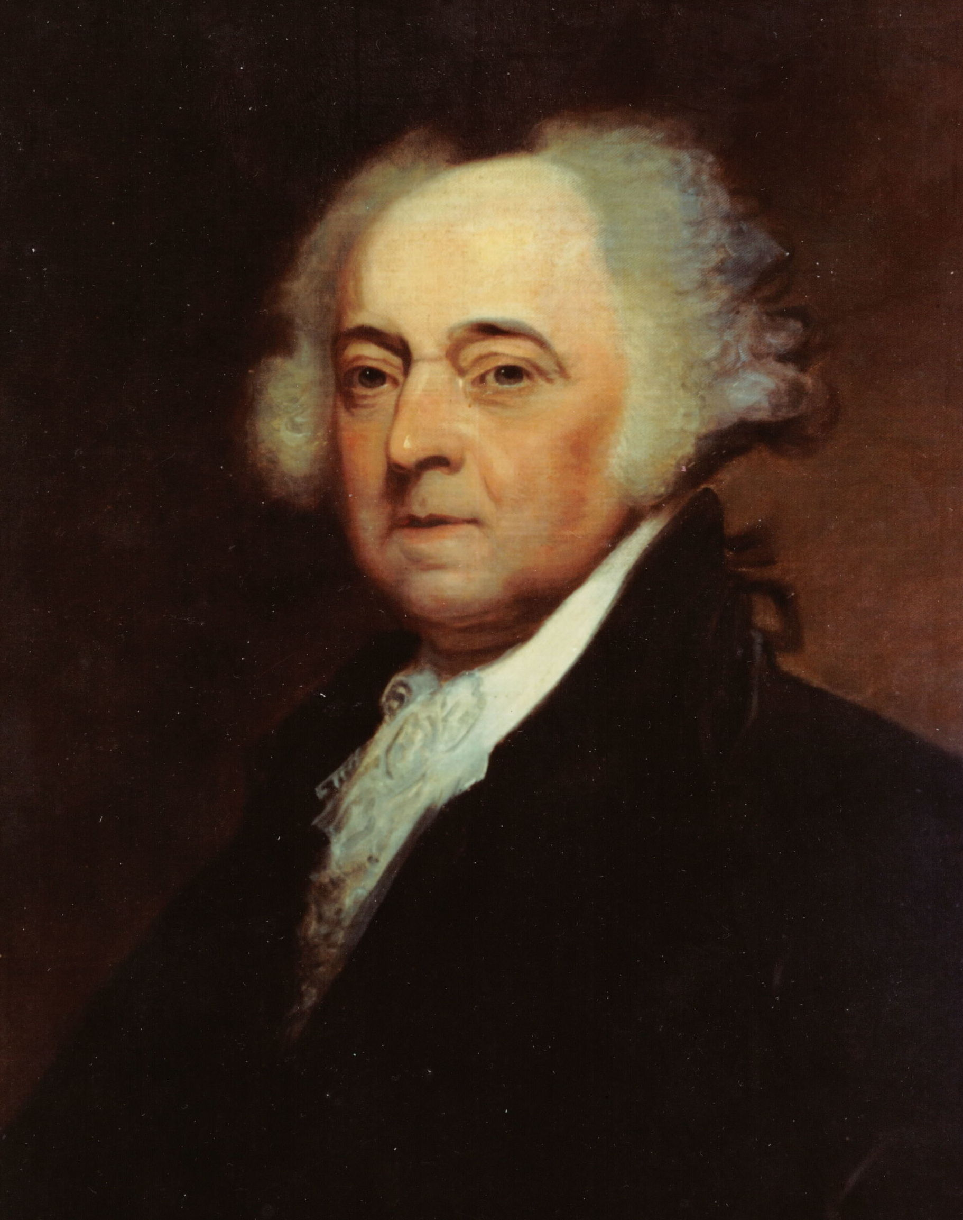
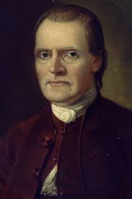
Declaration of Independence
Writers of the Declaration:
Committee of Five
*Thomas Jefferson- primary writer
John Adams
Benjamin Franklin
Thomas Jefferson,
Roger Sherman
Robert Livingston

Slide 7
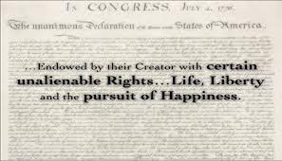
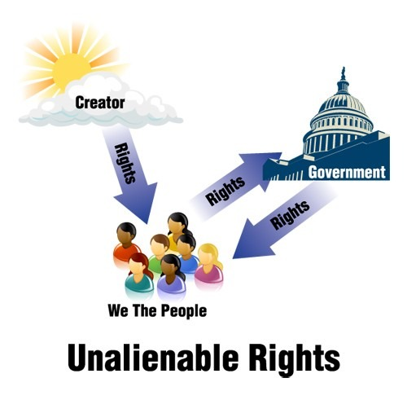
Idea of unalienable rights emerges
Unalienable rights:Rights that cannot be taken away by human law.
Personal Liberty
*Declaration of Independence is a primary source*
Notes:
Declaration of Independence: July 4, 1776, explained WHY (grievances) the colonists sought independence from England; written primarily by Thomas Jefferson.
Grievance: official complaint

Slide 9
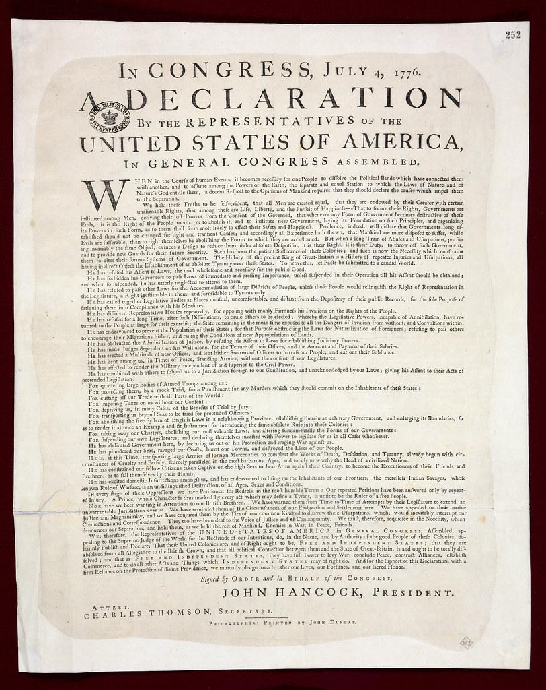
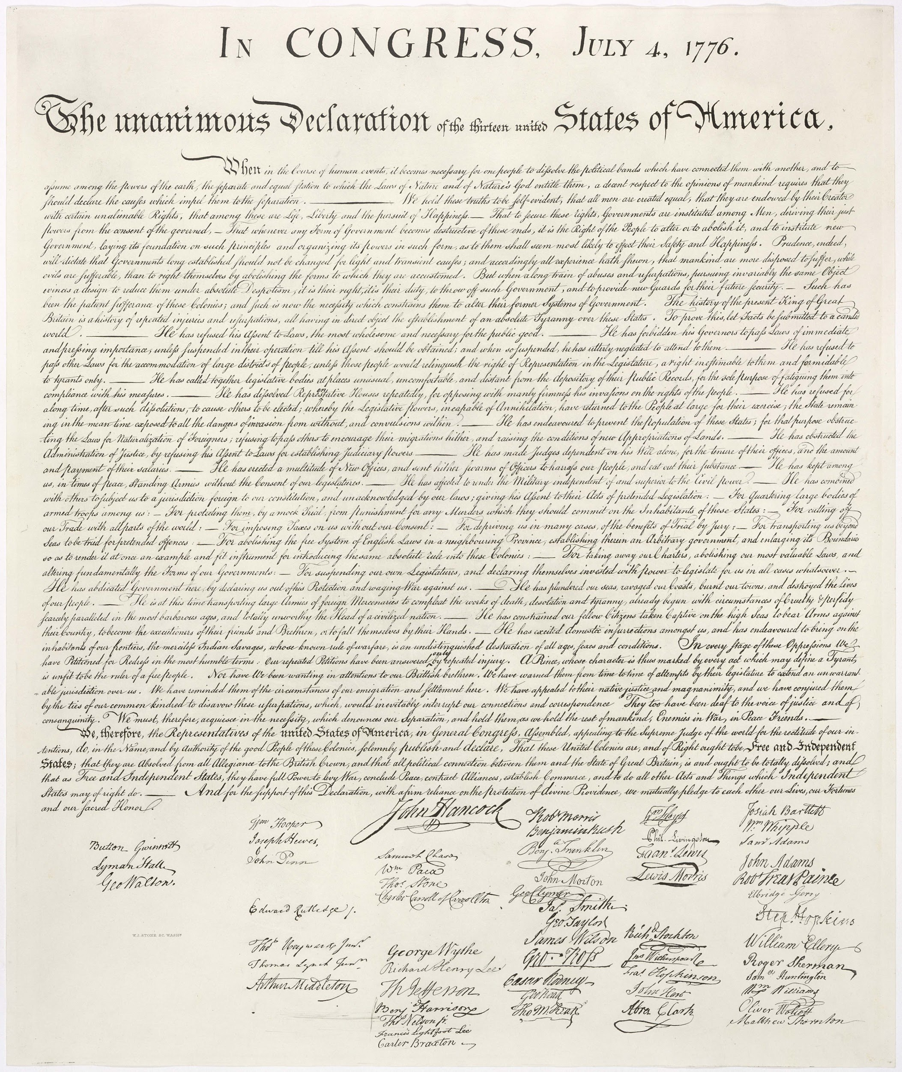
The Declaration of Independence Preamble
We hold these truths to be self-evident, that all men are created equal, that they are endowed by their Creator with certain unalienable Rights, that among these are Life, Liberty and the pursuit of Happiness.
Notes:
Preamble – explains that people have a right to separate from a government they feel is unjust. This is based on the theory of Thomas Hobbs who developed the idea of social contract (the idea that people should follow the laws of government so long as the laws are fair)
Grievances – 27 complaints against the British that caused us to leave
Official Separation – redefined our relationship with Great Britain and stated that we would be forming our own independent country

Slide 10
Significance (importance) of the Declaration of Independence was not just for the American people….it also allowed…
Foreign governments(such as: Mexico, Spain, & Germany) to officially recognize the United States as a new country.

Slide 11
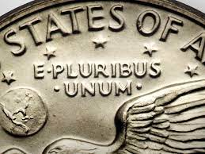
United States’ Motto
“E Pluribus Unum” = “Out of Many, One”
Colonies coming together to form one nation.
Notes:
Colonies coming together to form one nation
How do the colonies and the Declaration represent this motto?
13 colonies → 1 United States
1956-“IN GOD WE TRUST”

Slide 12
Think about a great break up song!!!

Slide 13
Here are a few…
Cry me a River
I will always love you
Someone I used to love
Someone I used to know
Gives you Hell
All too well
Memories
Easy on Me
Jolene
Nothing Compares to You
Thank you, next
Flowers
Slide away

Slide 14
NOW…write a break up text on the index card…school appropriate and when you’re done place it in the basket

Slide 15
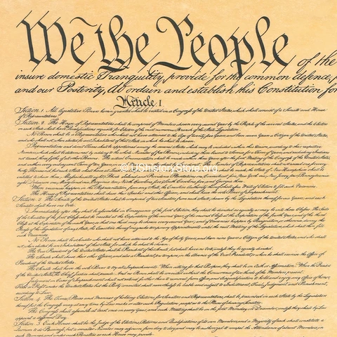
The Constitution

Slide 16
The Constitution*primary source*
Written in 1787
Addresses grievances in the Declaration
Outline-(preamble) “We the People” (what the government can and can not do)
Has the ability to be amended-living document
Why is this important?
*Want the ability to be able to change the law if they no longer find it useful
Reserves specific powers to the state and people
Acts as the supreme law of the land
Notes:
*Want the ability to be able to change the law if they no longer find it useful

Slide 17
The Preamble
The preamble sets the stage for the Constitution.
It is an introduction to the highest law of the land; it is not the law.
It communicates the intentions of the farmers

Slide 18
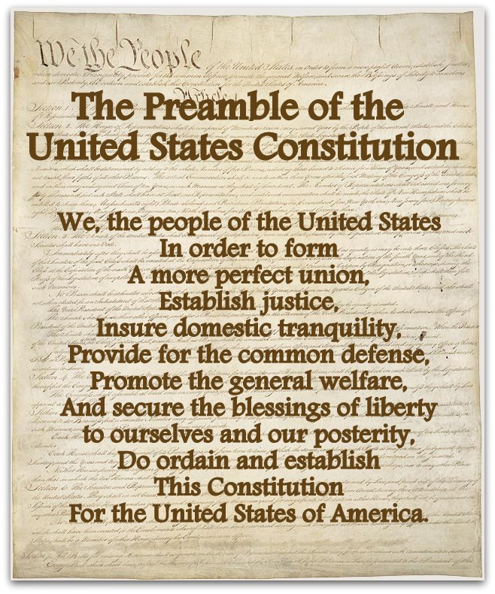
Notes:
We the people of the United States, in order to form a more perfect union, establish justice, insure domestic tranquility, provide for the common defense, promote the general welfare, and secure the blessings of liberty to ourselves and our posterity, do ordain and establish this Constitution for the United States of America
The objectives stated by the Preamble are to secure justice, liberty, equality to all citizens and promote fraternity to maintain unity and integrity of the nation.

Slide 19
SEPARATION OF POWERS
UNITED STATES CONSTITUTION

Slide 20
BRAIN BREAK 5 MINUTES

Slide 22
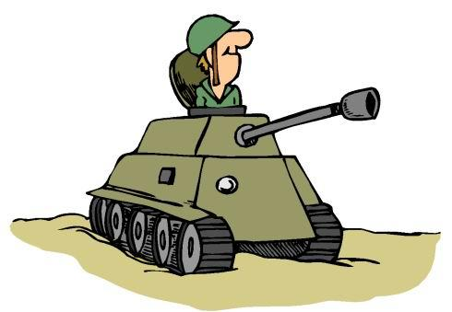
LEGISLATIVE BRANCH
Responsibilities
Makes Laws
Can declare war
Sets budget/controls spending
Sets taxes.
Bill Law Act

Slide 23
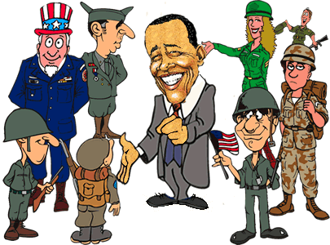
The President
Responsibilities
Enforces the Law
Commander in Chief
Appoints federal positions

Slide 24
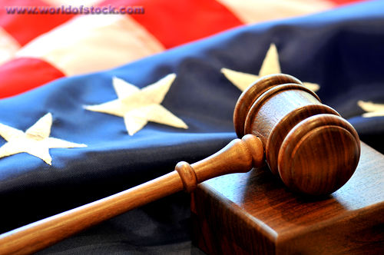
SUPREME COURT
Responsibilities
Interpret the law
Judge whether or not the law has been broken
Make sure laws and actions don’t violate the constitution

Slide 25
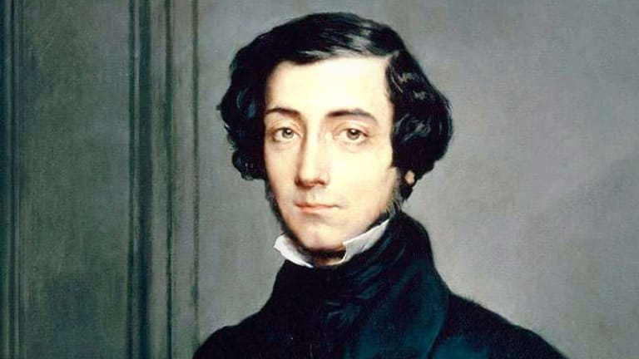
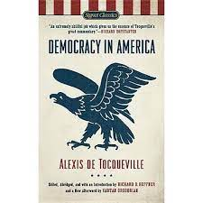
Alexis de Tocqueville
Values crucial to America’s success as a constitutional republic
Egalitarianism=equality
Populism=popular sovereignty
Popular sovereignty=The power of the government belongs to the people.
Liberty=freedom
Individualism
Laissez faire=government is hands off
Notes:
As “Democracy in America” revealed, Tocqueville believed that equality was the great political and social idea of his era, and he thought that the United States offered the most advanced example of equality in action
Best known for Democracy in America, which he wrote after spending 10 months of 1831 and 1832 in the United States on a mission from France to study American prisons (then considered progressive).

Slide 26
The Bill of Rights
First 10 Amendments to the Constitution
Created to protect particular rights of citizens of the United States
Memory Check: What is an inalienable right?

Slide 27
1ST AMENDMENT
Freedom of religion, speech, the press, assembly, and protest.

Slide 28
Why was the 1st Amendment added?
Under British rule, the colonists felt like they had little freedom to act as they wished
Protects your freedom of speech → You can speak out against governments or policies you feel aren’t fair
What policies did the colonists not like under British rule?

Slide 29
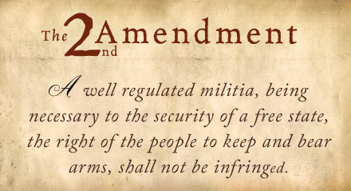
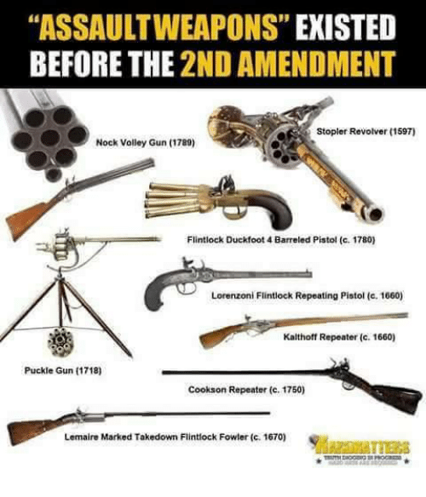
2ND AMENDMENT
Freedom to bear arms-Protects your right to own and carry weapons.

Slide 30
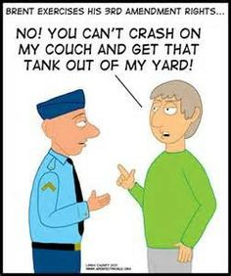
3RD AMENDMENT
No quartering-
Protects your home you don’t have to house/feed troops).

Slide 31
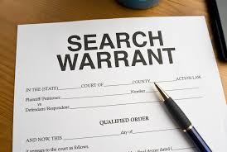
4TH AMENDMENT
No illegal searches.
Protects you from illegal searches.
There must be a warrant…Or probable cause

Slide 32
Why was the 4th Amendment added?
Under British rule, the colonists were taxed on a variety of things
Colonists often avoided these taxes and hid their items
British soldiers had search warrants called writs of assistance which allowed them to enter into a home and search for smuggled goods

Slide 33
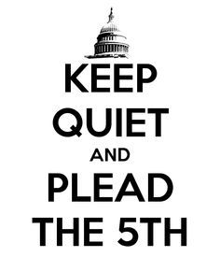
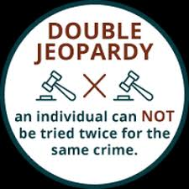
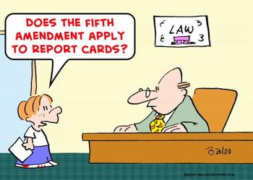
5TH AMENDMENT
Don’t have to testify against yourself.
“I Plead the 5th!”
Miranda Rights
Right to remain silent
Double Jeopardy (OJ Simpson)

Slide 34
Why was the 5th Amendment passed?
Ensures that those in positions of power cannot force you to self-incriminate → Right to remain silent, Right to an attorney

Slide 35
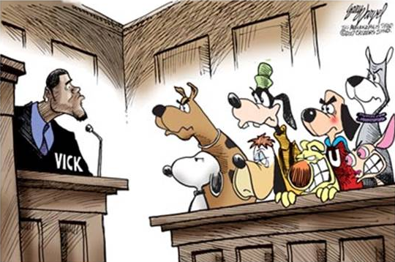
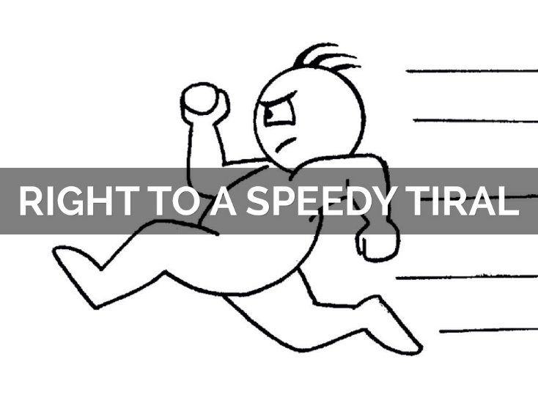
6TH AMENDMENT
Right to a quick, public, trial by jury.
PROTECTS YOUR RIGHT TO:
Right to an attorney
Right to know what you are being accused of

Slide 36
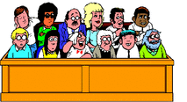
7TH AMENDMENT
Right to a jury in civil lawsuits.
PROTECTS YOUR RIGHT TO HAVE a Jury of Peers
*Civil lawsuits usually involve money

Slide 37
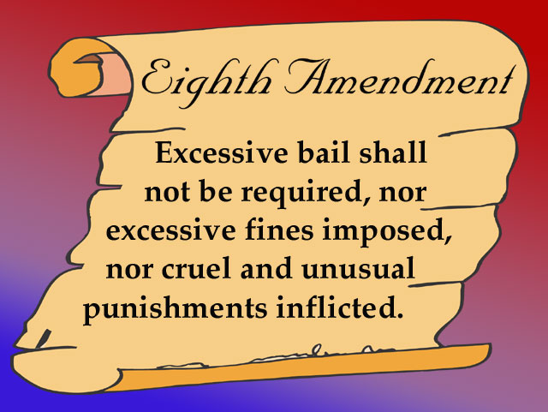
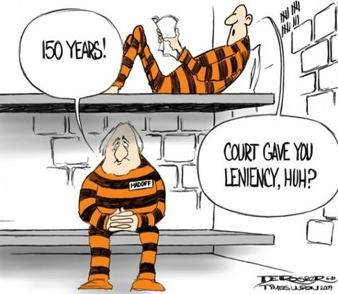
8TH AMENDMENT
No cruel or unusual punishment
PROTECTS:No excessive punishment

Slide 38
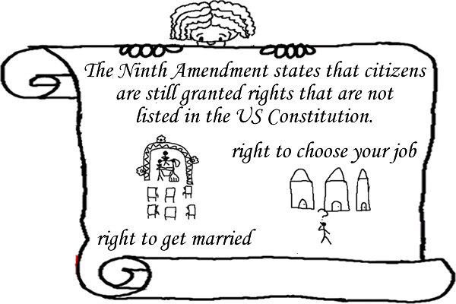
9TH AMENDMENT
Rights in the Constitution cannot be used to take away other rights.
* Protects your choices

Slide 39
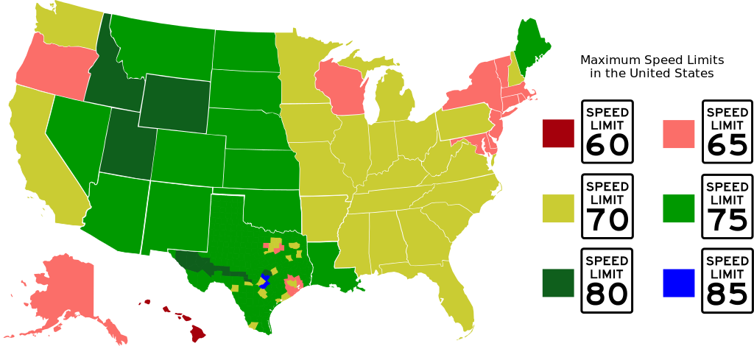
10TH AMENDMENT
Powers not given to the national government in the Constitution belong to the states.
Protects- states rights
Future Fright

Slide 40
Why was the 10th Amendment passed?
To ensure that the federal government did not have absolute control
Again, many of these Amendments are reactions to tyrannical British rule

Slide 41
HOW TO PARTICIPATE IN THE DEMOCRATIC PROCESS

Slide 42
HOW TO PARTICIPATE IN THE DEMOCRATIC PROCESS
Right to vote
Right to assemble
Writing to representatives

Slide 43
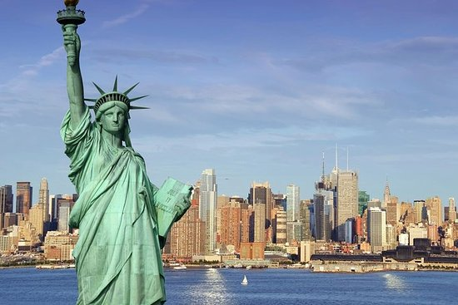
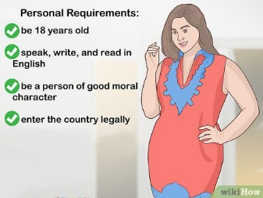
BECOMING A NATURALIZED CITIZEN
To be eligible:
At least 18 years old
Permanent residence for at least 5 years
Be able to read, write, and speak basic English
Have a basic understanding of U.S. history and government
Be of good moral character
Demonstrate an attachment to the United States

Slide 45
Written Reflection
Why do you think it’s important to participate in the Democratic process?
What amendment do you think is the most important to maintain freedom and democracy?

Slide 46
Please pick up your vocabulary and begin working on it. Yes you may work with a partner.

