Slide 2
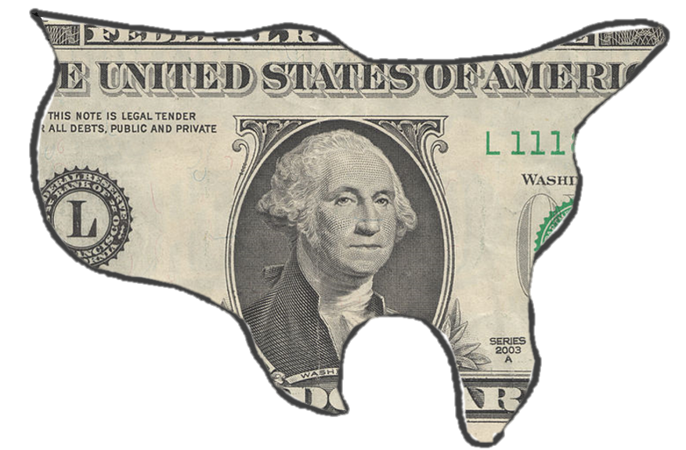
PART 1: DEFINING GDP
Directions: On the next slide, provide the formal definition of Gross Domestic Product, then provide a definition of GDP in your own words. Finally, find a picture that would represent the economy as a whole (macroeconomy) and paste it to the slide.

Slide 3
GROSS DOMESTIC PRODUCT
Formal Definition:
Definition in Your Own Words:
Place picture here

Slide 4
PART 2: THE COMPONENTS OF GDP
Directions: For each of the following slides, find pictures online for the four components of GDP. Define each and explain how your picture relates to the component.
Consumption
Investment
Government
Net Exports (export and import)

Slide 5
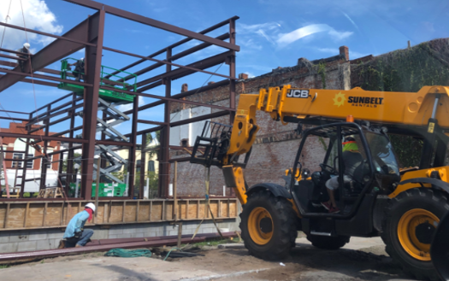
SAMPLE SLIDE
Investment Spending
Formal Definition:
Picture
Definition
Investment Spending - Money spent on capital goods, or goods used in the production of capital, goods, or services. Investment spending may include purchases such as machinery, land, production inputs, or infrastructure.
Definition in Your Own Words:
Definition
Investment Spending occurs when businesses spend money on capital goods, which then allow the business to expand or produce goods and services for the market.

Slide 6
CONSUMPTION SPENDING
Formal Definition:
Description of Picture:
Place picture here

Slide 7
INVESTMENT SPENDING
Formal Definition:
Description of Picture:
Place picture here

Slide 8
GOVERNMENT SPENDING
Formal Definition:
Description of Picture:
Place picture here

Slide 9
NET EXPORTS (IMPORT)
Formal Definition:
Description of Picture:
Place picture here

Slide 10
NET EXPORTS (EXPORT)
Formal Definition:
Description of Picture:
Place picture here

Slide 11
PART 3: EXCLUDED FROM GDP
Directions: For each of the following slides, find pictures online for the four components of GDP. Define each and explain how your picture relates to the component.
Intermediate products
Second-Hand sales
Nonmarket Transactions
Underground Economy (Black Market)
Transfer Payment (Cash Transfers )

Slide 12
INTERMEDIATE PRODUCTS
Formal Definition:
Description of Picture:
Place picture here

Slide 13
SECOND-HAND SALES
Formal Definition:
Description of Picture:
Place picture here

Slide 14
NON-MARKET TRANSACTIONS
Formal Definition:
Description of Picture:
Place picture here

Slide 15
BLACK MARKET
Formal Definition:
Description of Picture:
Place picture here

Slide 16
TRANSFER PAYMENTS
Formal Definition:
Description of Picture:
Place picture here

Slide 17
Great Job, you completed the project!
Please answer the following reflection questions based on what you learned throughout the activity.
List 1-3 things that you learned about gross domestic product.
List 1-3 things that you want to know more about gross domestic product.

