Slide 1
George W. Bush & Barack Obama
Unit 13: Modern Era #2

Slide 2
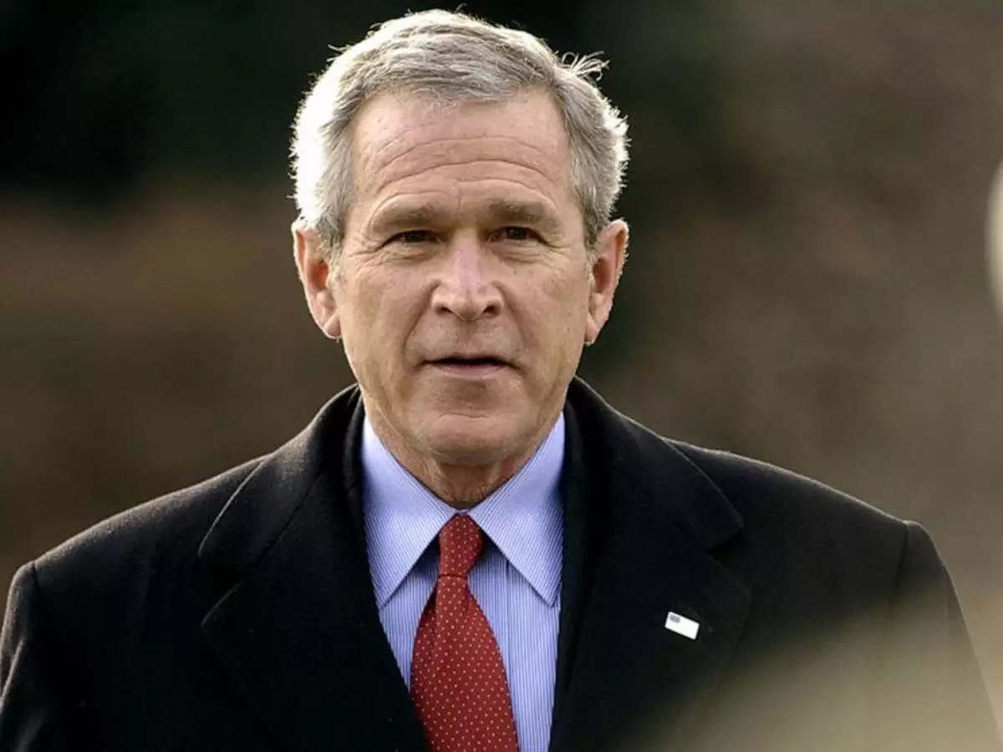
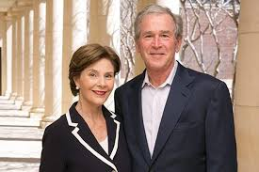
George W. Bush - The Decider
George Walker Bush was born in Connecticut but raised in Texas
He earned a B.A. from Yale and attended Harvard - the only president to hold an M.B.A.
Worked in the Texas oil business
Bought part of the Texas Rangers baseball team
Governor of Texas
Named Time Magazine’s Man of the Year TWICE

Slide 3
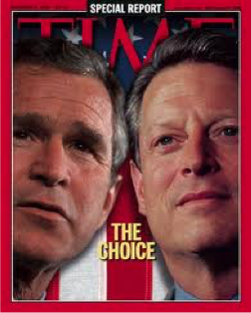
2000 Election
Al Gore won the popular vote; Bush won the electoral vote
Gore called for a recount of Florida votes, which would have gotten him the electoral votes he needed if the recount had gone his way
The Supreme Court blocked the recount

Slide 4
No Child Left Behind Act
The main law for K-12 general education in the U.S. from 2002-2015
Required all states to test all students in English and Math each year from 3rd - 8th grade
Ensure all students were receiving a good education
Hold states accountable for how kids learned & achieved

Slide 5
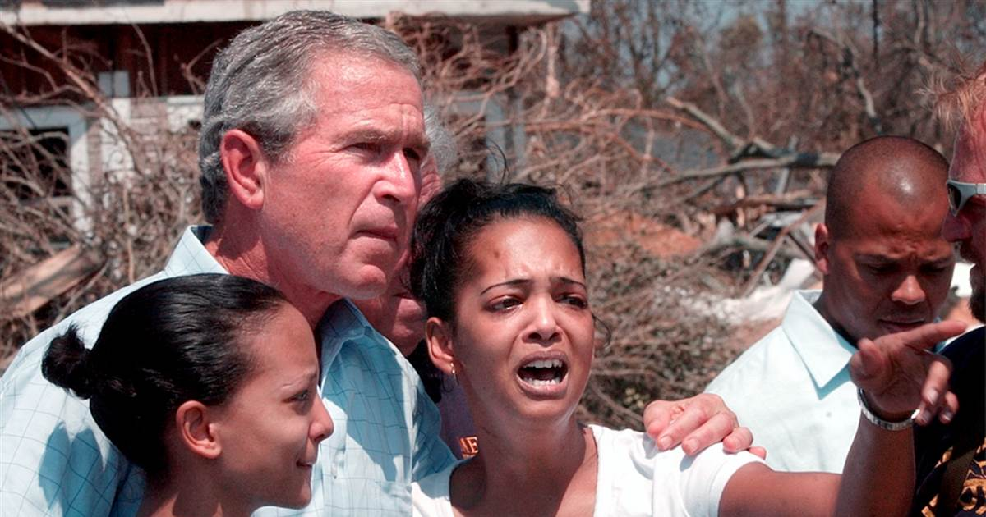
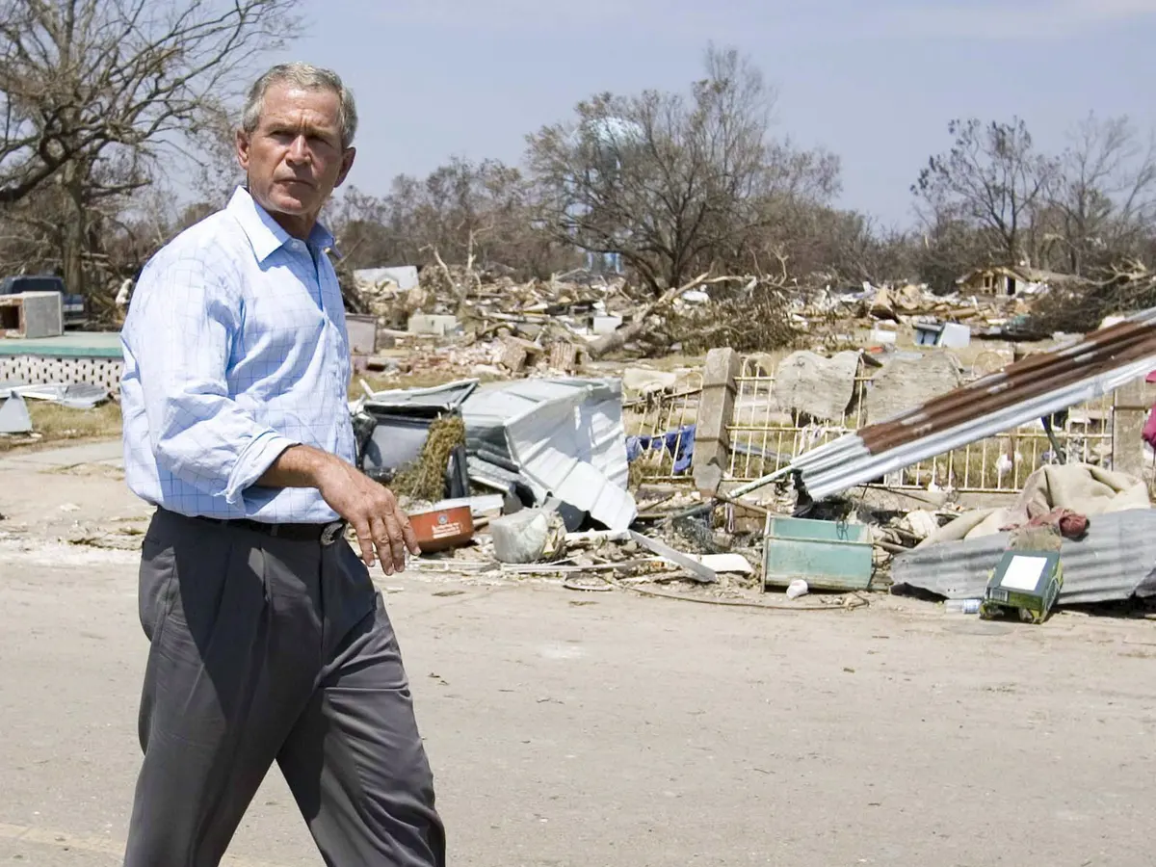
Hurricane Katrina
In August 2005, Katrina devastated the city of New Orleans; major flooding due to broken levees and the city’s low elevation
President Bush was criticized after appointing incompetent people to FEMA
He was also criticized for having been slow to respond
Katrina is seen by political analysts as the tipping point of Bush’s presidential approval

Slide 6
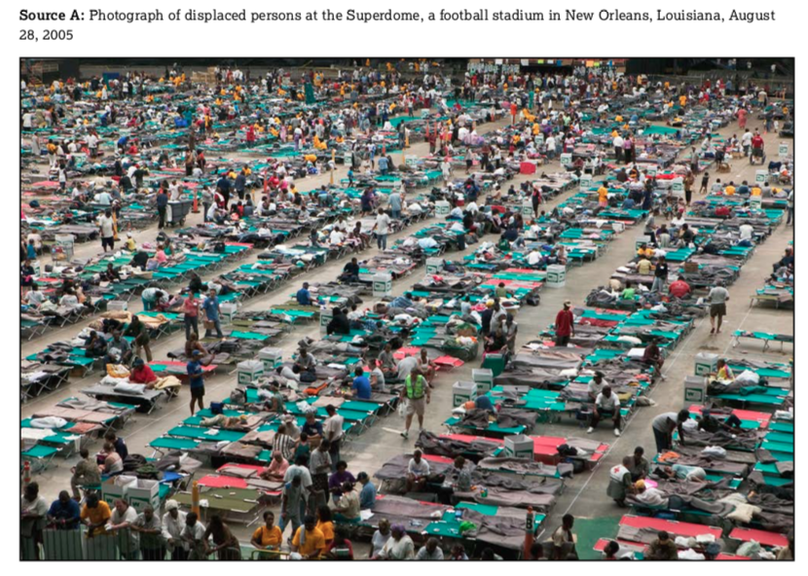

Slide 7
Foreign Policy

Slide 8
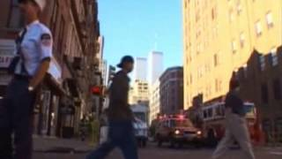

Slide 9
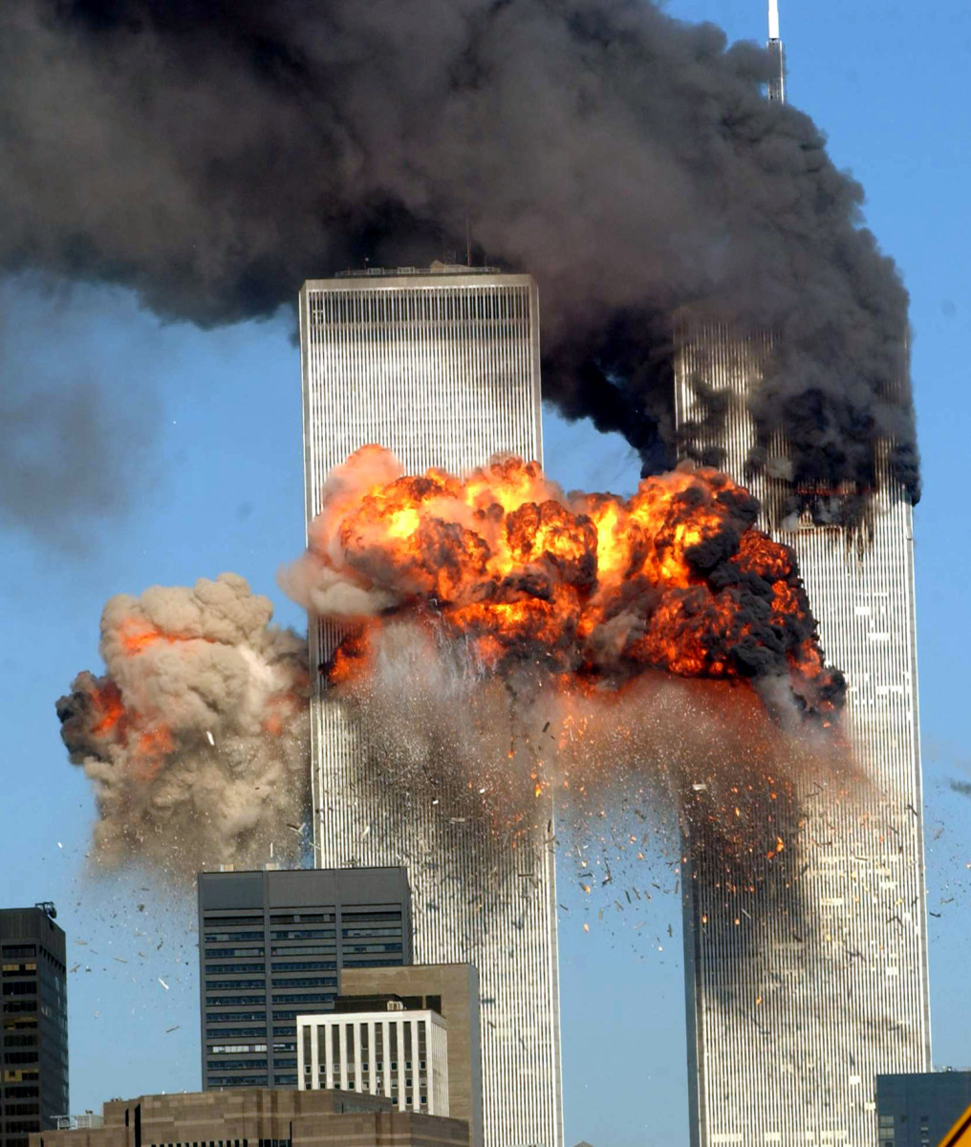
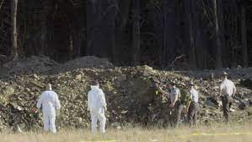
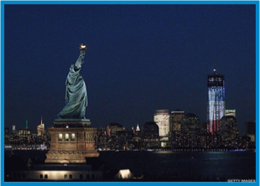
9/11
On September 11, 2001, terrorists belonging to the Muslim extremist group, Al Qaeda, hijacked four planes
Flew 2 into the World Trade Center
1 into the Pentagon
United Airlines Flight 93 crashed down in a field in rural Pennsylvania, never reaching its destination
3,000+ people died, worst attack on U.S. soil
Americans will unite like never before

Slide 10
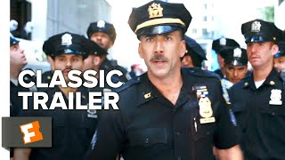

Slide 11
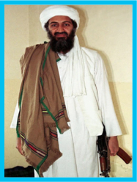
9/11 Con’t
Osama Bin Laden and Al Qaeda took credit for the attacks, sheltered by the Taliban in Afghanistan
Refused to surrender Bin Laden to the U.S.

Slide 12
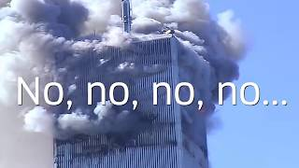

Slide 13
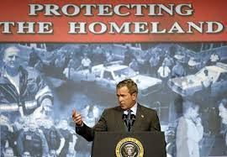
Effects of 9/11
USA Patriot Act
Intended to make it easier for law enforcement to prevent acts of terrorism
**VERY controversial**
Allowing the government to more easily get around 4th Amendment rights (against illegal searches)

Slide 14
Effects of 9/11 Con’t
Global War On Terror
Against nations that harbor terrorists (Afghanistan)
TSA
Transportation Security Agency - security at airports
Department of Homeland Security
Aimed at securing U.S. from all threats

Slide 15
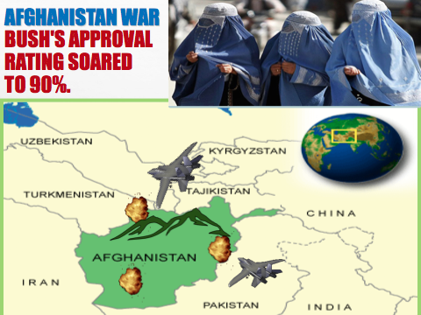

Slide 16
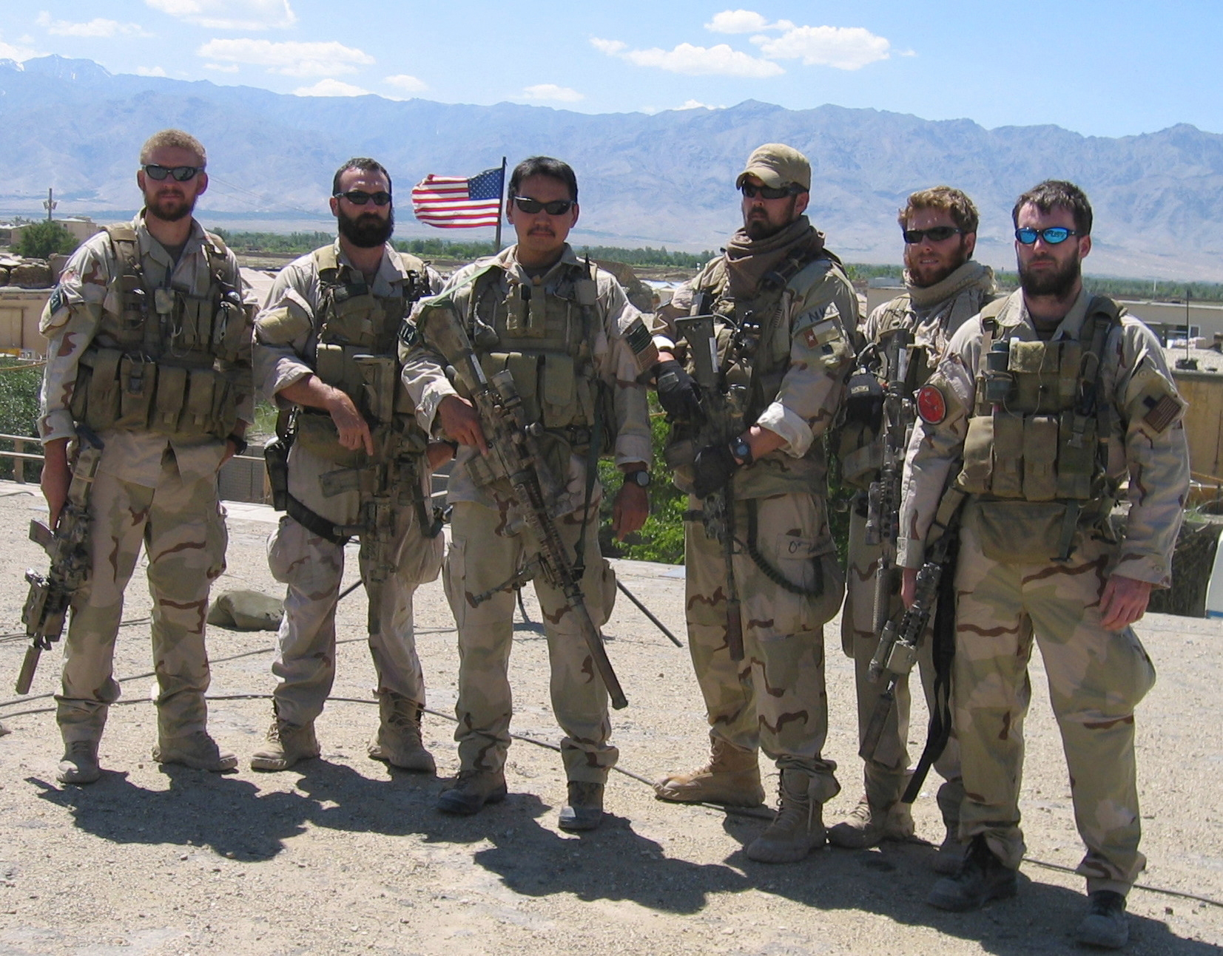
Operation Enduring Freedom - Afghanistan War
On October 7, 2001, U.S. forces (along with a coalition of allies) invaded Afghanistan
The operation had 3 goals:
To disable Al-Qaeda
To capture or kill Osama Bin Laden
To remove the Taliban regime from power
Removing the Taliban from official power was achieved quickly, as was disabling Al-Qaeda’s ability to operate in Afghanistan

Slide 17
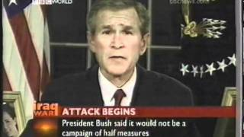

Slide 18
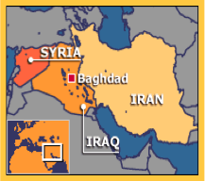
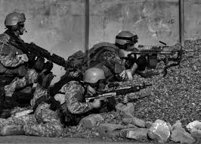
Iraqi Invasion
Fear that Iraqi dictator Saddam Hussein had weapons of mass destruction (WMDS) - biological, chemical, & nuclear
Used them on the Kurds
Refused to let U.N. inspectors search Iraq for WMDS
Later searched but none found - did he move and hide them?
Bush gave Hussein 48 hours to leave Iraq or face invasion
Hussein rejected the ultimatum and coalition forces took action

Slide 19
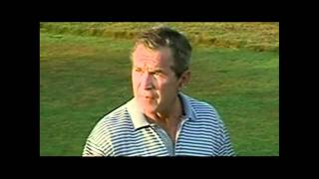

Slide 20
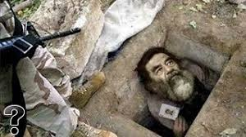
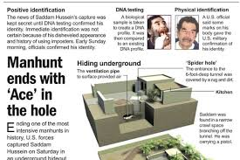
Operation Iraqi Freedom
On March 10, 2003, the U.S. and a coalition of over 30 allied countries invaded Iraq
Hussein’s dictatorship quickly collapsed
Iraqi national government - 1st Arab democracy in Middle East
Hussein was captured (2003) - placed on trial for crimes against humanity and was executed in 2006

Slide 21
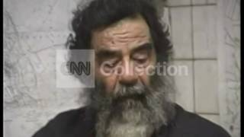

Slide 22
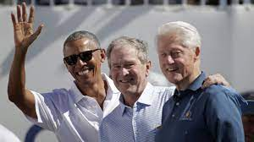
Bush Leaves Office
Leaves with low approval ratings
U.S. is in a recession
Hurricane Katrina aftermath
Hunt for Osama Bin Laden
However, he continues humanitarian efforts

Slide 23
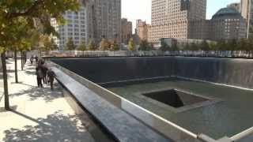

Slide 24
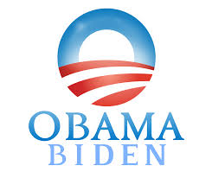
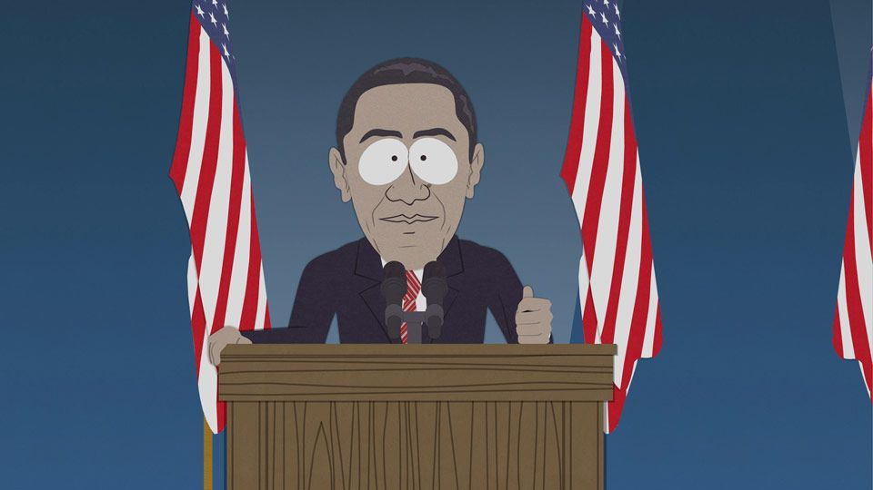
Barack Obama
Hope and Change
Unit 12: Modern Era

Slide 25
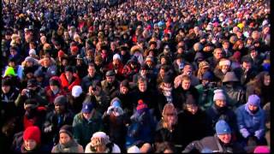

Slide 26
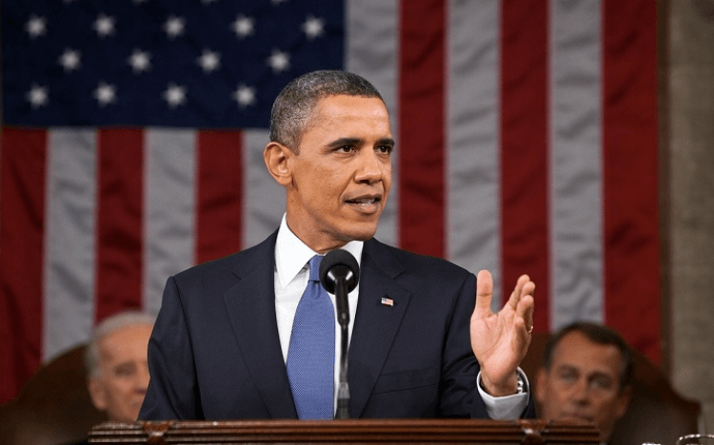
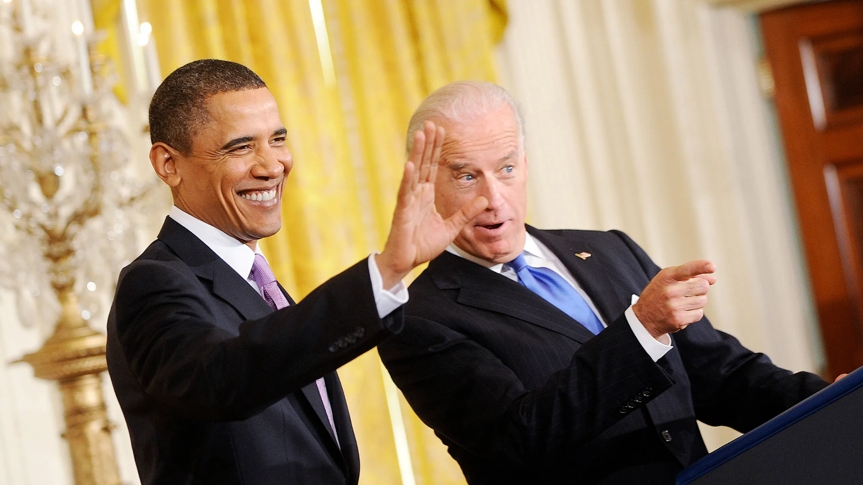
Barack Obama
44th President
In 2009, Barack Obama became the first African-American President of the United States, being elected in 2008
Before becoming president, Obama served as the first black president of the Harvard Law Review
An Illinois State Senator for 7 years & U.S. Senator for 3 years

Slide 27
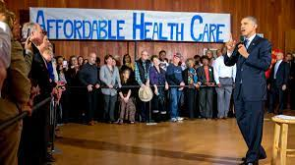
Healthcare Reform
His most notable and controversial achievement has been the Family Affordable Care Act (Obamacare)
Attempted to overhaul the nation’s healthcare
Expanded access to healthcare

Slide 28
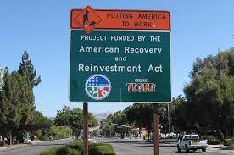
American Recovery & Reinvestment Act
Continued the government bail-out of the banking industry begun under President Bush
Stimulus to jumpstart the economy
The ARRA package included a series of federal government expenditures aimed at countering the job losses associated with the 2008 recession

Slide 29
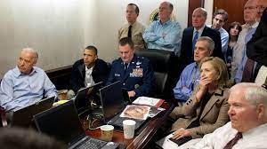
War On Terror
He continued the War on Terror around the world
Obama oversaw an approach that relies on a combination of targeted killing, relying on Special Operations forces and drones
Illustrating an approach designed to minimize the risk to American life and reshape the image of the U.S. overseas

Slide 30
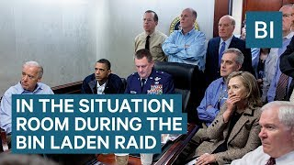

Slide 31
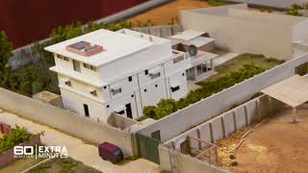

Slide 32
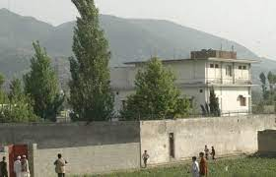
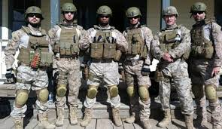
Death of Osama Bin Laden
Monday, May 2, 2011
Osama bin Laden is killed in Abbottabad, Pakistan, in a raid led by the U.S. Navy SEALs
Obama receives live updates in the White House Situation Room
Makes a statement to the nation @ 11:35 PM Eastern Time

Slide 33
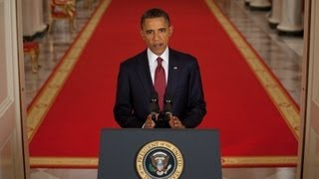

Slide 34
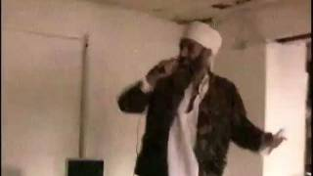
Just for fun… Do you think it’s actually him?

Slide 35
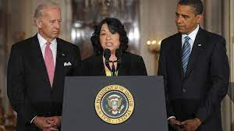
Supreme Court Nomination
Appointed Sonia Sotomayor
First Hispanic to serve on the U.S. Supreme Court
Graduated summa cum laude from Princeton University
In 1992, she was appointed by Pres. George H.W. Bush as a federal judge in the U.S. District Court, Southern District of New York

Slide 36
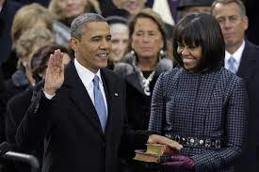
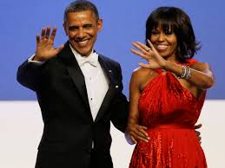
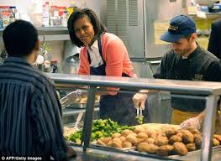
Obama & Michelle
Obama will serve 2 terms in office
Hunger-Free Kids Act
Championed by former first lady Michelle Obama and signed into law by former President Obama
Impacted the overall nutritional quality of school meals eaten by students, rather than meals served

