Slide 1
JFK, LBJ & The Great Society
Unit 10: Civil Rights #2

Slide 2
Recap
JFK was assassinated by Lee Harvey Oswald, who was then shot by Dallas nightclub owner, Jack Ruby
LBJ is V.P. and was sworn in as President of the United States
Johnson enacts many of JFK’s legislation pieces including the Civil Rights Act before moving onto his own agenda
With help from the sadness over JFK’s death, LBJ was able to gain (pass) the passage of the Civil Rights Act of 1964 & the Voting Rights Act of 1965

Slide 3
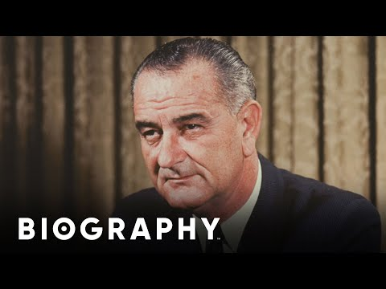
Lyndon Baines Johnson

Slide 4
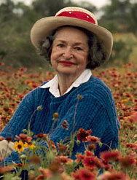
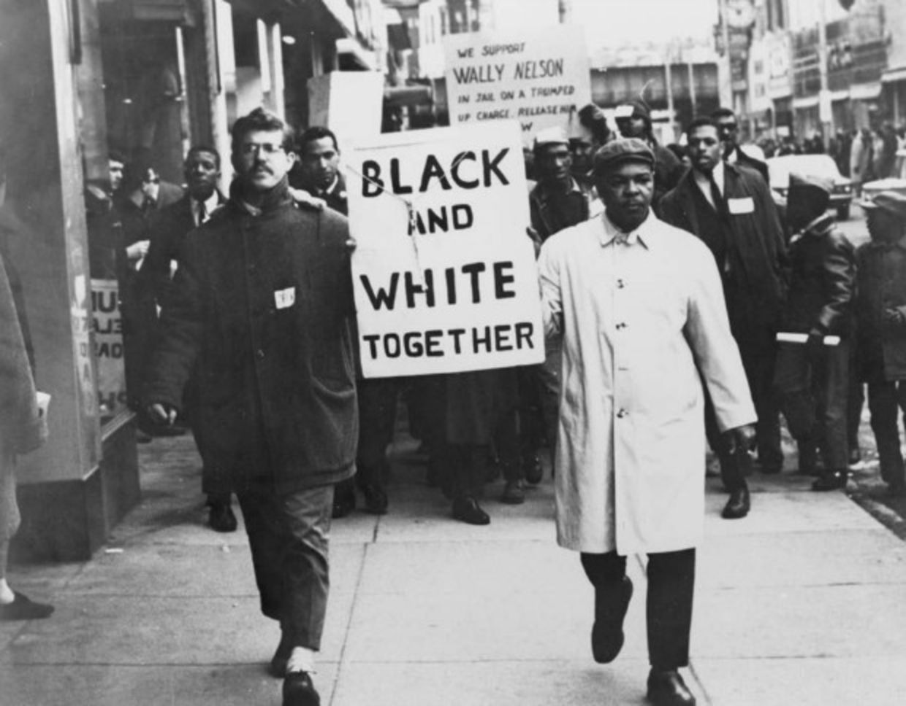
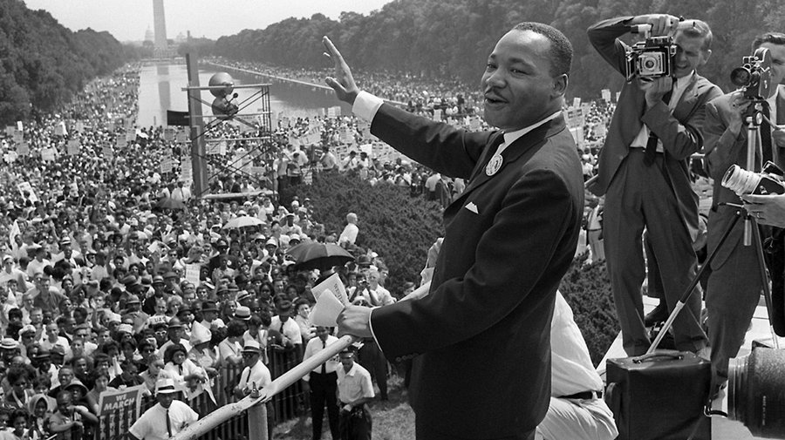
Lyndon B. Johnson Becomes President
Takes oath and sworn into office on the Presidential airplane, Air Force One, at Love Field Airport in Dallas
Tough negotiator; knew how to get things done
Southern Democrats shocked over LBJ’s dedication to African American Civil Rights

Slide 6
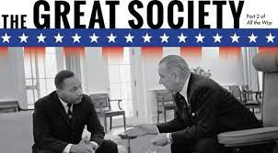
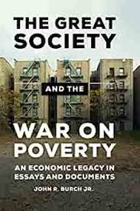
Great Society
LBJ saw himself as a domestic policy president
He wanted to make America a better, more fair place
He called this agenda “The Great Society”
The Goal:
Turn nation into a great society by opening up opportunities and improving quality of life for all Americans: End poverty & racial injustice
Supports:
Higher standard of living
Equal opportunity
Richer quality of life for everyone

Slide 7
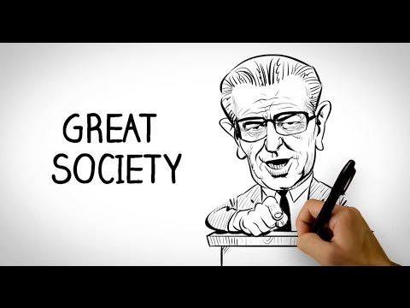

Slide 8
LBJ & Civil Rights Acts

Slide 9
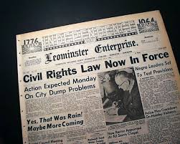
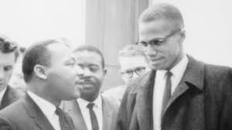
1964 Civil Rights Act
Johnson pushed through Kennedy’s idea for civil rights
Prohibited discrimination based on race, color, religion, and national origin
Granted the federal government new powers to enforce the law

Slide 10
What would be the impact of the 1964 Civil Rights Act?

Slide 11
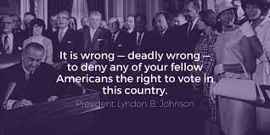
Voting Rights Act 1965
Part of the Civil Rights Act:
Voting rights for all Americans
The act prohibited literacy tests or other discriminatory practices for voting
The act insured consistent election practices

Slide 12
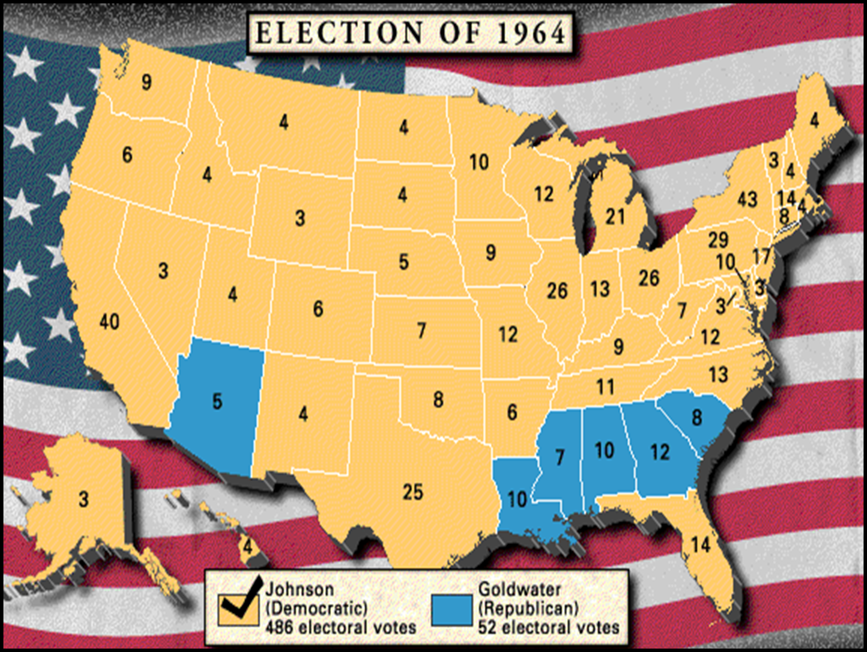

Slide 13
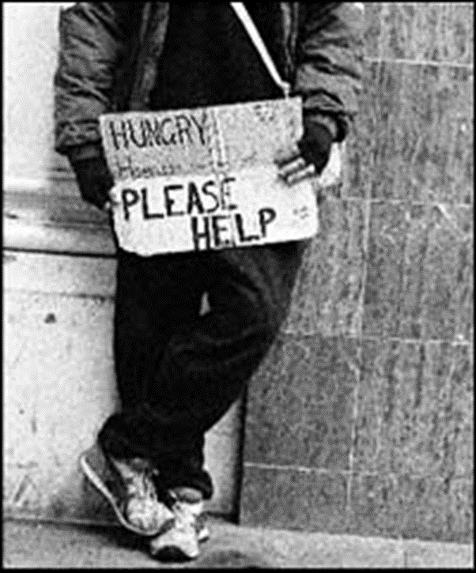
War on Poverty
In 1964, LBJ declares “Unconditional war on poverty”
In August of 1964, he pushed through Congress a series of measures known as the Economic Opportunity Act
The act provided $1 billion to aid poverty stricken citizens

Slide 14
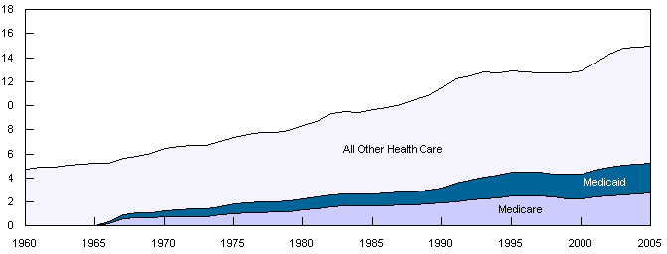
Attempts At Universal Healthcare
LBJ pushed two programs through Congress:
Medicare (healthcare for the elderly & disabled)
Medicaid (healthcare for the poor & disabled)
Percentage of U.S. GDP spent on healthcare, both privately and publicly.

Slide 15
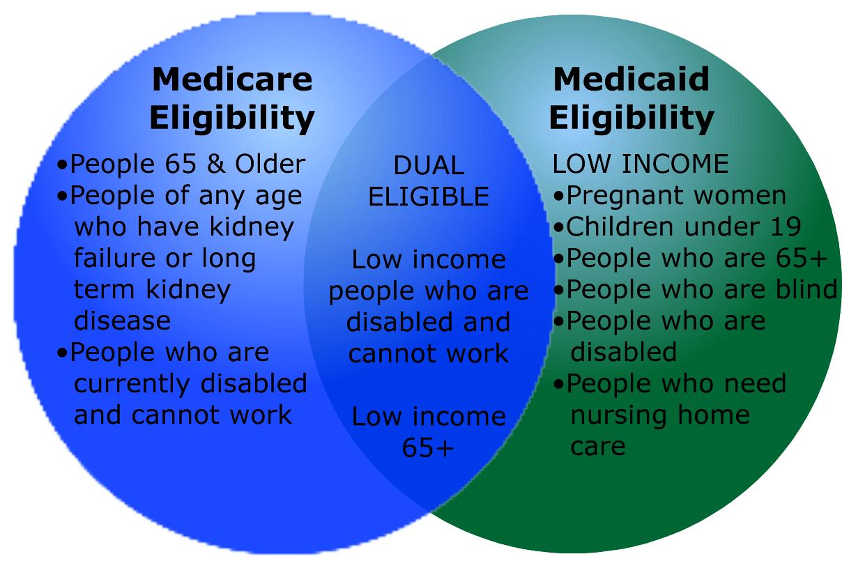

Slide 16
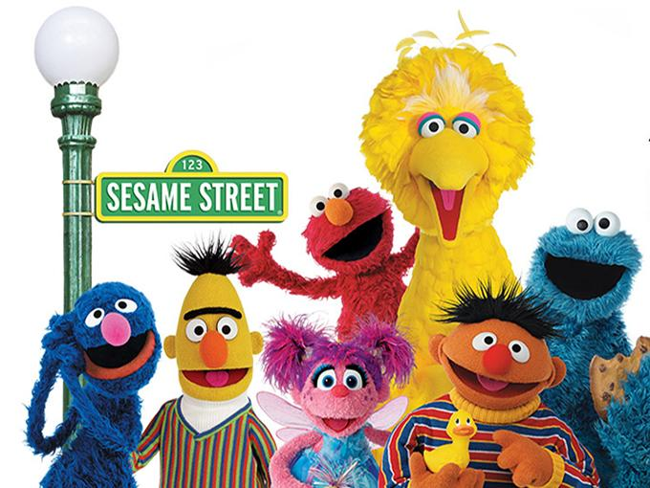
Other Great Society Programs
Other Great Society programs included:
Affordable housing laws
Childcare programs
Food stamps
Public educational programming

Slide 17
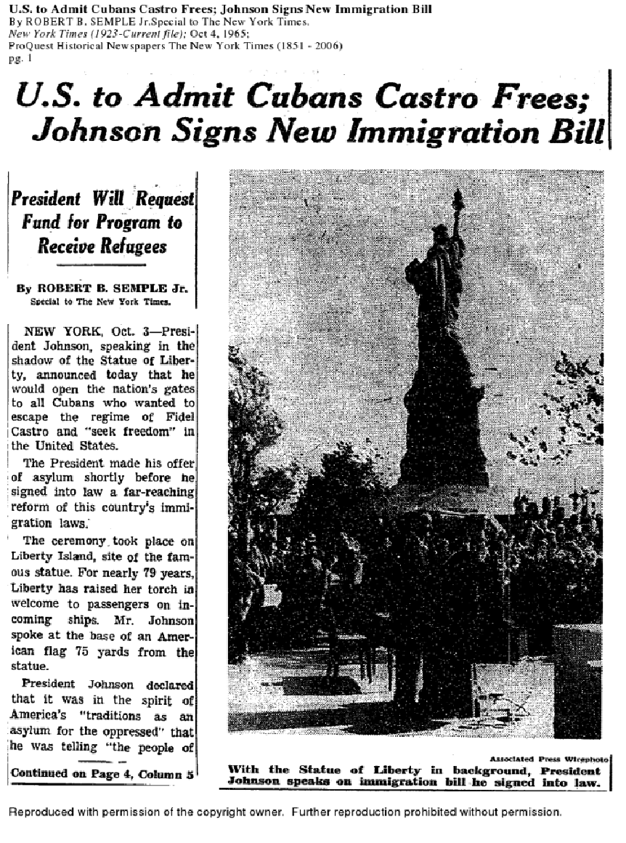
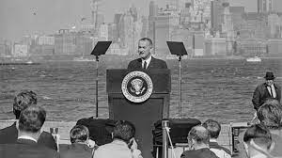
Immigration Act of 1965
Ended quotas based on nationality
Allows more people from 3rd world countries to enter U.S.
Separate quota from refugees
Ended Immigration Act of 1924 & National Origins Act of 1929

Slide 18
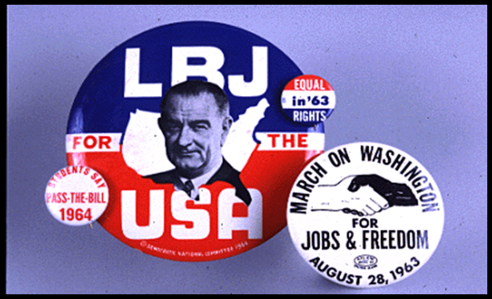
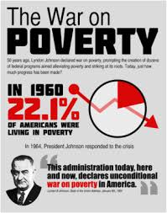
Impact of Great Society
The Great Society and the Warren Court changed the U.S.
No president in post-WWII era extended the power and reach of the federal government more than LBJ
Poverty drops from 21% of population in 1962 to 11% in 1973
Massive tax cut spurs economy
Great Society contributes to deficit:
Debate over finances, effectiveness of programs, and government’s role continued for years - and still continues today

Slide 19
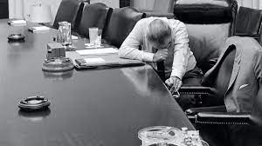
Vietnam & LBJ
We will discuss this in our next unit. All of this is going on at the same time as the Civil Rights movement, The Cold War, and will impact Johnson’s decision to not run for a second term.

Slide 20
