Slide 1
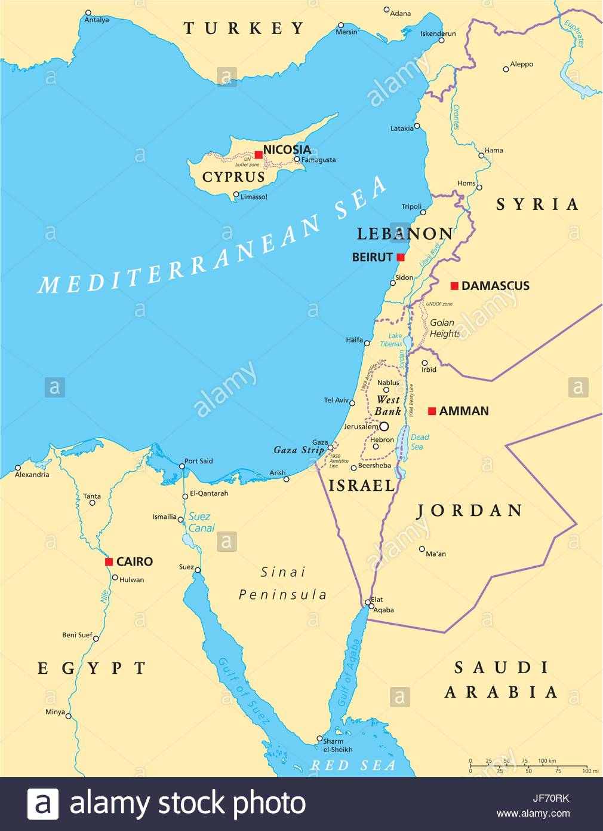
Human Geography
Eastern Mediterranean
Notes:
Friday April 10 was the last day of the 5th six weeks and grades are due Tuesday April 14th.
Monday April 13 begins the 6th six weeks.
Directions: After going through the lesson take the Quiz over the lesson.
This lecture is composed of 2 parts. Both equally important and both are necessary for you to complete the complete the quiz.
study of people and their communities, cultures, economies, and interactions with the environment
by studying their relations with and across space and place.

Slide 2
Eastern Mediterranean History and Government
The area is the birthplace of three major religions: Judaism, Christianity, and Islam.
Following World War II, armed conflicts broke out among Jewish and Arab groups in Palestine.
The Jews accepted a 1947 United Nations plan to divide Palestine into a Jewish state and an Arab state, while the Arabs rejected it.
Since 1948, tensions have riled both sides.
Other countries in the subregion have also struggled since independence.
Notes:
1947, the United Nations (UN) adopted a Partition Plan for Palestine recommending the creation of independent Arab and Jewish states.
The plan was accepted by the Jewish Agency and rejected by Arab leaders.
1948 the Jewish Agency declared the independence of the State of Israel,
All of Israel's neighbors declared war, this is the 1948 Arab-Israeli War.
Israel will fight many wars that they did not start gaining territory after winning each one.

Slide 3
Notes:
The Islamic symbol can be seen on the Turkish flag
The pastry Crescent is molded from the Islamic symbol after they lost the siege of Vienna.
The Viennese bakers made pastries in the shape of crescents to celebrate their victory over the Turkish in the 16th century.

Slide 4
Population Patterns
The dry, desert climate causes most people to live along the coastal plains.
Many ethnicities and religious sects reside in the subregion.
Demographics have changed drastically in the past century, with Israel experiencing a large migration of Russian Jews and the displacement of Palestinians following the establishment of the Israeli state.
Notes:
Demographics has changed drastically since the end of World War II and the establishment of a Jewish state.
Influx of European Jews followed by Russian Jews and African Jews all due to persecution or government instability
The displacement of the Palestinians has been a hot button topic and even today is a matter of debate.

Slide 5
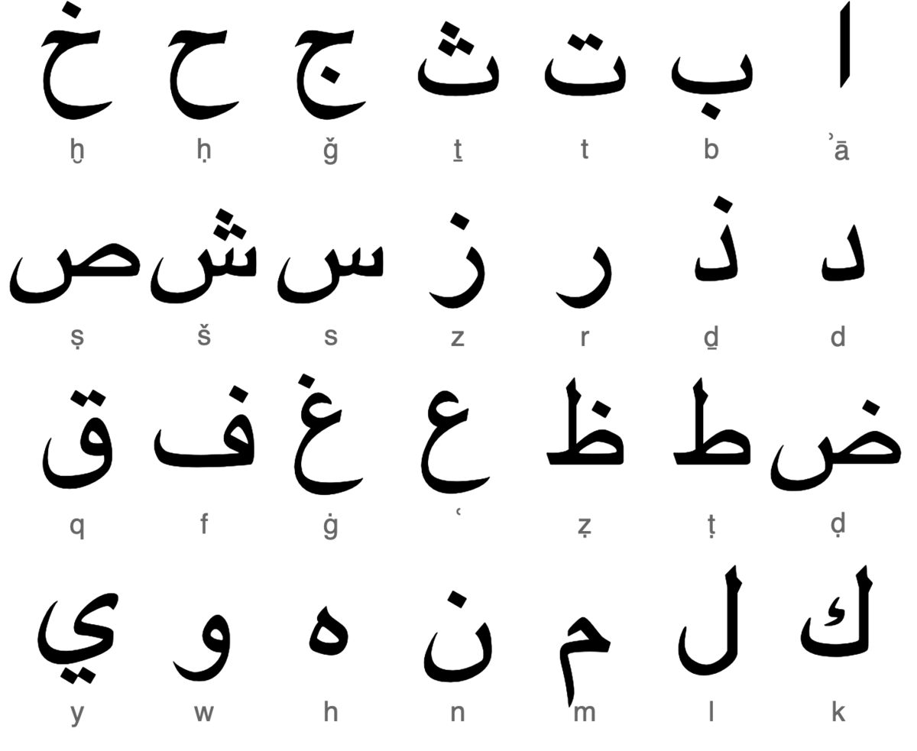
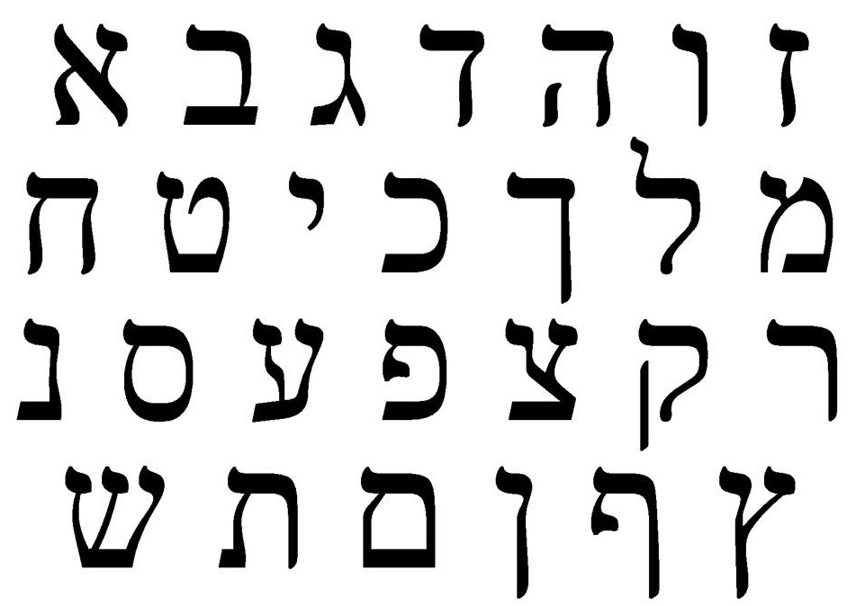
Society and Culture and Today
Arabic is the primary language in the subregion.
Hebrew also spoken in Israel.
Notes:
Example of the writing in this particular region
Israel is home to both Arabic and Hebrew speakers

Slide 6
Society and Culture and Today
Quality of education and health care varies widely from country to country.
Family life usually includes the extended family and often includes religious worship.
In Israel, women generally enjoy equal rights, while in Arabic countries, women’s rights vary greatly.
Notes:
Quality of education and health care varies widely from country to country.
Countries that enjoy more freedom are those whose government operates as democracy
The freedom that democracy allows can be seen in their ability to participate in the free markets.
Only Israel enjoys the freedom of democracy and capitalism in the region.
Healthcare and education is 1st class in Israel
Along with democracy and open markets women also enjoy equal rights.
Both men and women in Israel have to spend two years of mandatory service in the Israeli Defense Force.
Afghanistan under the Taliban women could not attend school
Women in most middle east countries are not allowed to drive.

Slide 7
Economic Activities
Economic growth is dependent on agriculture, small deposits of minerals, and manufacturing.
Service industries play a significant role in the subregion’s economy, as does tourism, although it can be negatively affected by conflicts and political instability.
Water transportation is vital to the area, with the Strait of Tirān linking the Gulf of Aqaba to the Red Sea.
Notes:
Service industry? Not involved with manufacturing but gives some type of service to the customer. Waiter, waitress, sales…
Terrorism has had a huge impact on tourism.
Currently the service industry in the US is taking a huge hit because of the coronavirus lockdown.

Slide 8
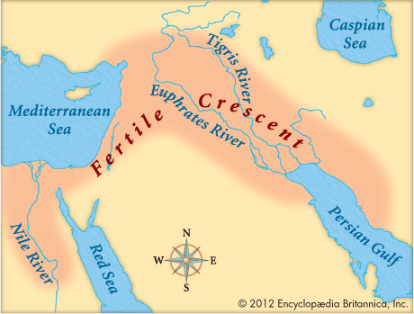
Human Geography
Northeast

Slide 9
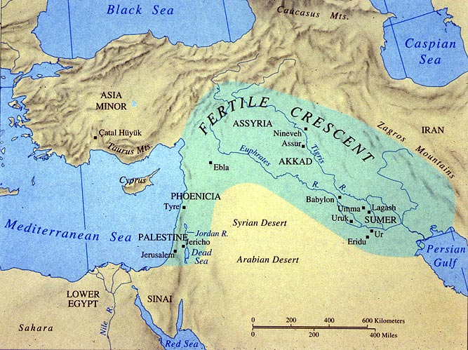
History and Government
The rich alluvial soils of Mesopotamia supported the development of agriculture, enabling it to become a culture hearth, or a center where rich cultures develop and spread to other areas.
Notes:
A cultural hearth is a site of innovation from which basic ideas, materials
and technology diffuse to many cultures.

Slide 10
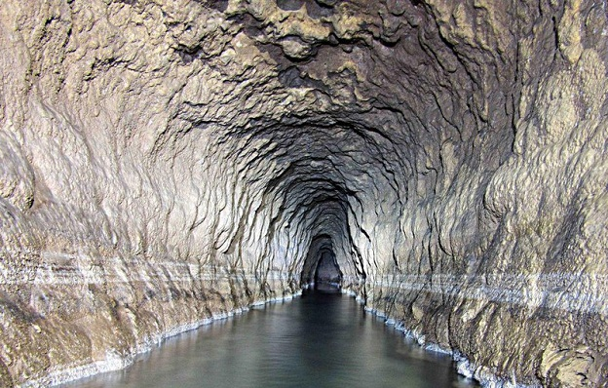
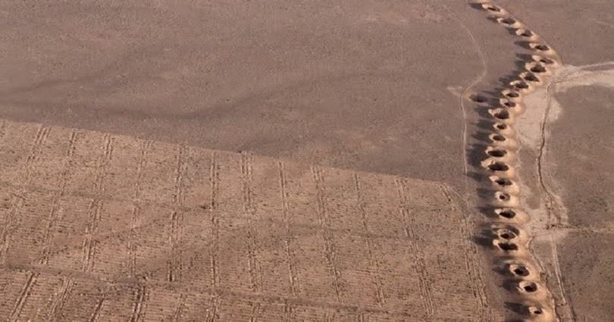
History and Government
The Persian qanat, or underground canals used for irrigation.

Slide 11
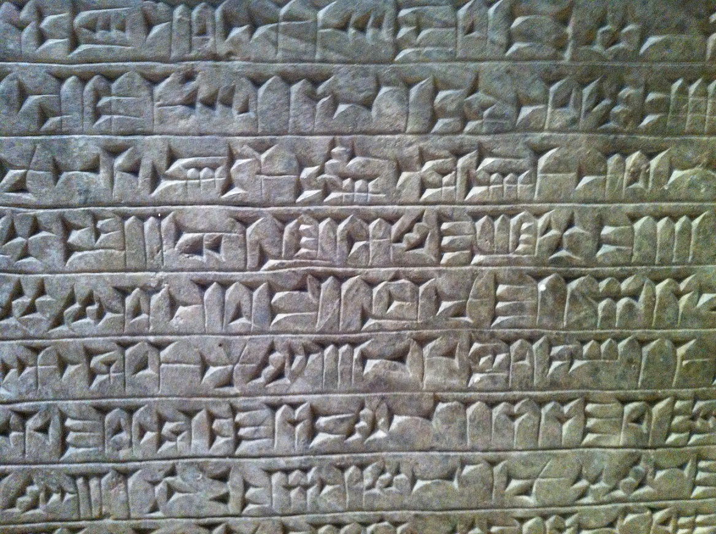
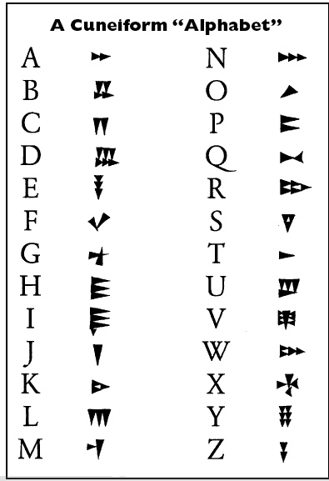
History and Government
Cuneiform, a form of early writing invented by the Sumerians, show the achievements of early civilizations.
Why do you think writing needed?
Turkey is working toward membership in the EU, while Iraq and Iran have struggled with political turmoil in recent decades.
Notes:
Cuneiform is a series of triangular indentions into clay tablets.
Record trade or value, payments
Most tablets found are from merchants recording sale and purchase transactions

Slide 12
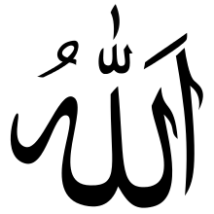
Population Patterns
While Islam is the dominant religion and significantly influences the culture, the population is ethnically diverse.
Major ethnic groups include Turks, Iranians, Arabs, and Kurds.
The Kurds are an ethnic group without an official country, although they call the area in which they live Kurdistan.
Countries in the subregion are increasingly urban, with overcrowding common in cities.
Notes:
Islam is the dominant religion and it has significant influence over their culture.
There are more than just Arabs other ethnic groups include Turks, Iranians (formally Persians) and Kurds.
Overcrowding in the cities due to the arid landscape or the inability to make a living in the rural areas.

Slide 13
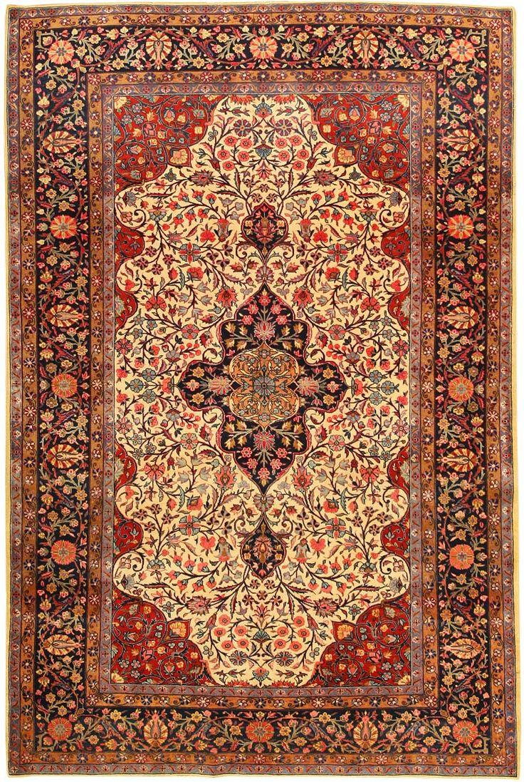
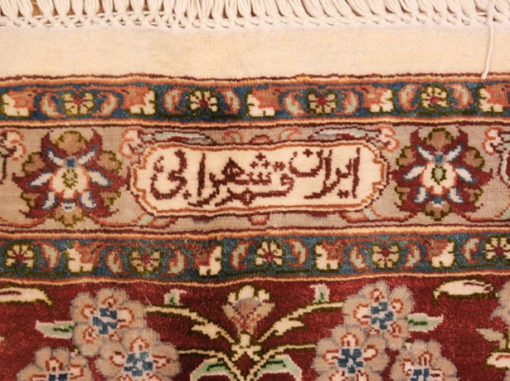
Society and Culture Today
Languages and customs differ depending on ancestral homes.
Family life includes the extended family.
In more secular societies such as Iraq, women and men have equal rights under the law, while women’s rights have been curtailed in Iran.
Early civilizations created important pieces of art and architecture, with Iran still the epicenter for the production of world-famous Persian rugs.
https://www.cnn.com/2017/09/27/middleeast/saudi-women-still-cant-do-this/index.html
Notes:
Women's rights have been curtailed in Iran is an understatement
Women in some Islamic countries must be accompanied/escorted by a male
There are morality police in Iran who enforce women's obedience
Women who get raped are charged with having sex outside of marriage
Secular means not subject to or bound by religious rule
In secular societies men and women enjoy equal rights while non-secular such as Iran women have few rights

Slide 14
Women in Iran: How are women's roles changing?

Slide 15
Economic Activities
Oil is a major economic resource in Iran and Iraq, allowing them to exert considerable influence in global affairs.
Natural gas, fishing, and agriculture also play important roles in the subregion’s economy.
Interdependence and trade are necessary in the area, as the countries of the Northeast need industrial products for their own markets, while industrialized countries need oil.
Notes:
Why does the US care what goes on in the Middle East?
US is not dependent on Middle East oil
If OPEC over produces prices go down
If there is a problem or a perceived problem prices will go up

Slide 17
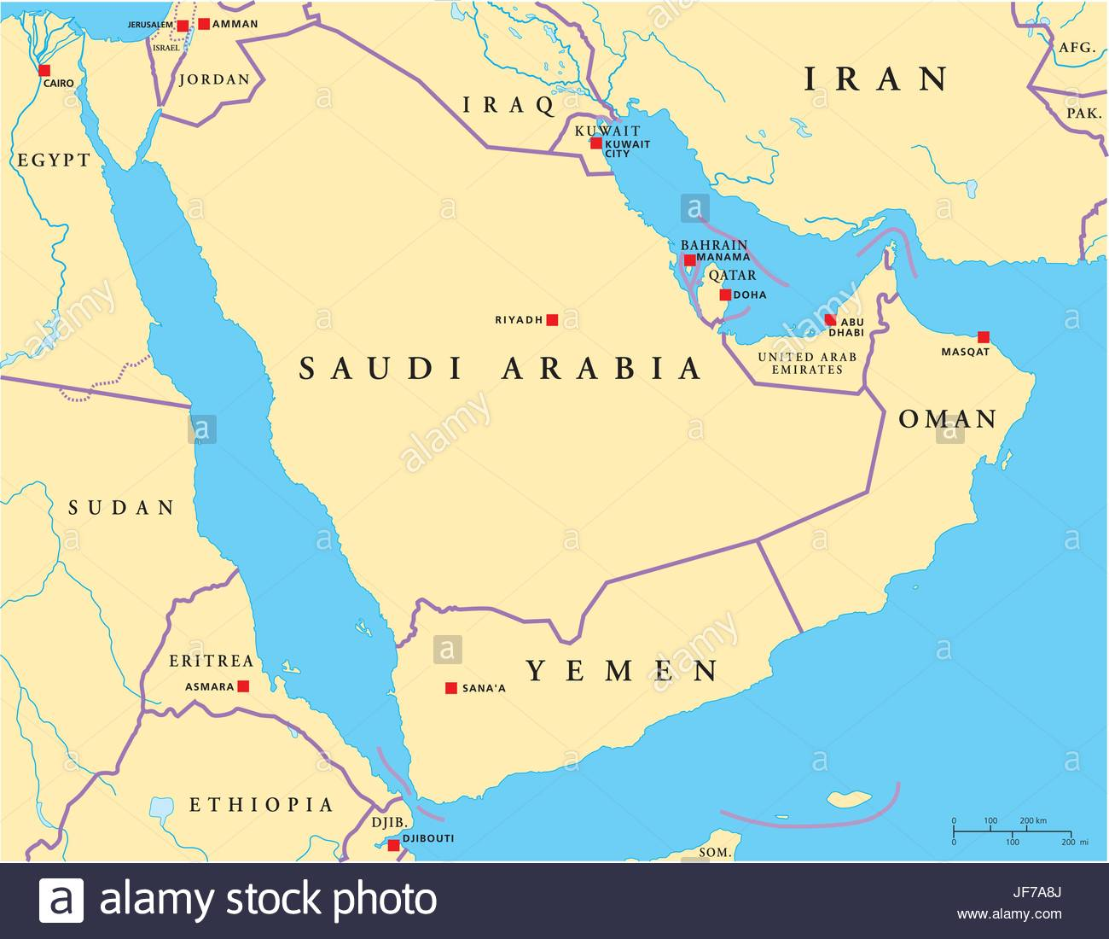
Human Geography
Arabian Peninsula

Slide 18
History and Government
Religion, ethnicity, and shared culture define the region, with most people being ethnic Arabs who practice Islam.
For centuries, tribal groups based on family relationships, or sheikdoms, controlled specific areas of the subregion, and their influence continues.
The majority of governments in the area are monarchies, with Saudi Arabia, Oman, and Qatar being absolute monarchies.

Slide 19
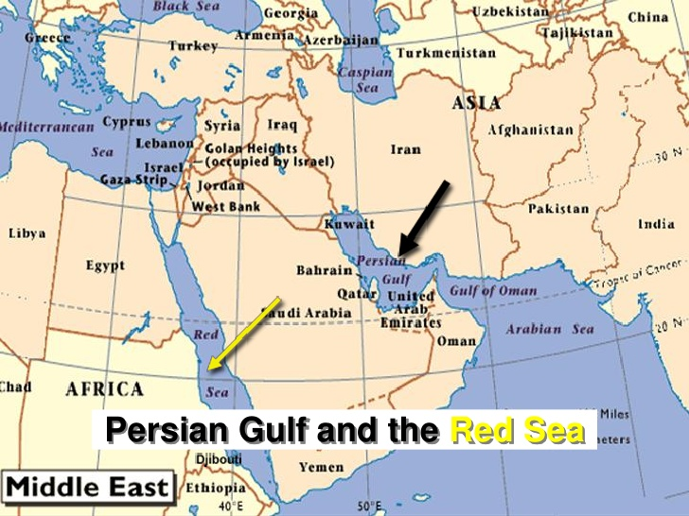
Population Patterns
The dry, desert climate causes most people to live along the coasts of the Persian Gulf and Red Sea.
Migration of workers to oil and construction jobs has altered the once exclusively Arab population.
In the interior of Saudi Arabia lies Makkah (Mecca), the holiest city of Islam, Madinah (Medina), which houses the tomb of the prophet Muhammad, and Riyadh, an important oil refining center and the capital.

Slide 20
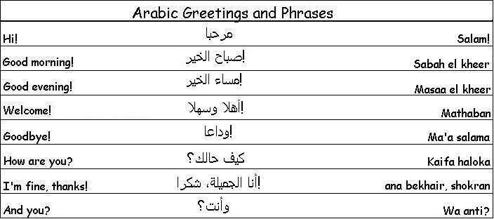
Society and Culture Today
Arabic is the primary language in the subregion, with English the most common second language.
After Muhammad’s death, conflicts arose over who would be the rightful successor, breaking the religion into different sects.
Shari’ah, or Islamic law, governs every aspect of a Muslim’s life.
Most countries do not enforce equal rights for women, and women have little political power.
Notes:
Sunni and Shia
Compared to Christianity that broke into Catholicism and Protestant
or even prior to that Christianity split between Roman Catholic and Eastern Orthodox

Slide 21
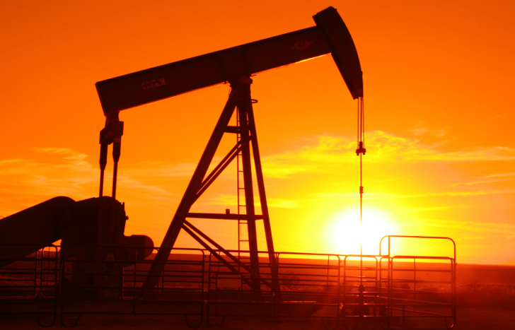
Economic Activities
Oil has produced great wealth for the Arabian Peninsula; it is one of the world’s most important regions for oil production.
Countries with smaller oil reserves have developed other industries, such as banking and finance in Bahrain, and fishing in Oman, to foster economic growth.
Lack of water remains the most important natural resource issue.
Notes:
Most of the Arabian Peninsula is a huge desert the Arabian desert.

Slide 22
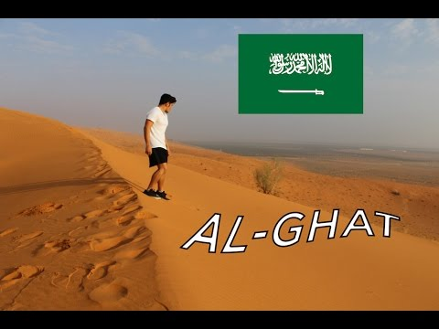
Geography Now Go: Saudi Arabia
Notes:
Small town in the desert

Slide 23
Human Geography
Central Asia
Notes:
Central Asia region has been dominated by Soviet control until the 1990’s when the Soviet Union fell apart

Slide 24
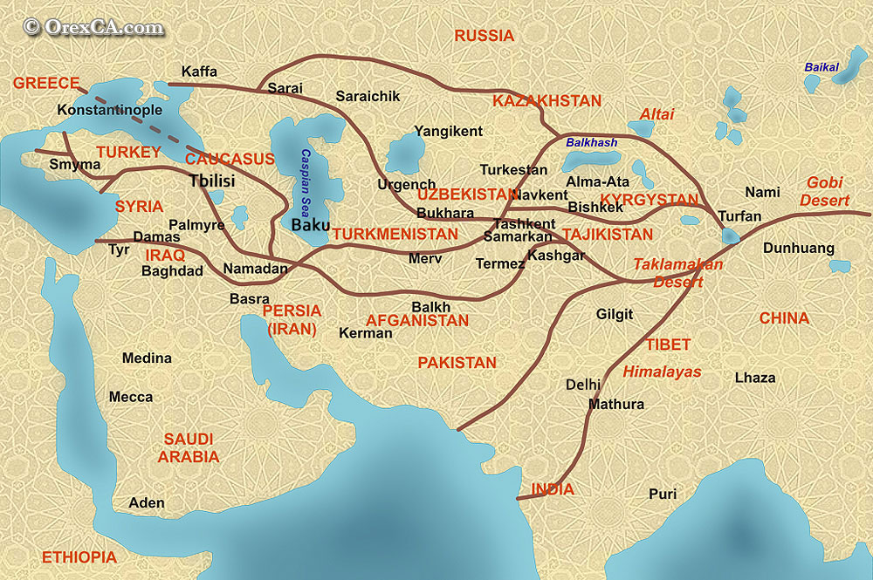
History and Government
Christianity has been a significant influence in Armenia and Georgia, while Islam became the predominant religion of the “stan” countries.
Established for trade between Europe and China, the Silk Road became an important asset and target for various empires.
Notes:
“stan” countries such as Turkmenistan, Uzbekistan, Tajikistan, Kazakhstan and Kyrgyzstan ethnic enclaves and groups
former Soviet states before the fall of the Soviet Union.

Slide 25
History and Government
The entire region, except Afghanistan, was under Soviet control until the 1990s.
Ethnic conflict and political turmoil continue to plague the region.
Notes:
Political vacuum was created and there was a rush to fill that vacuum.

Slide 26
Population Patterns
Although several countries are named for one ethnic group, most have a complex mix of ethnic groups.
Populations are shrinking in Armenia and Georgia due to low birth rates, while the populations of other nations are increasing.
The rate of urbanization is low overall but growing.
Ethnic differences have created conflict in some areas resulting in displaced persons.

Slide 27
Society and Culture Today
Languages in the Turkic language family are the most commonly spoken, though Russian is still widely used.
Literacy rates are high except in Afghanistan, and health care spending overall is low, except in Georgia.
Family life is a mix of traditional and modern influences, depending on rural or urban location.
Under Soviet control, women enjoyed more equal rights than in many countries, especially Afghanistan.
Notes:
Literacy – the ability to read and write

Slide 28
Economic Activities
Economic growth is dependent on agriculture and exports of natural resources, such as oil and natural gas.
Economic output remains low, as many people rely on agriculture, but farming methods and lack of arable land constraint yields.
Most countries have not yet shifted to market economies, leaving governments in control of many facets of manufacturing and farming, resulting in inefficient business practices that are also susceptible to corruption.
Notes:
Economic success = ability to export natural resources
Most countries do not have market economies and government control leads to inefficiency and
very susceptible to corruption

