Slide 1
Life in the Twenties
Unit 6: Life in the Twenties #2

Slide 2
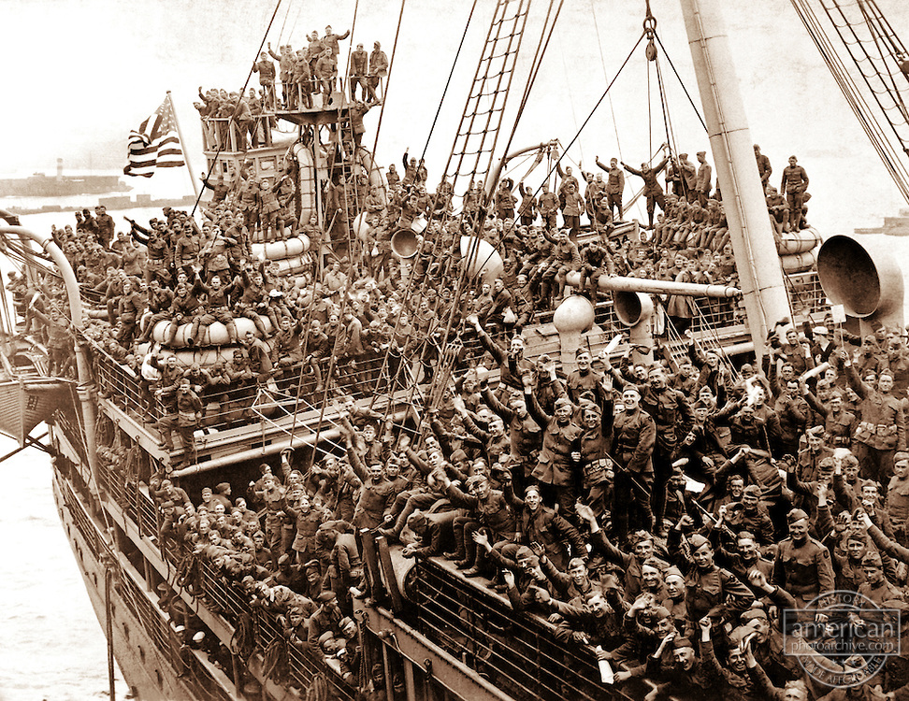
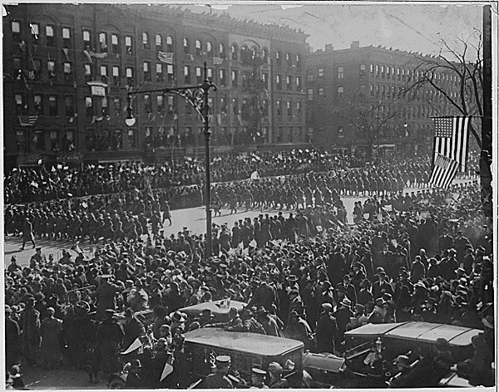
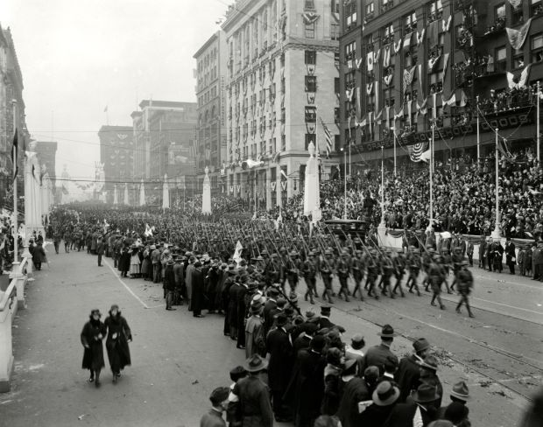
Coming Home
As American soldiers came back from war, they were celebrated as war heroes, but quickly, life went back to “normal”

Slide 3
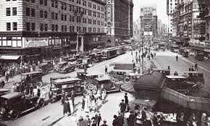
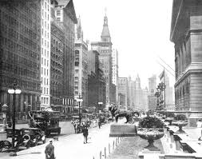
Cities were the place to be…
Small town attitudes began to lose their hold on the American mind as cities rose to prominence
Between 1922 and 1929, migration to the cities accelerated, with nearly 2 million people leaving farms and towns each year flocking to the cities

Slide 4
Americans & Leisure time
Americans began working more 8AM - 5PM jobs
They had time that wasn’t tied up with work and survival
They had money to spend (not having to make enough to “get by”)
Leisure Time - time to do what you enjoy
The mass media, movies, music, and spectator sports played important roles in the 1920s
Radio
“Talkies”
Flappers: young women refusing to obey cultural norms
Air travel: Curtiss (first long distance flight across N. America); Lindbergh (first Transatlantic flight)
Americans’ standard of living rose

Slide 5
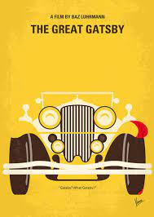
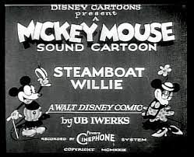
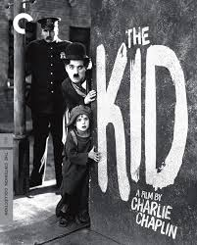
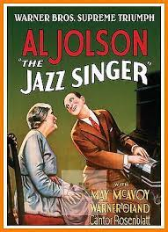
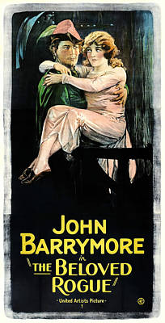
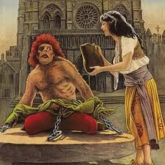
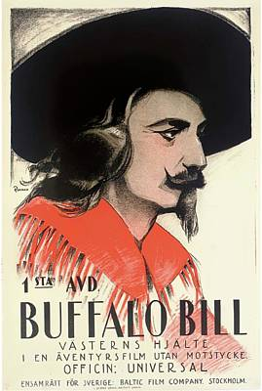
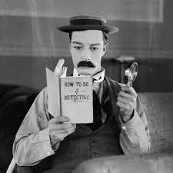
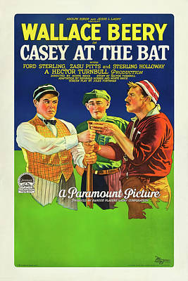
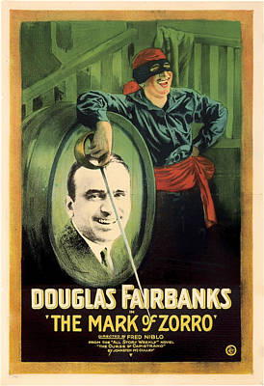

Slide 6
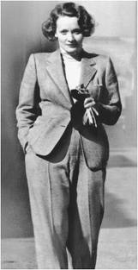
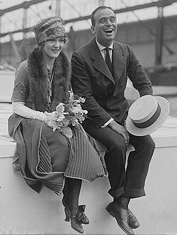
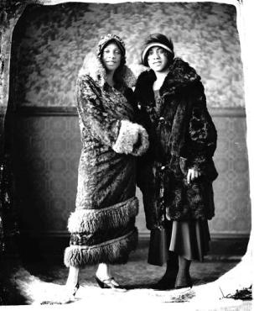
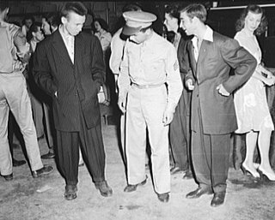
Fashion
Coco Chanel was one of the first women to cut her hair and wear pants
Women also started wearing shorter pleated skirts and bathing suits
Corsets were replaced with camisoles and bloomers
Men wore sweaters and athletic clothes as leisure wear

Slide 7
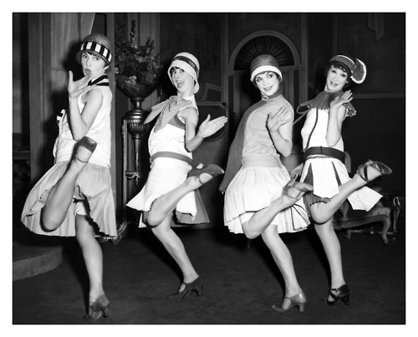
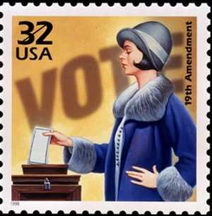
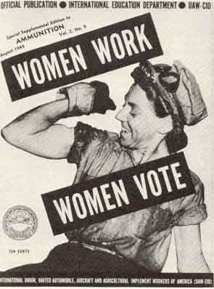
Women: Flappers & 19th Amendment
Women who rebelled against tradition
Clipped their long hair into short boyish cuts
Started smoking cigarettes and drinking in public, talking openly about sex
Marriage was starting to be seen as a partnership, although both agreed that the house and children remained a woman’s job
*Considered going against the social norms*
19th Amendment:
Passed by Congress June 4, 1919
Ratified on August 18, 1920
19th amendment granted women the right to vote

Slide 8
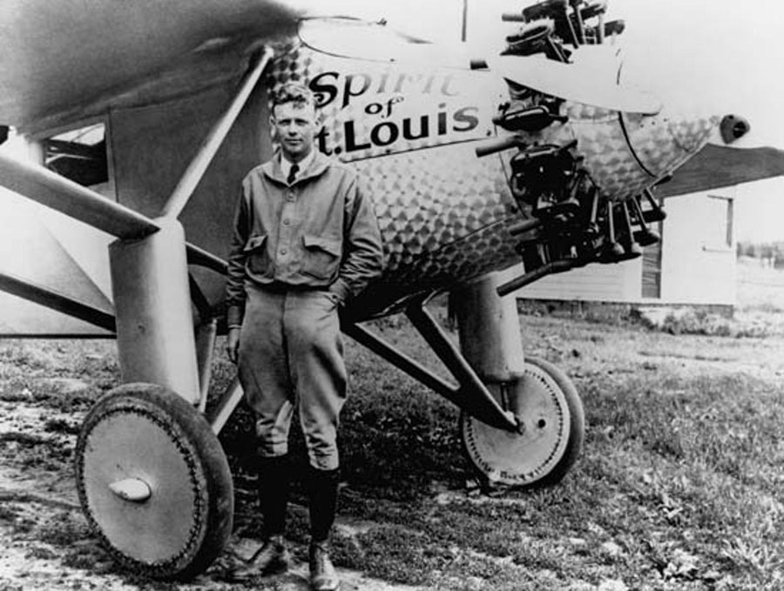
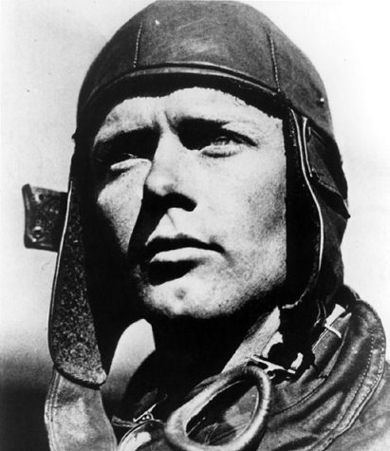
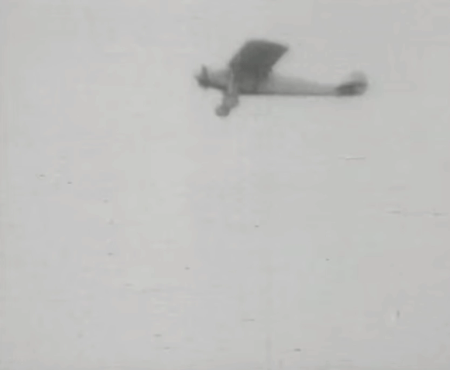
Air Travel & Charles Lindbergh
A price of $25,000 was offered for anyone that could fly solo nonstop across the Atlantic
In May of 1927, Lindbergh took off from New York in his plane, The Spirit of St. Louis
After 33 hours and 29 minutes in the air, Lindbergh landed outside of Paris
He was the first to fly solo across the Atlantic
Inspired by Amelia Earhart

Slide 9
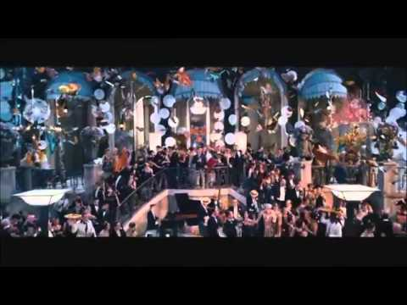

Slide 10
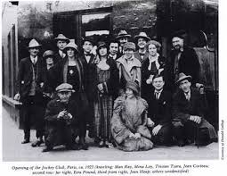
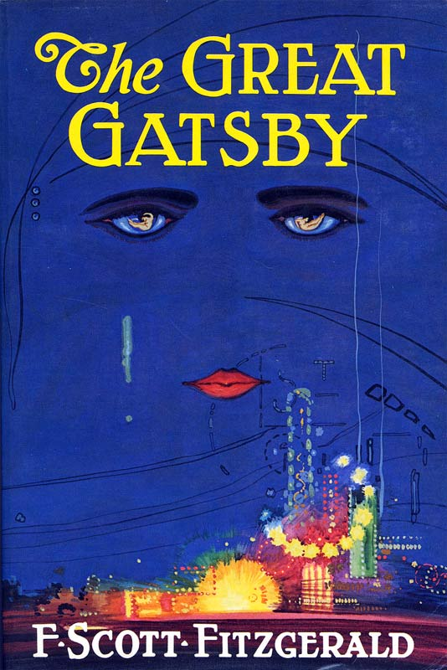
Lost Generation
Group of writers who rejected the desire for material wealth
Felt they did not fit in the patterns of everyday life after the horrors and brutality of WWI
Felt America had become overly materialistic and lacking spirituality
F. Scott Fitzgerald: Wrote “The Great Gatsby” and coined the term “The Jazz Age”

Slide 11
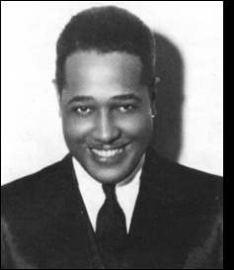
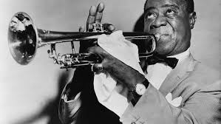
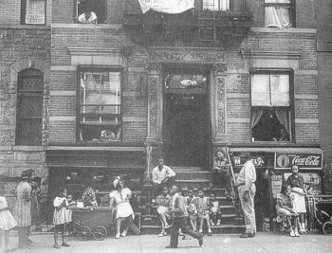
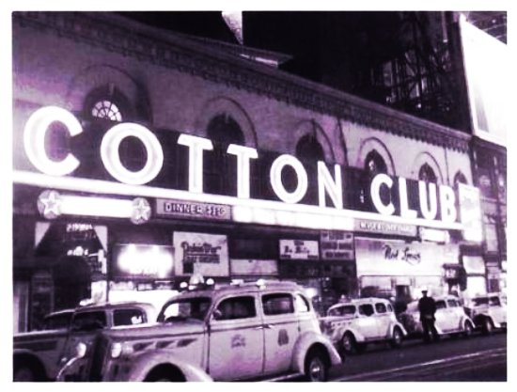
The Harlem Renaissance
A literary and artistic movement celebrating African American culture
Many African Americans who migrated north moved to Harlem
A neighborhood on the Upper West Side of New York’s Manhattan Island
In the 1920s, Harlem became the world’s largest African American community
The explosion of African American culture in Harlem
Louis Armstrong
Duke Ellington

Slide 12
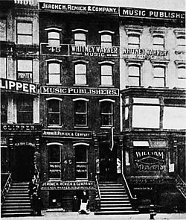
Tin Pan Alley
Tin Pan Alley: a group of music companies that spread the sounds of jazz and blues across America
Beginning of the modern music industry (“popular” music)
Easy-to-play songs that sounded similar to authentic Jazz & Blues music became very popular in American culture

Slide 13
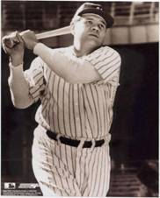
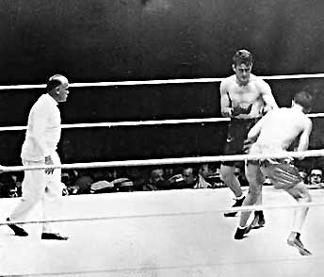
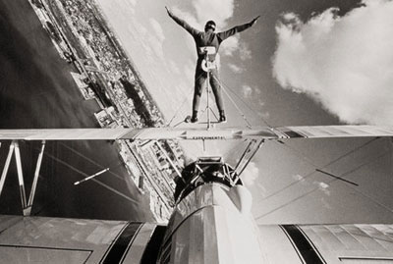
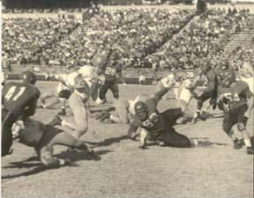
Sports
Publicity, money, and promotion made sports a big part of the 1920s
Tennis, golf, baseball, swimming, football, and boxing were some of the most popular
Babe Ruth was traded from Boston to NY and went on to hit a career total of 714 home runs (3rd highest overall)
Americans had time to enjoy “leisure” and sports exploded

Slide 14
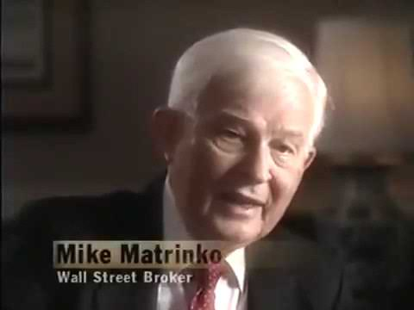

Slide 15
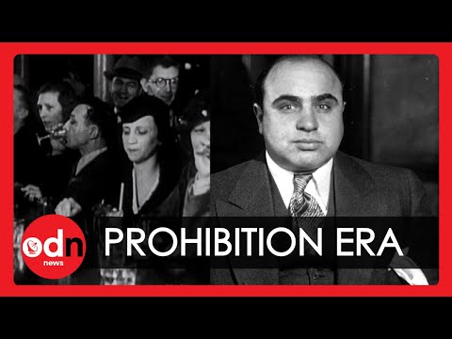
A peak at tomorrow…

Slide 16
Knowledge Check
How were women impacted during the 1920s?
Harlem Renaissance:
What was it?
Name someone who began their career during this time.
How did it connect America?
Tin Pan Alley
What is the connection to modern times?
Changed the way society viewed them: changed their appearance (clothes, hair), changed how they acted in public (smoked, drank, danced), and moved away from traditional values
A literary and artistic movement celebrating African American culture
Duke Ellington & Louis Armstrong
People united over the new music; led the way to modern music
The music became very popular in American culture; beginning of modern music

Slide 17
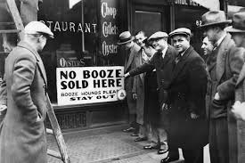
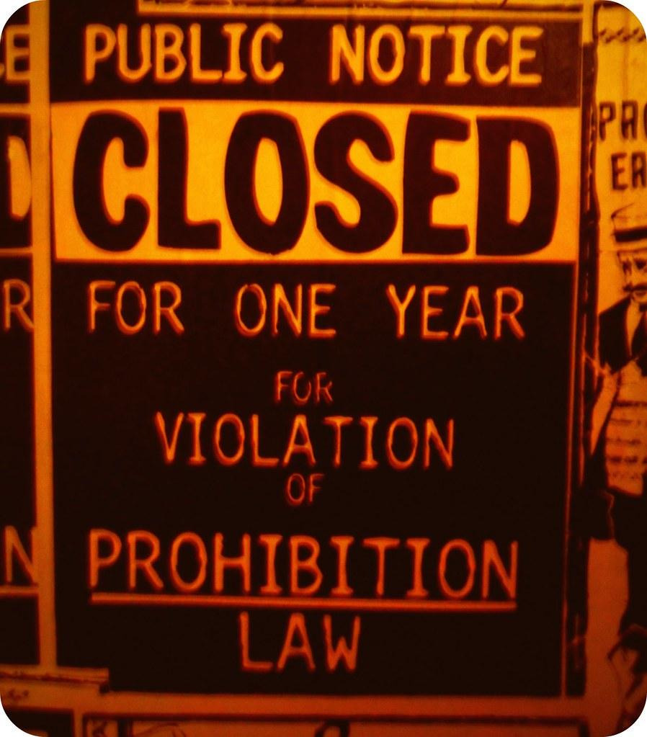
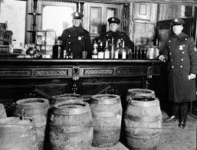
Prohibition
Prohibition: the manufacture, sale, and transportation of alcoholic beverages was illegal
Reformers had considered liquor to be the prime cause of corruption for many years
Drinking was thought to lead to crime, wife and child abuse, accidents on the job, and other serious problems
Prohibition actually led to disrespect for the law and a rise in organized crime in nearly every major city

Slide 18
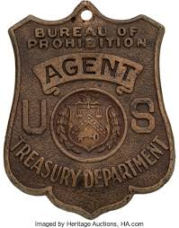
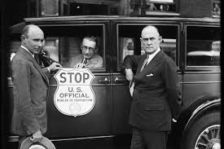
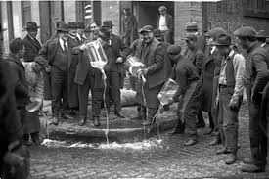
The Volstead Act
Established a prohibition bureau in the Treasury Department in 1919
The agency was underfunded (not enough $$)
Only 1500 federal agents

Slide 19
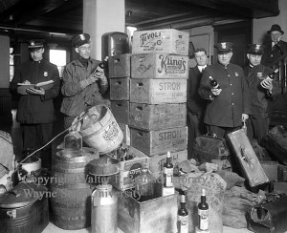
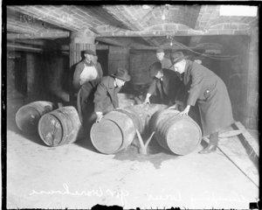

Slide 20
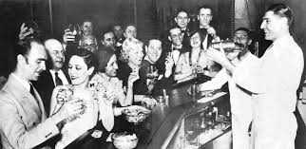
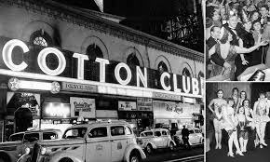
Speakeasies
Speakeasies: hidden saloons and nightclubs
So called because when inside, one spoke quietly, or “easily” to avoid detection

Slide 21
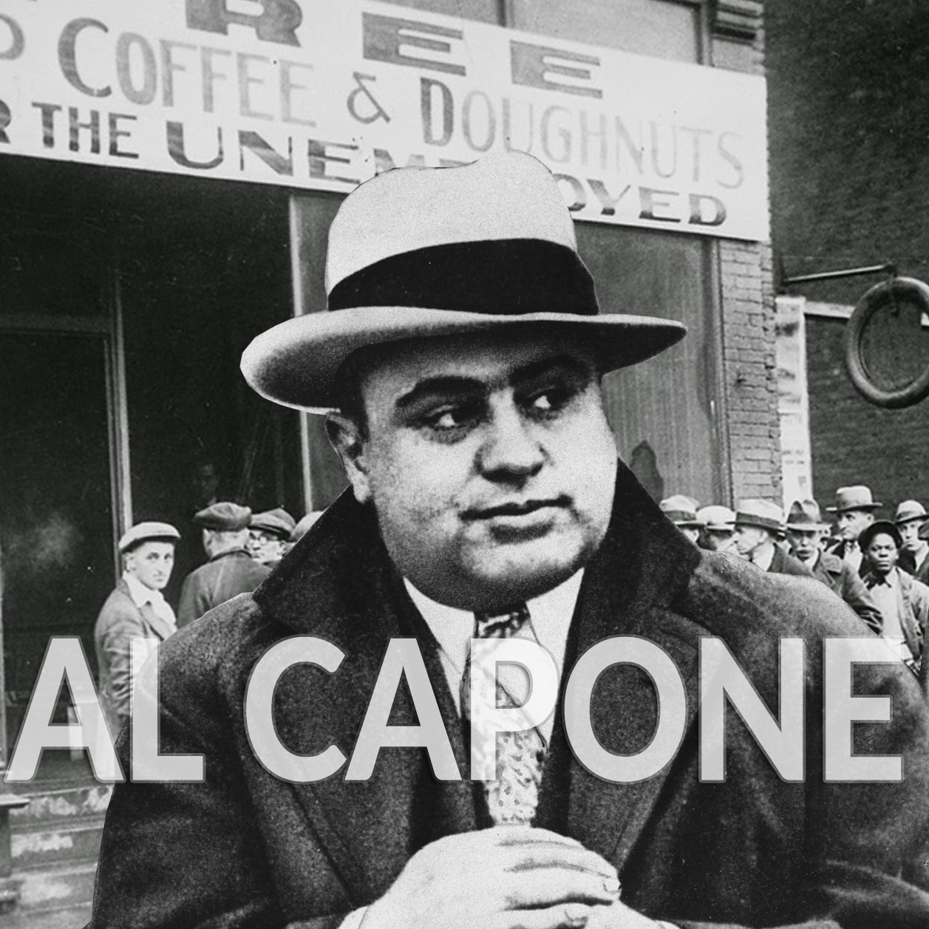
Bootleggers
Smuggled alcohol into the country for sale
Named for the smugglers practice of carrying liquor in the legs of boots
The name came from the Midwest in the 1880s to stand for the practice of concealing flasks of illicit liquor in boot tops when going to trade with Native Americans

Slide 22
Quick Check
What was the Volstead Act?
It created a prohibition bureau in the Treasury Dept. in 1919 to enforce prohibition laws

Slide 23
Al Capone - The Celebrity Gangster
Chicago became notorious as the home of Al Capone
A gangster whose bootlegging empire netted over $60 million a year
Capone bootlegged whiskey from Canada, operated illegal breweries in Chicago, and operated 10,000 speakeasies
Al Capone’s defiance of Prohibition quickly turned him into a celebrity criminal
Law could not tie him to bootlegging industry
“Well I sell liquor, it’s called bootlegging; when my patrons serve it on Lake Shore Drive, it’s called hospitality…”

Slide 26
The End of Al Capone
Al Capone was finally arrested in 1931 for not paying income taxes
Spent more than 4 years at Alcatraz, where he worked in the laundry

Slide 27
St. Valentine’s Day Massacre
February 14, 1929 - Chicago’s North Side
Gang warfare was high as Al Capone looked to take out his competition in illegal trades of bootlegging, gambling, and prostitution
Gang violence reached its bloody climax in a garage, when 7 men associated with Irish gangster George “Bugs” Moran, were shot to death by several men dressed as policemen
Remains an unsolved crime and never official linked to Capone

Slide 29
Prohibition
By the mid-1920’s only 19% of Americans supported prohibition; most said it made problems worse
The 18th amendment remained in force until 1933 when it was repealed with the 21st Amendment

Slide 30
DAy 2 Notes

Slide 31
The Scopes Trial
What is evolution?

Slide 32
Fundamentalism
Fundamentalists:
Skeptical of science
Felt all important knowledge is in the Bible
Felt the Bible should be interpreted literally
Rejected Charles Darwin’s Theory of Evolution
Followers began to call for laws prohibiting the teaching of evolution

Slide 33
The Scopes “Monkey” Trial
In 1925, Tennessee passed the nation’s first law that made it illegal to teach evolution
The American Civil Liberties Union (ACLU) promised to defend any teacher who would challenge the law
John T. Scopes, a biology teacher, accepted the challenge

Slide 34
Scopes: In his biology class…
“We have now learned that animal forms may be arranged so as to begin with the simple one-celled forms and culminate with a group which includes man himself”
Scopes was promptly arrested and put on trial
Little town of Dayton, Tennessee exploded with reporters:
The trial quickly became a symbol of the conflict between science and religion
First trial in American history to be broadcast over national radio

Slide 35
The Attorneys of Scope Trial
William Jennings Bryan:
Prosecutor
AGAINST evolution
Supported the ideas of fundamentalism
Clarence Darrow:
Defended Scopes
In support of evolution
Very successful attorney

Slide 36
Quick Check
Scopes Trial showed the struggle between what two sides?
Religion vs. Science

Slide 37
The NAACP
Northern cities in general had not welcomed the massive influx of African Americans
Many African Americans found a voice in the NAACP
African Americans faced many daily threats and discrimination

Slide 38
Marcus Garvey
Born in Jamaica - Black Nationalist
Founded the United Negro Improvement Association (U.N.I.A.)
Back-to-Africa Movement: Promoted African Americans resettle in Africa
Start of black nationalism
Sought to maintain and promote their separate identity as a people of black ancestry
Advocated that Blacks separate from Whites in society
Journalist & Publisher
Wrote about Black empowerment and liberation

Slide 39
If you have a credit card with no limit on it… what would you buy?

Slide 40
Consumerism & Credit
During the 1920s, people started buying things they didn’t really need
Examples:
Vacuums
Washing machines
Installment plan = credit
Buy now, make small payments over time
First time we used credit for things that weren’t necessary
Made Americans look wealthy
Really, we just had a lot of debt

Slide 41
Superficial Prosperity
Americans believed prosperity would go on forever
We were producing great quantities of goods
From 1920-1929, average annual income went from $522 to $705 (+35%)
Modern advertising: stimulated demand for goods

Slide 43
Henry Ford
Henry Ford mastered the use of the assembly line with his Model T Ford
Assembly line:
Product moves down a line, each worker completing one simple job

Slide 44
What is the outcome?
Production costs go
The cost of a car goes
Which means everybody can get one!

Slide 45
Forms of Transportation
The Breezer
The roaring 20s provided transportation to rural residents as larger schools were replacing the one-room schoolhouse

