Slide 1
IMMIGRATION ACTIVITY
Directions: You get to decide if they are in or out! Based on their information, will you allow them to stay?
You can only allow 7 of the 14 people to enter!
Choose wisely!

Slide 2
Candidate #1
Nationality: Italian
Religion: Catholic
Background: A barber who lives in a small village outside of Naples, Italy. Wife is a seamstress. They have 7 sons and 2 daughters. His sons have been known to cause problems. He wants to come to America so that his sons can start over and not live a life that will lead to jail.

Slide 3
Candidate #2
Nationality: Born in Barbados
Background: Grew up in Barbados with a Barbadian father and Guyanese mother. As a child, she listened to Caribbean music, such as reggae, as well as American hip-hop and R&B. She won her high school talent show and wants to come to America and make it big in the music business.

Slide 4
Candidate #3
Nationality: German
Religion: Unknown
Background: Occupation unknown. Married to third wife. Has a drinking problem, occasionally violent. Son has artistic skills. Desires a better way of life.

Slide 5
Candidate #4
Nationality: South Korean
Background: The father wants to become a physician. He has a son that he wants to become a doctor one day as well. The son is very smart and very funny!

Slide 6
Candidate #5
Nationality: French Canadian
Religion: Unknown
Background: Secretary. 18-year old single mother wants better opportunities for her and her son. She is tired of working at low paying jobs and living in low-income housing.

Slide 7
Candidate #6
Nationality: German
Religion: Unknown
Background: Factory worker. Family is in a constant struggle to survive. His son and daughter in law recently had twins and one died. His wife is very sick as well. Wants to bring his family over so that his only grandson can live the American Dream.

Slide 8
Candidate #7
Nationality: German
Religion: Jewish
Background: Small businessman, very optimistic, yet just went bankrupt. Married with two children. Son 7, who cannot read or write, and daughter, age 5. Desires to live in Philadelphia

Slide 9
Candidate #8
Nationality: Mexican
Background: Small business owner. Wants to relocate his family to the United States due to financial difficulties. Currently has a troublesome relationship with his wife, and is thinking about a divorce. Wants a better way of life for his daughter.

Slide 10
Candidate #9
Nationality: Mexican
Background: Very wealthy Mexican in the pharmaceutical business. He was a leader in his community and offered protection to those in danger. He gave a lot of money to churches. He wants to move to the U.S. to live in a gated community.

Slide 11
Candidate #10
Nationality: Australian
Background: His father immigrated to Australia from Spain and married his mother. He grew up in Brisbane, Australia. He really wants to move to LA to pursue acting. In high school he played sports and developed a love for art and photography. He was also in a ‘Seussical,’ which featured him as ‘Cat in the Hat.’

Slide 12
Candidate #11
Nationality: Croatian
Background: Born in 1962, in Zbjeg, Croatia. When he was 8, he fled the communist regime with his family to live in Canada; one suitcase and $20. At the time he spoke no English. They lived for 18 months in a friend’s basement while they began rebuilding their new life in North America. He worked as a newspaper deliveryman and a waiter; later graduated from the University of Toronto in 1984 with a Bachelor’s in English literature.

Slide 13
Candidate #12
Nationality: Kenyan-Mexican
Background: The daughter of a Kenyan politician she was born in Mexico City. Her parents, Dorothy and Peter, were in political exile at the time of her birth, but were able to return to their homeland of Kenya during their daughter’s childhood. Her father later became part of the country’s senate while her mother, who worked in family planning, took a leadership position with the Africa Cancer Foundation. She wants to go to college in the U.S. and major in African Studies.

Slide 14
Candidate #13
Nationality: Russian
Background: Born in Moscow, Russia in the early 1970s, when Russia was still the Soviet Union. His parents were both intellectuals - his father, a math professor, and his mother, a scientific researcher. The family sought to leave the Soviet Union in 1978 due to rampant anti-Semitism, though it was easier said than done. Upon applying for an exit via, both of his parents lost their jobs. His parents encouraged him to develop his math talents. He wants to go to Stanford University.

Slide 15
Candidate #14
Nationality: Ukrainian
Background: Born in the Ukraine when it was still part of the Soviet Union. In the USSR, her mother was a physics teacher and pharmacy manager, and her father was a mechanical engineer and cab driver. And while they did okay financially, the family saw no future in the Soviet Union and were concerned with the ever lingering threat of anti-Semitism. They want their 7 children to have opportunities, and see such potential in their daughter.

Slide 16
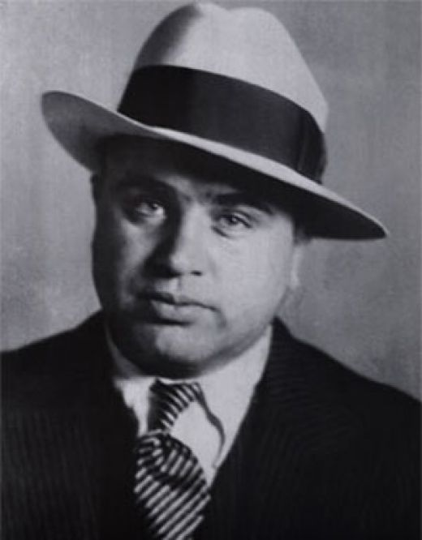
Candidate #1: Father of Al Capone

Slide 17
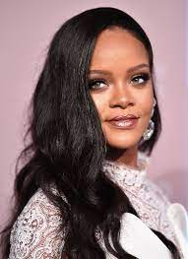
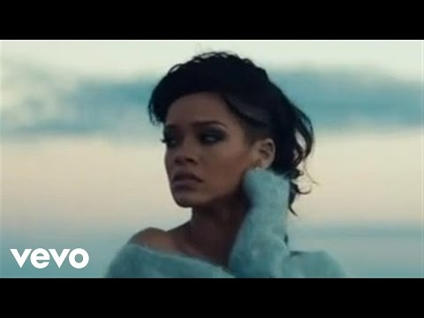
Candidate #2: Rihanna

Slide 18
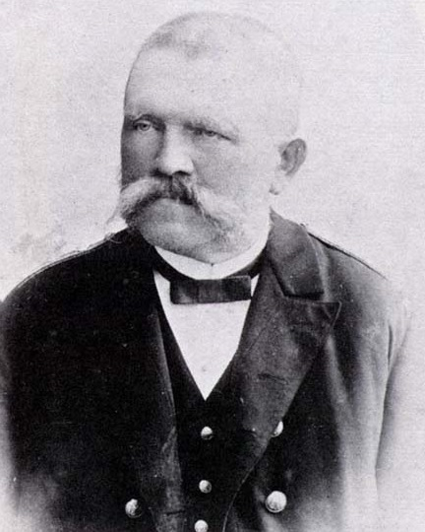
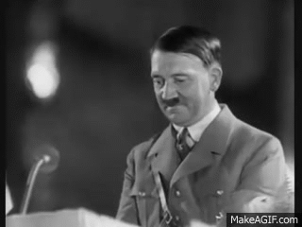
Candidate #3: Father of Adolf Hitler

Slide 19
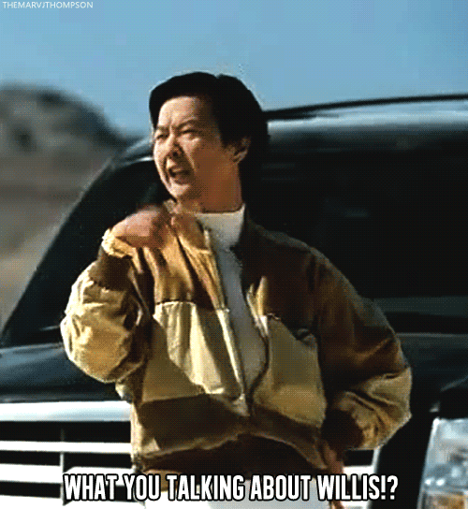
Candidate #4: Father of Ken Jeong

Slide 20
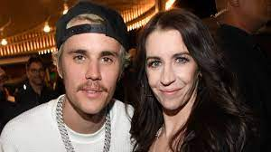
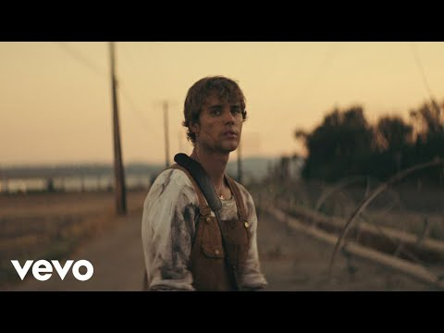
Candidate #5: Mother of Justin Bieber

Slide 21
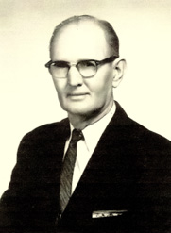
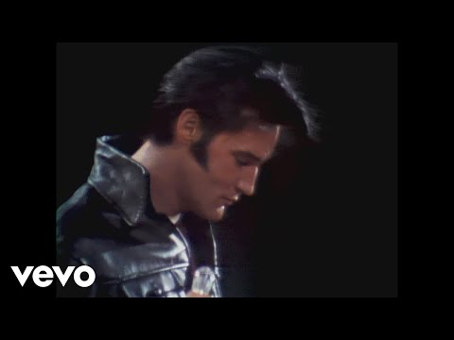
Candidate #6: Grandfather of Elvis Presley

Slide 22
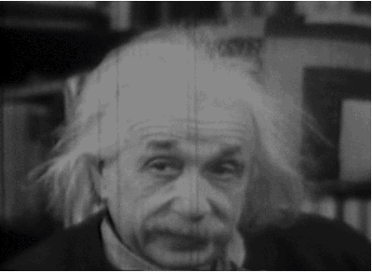
Candidate #7: Father of Albert Einstein

Slide 23
Candidate #8: Father of Selena Gomez

Slide 24
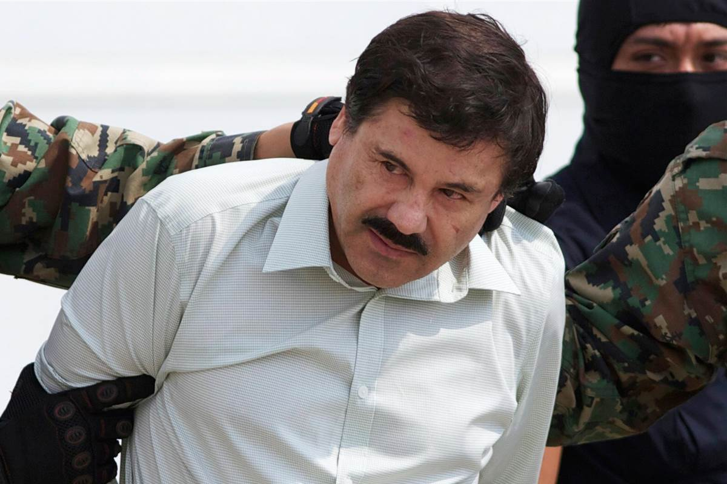
Candidate #9: Joaquin Guzman “El Chapo”

Slide 25
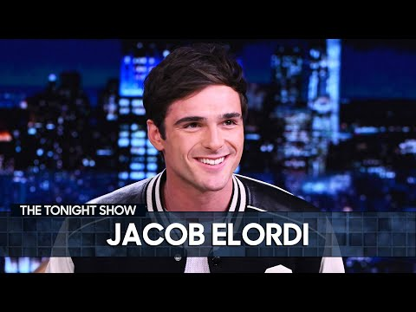
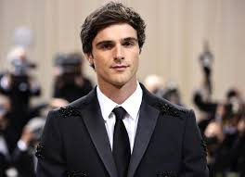
Candidate #10: Jacob Elordi

Slide 26
Candidate #11: Robert Herjavec

Slide 27
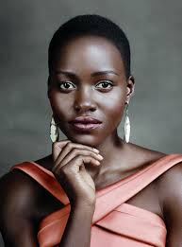
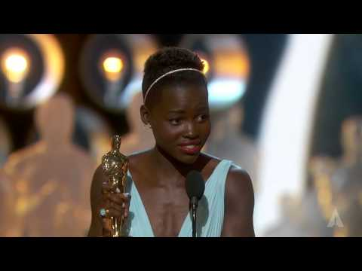
Candidate #12: Lupita Nyong’o

Slide 28
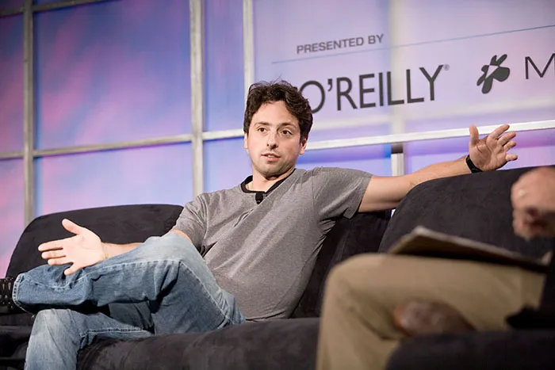
Candidate #13: Sergey Brin: Co-Creator of Google

Slide 29
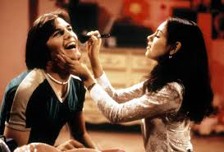
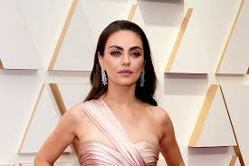
Candidate #14: Mila Kunis

