Slide 1
QUESTION OF THE DAY
Managing Credit
Q:
Which credit score band has the highest percentage of people: 300-599, 600-699, 700-749, 750-799, 800-850?
View blog post
ngpf.org 10/22/20

Slide 2
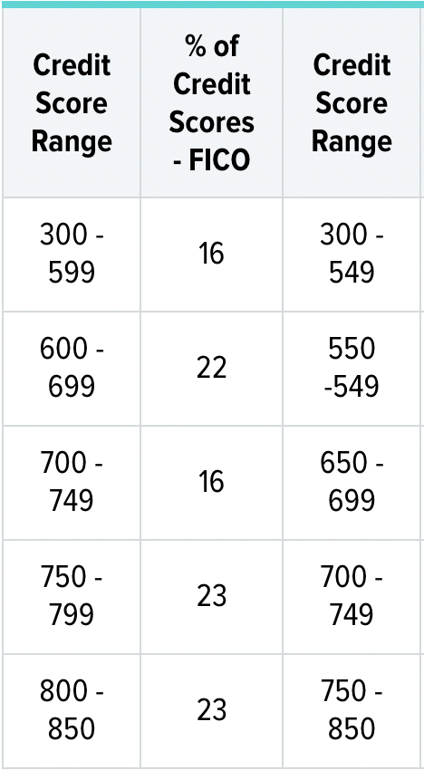
QUESTION OF THE DAY
Managing Credit
A:
23.3% at 800-850
Source: WalletHub

Slide 3
FOLLOW-UP QUESTIONS
What are some of the disadvantages of having a low credit score?
What are some advantages of having a high credit score?
Why do lenders use credit scores? How is this information helpful in running their business?
Should you be discouraged if your credit score isn’t 800-850? Explain why or why not.
ngpf.org 10/22/20

