Slide 1
QUESTION OF THE DAY
Managing Credit
Q:
What percentage of young people (age 18-24) have never checked their credit score?
View Blog Post
ngpf.org 8/23/22

Slide 2
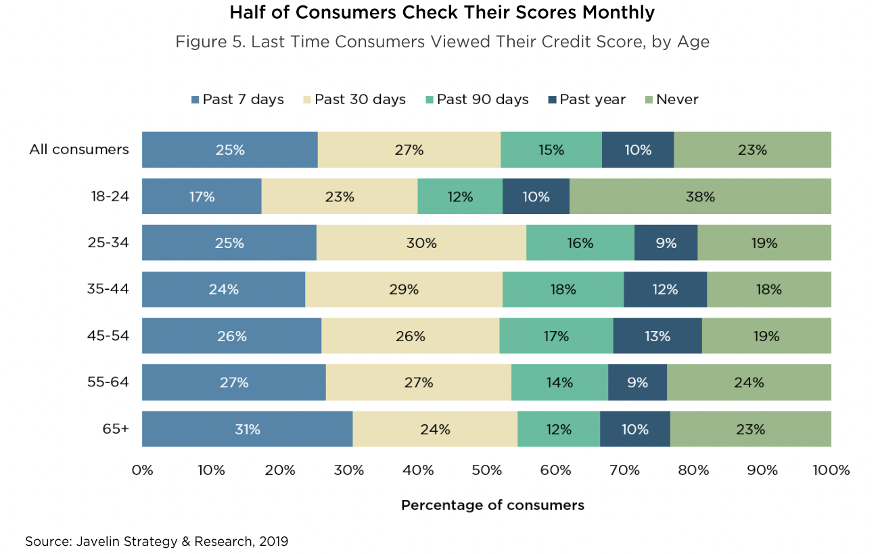
QUESTION OF THE DAY
Managing Credit
38%
A:
Source: Lexington Law

Slide 3
FOLLOW-UP QUESTIONS
Have you ever checked your credit score? Explain why or why not.
Why do you think such a greater number of young people have never checked their credit score compared to all other age groups?
Credit scores are a factor considered by banks when deciding whether or not to loan money. What are some purchases you foresee making in the future for which it would be beneficial to know your credit score?

