Slide 1
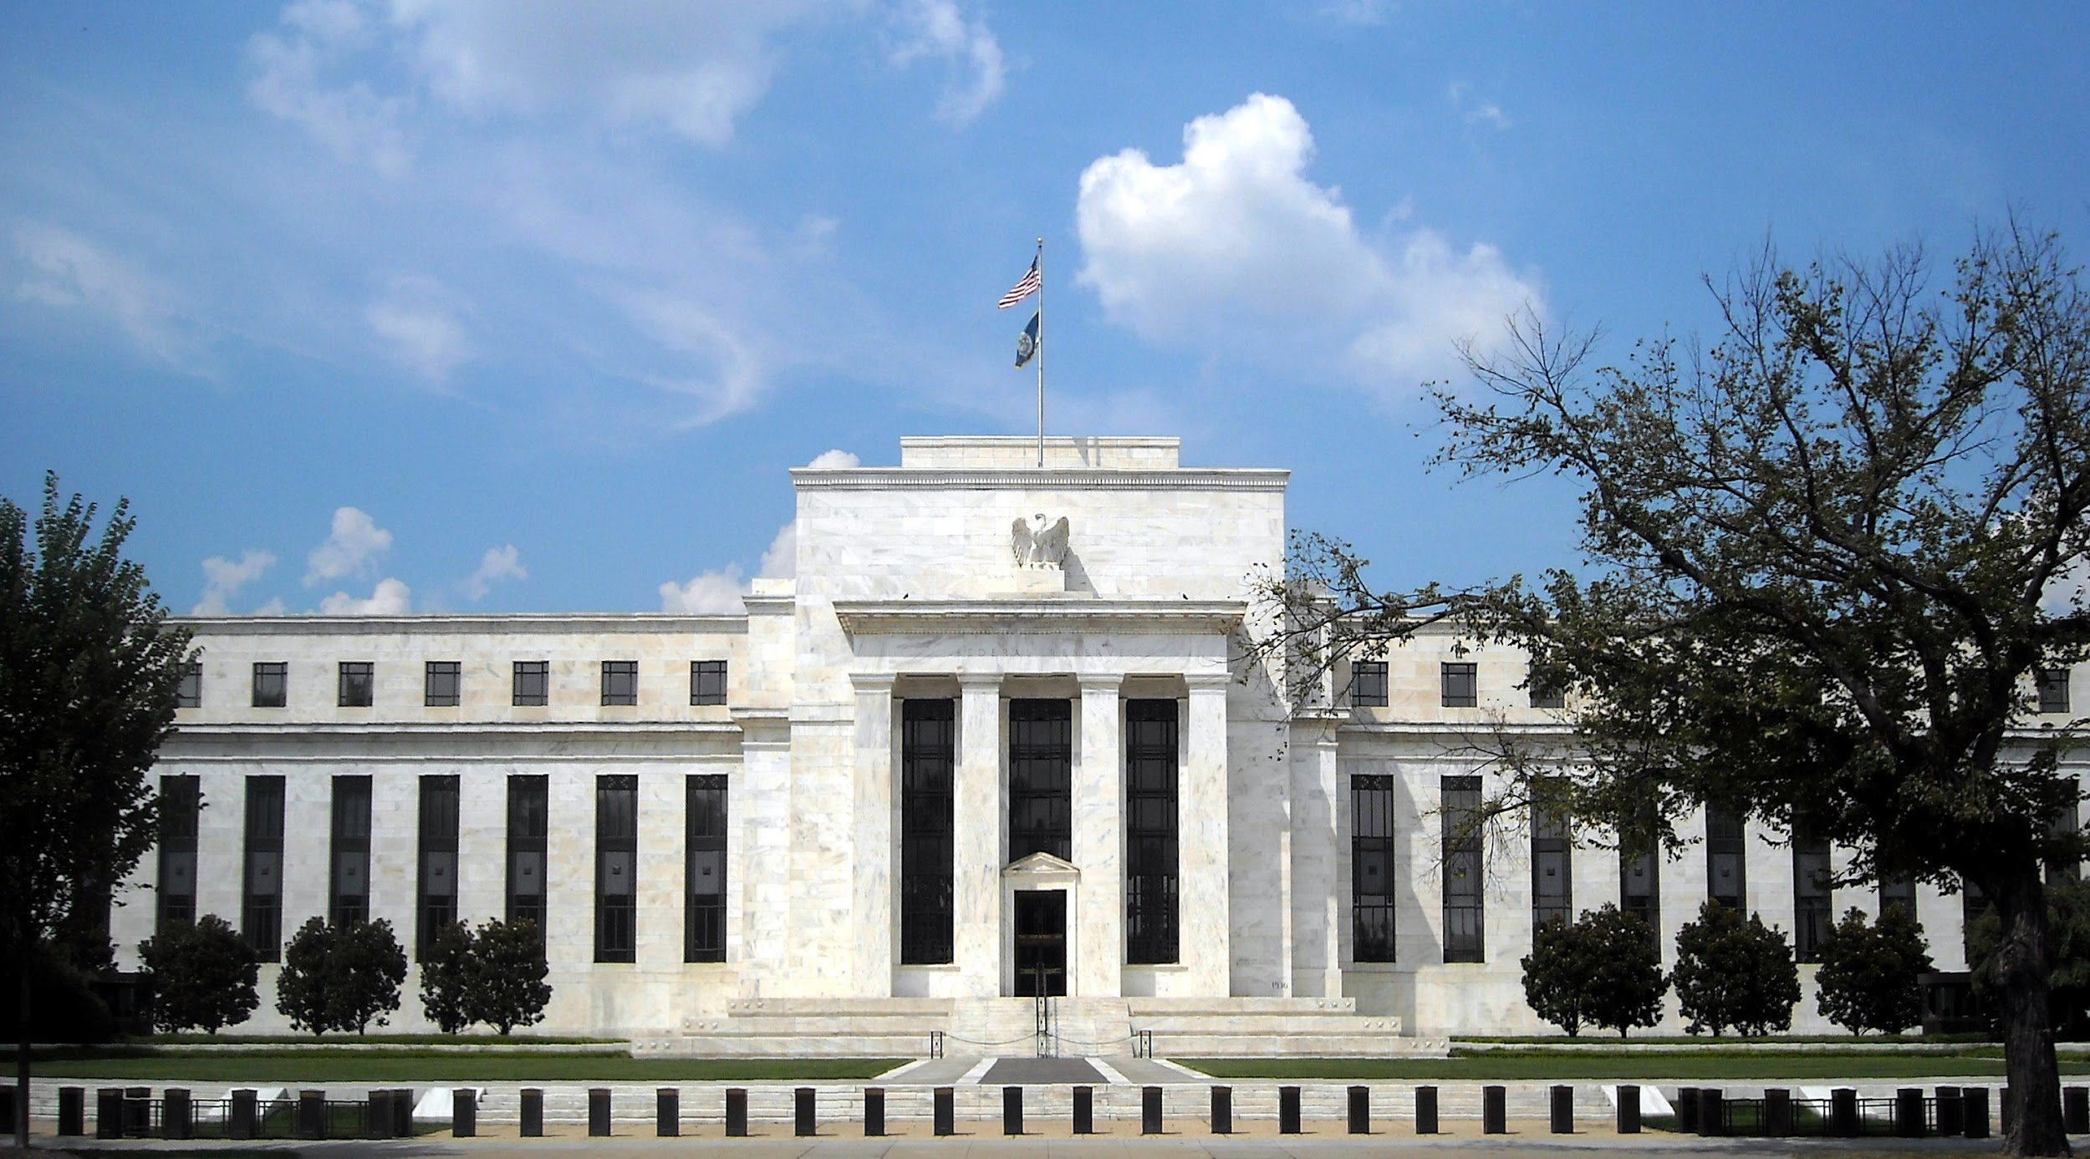
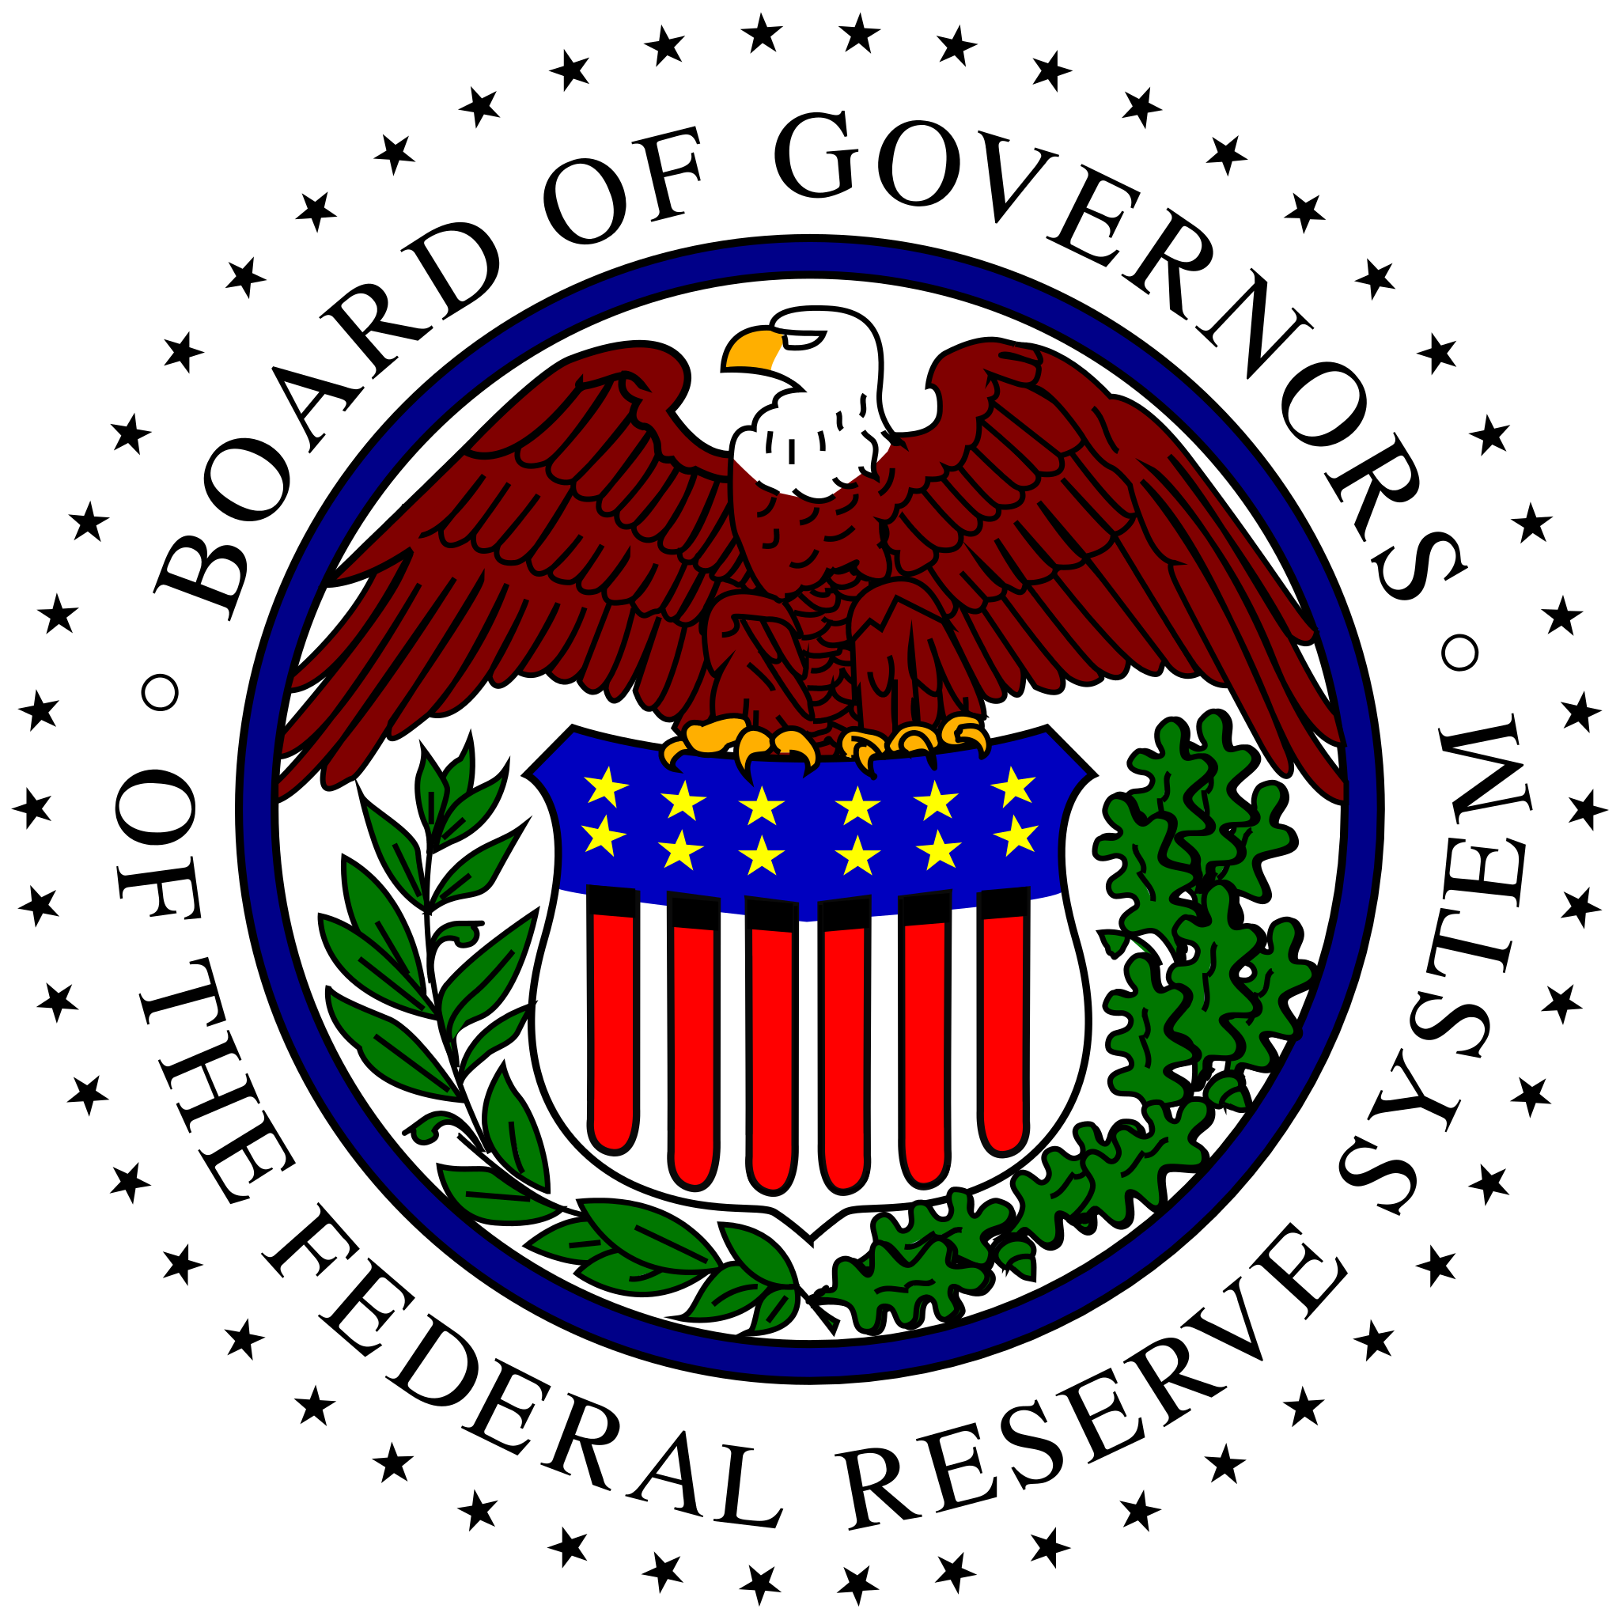
Monetary Policy
actions of the Federal Reserve System to influence the level of real GDP and rate of inflation

Slide 2
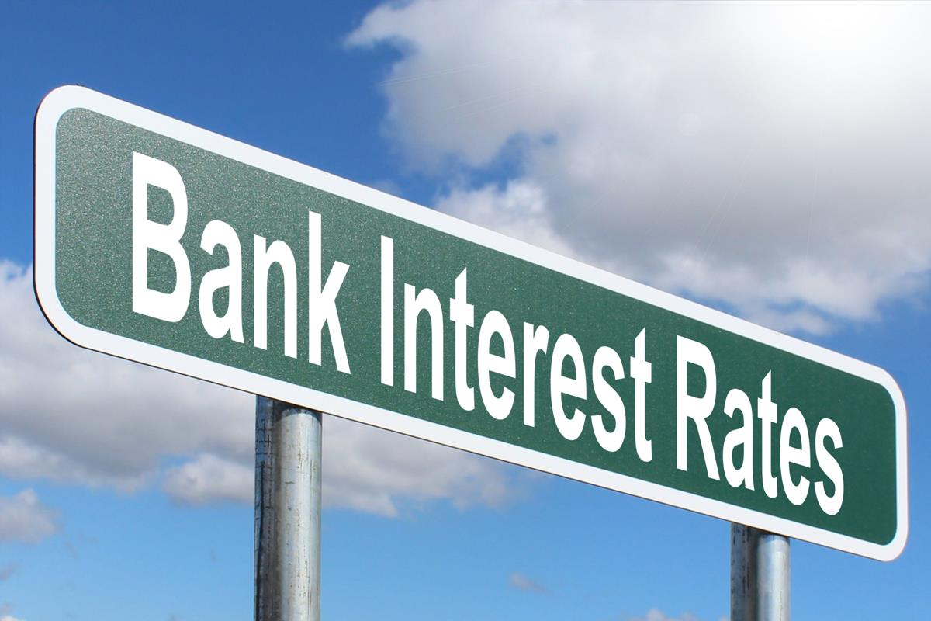
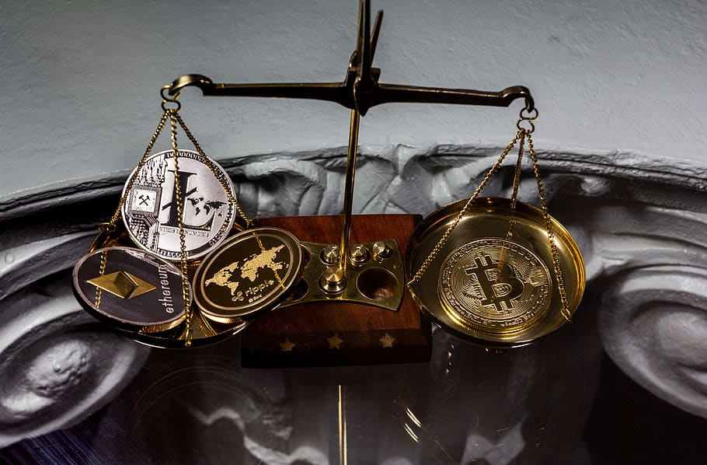
Federal Reserve System
“the Fed” the central bank of the United States
created by Congress to provide nation with
safe, flexible, stable monetary & financial system

Slide 3
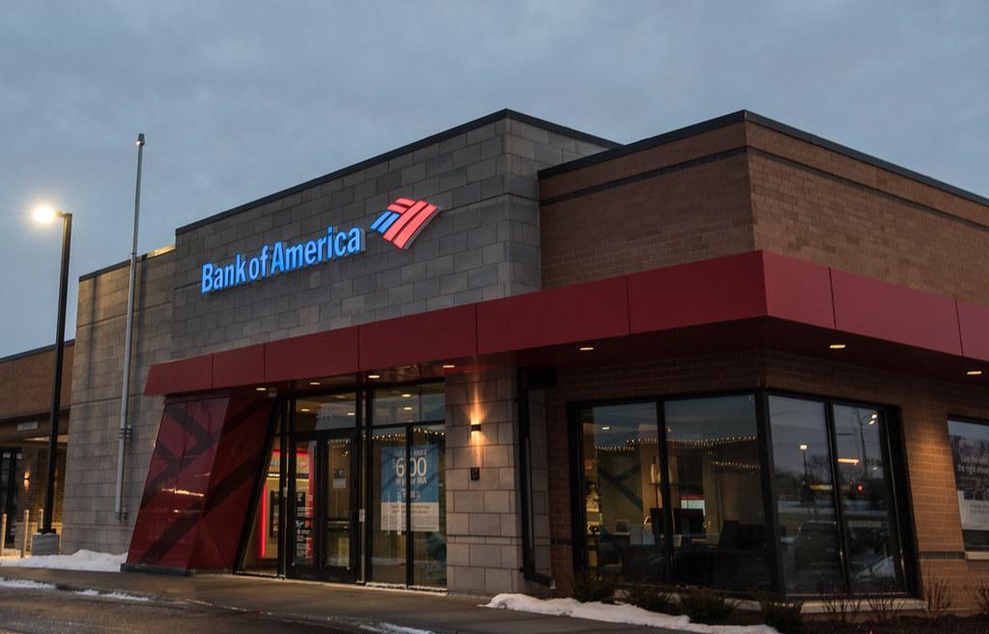
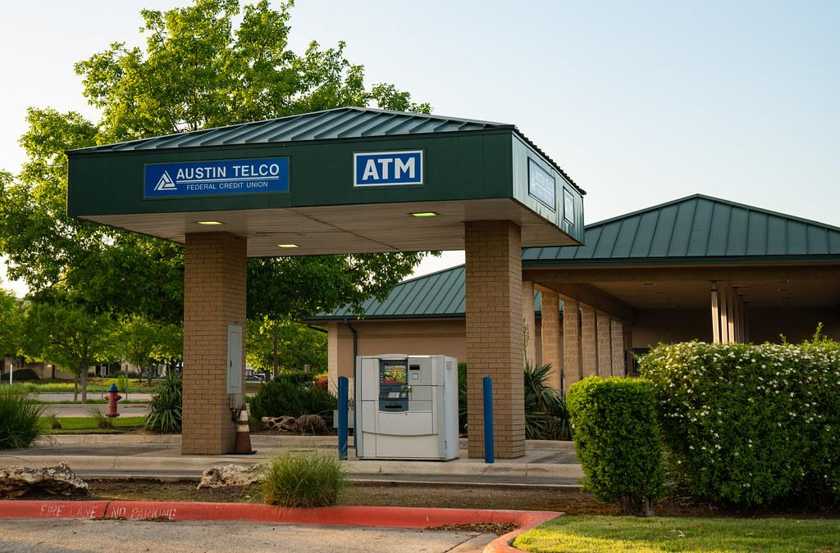
Financial Institutions
a company engaged in the business of dealing with financial and monetary transactions such as deposits, loans, investments, and currency exchange

Slide 4
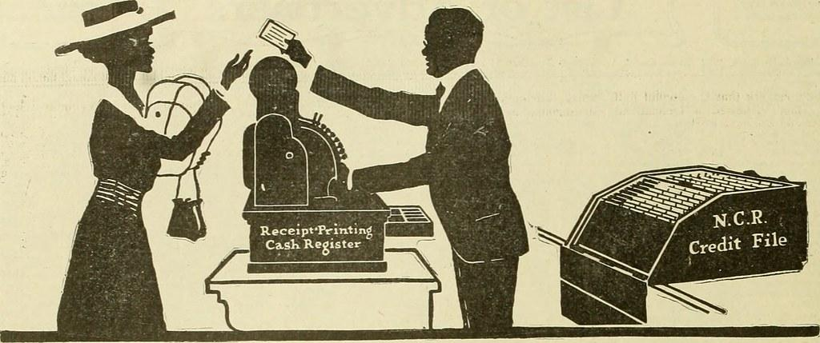
Functions of Money
serving as a medium of exchange, a unit of account, and a store of value

Slide 5
Medium of exchange
anything that is used to determine value during the exchange of goods and services

Slide 6
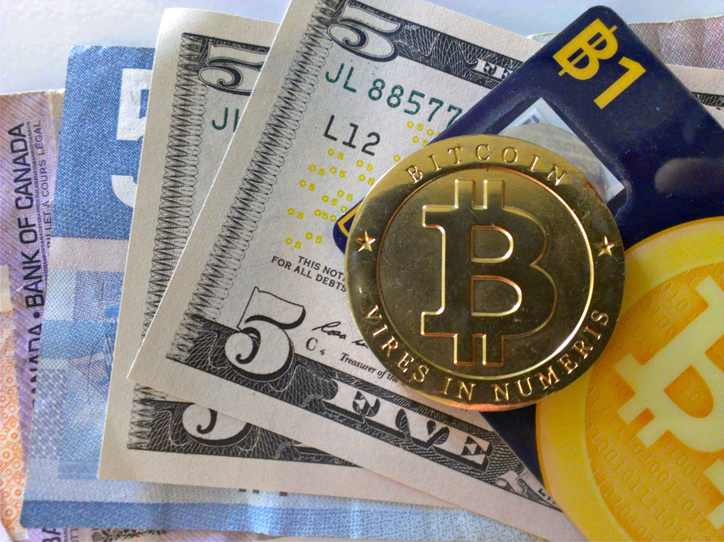
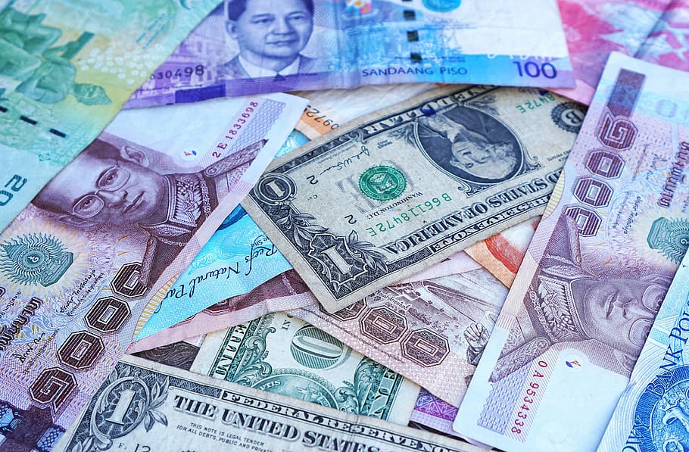
Fiat Money
Objects that have value because the government has decreed that they are an acceptable means to pay debts

Slide 7
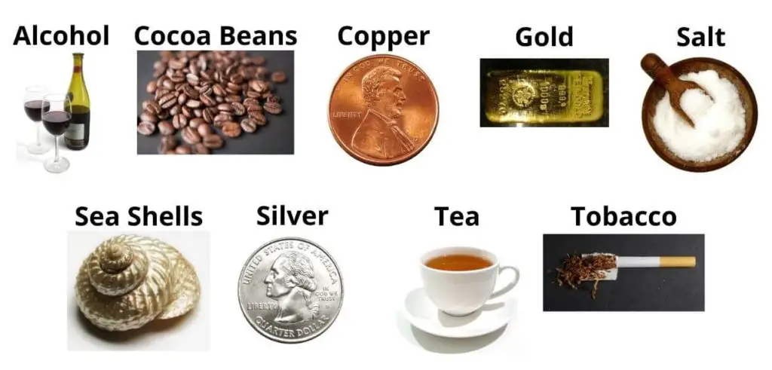
Commodity Money
a type of currency that has intrinsic value as a specific good or material, such as gold

Slide 8
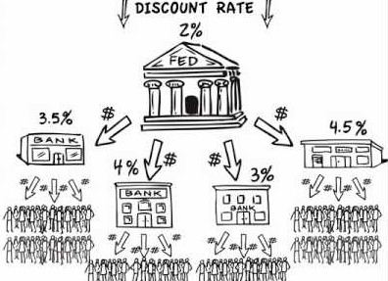
Discount Rate
interest rate the Federal Reserve charges commercial banks for short term loans

Slide 9
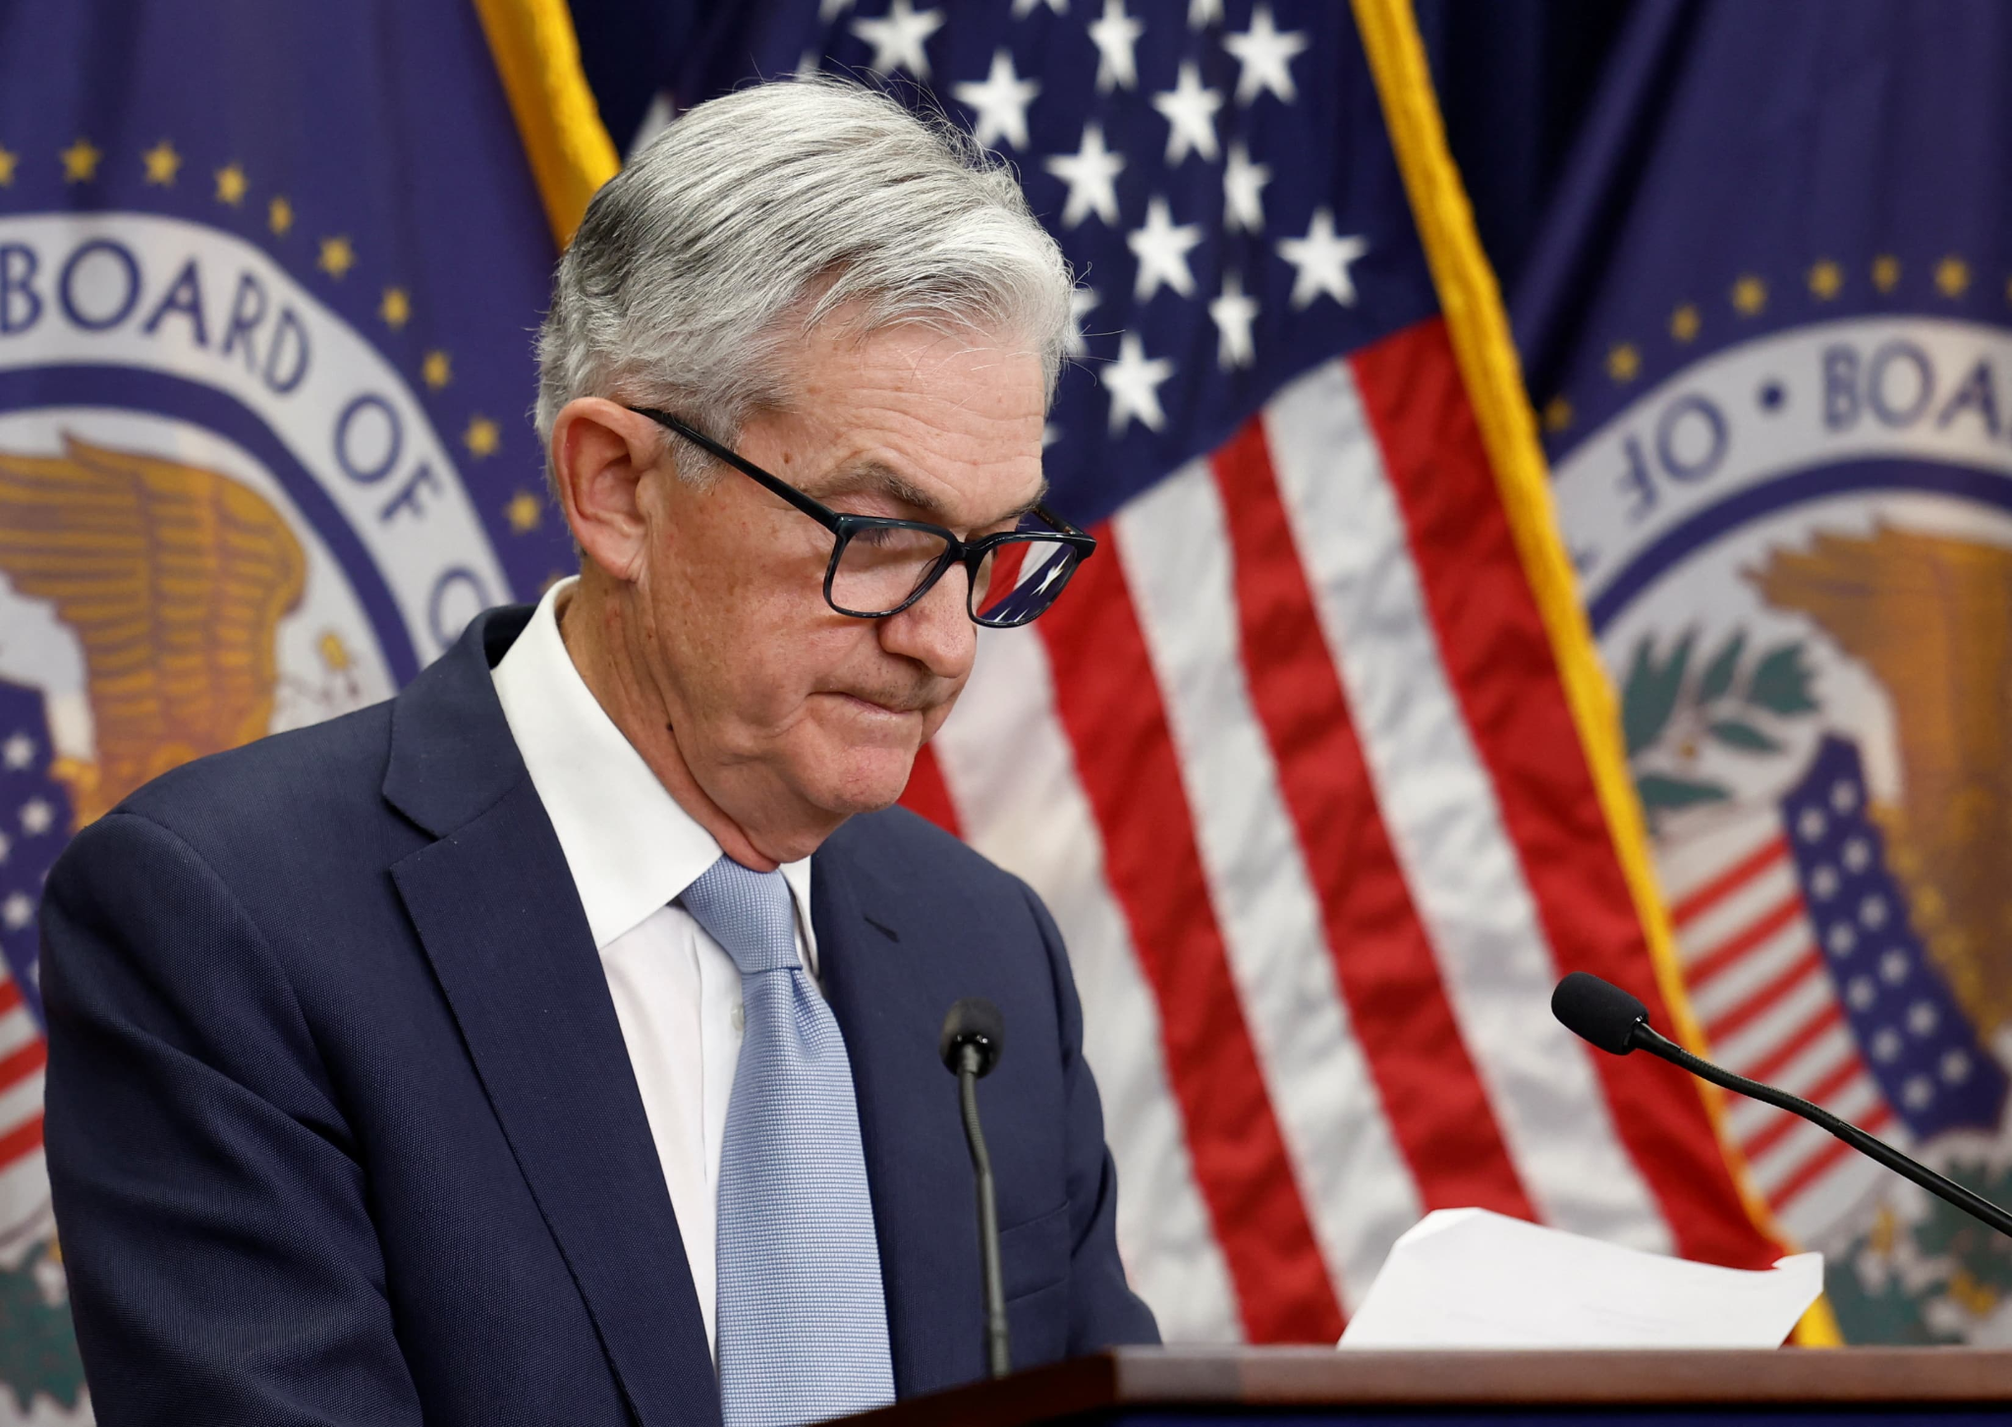
Federal Funds Rate
interest rate set by the Fed to indirectly manage interest rates, inflation and unemployment

Slide 10
Open Market Operations
term that refers to the purchase and sale of securities in the open market by the Fed

Slide 11
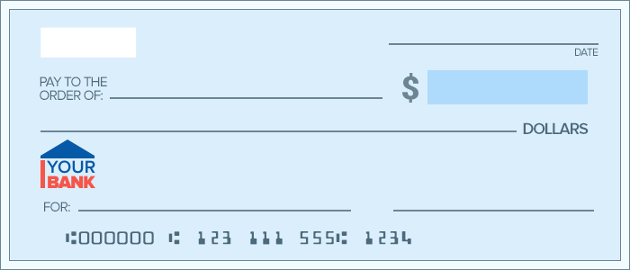
Representative Money
a form of currency that represents the intent to pay, such as a check or credit card

Slide 12
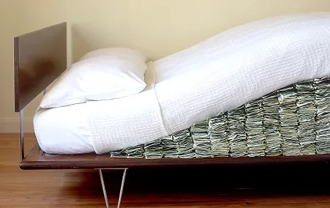
Reserve Requirement
percentage of commercial bank’s deposits that it must keep in cash

