Slide 1
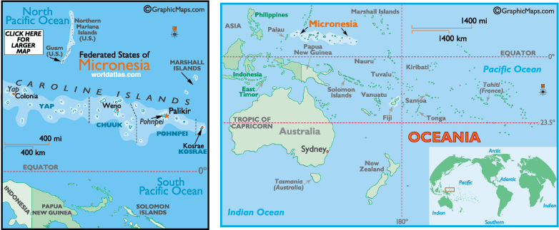
Human Geography of Oceania
History and Government
Many indigenous cultures existed in Oceania before the arrival of European settlers in the 1800s.
World War I and II dramatically changed Oceania, with islands turned into trust territories, or dependent areas under a foreign country’s temporary control.
Today, most islands enjoy independence, with many exercising dual forms of government that combine colonial influences with indigenous traditional practices.

Slide 2
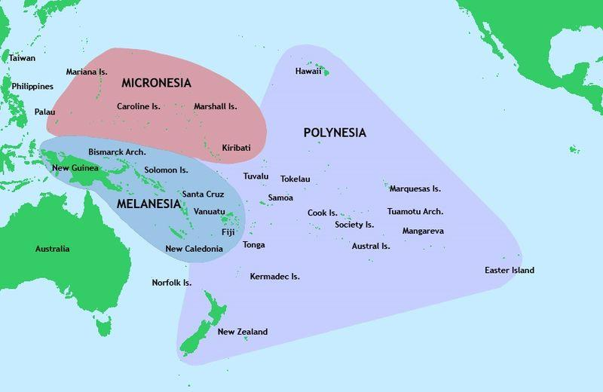
Human Geography of Oceania
Population Patterns
Melanesia includes Papua New Guinea, Fiji, the Solomon Islands, and New Caledonia, though island cultures differ greatly.
Micronesia’s densely populated islands include the Federated States of Micronesia, Nauru, Kiribati, Guam, and the Mariana Islands.
Polynesia includes Samoa, Tonga, Tuvalu, and French Polynesia, with most sharing similar languages and culture.
Populations vary widelyfrom island to island.

Slide 3
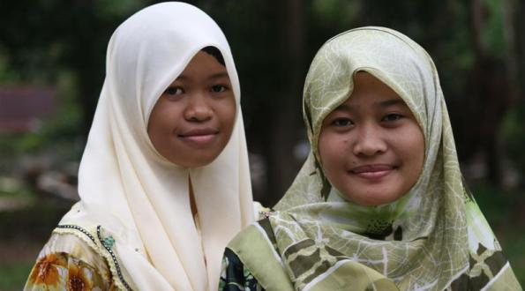
Human Geography of Oceania
Society and Culture Today
South Pacific countries practice a blend of European, Asian, and indigenous traditions.
French is widely spoken, along with varieties of pidgin English, a mix of English and an indigenous language.
The quality of the islands’ education and healthcare vary widely, and many islands suffer from poor economic prospects.
The status of women is of great concern, as some cultural practices tolerate violence against women.

Slide 4
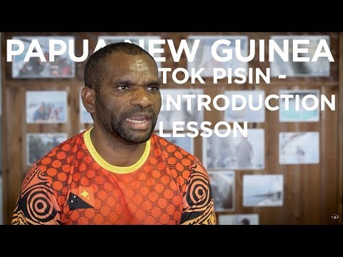
Pidgin English

Slide 5
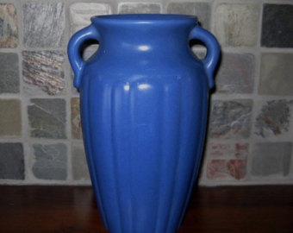
Human Geography of Oceania
Economic Activities
Agriculture is the sub-region’s main economic activity, but ecotourism is becoming more popular.
Trade between Oceania and the rest of the world has increased because of improvements in both transportation and communications.
Agriculture and mining produce most of the area’s export income, but handicrafts, such as baskets, masks, and pottery, also contribute.

Slide 6
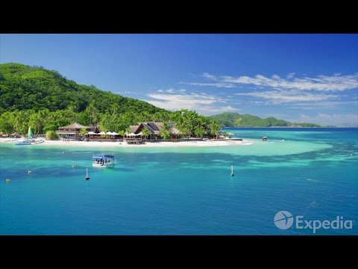
Fiji
Fiji is located between _________ and __________
How many island make up Fiji?
The Fijian meeting of Bulla means:
Fiji is one of the world’s great __________ and _________ destinations
How do visitors get to the smaller islands?
Beachcomber Island is known as “___________” island

Slide 7
Guam
List the 5 inhabited US territories:
How far is Guam from Washington DC?
After what war did the US take control of Guam?
What is the population of Guam?
What currency do they use in Guam?
Why do Asian Tourist come here?
How many tourist come each year?
Guam representative in the US congress does not get a _______
Only _______ ships can bring good for the US to Guam.
A quarter of the territory is US _________ bases.
Who is the biggest employer on the island?

Slide 8
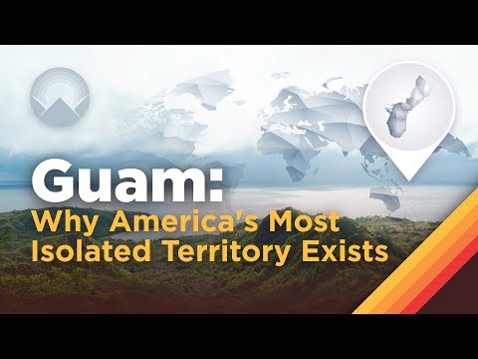
Guam

Slide 9
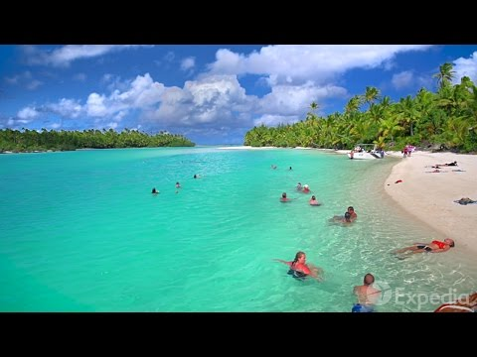
Cook Islands
How many islands are in this archipelago?
How long is the flight from New Zealand?
What is the largest of the Cook Islands?
Kiriti maro tai means:
Who was the first European to discover these islands?

