Slide 1
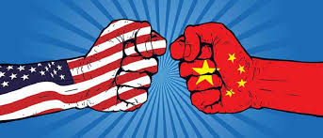
Origins of The Cold War
Unit 9: The Cold War

Slide 2
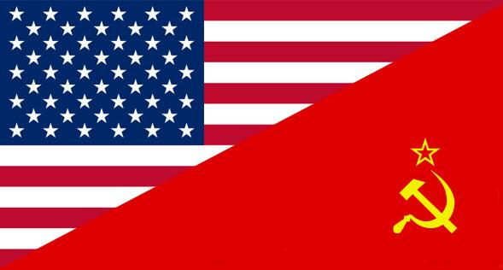
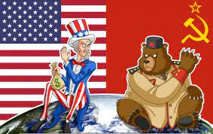
Why was it called the “COLD” War?
When WWII ended in 1945, the U.S. and Soviet Union were the #1 & #2 leading industrial powers in the world
Because of nuclear weapons, the superpowers never actually confronted each other in open warfare
Their global competition (to be the most powerful nation) led to frequent other conflicts

Slide 3
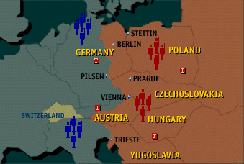
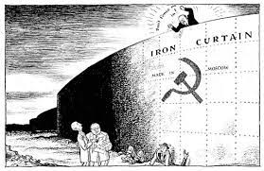
The Iron Curtain
The Iron Curtain was a non-physical boundary that divided Europe
Communist East
Democratic West
Existed from the end of WWII in 1945 until the end of the Cold War in 1991

Slide 4
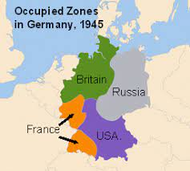

Slide 5
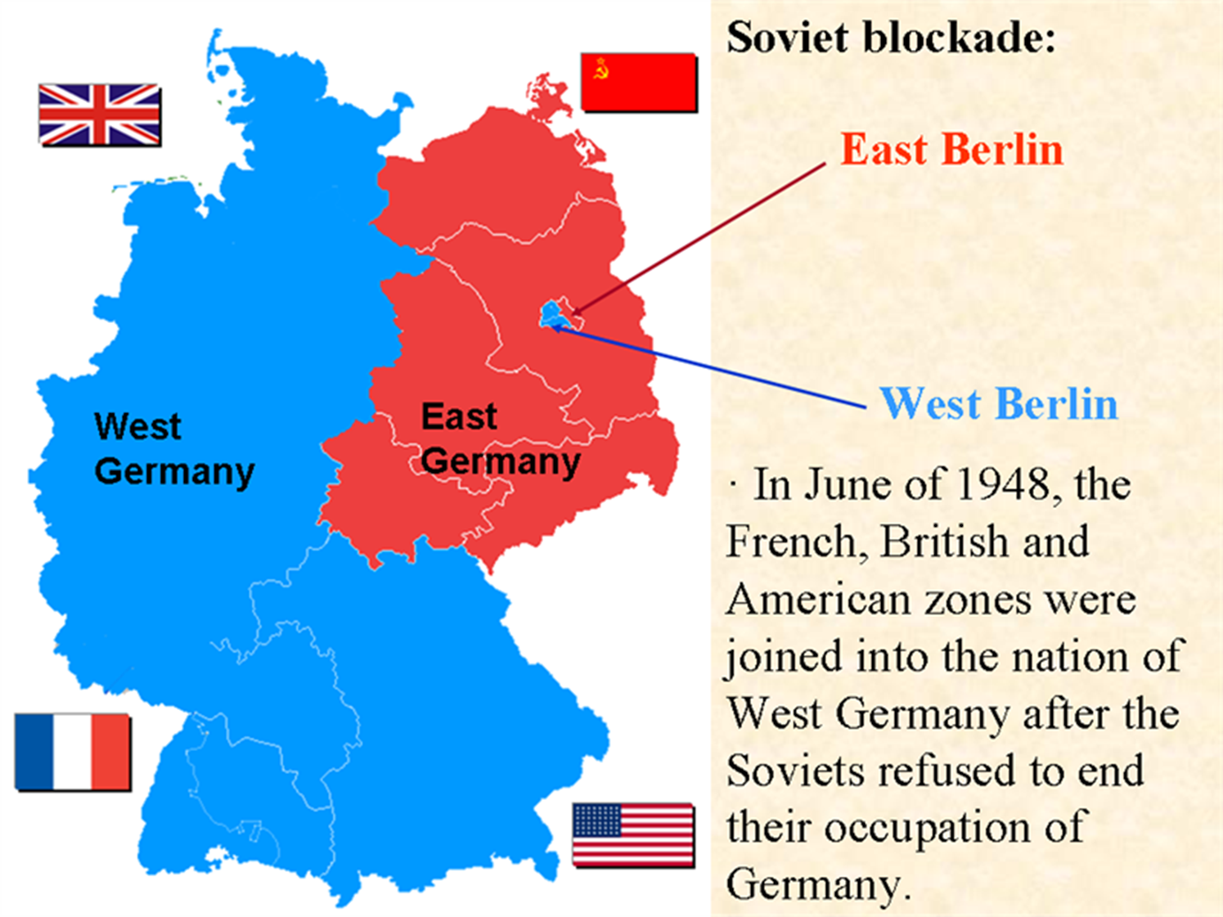

Slide 6
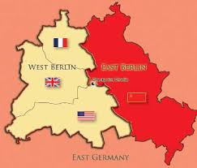

Slide 7
Post WWII: Fear of Communism

Slide 8
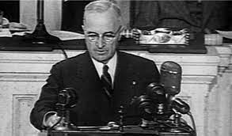
Truman Doctrine (Containment)
U.S. Foreign Policy established by Harry Truman (1947)
The U.S. would provide economic and military aid to countries (EUROPE) who were attempting to resist Communist takeover

Slide 9
Marshall Plan (1948-1951)
America restored economic stability to Western Europe
Offered money to any countries that needed it, including Germany & Italy
Discouraged turning to communism

Slide 10
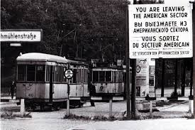
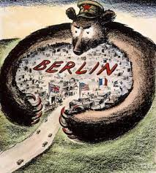
Berlin Blockade
The Berlin Blockade was an attempt in 1948 by the Soviet Union to limit the ability of the U.S., Great Britain, and France to travel to their sectors of Berlin, which lay within Russian-occupied territory
Soviets blocked:
All railroad & canal access to the western zones of Berlin
2.5 million civilians had no access to food, medicine, fuel, electricity, & basic goods
Germany
Berlin

Slide 11
Germany
How would you get supplies to the West part of Berlin when it is surrounded by the Soviet Union?
Berlin

Slide 12
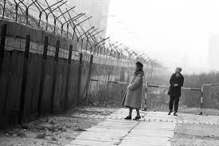
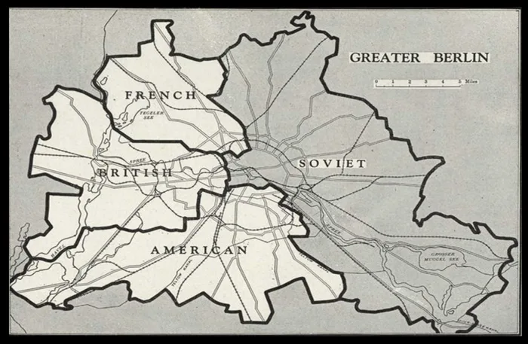

Slide 13
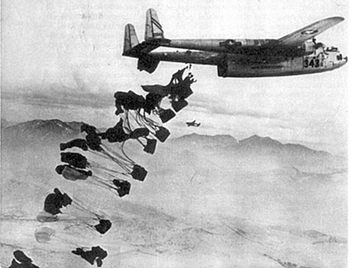
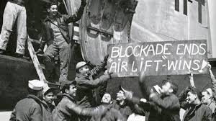
Berlin Airlift (1948-1949)
West Berlin was airlifted supplies
One of the first major international crises of the Cold War
Brought about 2.3 million tons of supplies to West Berlin
The U.S. flew in supplies for 327 days (277,000 flights)
Outcome: Soviets lifted the blockade & Germany officially becomes TWO countries

Slide 14
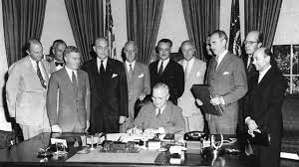
North Atlantic Treaty Organization (NATO)
Created in 1949
A formal alliance between the territories of North America & Europe
Job was to provide collective security against the Soviet Union
First peacetime military alliance the U.S. entered into

Slide 15
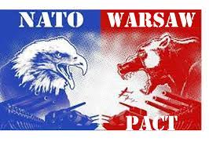
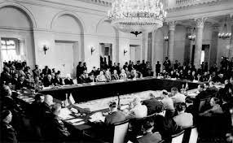
Warsaw Pact
Soviet Union & its affiliated Communist nations in Eastern Europe founded a rival alliance
Warsaw Pact:
Soviet Union & satellite nations would provide collective security to each other

Slide 16
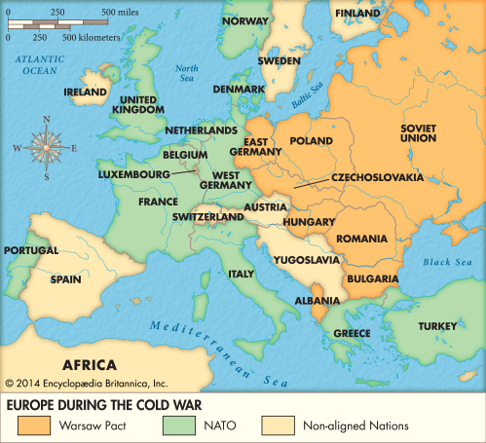

Slide 17
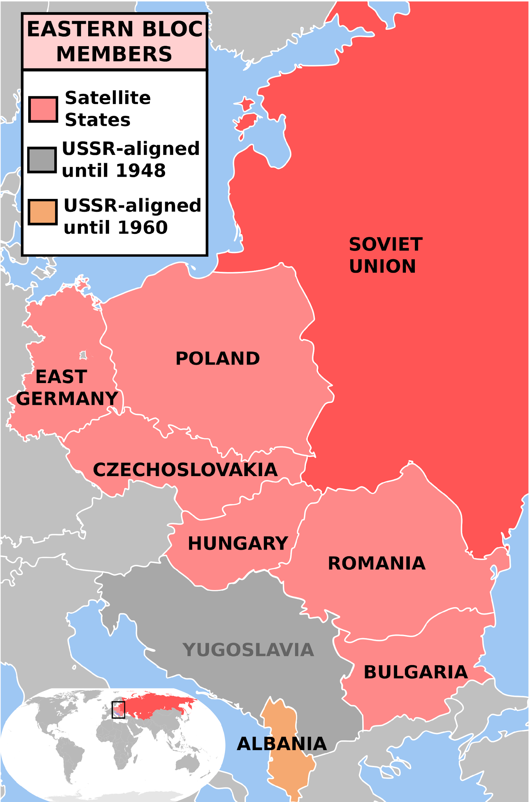
How does the Warsaw Pact represent a threat to the United States?

Slide 18
Communist or Capitalist questions:
Raise your hand for Communist
Or -
Stand for Capitalist

Slide 19
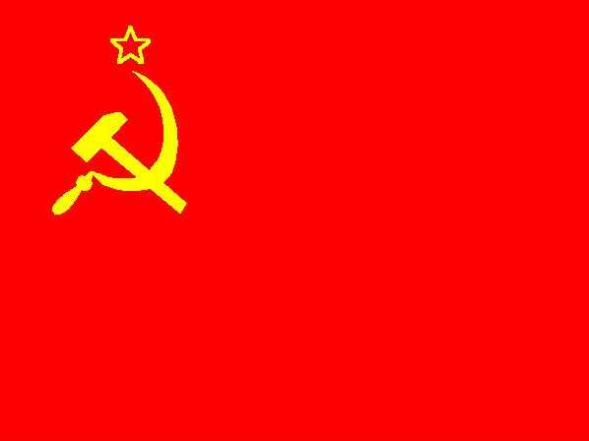
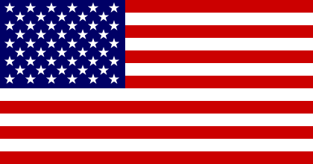
Communist or Capitalist?
You will read a description of an individual
When you think you know if the person is a communist or capitalist, please choose the correct response (raise hand for Communist or stand for capitalist)
To make sure you know which country is which, look at the flags below:

Slide 20
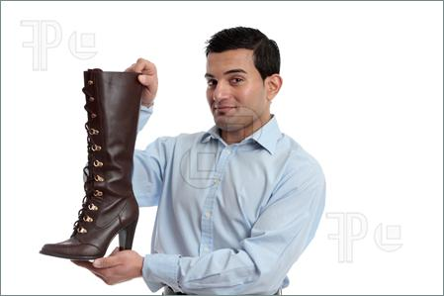
Communist or Capitalist?
John works at JCPenney
He earns $7.25/hr
He pays taxes on what he earns
He is part of the “retail workers union”
He is quite outspoken of his dislike for the current leader of his nation

Slide 21
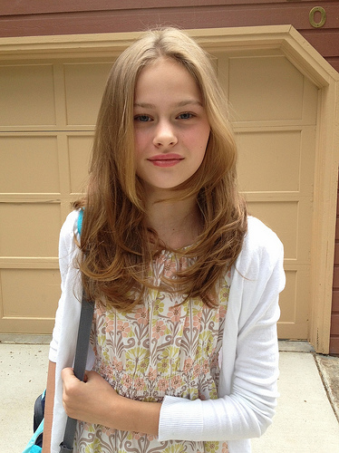
Communist or Capitalist?
Sarah attends 5th grade at an intermediate school
Every morning she pledges allegiance to her nation
Her parents work on a farm that is owned by the government
Her father was arrested for saying negative things about the government

Slide 22
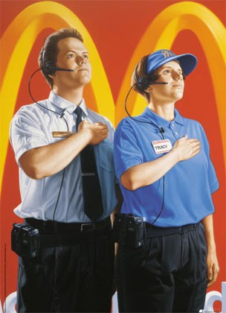
Communist or Capitalist?
Frank works at McDonalds
He earns $7.25/hr
His job is protected because of his labor union
Both the McDonalds and the labor union are owned by the government
He cannot change jobs, even if he doesn’t like his job

Slide 23
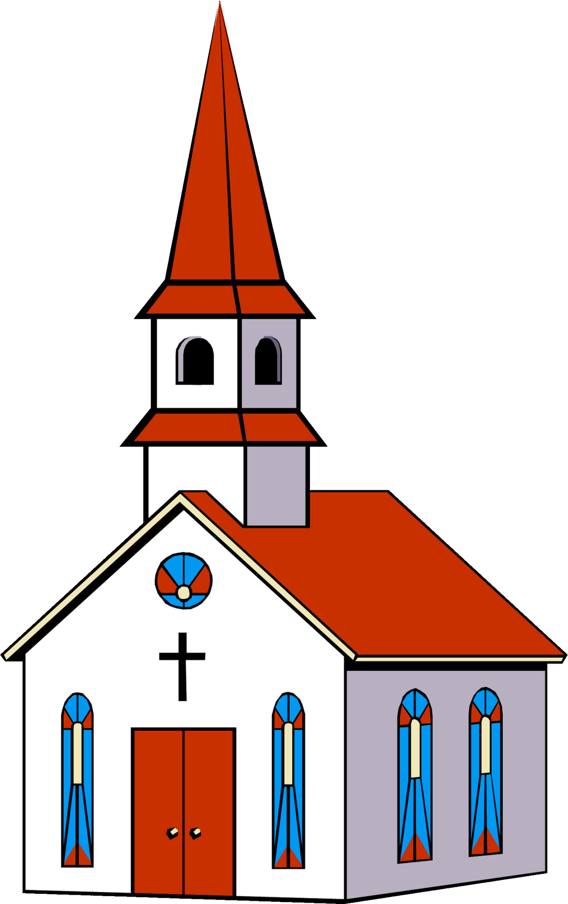
Communist or Capitalist?
Jose has the freedom to go to any church he wants to. Most Sundays, Jose goes to the local Catholic church in his town

Slide 24
Communist or Capitalist?
The owner of a local newspaper was arrested for publishing an article speaking negatively about the government

