Slide 1
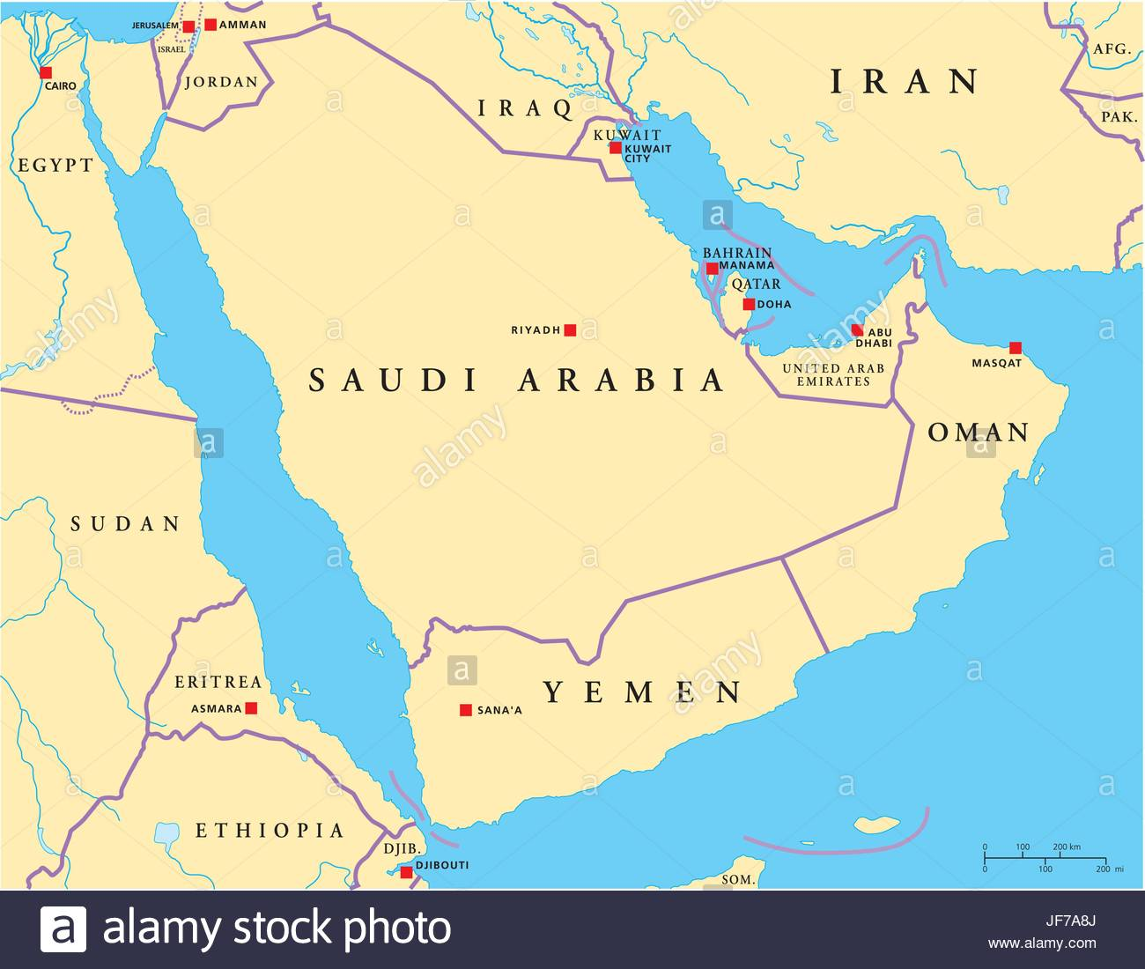
Human Geography
Arabian Peninsula

Slide 2
History and Government
Religion, ethnicity, and shared culture define the region, with most people being ethnic Arabs who practice Islam.
For centuries, tribal groups based on family relationships, or sheikdoms, controlled specific areas of the subregion, and their influence continues.
The majority of governments in the area are monarchies, with Saudi Arabia, Oman, and Qatar being absolute monarchies.

Slide 3
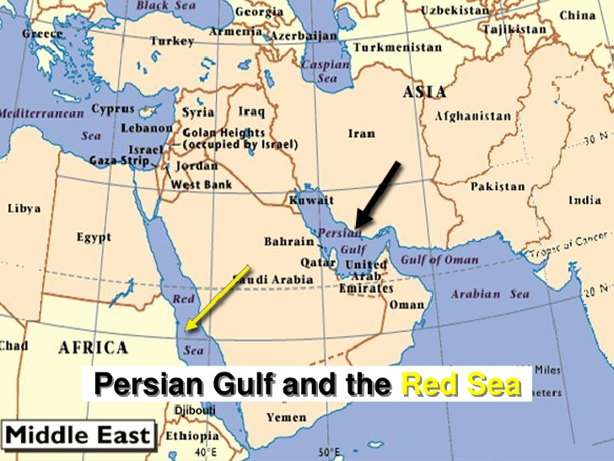
Population Patterns
The dry, desert climate causes most people to live along the coasts of the Persian Gulf and Red Sea.
Migration of workers to oil and construction jobs has altered the once exclusively Arab population.
In the interior of Saudi Arabia lies Makkah (Mecca), the holiest city of Islam, Madinah (Medina), which houses the tomb of the prophet Muhammad, and Riyadh, an important oil refining center and the capital.

Slide 4
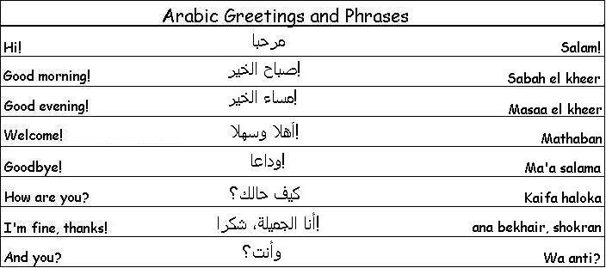
Society and Culture Today
Arabic is the primary language in the subregion, with English the most common second language.
After Muhammad’s death, conflicts arose over who would be the rightful successor, breaking the religion into different sects.
Shari’ah, or Islamic law, governs every aspect of a Muslim’s life.
Most countries do not enforce equal rights for women, and women have little political power.

Slide 5
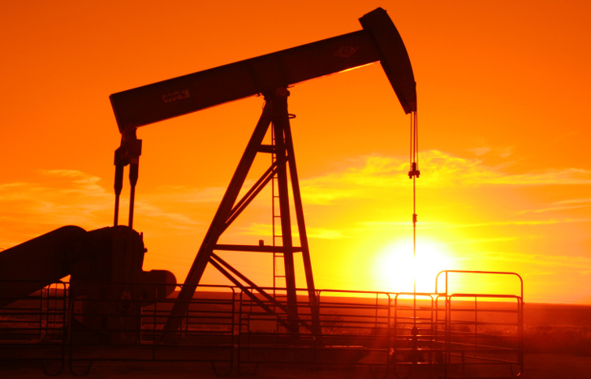
Economic Activities
Oil has produced great wealth for the Arabian Peninsula; it is one of the world’s most important regions for oil production.
Countries with smaller oil reserves have developed other industries, such as banking and finance in Bahrain, and fishing in Oman, to foster economic growth.
Lack of water remains the most important natural resource issue.

Slide 6
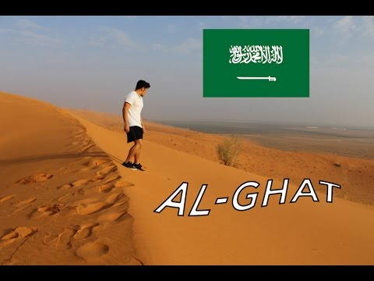
Geography Now Go: Saudi Arabia

Slide 7
Human Geography
Central Asia

Slide 8
History and Government
Christianity has been a significant influence in Armenia and Georgia, while Islam became the predominant religion of the “stan” countries.
Established for trade between Europe and China, the Silk Road became an important asset and target for various empires.
The entire region, except Afghanistan, was under Soviet control until the 1990s.
Ethnic conflict and political turmoil continue to plague the region.
American troops have been fighting in Afghanistan for almost 20 years.

Slide 9
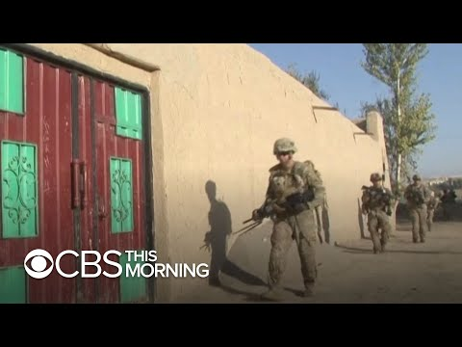
American Troops Leaving Afghanistan?

Slide 10
Population Patterns
Although several countries are named for one ethnic group, most have a complex mix of ethnic groups.
Populations are shrinking in Armenia and Georgia due to low birth rates, while the populations of other nations are increasing.
The rate of urbanization is low overall, but growing.
Ethnic differences have created conflict in some areas resulting in displaced persons.

Slide 11
Society and Culture Today
Languages in the Turkic language family are the most commonly spoken, though Russian is still widely used.
Literacy rates are high except in Afghanistan, and health care spending overall is low, except in Georgia.
Family life is a mix of traditional and modern influences, depending on rural or urban location.
Under Soviet control, women enjoyed more equal rights than in many countries, especially Afghanistan.

Slide 12
Economic Activities
Economic growth is dependent on agriculture and exports of natural resources, such as oil and natural gas.
Economic output remains low, as many people rely on agriculture, but farming methods and lack of arable land constraint yields.
Most countries have not yet shifted to market economies, leaving governments in control of many facets of manufacturing and farming, resulting in inefficient business practices that are also susceptible to corruption.

