Slide 1
President Hoover & FDR’s
Response to The Great Depression
Unit 7 #2

Slide 2
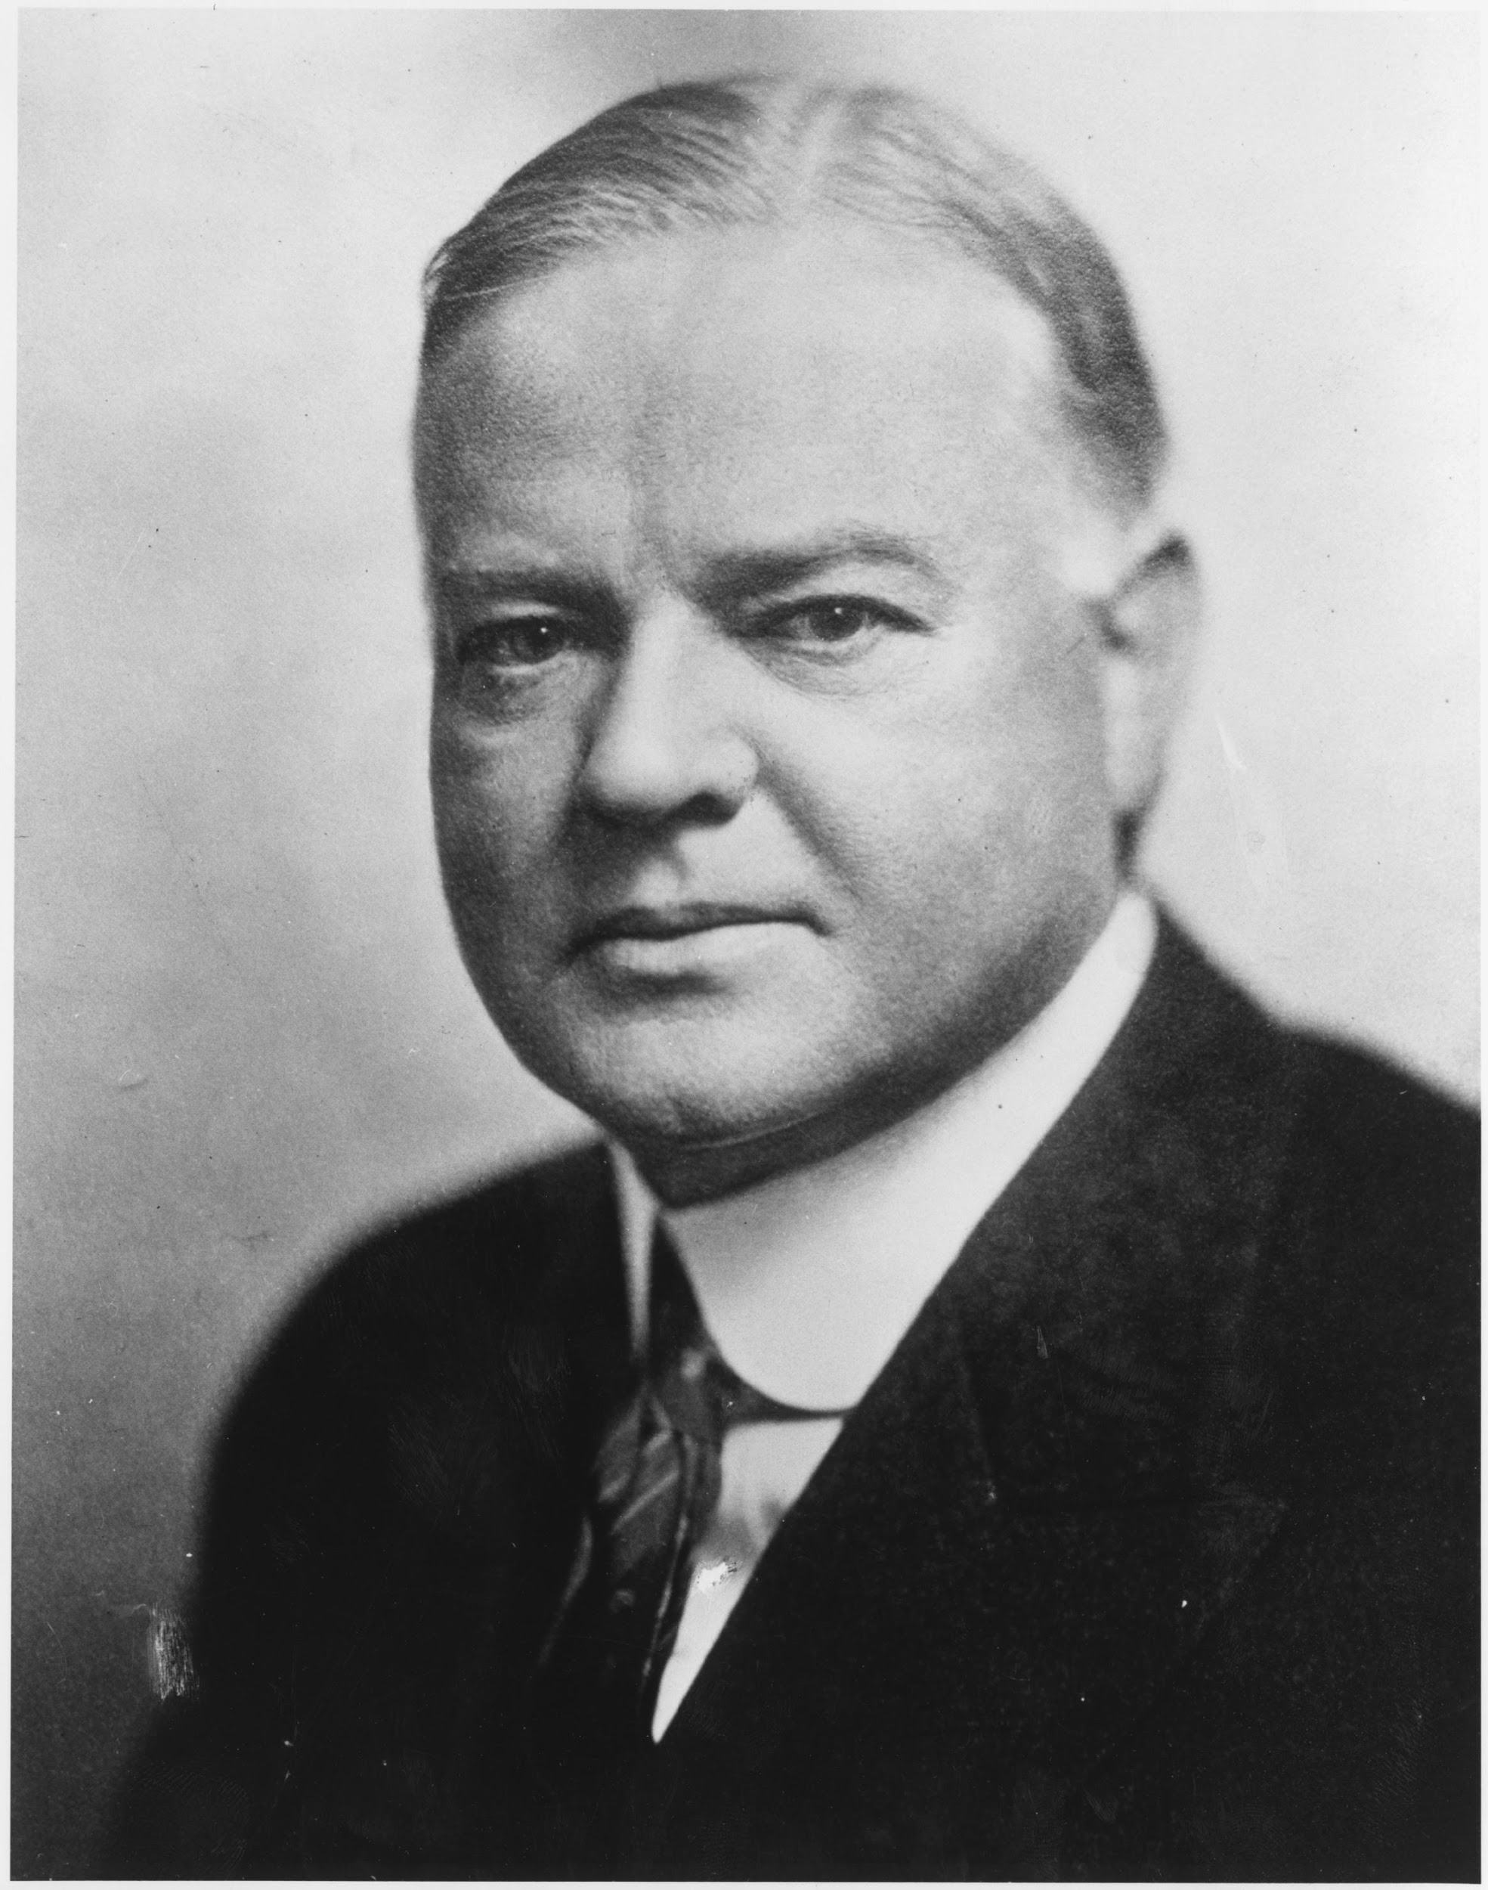
Herbert Hoover
President at the beginning of the Great Depression
Believed the following:
The economy would correct itself
Government should not interfere
Laissez faire
Opposed to direct relief (welfare)
Thought people would become dependent on the government.
He did a few things to help the economy
But people felt it was too little too late
Blamed Herbert Hoover for the Depression

Slide 3
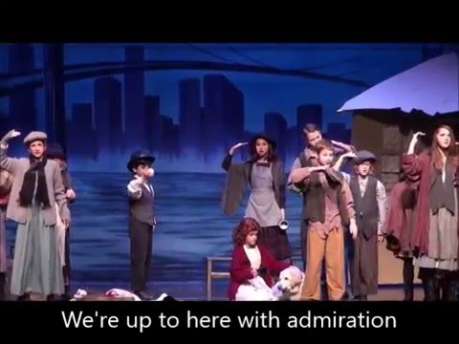

Slide 4
Hoover’s Response

Slide 5
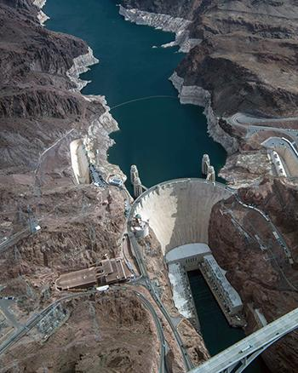
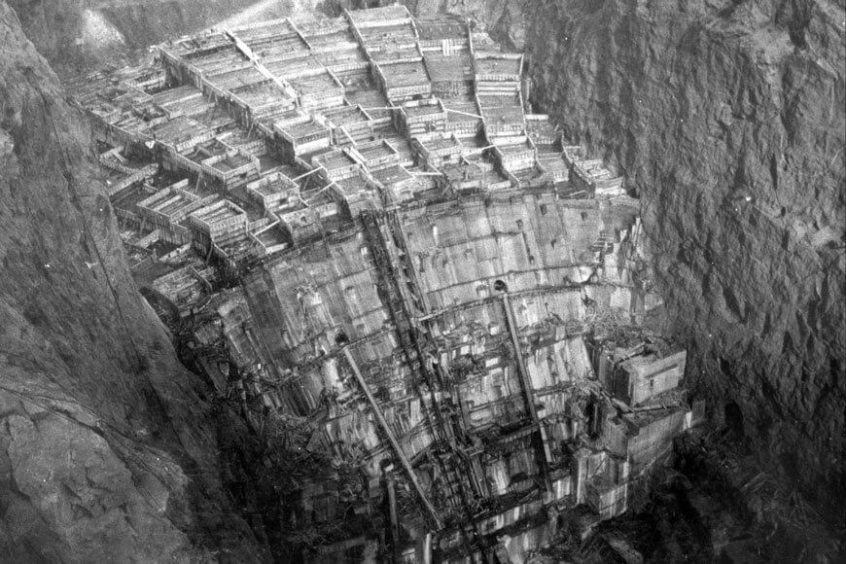
Public Works Program:
Construct roads, Bridges, and dams to create jobs
Constructs the Hoover Dam which created
Jobs
Electricity
flood control
and provided water for the West
*Provides resources*

Slide 6
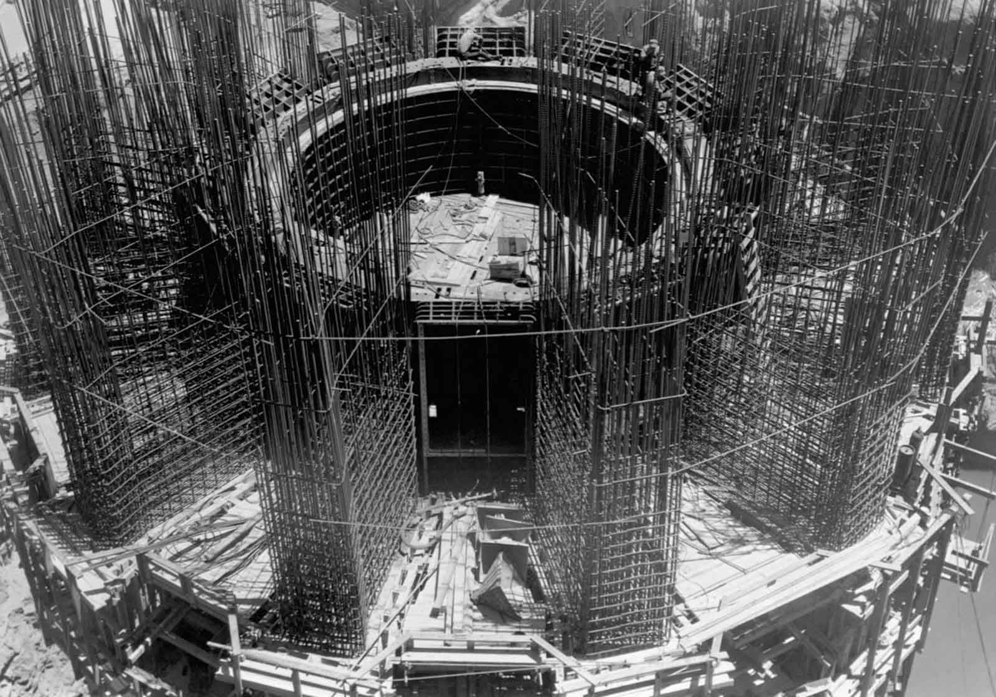

Slide 7
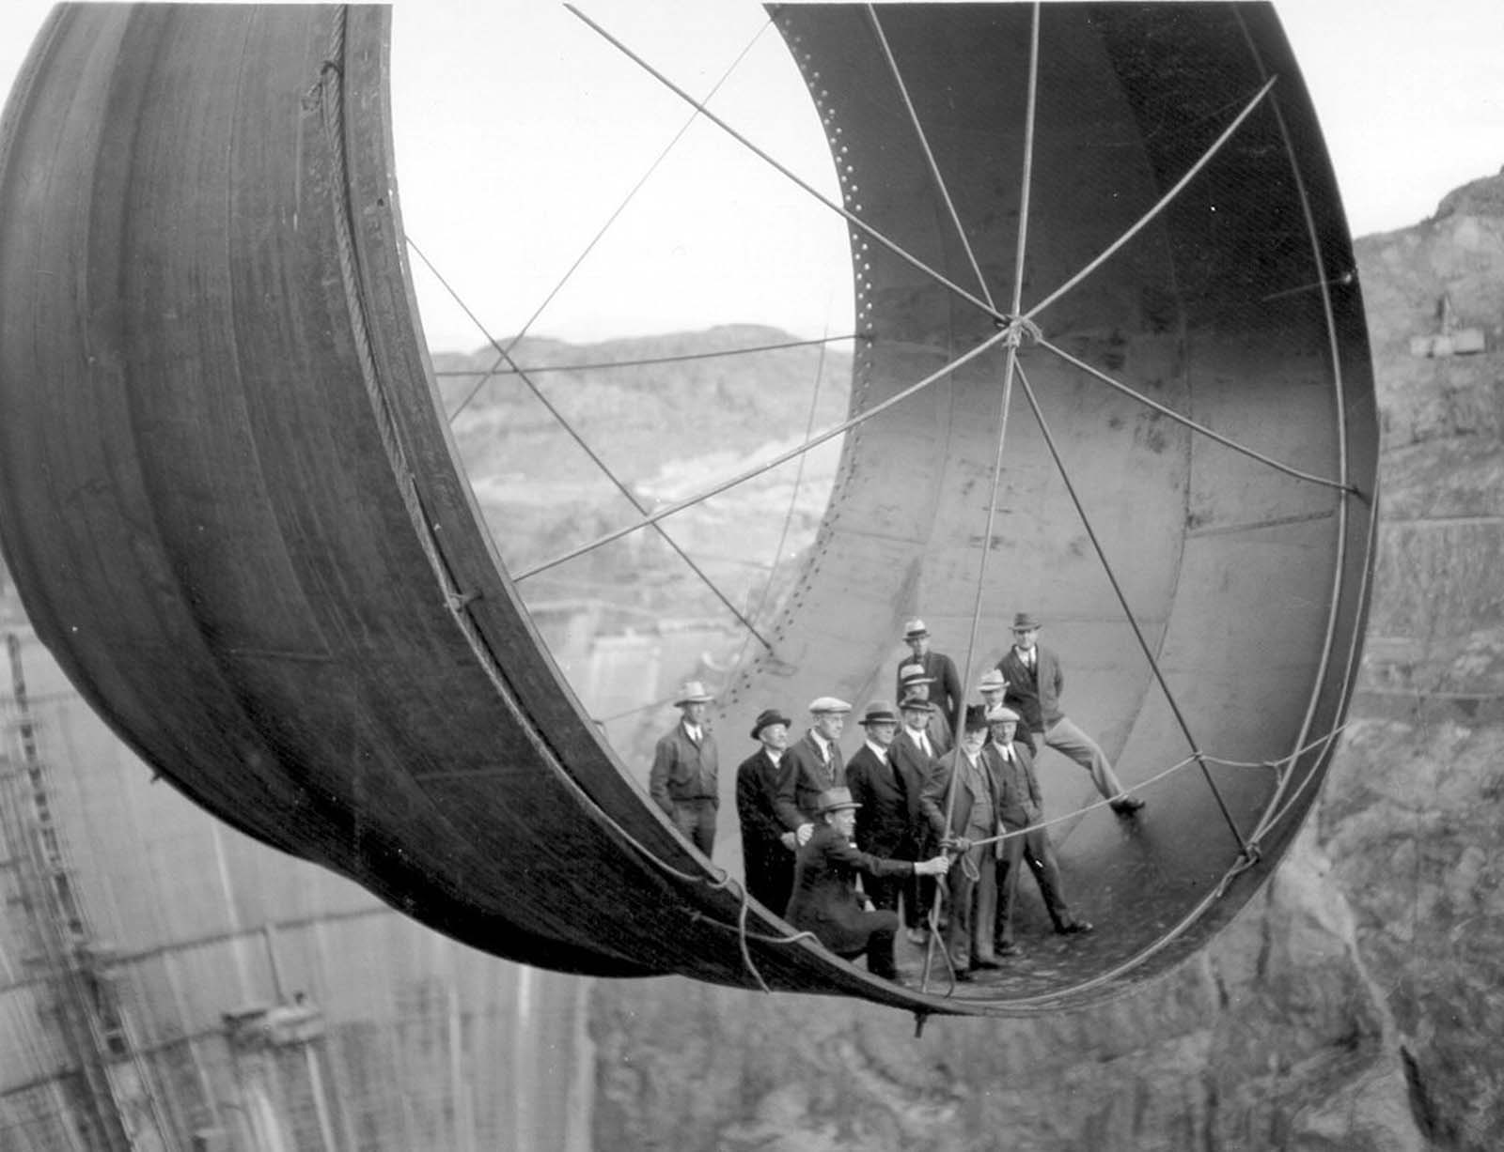

Slide 8
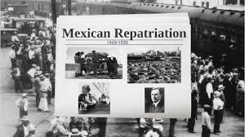
Programs to Help Farmers and Homeowners:
Raise food/crop prices
Mexican Repatriation Act: 2 million Mexicans, some U.S. citizens were deported to free up jobs.
Federal Home Loan Bank Act: Lowered interest rates and refinanced to avoid foreclosure.
Notes:
Unemployed whites wanted jobs held by Mexican- Americans
Law authorized the deportation of Mexicans out of the United States
Split up many families

Slide 9
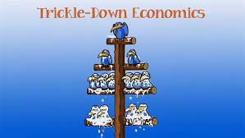
Trickle Down Economics:
Idea that money invested in business “trickles” down to people through jobs and higher wages.
Did not work!!!
People did not have the $$ to spend.

Slide 10
Reconstruction Finance Corporation
Banking Reform:
Hoover gave emergency loans to banks, believing that money would spur (encourage) economic growth
2 billion in financing for banks, insurance companies and other large companies
Notes:
Hoover’s most ambitious economic measure was the Reconstruction Finance Corporation, which authorized up to $2 billion for emergency financing for banks and other large businesses
Trickle Down Economics:the idea that money invested in businesses would “trickle down” and create more jobs and higher wages
It did not.

Slide 11
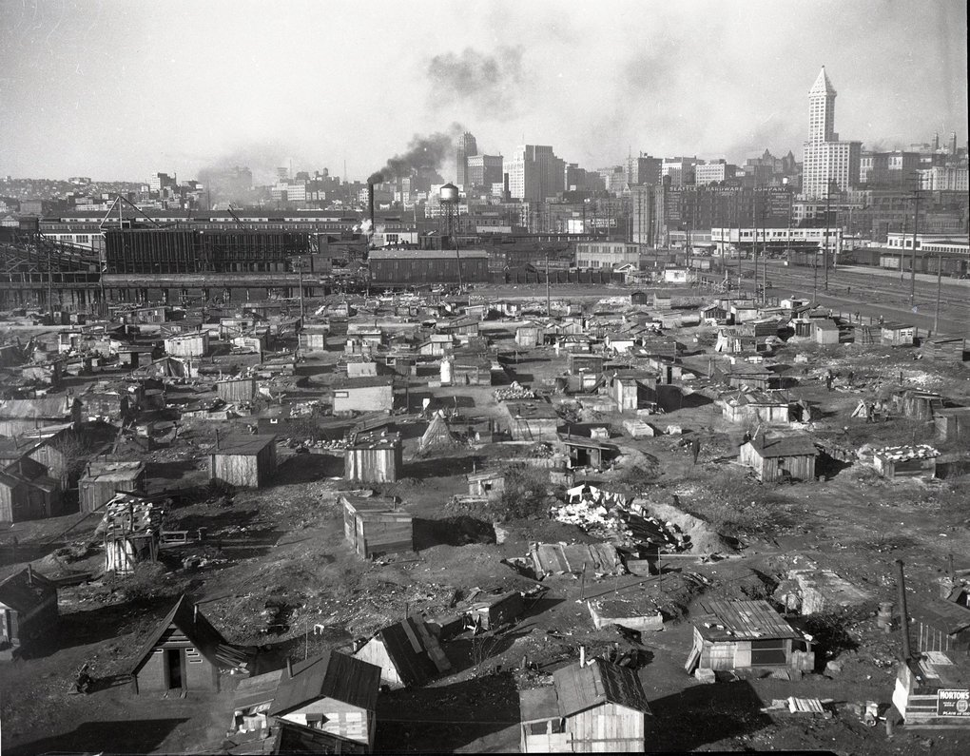
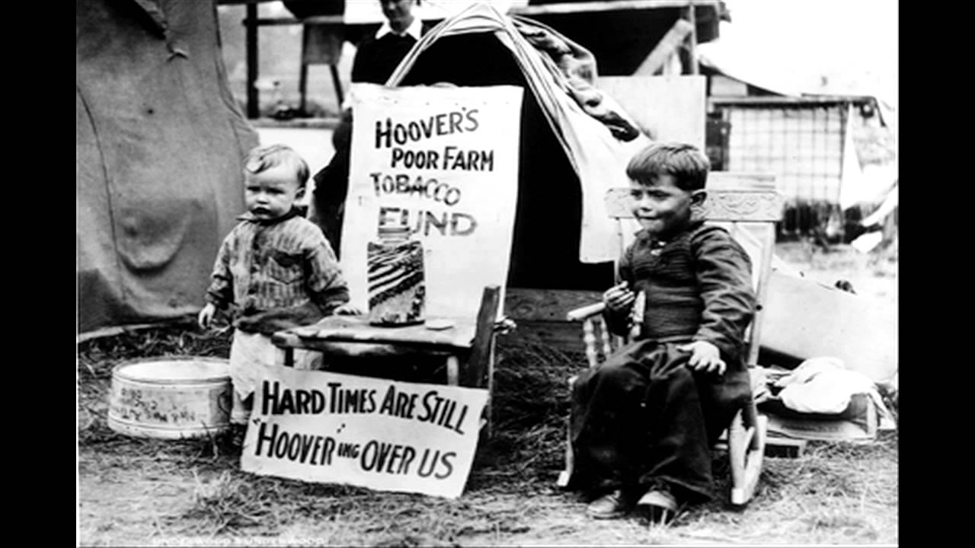
Do you think Hoover’s response worked? Why or Why Not?

Slide 12
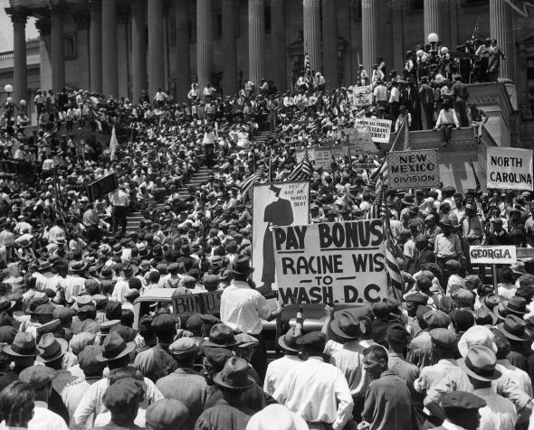
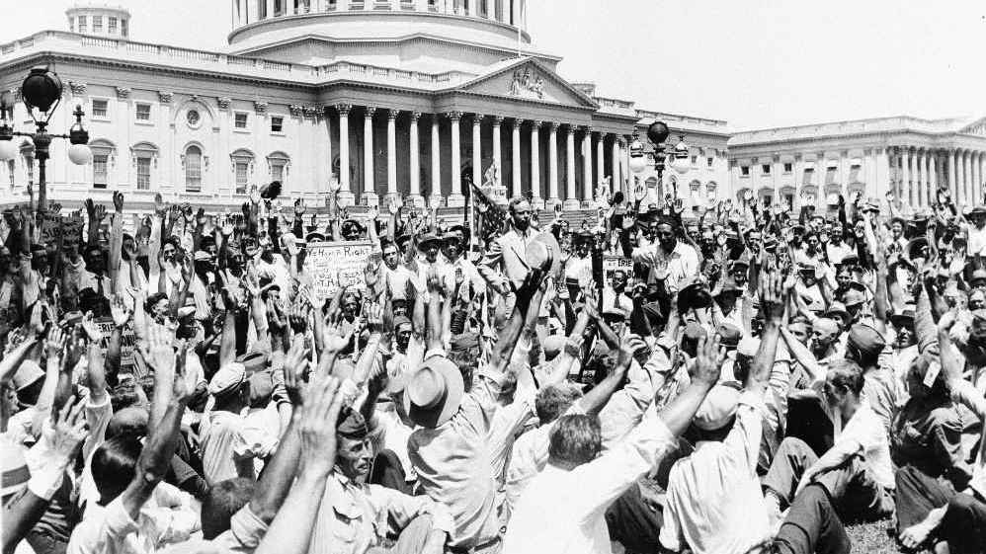
*“1932 Bonus Army March”
WWI veterans promised a $1,000 bonus check to be distributed in 1945
*20,000 Veterans “Bonus Army” marched to Washington, to demand economic relief by receiving their pension early
Notes:
The Bonus Army was made up of World War I veterans
They were supposed to get a bonus check in 1945, but in 1932 they came to Washington D.C. with their families to demand that Congress give them their checks early
They built a large camp on an island in the Potomac River, just outside of the capital

Slide 13
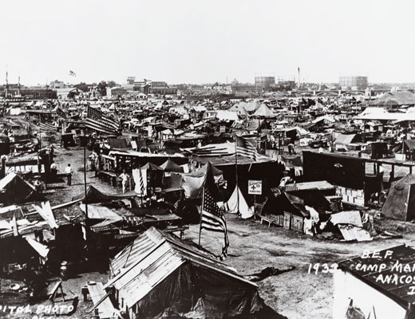

Slide 14
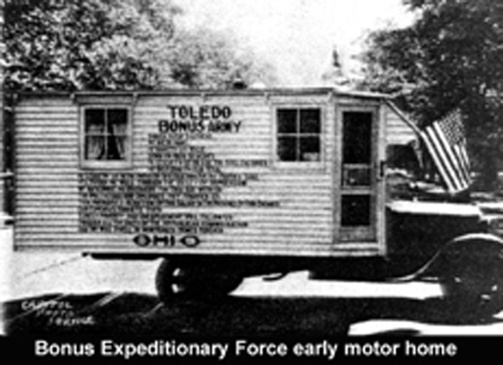
Hoover’s Response to Bonus Army
President Hoover ordered the army to remove them peacefully.
General MacArthur disobeyed the order and burned the camp down.
Helps seal the victory for FDR’s presidential victory!
Notes:
President Hoover ordered the army to remove them peacefully, but Army Chief of Staff General Douglas MacArthur disobeyed the order and attacked the camp with cavalry and tanks and burned it down
Democratic presidential candidate Franklin Roosevelt knew that this would guarantee him a victory in that year's election.

Slide 15
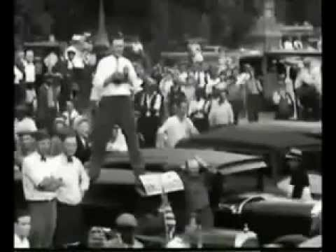

Slide 16
Hoover becomes even less popular going into the 1932 election….

Slide 17
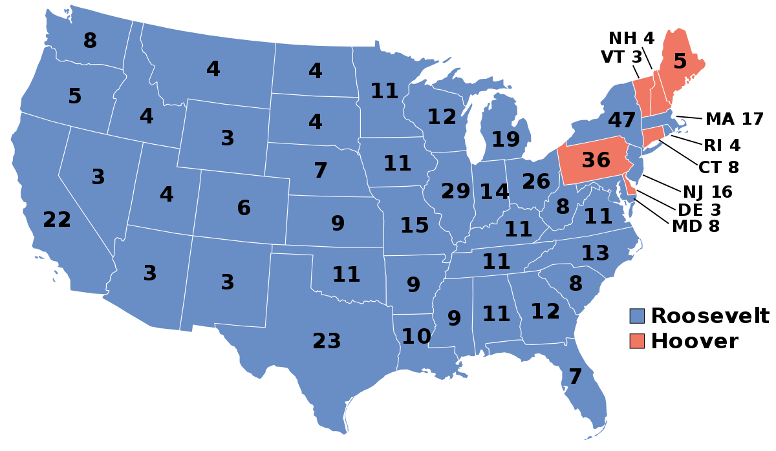
Who won the Election?
Was the Election close?
Notes:
Test #37

Slide 18
FDR AND THE NEW DEAL

Slide 19
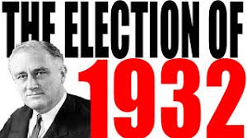
The 1932 Election:
Democrat Franklin Delano Roosevelt wins the presidency in the election of 1932.
The Democrats win control of both the Senate and House of Representatives.
This means that the Democrats would have control over what the government did for at least two years.

Slide 20
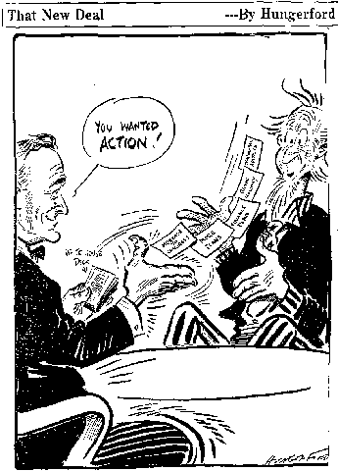
The First 100 Days:
After his inauguration, Roosevelt launched a period of intense activity known as the Hundred Days lasting from March 9 to June 16, 1933.
Since then every president is judged by the media on how much he is able to get done in his first 100 days.
The actions FDR took during his first 100 days significantly expanded the federal government’s role in the nation’s economy.

Slide 21
NEW DEAL POLICIES

Slide 22
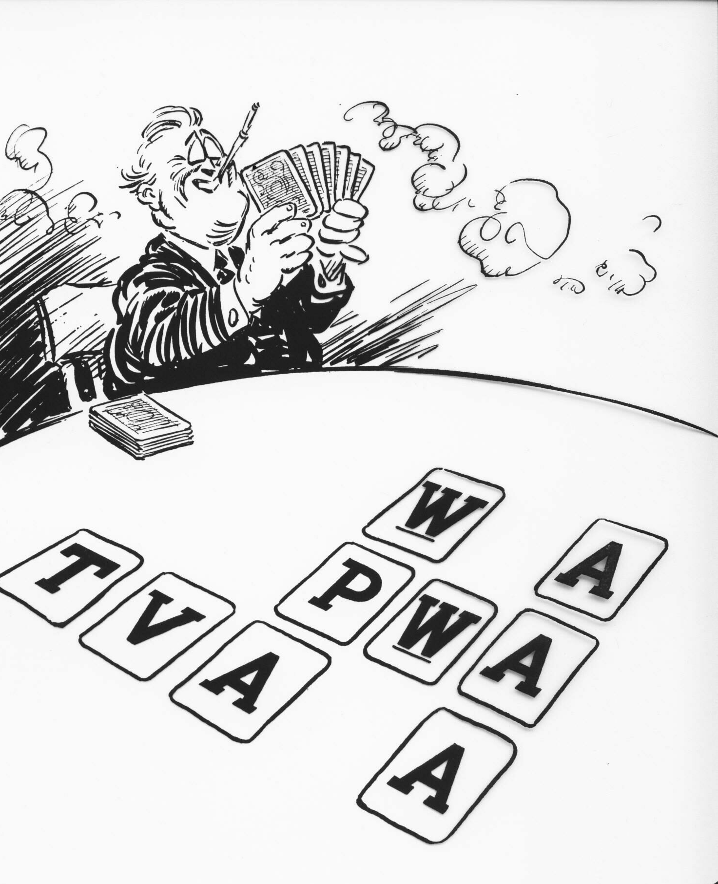
The New Deal:
“Alphabet Soup”
Agencies/Legislative changes that increased the power of the federal government to provide aid and welfare to the people. (input in their everyday lives)

Slide 23
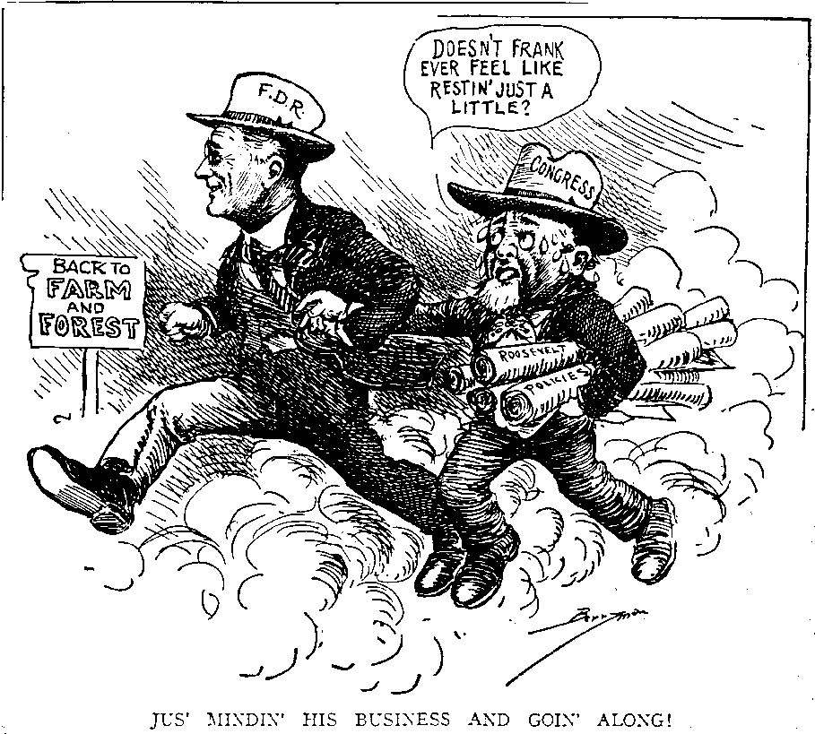
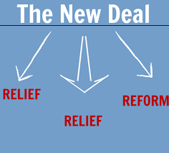
Relief: Programs to help the poor, either with direct relief or through job programs
**IMMEDIATE**
Notes:
Think of FOOD STAMPS….offers immediate

Slide 24
2. Recovery : fixing the economy with programs to help business recover.
**LONG TERM**

Slide 25
3. Reforms: financial fixes to the lack of banking rules.
Created new regulations on banking and the stock market
**PERMANENT**

Slide 26
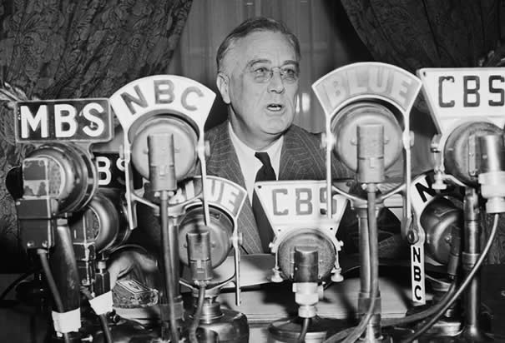
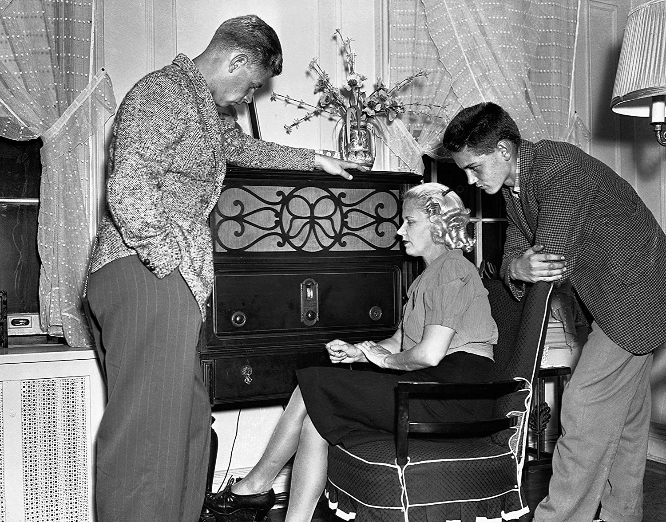
Fireside Chats:
One thing that helped FDR to get his programs passed were his “Fireside Chats”.
Radio speeches about current issues and proposed New Deal policies.
*People felt the President cared and understood
*Helped gain support
Notes:
They made America feel like the president actually cared about them and understood their problems. They also helped FDR to cement popular support for the New Deal, pressuring Congress to go along with it.

Slide 27
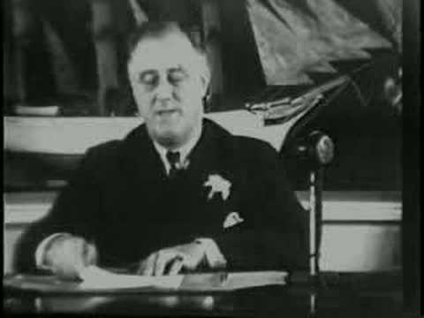

Slide 28
BANK REFORMS

Slide 29
FDIC 1933 - Present
Federal Deposit Insurance Corporation
Protects citizens from potential bank failures
Ensures savings

Slide 30
SEC 1934 - Present
Securities Exchange Commission
Regulates the stock market
The “stock cops”
Notes:
Still in use today…**TESTED**

Slide 31
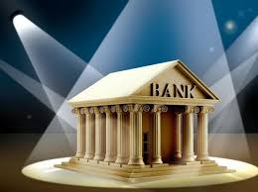
Emergency Banking Relief Act-1935:
immediately put all banks on a “holiday”
US Treasury Dept inspected each bank to make sure it was ok.
Notes:
Prior to the Great Depression, there had been few laws regulation banks – specifically there were no laws saying how much money banks had to keep on site. So, when panicked people made “bank runs” trying to get all of their money out before a bank closed down, it actually caused the banks to close down.
FDR realized that to fix the great Depression, people needed to be confident in their banks. So, one of his first New Deal policies was the Emergency Banking Relief Act. The act immediately put all banks on a “holiday”. Then the U.S. Treasury Department could inspect each bank to make sure it was okay. If it was, it reopened. If not, the bank stayed closed and were offered loans to help them reopen.

