Slide 1
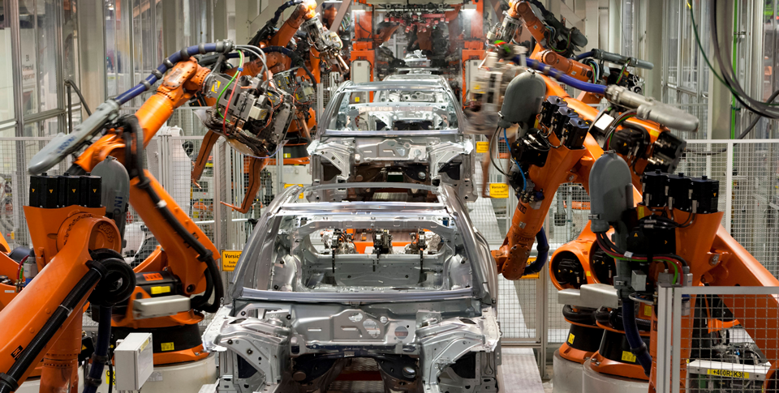
Production Possibilities Curves

Slide 2
Production Possibilities Curves
Learning Objectives
Interpret a production possibilities curve.
Explain how production possibilities curves show efficiency, growth, and opportunity cost.
Explain why a country’s production possibilities depend on its resources and technology.

Slide 3
Production Possibilities Curves
Key Terms
production possibilities curve
production possibilities frontier
Efficiency
underutilization
law of increasing costs

Slide 4
Production Possibilities
Drawing a Production Possibilities Curve
Trade-Offs Along the Production Possibilities Frontier

Slide 5
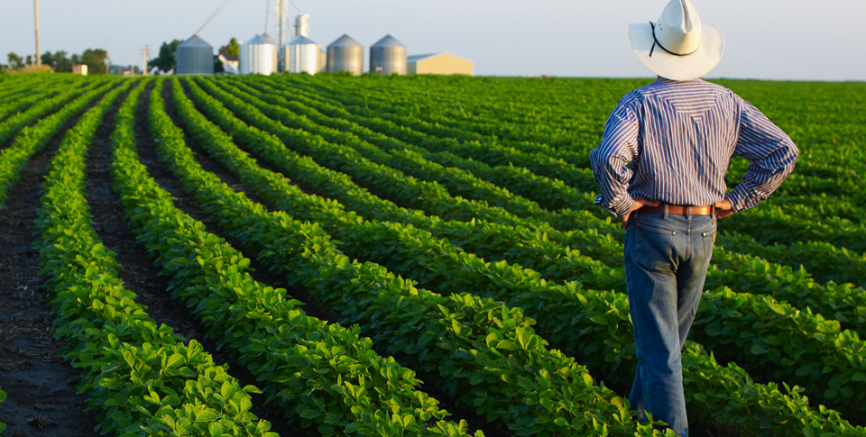
Production Possibilities
Farmers have to decide how to use their resources most efficiently, which means choosing what crops to grow and how much land to devote to each crop.

Slide 6
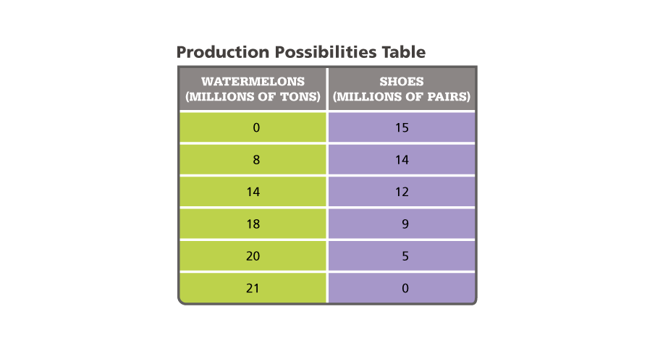
Production Possibilities
Capeland can produce these different combinations of watermelons and shoes. Analyze Charts If Capeland produces 20 million tons of watermelons, how many pairs of shoes can it produce?

Slide 7
Changing Production Possibilities
Efficiency
Growth
Opportunity Cost
Technology and Training

Slide 8
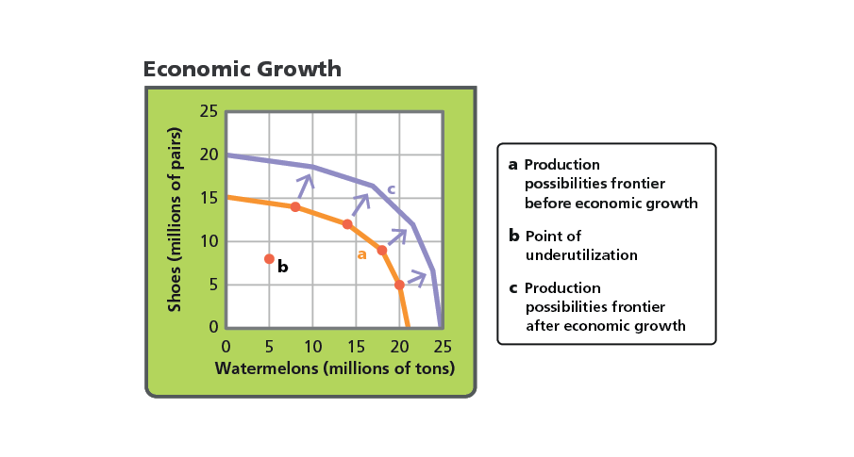
Changing Production Possibilities
Analyze Graphs Based on this curve, how would you describe a situation in which Capeland produces 10 million tons of watermelons and 10 million pairs of shoes?

Slide 9
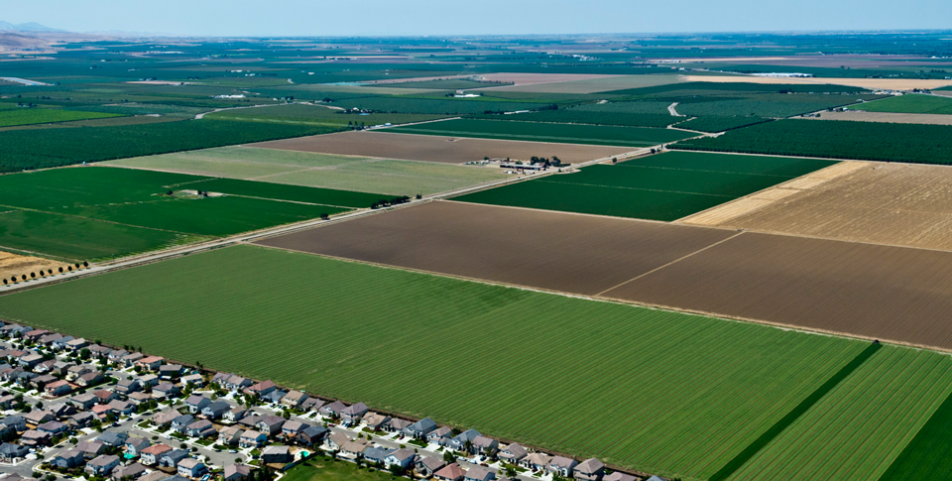
Changing Production Possibilities
This photograph shows an area of farmland that was converted to housing. The opportunity cost of the housing is the crop that could have been grown on that farmland.

