Slide 1
[ 2.3 ] Centrally Planned Economies

Slide 2
How Socialism and Communism Differ
Socialism:
Includes a range or spectrum of economic systems and economies
Allows ownership of some private property
Can be party of democratic system
Socialism/Communism has killed over 100 Million people in the 20th Century!

Slide 3
How Socialism and Communism Differ
Socialism:
What's wrong with Socialism?
The people only have the rights given to them by government!!
If the government gives the rights, the government can take them!!
Socialism/Communism has killed over 100 Million people in the 20th Century!

Slide 4
How Socialism and Communism Differ
Communism:
Requires revolutionary change?
(That means violence to force control)
Government is authoritarian not democratic
State ownership of factors of production
Socialism/Communism has killed over 100 Million people in the 20th Century!

Slide 5
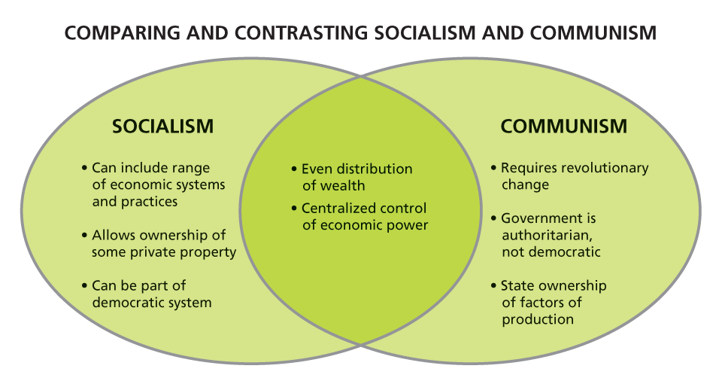
How Socialism and Communism Differ
Socialism/Communism has killed over 100 Million people in the 20th Century!

Slide 6
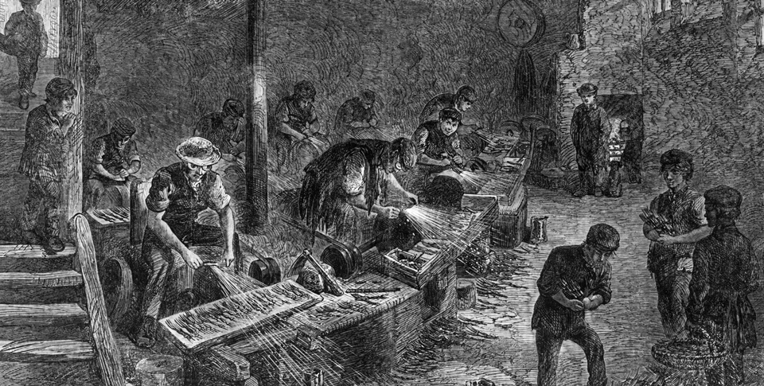
How Socialism and Communism Differ
Industrialization in the 1800s sometimes led to grim working conditions. The communist ideology of Karl Marx was in part a reaction to these developments.

Slide 7
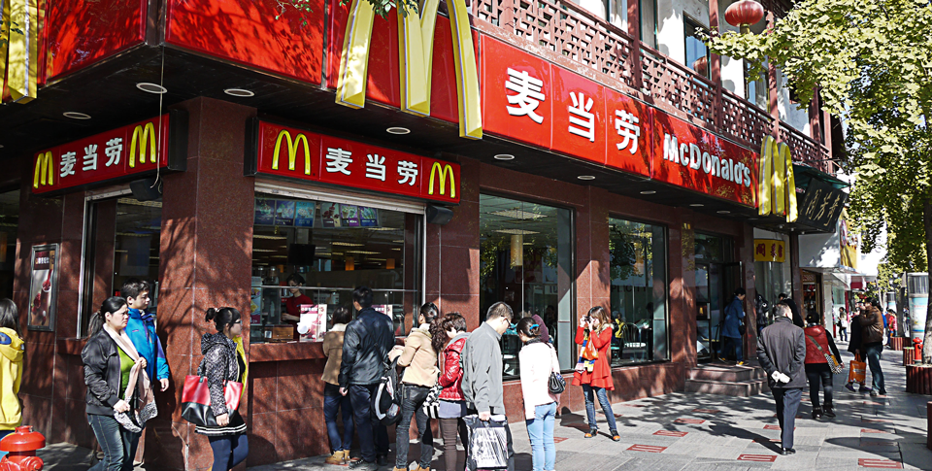
Two Communist Economies
In recent years, China has undergone significant economic reform, leading to the limited introduction of free market principles—and companies.

Slide 8
Disadvantages of Central Planning
A woman shops in a mostly empty Soviet food store in 1990. Express Problems Clearly How does this photo illustrate the shortcomings of the Soviet Union’s centrally planned economy?

Slide 9
Disadvantages of Central Planning
Despite the differences between centrally planned and free market economies, the two systems share many of the same basic goals. However, nations with centrally planned economies have often had trouble meeting these goals in practice.

Slide 10
Disadvantages of Central Planning

Slide 11
Answer the three (3) questions on the Government Regulation of the U.S. Economy.
On the back you are to describe the role (what each agency does) of each government agency listed. You may use your device with a partner or by yourself.

