Slide 1
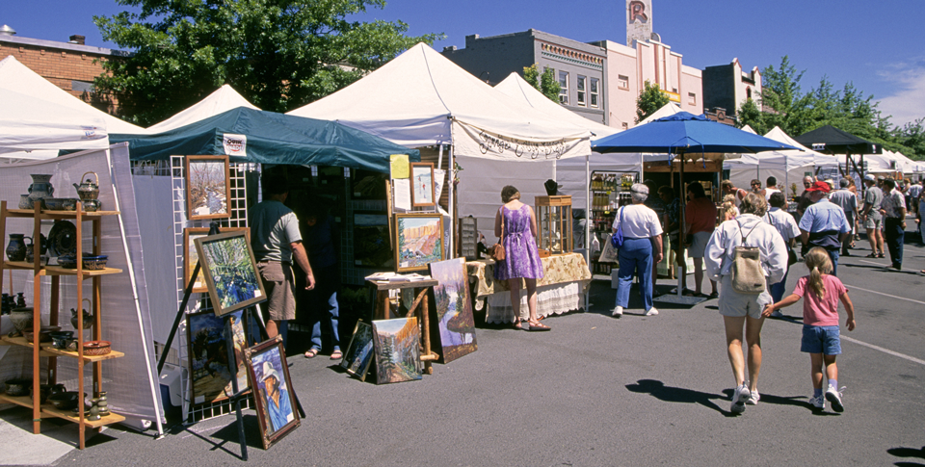
Sole Proprietorship
Art fair vendors may be artists who are sole proprietors. Art fairs provide an opportunity for these sole proprietors to reach more customers.

Slide 2
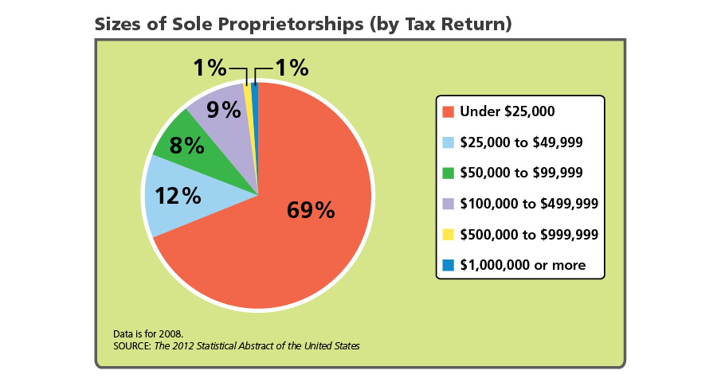
Sole Proprietorships
Owned and controlled by one person
Analyze Graphs Based on the graph, how would you describe the size of most sole proprietorships?

Slide 3
Unique Characteristics of Sole Proprietorships
Most common form of business in the US (90%)
Highest risk of failure of any form of business

Slide 4
Advantages of Sole Proprietorships
Easy to Start and End
Relatively Few Regulations
Sole Receiver of Profit
Full Control Quick decision making
Personal satisfaction in the success of the company

Slide 5
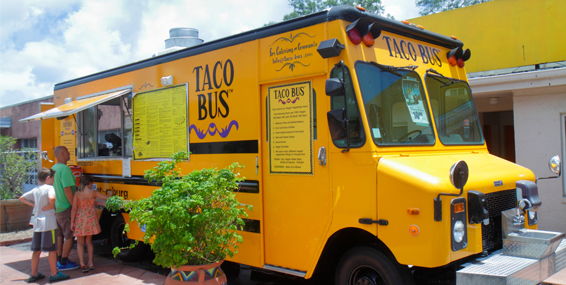
Advantages of Sole Proprietorships
Some sole proprietorships need to be licensed. The owner of a food truck must be licensed to sell food and must submit to inspections to ensure that safety guidelines are followed.

Slide 6
Disadvantages of Sole Proprietorships
As with everything else, there are trade-offs with sole proprietorships.
The independence of this form of business organization comes with a high degree of responsibility.
Unlimited Personal Liability
Limited Access to Resources
Lack of Permanence/limited life/limited growth
Sole responsibility

Slide 7
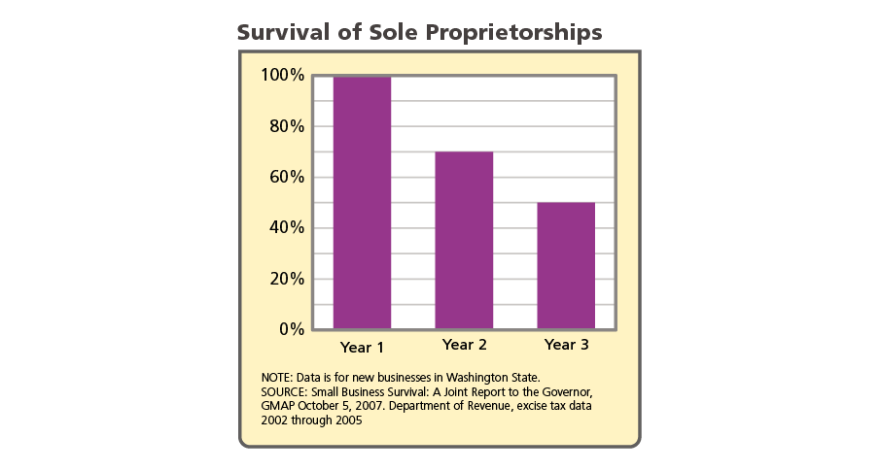
Disadvantages of Sole Proprietorships
Analyze Graphs Suppose that 80 new sole proprietorships were started in a city in 2014. Based on this graph, how many of these would you expect to still be in business after three years?

Slide 8
Quiz: The Role of Sole Proprietorships
Which statement about sole proprietorships is true?
A. Sole proprietorships can be owned by more than one person.
Sole proprietorships are the most common form of business
organization in the United States.
C. Sole proprietorships generate about 40 percent of all sales in the United States.
D. Sole proprietorships do not have to pay employment taxes.

Slide 9
Quiz: Advantages of Sole Proprietorships
Why is it easy to start a sole proprietorship?
A. Sole proprietors do not need to file a lot of paperwork to start a business.
B. Sole proprietors are not subject to zoning laws.
C. Sole proprietors do not have any legal obligations.
D. Sole proprietors do not need to follow any government regulations.

Slide 10
Quiz: Disadvantages of Sole Proprietorships
Which is a disadvantage of sole proprietorships?
A. full control
B. few regulations
C. easy to start and end
D. limited access to resources

