Slide 1
Stock Market Project

Slide 2
What is the stock market?
A stock market or equity market is a public entity for the trading of company stock (shares) at an agreed price; these are securities listed on a stock exchange as well as those only traded privately.
a loose network of economic transactions, not a physical facility or discrete entity

Slide 3
What is the stock market?
The size of the world stock market was estimated at about $111 trillion at the end of 2022
The U.S. makes up 46% of the world markets.

Slide 4
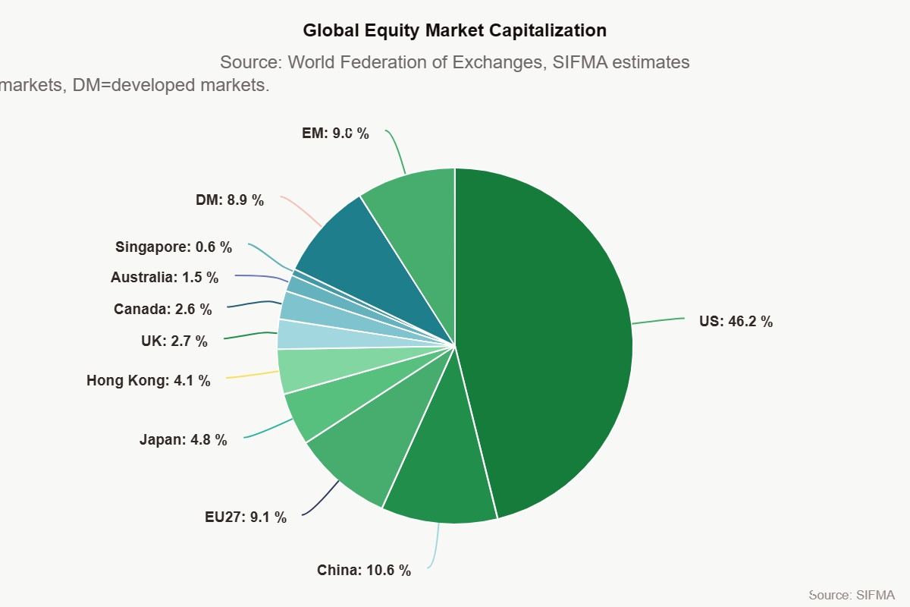
What is the stock market?
The size of the world stock market was estimated at about $111 trillion at the end of 2022
The U.S. makes up 46% of the world markets.

Slide 5
Stock Indexes
So what is the Dow Jones…
It is an average of how the biggest 30 companies stock
Created in 1885 by the Wall Street Journal editor Charles Dow
S&P 500
How 500 companies are doing on the NYSE

Slide 6
How do you find a company on the stock exchange?
All companies are given a “call sign”. 2, 3 or 4 letters that represent their company.
Examples:
GOOG is google’s
MCD is McDonalds
MSFT?
FB?
KO?
BBY?

Slide 7
What is stock price? How to find it?
Stock price is the going price of 1 share of stock?
Can be as high as it goes ($481,258.03 Berkshire Hathaway) to $1
How do you find the stock/share price?
Can use several different sites.
Investing.com
Google Finance
NYSE.com (only for stocks traded on NYSE)

Slide 8
Questions about stock market?
New Project all semester long.
1major grades (taken the day you sell your stock)
4 daily grades (Beginning today, initial buy)
Initial buy sheet and stock performance summary
4 Graphs depicting the performance of each stock

Slide 9
Today
Determine what stocks you want to buy.
I suggest diversifying among major industries.
You have a maximum of $10,000 to spend (total).
Pick 4 stocks that you want to purchase and find the stock price.
Find out how many shares you want to buy
Divide out your money among the 4 stocks. 2 ways to do this:
Each stock get an even amount. Amount you have to spend divided by 3.
Give each stock a different number of shares.
Find the number of shares
Complete your initial buy form
You will create a graph for each stock. Everytime you look up the price you will plot the price point and watch you stock perform over time.

