Slide 1
The Battlefront: Ending the War
Unit 5: WWI #3

Slide 2
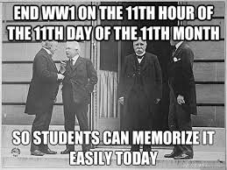

Slide 3
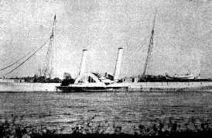
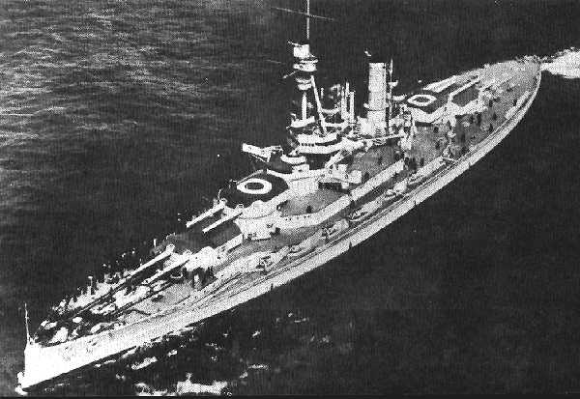
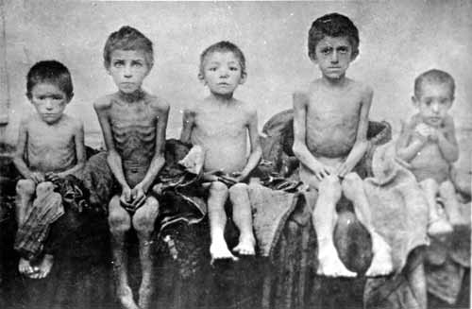
The British Blockade
As fighting on land continued, Britain began to make more use of its naval strength
It blockaded the German coast to prevent military supplies (weapons) and food from getting through
Results:
Ships carrying goods for Germany refused to challenge the blockade and seldom reached their destination
By 1917, famine struck the country
An estimated 750,000 Germans starved to death as a result of the British blockade

Slide 4
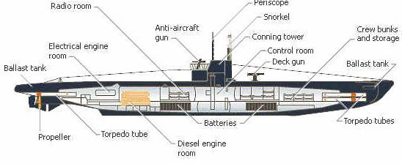
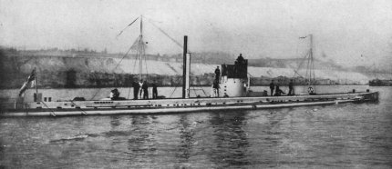
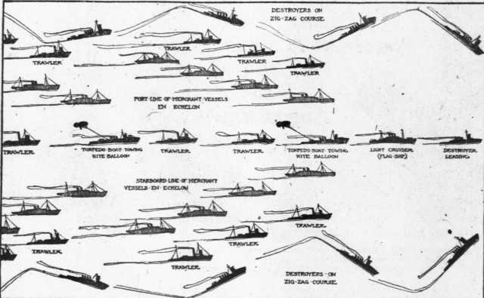
Germany’s Response & America’s Interference
Germany threatens that any ships around Britain would be sunk by German U-Boats (submarines) without warning unless Britain lifted the blockade
German U-boats attacks on merchant ships in the Atlantic were a serious threat to the Allied war effort
American Vice Admiral William Sims convinced the British to try the convoy system, in which a heavy guard of destroyers escorted merchant ships back and forth across the Atlantic in groups
By fall 1917, shipping losses had been cut in half

Slide 5
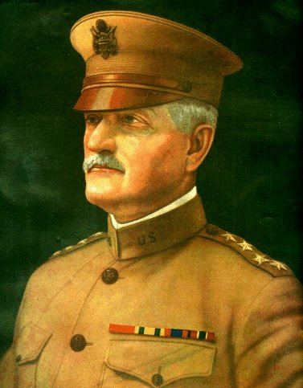
John J. Pershing
The commander of the American Expeditionary Forces (the U.S. forces who would fight with the Allies)
He believed in aggressive combat and that three years of trench warfare made the Allies too defensive
Under Pershing, American forces helped to stop the German advance
After the war, Pershing was made General of the Armies of the U.S. – the highest rank given to an officer

Slide 6
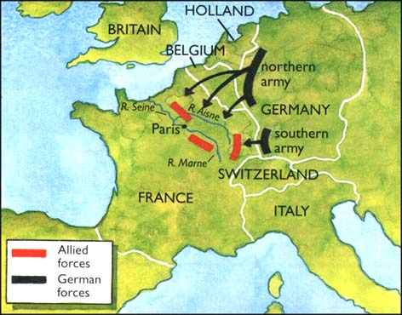
American Troops Go on the Offensive
When Russia pulled out of the war in 1917, the Germans shifted their armies from the eastern front to the western front in France
By May, they were within 50 miles of Paris
The American Expeditionary Forces arrived just in time to help stop the German advance in France
The tide had turned against the Central Powers

Slide 7
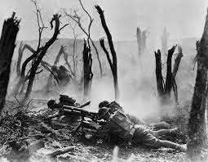
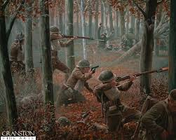
Battle of Argonne Forest
September 26, 1918 – November 11, 1918
The turning point battle in World War I
American troops were able to cut off the German supply lines

Slide 8
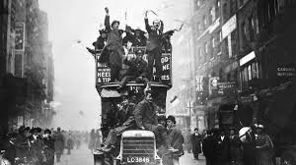
THE WAR IS OVER!

Slide 9
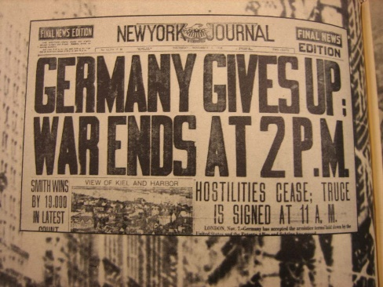
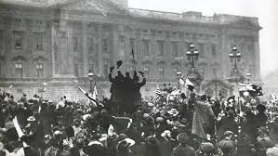
The Collapse of Germany (The War Ends)
On November 3, 1918 Austria-Hungary surrenders to the Allies
German sailors mutiny (revolt) against the government; spread quickly
Everywhere in Germany, groups of soldiers and workers organized revolutionary councils
On November 9, socialist leaders in Berlin establish a new German republic
The Kaiser gave up the throne

Slide 10
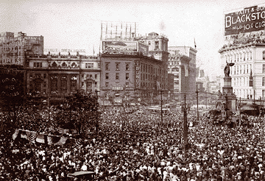
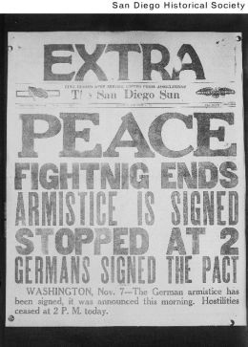
Armistice = ends the war, Allies win
“The fighting stopped on the eleventh hour of the eleventh day of the eleventh month.”
- Nov. 11, 1918

Slide 12
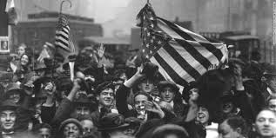
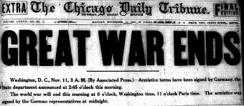
World War I Statistics
World War I was the bloodiest war in history up to that time
The direct economic costs of the war may have been about $338 billion
The U.S. lost 50,000 men in battle with another 62,000 dying of disease

Slide 13
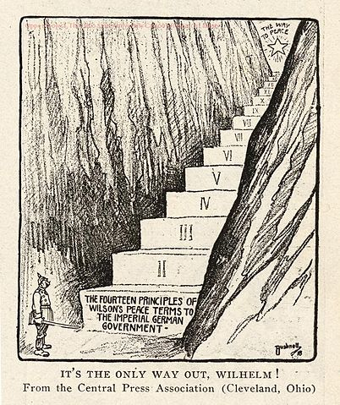
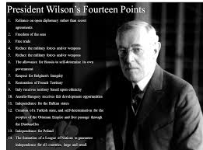
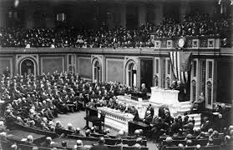
President Wilson’s “Fourteen Points”
President Wilson’s plan for post-war world peace
Reduce the military and navy
Remove trade barriers
Create a “League of Nations”

Slide 14
League of Nations
International organization whose goal was to keep the peace among nations
Had no military
If one country was attacked, all countries would be drawn into war
Wilson’s idea - failed

Slide 15
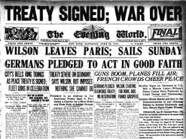
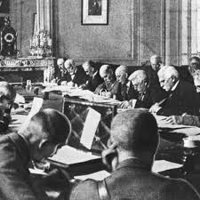
The Treaty of Versailles
Allies agreed to a League of Nations
Germany = War Guilt Clause – forced to accept total responsibility for the war
European powers way of revenge – blame Germany!
Treaty of Versailles: Peace agreement & punished Germany

Slide 16
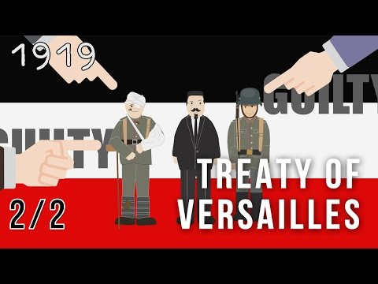

Slide 17
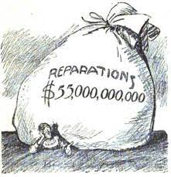
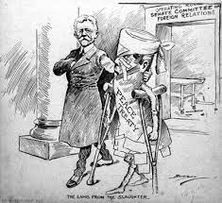
War Guilt Clause
Germany’s punishment for World War I:
Pay $33 billion in reparations (payment of war debt)
Forced to give up its colonies
Limit their armed forces (demilitarization) or reduce their army

Slide 18
The Failure of the Treaty
War Guilt Clause, loss of colonies, & high reparations → Germany angry & bitter
Americans were traumatized by the war
The U.S. did not join the League of Nations because they feared that the U.S. would get drawn into future conflicts

Slide 19
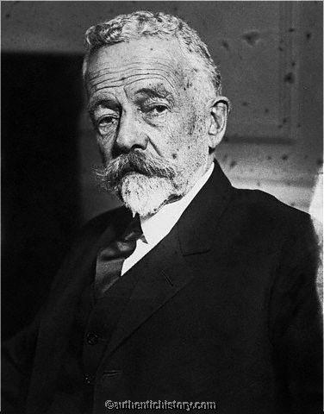
U.S. and the End of the War
The U.S. did not ratify the Treaty of Versailles
U.S. returns to isolationism
U.S. Reaction to the Treaty:
Some, like Henry Cabot Lodge, feared the League of Nations would lead to more wars
Alliances would put countries into their allies’ wars

Slide 20
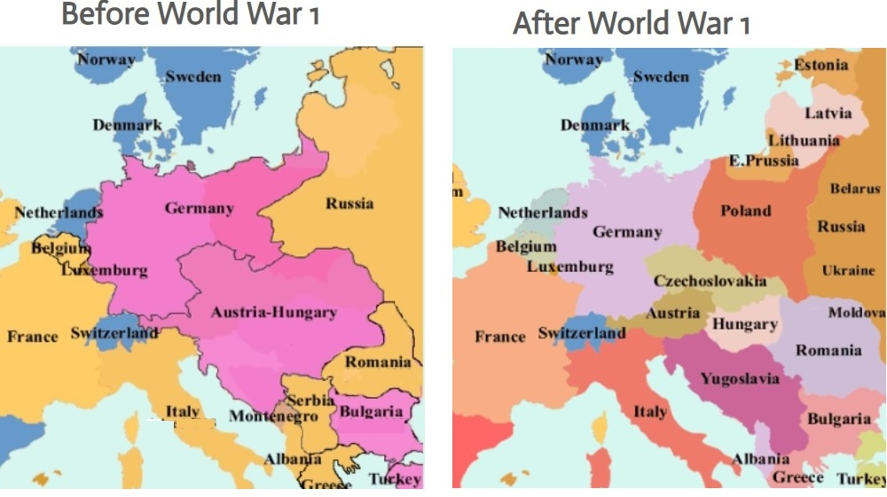

Slide 22
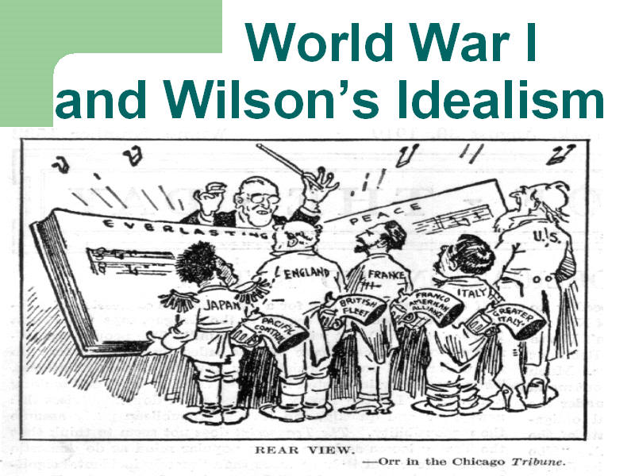
A Separate Treaty
The U.S. finally signed a separate treaty with Germany in 1921, after Wilson was no longer president
The U.S. never joined the League of Nations, but it maintained an unofficial observer at the League meetings

Slide 23
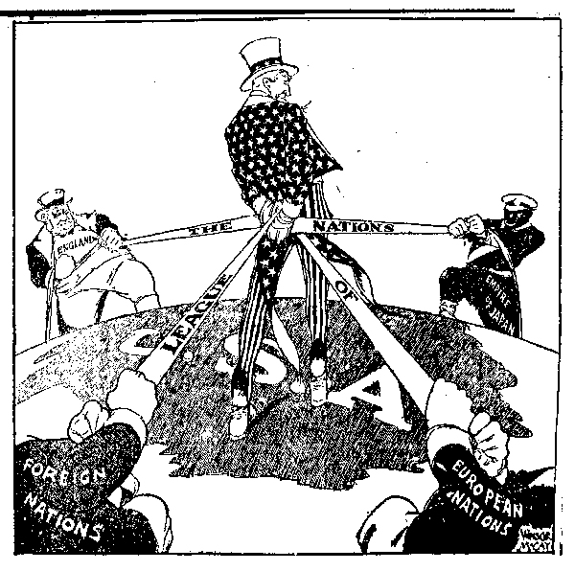
Unresolved Issues
Unresolved issues in Europe would eventually drag America into an even wider war
The Treaty of Versailles had settled nothing
In fact, some Europeans longed to resume the fight
The treaty helped to start WWII

