Slide 2
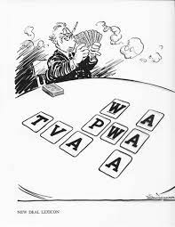
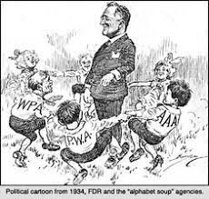
Alphabet Agencies
Agencies created by FDR as a part of the New Deal

Slide 3
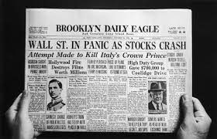
Black Tuesday
October 29, 1929; the day the Stock Market crashed

Slide 4
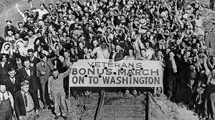
Bonus Army
Group of veterans who marched in Washington D.C. demanding pay that the government owed them

Slide 5
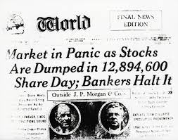
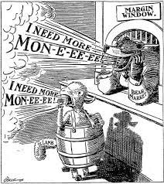
Buying on Margin
Paying a down payment on a stock and borrowing money to pay for the rest

Slide 6
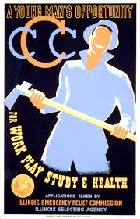
Civilian Conservation Corps (CCC)
3 million young men to work camps to build bridges, replant forests; develop job skills and improve environment

Slide 7
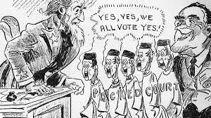
Court-Packing
The President’s ability to appoint new Supreme Court Justices

Slide 8
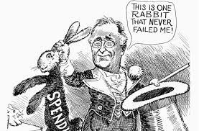
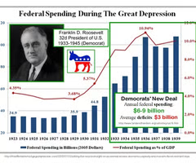
Deficit Spending
Spending exceeding revenue over time

Slide 9
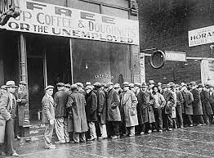
Direct Relief
Cash payments for food from the government to the poor

Slide 10
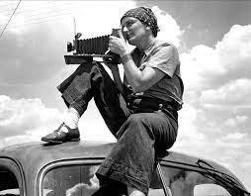
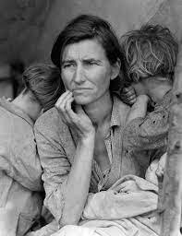
Dorothea Lange
Photographer who documenting the hardship of the Great Depression through photography

Slide 11
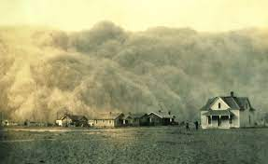
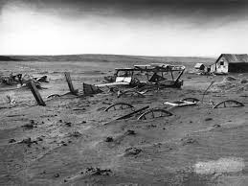
Dust Bowl
Region in the central U.S. that was hit hard with dust storms for several years, due to overfarming and drought

Slide 12
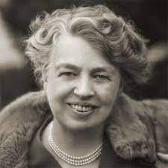
Eleanor Roosevelt
Wife of FDR; advocate for farmers, workers, women, and minorities; became UN Ambassador (human rights)

Slide 13
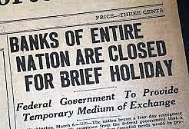
Emergency Banking Relief Act
Put all banks on a “holiday” break so that they could be inspected

Slide 14
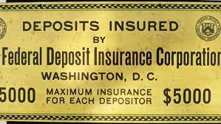
Federal Deposit Insurance Corporation (FDIC)
Created federally insured bank deposits to prevent bank failures

Slide 15
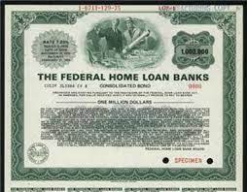
Federal Home Loan Bank Act
Lowered mortgage rates and allowed people to refinance their homes and farms

Slide 16
Federal Reserve System
National banking system that controls the U.S. money supply and the availability of credit in the country

Slide 17
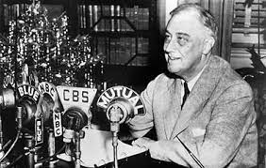
Fireside Chats
President F.D. Roosevelt’s radio talks to calm Americans

Slide 18
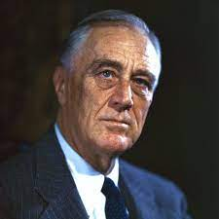
Franklin Delano Roosevelt
2nd Great Depression President, New Deal programs, and had a hands on approach

Slide 19
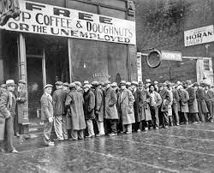
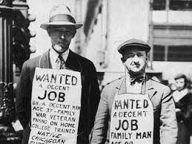
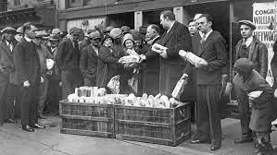
The Great Depression
The stock market crash followed by high unemployment, low production, and low investment

Slide 20
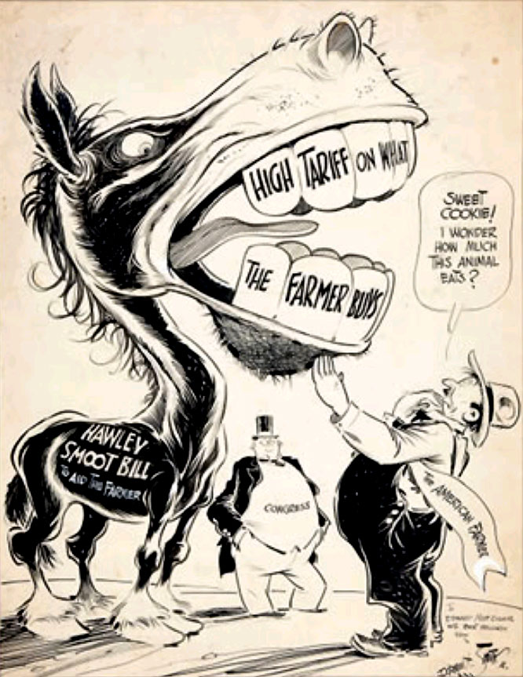
Hawley-Smoot Tariff
Highest protective tariff in U.S. history; world trade slowed down

Slide 21
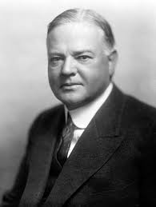
Herbert Hoover
President (31st) during the first part of the Great Depression; laissez-faire approach with the economy

Slide 22
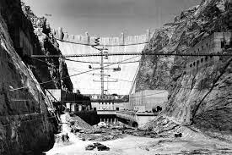
Hoover Dam (Boulder Dam)
Built on Colorado River; created jobs, electricity, flood control, provided water for the West

Slide 23
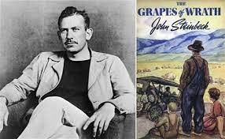
John Steinbeck
“Grapes of Wrath” author; story of family fleeing the Dust Bowl for a new start in California

Slide 24
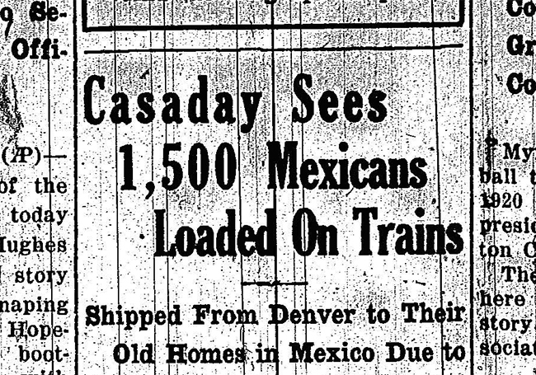
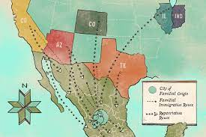
Mexican Repatriation Act
Deportation of Mexican Americans in order to open up jobs for Americans during the Great Depression

Slide 25
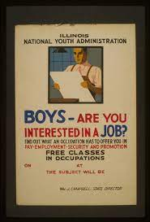
National Youth Administration (NYA)
Provided young Americans with aid and employment; youth employment

Slide 26
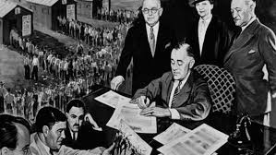
New Deal
Roosevelt’s aggressive programs to turn the economy around from the Great Depression

Slide 27
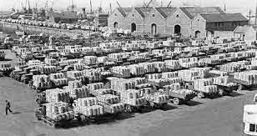
Overproduction
Producing more of a product or commodity than is needed for society

Slide 28
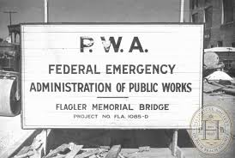
Public Works Administration/ Works Progress Administration
Adult men built bridges and libraries; 8.5 million workers’ in construction, ars, theater, and literary projects

Slide 29
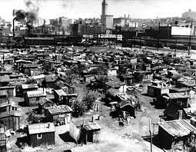
Shantytown (Hooverville)
Little towns of shacks where homeless people were forced to live

Slide 30
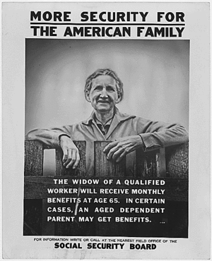
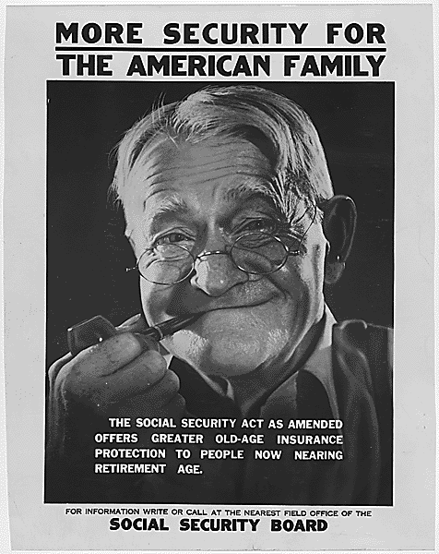
Social Security Act
Provided retirement pensions, unemployment insurance, aid to blind, deaf, disabled, and dependent children

Slide 31
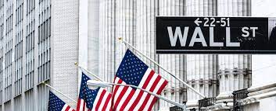
Securities and Exchange Commission (SEC)
Regulated stock market and restricted margin buying to prevent fraud

Slide 32
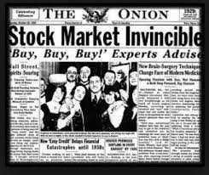
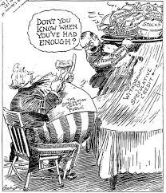
Speculation
Buying stocks and bonds for a quick profit and ignoring the risks

Slide 33
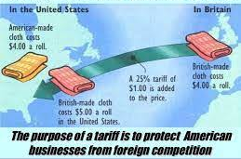
Tariff
A tax on foreign goods, meant to help American businesses

Slide 34
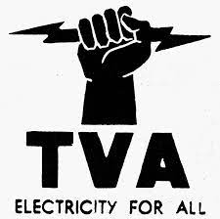
Tennessee Valley Authority (TVA)
Built dams to prevent flooding and provide electricity in the rural South

Slide 35
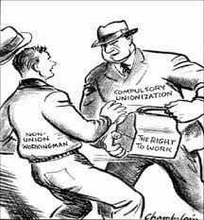
Wagner Act
Reaffirmed labor’s right to unionize, prohibited unfair labor practices

