Slide 1
The Roaring 20s!
Unit 6: Politics in the Twenties #1

Slide 2
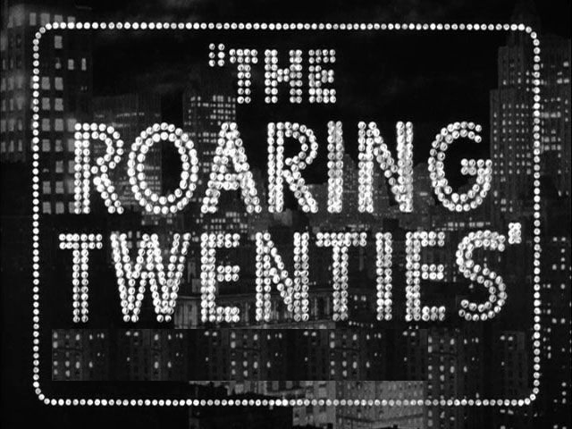

Slide 3
Cultural Conflicts of the 1920s
Traditional vs. Modern values
Old ways vs. New ways
Older Generations vs. Younger Generations

Slide 4
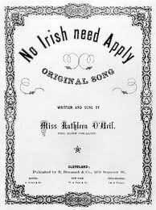
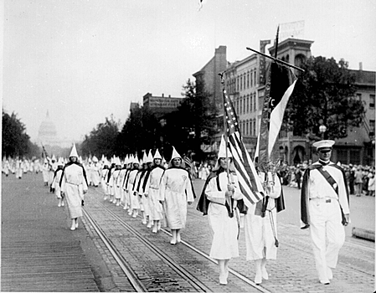
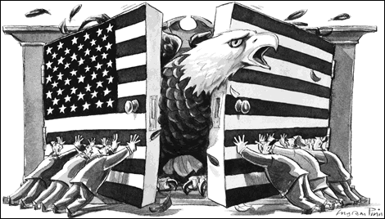
Nativism & Isolationism
Nativism: prejudice against foreign-born people
Isolationism: pulling away from involvement in world affairs

Slide 5
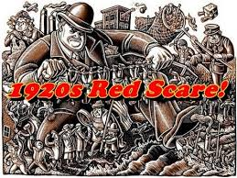
Communism & The Red Scare
Communism: economic and political system based on a single-party government ruled by a dictatorship
Government owns businesses; no private property
Red Scare in U.S.:
Started with Russian Revolution
Communist party formed in U.S.
Fear of the spread of Communism in the U.S.

Slide 6
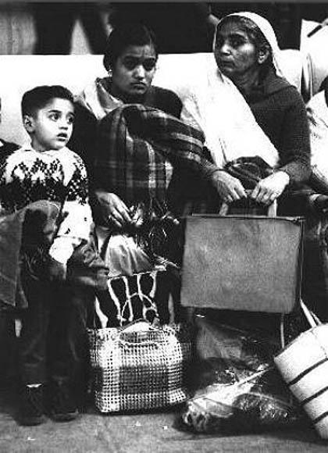
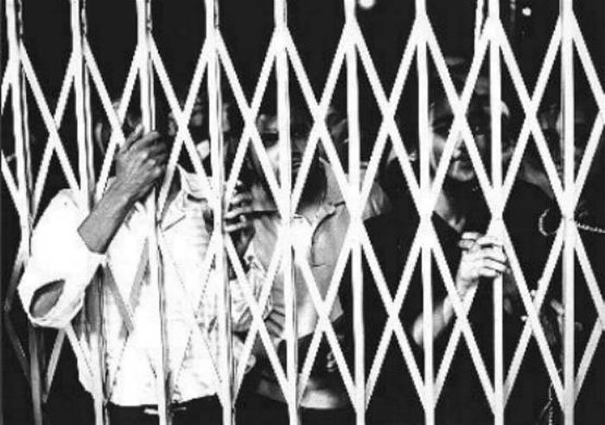
Limited Immigration
“Keep America for Americans”
Nativism once again on the rise
Quota System:
Set maximum # of people allowed to enter U.S. each year
Target was Southern and Eastern Europeans

Slide 7
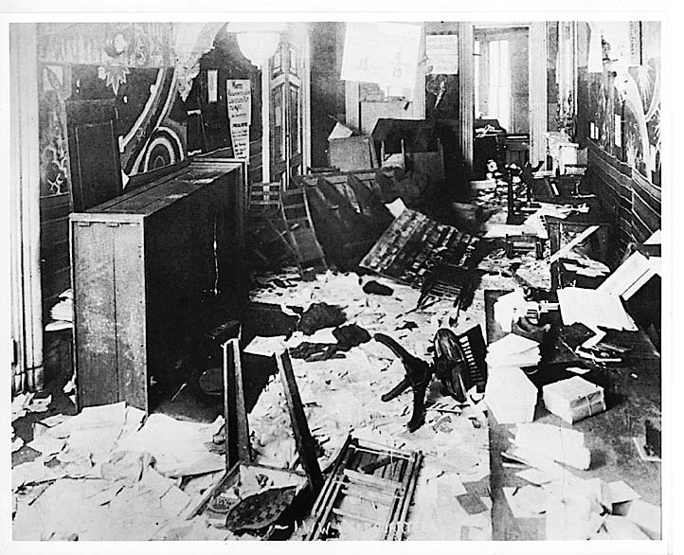
The Palmer Raids
U.S. Attorney General Mitchell Palmer & J. Edgar Hoover
The government hunted down anyone that was suspected to be:
Communists
Anarchists: people opposed to any form of government
Failed because people didn’t believe it

Slide 8
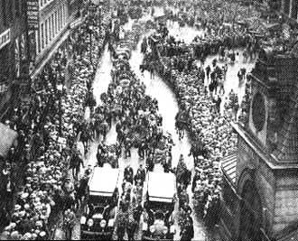
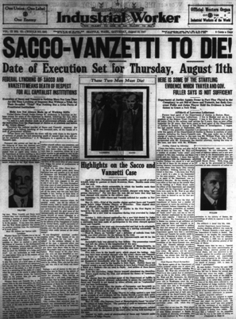
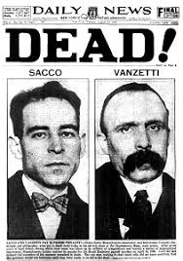
Nicola Sacco &
Bartolomeo Vanzetti
They were victims of nativism
Accused of murder based on witnesses seeing “Italians” at the scene
Circumstantial evidence and accused had alibis
Both men were sentenced to death by electric chair
Protests rang out all over the country

Slide 9
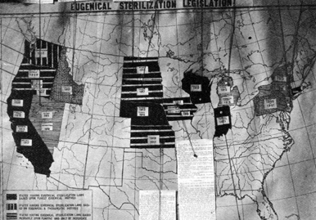
Eugenics
Eugenics: belief that the human race can be improved genetically by selective breeding
Making specific decisions about who has children with whom
Eugenics advocates wanted to better the human race, but their definition of “better” often involved racism and classism
This map from 1921, the shaded states had programs to forcibly sterilize “undesirables”

Slide 10
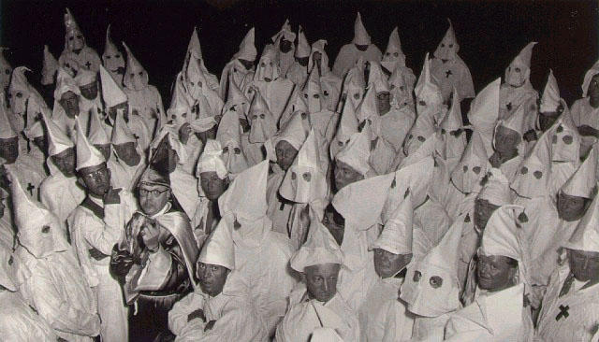
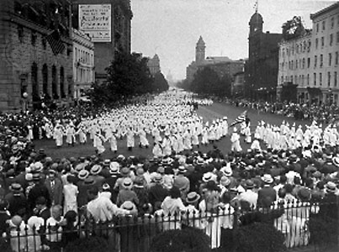
Ku Klux Klan
Created in 1865 to resist the change the Republican party brought to the South
The KKK saw big rise in membership during the 1920s → due to population shifts
By 1924, memberships reached 4.5 million people
The KKK was devoted to “100% Americanism” (NATIVISM)
The Klan also believed in:
Keeping African Americans as second class citizens
Destroying saloons
Opposing unions
Wanted Catholics, Jews, & foreign-born people out of the country
Northern cities in general had not welcomed the massive influx of African Americans
African Americans faced many daily threats and discrimination (found a voice in the NAACP)

Slide 11
Return to Normalcy

Slide 12
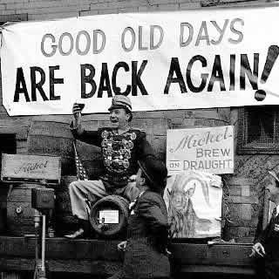

Slide 13
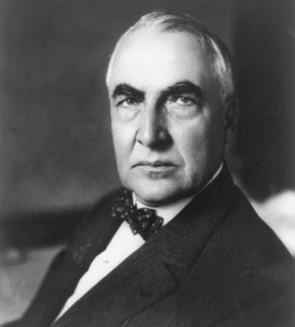
Return to Normalcy
After WWI, post-war economic problems, and the Red Scare, people in the U.S. wanted everything to just calm down and be alright
Warren G. Harding ran for President promising a “Return to Normalcy”
Won by the biggest margin ever in 1920
The Real Harding:
Disputed evidence that Harding was a member of the KKK (He allowed them to have a rally at the White House)
Took his mistresses to a 5X5 ft coat closet in the White House that he secretly had built
Gave one mistress a Cadillac and paid her $50,000 to avoid scandal; she received monthly payments as well
Had a child with another one of his mistresses who was 30 years younger than him
Bet and lost the White House to China in a poker game
During Prohibition, Harding kept the White House full of illegal liquor
“I am not fit for this office, and never should have been here.” -Warren G. Harding

Slide 14
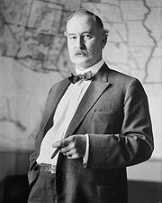
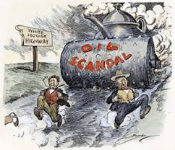
Teapot Dome Scandal
President Harding’s administration was marred by the Teapot Dome Scandal:
Harding’s Secretary of the Interior took bribes from oil companies in exchange for giving them a sweet deal on oil drilling contracts
It was the biggest presidential scandal up until Watergate in the 70s

Slide 15
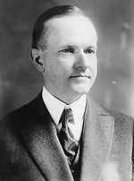
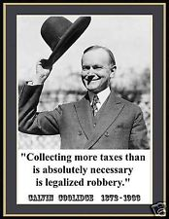
Silent Cal…
When Warren G. Harding suddenly died in 1923, his V.P., Calvin Coolidge became President
Where Harding was corrupt and scandalous, Coolidge was boring
Dubbed “Silent Cal,” Coolidge believed the president should be “the most unimportant person in America.”
Coolidge believed in little government intervention in the economy and was very pro-business

Slide 16
High Tariffs + Reparations = A New Conflict
Congress passed tariffs that protected U.S. manufacturers by keeping out foreign-made goods
Gov’t favored big business again (return to laissez-faire)
Paying war debts becomes a problem for Germany
Fordney-McCumber Tariff:
Supposed to help American businesses
Instead it hurt world trade
European economies suffered
Significantly raised taxes on imports
Germany could not repay; devastated economy
U.S. gave Germany a loan; everyone got paid back (with our own money)
Other European countries resented it

Slide 17
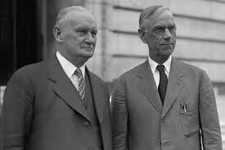
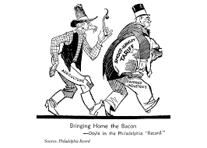
Smoot-Hawley Act
Increased 900 import tariffs by an average 40-50%
Most economists blame it for worsening the Great Depression
Also contributed to the start of WWII
Congress wanted to protect American farmers from the now cheap agricultural imports
Sought to raise farm tariffs to the same level as tariffs on manufactured goods
By 1929, the bill proposed tariffs on 20,000 imported goods
Many knew it would become a barrier to international trade

Slide 18
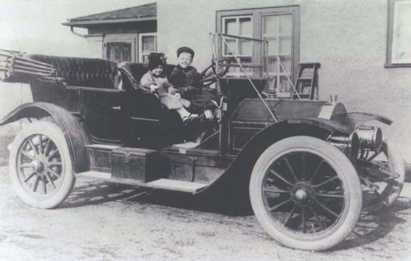
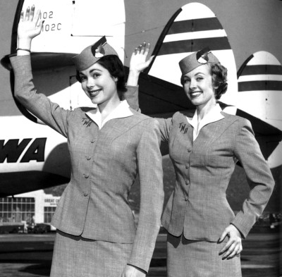
Business of America
Automobile
Airplane
Electricity
Invention of new electrical appliances
Advertising
Luring customers
Credit
Installment plan
“Dollar down and a dollar forever”

