Slide 1
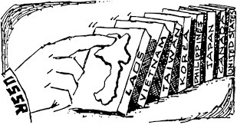
Answer the following
Explain the “Domino Theory”
Define Self-Immolation.
What group did this as a sign of protest?
The U.S. goes to war in Vietnam what type of warfare will the U.S. military men face?

Slide 2
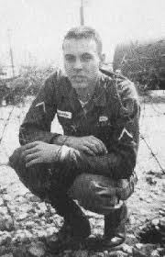
A Texas Hero: Roy Benavidez

Slide 3
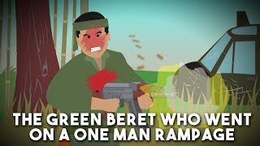

Slide 4
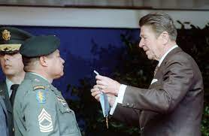
Army Master Sergeant Raul “Roy” Perez Benavidez
Texan, Latino-American hero
Fought in Vietnam
Received the Congressional Medal of Honor for his unquestioned bravery and self-sacrifice in the face of incredible danger as he saved the lives of several fellow soldiers

Slide 5
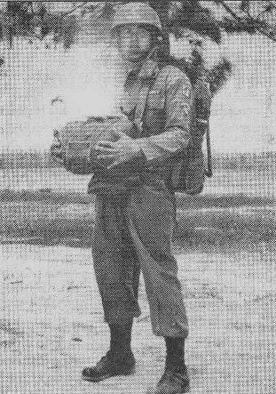
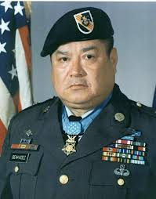
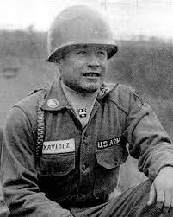

Slide 6
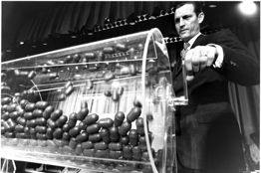
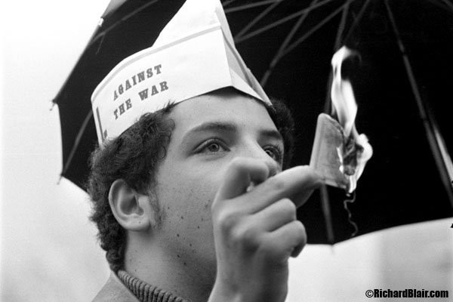
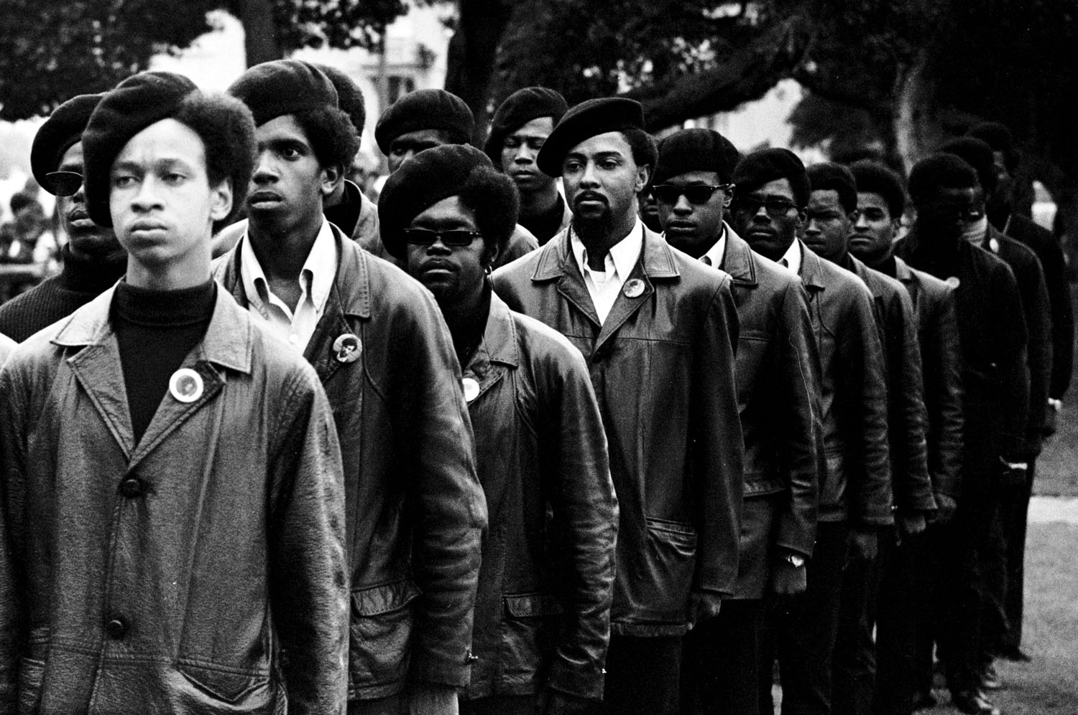
The Draft
3.5 million U.S. soldiers, Marines, and sailors served in Vietnam.
2.2 million were drafted.
Many young people opposed the war in Vietnam and the draft.
Hundreds of thousands refused to serve - leading to the term "draft dodger."
The Black Panthers argued that African-Americans should be exempt from the draft due to their lack of voting rights.
**Draft: 1964-1973** Strengthened the anti-war movement.
Notes:
1964 and 1973
The 1969 draft lottery only encouraged resentment of the Vietnam War and the draft. It strengthened the anti-war movement, and all over the United States, ...

Slide 7
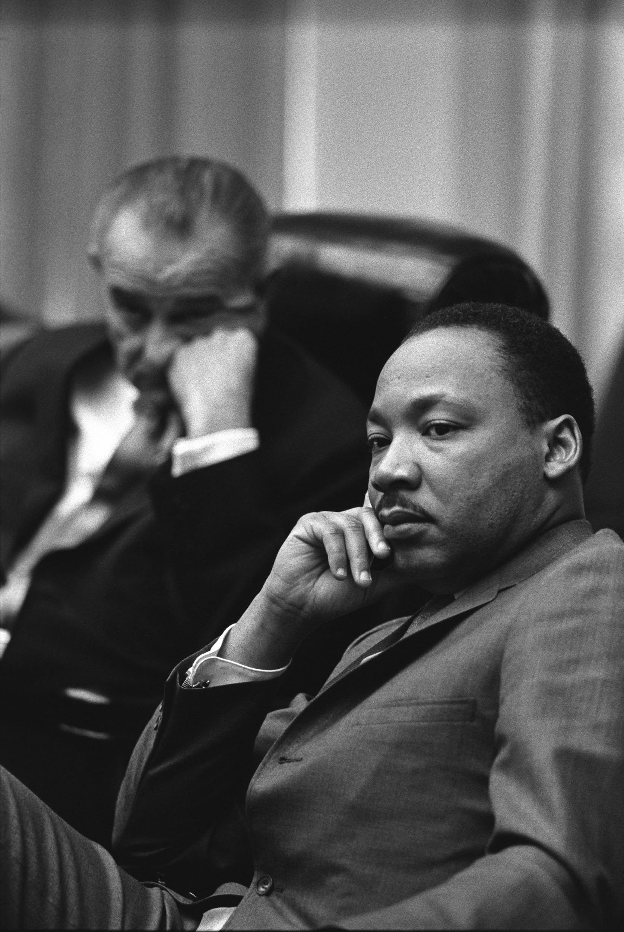
Martin Luther King, Jr
In the last few years of his life,
Martin Luther King began to speak out against the war in Vietnam.
This cost him the friendship and support of many of his white civil rights allies, such as President Lyndon Johnson,
who came to feel that King had betrayed him after he had done so much for African-Americans.

Slide 8
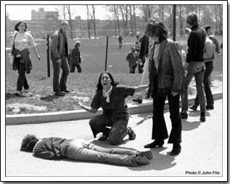
Kent State & the anti-war movement
The anti-war movement took a tragic turn on May 4th, 1970
National Guardsmen fired on peaceful protesters at Kent State University in Kent, Ohio killing 4 students and wounding 9.
This event led to an increase in student protests
Shifted public opinion more strongly against the war.

Slide 9
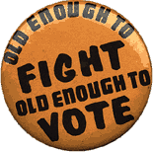
Expanding the Vote
The main protestors of the Vietnam war were college students, many of whom were too young to vote.
They argued that it was unfair that people 18-20 were old enough for the draft but not to vote.
In response Congress passed the 26th Amendment to the Constitution in 1971.
lowered the voting age to 18 in all elections.

Slide 10
The Vietnam War:
Turning Point

Slide 11
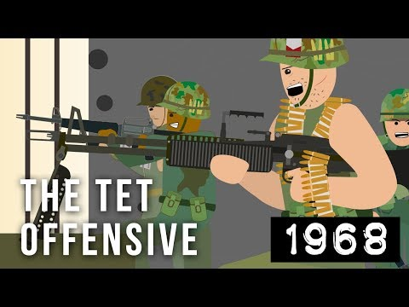

Slide 12
The Tet Offensive
1968 - North Vietnamese surprise attack
Reveals that US troops were doing much worse than President Johnson had said
Notes:
The Tet Offensive was a surprise attack by North Vietnam in 1968 across all of South Vietnam during the holiday of Tet (the Tet: Vietnamese New Year and is the most important festival and public holiday in Vietnam.)
It was so surprising because both sides had generally agreed there would be no fighting on this holiday.
The Tet Offensive seemed like a big loss for North Vietnam.
45 thousand out of 100 thousand men were killed
In the U.S., the American people were shocked by the offensive and felt like the U.S. must be losing the war.
The Johnson administration tried to convince the American people that the U.S. was still winning, but they weren't believed.

Slide 13
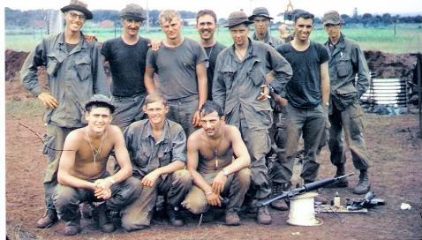
My Lai Massacre (1968)
March of 1968( a month after the deadly Tet Offensive)
Charlie Company had taken heavy losses during recent missions – 28 men recently had been killed or injured
Sent into an area of Vietnam that was believed to be a Vietcong stronghold – Son My – on a “seek and destroy” mission to find Vietcong and destroy them
Commanders advised the soldiers of the company that all people found in the area could be considered VC sympathizers
ordered them to destroy the village.
Charlie Company

Slide 14
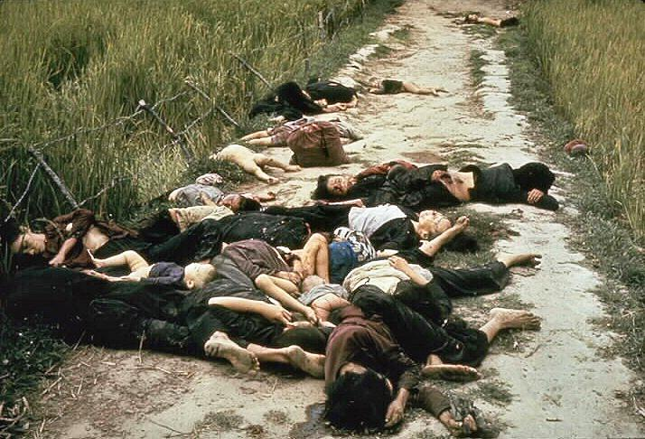
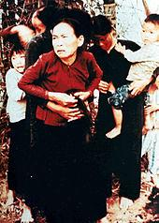
Soldiers arrived at My Lai village shortly after dawn
No Vietcong were found, in fact no soldier-age men were there… only women, children and elderly
Lieutenant William Calley then ordered soldiers to begin shooting the villagers - women, children elderly
More than 500 people in total were killed
Slaughtered livestock, raped an unknown number of women, burned the village to the ground
Children or anyone running away was shot and killed

Slide 15
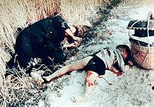
Only Stopped when Hugh Thompson, a helicopter pilot on reconnaissance mission noticed the dead bodies, saw retreating villagers in front of soldiers
He threatened to open fire on American soldiers if they continued.
Total losses – 182 Women, 17 were pregnant; 173 children, 56 of whom were infants
Notes:
The event was covered up and America was not made known of it until 1969
14 men, including Calley were charged with crimes relating to the event.
Only Cally was found guilty – found guilty of premeditated murder
He claimed he was only following orders of his commanding officer Ernst Medina
Life sentence, but was reduced upon appeal to 20 years, then 10, he was let out on parole in 1974.

Slide 16
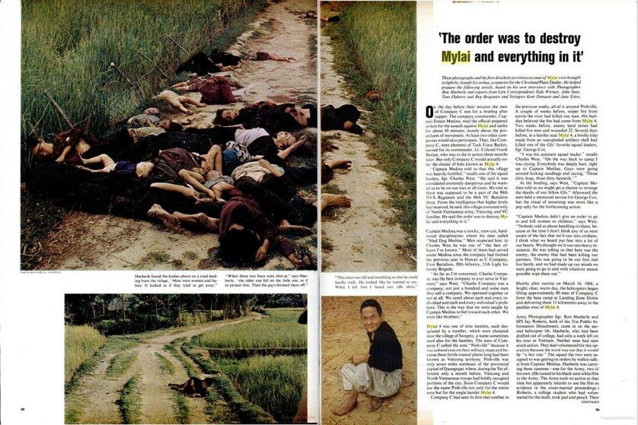
First reported in 1969
The event was covered up and America was not made known of it until 1969
14 men, including Calley were charged with crimes relating to the event.
Only Cally was found guilty – found guilty of premeditated murder
He claimed he was only following orders of his commanding officer Ernst Medina
Life sentence, but was reduced upon appeal to 20 years, then 10, he was let out on parole in 1974.

Slide 17
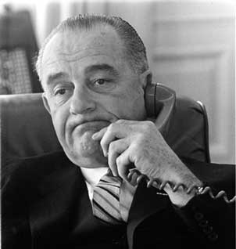
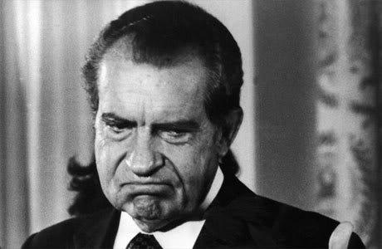
The “Credibility Gap”
There was a discrepancy (gap) between what the government said and what the media reported
***Americans distrust the government***

Slide 18
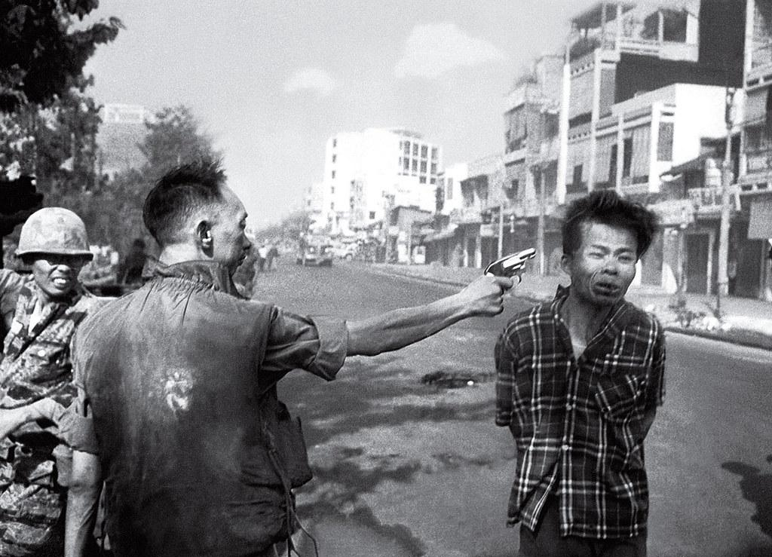

Slide 19
Behind the Photo
Adams, a former Marine Corps Korean War photographer who joined the AP in 1962, and NBC cameraman Vo Suu had been checking out fighting in a Saigon neighborhood when they saw South Vietnamese soldiers pulling a prisoner out of a building, toward the newsmen.
The soldiers stopped. The police chief, Lt. Col. Nguyen Ngoc Loan, walked up and lifted his pistol. Adams figured the chief planned a gunpoint interrogation.
Instead, Loan fired, and Adams’ photo froze prisoner Bay Lop’s grimace as he was shot. Suu’s footage also captured the moment, in motion.
Loan told the two: “They killed many of my men and many of your people” and walked away, Adams recalled in a 1998 interview for an AP oral history project.
Taken during the North’s surprise Tet Offensive, Adams’ Feb. 1, 1968, photo showed the war’s brutality in a way Americans hadn’t seen before. Protesters saw the image as graphic evidence that the U.S. was fighting on the side of an unjust South Vietnamese government.
It was the second day of the Tet Offensive. North Vietnamese forces and Viet Cong guerrillas had attacked South Vietnamese towns and cities, including the capital, Saigon, during a holiday cease-fire.

Slide 20
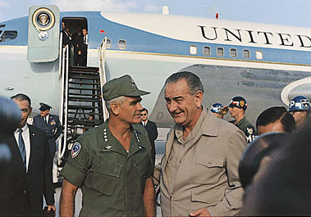
General Westmoreland & the Credibility Gap
“Vietcong surrender is imminent”
“The U.S. has never lost a battle in Vietnam”
“There is a light at the end of the tunnel”
But, the military continued to draft more young men to fight in Vietnam
The American public believed there was a “credibility gap” between what the gov’t was saying & the reality of the Vietnam War

Slide 21
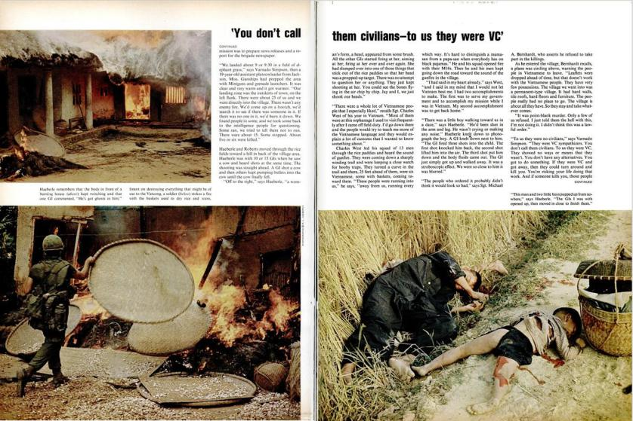
Leads to more protests.
decreased soldier morale.

Slide 22
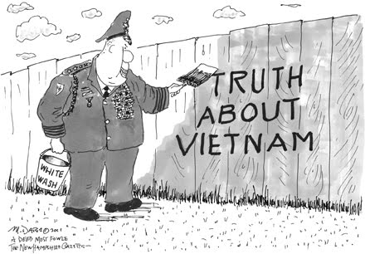

Slide 23
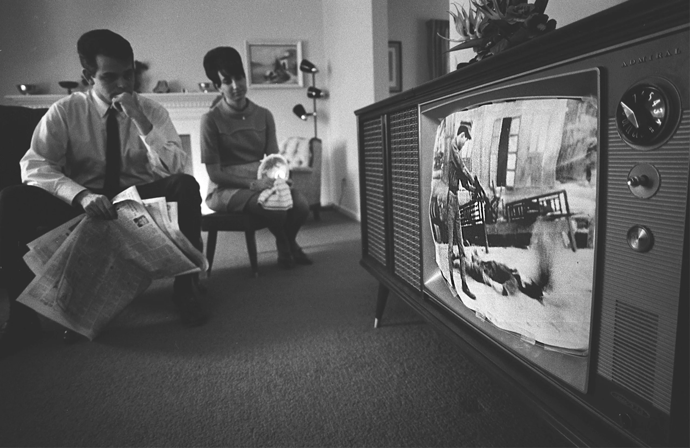
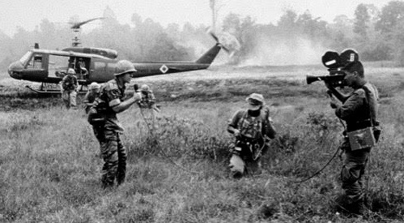
The Media
Brought the reality of the war to the people through television
This became a living room war
President Johnson becomes unpopular→

Slide 24
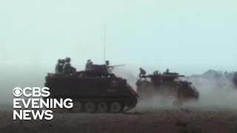

Slide 25
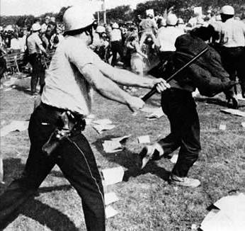
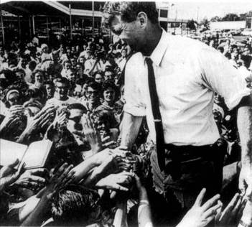
Richard Nixon & the Election of 1968
LBJ’s decision not to run for re-election & the assassination of Robert Kennedy left the
Republican Richard Nixon took advantage of the divided Democrats & won the 1968 election
Notes:
25

Slide 26
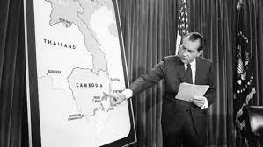
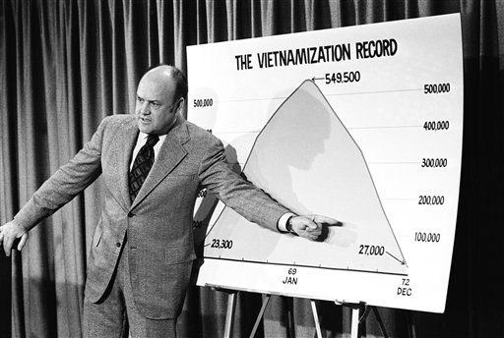
Vietnamization
President Nixon vowed to end the Vietnam War "with honor." This involved a tactic known as "Vietnamization
President Nixon gradually withdrew US troops
Trained South Vietnamese troops to fight independently
Notes:
President Nixon vowed to end the Vietnam War "with honor." This involved a tactic known as "Vietnamization." Vietnamization meant training South Vietnamese troops (the Army of the Republic of Vietnam, or ARVN) to take over the war for themselves. By 1973, all U.S. troops had left Vietnam (except for the Marines guarding the U.S. embassy in Saigon).

Slide 27
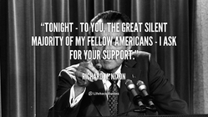
The Silent Majority
Americans who were not protesting the war and did not speak out against the war
Also known as-Hawks

Slide 28
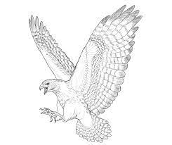
HAWKS & DOVES
Hawks
Aggressive
Favored the War
Silent Majority
Doves
Peaceful
Did not favor the war
Hippies

Slide 29
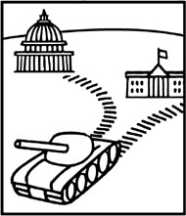
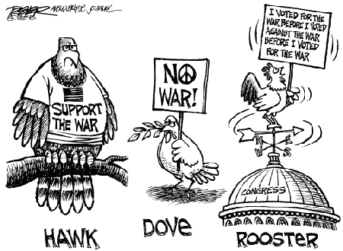
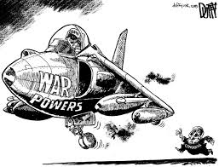
The War Powers Act
Prohibited the President from engaging in military action for more than 60 days unless Congress approved
Notes:
It was passed by Congress in 1973 over President Nixon's veto.

Slide 30
Vietnam: Attitudes at Home

Slide 31
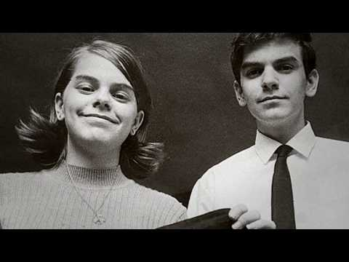

Slide 32
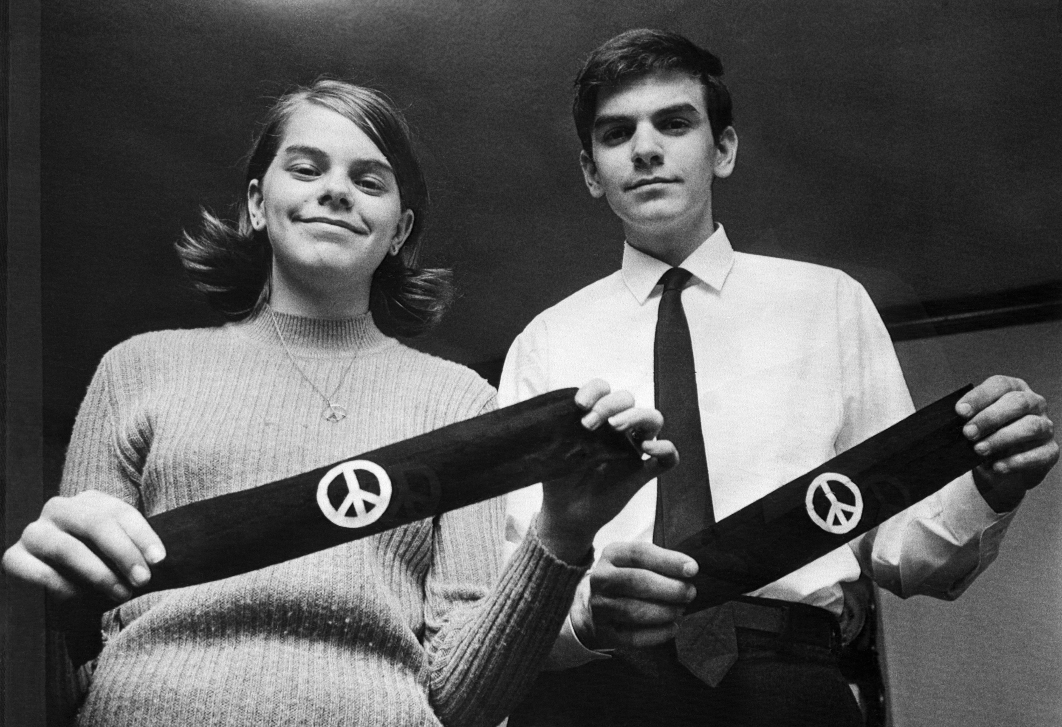
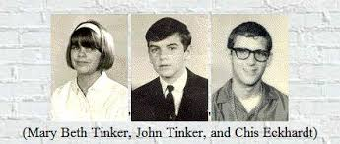
Tinker v. Des Moines
Anti-war protest movements
Determined students had the right of freedom of speech as long as it didn’t interfere with school
Notes:
Students in Des Moines, Iowa wore black armbands to show support to end the Vietnam war.
Principals created a policy that stated any student wearing an armband would be asked to remove it-with refusal to do so resulting in suspension.

Slide 33
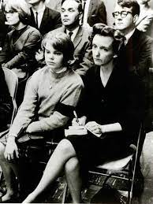
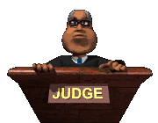
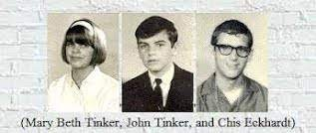
Outcome
District court dismissed case saying “the school district’s actions were reasonable to uphold school discipline.”
U.S. Court of Appeals for the Eighth Circuit affirmed the decision without opinion.
Supreme Court: “Students did not lose their First Amendment rights to freedom of speech when they stepped onto school property.” ***Still used today!

Slide 34
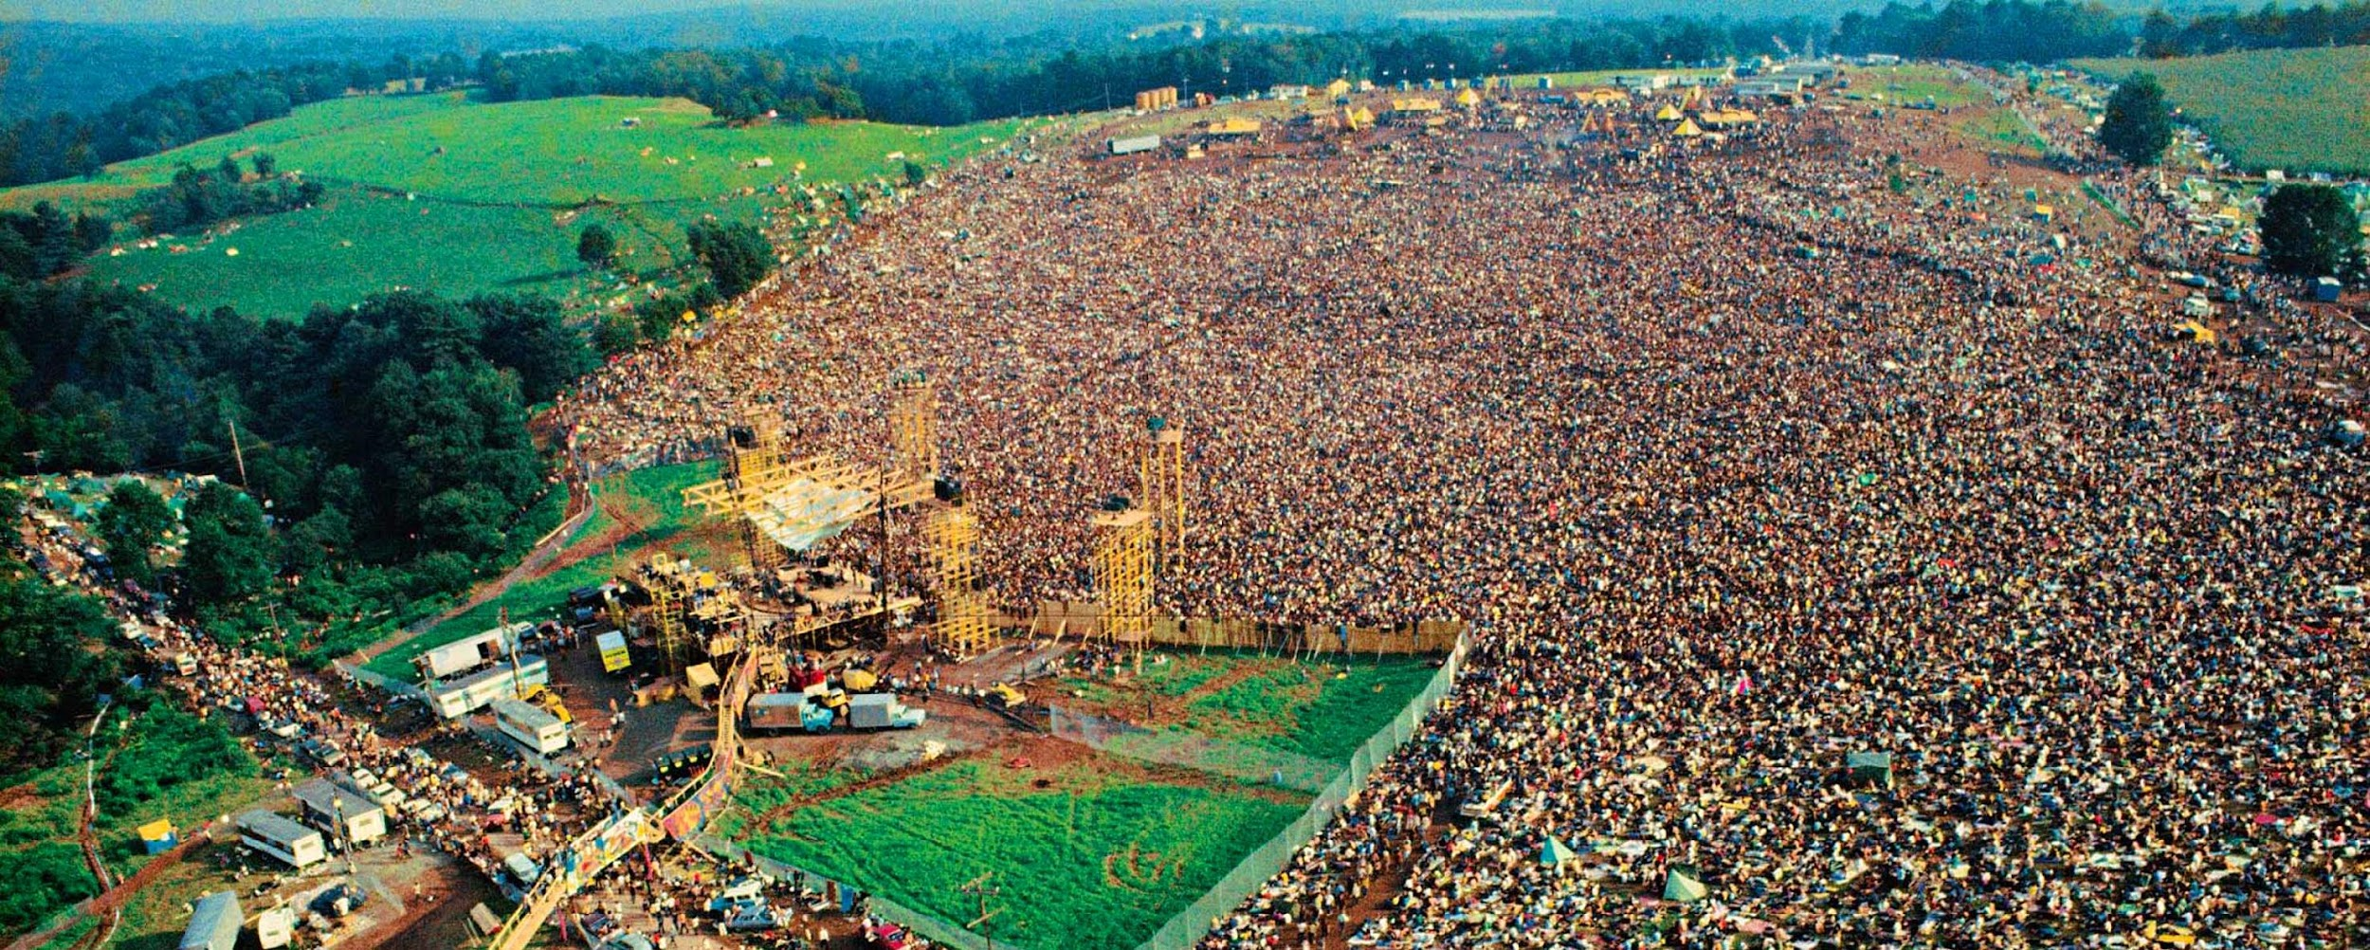
Woodstock (1969)
This was a massive anti-war concert that came to represent the counterculture movement.
Anticipated attendance of 200,000 but there actually ended up being 500,000
Biggest names in music were there
was also where a number of artists first made it big
Much of the music reflected the anti-war sentiment of the time

Slide 35
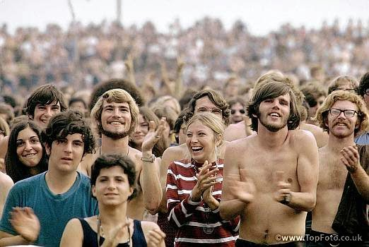
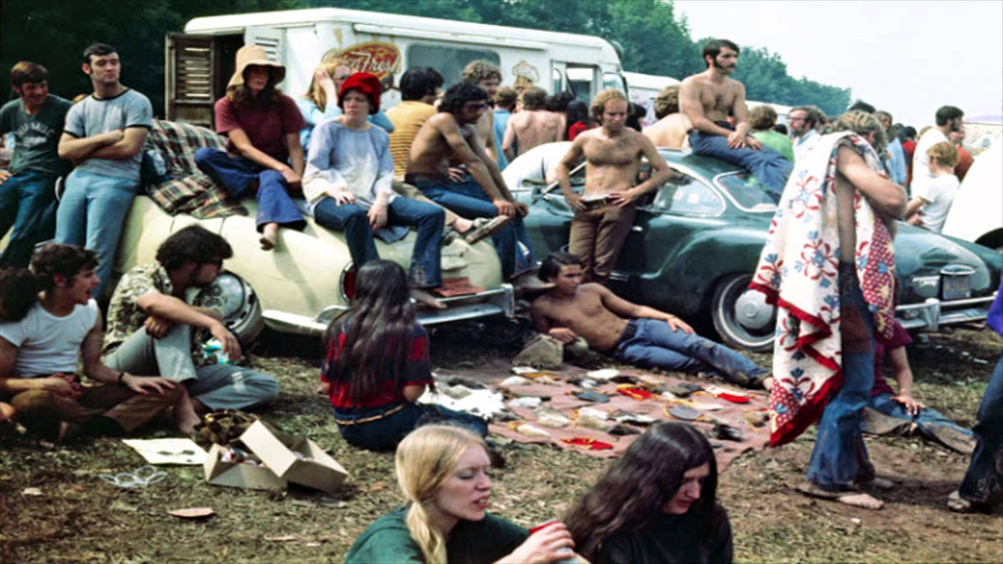
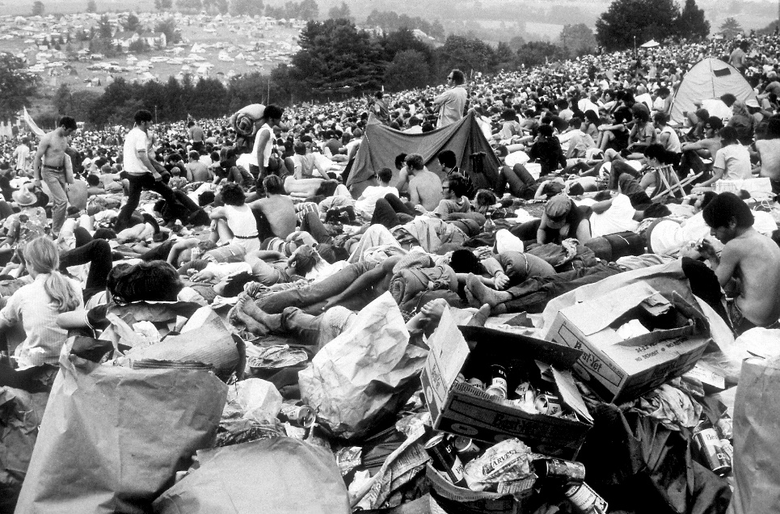
Many of the ideals of the counterculture movement were prominent
– communal living/sharing resources
- experimentation with drugs
“free love”, etc.

Slide 36
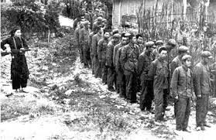
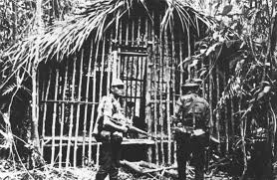
Cease Fire
1973: US negotiators (Henry Kissinger) in Paris worked out a cease fire agreement with the North Vietnamese
Nixon would pull ALL US troops out
North Vietnam would release POWs (prisoners of war)

Slide 37
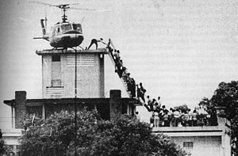
The Fall of Saigon & The War
Even with the U.S. Navy and Air Force providing some support, ARVN was no match for North Vietnam.
In April of 1975 communists were able to conquer the capitol (Saigon) and take control of South Vietnam.
Vietnam unified under a single Communist government and remains under it to this day.

Slide 38
The War’s Legacy at Home
Returning Vietnam Veterans did not get victory parades or cheering crowds, instead they faced indifference or even hostility

Slide 39
MIA’s & POW’s
More than 760 Americans were taken as prisoners & at least 110 died in captivity (interrogations, solitude, torture)
North Vietnam released all prisoners by April 1, 1973 but another 2,600 were missing…about 1,800 are still unaccounted for today & some are likely to be alive

Slide 40
Vietnam Songs Activity

Slide 41
If the majority of a country's citizens oppose a war, should the government immediately end it?
Why or why not?
Notes:
Hawks and Dove music is linked…just click on the right of the ppt

