Slide 1
VIETNAM
Day #1

Slide 2
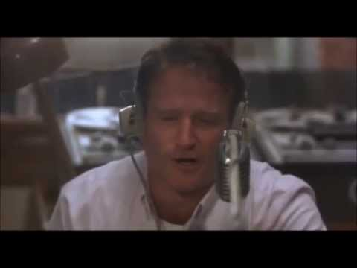
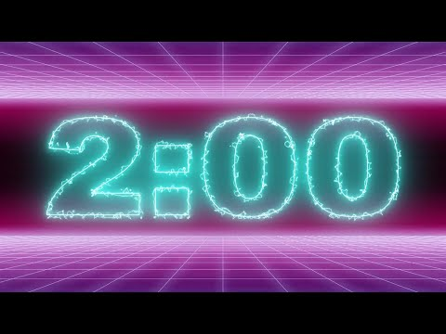
Warm Up
What do you know about the Vietnam war? List as many things as possible-may include books, movies and songs about the war. (2 minutes)
Do you think the President should have the power to declare war?
Do you trust the U.S. government? Why or why not? Why do you think many people do not?

Slide 3
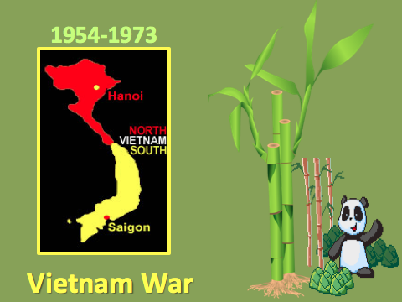
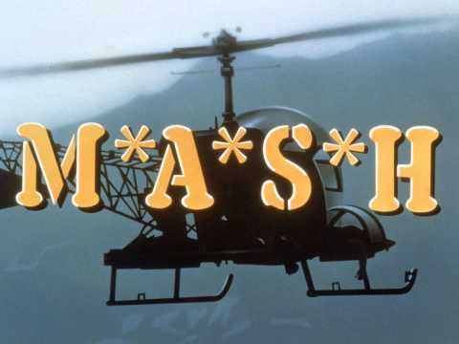

Slide 4
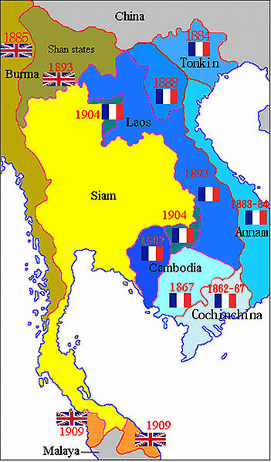
French Indochina
In the late 1800s, France colonized what is today Vietnam, Laos, and Cambodia, naming it French Indochina.
France surrendered to the Nazis in 1940:
a group of Communist rebels rose up in revolution against them in Vietnam.
This group was called the Vietminh and were led by a man named Ho Chi Minh.
In 1954, the Vietminh succeeded in getting the French to retreat from Vietnam and give up their claims to French Indochina.
Notes:
2,000 years ruled independently or by China.
1883, French colonize Indochina (Laos, Cambodia, Vietnam)
French colonists build plantations, extract rice/rubber for own profit.
Vietnam fought for independence against the French 1946 to 1954.

Slide 5
WHAT DOES VIETNAM LOOK LIKE?

Slide 6
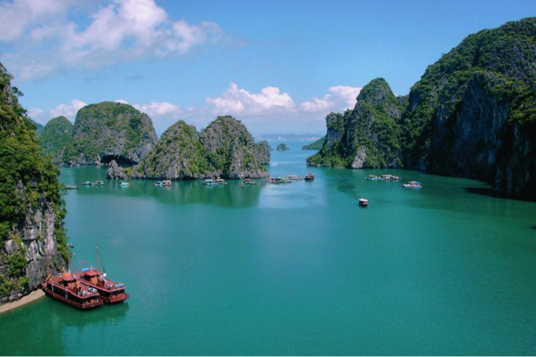

Slide 7
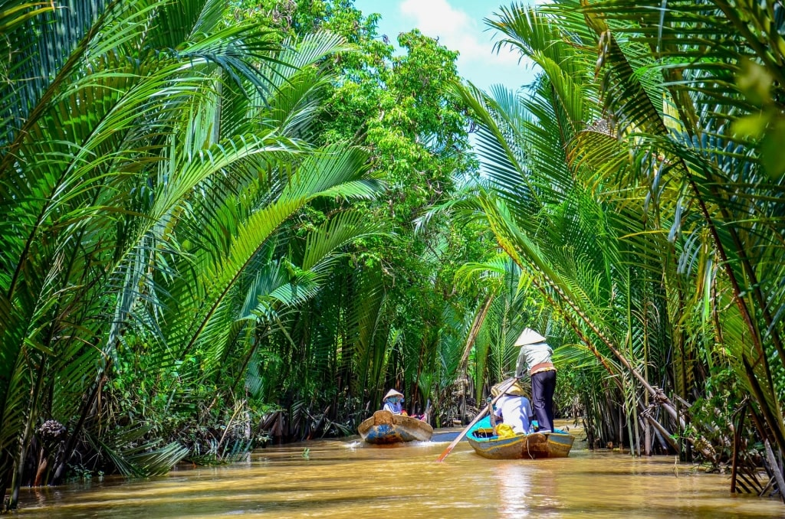

Slide 8
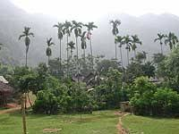
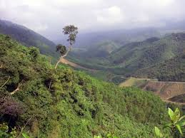
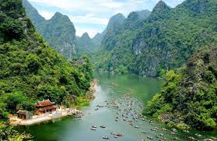

Slide 9
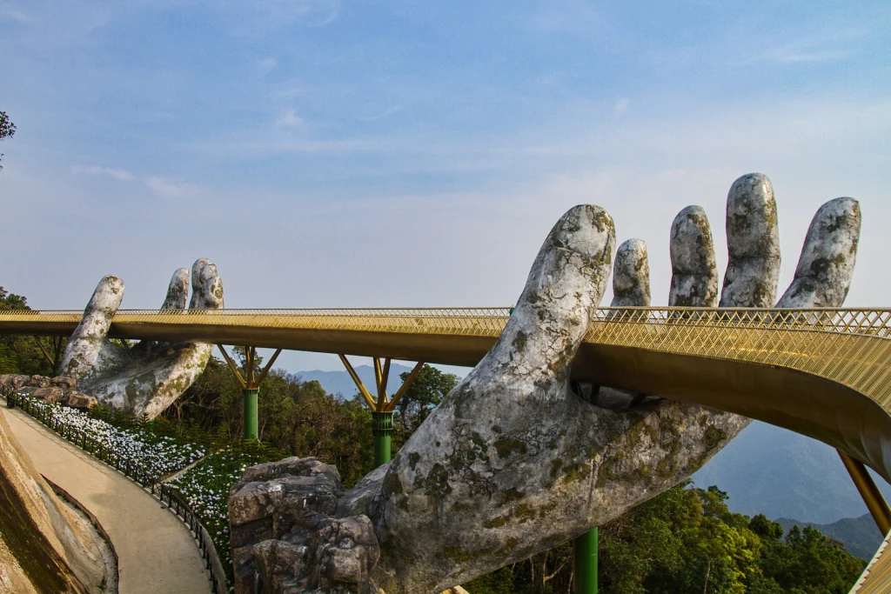
Notes:
Perhaps the main attraction is the Golden Bridge, a creatively designed footbridge featuring two giant, mythical hands. The 490-foot-long pedestrian bridge has become one of the most famous places to visit in Vietnam for its beautiful artistry and unique appearance of being held in the sky.

Slide 10
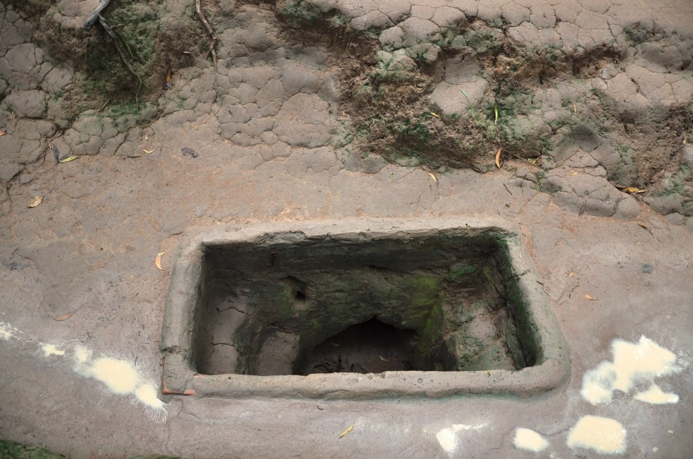
Notes:
In the northwest portion of Ho Chi Minh City, you’ll find a web of underground tunnels used in the Vietnam War. Soldiers used these tunnels as living quarters, kept supplies there, and as a base to set traps and prepare surprise attacks.
Creating the tunnels, which stretch a total of 75 miles, wasn’t an easy feat—they were dug by hand between the late 1940s and early 1960s. During your visit, you can even crawl through some of these tunnels and observe artifacts from the war while a tour guide shares the history behind the Cu Chi Tunnels.

Slide 11
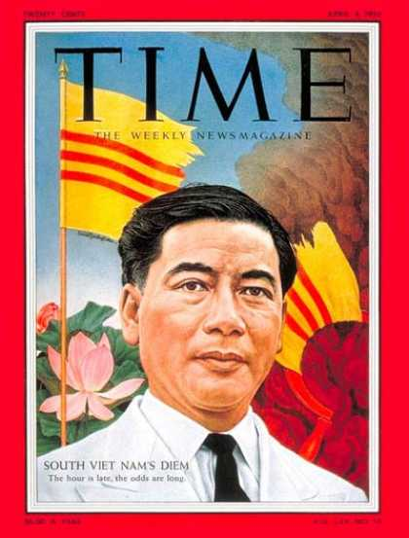
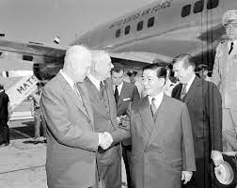
Republic of Vietnam:
In 1954, France and the Vietminh signed a peace treaty, the Geneva Accords.
In the accords, Vietnam was split in half, with national elections set for 1956.
The has supported the Viet Minh originally, but now refused to recognize the treaty
In the South, the U.S. helped Ngo Dinh Diem become president.
Diem was a Catholic, Vietnamese man who had gone to college in the U.S. and spoke French and English better than Vietnamese.
Notes:
The U.S. had supported the Viet Minh originally, but now refused to recognize the treaty.
US provided France with $ 15 Million in economic aid; then $1 billion over the next four years to fight communism (containment)
$ May 1954: Ho Chi Minh defeated French rulers
$ French forced to surrender their hold in Vietnam under the Geneva Accords despite help from US.

Slide 12
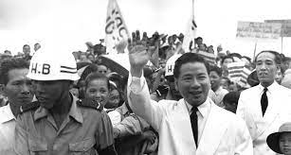
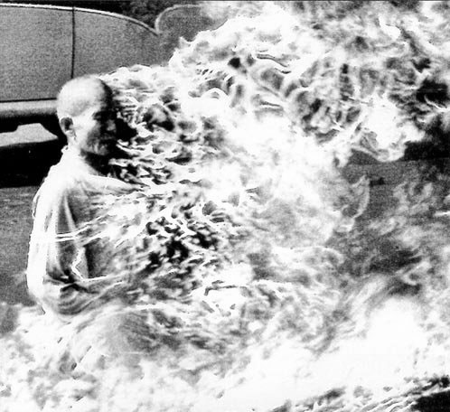
Diem made many mistakes. In 1956, he announced that the South would not be holding the agreed-upon elections.
First mistake he had his own elections which were rigged.
Second mistake was a crackdown on the Buddhist religion,
leading to infamous self-immolation
(setting yourself on fire)
protests by Buddhist monks and nuns.

Slide 14
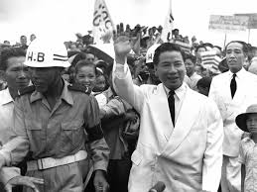
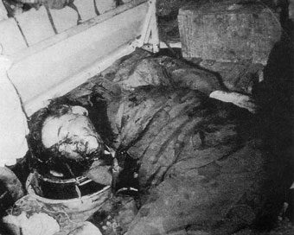
It became clear to the US that Diem would have to go.
Nov. 1963-US supported military coup topples Diem Regime.
Diem was assassinated against Kennedy’s wishes
Kennedy states his intent to withdraw from Vietnam
Weeks later Kennedy is assassinated.
Notes:
When South Vietnam President Ngo Dinh Diem and his brother were assassinated in November, 1963, their deaths were ruled suicides even though their hands were bound behind them and they were shot in the back of the neck. JFK claimed he didn’t order their deaths. He merely wanted them “replaced.”
https://www.thegirlwhoshotjfk.com/jfk-sends-his-own-assassins-to-viet-nam/

Slide 15
LBJ & Escalation in Vietnam (1963-1968)
Diem's death brought more chaos
Military leaders attempt to take control
Vietcong influence grows.
Escalated the nation’s role in Vietnam and began what would eventually become America’s longest war.
Increased military support
Why?? Avoid communist take over.

Slide 16
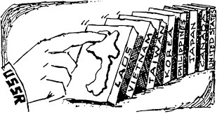
Domino Theory….
The U.S. supported the Viet minh during WWII because they were fighting the Japanese.
After the war, the U.S. stopped supporting them.
The reasoning was the Domino Theory: the idea that a small country falling to Communism would lead to other nations falling, like a line of dominoes.
“You have a row of Dominoes set up....”, “You knock over the first one and what will happen to the last one is the certainty that it will go over very quickly.”
- President Eisenhower
Notes:
Eisenhower promises military aid and training to Diem (South Vietnam’s leader) in return for a stable, reform government
Why? Domino Theory: Eisenhower compares countries on the brink of communism to a row dominoes waiting to fall one after the other
President Kennedy will continue support as well
Weeks later, Kennedy assassinated as well

Slide 17
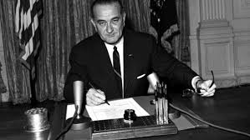
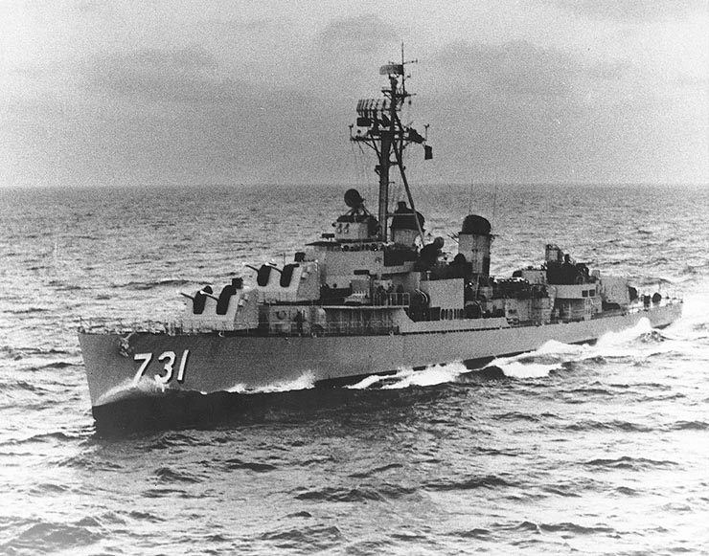
Gulf of Tonkin
In 1964, President Johnson gave a speech to the American people in which he claimed that the North Vietnamese Navy had fired on two U.S. Navy ships in the Gulf of Tonkin off the coast of Vietnam.
He then used this attack to get Congress to pass the Tonkin Gulf Resolution, which gave the President permission and money to do "whatever necessary" to support South Vietnam.
*In 2005, declassified documents revealed that the attack was a hoax by the Johnson administration.
Notes:
August 2nd a Viet patrol boat fired a torpedo at an American destroy the USS Maddox which was patrolling in the Gulf of Tonkin off the North Vietnamese coast. The torpedo missed its target but the Maddox returned fire and inflicted heavy damage on the patrol boat. Two days later the Maddox and another destroyer were again off the Vietnamese coast. In spite of bad weather that could affect visibility, the crew reported enemy torpedoes and the American destroyers began firing. The crew of the Maddox latter declared that they had neither seen nor heard hostile gunfire.
What you need to know is that Truman already had prepared the TONKIN RESOLUTION months in advanced! He was just waiting for reason to push it through Congress.

Slide 18
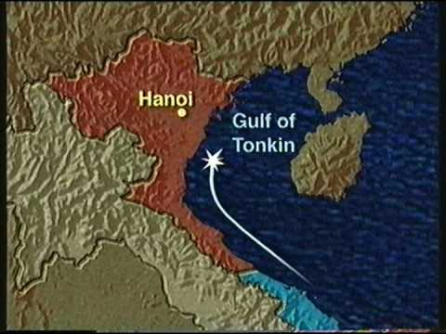

Slide 19
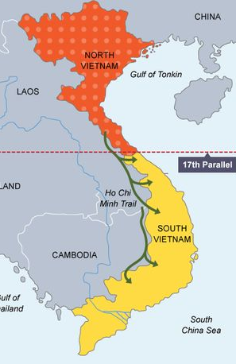
Vietnam War Background
Vietnam was divided at the 17th parallel
US supports South Vietnam
Communist China & The Soviet Union supports the North Vietnam

Slide 20
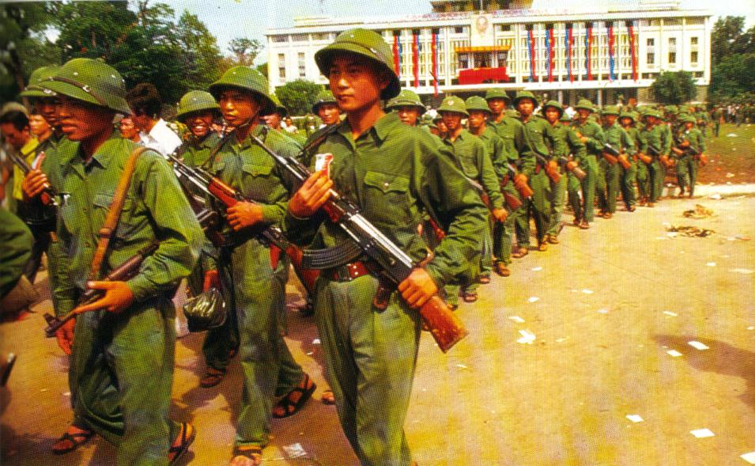
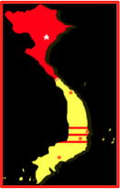
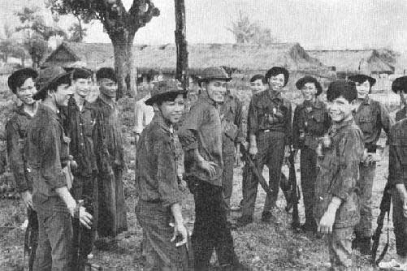
Fighting Two Enemies
North Vietnamese Army
NVA (communist)
Official army of North Vietnam
Vietminh
Vietcong(supported the North)
Army recruited of South Vietnamese villagers
Guerilla warfare (no uniforms)
hit and run attacks/ sabotage
Notes:
,

Slide 21
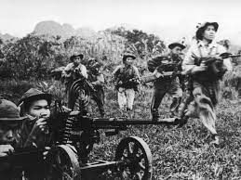
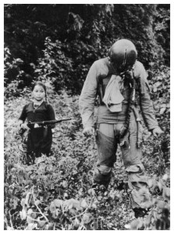
Who were we fighting????
From the North, the U.S. fought the North Vietnamese Army (NVA). They were the official army of North Vietnam.
In the South, the U.S. fought the Viet Cong, an army recruited from South Vietnamese villagers.
They mostly used guerrilla warfare, which means they did not wear a uniform and attacked in hit-and-run type attacks and sabotage, using to their advantage.
A young girl aligned with the Viet Cong and a captured pilot.
Notes:
This will hopefully help the students understand that at times the soldiers did not know who the enemy was…which played heavily on their mental state
Many southerners joined the Viet Cong and fought against both the government of South Vietnam and the armed forces of the United States between 1959 and 1975. They wanted self-determination for the people of Vietnam and a path forward economically after the devastating imperial occupations by France and by Japan during the Second World War. However, joining the communist bloc actually resulted in continued foreign interference, this time from China and the Soviet Union

Slide 22
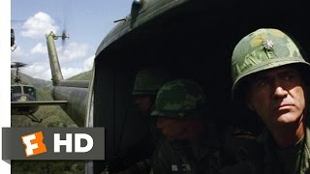

Slide 23
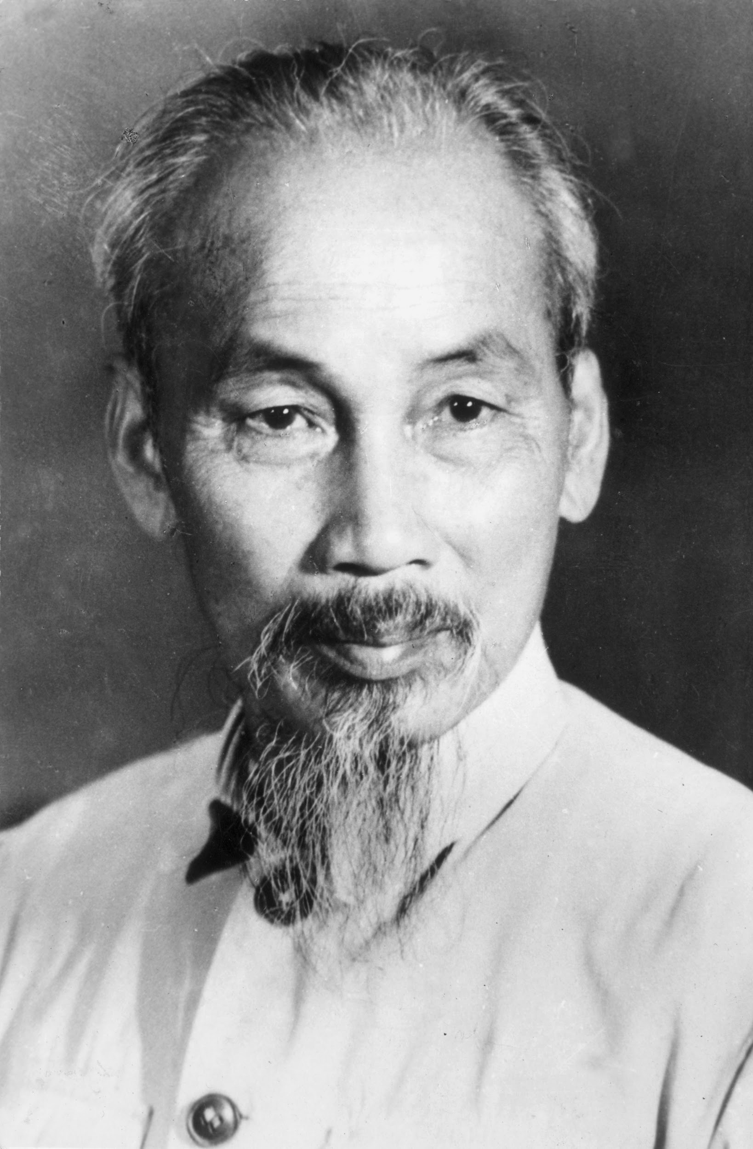
Who was this mastermind…Ho Chi Minh
The leader of the Viet Minh (North Vietnam Army) was Ho Chi Minh.
He had lived in the U.S., England, the Soviet Union, and China before returning to Vietnam to lead the resistance against the French and Japanese during World War II.
He had asked the U.S. multiple times to recognize a democratic republic in Vietnam but was ignored. It was generally agreed that he would have won the 1956 elections if they had been held.

Slide 24
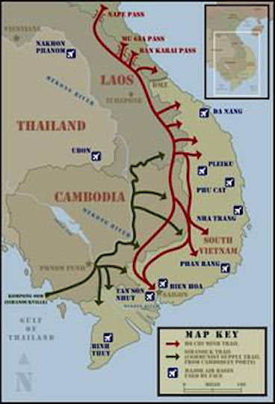
Early Protest of Diem’s Government
Vietcong: Communist opposition group in south begin attacks on Diem’s government in 1957 & protest against his relocation of peasants
Ho Chi Minh Trail: 1959 North begins supplying arms to the Vietcong via a network of trails along the borders of: Laos, Cambodia, & Vietnam
South Vietnam grows more unstable

Slide 25
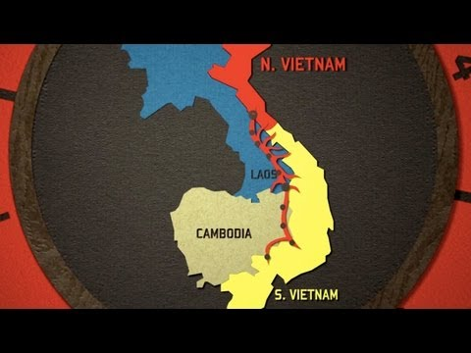

Slide 26
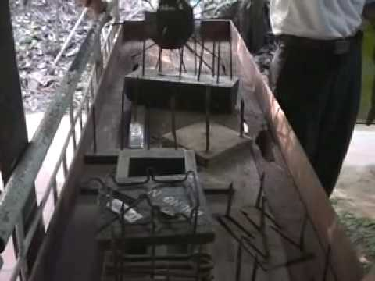

Slide 27
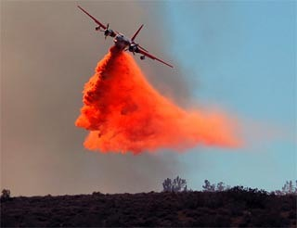
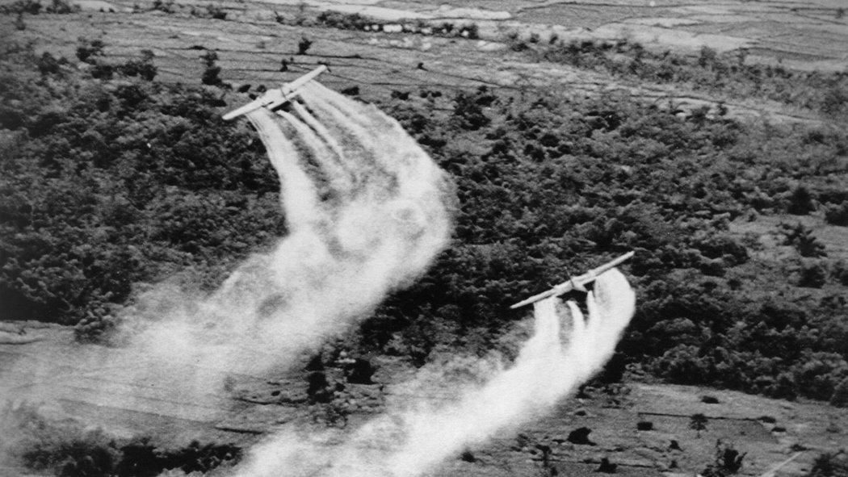
Weapons of Vietnam
Agent Orange
Herbicide – remove forest cover and food from Vietcong – Force people to move to city – Huge Health problems
Notes:
Agent Orange was a tactical herbicide used by the U.S. military for control of vegetation. It was named for the orange band around the storage barrel. The military sprayed Agent Orange and other tactical herbicides during the Vietnam War.
proven to cause serious health issues—including cancer, birth defects, rashes and severe psychological and neurological problems—among the Vietnamese people as well as among returning U.S. servicemen and their families.

Slide 28
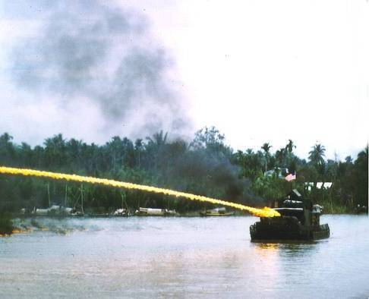
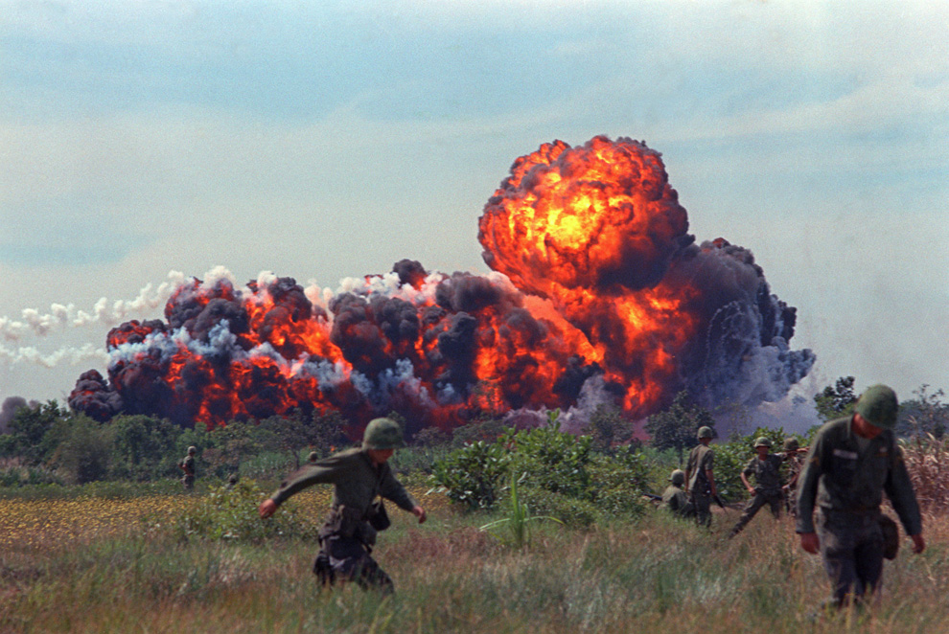
Napalm: Used for fire bombing Vietcongs strongholds
Notes:
. a highly flammable sticky jelly used in incendiary bombs and flamethrowers, consisting of gasoline thickened with special soaps.

Slide 29
Making the Connection
Think back to the Korean War.
What similarities can you think of between the Korean War and the Vietnam War?
What differences can you think of?
Notes:
Similarities:
Both of these wars started and were fought to contain the spread of communism.
Was never an actual declaration of war.
Both wars were very unpopular back home in America.
Both were hot spots fought during the Cold War.
Differences:
Vietnam War was officially ended. The Korean War ended in a "cease-fire" which means it was never officially ended.
After the war, Vietnam went back to being one all communist countruy. After the Korean War, the country remained divided with the North still being cmmunist and the south remaining non-communist.
Korea was a short war and Vietnam was a long war.
Korea was similar to WW2 in terms of fighting. Vietnam was more of a guerilla war.

Slide 30
Let’s respond to this question on a sticky note be ready to share.
Write a sentence answering the question
The actions of a government can divide its people….
Do you agree or disagree with the statement above?

