Slide 1
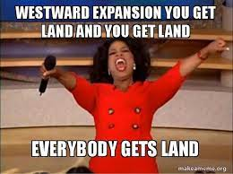
15 minutes to complete Constitution Pamphlet
Westward Expansion Notes
Westward Expansion Map Activity

Slide 2
Westward Expansion
Unit 1

Slide 3
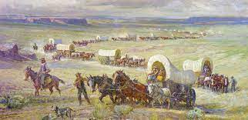
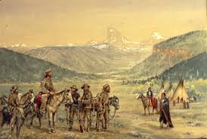
THREE FACTORS AFFECTING WESTWARD EXPANSION
Political: include laws and regulations that either force a business to take certain actions or prohibit it from taking certain actions
Economic: financial (money) factors that influence individuals and businesses
Social: the interaction of people within a community and the factors that influence the movement of those people

Slide 4
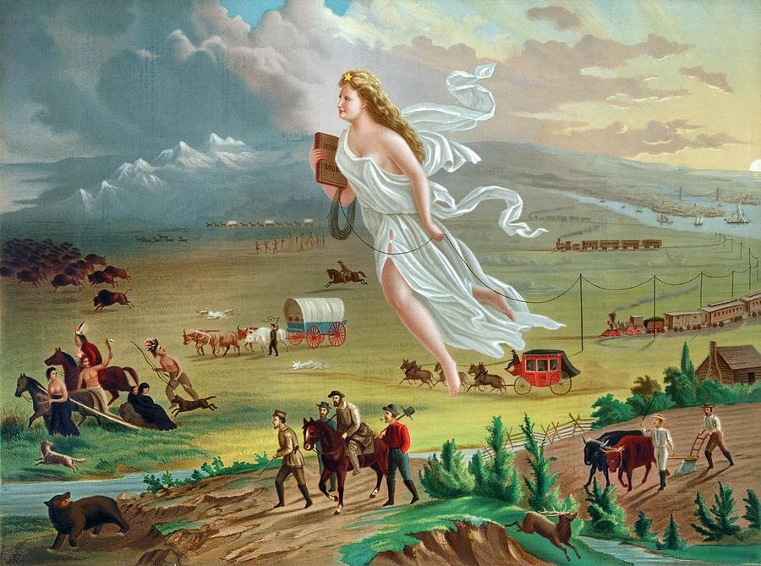

Slide 5
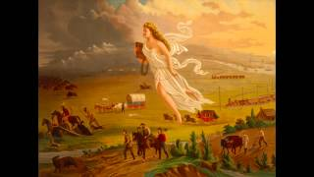

Slide 6
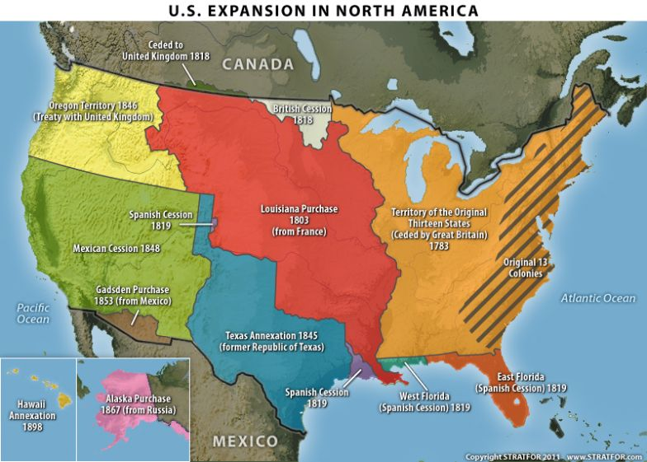
U.S. EXPANSION IN NORTH AMERICA
Many Americans felt it was their destiny (predetermined course) of events to expand all the way from the Atlantic Ocean to the Pacific Ocean
The idea is Manifest Destiny – meaning that they believed it was God’s will for Americans to spread across the continent

Slide 7
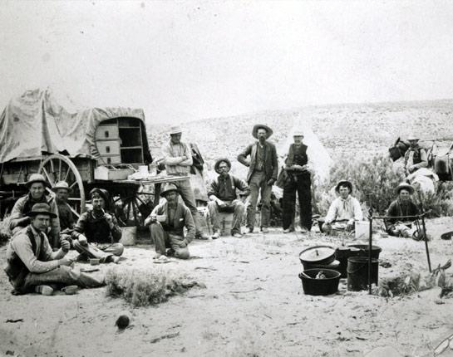
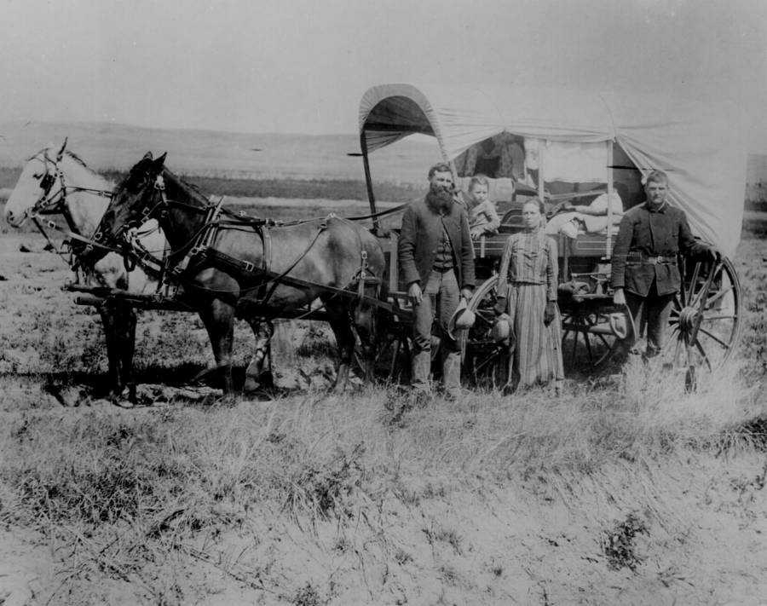
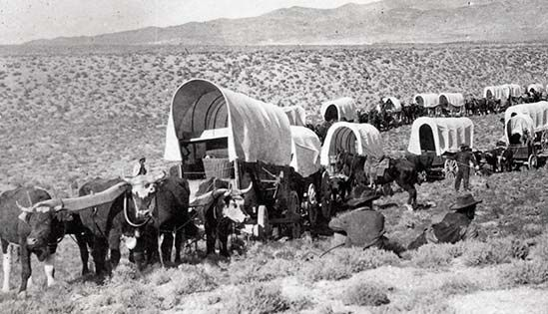
WESTWARD EXPANSION
The movement of people to the West
Klondike Gold Rush
Cattle drive; big role in settling Texas
Homestead Act: 160 acres of free land; live on for 5 years and improve land

Slide 8
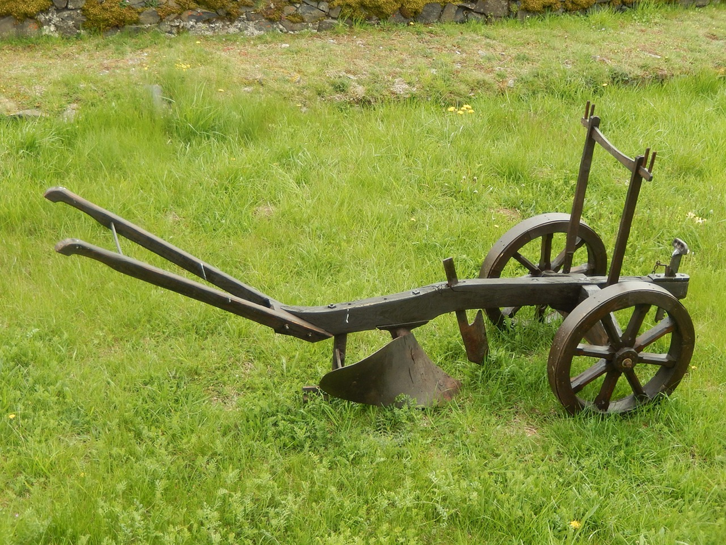
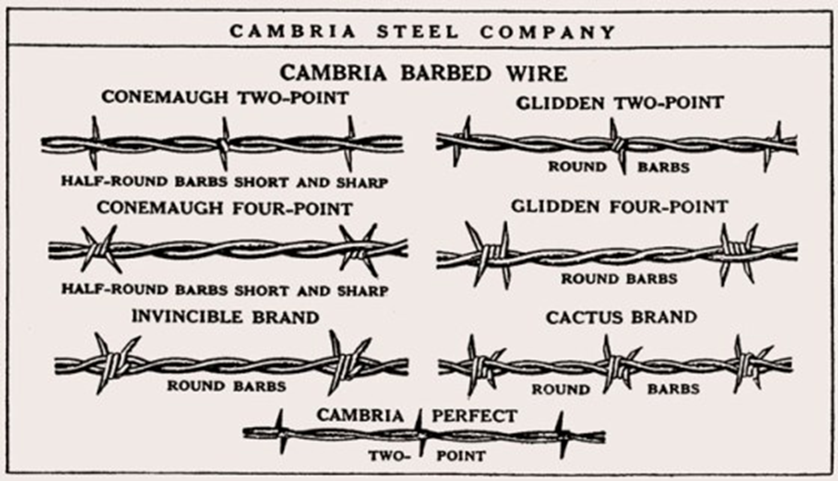
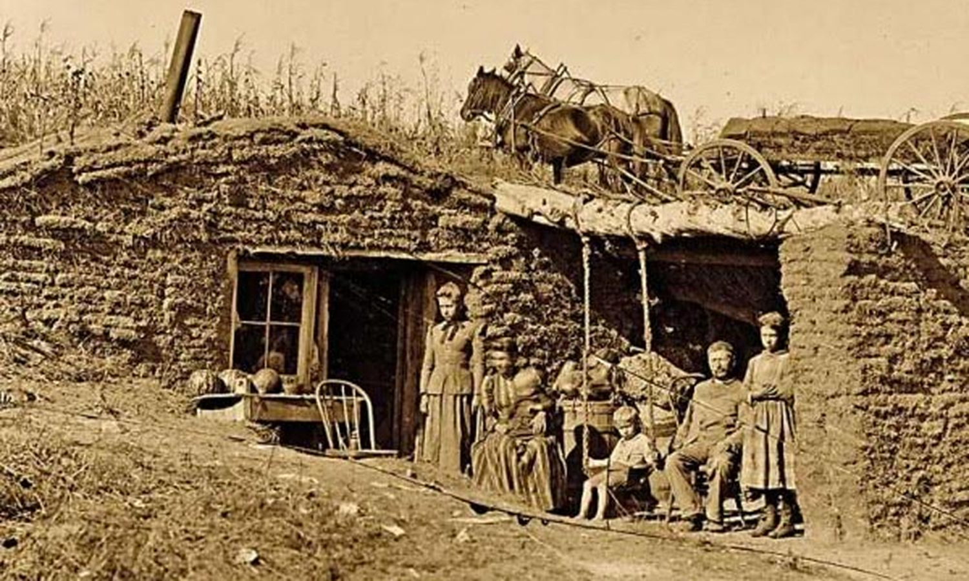
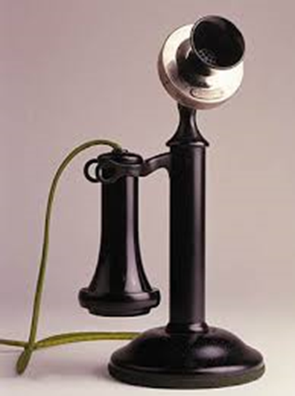
NEW TECHNOLOGIES
Due to the environment being different than what the settlers came from in the east, adaptations, or new technologies emerged

Slide 9
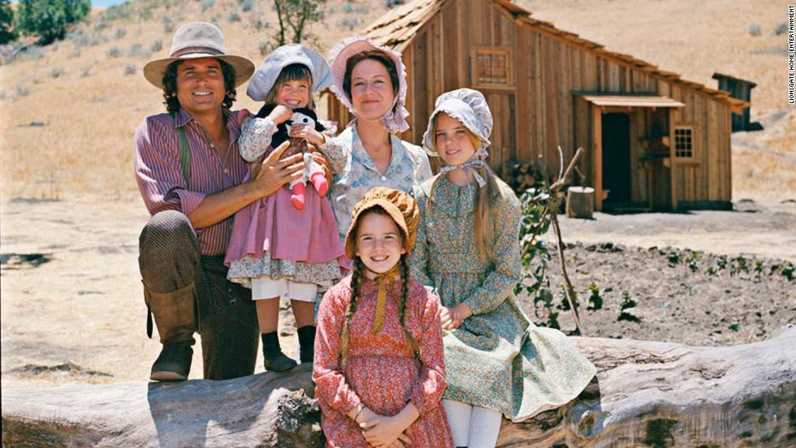
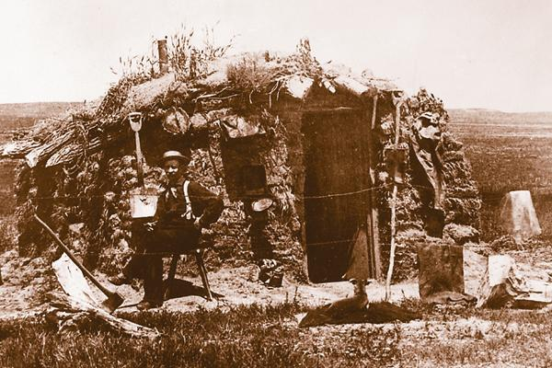
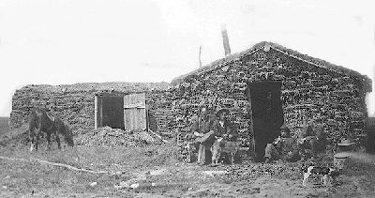
WHAT WE THINK VS. REALITY

Slide 10
SODDIES
On the Great Plains, there were few trees
Bringing building materials during the move west was expensive
Most homesteaders built sod houses or “soddies” – made out of bricks made from mud and grass

Slide 11
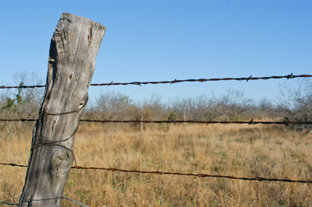
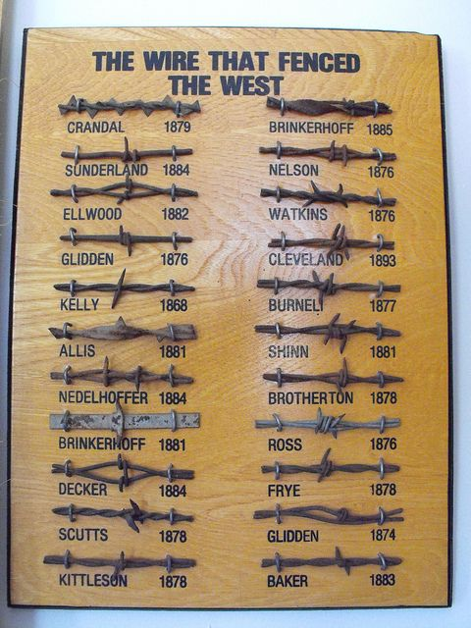
BARBED WIRE
Barbed wire was an adaptation to the lack of materials on the Great Plains
Allowed ranchers to keep their cattle secure and farmers to keep roaming cattle off their land

Slide 12
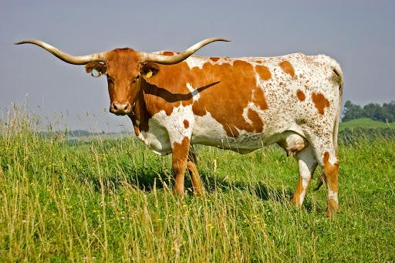
CATTLE BOOM
The cattle boom began with the increased demand for beef in the East after Civil War due to growing economy and population
Ranchers allowed their cattle to graze (eat) in the open ranges (areas without fences or borders)
Later, as the industry grew and there was more competition for land, ranchers began to fence their land with barbed wire.

Slide 13
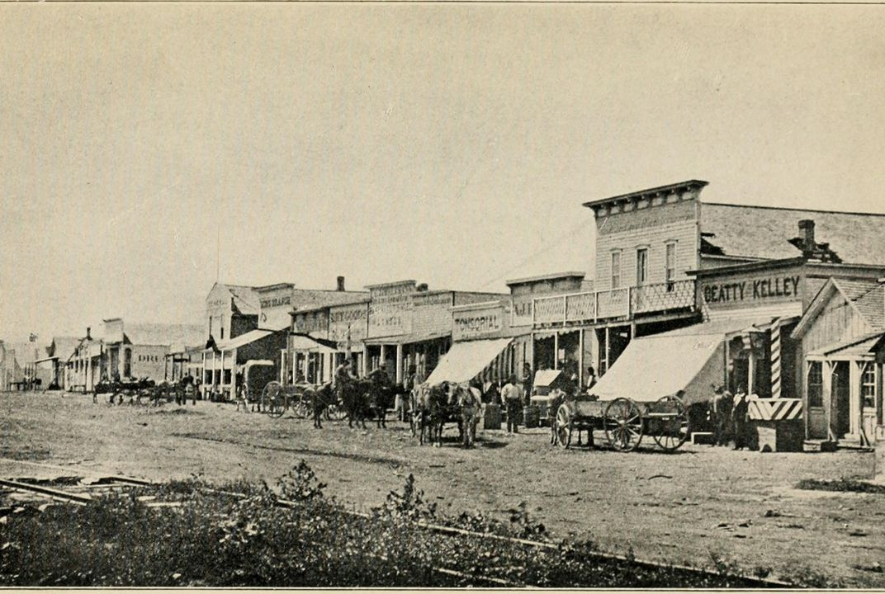
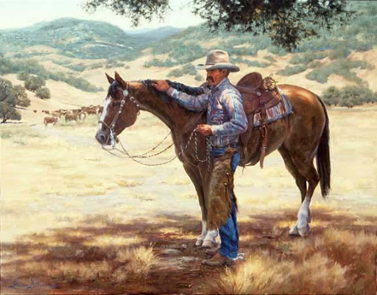
CATTLE BOOM #2
Towns like Abilene, KS (boom town) grew because it became a central market for buyers to all meet in one location
It was a stop on the new railroad lines which allowed ranchers to get their product to market
Vaqueros (cowboys): those who would take the large herds of cattle to market

Slide 14
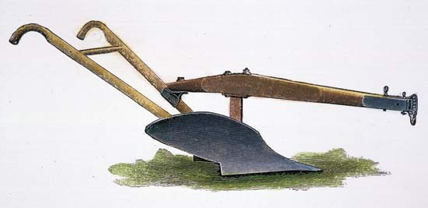
STEEL PLOW
When farmers moved to the Great Plains, they brought the cast iron plows they had used in the East
The thick sod of the Great Plains stuck to the plow, making it difficult to plow a field
Blacksmith, John Deere, came up with a solution – a steel plow
The sod slid right off of the polished surface

Slide 15
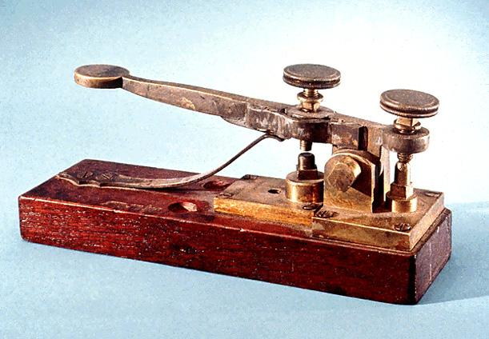
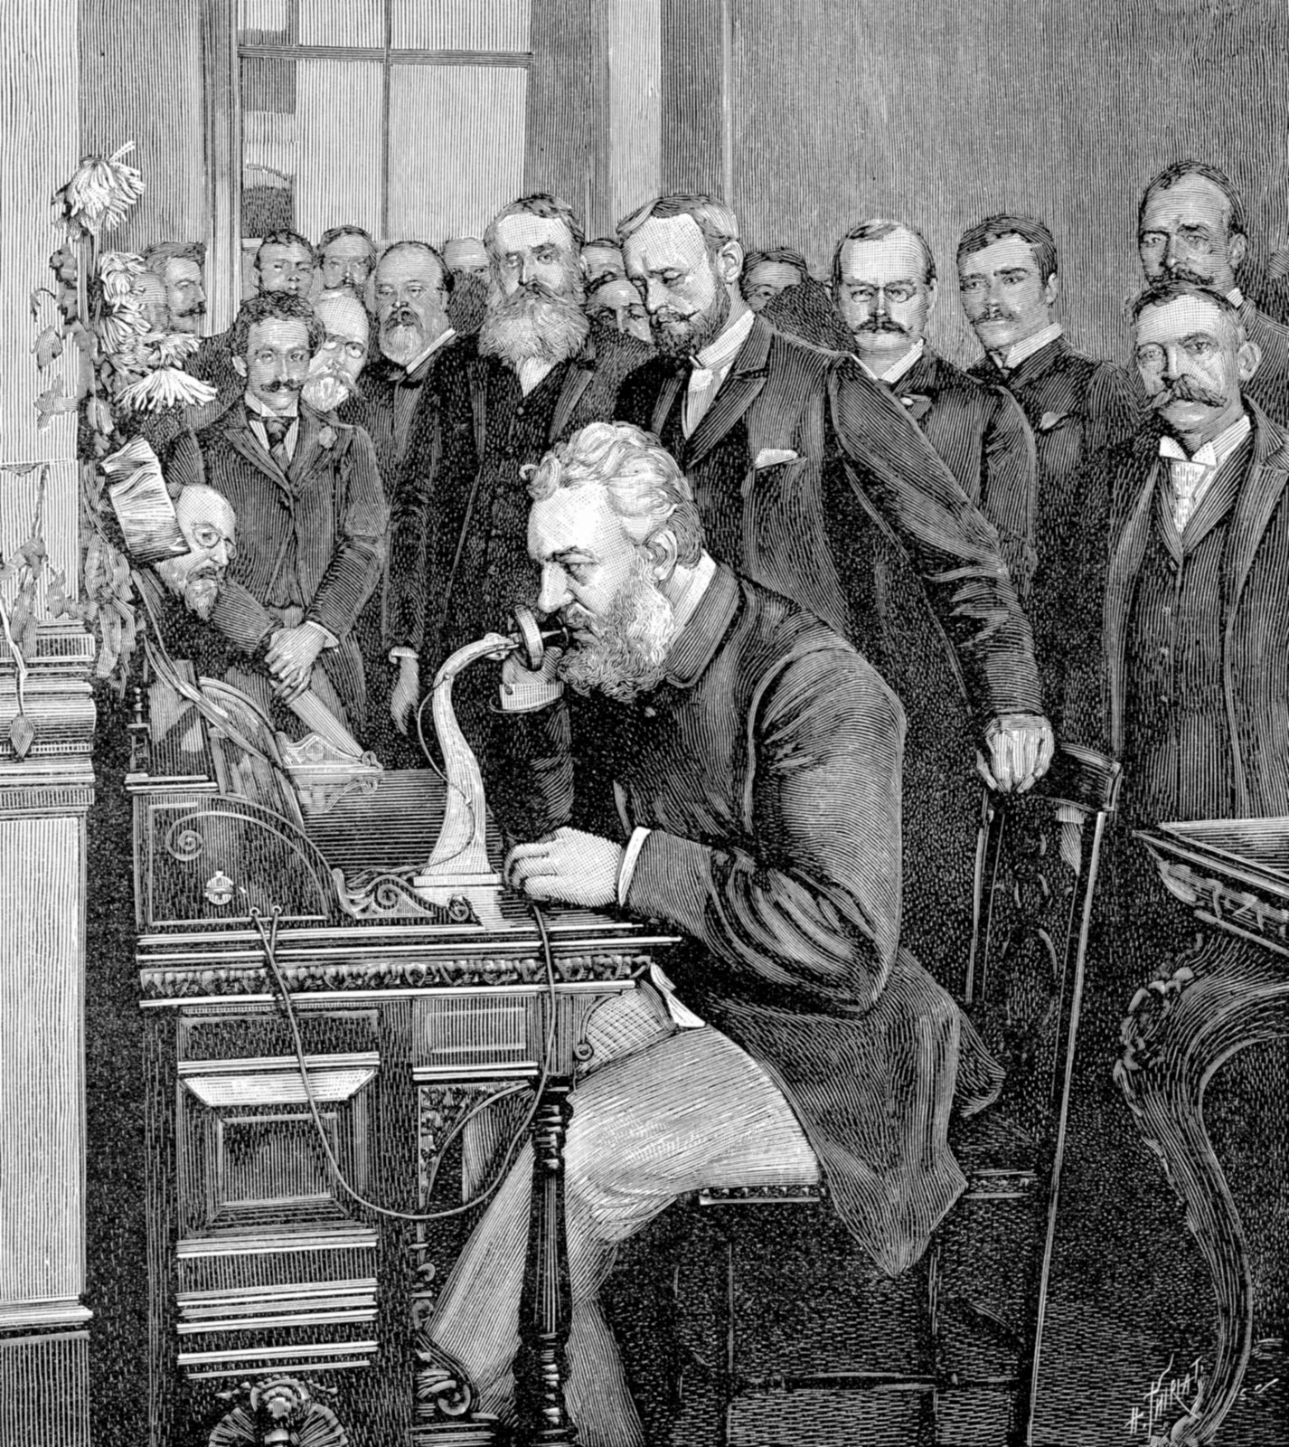
CAN YOU HEAR ME NOW?
Living on the plains was extremely isolated
Two inventions:
Telegraph: invented by Samuel Morse; allowed people to send messages along wire
Telephone: invented by Alexander Graham Bell; allowed instant voice communication, helping to bring the frontier closer

Slide 16
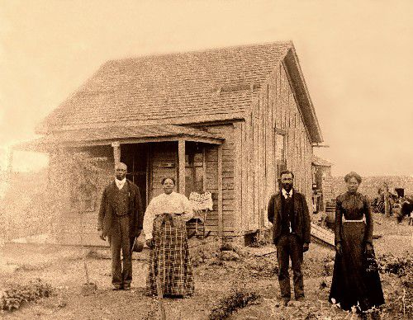
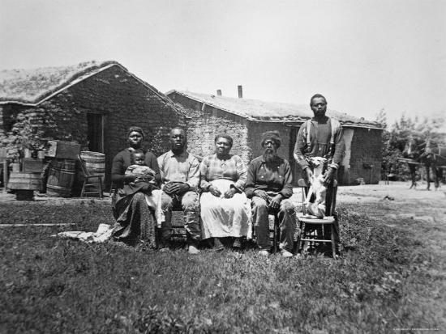
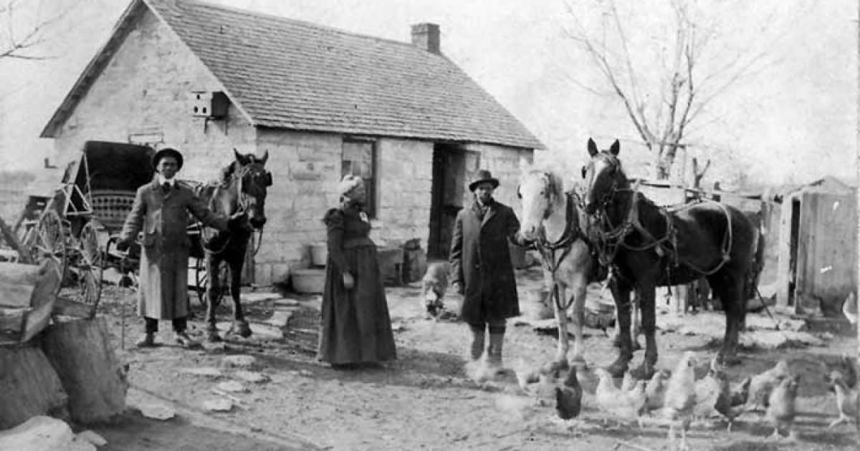
EXODUSTERS
Exoduster Movement or Exodus of 1879: African Americans who migrated from states along the Mississippi River to Kansas in the late 1800’s
It was the first general migration of black people following the Civil War

Slide 17
AMERICAN CONFLICT WITH THE NATIVE AMERICANS
POLITICAL ISSUES

Slide 18
LAND IN CONFLICT
Most Indians did not believe in owning land, like Americans did
Indians believed in having rights to use the land for hunting & farming
To Americans, Indians not owning the land meant that it was free for the taking 🡪 lead to large conflict

Slide 19
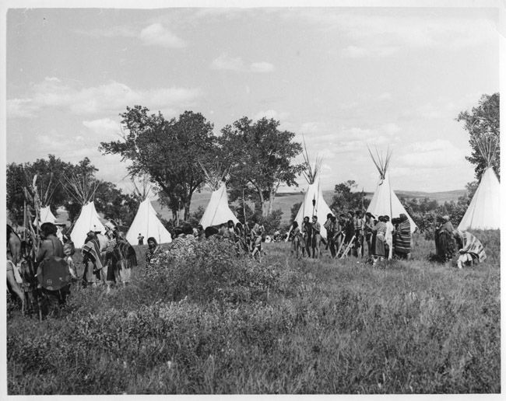
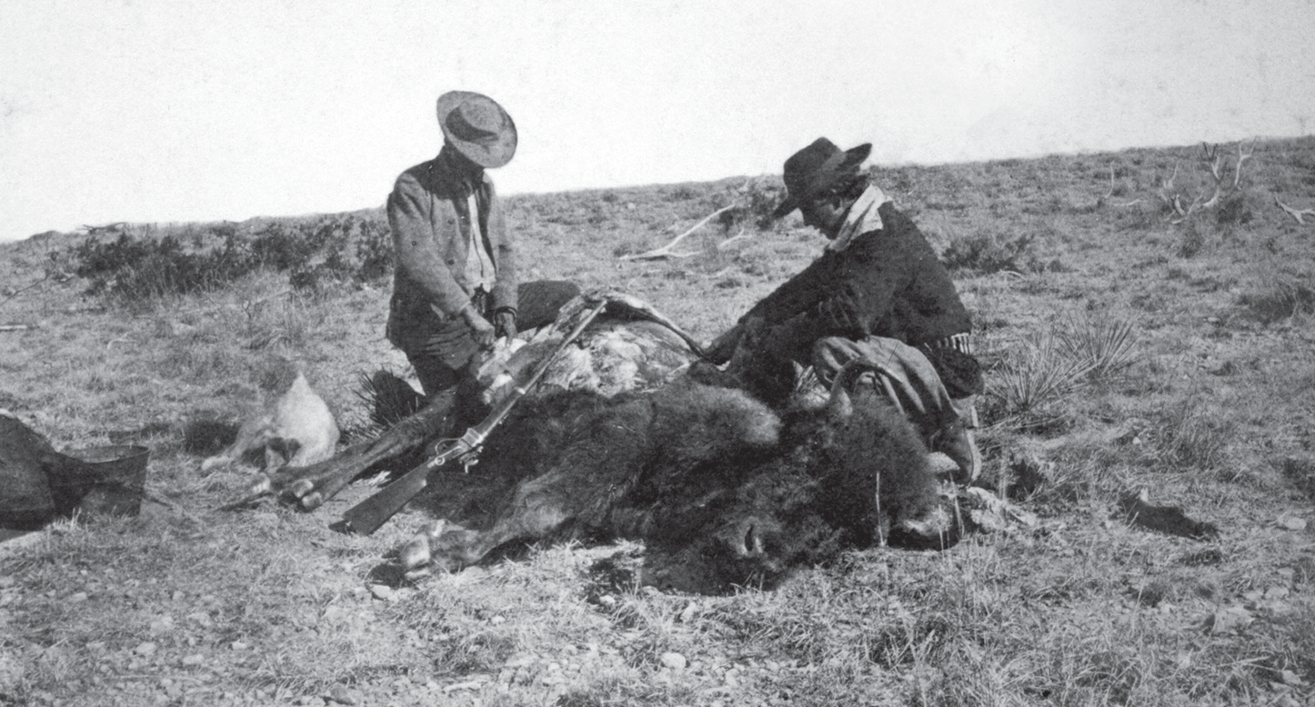
BUFFALO: THE INDIAN SURVIVAL
A tactic that the U.S. used to remove or control the Indians was the destruction of the buffalo
Hired hunters to wipe out the buffalo in order to take away the Indians’ main means of survival
Indians were also removed, either by force or a treaty, onto land called reservations – the land that was reserved for them, usually undesirable land

Slide 21
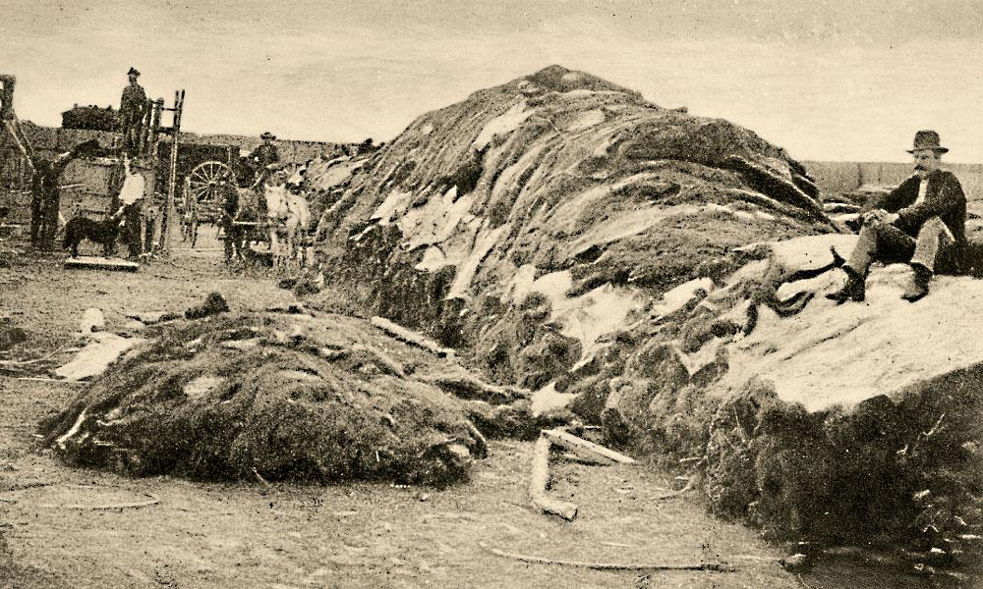
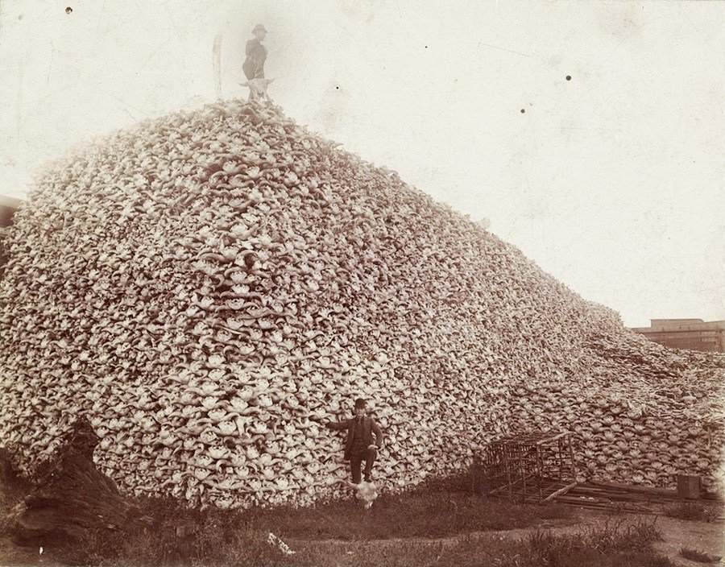

Slide 22
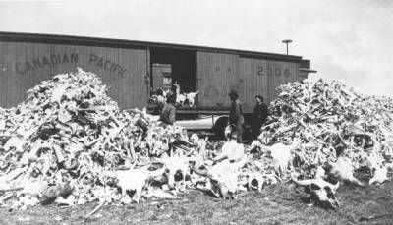
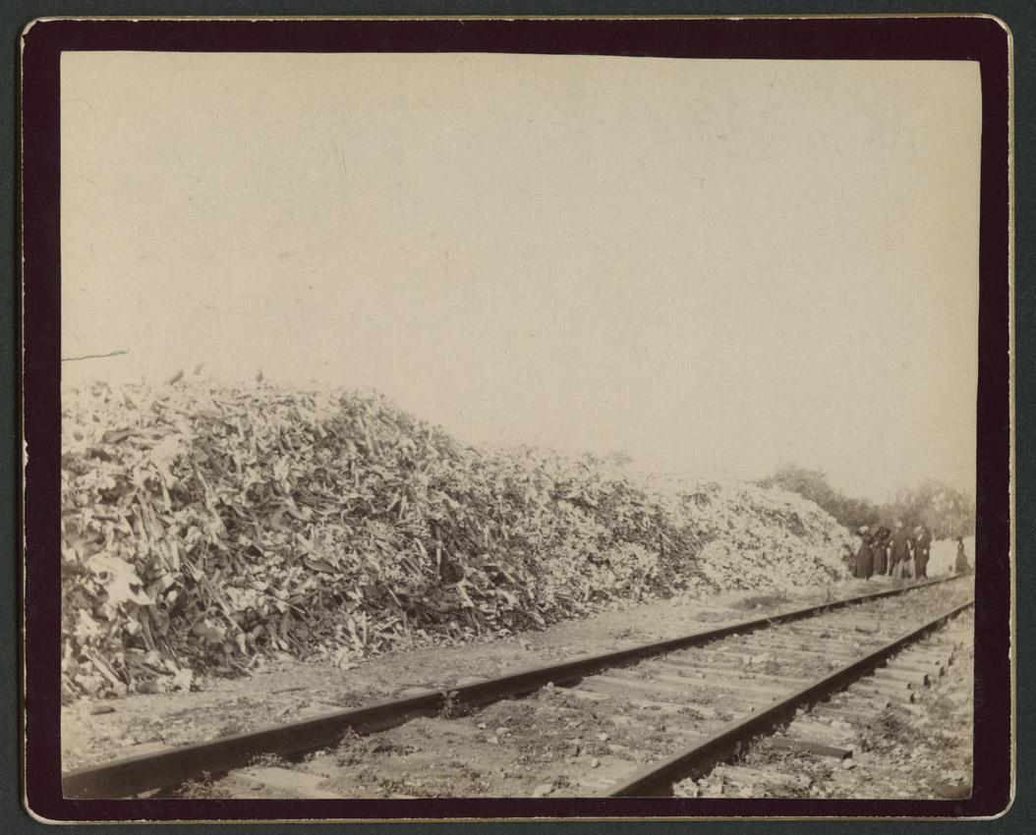
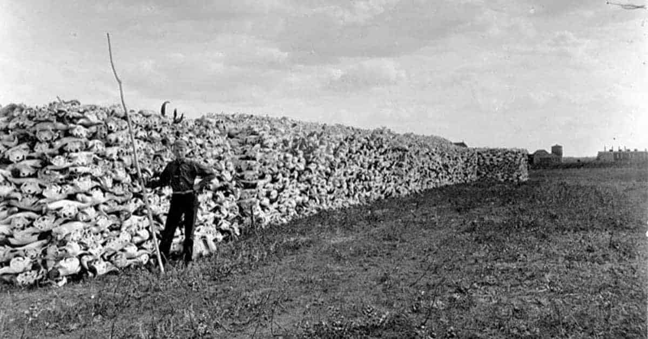

Slide 23
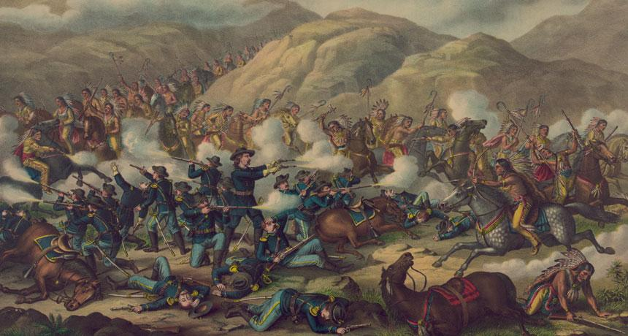
BATTLE OF LITTLE BIGHORN - CUSTER’S LAST STAND
Indians did not move quickly enough from the Montana Territory for the U.S. government
Gold had been discovered; miners were on the way
Sitting Bull and Crazy Horse joined forces and defeated U.S. General Custer
This defeat fueled the U.S. to remove Plains Indians

Slide 24
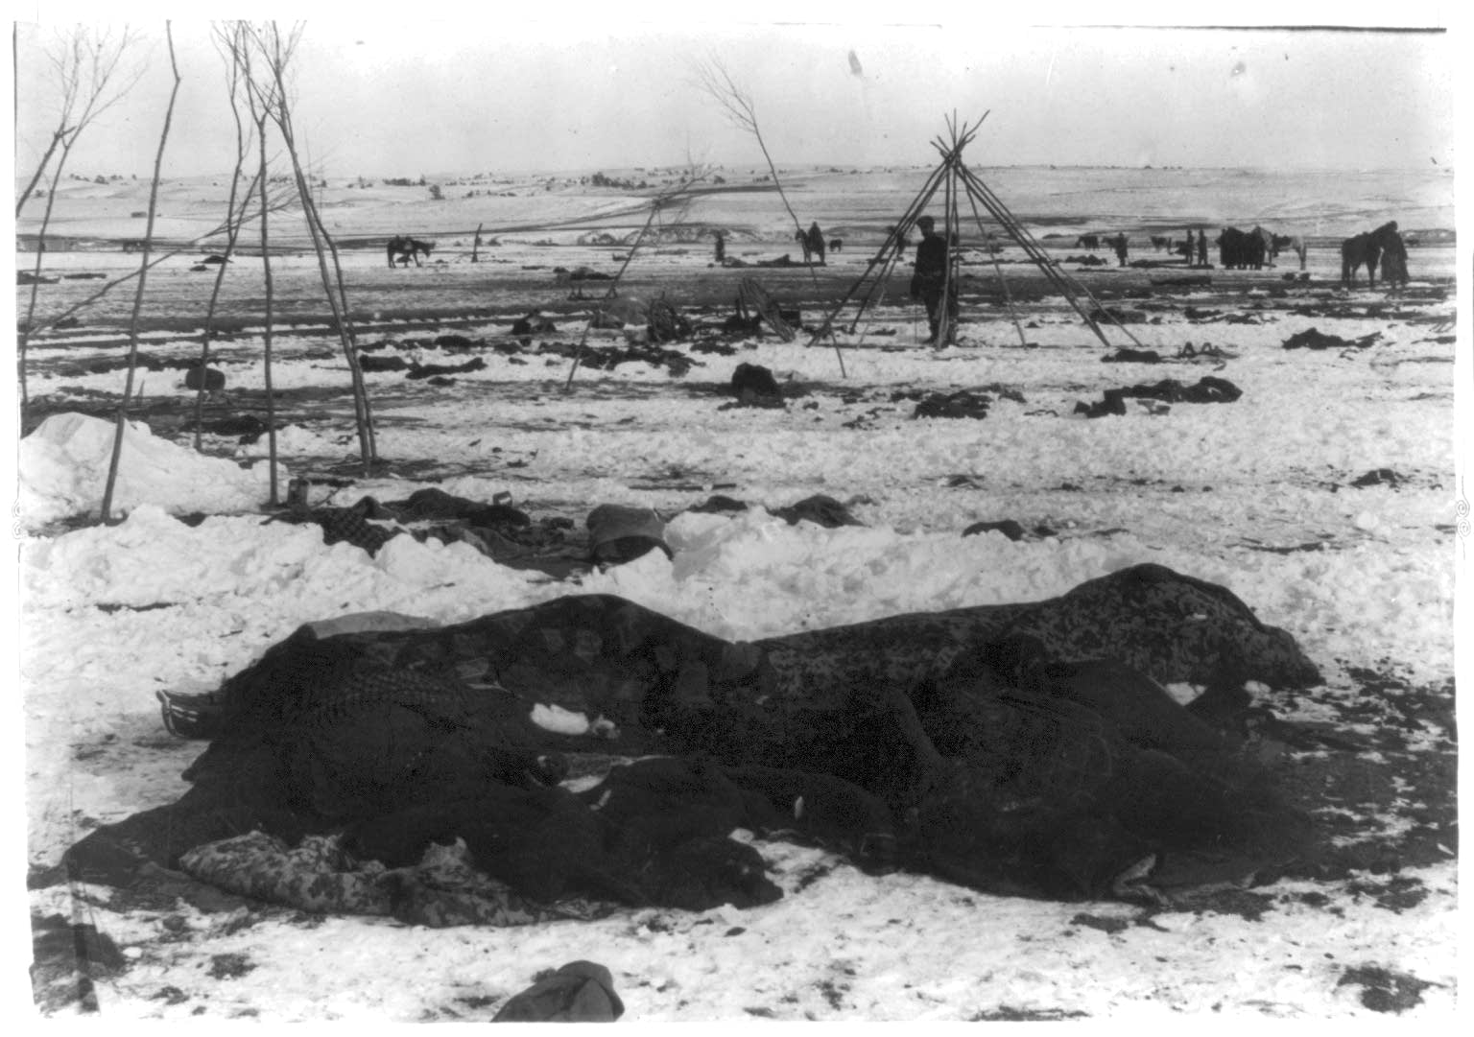
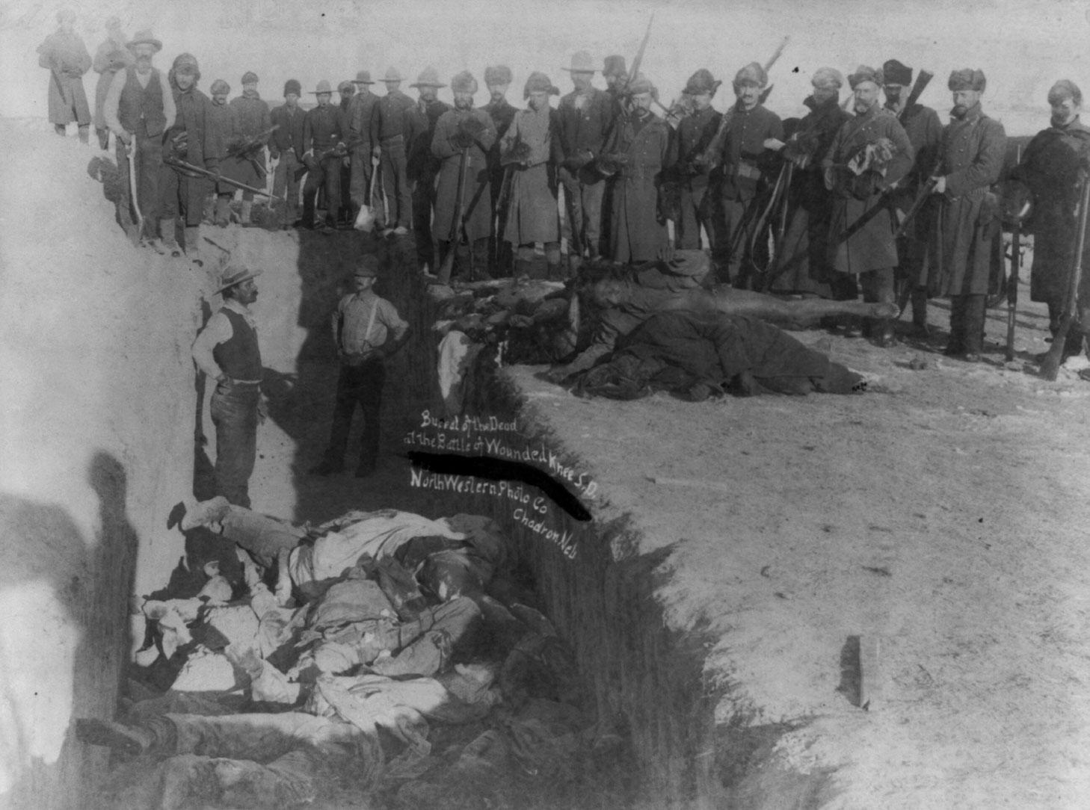
WOUNDED KNEE
Indians often fought back against tactics, culminated in the last violent conflict with Indians and the U.S.
Often called the Massacre at Wounded Knee because the U.S. Army slaughtered around 300 Indians

Slide 25
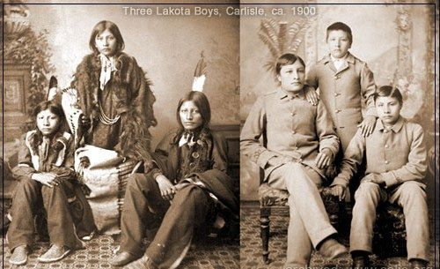
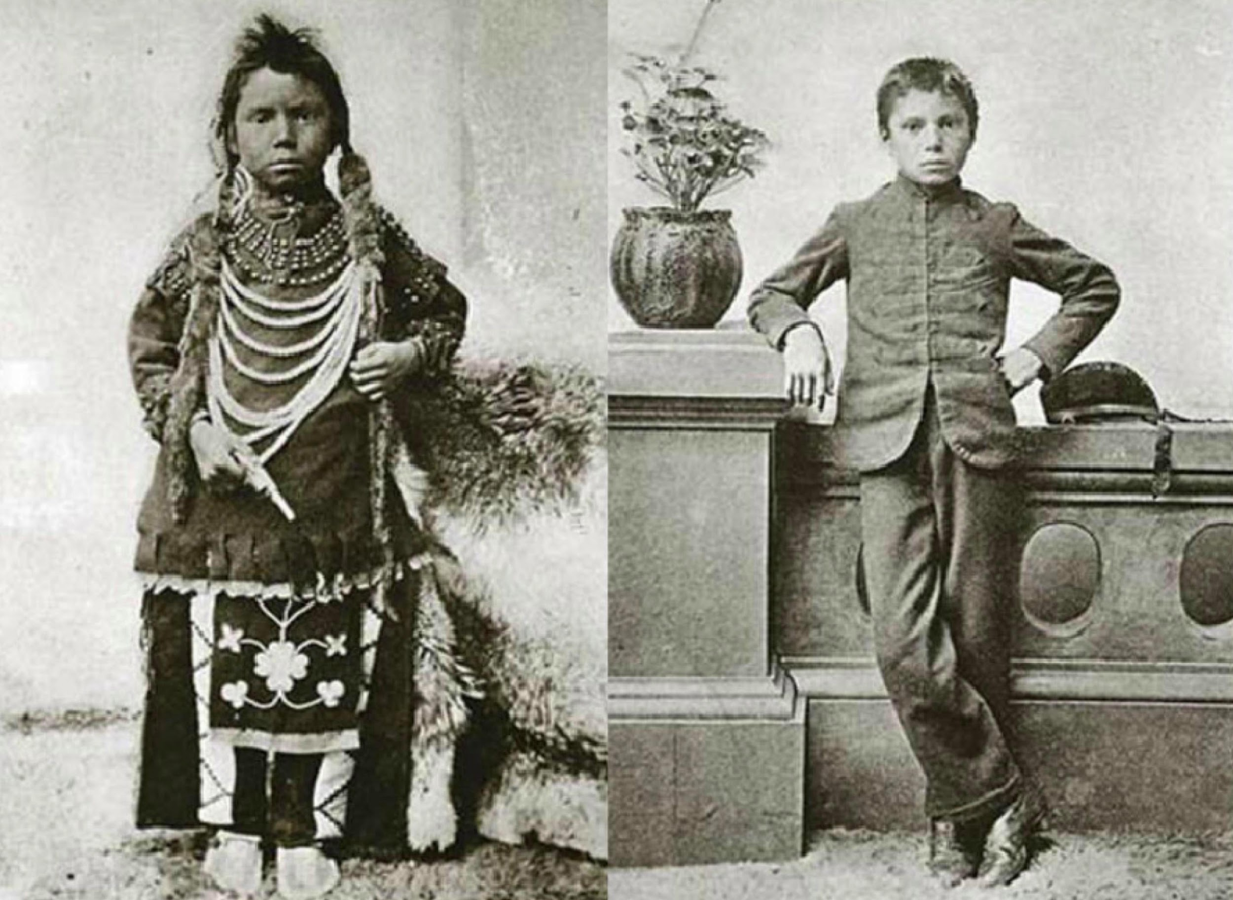
ASSIMILATION – A LESS VIOLENT APPROACH
AKA Americanization: making Indians change their culture to the American culture

Slide 26
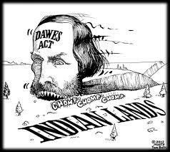
THE DAWES ACT
Broke up reservations into family farms, owned by U.S.
U.S. gave farms to Indians who agreed to assimilate (house, farm, English, Christianity, children to English School)
Effects:
Increase assimilation
Destroy tribal authority
Make $$$ (sold land to highest white bidder instead of giving it away)

Slide 27
FARMERS AND THE RAILROADS
ECONOMIC ISSUES

Slide 28
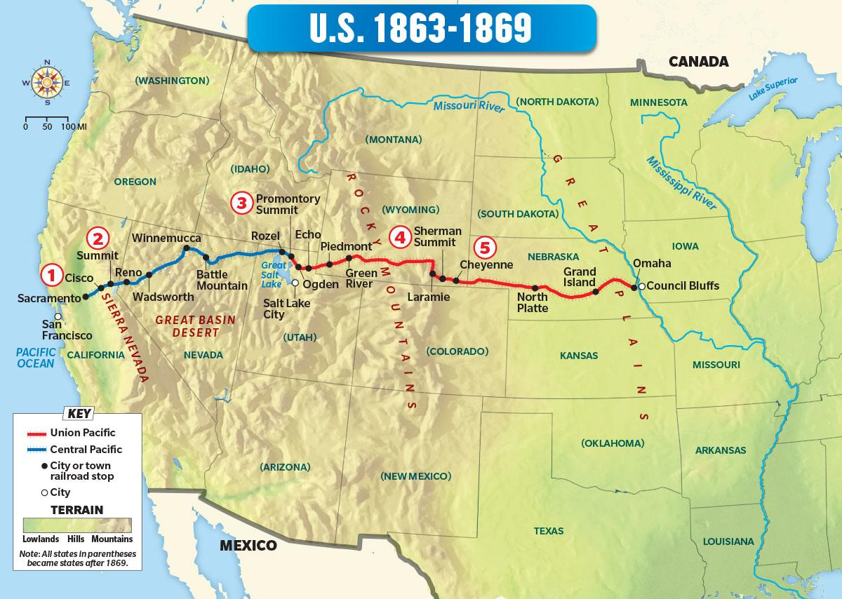
TRANSCONTINENTAL RAILROAD
Making the journey west over land was difficult, dangerous, and time consuming
U.S. needed a transcontinental railroad to link the east and west
Big/profitable business (railroads were granted huge amounts of land on each side of the tracks, then sold for big profits)
A few companies controlled the industry (monopoly) and offered special rates (rebates) to big businesses

Slide 29
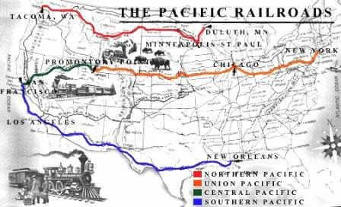
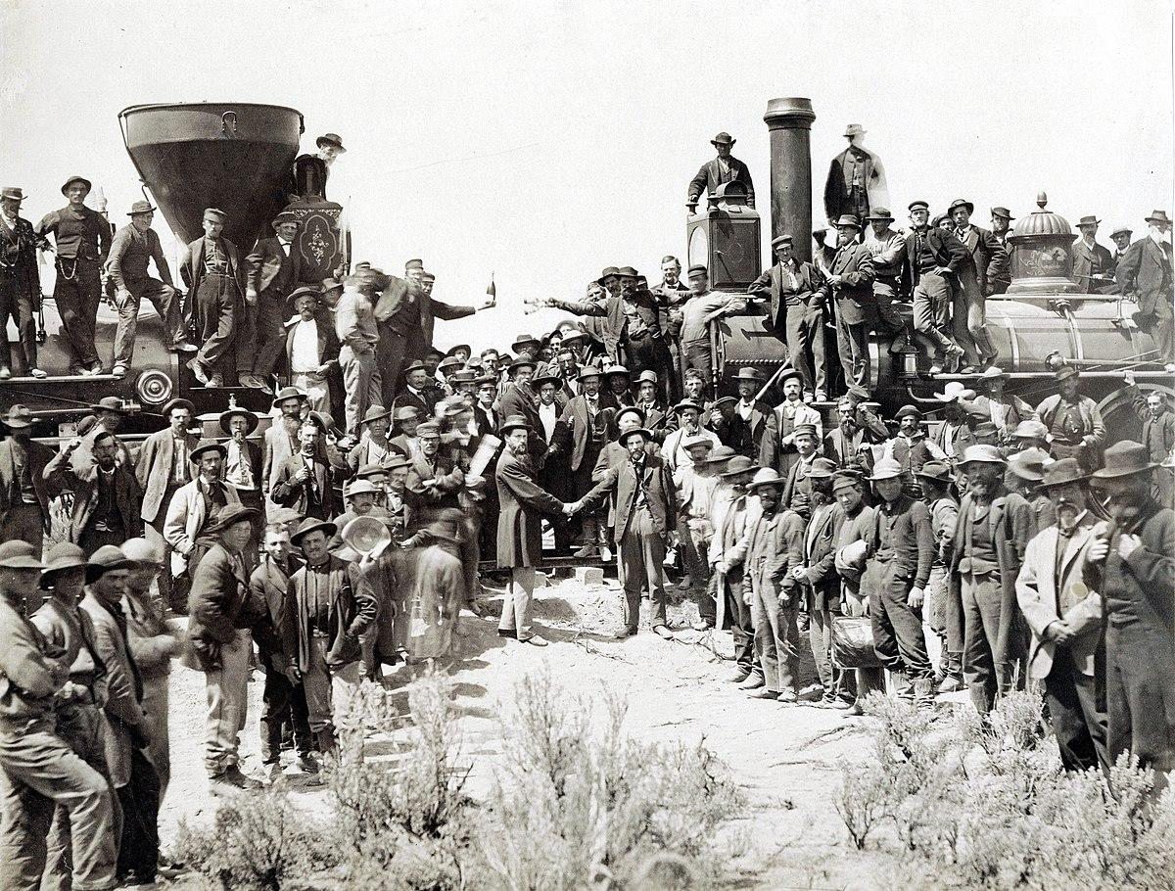
RAILROAD SUCCESS
Completion of first transcontinental railroad was a huge success for the U.S.
Bigger success for R.R. industry as companies were granted large amounts of land on both sides of tracks 🡪 sold for big profit ($$)
Benefitted the U.S. by allowing people and goods to be taken across the country faster and safer
Increased farmers’ ability to get their products to market and allowed more settlers to travel westward

Slide 30
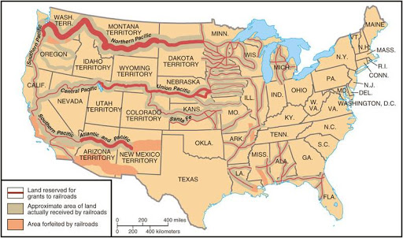
BIG BUSINESS = BIG PROBLEMS
R.R. industry quickly became the biggest, most profitable business in the world
A few large companies dominated the market:
Companies made so much money partly because they were given the amount of land from government 🡪 sell what they did not want/need
Offered special rates (rebates) to big business customers

Slide 31
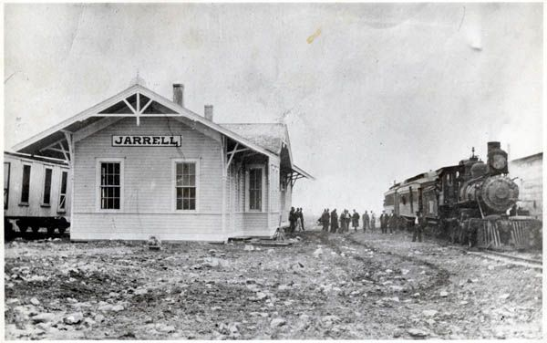
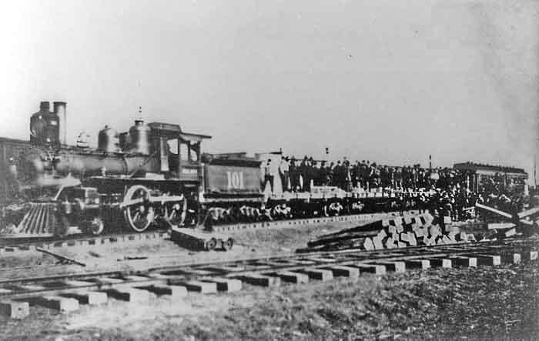
EFFECTS OF THE RAILROADS
Attracted more people, especially immigrants to settle in the West (large Chinese population contributed to R.R. construction)
Created jobs in the West to build the R.R.
Reduced travel time for both people and goods
Helped create new towns and cities
Contributed to the destruction and depletion of the buffalo

Slide 32
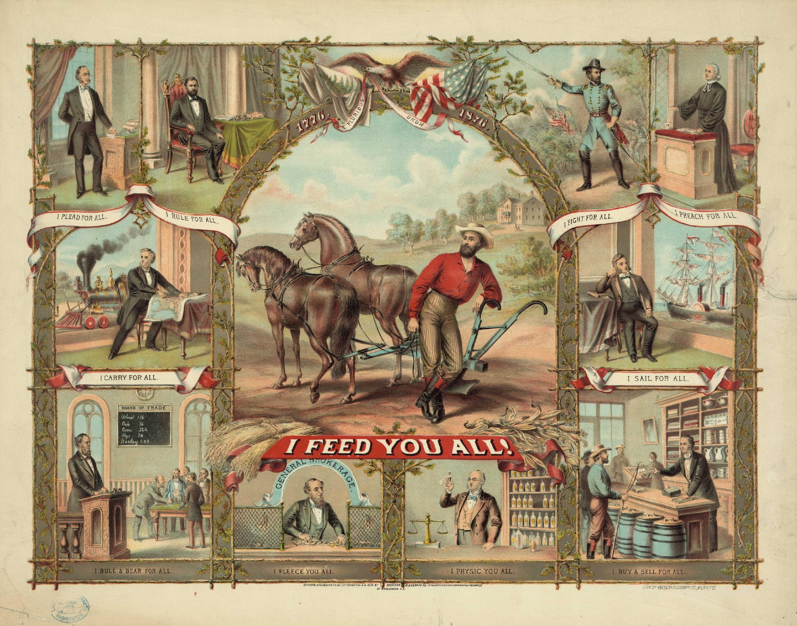
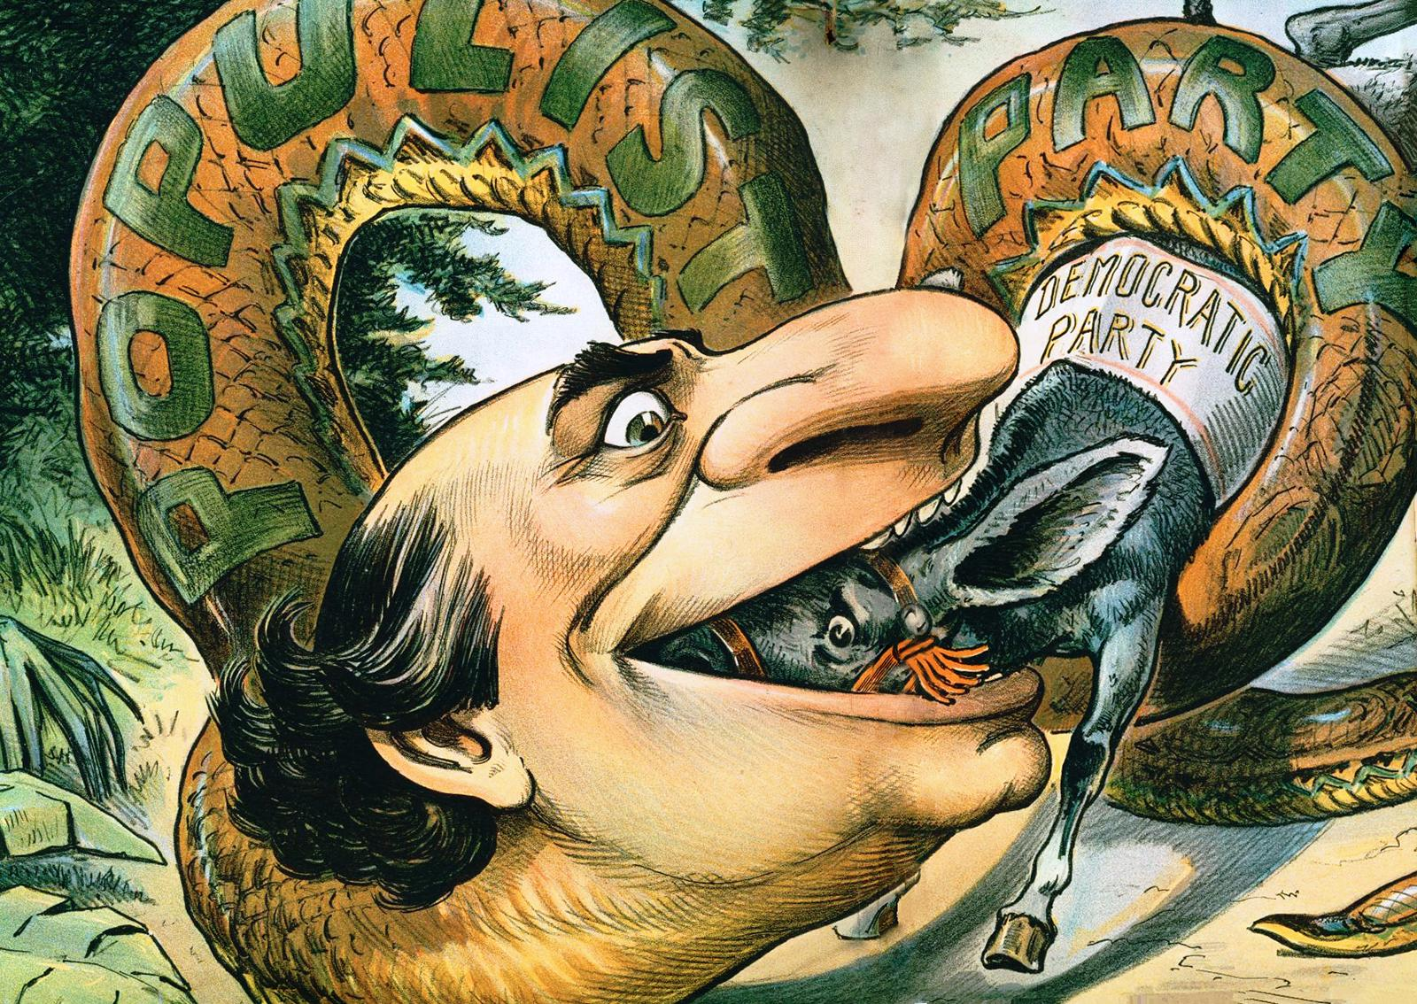
BAD TIME TO BE A FARMER
Debt purchasing farm equipment
Couldn’t pay off debts because railroads charged so much to ship grain
Formed the Populist Party

Slide 33
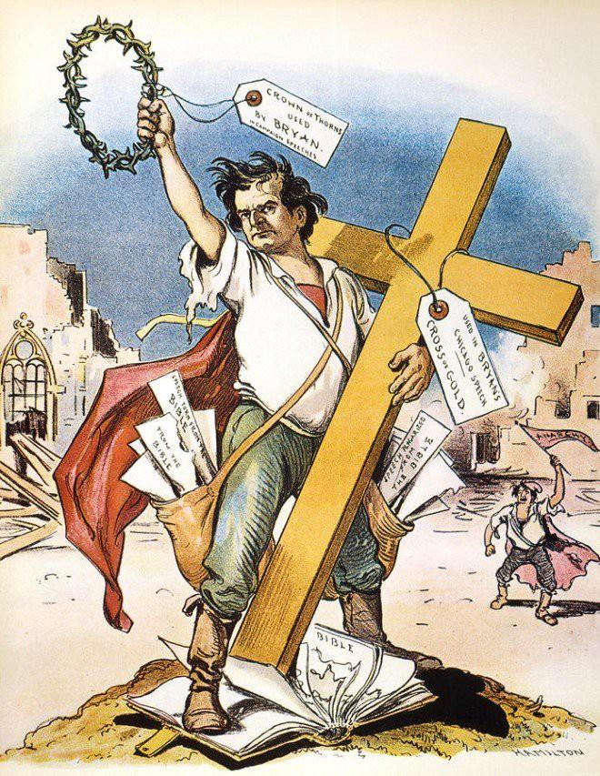
A PARTY FOR THE PEOPLE
Farmers began to meet and created the Farmer’s Alliances
Demanded that the government take over the R.R.
Eventually formed the (a third) political party, the Populist Party (not Democrat or Republican) that fought for farmer and worker rights
Third parties began to form when the Democrats and Republicans would not champion causes that were important to the American people
*Third parties contribute ideas that often influence new laws

Slide 34
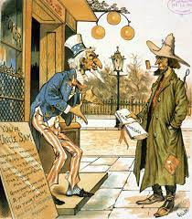
THE POPULIST PARTY
Populists believed the wealthy had a hold over the government
Wanted government to take a larger role, ending oppression, injustice, and poverty
1892: held a national convention and chose a presidential candidate
Innovative Proposals:
Direct election of Senators
Term limits of President (1 term)
Secret ballot
Government ownership over R.R.
Immigration restrictions
Graduated income tax
Shorter work day

Slide 35
INTERSTATE COMMERCE ACT
Farmers had one big success: helping convince the government to pass the Interstate Commerce Act
It created rules to make R.R. rates more fair to small farmers and businesses
Also created the Interstate Commerce Commission to enforce the new rules
The act is the first time government regulated private business

Slide 36
YOUR THOUGHTS?
Does the government have the right to tell businesses how much they can charge for produce or service? Why or why not? Explain your answer in 3-5 complete sentences.

