Slide 1
World War II: Allied Strategy in Africa & Europe
Unit 8: WWII #3 War in Europe

Slide 2
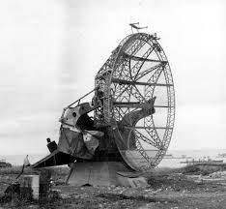
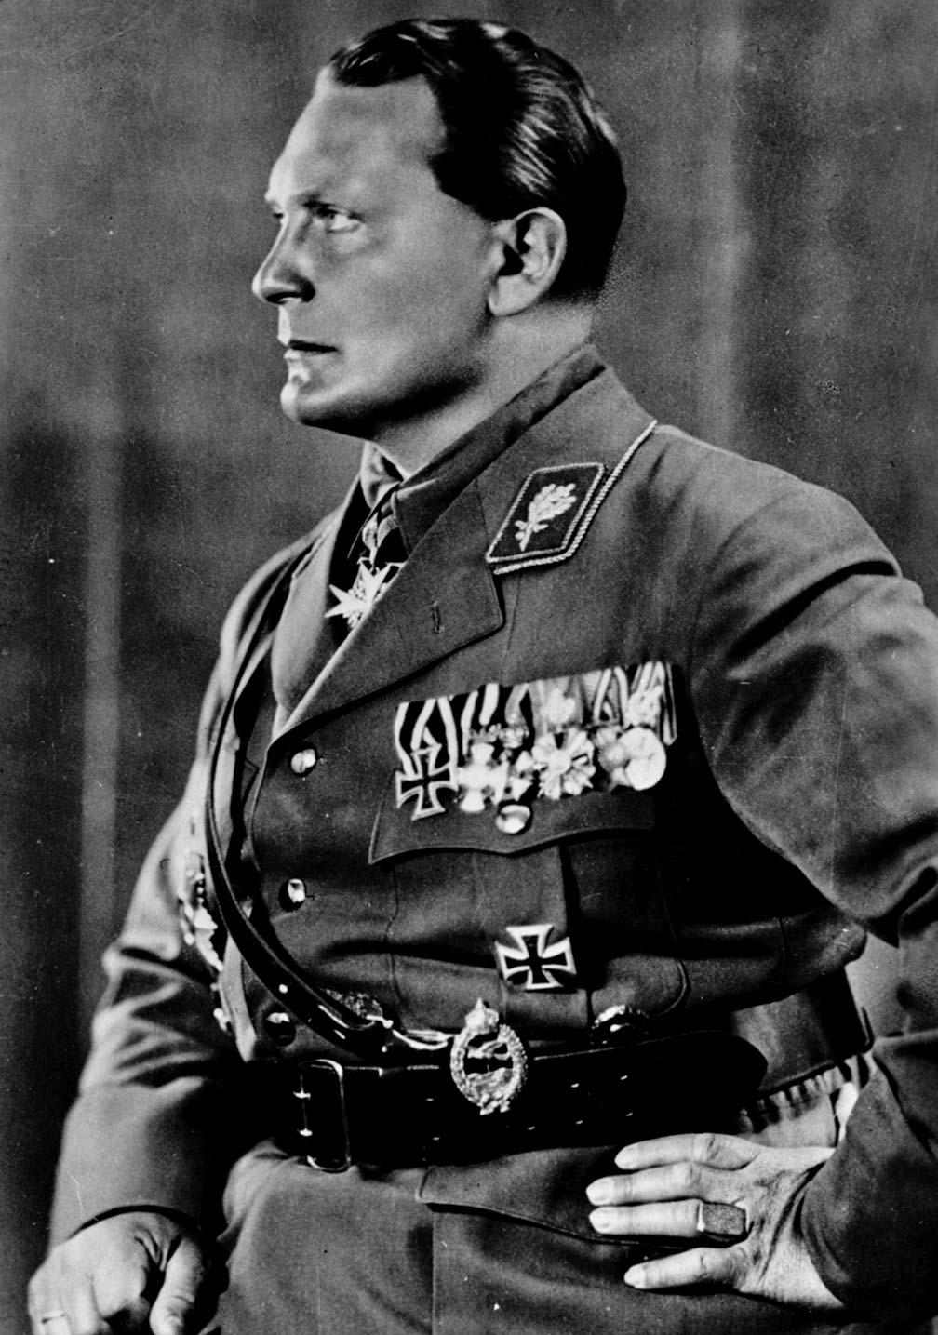
Battle of Britain
Hitler wanted to bomb Britain into submission (Operation Sea Lion)
The bombing lasted from July to October of 1940, but failed to make England surrender
British made use of radar (new technology that allowed the British to see the bombing attacks coming and prepare for them)
Germans did also have radar, but they failed to see how important it was to fight and never focused enough attention on destroying British radar stations
Reichsmarschall Herman Goring was the head of the German Luftwaffe (air force). The battle was his greatest failure

Slide 3
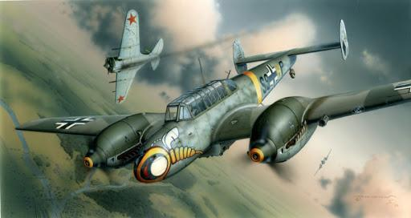
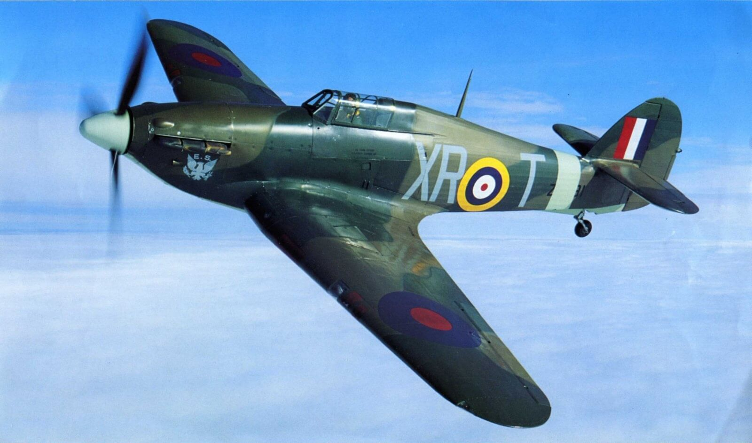
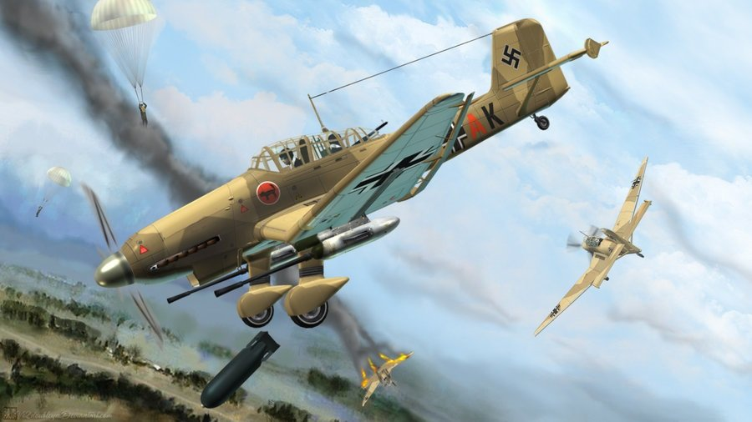
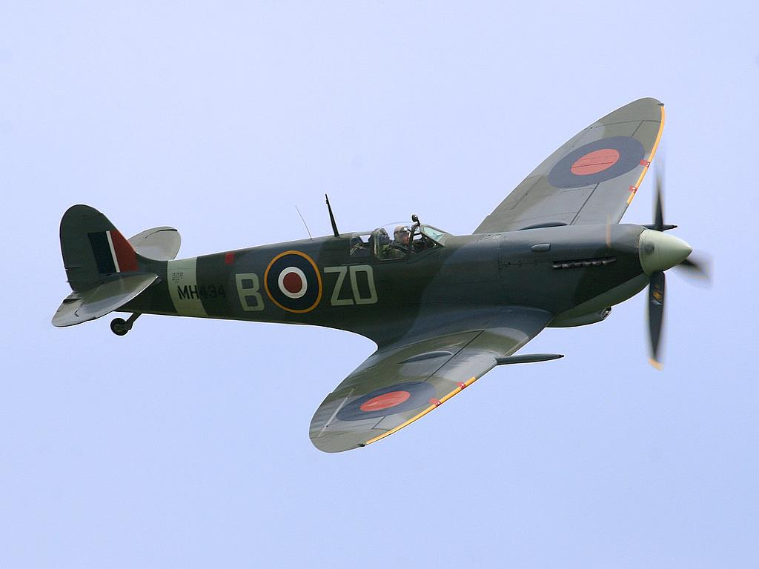
VS.
German Heavy Fighter Messerschmitt Bf 110 – main fighter used in the Battle of Britain
British Hawker Hurricane, the most numerous of the fighter planes used in the Battle of Britain
British Supermarine Spitfire Mk 1 – the most famous of the British fighter planes used in the Battle of Britain
British Hawker Hurricane, the most numerous of the fighter planes used in the Battle of Britain

Slide 4
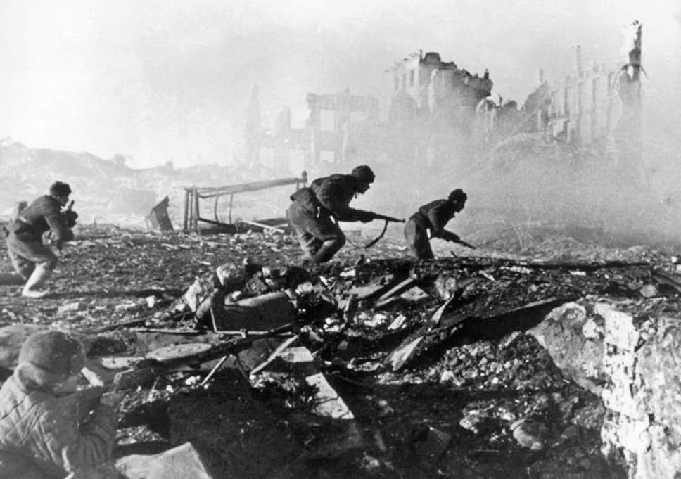
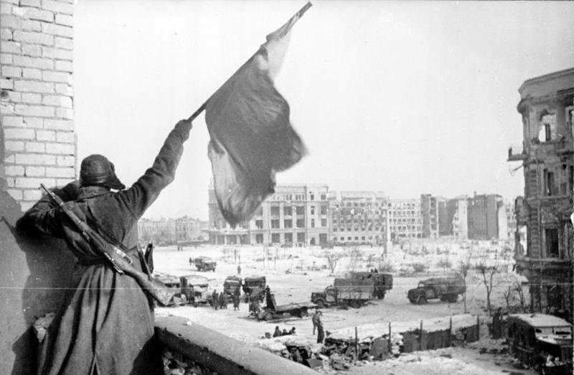
Hitler vs. The Soviet Union
In 1941, Hitler broke the “Non-Aggression Pact” (agreement between Germany and Russia that they would not invade each other) with Stalin and invaded the Soviet Union
Hitler needed oil - he decided to invade the city of Stalingrad (now called Volgograd)
The battle lasted until 1943 - was one of the bloodiest battles in the history of the world
Both sides lost over 1 million lives
In the end, the Soviet Union won - HUGE victory and the real turning point in the war in Europe

Slide 5
Allied Strategy in Africa & Europe

Slide 6
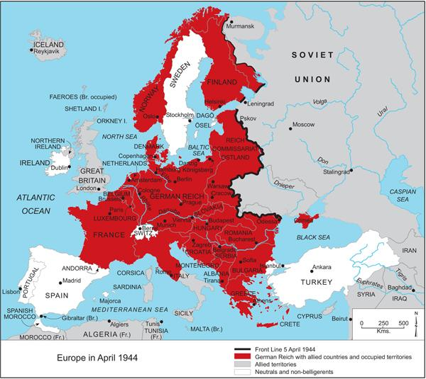

Slide 7
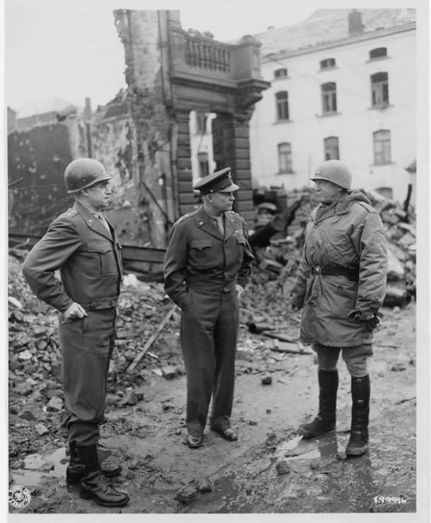
Stalin & The Soviet Union
Wanted Great Britain and U.S. to attack in Europe so Allied forces could “sandwich” Axis powers in Europe “open the Western Front”
Key Leaders:
D. Eisenhower: Supreme Commander of the Allied forces in Europe
George Patton: General who expertly used tanks to liberate Africa, crush Italy, and eventually break through the German line → KEY to winning the war

Slide 8
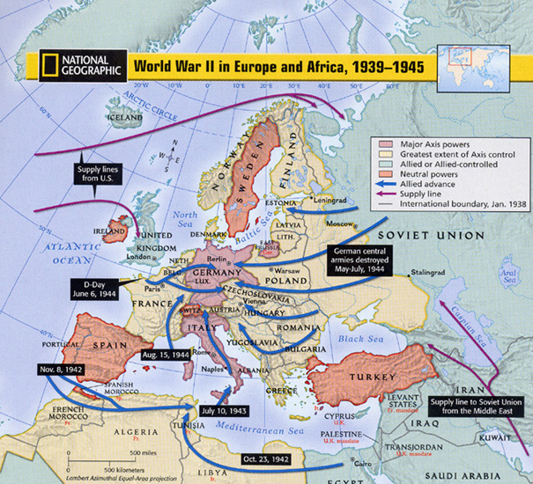

Slide 9
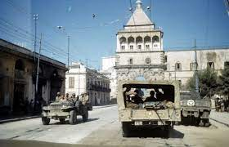
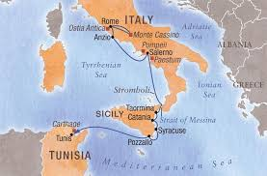
Africa & Sicily: The Allies Attack
Our chosen strategy:
Remove Italy and Germany from Africa
Go through the Mediterranean to take out Italy, then focus on Germany
Allies move into Africa then Italy by capturing Sicily, helping the king to overthrow Mussolini
Hitler then seized Italy and dug in to fight
The Allies’ advanced through Italy - it was slow and bloody

Slide 10
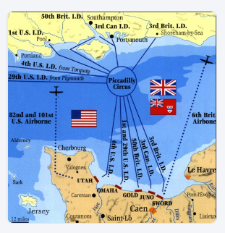
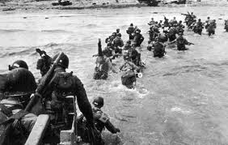
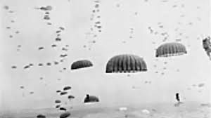
D-Day: June 6, 1944
Finally, the Allies did open that Western front
On June 6, 1944, the Allies launched a massive invasion of France
Code name: Operation Overlord
On D-Day (a military code for the first day of any operation)
Nearly 160,000 soldiers from 12 different countries landed on the beaches of Normandy, France or parachuted behind enemy lines
By August, the Allies had more than 3 million troops in France
D-Day is the beginning of end for Germany
Forced to fight a two-front war (could not handle it)

Slide 11
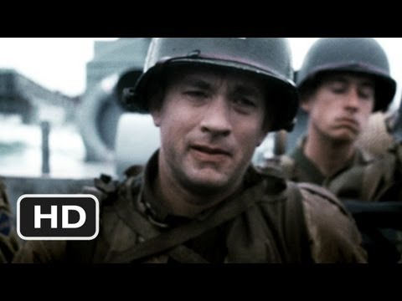

Slide 12
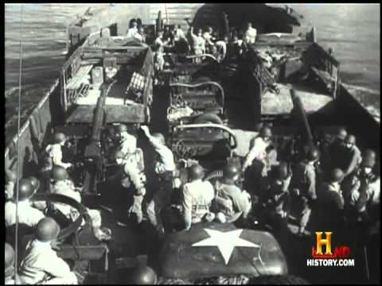

Slide 13
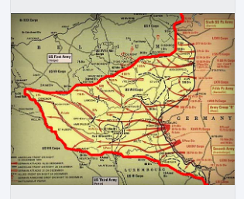
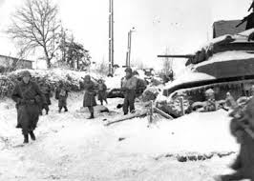
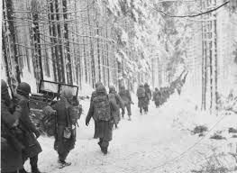
Battle of the Bulge
It was called the Battle of the Bulge because of the way the German line (thick red line) “bulged” into the Allied territory
British Field Marshal Montgomery planned a massive airborne assault of the Netherlands called: Operation Market Garden
Hoped it would lead to a swift end of war, with promises that soldiers would be “home by Christmas” (failed horribly)
It was followed by the Battle of the Bulge:
A huge German counterattack that “bulged” into the territory the Allies had gained
Lasted through one of the coldest winters in recorded history
German forces were crippled and spent the rest of the war in retreat
After the loss of the Battle of the Bulge Germany was essentially beaten

Slide 14
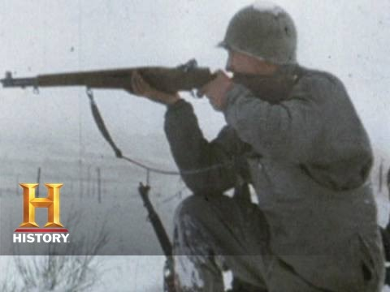

Slide 15
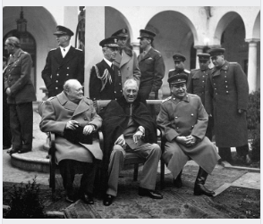
Yalta Conference
In February 1945 (3 months before FDR, Mussolini, and Hitler died), the Big Three - Churchill, FDR, and Stalin met in the city of Yalta in the southern Soviet Union
The purpose of the meeting was to discuss what to do with Europe after the war was over
The Big Three made several decisions at Yalta, but the biggest ones were:
Germany must surrender unconditionally
Britain, France, Soviet Union, and the U.S. would each occupy a “zone” in Germany
Soviet Union would enter the fight against Japan 90 days after Germany’s defeat
Soviet Union would join the newly-created United Nations
The British and Soviets shared nuclear research with the U.S.

Slide 16
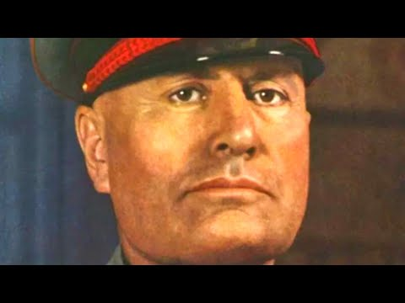

Slide 17
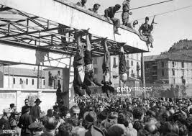

Slide 18
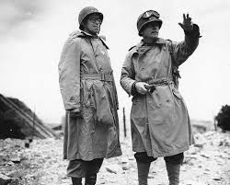
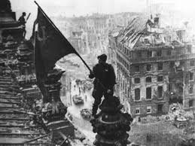
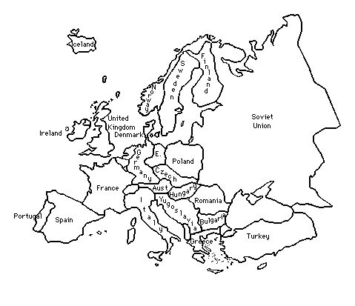
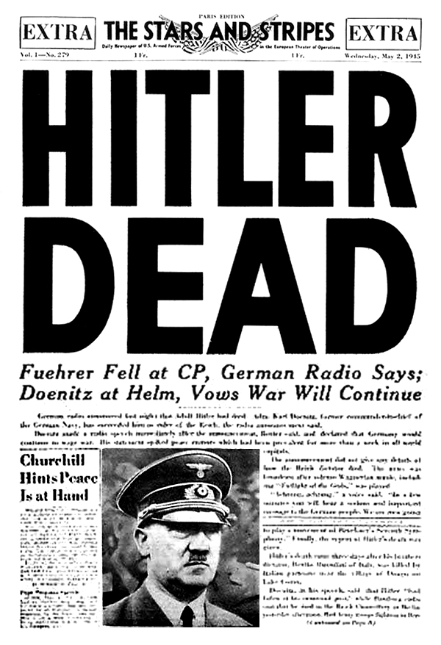
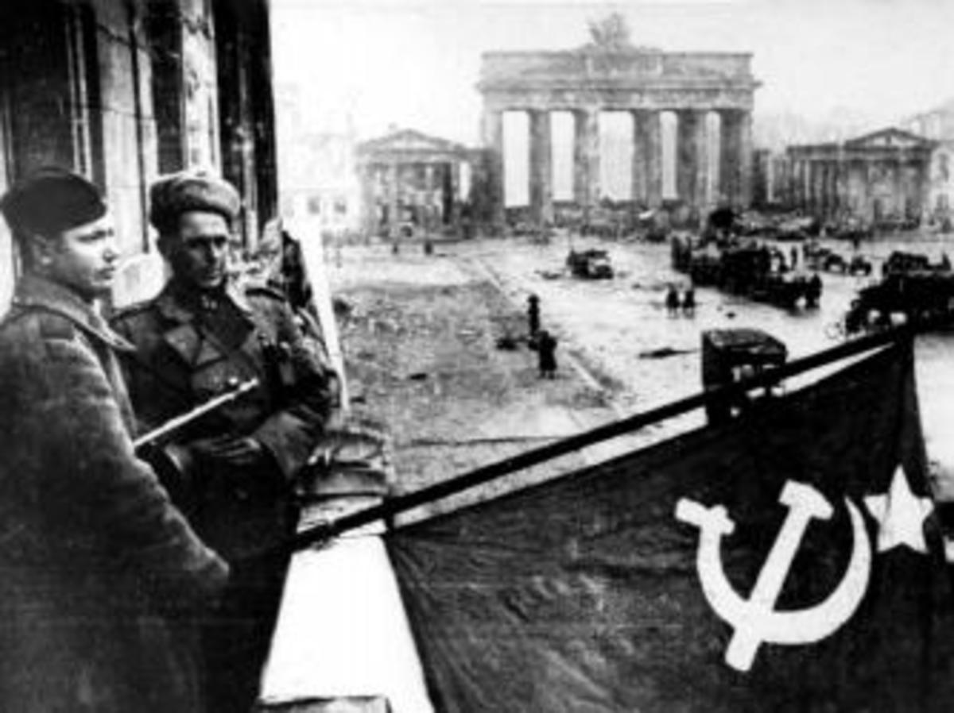
Race to Berlin
The war now became a race between the U.S. and the Soviets to see who would take Berlin first
The General Omar Bradley successfully led the U.S. invasion of Germany, but the Soviets still beat the U.S. to Berlin
Soviet Offensive:
Soviet Union (USSR) pushes Germany back from the east
Surrounds Berlin
Hitler commits suicide

Slide 19
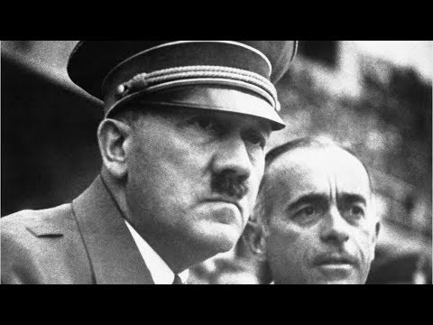

Slide 20
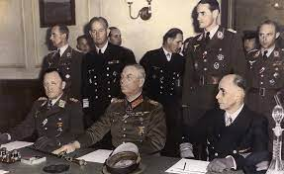
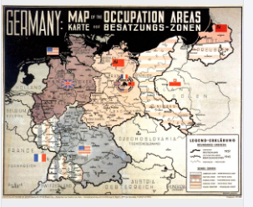
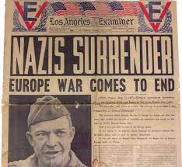
Germany Surrenders
Germany surrenders May 7, 1945
The country was divided into 4 zones to be temporarily governed by the Allies: Soviet Union, Great Britain, France, & U.S.
The capital city of Berlin was divided, even though it lay far within the Soviet zone (this will have impact on the future)

Slide 21
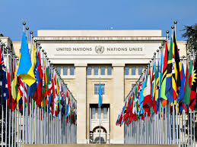
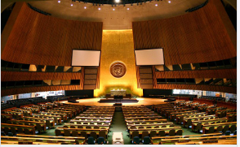
The United Nations
One of the very last things FDR did before his death was to help create the United Nations
Replaced the useless League of Nations
Created with the goal of:
Maintaining world peace
Preventing human rights violations
Helping economic development around the world
Originally there were 51 countries in the UN - today there are 193

