Slide 1
World War II: Intro & The Rise of Dictators
Unit 8: World War II #1

Slide 2
Class Expectations
When you come into class pick up class work on table by my desk
Sit in your seat (please do not move desks)
Have something to write with (get this before we start working)
Cell phones and headphones need to put away at beginning of class (I will let you know when you need them)
If you cannot follow directions in regards to phone, you will need to leave it on my desk (cell phones were an issue for several of you and that impacted your grades)
Turn in assignments ON TIME - if you need extra time please coordinate that with me - lack of trying to do work in class is not an excuse for late work
Testing Policy: ALL items (cell phones & earphones/Airpods) will go into your backpack and put in front of the classroom moving forward

Slide 3
Class Expectations
When you come into class pick up class work on table by my desk
Sit in your seat (please do not move desks)
Have something to write with (get this before we start working)
Cell phones and headphones need to put away at beginning of class (I will let you know when you need them)
If you cannot follow directions in regards to phone, you will need to leave it on my desk (cell phones were an issue for several of you and that impacted your grades)
Turn in assignments ON TIME - if you need extra time please coordinate that with me - lack of trying to do work in class is not an excuse for late work
Testing Policy: ALL items (cell phones & earphones/Airpods) will go into your backpack and put in front of the classroom moving forward

Slide 4
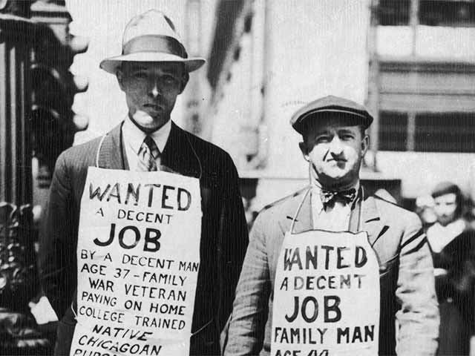
The last thing we studied before break was…

Slide 5
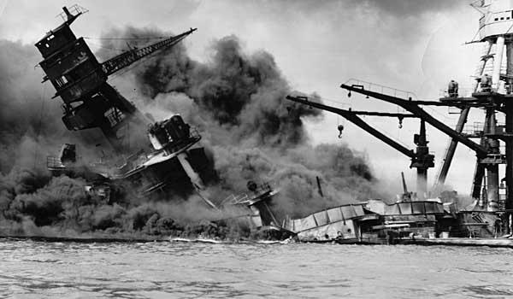
What actually ended the Great Depression?
WWII

Slide 6
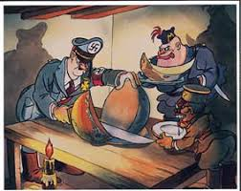
Political Cartoon
Look at the cartoon - use the clues: the title, the images, and the scale of the items in the picture to help you answer the questions.
Title: “Carving It Up”
What were the Axis leaders (Hitler, Mussolini, & Tojo) greedily carving up?
What do you think the artist meant by showing Hitler doing the carving?

Slide 7
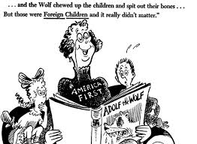
Political Cartoon
Now you try…
How does this cartoon reflect the attitude of Americans during this time?
What U.S. policy does this imply?
What were American beliefs of Hitler based on this cartoon?

Slide 8
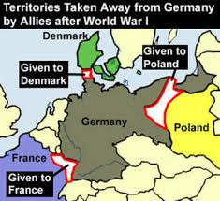
Europe & Japan: The Rise of the Dictators
In the aftermath of WWI, three factors led to the rise of dictatorship:
Fear of Communism
Angry about how WWI ended
Economic hardship

Slide 9
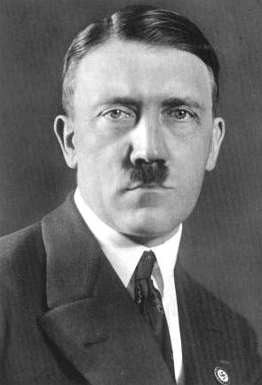
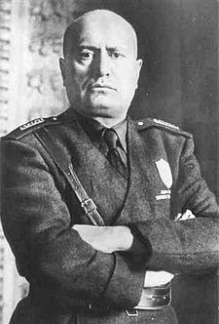
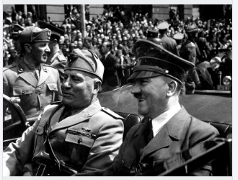
Dictators Take Over Europe
Italy: Benito Mussolini led the military to take control from the King
Germany: Adolf Hitler took control through elections
Both established Fascism: where the government demands:
Extreme loyalty
Controls the economy
Controls elements of daily life

Slide 10
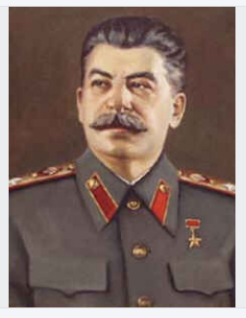
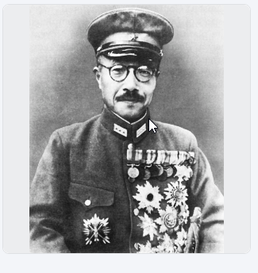
Dictators Take Over Europe
Soviet Union: Joseph Stalin took control of the Communist Party and turned the country into a dictatorship
Japan: Military leaders under General Hideki Tojo (later Prime Minister) took control of the country from the Emperor and turned it into a dictatorship

Slide 11
Think About It:
In all of these countries, many people were happy when the dictators took control.
Why do you think people might welcome a dictatorship taking control of their country?

Slide 12
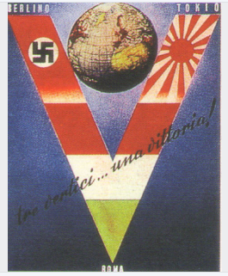
The Axis Powers (The Phantom Menace)
Germany, Italy, and Japan gained new territory around Europe, Africa, and Asia in the late 1930s
They will form the AXIS POWERS in 1940
Many were afraid of what would happen if this continued…

Slide 13
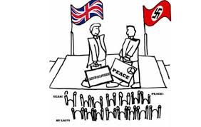
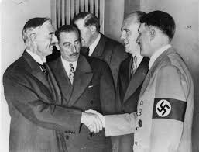
The Munich Conference
Munich Conference 1938:
France
Britain
Germany
The countries met to make sure war was avoided
Appeasement: giving into someone’s demands in order to keep peace
France and Great Britain used this policy with Hitler
Do you think it worked?

Slide 14
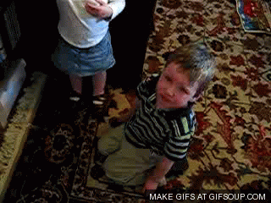
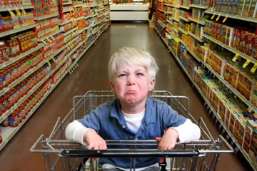
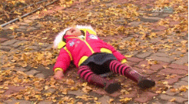
Appeasement

Slide 15
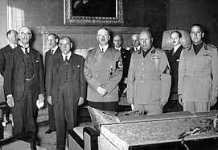
Appeasement
The appeasement did NOT work
Instead…
Hitler took more control of territory (land, cities, countries) in Europe
The League of Nations did not enforce the Treaty of Versailles
DID NOT PREVENT WAR

Slide 16
The Rise of Dictators

Slide 17
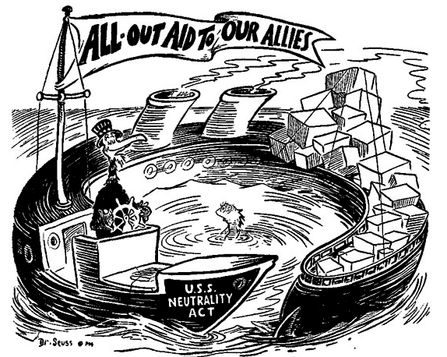
Meanwhile in America…
The U.S. stayed isolated (out of the war)
Neutrality Acts 1935:
Americans couldn’t travel on ships of countries at war
Americans couldn’t sell weapons to nations at war

Slide 18
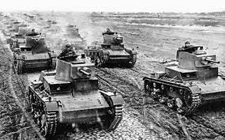
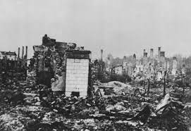
Blitzkrieg!
Germany achieved quick and easy victories using a type of warfare American reporters named “Blitzkrieg”
Blitzkrieg: literally means lightning fast war by hitting an enemy fast and hard using land and air forces

Slide 19
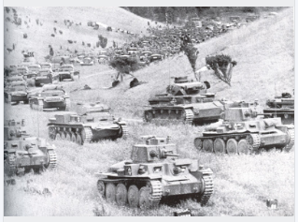
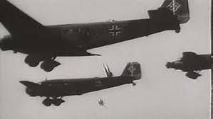
Start of World War II
Germany invaded Poland in 1939
France and Great Britain declared war on Germany
1940: Germany quickly invaded France, driving the British out of mainland Europe and force France to surrender

Slide 20
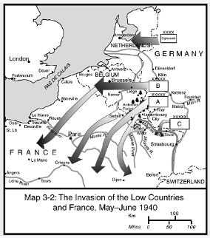

Slide 21
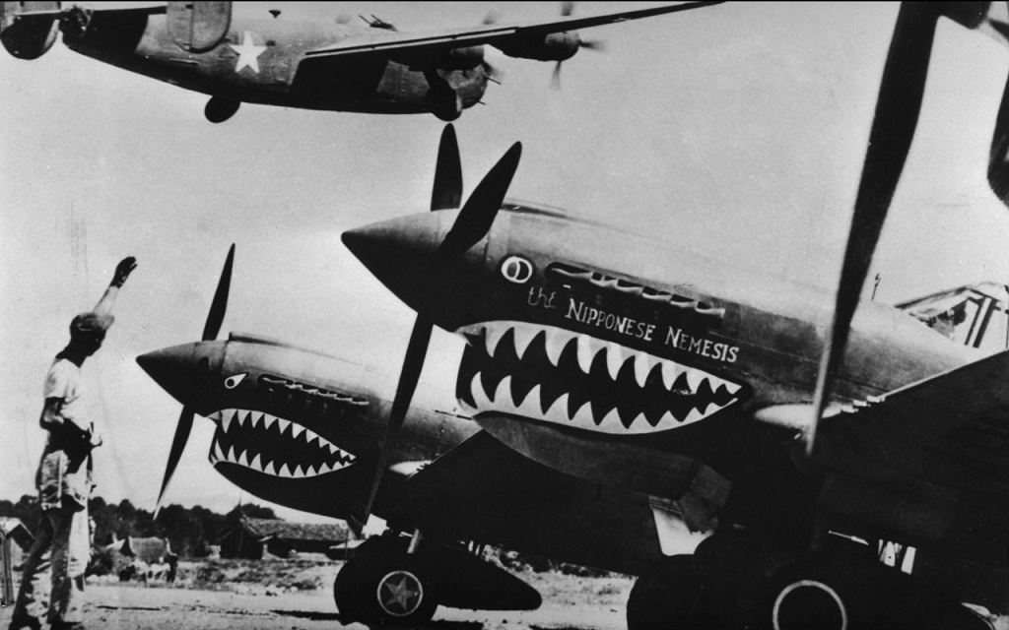
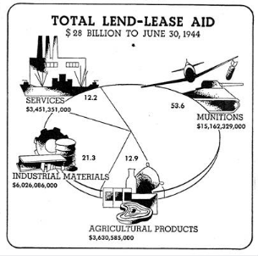
American Neutrality
The U.S. technically stayed neutral but FDR made it clear that America supported the Allies
When Japan invaded China, the U.S. intervened to help China
Flying Tigers:
U.S. fighter pilots secretly sent to China to fight the Japanese and train Chinese pilots
Lend-Lease Act (1941):
Allies allowed to rent or borrow crucial supplies from the U.S.

Slide 22
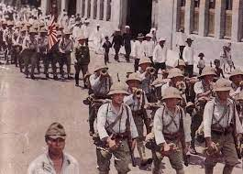
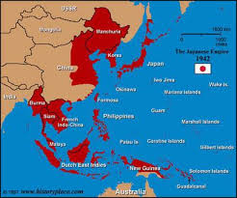
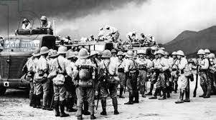
Tense Relations: U.S. & Japan
1930s: relations between U.S. & Japan worsened
1937: Japan invaded China
1941: Japan invaded the rest of Indochina (Vietnam, Laos, Cambodia)

Slide 23
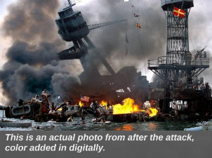
Tense Relations: U.S. & Japan
U.S. Response:
FDR froze Japanese funds in American banks and cut off all trade with Japan until they agreed to leave → Japan refused
Japanese Response:
Japan attacked the U.S. Pacific fleet at Pearl Harbor, Hawaii
Japan thought the U.S. would be crippled by the attack, allowing Japan to control the region
Instead they awake a “sleeping giant”

Slide 24
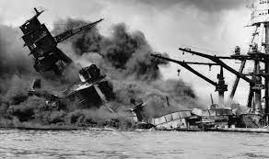
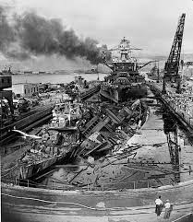
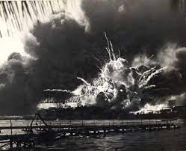
Japan Thought Wrong…
The attack on Pearl Harbor was deadly but not as effective as Japan had hoped
Of the 18 ships damaged, only 1 was unable to be repaired
The attack also failed to destroy the shipyards and oil depot on the other side of the island
Within 6 months, the U.S. Pacific fleet was fully recovered and ready to fight back

Slide 25
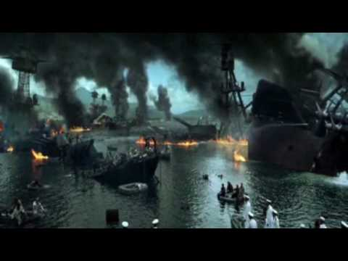

Slide 26
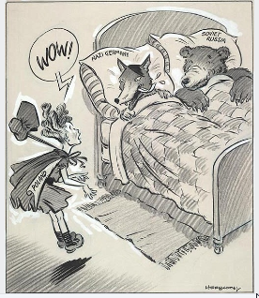
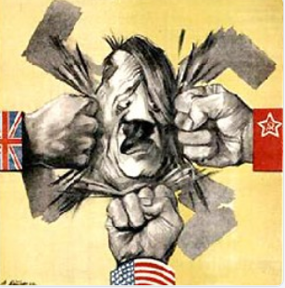
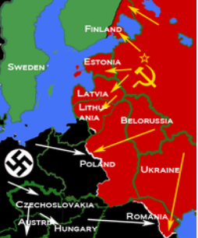
Hitler’s Big Mistake
1937: Germany and the Soviet Union signed the Nazi-Soviet Union Non-Agression Pact:
The two agreed NOT to attack each other
1941: Germany broke the pact by invading the Soviet Union
Initially a German success but soon failed with the Soviets joining the Allies

Slide 27
The Build Up to World War II

Slide 28
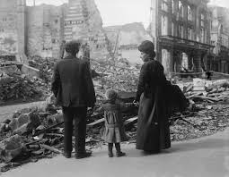
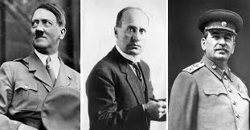
Nationalism Grips Europe & Asia
For many nations, the end of WWI did not bring peace and prosperity
The economies in Europe suffered:
Countries faced revolutions and political turmoil
The postwar years also brought the rise of dictators
Men who were driven by the belief in nationalism
Many of the dictators also dreamed of territorial expansion

Slide 29
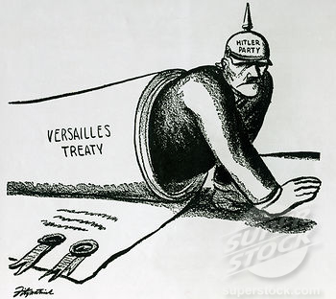
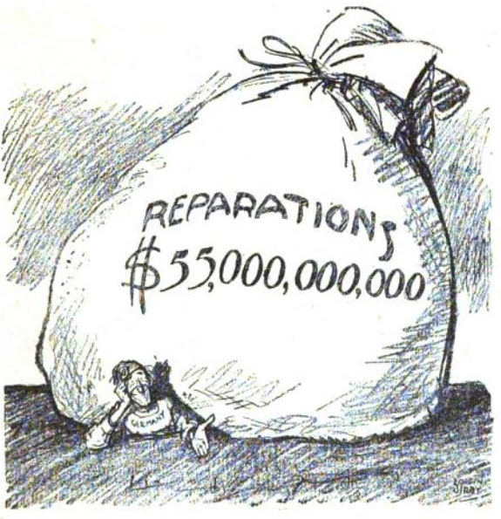
Failures of the WWI Peace Settlement
The new democratic nations that emerged after the war failed
Instead of securing a “just and secure peace,” the Treaty of Versailles caused anger and resentment
Without a democratic tradition, people turned to authoritarian leaders to solve their social and economic problems

Slide 30
How would you define these terms?
Dictatorship
Nationalism
Territorial Expansion
A person with absolute power over a region
Extreme pride in your country
Wanting to make your country bigger

Slide 31
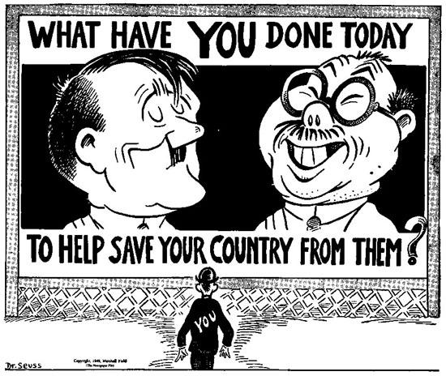
Dictators Threaten World Peace

Slide 32
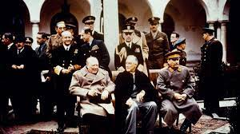
The Leaders -
“The Big Three”

Slide 33
Dictator Data Collection
Around the classroom, biographical information about the important leaders that emerged in the world during the 1930s are posted.
You job is to research each leader to develop a biographical profile on them.

