Slide 1
World War II: The Holocaust
Unit 8: WWII #2

Slide 3
What do you know about the Holocaust?
Write down what you know in the box in your notes.

Slide 4
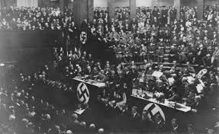
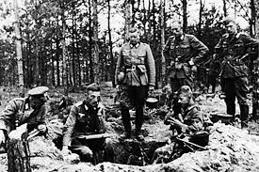
The Holocaust
In the 1930s, Hitler and the Nazis made anti-Semitism (hatred of Jews and Arabs) a center point of their campaign to control Germany
How did they succeed in this?
Stirred up hatred of the Jews partially in order → gave Germans a common enemy
Hitler also hoped to create a unified Germany in which all people would be of similar mind and body
This meant getting rid of people like the Jews, either by deportation, voluntary emigration, or death

Slide 5
Steps Hitler Took…

Slide 6
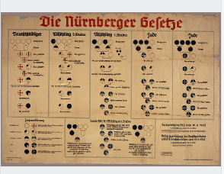
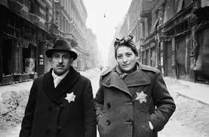
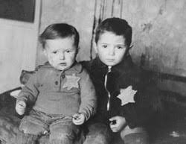
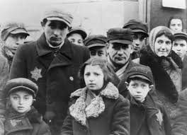
Steps Hitler Took:
The Holocaust was to greatly restrict the rights of the Jews:
Only person exempt is on far left of chart
Children were NOT allowed to go to public schools
Cannot go to public places: restaurants or stores
Must wear the Star of David
Kristallnacht - burning down all the Jewish synagogues and businesses
Not allowed to go to the hospital

Slide 7
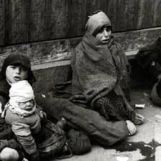
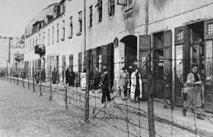
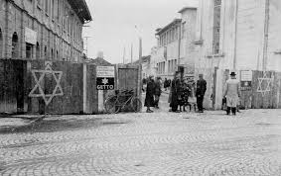
Steps Hitler Took:
2. In some of the occupied countries, the Nazis set up ghettos (fenced-off neighborhoods) for Jews:
This was supposed to be temporary until they could be deported, but they ended up being permanent

Slide 8
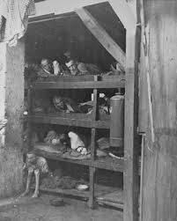
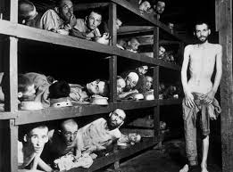
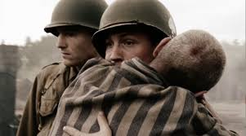
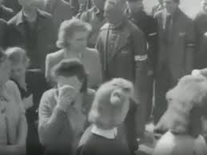
Steps Hitler Took:
3. Jews were put in concentration camps
Many died in these camps by either overwork, abuse, disease, or starvation

Slide 9
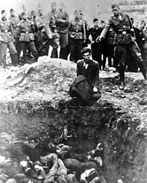
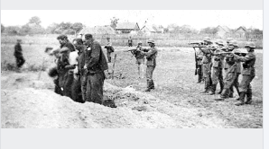
Steps Hitler Took:
4. The Nazi “death squads” in occupied territories rounded up and shot Jews, often with the help of local people
This proved too inefficient and bad for morale

Slide 10
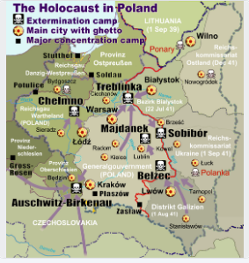
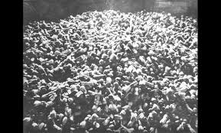
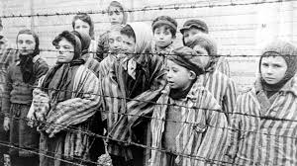
Extermination Camps:
Part of the “Final Solution to the Jewish Question” starting in 1942
The sole purpose of these camps was to kill as many Jews as possible and as fast as possible
By the end of the war, there were 8 of these camps
The ultimate result of the Nazi’s practice of genocide: 6 million Jews died and the Jewish population decreased.

Slide 11
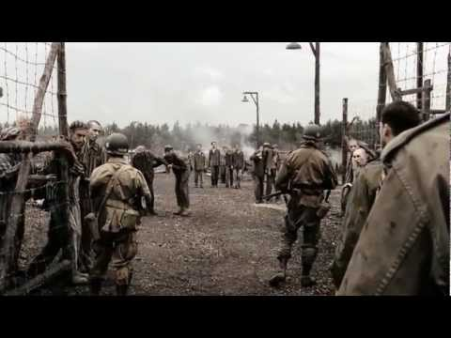

Slide 13
The Holocaust ID Activity
You will each receive an individual person
You will have to read their biography
Only answer questions 1-6 on a separate sheet of paper
Lastly, I will give you an envelope with your fate inside of it
Answer the 2 remaining questions on the handout.
*Please be respectful and keep all inappropriate or rude comments to yourself*
Turn in the paper you answered the questions on as well as the envelope and complete the Dictators/Leaders of WWII Biographical Profiles (both assignments are grades)

